Slide 1
Body Contact Progression

Slide 2
“Body contact is separating the player from the puck, not the player from the game”
Bob O’Connor – National Coach-in-Chief
“The objective of a body check is to separate the opponent from the puck, not to separate him from consciousness.”
Dr. Alan Ashare – USA Hockey safety and protective equipment committee and President, Hockey Equipment Certification Council (H.E.C.C)

Slide 3
Building Blocks
Angling (U8 and Older)
Stick Checks (U8 and Older)
Body Play (U8 and Older)
Defensive Zone Coverage (U10 and Older)
Body Check (U14 and Older)

Slide 4
Angling
Skating, Quickness, Balance, Agility
Forecheck
Backcheck
Skating Backward
Contact Confidence
Puck Protection

Slide 5
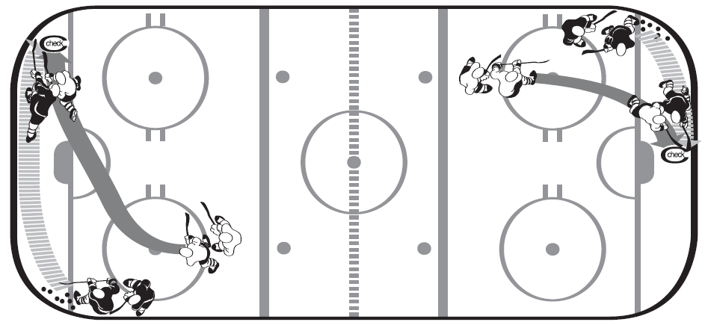
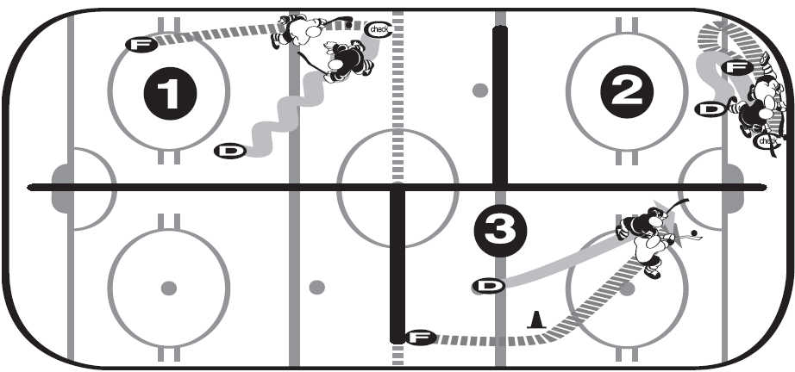

Slide 6
Stick Checks
Poke Check
Stick Lift
Stick Press
Sweep

Slide 7
Body Play
Wrap Check (Lasso)
Body Block
Gap Control
Attack the Hands

Slide 8
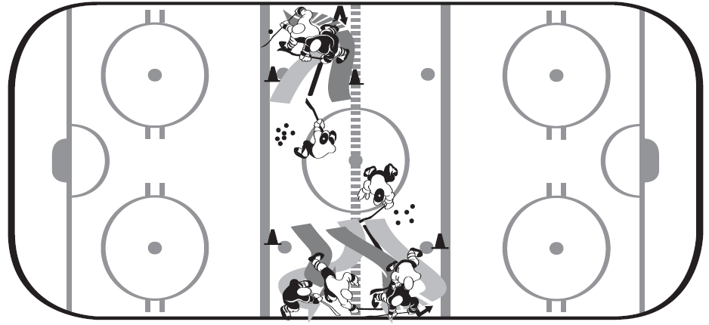
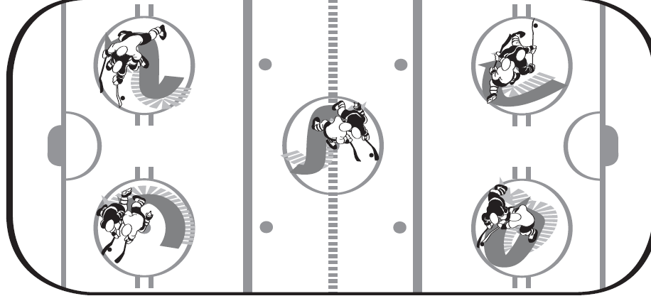

Slide 9
Defensive Zone Coverage
Defense Responsibilities
Wing Responsibilities
Center Responsibilities

Slide 10
Body Check
Body Protection
Rub Out
Pin
Shoulder
Hip

Slide 11
Questions

