Slide 1

2015-16 Pre-Season Coaches Meeting
August 6, 2015
The Rinks - Anaheim Ice, Club 32
6pm-8pm

Slide 2

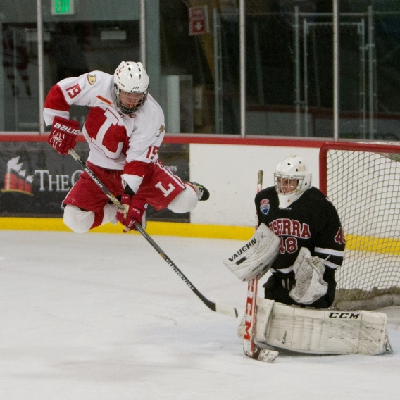
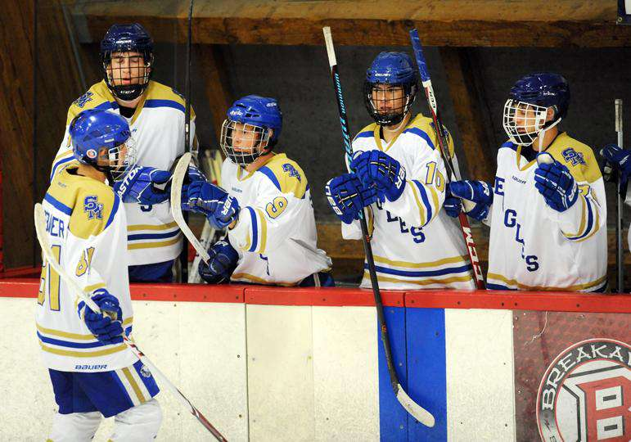
AGENDA & ITEMS TO DISCUSS
Team Equipment (pick-up)
Registration Update/Information
Financial Material
Concussions; Training, Certification, Testing & Notification
League Website – Champ Baginski, Anaheim Ducks (Roster Upload)
Player Petitions
School ID’s/Player Grades
Varsity Frozen Player List (DUE 8/22, 7pm)
30 Man vs. 20 Man Rosters
Rostering Deadline (Date is Nov 10th)
School Transfers
Game Rules
No major playing rule changes
Player Up Rule (Rule 6.7)
Checking from behind (2+10)
Referee Interaction
Approachability
Team Captains
Important selection
“Pre-Season” Meeting
League Divisions
Schedule
Process
Games in San Diego
JV (4 games then split)
Varsity (Cross-Over games)
Schedule through 10/31
PA/Game Announcer
Game Day Roster Card, Referee Vouchers
Play-Offs
CA State Championships
ADHSHL format & dates
Admission Charge
Developmental In-House program (JV-D)
All-Star Games
Misc Items:
Game Video – Blackdog Enterprises
Varsity Division 1, 2 & 3
USA Hockey Nationals; Reston, VA – March 17-21, 2016
America’s Showcase, Team CA; Pittsburgh, PA – April 14-18, 2016
Q & A

Slide 3
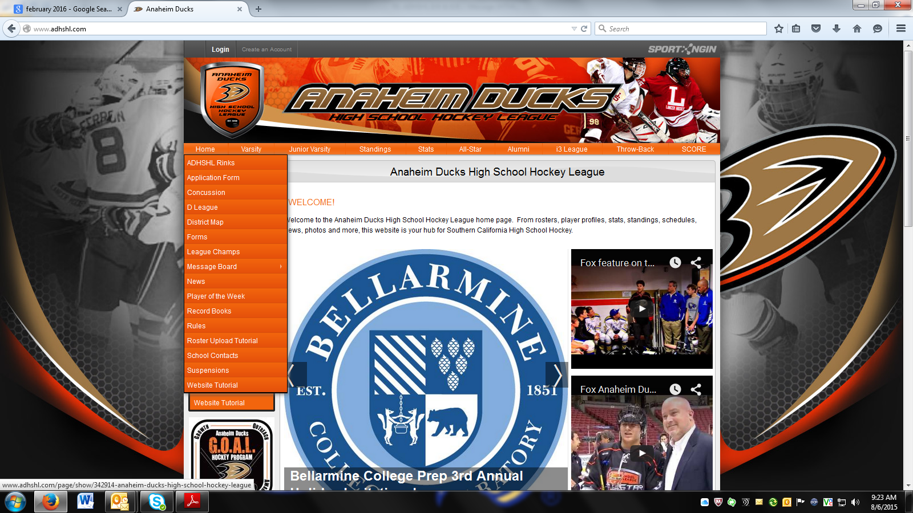
ADHSHL League Administrator – Champ Baginski
Player Stories
League Website

Slide 4
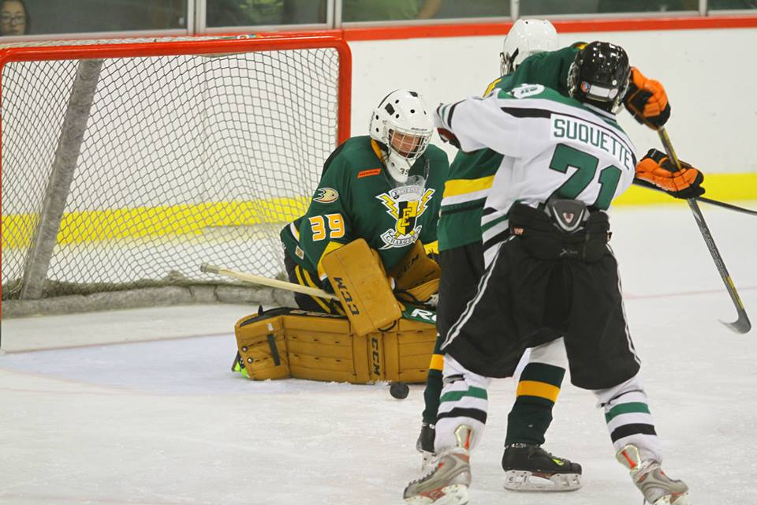
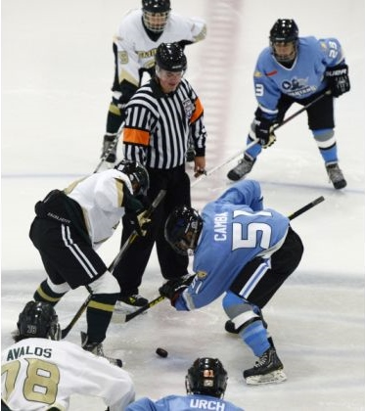
ADHSHL Director of Officials – Art Kitano
ADHSHL Rule Changes & Reminders

Slide 5

Arthur Kitano
E-mail: a_Kitano@wshl.org
Phone: 714-679-1855

Slide 6
Captains
How do you as a coach select your captains?
What is the most important duty your captain has?

Slide 7
Problems Officials have with Captains
Captains do not approach the Referee before coach tells them there is a problem (No Initiative)
Captains have no clue what is going on
Captains need to relay information correctly “Telephone”
Keep their cool – Don’t lose their temper – Not Level Headed enough
Captains do not relay information correctly to the referee or vice versa “Telephone”
Captains talk out of line (Listen first to entire statement then ask questions [No Interruptions])

Slide 8
Problems Officials have with Captains Continued
Captains not watching their mouth – NO SWARING
Captains delivering idle threats – i.e. If you don’t do this then I’m going to tell my players to do that
Captains not being courteous and yelling or going off during a stressful play (Maturity)
Misrepresenting what the Referee says
Example: There is a courteous discussion between the captain and the referee. Then when the captain returns to the bench to deliver the information to the coach, he uses vulgar language which makes the coach believe that the official used vulgar language. This makes the coach even more upset because he feels that the referee is using profanity towards his captain.

Slide 9
Problems Officials have with Captains Continued
All of these problems can be solved with four easy solutions.
Better rule knowledge
Better understanding of the game
Maturity/Self Control
Know how to properly play the game telephone

Slide 10
RULE CHANGE! Progressive Suspensions Player
3rd Major Penalty will receive a
3 Game Suspension
4th Major Penalty (One More Major) will receive a
5 Game Suspension
5th Major Penalty (One More Major) will be
Suspended Pending Hearing

Slide 11
RULE CHANGE! Progressive Suspensions Head Coach
3 Major Penalties in one game will result in
Head Coach 1 Game Suspension
2nd Time 3 Major Penalties in one game will result in
Head Coach 3 Game Suspension
3rd Time 3 Major Penalties in one game will result in
Head Coach Suspended Pending League Hearing

Slide 12
Arthur Kitano
E-mail: a_Kitano@wshl.org
Phone: 714-679-1855

Slide 13


Slide 14

ADHSHL Divisions VARSITY
VARSITY – DIVISION 1
Pure Only
16 Regular Season Games
VARSITY DIVISION 2
Combined Only
15 Regular Season Games
VARSITY DIVISION 3
Pure & Combined
14 Regular Season Games
JUNIOR VARSITY
Junior Varsity - Orange
Pure & Combined
14 Regular Season Games
Junior Varsity - White
Pure & Combined
14 Regular Season Games

Slide 15
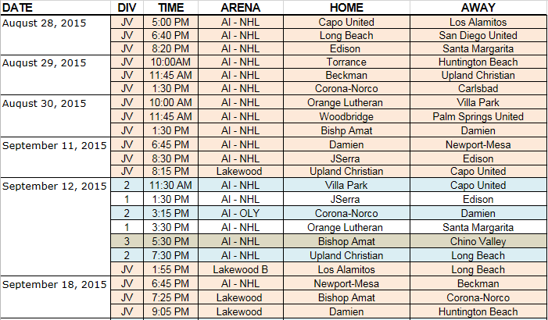
ADHSHL Schedule (tentative)
DATE | DIV | TIME | ARENA | Home | Away
September 5, 2014 | JV - A | 6:45 PM | AI - NHL | O Lu | JSerra
 | JV - A | 8:30 PM | AI - NHL | Servite | St. John Bosco
September 6, 2014 | JV - A | 11:00 AM | Lakewood A | Los Al | Capo
 | JV - B | 12:40 PM | Lakewood B | Los Al | UCA
 | JV - B | 12:40 PM | Lakewood A | Villa Park | Torrance
 | JV - A | 2:20 PM | Lakewood A | Bishop Amat | Beckman
 | 1 | 11:30 AM | AI - NHL | SMCHS | Servite
 | 1 | 1:30 PM | AI - NHL | JSerra | O Lu
 | 1 | 3:30 PM | AI - NHL | Damien | Edison
 | 2 | 5:30 PM | AI - NHL | Corona-Norco | Conejo Valley
 | 2 | 7:30 PM | AI - NHL | Capo United | La Jolla CD
September 12, 2014 | 2 | 6:45 PM | AI - NHL | Villa Park | Newport-Mesa
 | 2 | 8:30 PM | AI - NHL | Los Al | Long Beach
September 13, 2014 | JV - A | 11:00 AM | Lakewood A | Edison | Corona-Norco
 | JV - A | 12:40 PM | Lakewood B | O Lu | Torrance
 | JV - A | 12:40 PM | Lakewood A | SMCHS | HBHS
 | JV - A | 2:20 PM | Lakewood A | Woodbridge | Cal Desert
 | 1 | 11:30 AM | AI - NHL | Servite | JSerra
 | 1 | 1:30 PM | AI - NHL | Edison | SMCHS
 | 1 | 3:30 PM | AI - NHL | O Lu | Damien
 | 2 | 5:30 PM | AI - NHL | Conejo Valley | San Diego United
 | 2 | 7:30 PM | AI - NHL | La Jolla CD | UCA

Slide 16
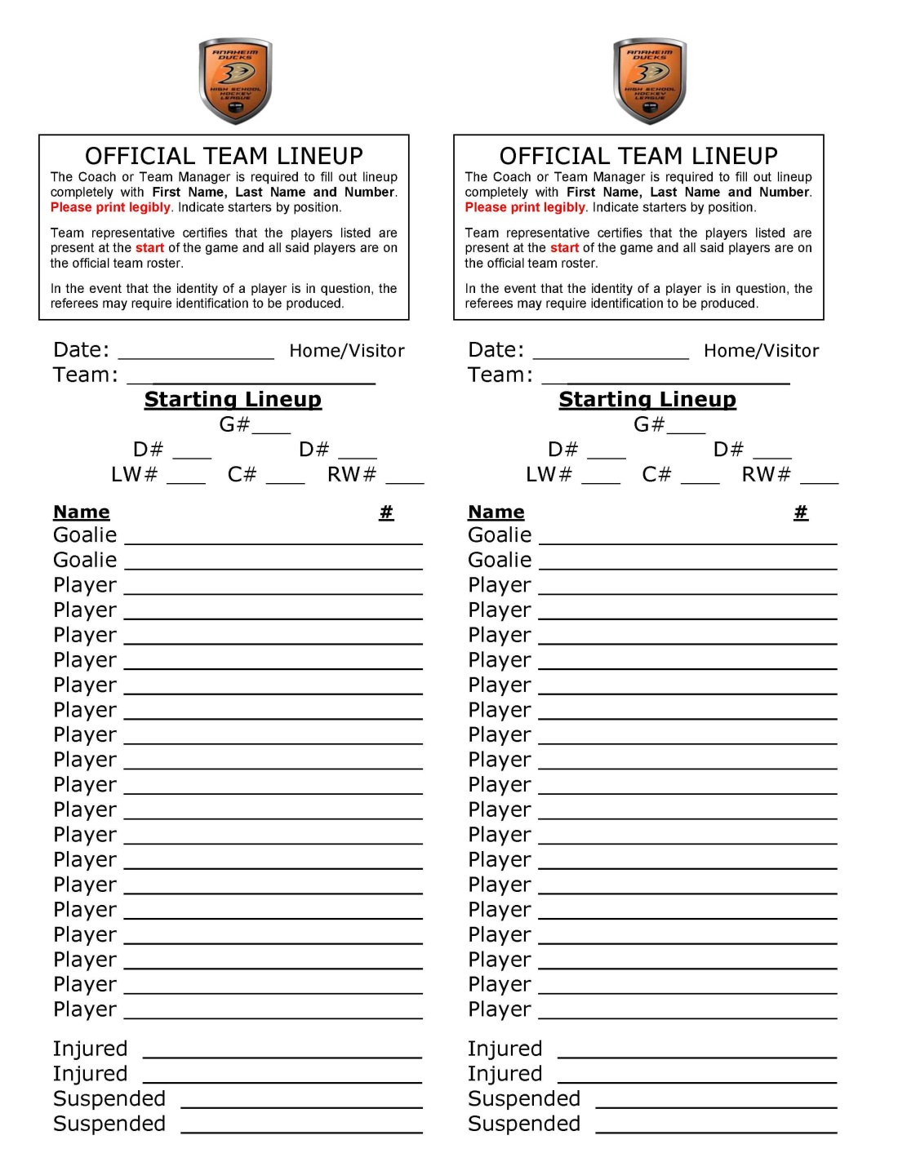
ADHSHL Roster Card

Slide 17
Play-Off Format
ADHSHL
• ALL DIVISIONS
― Single game elimination
― Play-Off bracket for each division
― Seeding based upon regular season finish
― All schools qualify
CAHA
• Varsity Division 1 schools only
• February 19-21, 2015; Location - TBD

Slide 18
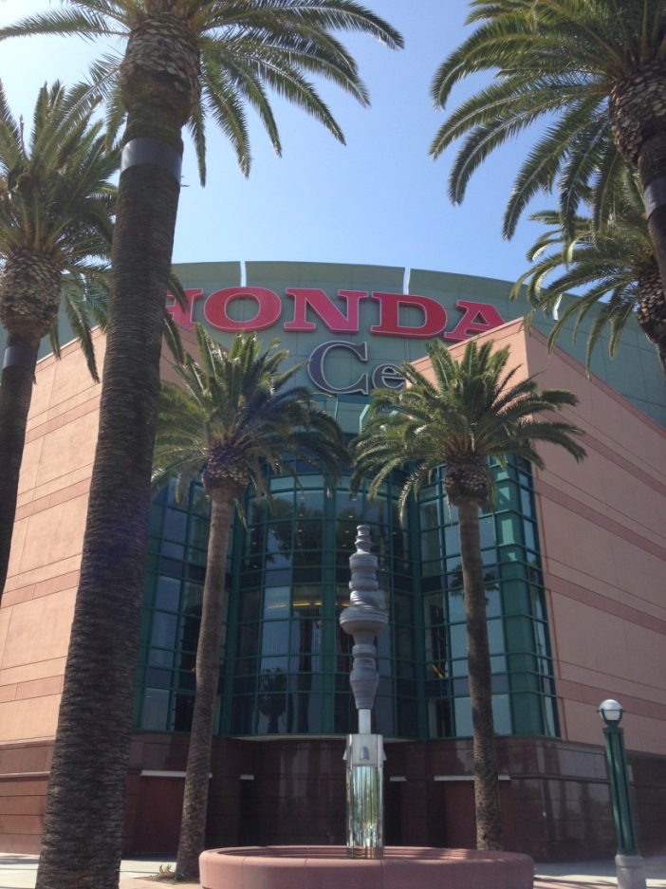
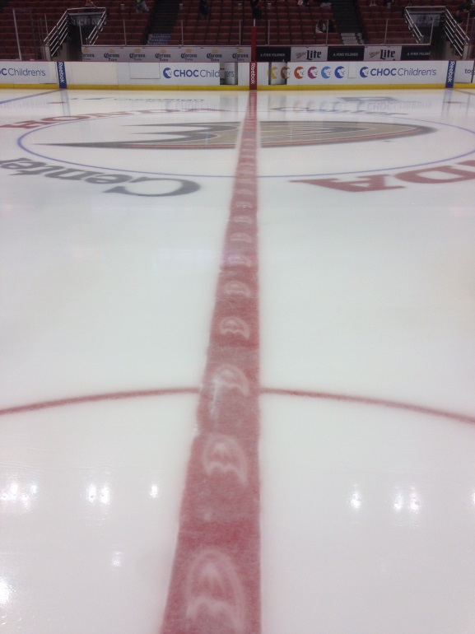
ADHSHL at Honda Center

Slide 19
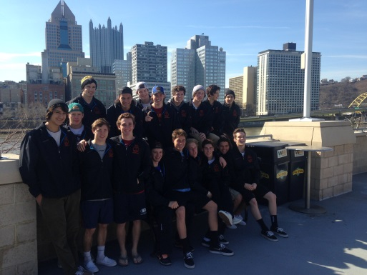
Misc. Items
High Res Logo for new schools
Blackdog Enterprises
Video & Audio available for all Division 1 games on Blackdog (fee)
Video & Audio available for select Division 2 and 3 game(s) of the week on Blackdog (fee)
USA Hockey High School Nationals
March 17-21, 2016; Reston, VA
America’s Showcase – Team CA
April 14-18, 2016; Pittsburgh, PA
Juniors & Seniors only

Slide 20

Coverage Details Roughly 150 Total Games, streamed live and archived on-demand on our website. All Varsity D1 Games Select Varsity D2 and Varsity D3 Games All-Star Games, Playoffs and Championships Games will feature single camera HD videography, live 2-man audio commentary and dynamic integrated scoreboard graphics. Select broadcasts will also feature multi-camera coverage, dynamic lower third graphics, instant replay and post-game MVP interviews. Additionally, we will produce weekly recap highlight reels for the league, posted on YouTube, the league website and BDE social media outlets. Watch Games Live and On-Demand (VOD) Live: www.blackdogenterprises.org/watchADHSHL.php Single Game: $7.50 Season Pass: $75.00 VOD: www.blackdogenterprises.org/vaultADHSHL.php 2-Hour Pass: $7.50 Unlimited Access: $75.00 Additional Services Game DVDs: http://www.blackdogenterprises.org/OrderDVDs.html Every Live Broadcast available for purchase on DVD $30.00 for 1 Game, $50.00 for 2 Games, $65.00 for 3 Games, $75.00 for 4 Games and then $10.00 for each additional game Personal Video Vault: Coming Soon! Purchase a digital copy of any game archived on our platform Viewable online for 3 years from original game date After 3 years, games will be available for download to your personal computer Cost: Similar to DVD purchase scale. Exact rates TBA. Scouting Reels and Coaches’ Film We offer a variety of dynamic edited reels that showcase the skills of an individual player or an entire team for junior/college recruiters. Highlight Reels, Recruiting DVDs, and Skills Assessments are just a sample of what we offer. We also offer coaches’ film, unedited or edited to coaches’ selections, to assist in player evaluation and training. Questions? Contact CEO/Founder Andy Dickerson at info@blackdogenterprises.org

Slide 21
Q & A

