Slide 1


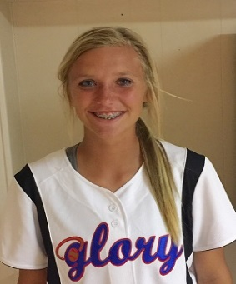
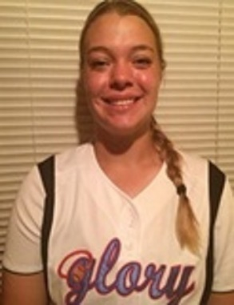
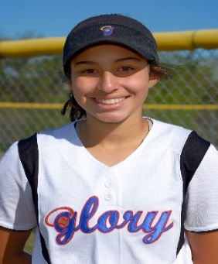
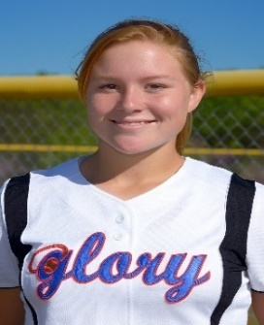
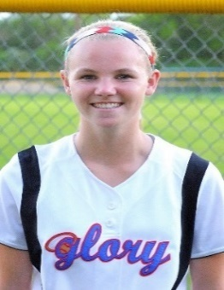
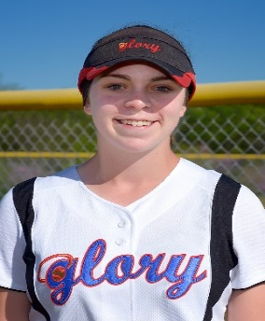

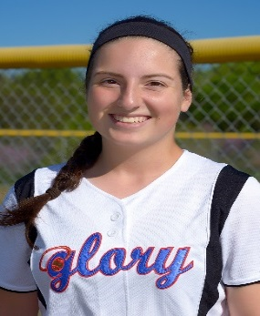
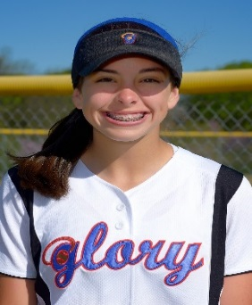
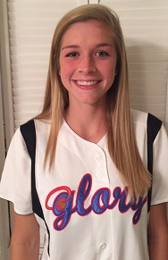
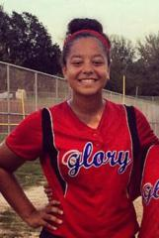
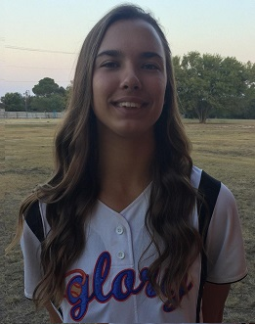
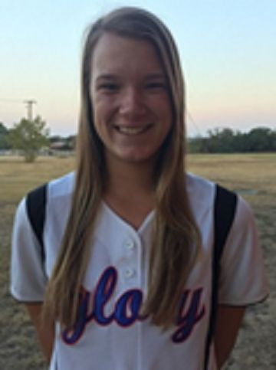


Texas Glory Adkins 16U Gold
#10 - 2017
Parker Smith
C / MI / OF
Bat: Both
Throws: Right
HT 5’6”
Early HS
GPA: 4.0
#17 – 2017
Georgia Capell
#2 – 2018
Marissa Hernandez
SS / 2B / Utility
Bat: Both Throws: Right HT 5' 3“
Byron Nelson
GPA 3.45
#13 - 2018 Abby Stuart
3B / 1B / RF
Bat: Right Throws: Right HT 5' 6"
Southlake
GPA 3.50
#15 - 2018
Grace Meador
CF / Utility
Bat: Left/Slap Throws: Right HT 5' 3“
Flower Mound
GPA 4.0
#16 - 2018 Reagan Ellison
CF / SS
Bat: Right Throws: Right HT 5' 7“
Burleson Cent
GPA 4.3
#18 - 2018
Jenna Kash
OF / 2B / Util
Bat: Slapper Throws: Right HT 5' 2"
Flower Mound
GPA 4.00
#22 - 2018 Maddie Flores
OF / 2B / Utility
Bat: Right Throws: Right HT 5' 7“
Byron Nelson
GPA 4.0
#32 - 2018 Maggie Black
SS / 3B/ Util
Bat: Right Throws: Right HT 5' 5“
Colleyville Heri
GPA 4.0
#33 - 2018
Riley Cantrell
#42 - 2018 Gabby Kowalik
RHP/ SS / OF
Bat: Right Throws: Right HT 5' 7“
New Braunfels CA
GPA 4.0
#99 - 2018
Kayla Kowalik

Slide 2

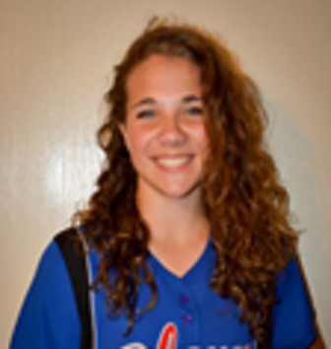
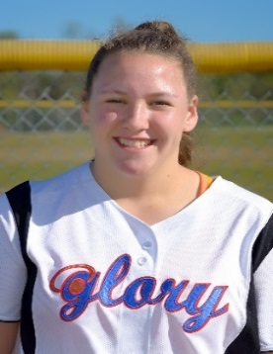
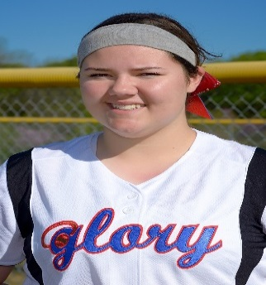
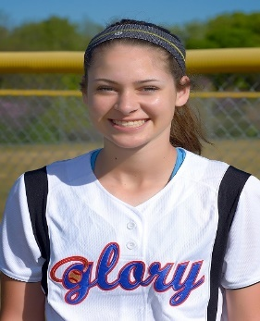
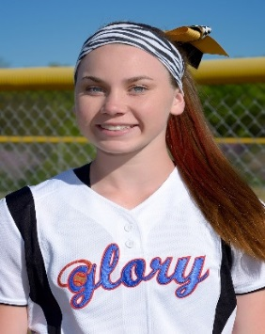
Texas Glory Adkins Gold
#11 - 2019
Madelyn Wright
RHP / 1B
Bat: Right Throws: Right HT 5' 11“
VR Eaton HS
GPA 3.5
#27 - 2019 Reagan Chism
RHP / 1B
Bat: Right Throws: Right HT 5' 10"
Decatur HS
GPA 4.0
#55- 2019
Dylann Kaderka
LFP / DP / 1B
Bat: Left Throws: Left HT 5' 9“
Keller HS
GPA 3.6
#25 - 2019
Jordan Lorenzini
SS / 2B / OF
Bat: Right Throws: Right HT 5' 9“
Flower Mound
GPA 4.0
#6 - 2019 Lauren Ledbetter
Catcher / Utility
Bat: Right Throws: Right HT 5' 5“
McKinney North
GPA 3.8
WWGLORY.NET
05/28 - 05/29 - USA Select Elite National Qualifier
06/04 - 06/05 - PGF National Qualifier
06/10 - 06/12 - ASA 16U Gold National Qualifier
06/17 - 06/19 - TCS Texas State Championships
06/27 - 07/03 - Colorado TCS Sparkler Power Pool 16U
07/11 - 07/17 - USA Select Elite World Fast Pitch Championships
07/25 - 07/30 - Mariette GA - JO Cup ASA 16U
Head Coach
Jack Fultz
214-557-7722
jsfultz@txglory.com

