Slide 1
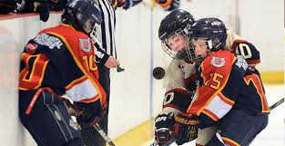
Rules Session
Notes:
We have intentionally removed the answers or the suggested answers to avoid the discussion on the particular check in question
What the instructor needs to focus on is the knowledge of the rule, the fact that there was a “danger zone” trigger and a consequence and that the officials know how to handle the situations when they occur.

Slide 2
A forward motion of both arms, with the palms of the hands open and facing away from the body, fully extended from the chest at the shoulder level is the signal for:
Q1 - Q

Slide 3
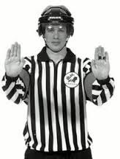
Checking from Behind

Slide 4
When a team’s trainer comes onto the ice to attend to a player (except a goaltender), that player shall be classified as injured and required to leave the ice surface before the play resumes.
Q2

Slide 5
True
Rule 2.6 (g) Sit. 4

Slide 6
If a team is shorted handed and a penalty shot is called against them and the penalty shot is successful does the player in the penalty box return?
Q3

Slide 7
No the penalty shot washes out the infraction that resulted in the Penalty Shot
Rule 4.9 Situation 14

Slide 8
What is the question to the following answer?
Home base
Half piston
At the net
Cone.
Q4

Slide 9
Four positions of end zone positioning
(Piston System)

Slide 10
Team “A” is serving a Minor penalty.
Referee signals a delayed Minor penalty to Team “A”.
Team “B” scores a goal prior to the stoppage of play.
Which penalty is washed out on the scoring of the goal?
Q5 - Q

Slide 11
The Minor Penalty being served.
Rule 4.13(b)

Slide 12
What penalty shall be called…
A player impedes or seeks to impede the progress of an opponent with his stick?
What two discretional penalties may be assessed?
Q6

Slide 13
Minor penalty
or
Major penalty and a Game Misconduct penalty
Rule 8.4a

Slide 14
A stoppage of play occurred in the end zone.
Players of both teams are assessed penalties.
Where is the resulting face-off?
Q7

Slide 15
The end zone face-off spot closest to where the stoppage of play occurred
Rule 10.2(f)

Slide 16
What penalty would you call for the following answer?
Minor Penalty or
Double Minor Penalty or
Major Penalty and Game Misconduct or
Match Penalty
Q8

Slide 17
Head Contact
Rule 6.5

Slide 18
Where is the face-off when the puck strikes an official and goes out of the playing surface?
Q9

Slide 19
The face-off takes place at the spot where the puck goes off the official in accordance with Rule 10.2 (g)
Rule 10.2(e) Situation 10

Slide 20
What is the Rule?
Rule 4.9 Situation 2
Q10

Slide 21
Penalty Shot
Where a penalty shot has been awarded during a gam, this shall be recorded on the Official Game Report, along with the time it was awarded, the player designated to take the shot and whether or not the goal was scored on the play. In order to assess a Penalty Shot as a result of a foul against the puck carrier, the following conditions must be met:
The attacking player must have control of the puck.
The determing factor is the position of the puck whenthe infraction is committed. The puck must be in neutral or attacking zone when the infraction is committed.
The attacking player must hane no defending player to pass other than the goaltender.
The attacking player must be fould from behind
The attacking player must have been denied a reasonable scoring opportunity.

Slide 22
A defending player shoots the puck out over the defending blue line. It then deflects off an official back into the defending zone while an attacking player is in that zone. Should the official indicate a delayed offside?
Q11

Slide 23
Yes, delayed offside.
Rule 10.8(b) Situation 17

Slide 24
The referee instructed the Coach that he needs to take a minor penalty or exchange the goaltender or place a sixth skater on the ice.
What has occurred?
Q12

Slide 25
At a stoppage of play, the Referee observes the goaltender at the bench.
He notifies the team that they must replace the goaltender with their substitute goaltender.
Rule 3.1 (c) Sit. 4

Slide 26
Attacking player is standing in the
goal crease.
The puck is shot, hits the player in the crease and the puck drops down in the crease.
The attacking player gets out of the crease and then shoots the puck into the goal.
The goal is allowed?
Q13

Slide 27
Yes
Rule 10.4 (f)

Slide 28
Should the helmet of a player come off while play is in progress, that player shall replace the helmet (properly fastened) or shall proceed to the player’s bench for substitution. If the player participates in the play in any manner without his helmet fastened properly, the Referee shall:
Q14

Slide 29
Stop play immediately & assess the player a Minor penalty for ineligible player.
Rule 3.6 (c), OMHA 17.3

Slide 30
The open palm of the non-whistle hand, with fingers together, comes across the body onto the opposite shoulder, is the signal for:
Q15

Slide 31
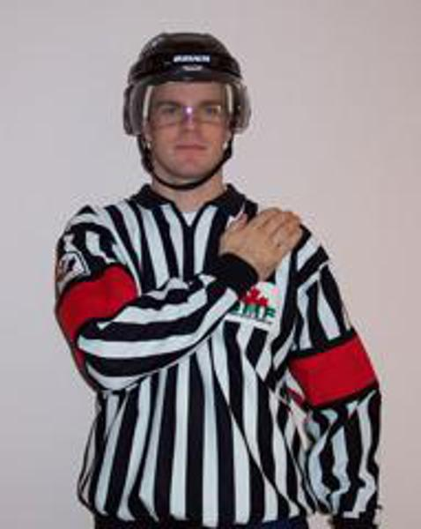
Body checking

Slide 32
The position of the player skates is the determining factor for what call when the puck has completely crossed the blue line?
Q16

Slide 33
Off-Side
Rule 10.8 (c)

Slide 34
What is the Rule?
Rule 10.3 (c)
Q17

Slide 35
A defending player (not the goaltender) deliberately covers the puck in her own crease.
The Referee shall:
Award a Penalty Shot

Slide 36
When there is a deliberate attempt to injure, the penalty is always a:
Q18

Slide 37
Match Penalty
Rule 6.1 (a)

Slide 38
What penalty is assessed a player who uses an obscene gesture towards another player?
Q19

Slide 39
Misconduct penalty
Rule 9.2(b) 1 pg.110

Slide 40
Who is responsible for placing the correct number of players on the ice?
Q20

Slide 41
Situation
Face-off in the attacking zone
Defending team only places four players on the ice.
The linesman drops the puck.
Defending team wins the face-off and throws the puck up ice
Defending team then throws a player over the boards to receive the pass, goes in and scores a goal.
Is this a goal?

Slide 42
Yes- as it is the referee and linesman’s responsibility that the correct number of players are on the ice to start play.
Rule: 2.5 (d)

Slide 43
A player has his stick above the normal height of his shoulders. The puck hits the butt-end of the stick which is below the shoulders and goes into the net.
Is this a legal goal?
Q21

Slide 44
GOAL!
Rule: 8.3 (d) SIT 5 pg. 105

Slide 45
A player bats the puck with an open hand and the puck deflects off the stick of his teammate in the net of the opponent
Q22

Slide 46
No Goal
Rule 9.1 (e) Situation 5

Slide 47
The puck is shot by an attacking player in his attacking zone. The puck deflects off the goalpost and goes out of play. Where does the resulting face-off take place?
Q23

Slide 48
In the neutral zone in accordance with Rule 10.2(g)
Rule 10.11(a) Situation 2

Slide 49
Team A player has two stick penalties.
She then is about to be assessed a double minor for butt-ending.
Team B scores.
Is the player from Team A ejected?
Q24

Slide 50
The first of the double Minor penalties is nullified by the goal.
The second penalty is assessed and the Game Ejection penalty applies.
Rule: 4.2 SIT 21(f) example E
pg. 52

Slide 51
A player who is about to come on the ice plays the puck with her stick. This player has either one or both skates still on the bench.
What does the Referee call?
Q25

Slide 52
Assess a bench minor; both skates must be on the ice.
Rule2.5(f) Situation 2 pg.23

Slide 53
A forward and backward motion of the arms with both fists clenched, extending from the chest for a distance of about one foot is the signal for:
Q26

Slide 54
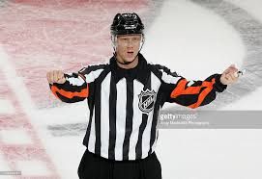
Cross Checking

Slide 55
A player has a breakaway in the neutral zone but the goaltender is apparently hurt.
Assuming an injury, the Referee stops the play.
What is the ruling?
Q27

Slide 56
Penalty Shot
Rule 2.6 Situation 6 pg.27

Slide 57
What penalty shall be assessed a player who, at the discretion of the Referee, impedes or seeks to impede the progress of an opponent by slashing with his stick?
Q28

Slide 58
Minor penalty or a Major penalty and a Game Misconduct penalty.
Rule 8.4 (a)

Slide 59
Time Clock
Team A player receives double minor penalty for Head Contact
When a goal is scored by Team B and the time keeper stops the clock.
The clock reads 2:00
Does Team A player come out of the box?
What do you do?
Q29

Slide 60
You ask yourself when a team is scored upon:
1) Is the team short handed?
2) Is the team serving a minor or bench minor penalty?
If the answer is “yes” to both, then the minor or bench minor penalty with the least amount of time is cancelled.
As the second minor is now “on the clock”, then it is the penalty which would be cancelled.
Think about it this way: if there were 2:01 in the double minor, the :01 would be removed and the second minor would be put on the board (2:00). In this case, the clock reads 2:00 – so the second minor is cancelled.

Slide 61
When a player intentionally contacts her opponent in the head, face or neck area in any manner, the Referee shall assess what penalty?
Q30

Slide 62
Double Minor penalty or Major penalty and a Game Misconduct penalty.
Rule 6.5

