Slide 1

2017 AHU Awards Ceremony
Team Memories

Slide 2
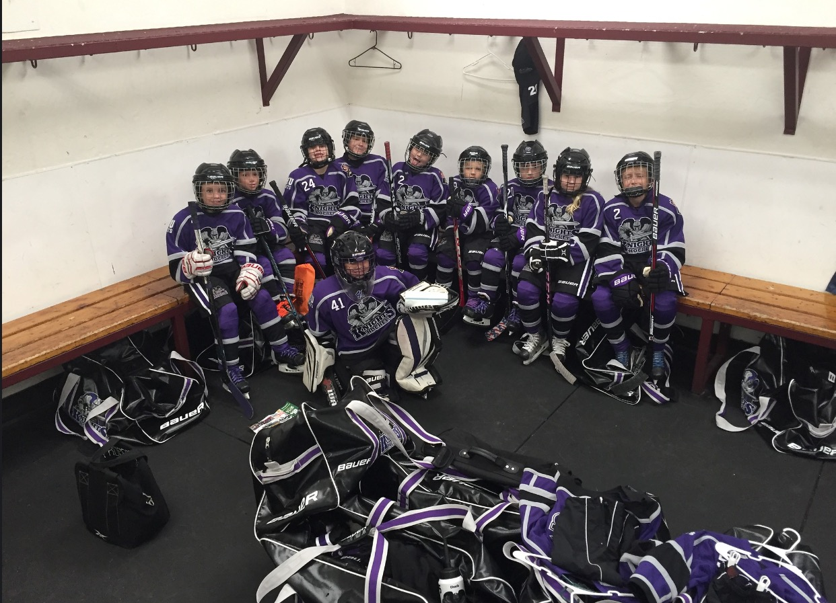
MITE BLACK

Slide 3
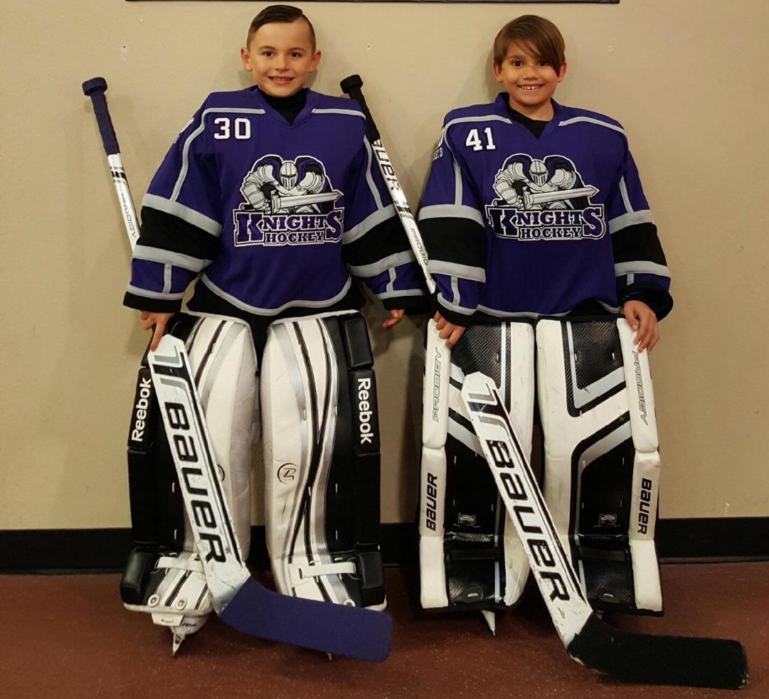
MITE BLACK GOALIES

Slide 4
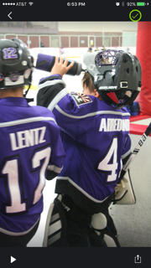
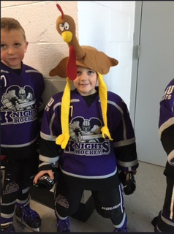
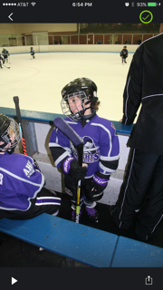
MITE BLACK FUN

Slide 5
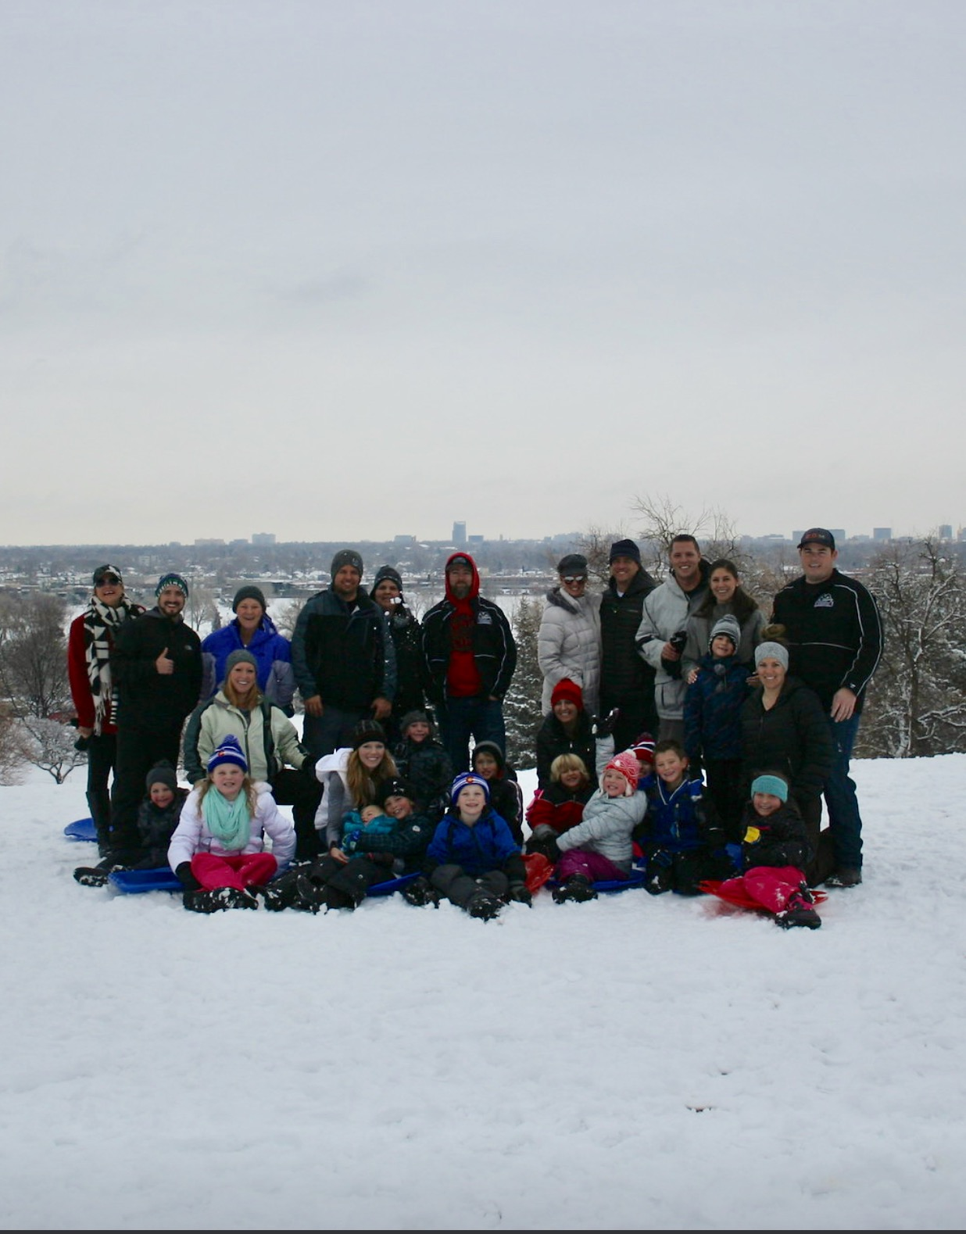
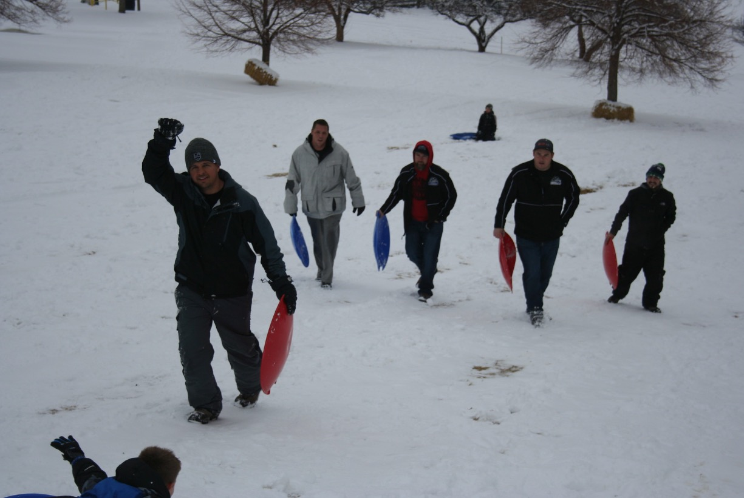
MITE BLACK FUN

Slide 6
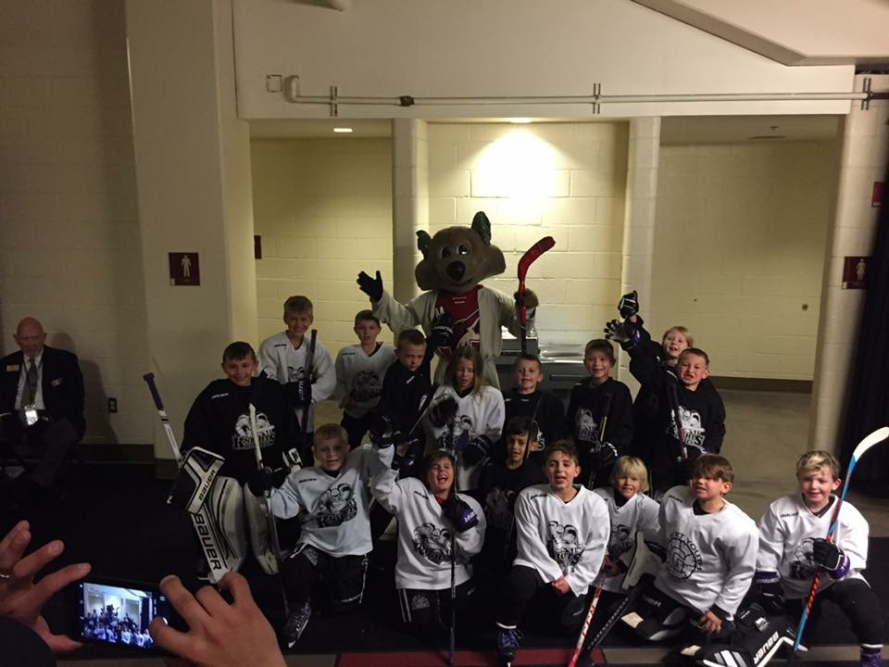
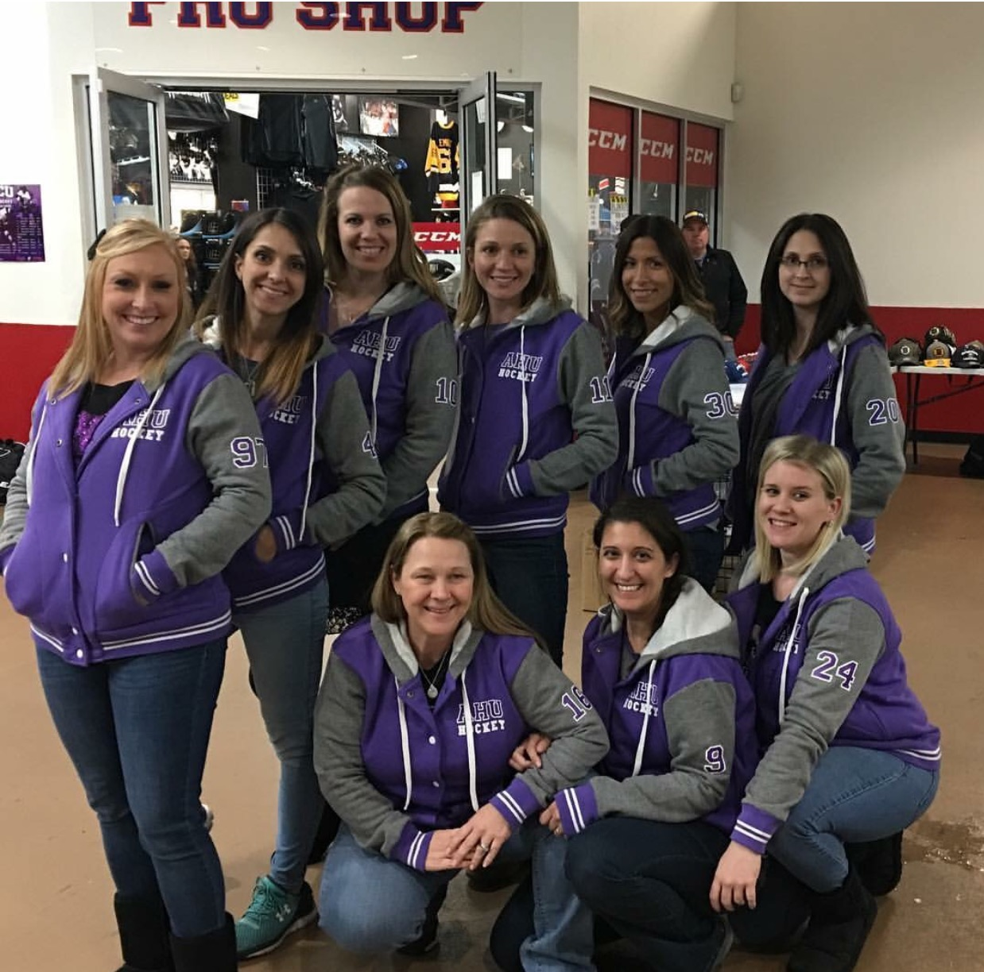
MITE BLACK FUN

Slide 7
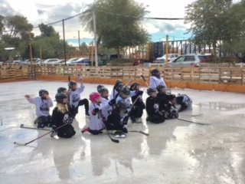
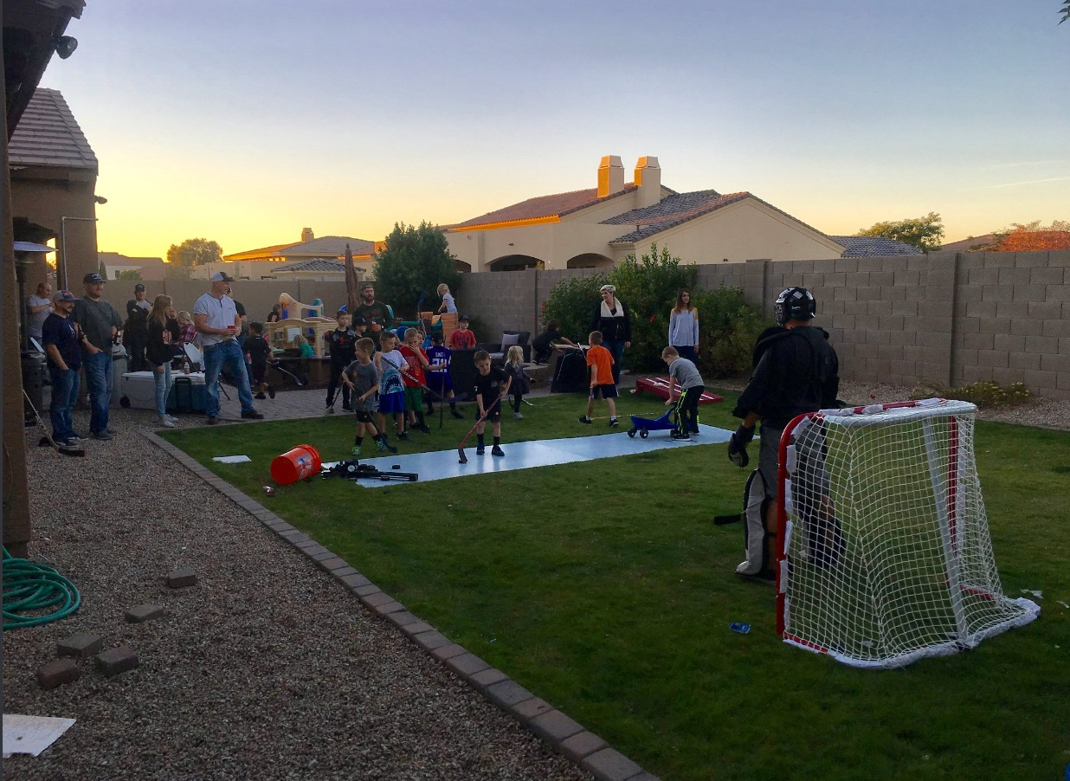
MITE BLACK FUN

Slide 8
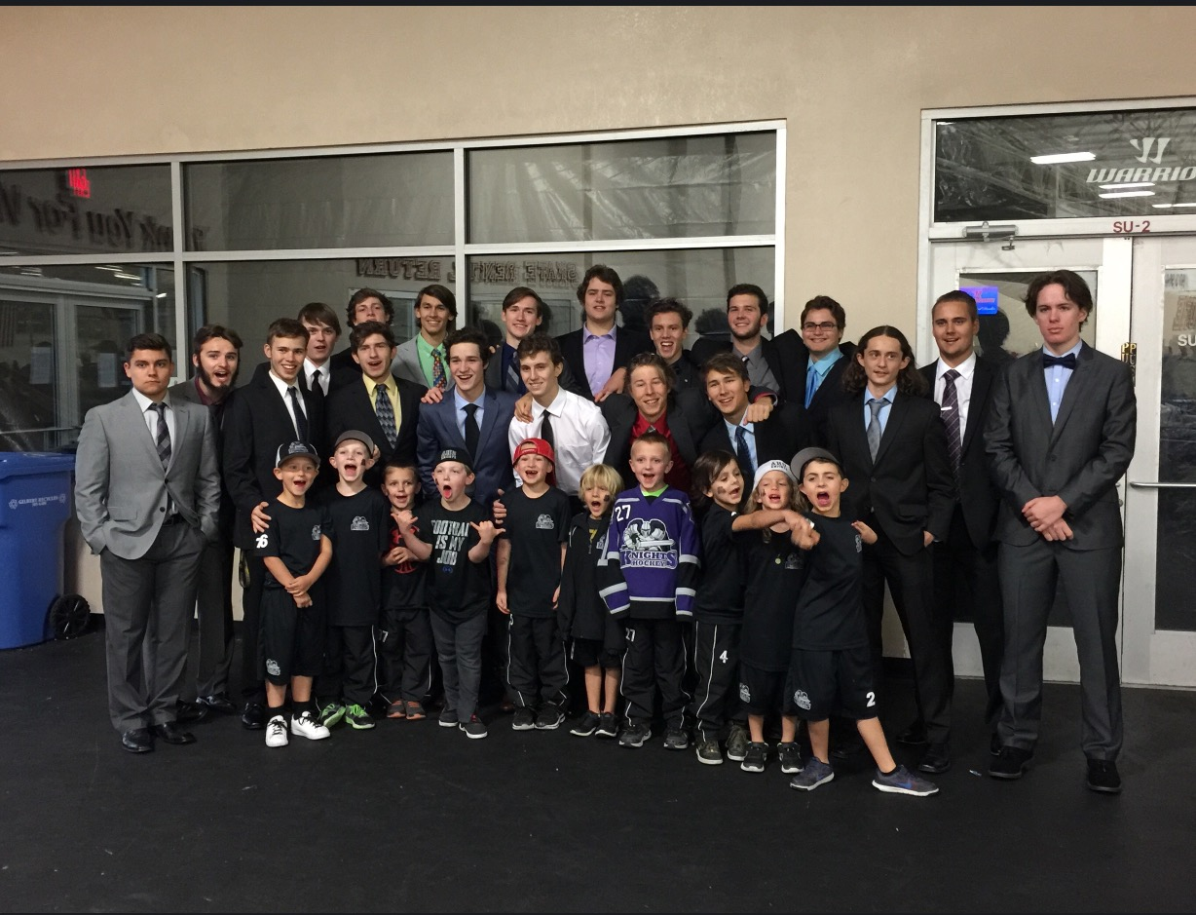
MITE BLACK BIG BROTHERS

Slide 9
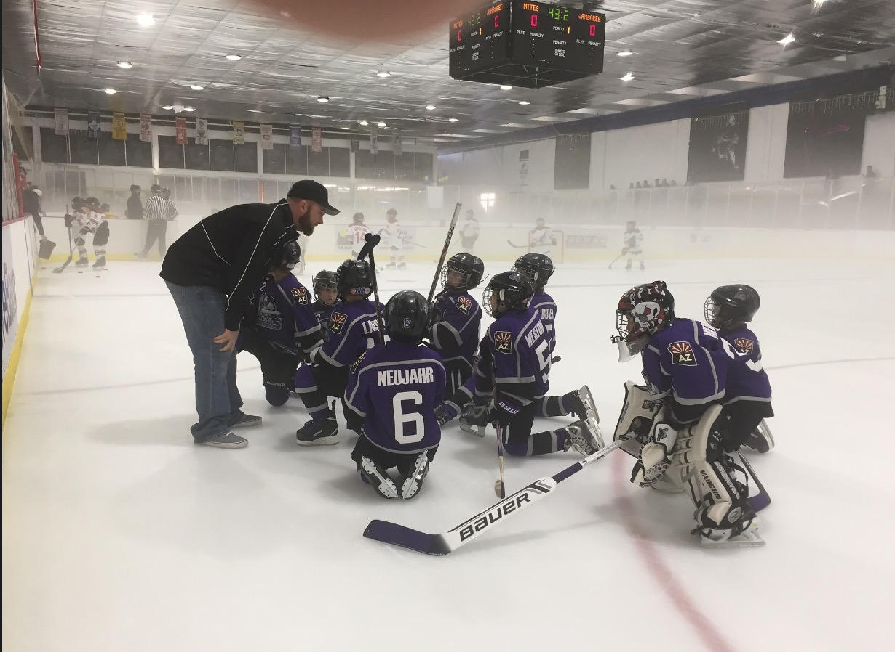
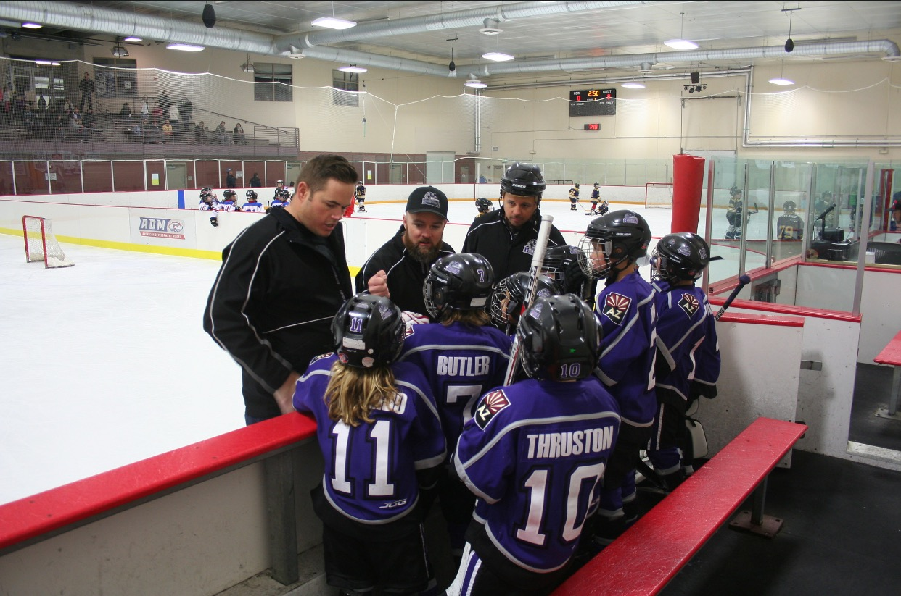
MITE BLACK ON ICE

Slide 10
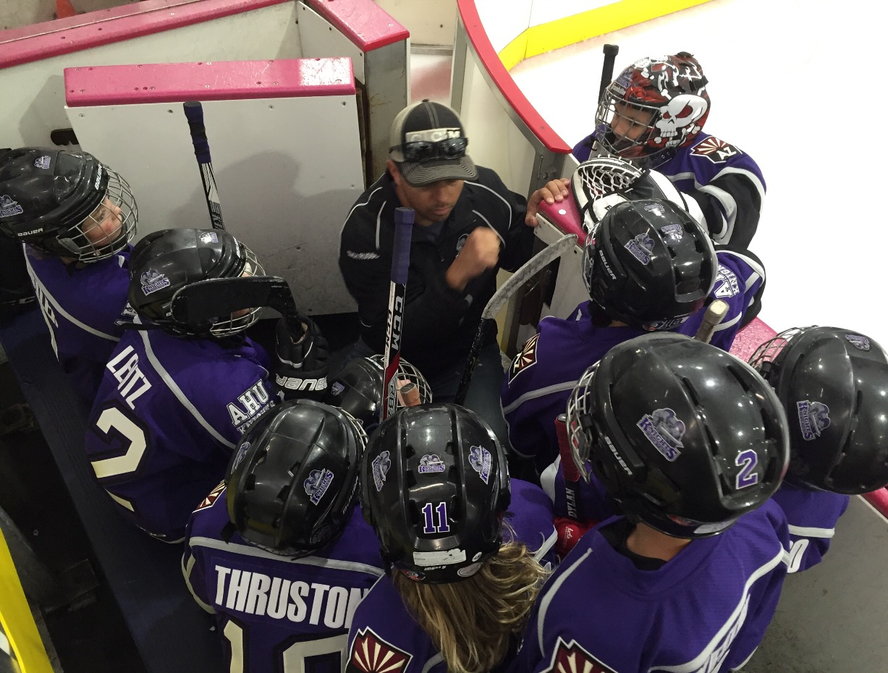
MITE BLACK COACHING

Slide 11
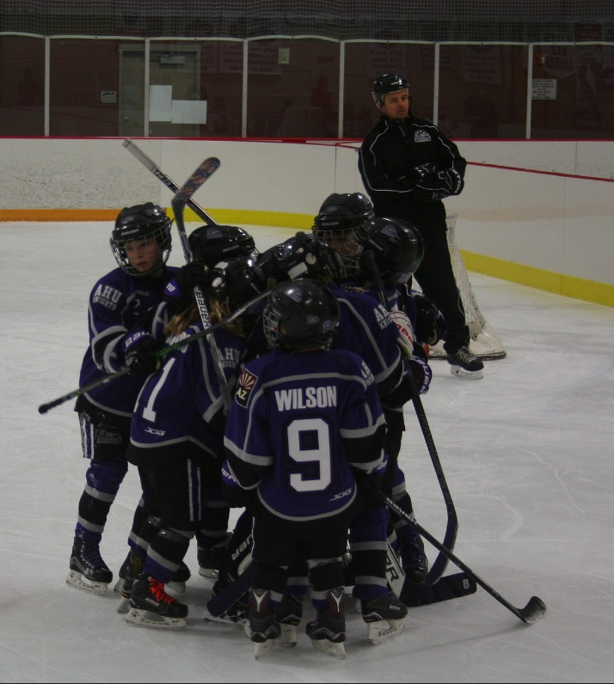
MITE BLACK CELEBRATION

Slide 12
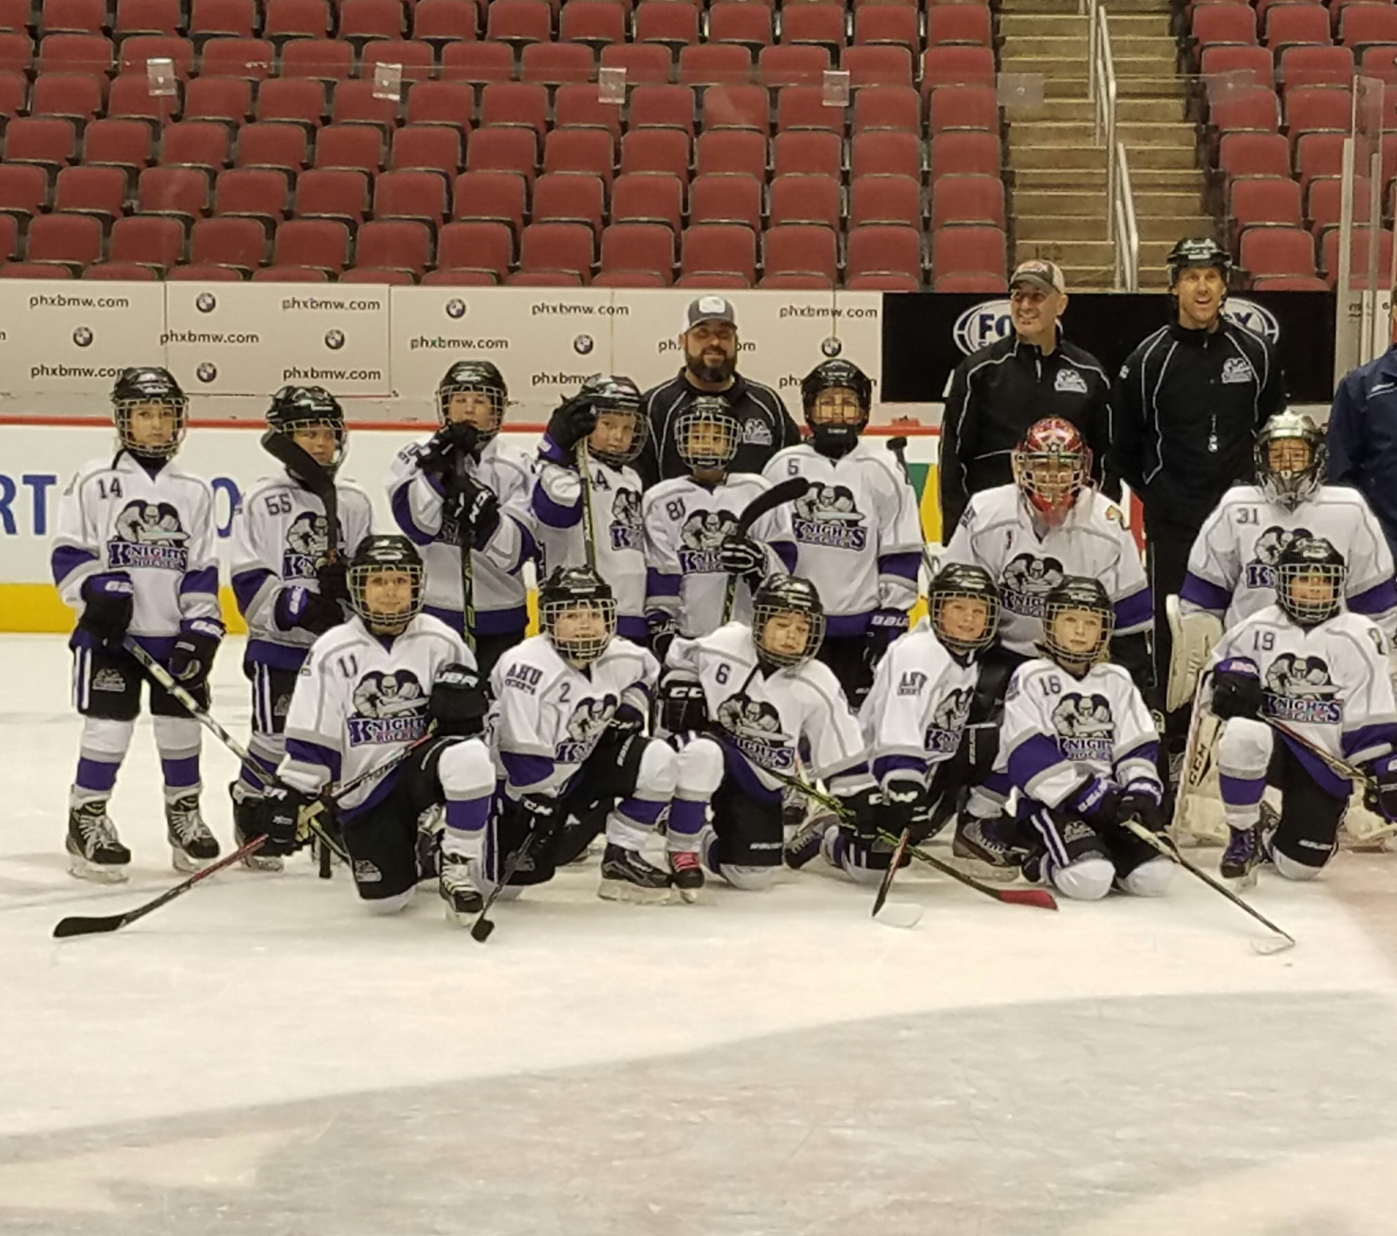
MITE WHITE

Slide 13
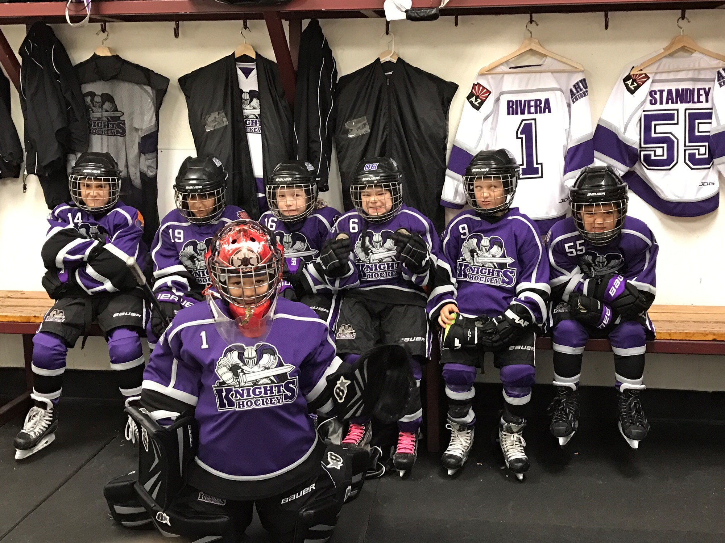
MITE WHITE GAME FACES

Slide 14
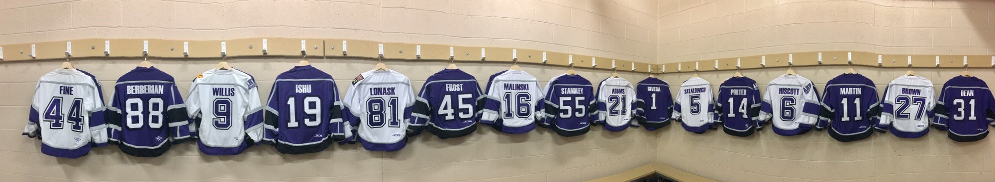
MITE WHITE FOREVER

Slide 15
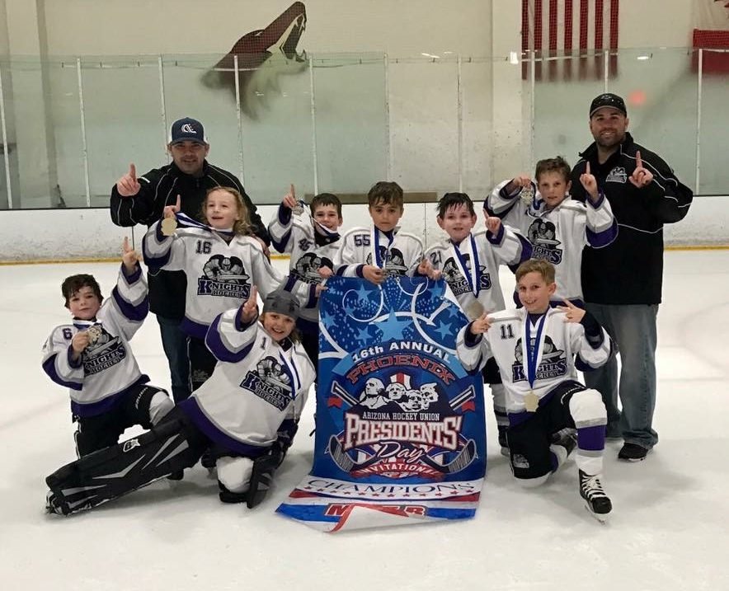
MITE WHITE

Slide 16
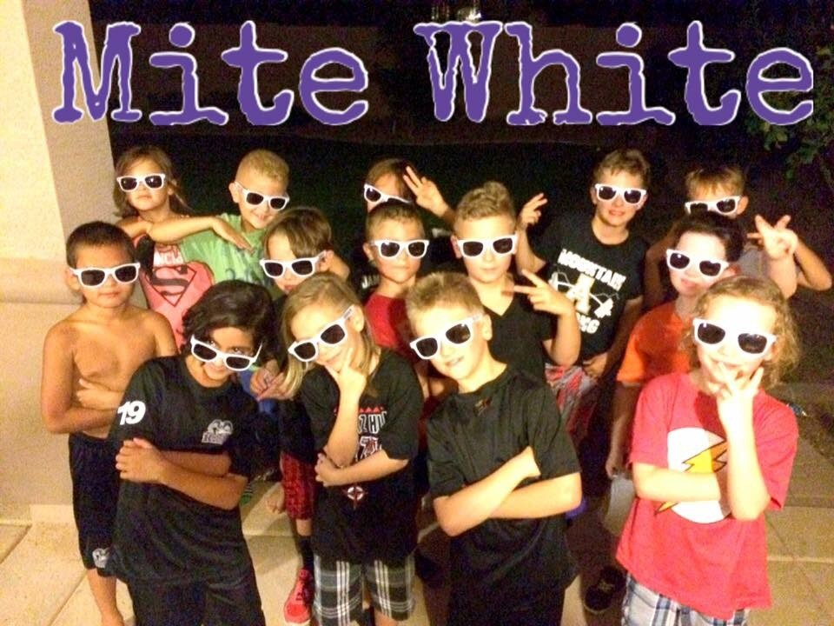

Slide 17
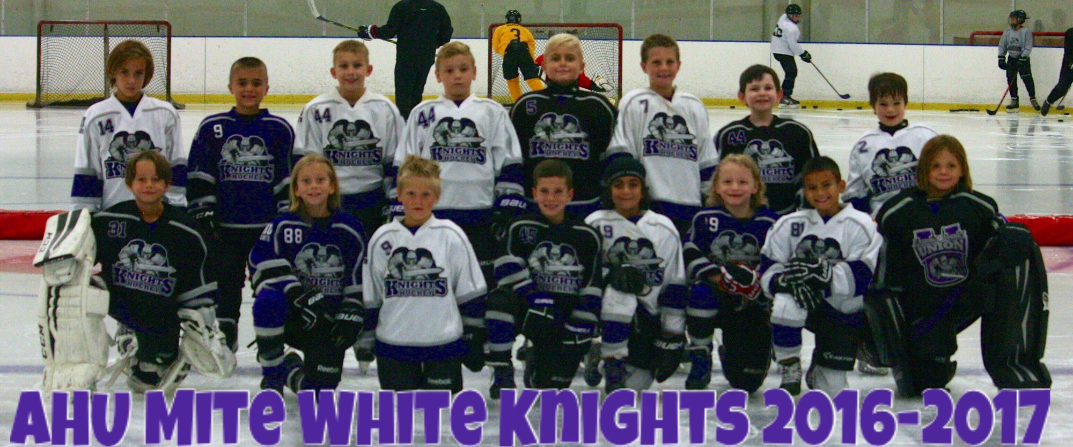
MITE WHITE FOREVER

Slide 18

MITE WHITE

Slide 19
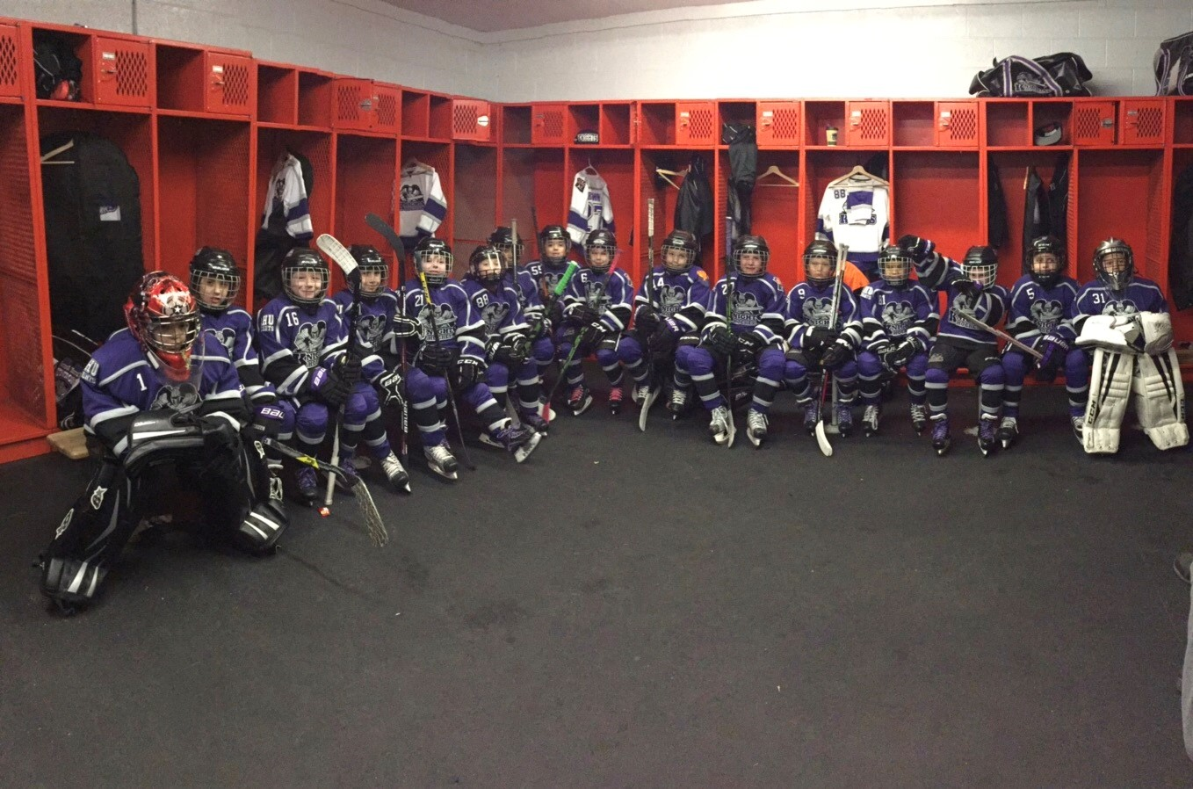
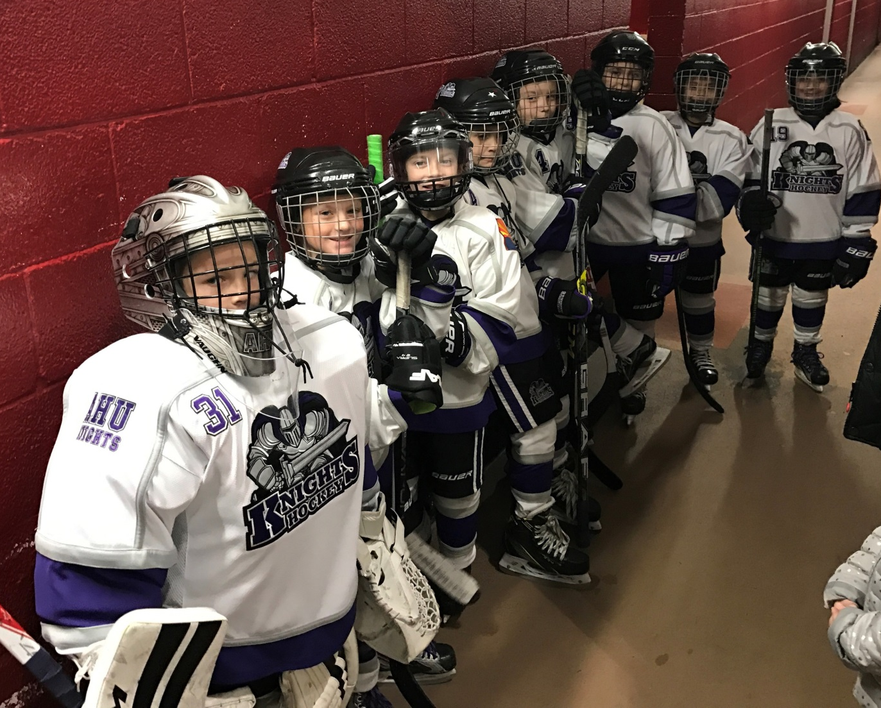
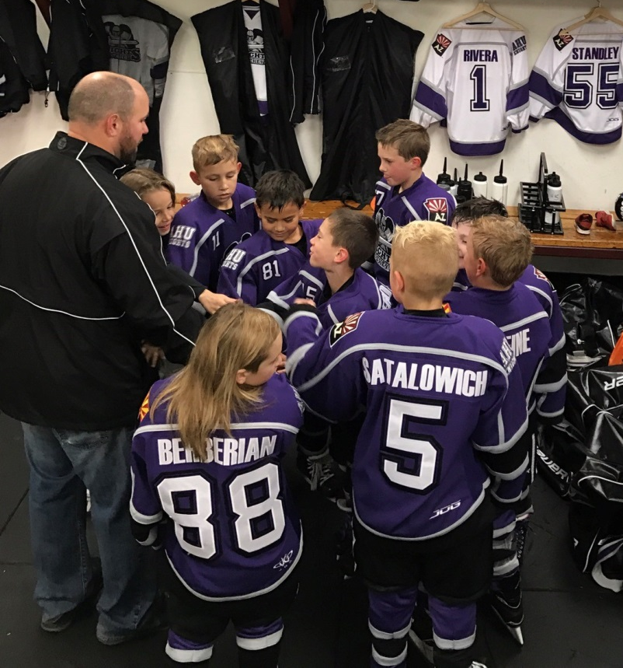
MITE WHITE

Slide 20
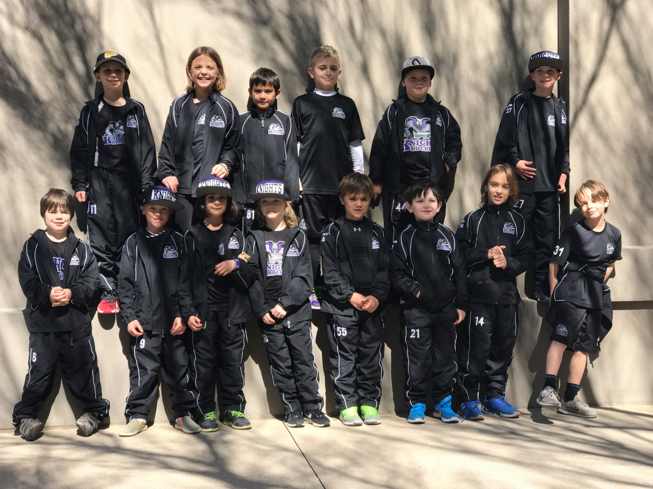
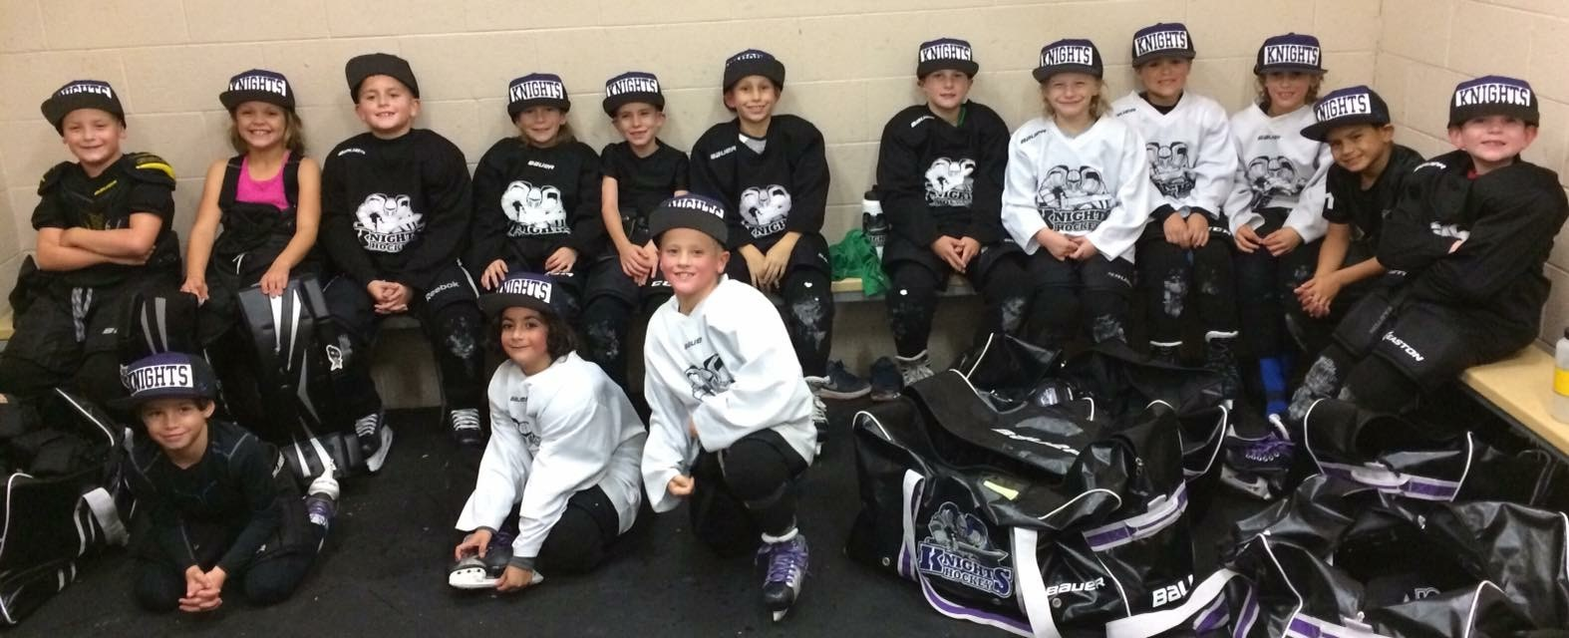
MITE WHITE

Slide 21
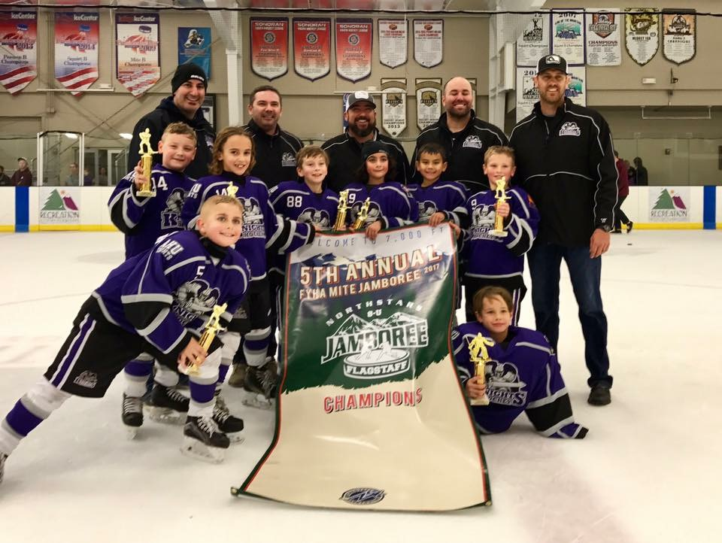
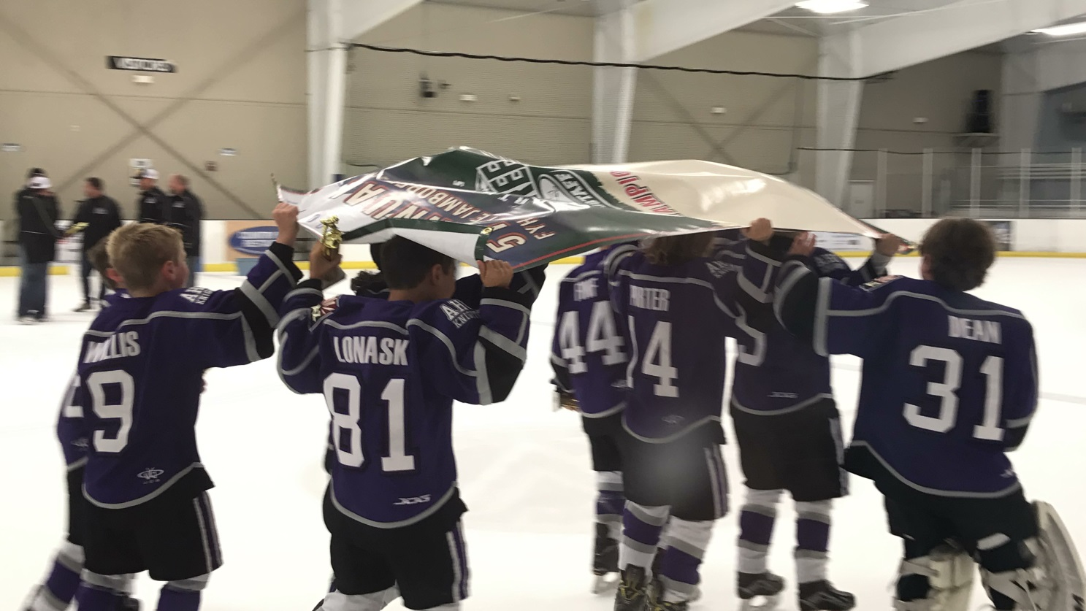
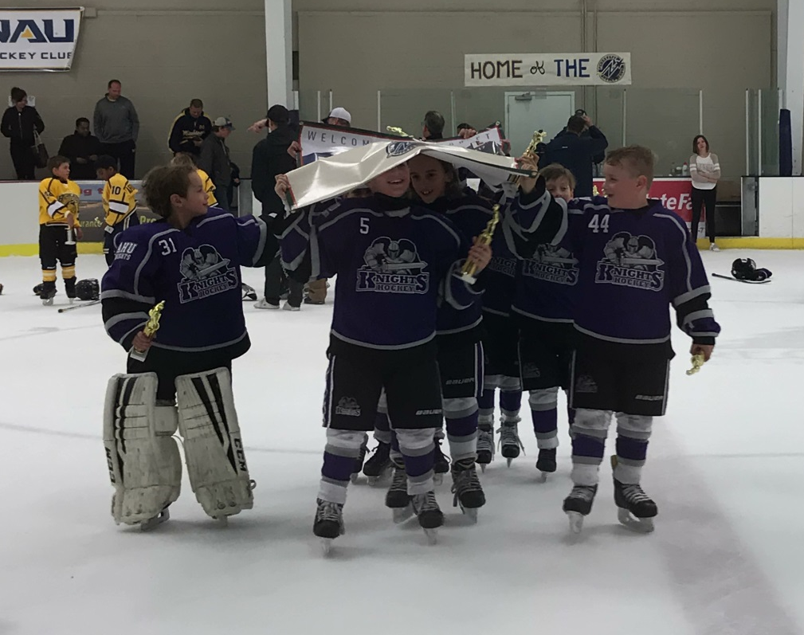
MITE WHITE

Slide 22
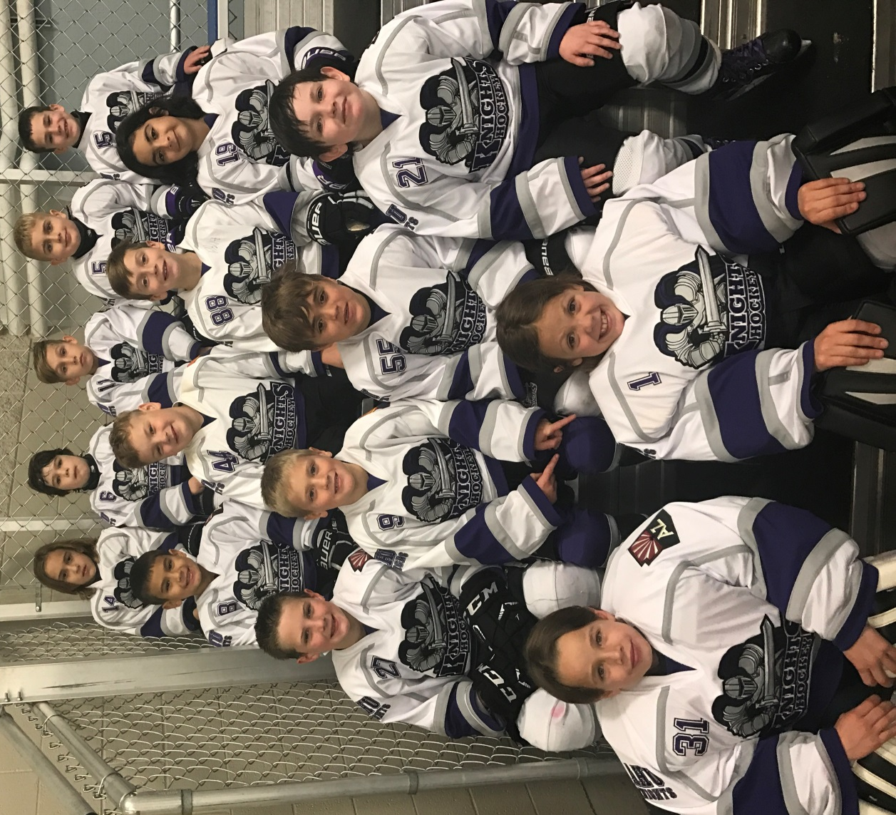
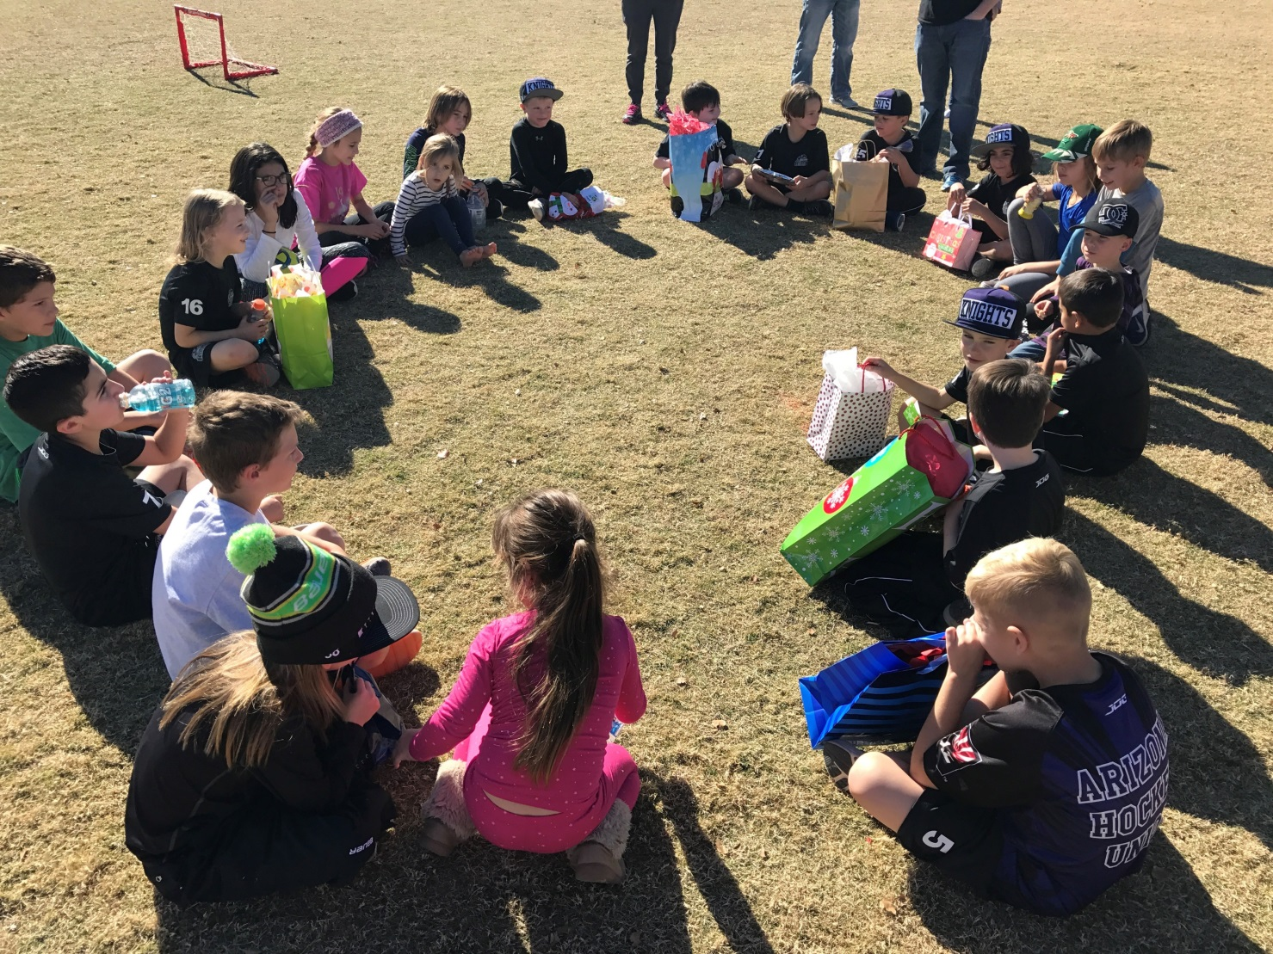
MITE WHITE

Slide 23
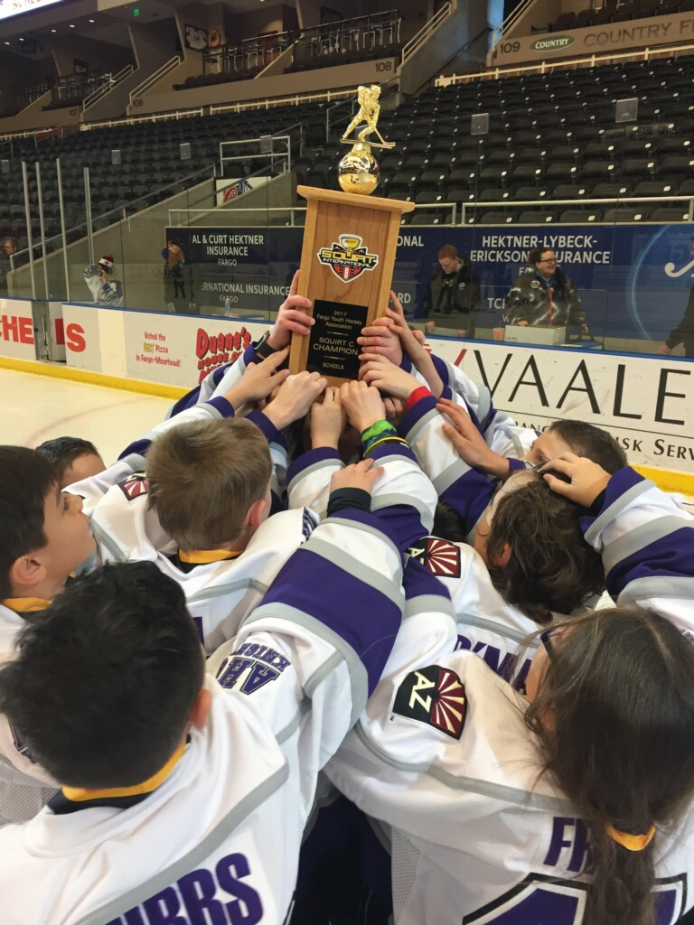
SQUIRT BLACK

Slide 24
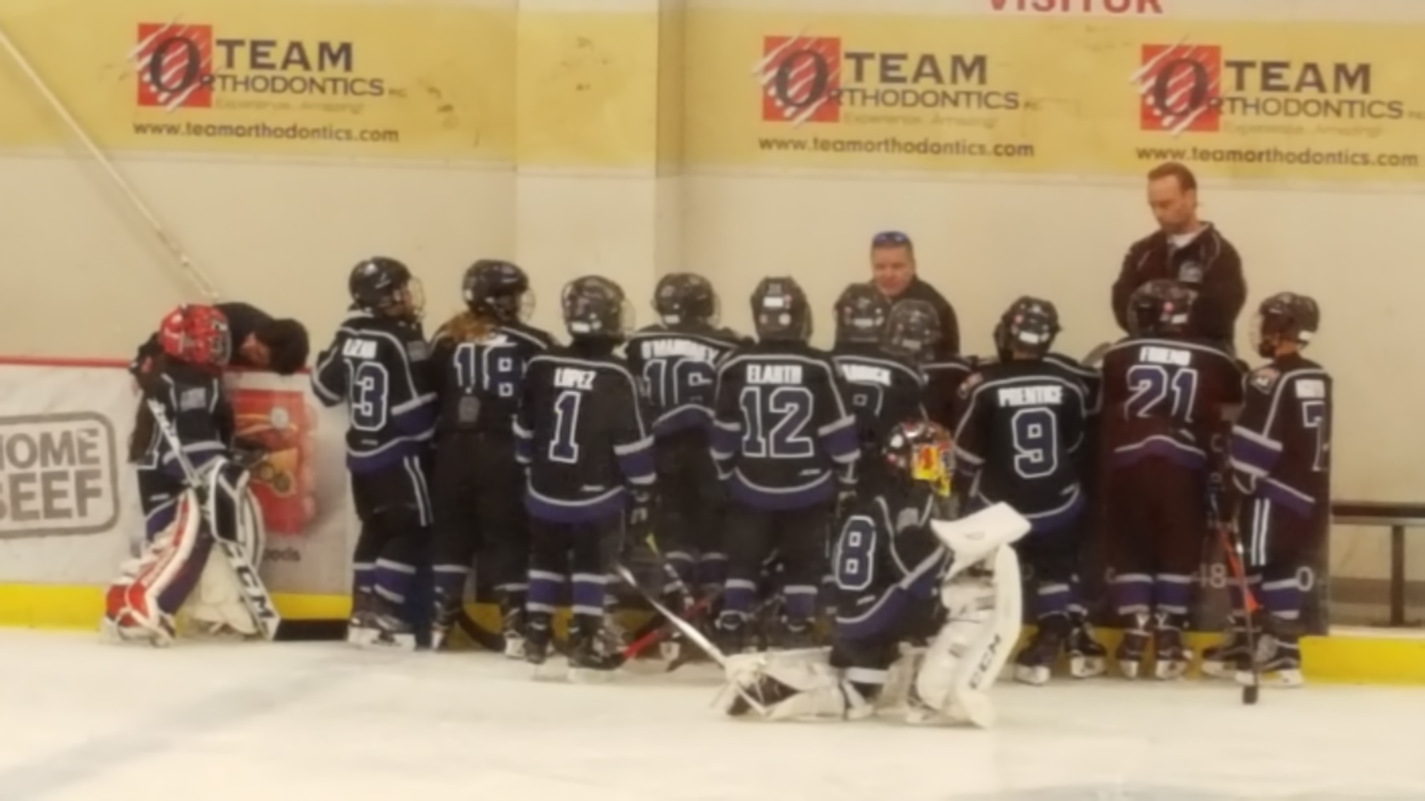
SQUIRT BLACK

Slide 25
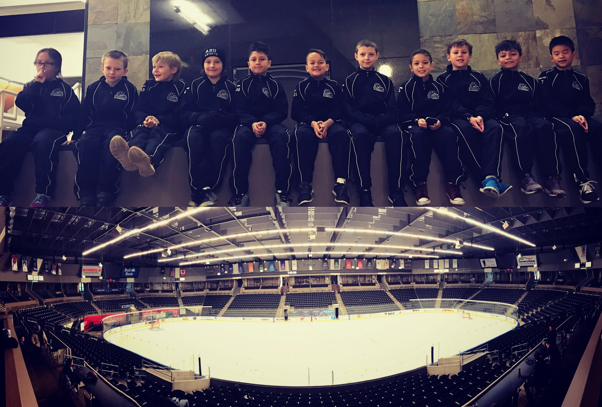
SQUIRT BLACK

Slide 26
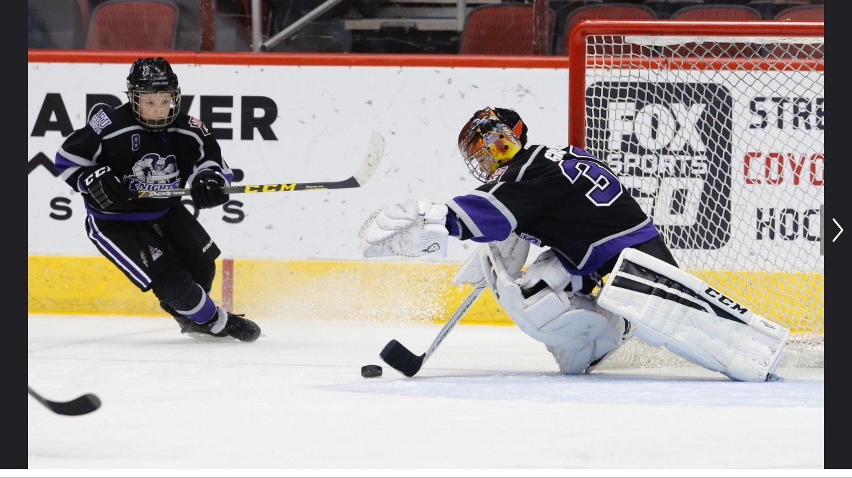
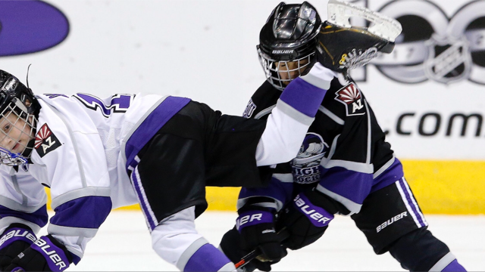
SQUIRT BLACK

Slide 27
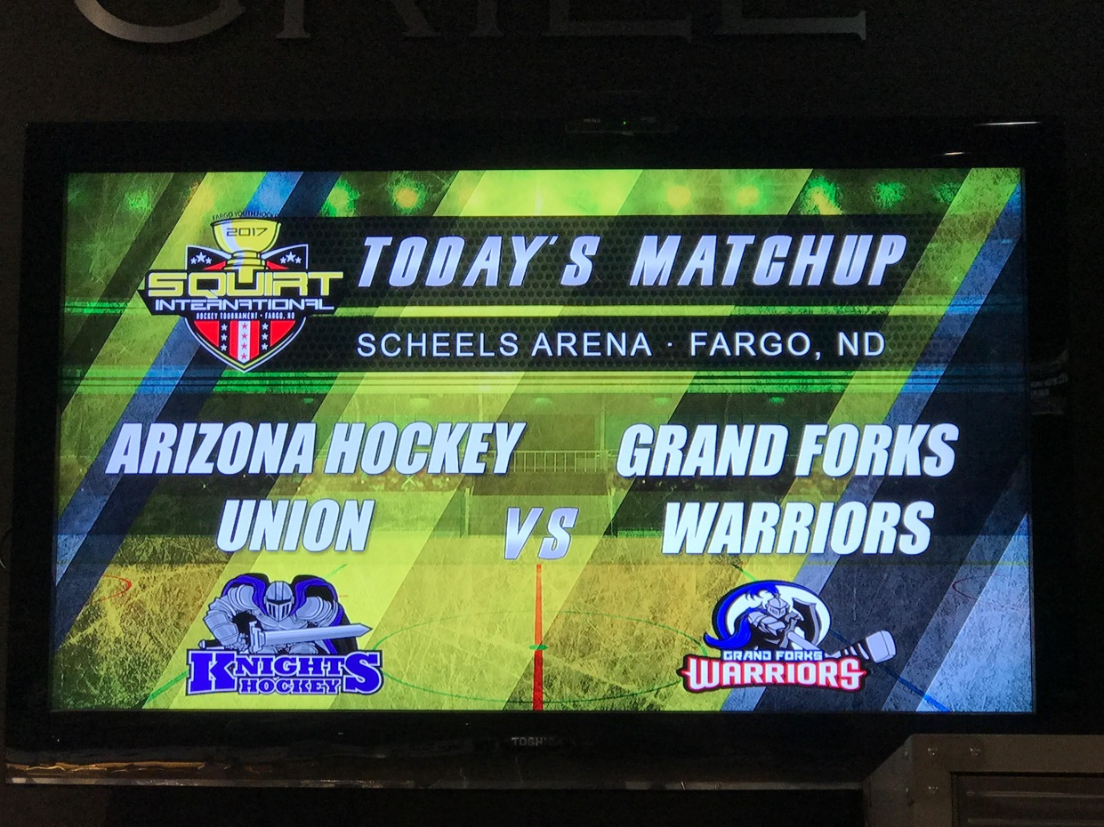
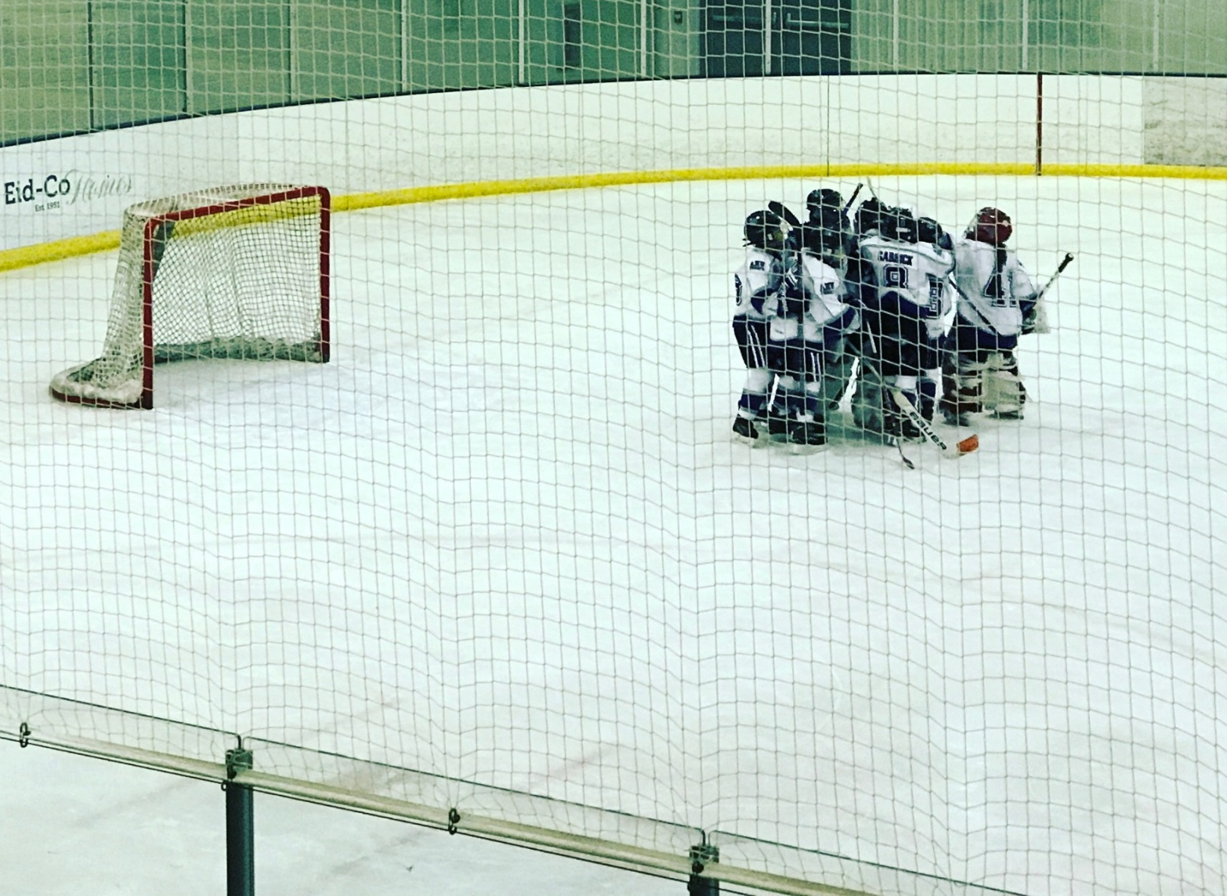
SQUIRT BLACK

Slide 28
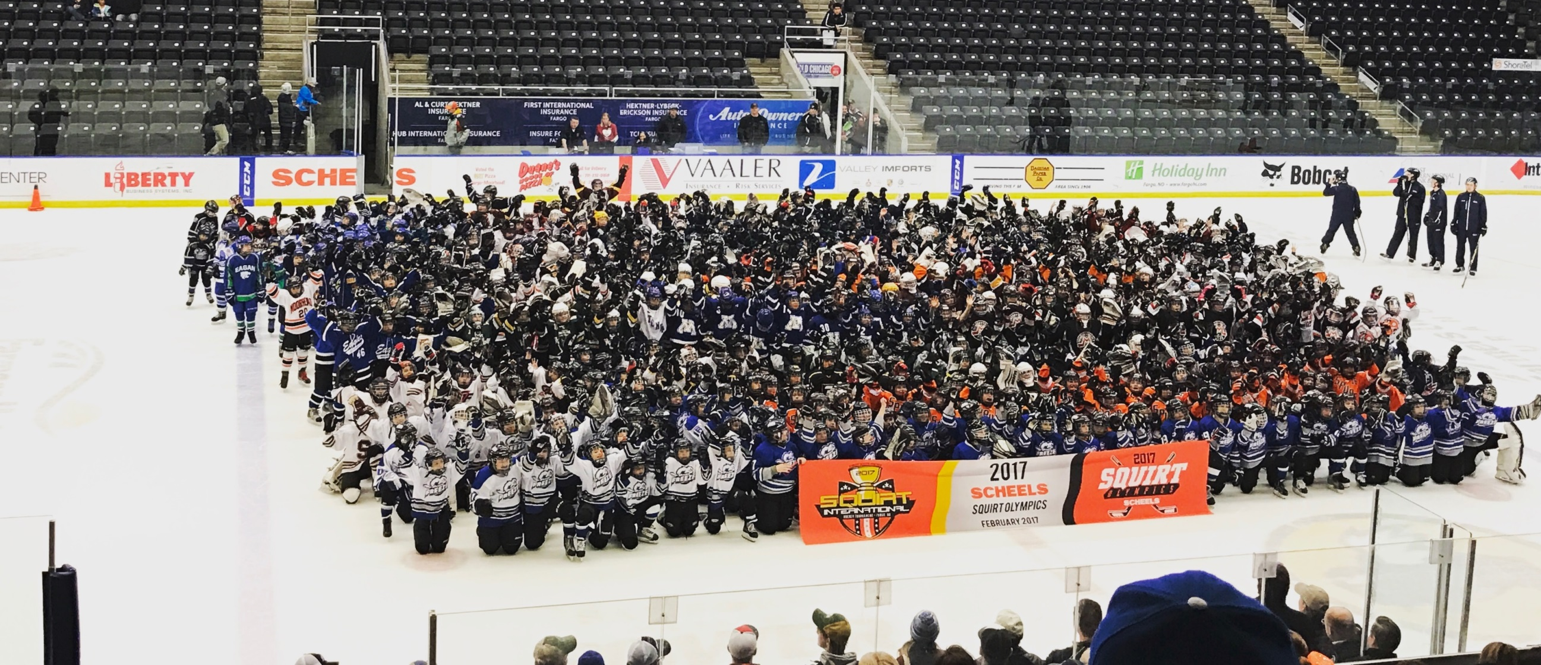
SQUIRT BLACK

Slide 29
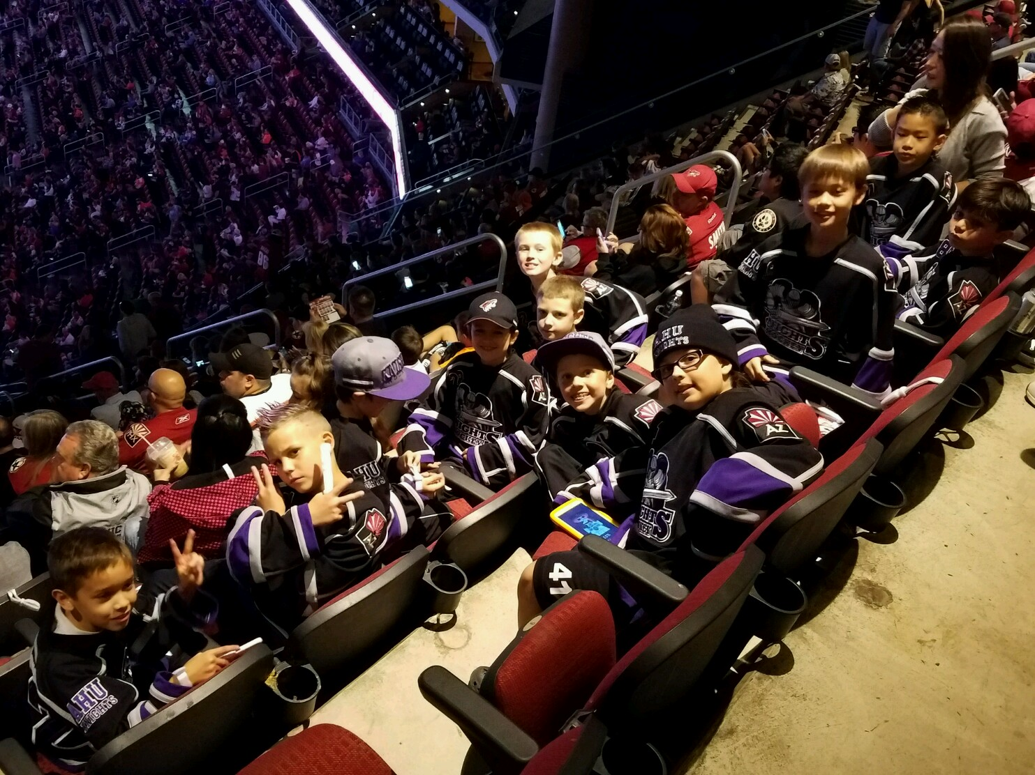
SQUIRT BLACK FUN

Slide 30
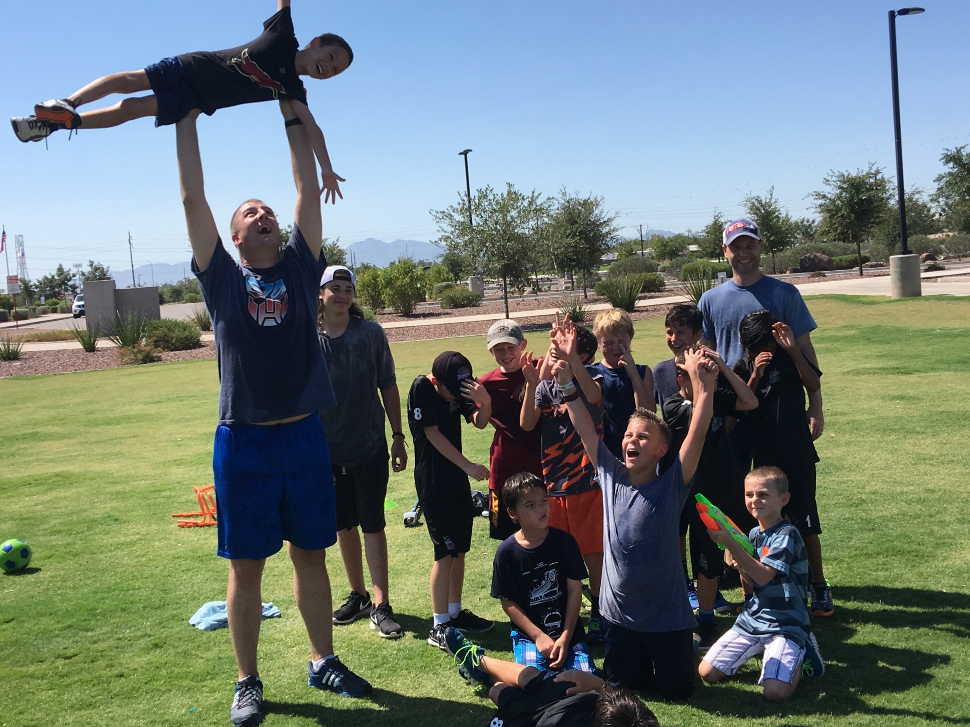
SQUIRT BLACK ANTICS

Slide 31
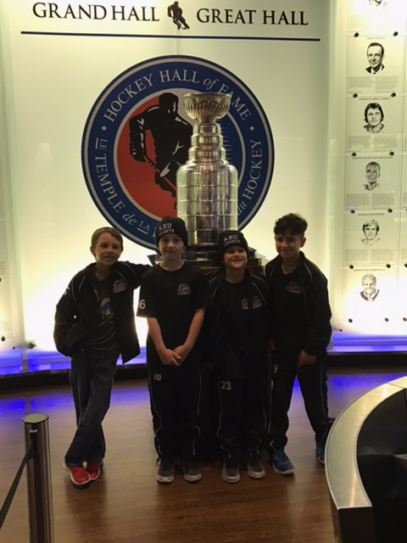
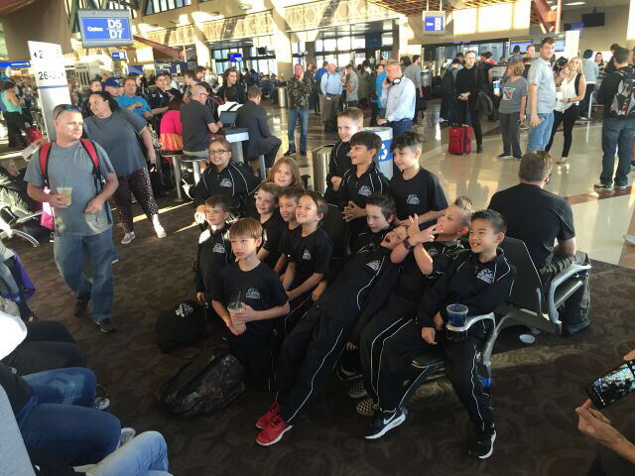
SQUIRT BLACK ANTICS

Slide 32
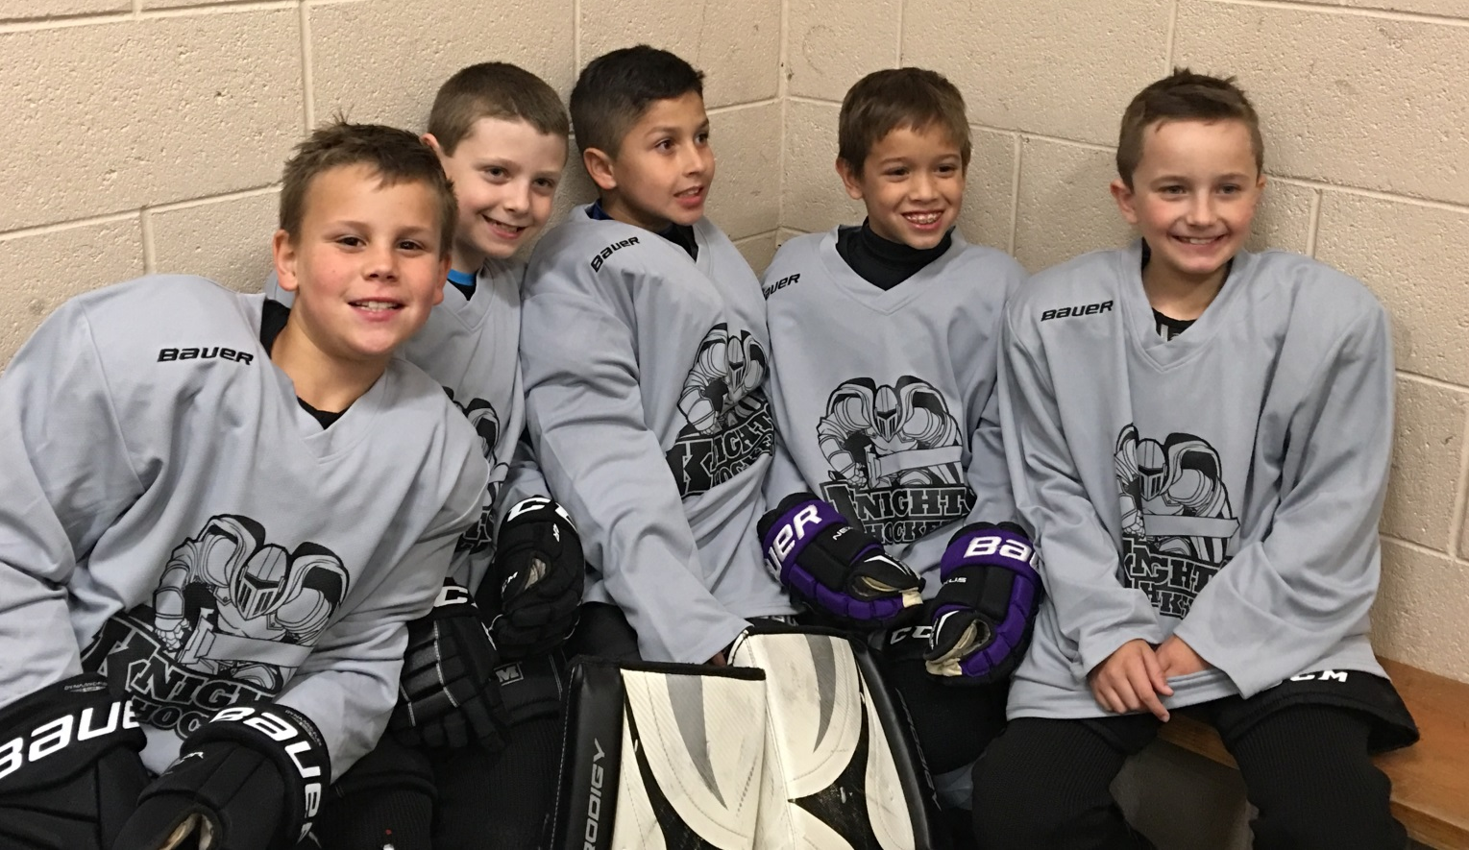
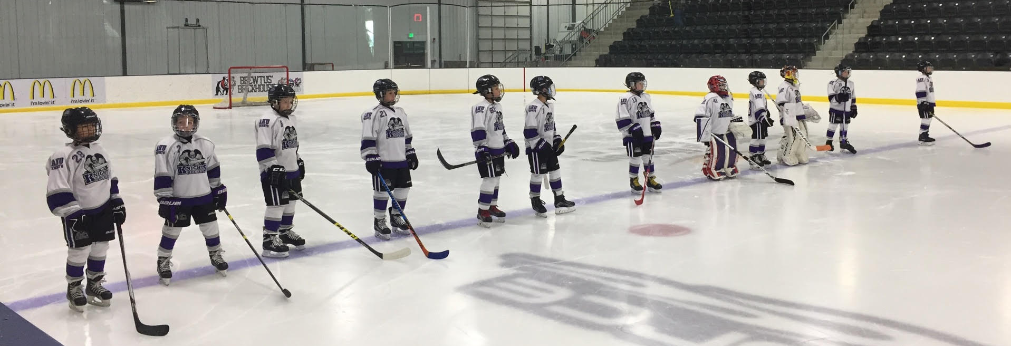
SQUIRT BLACK nation

Slide 33
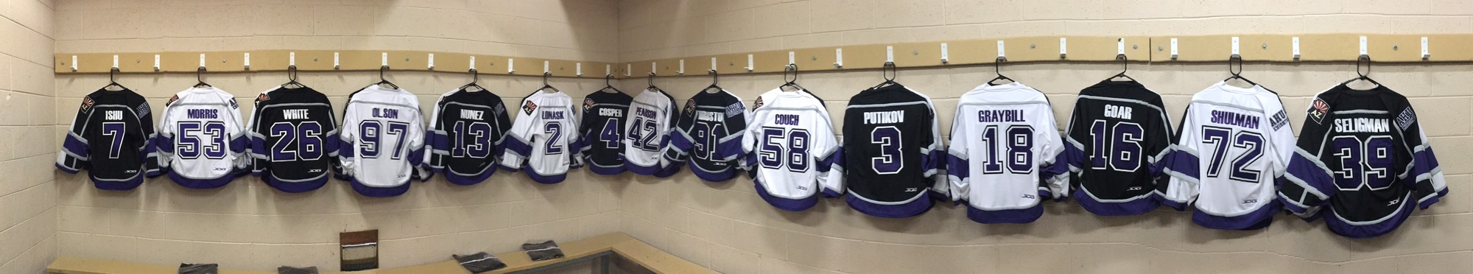
SQUIRT WHITE

Slide 34
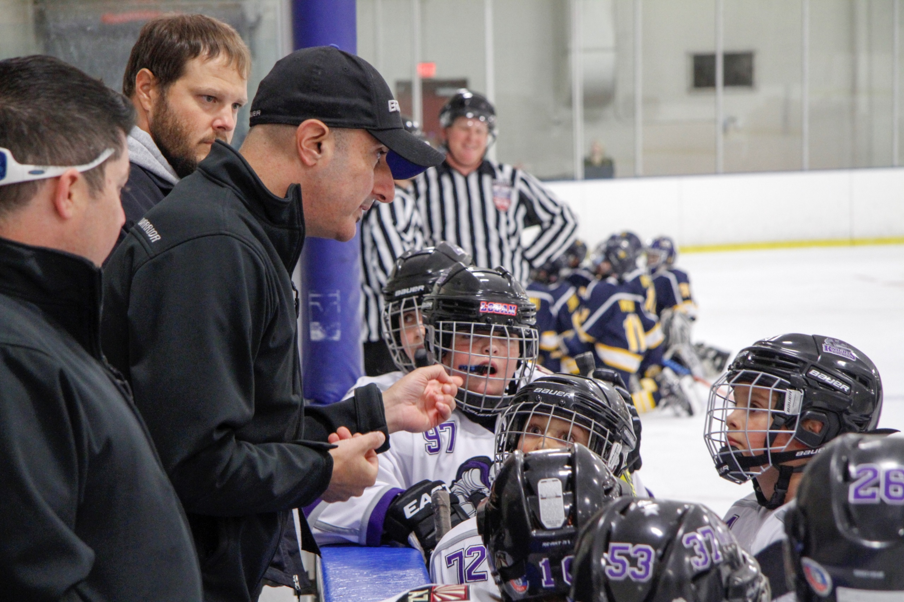
SQUIRT WHITE WORDS OF WISDOM

Slide 35
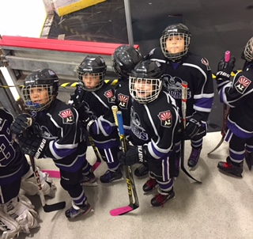
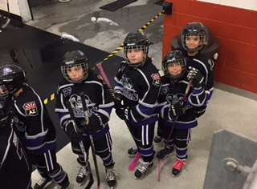
SQUIRT WHITE PUT ME IN COACH

Slide 36


SQUIRT WHITE

Slide 37

SQUIRT WHITE SHOUT OUT

Slide 38


SQUIRT WHITE BAUER

Slide 39


SQUIRT WHITE CHAMPS

Slide 40

SQUIRT WHITE GIVES BACK

Slide 41

SQUIRT WHITE HAPPY HOWLIDAY

Slide 42



SQUIRT WHITE

Slide 43


SQUIRT WHITE CELEBRATE

Slide 44

SQUIRT WHITE PAPA DON

Slide 45

SQUIRT PURPLE

Slide 46


SQUIRT PURPLE

Slide 47


SQUIRT PURPLE FUN

Slide 48



SQUIRT PURPLE LETS EAT

Slide 49



SQUIRT PURPLE PRACTICE CRASH

Slide 50

SQUIRT PURPLE GILA RIVER

Slide 51



SQUIRT PURPLE FUN

Slide 52

SQUIRT PURPLE HOLIDAYS

Slide 53

SQUIRT PURPLE TRICK OR TREAT

Slide 54

SQUIRT PURPLE

Slide 55

SQUIRT PURPLE CHEERLEADERS

Slide 56

SQUIRT SILVER

Slide 57

SQUIRT SILVER POWERSKATING

Slide 58

SQUIRT SILVER GIVES BACK

Slide 59

SQUIRT SILVER TRICK OR TREAT

Slide 60


SQUIRT SILVER SHENNANIGANS

Slide 61

SQUIRT SILVER MASCOT

Slide 62

SQUIRT SILVER
Dry Land

Slide 63

SQUIRT SILVER in CO

Slide 64

SQUIRT SILVER champs

Slide 65

SQUIRT SILVER fun

Slide 66


SQUIRT SILVER

Slide 67

PEEWEE BLACK

Slide 68

Peewee black

Slide 69


Slide 70


Slide 71



Slide 72


Peewee black

Slide 73

Peewee black

Slide 74



Slide 75

Peewee black

Slide 76

Peewee black

Slide 77

Peewee black

Slide 78

PEEWEE WHITE

Slide 79

Peewee white huddle

Slide 80

Peewee white pep talk

Slide 81


Peewee white grub

Slide 82


Peewee white fun

Slide 83

Peewee white sarnia

Slide 84



Peewee white pregame

Slide 85

Peewee white

Slide 86



Peewee white action

Slide 87

Peewee white celly

Slide 88

Peewee white

Slide 89

PEEWEE PURPLE

Slide 90

Peewee purple huddle

Slide 91

Peewee purple fun

Slide 92

Peewee purple invade peoria

Slide 93

Peewee purple greetings

Slide 94

Peewee purple holidays

Slide 95

Peewee purple

Slide 96


Peewee purple fun

Slide 97



Peewee purple CALI

Slide 98


Peewee purple family

Slide 99

Peewee purple state champs

Slide 100

BANTAM PURPLE

Slide 101

bantam purple ready to play

Slide 102

bantam purple huddle

Slide 103

bantam purple ambassadors

Slide 104

bantam purple champs

Slide 105

BANTAM BLACK

Slide 106

bantam black anthem

Slide 107



bantam black celly

Slide 108

bantam black huddle

Slide 109

bantam black gives back

Slide 110

bantam black

Slide 111

bantam black

Slide 112


bantam black fun

Slide 113

bantam black food drive

Slide 114

bantam black

Slide 115

bantam black knee hockey

Slide 116

U16 PURPLE

Slide 117

U16 Purple coaching staff

Slide 118

U16 Purple on ice

Slide 119




U16 Purple game time

Slide 120


U16 Purple

Slide 121

U16 Purple grub

Slide 122

U16 Purple cali

Slide 123


U16 Purple practice

Slide 124


U16 Purple top golf fun

Slide 125

U16 Purple ftb

Slide 126

U16 Purple we got this!

Slide 127

U16 BLACK

Slide 128

U16 black

Slide 129


U16 black on Ice

Slide 130

U16 black fundraiser

Slide 131



U16 black las Vegas

Slide 132

U16 black snow angels

Slide 133

U16 black #37 tribute

Slide 134

U16 black beach

Slide 135

U16 black sea world

Slide 136

U16 black

Slide 137




U16 black fun

Slide 138

U16 WHITE

Slide 139

U16 white

Slide 140

U16 white family

Slide 141



U16 white boo boos

Slide 142

U16 white holiday

Slide 143

U16 white holiday fun

Slide 144


U16 white celly

Slide 145



U16 white wTB

Slide 146


U16 white staff

Slide 147

U16 white amazing season

Slide 148

U17 SILVER

Slide 149



U17 silver pregame

Slide 150

U17 silver antics

Slide 151


U17 silver grub

Slide 152

U17 silver angels

Slide 153

U17 silver holiday

Slide 154

U17 silver Niagara falls

Slide 155


U17 silver brrrr

Slide 156

U17 silver shut out

Slide 157


U17 silver fun

Slide 158


U17 silver

