Slide 1

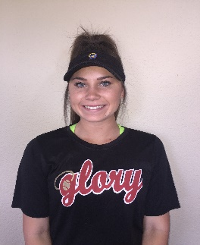
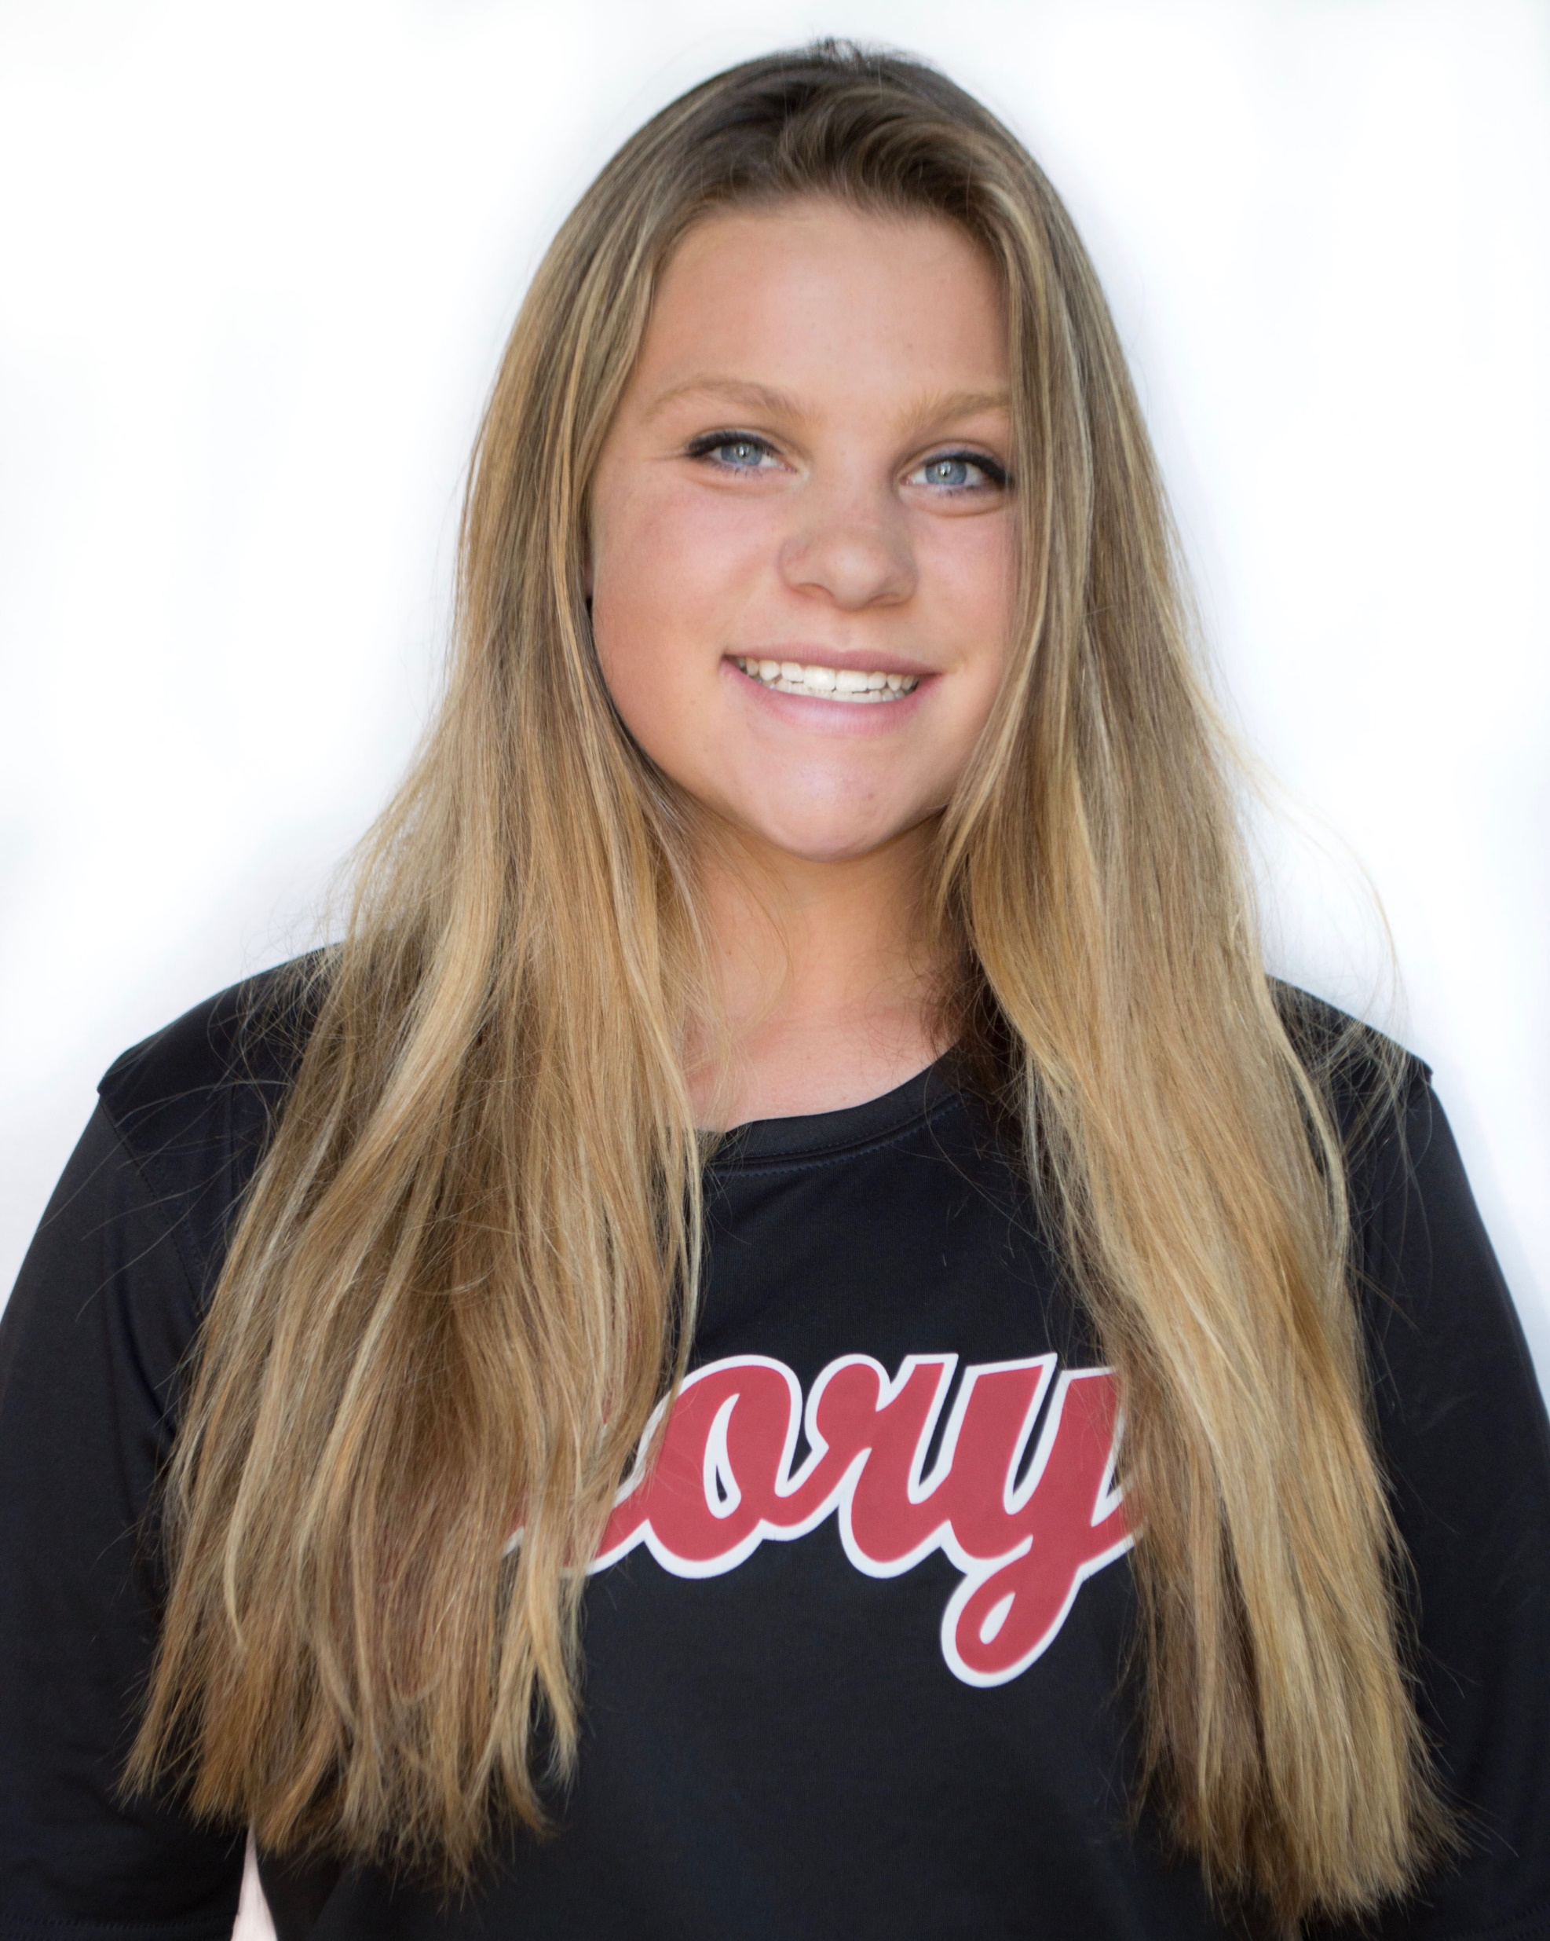
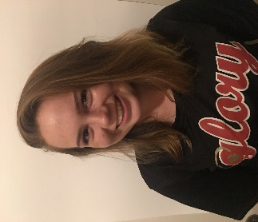
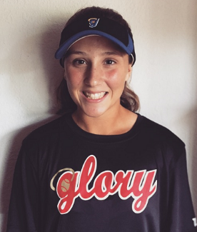
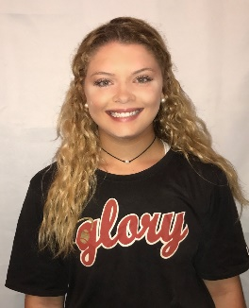
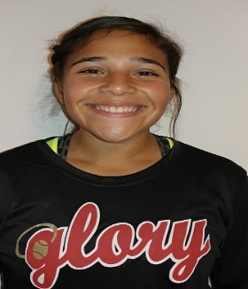
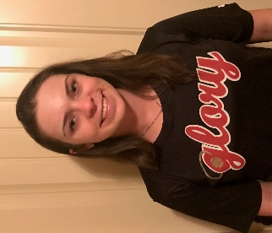
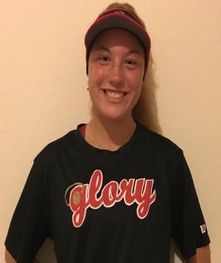
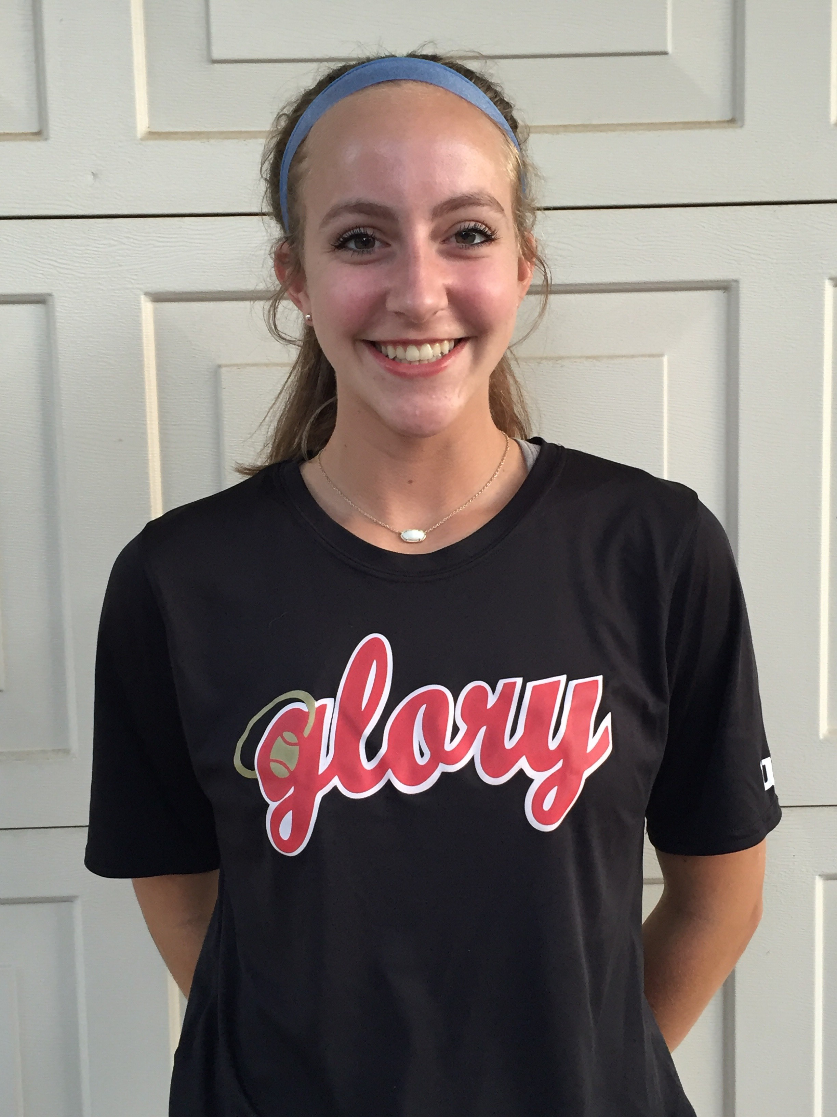
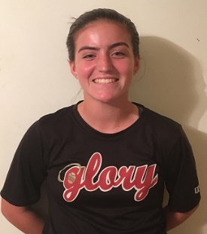
Texas Glory Adkins 16U Gold
Head Coach Jack Fultz
214-557-7722 jsfultz@txglory.com
2019 - #2 Ronni Ramos
SS / 2B / OF
GPA 4.2 of 4.0
Bats: R Throws: R
Plano East High School
HT 5’ 6“ (972) 975-8160
ramos.ronni@gmail.com
2019 - #6 Lauren Ledbetter
Catcher / Utility
GPA 3.9 of 4.0
Bats: R Throws: R
McKinney North HS
HT 5' 6” (972) 268-3795
laurenledbetter19@gmail.com
2019 – #9 Allie Nuenke
RHP / 1B / DP
GPA 3.8 of 4.0
Bats: R Throws: R
Southlake Carroll
HT 5' 5” (817) 807-3274
allienuenke@gmail.com
2018 - #10 Avery Zeigler
3B / 2B / OF
GPA 3.80 of 4.0
Bats: R Throws: R
Carroll Senior HS
HT 5' 5” (817) 291-6407
zeigler.avery@yahoo.com
2019 - #11 Payton Deaton
3B / 1B / DP
GPA 3.6 of 4.0
Bats: R Throws: R
Pottsboro High School
HT 5' 10” (903) 267-9202
paytondeaton11@gmail.com
2018 - #12 Melinda Martinez
CF / OF
GPA 4.4 of 4.0
Bats: R Throws: R
Crowley High School
HT 5' 7” (817) 902-2687
melrosemtz@gmail.com
2018 - #16 Reagan Ellison
CF / SS
GPA 4.4 of 4.0
Bats: R Throws: R
Burleson Cent
HT 5' 7” (817) 991-2318
ellisonreagan@gmail.com
2018 - #18 Jaden Hoelker
SS / 3B / OF
GPA 3.97 of 4.0
Bats: R Throws: R
Denton Ryan HS
HT 5' 9” (972) 822-4971
hoelkerjaden@gmail.com
2018 - #37 Abby Pounds
CF / LF / RF
GPA 4.0 of 4.0
Bat: L Throws: R
Colleyville Heritage HS
HT 5' 7” (858) 699-8359
abbypounds.softball2018@gmail.com
2018 - #41 Sierra Stone
CF / OF
GPA 4.5 of 5.0
Bats: R Throws: R
Garland HS
HT 5' 8” (469) 644-4358
sierrastone2018@gmail.com
2017 Summer Schedule
05/27/2017 - 05/28/2017 USA ES DFW Qualifier 16U
06/09/2017 - 06/11/2017 TCS Texas State Championships
06/16/2017 - 06/18/2017 Texas Summer Cup Sugar Land
06/25/2017 – 07/02/2017 Colorado Fireworks 2017
07/10/2017 - 07/13/2017 TC/USA Nationals on ESPN3 Austin
07/24/2017 - 07/29/2017 USA ASA JO Cup - Lake Elsinore, CA

Slide 2

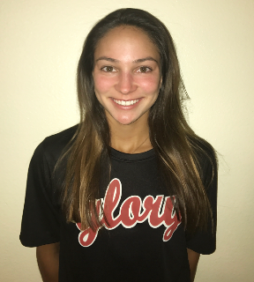
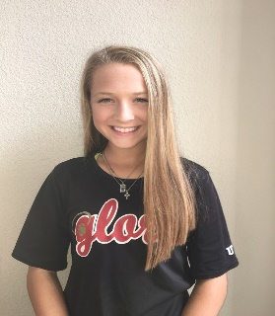


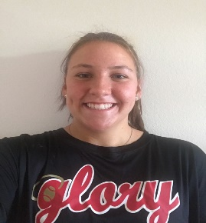
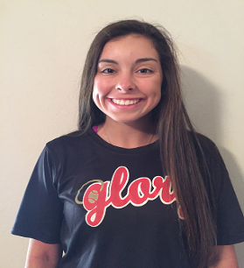


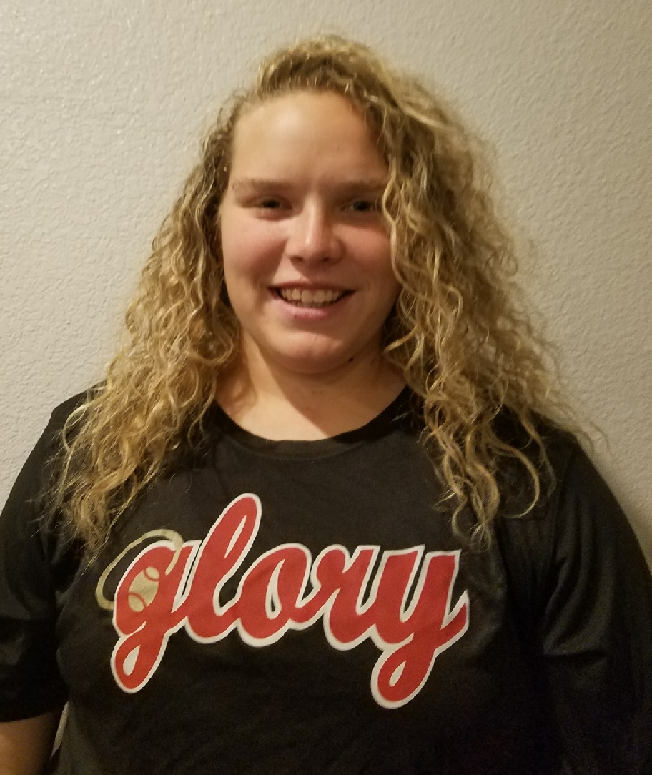
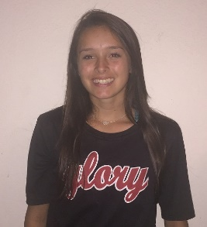

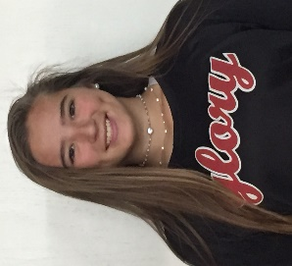
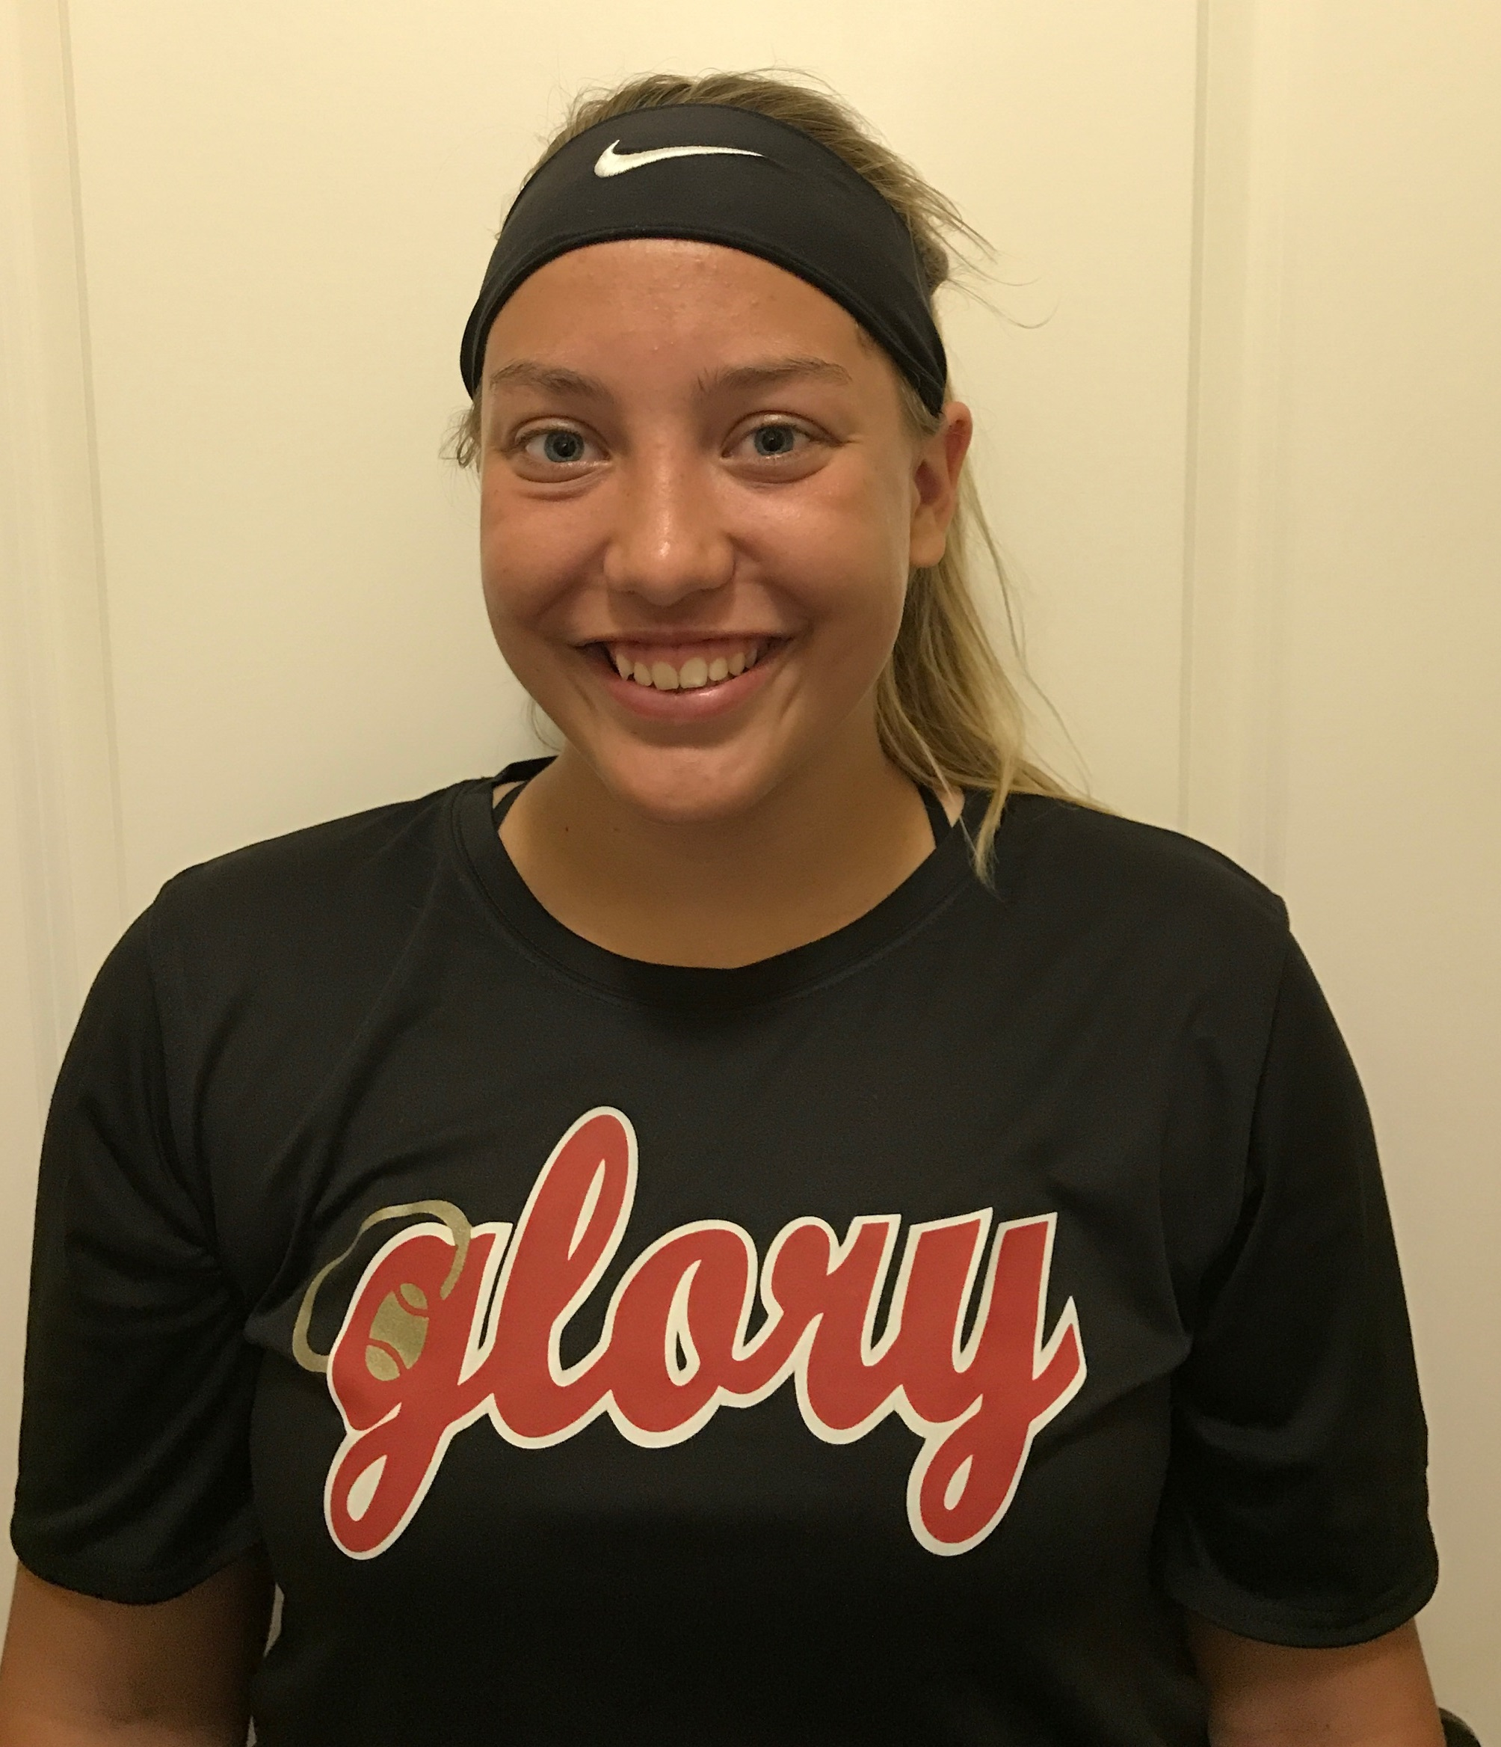
Texas Glory Adkins 16U Gold
WWW.GLORY.NET
2018 - #3
Amy Jensen
Catcher / OF
GPA 4.1 of 4.0
Plano East High School
amyjpride9@gmail.com
2019 - #4
Madison Cashon
SS / 2B / OF
GPA 3.8 of 4.0
Southlake Carroll HS
madisoncashon4@gmail.com
2019 - #17
Reagan Chism
RHP / 1B
GPA 3.7 of 4.0
Decatur HS
reagan.chism@yahoo.com
2018 - #22
Maddie Flores
2B / OF
GPA 5.7 of 5.0
Byron Nelson HS
maddieflo22@gmail.com
2018 - #26
Avery Boley
1B / DP
GPA 4.0 of 4.0
Nolan Catholic
avery@boleyfamily.com
2018 - #29
Ashleigh Sgambelluri
SS / OF
GPA 3.9 of 5.0
Arlington Heights HS
ashleighsgambelluri@yahoo.com
2019 - #34
Gaby Garcia
C / 3B / OF
GPA 4.0 of 4.0
Southlake Carroll
gngarcia34@gmail.com
2020 - #60
Payton Lee
RHP / 1B / DP
GPA 4.0 of 4.0
Clyde High School
peytonlee2020@gmail.com
Head Coach Jack Fultz (214) 557-7722 jsfultz@txglory.com

