Slide 1

Welcome to the 2018
Informational Meeting

Slide 2

NPGFA Mission Statement:
New Prague Girls Fastpitch Association is committed to teaching the fundamentals of competitive Fastpitch softball.
We are here to promote leadership, cooperation, team skills, to deal with accomplishments and disappointments, to improve self-confidence and self-esteem and to have FUN!
We do this as a feeder system to New Prague Schools.

Slide 3
Making History…
NPHS Varsity Softball Program wins its 2nd Section Championship.

Slide 4
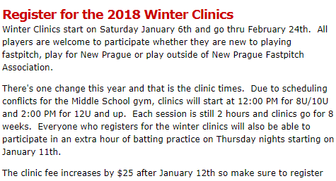
Clinics
Clinics have Started

Slide 5

Training Information

Slide 6
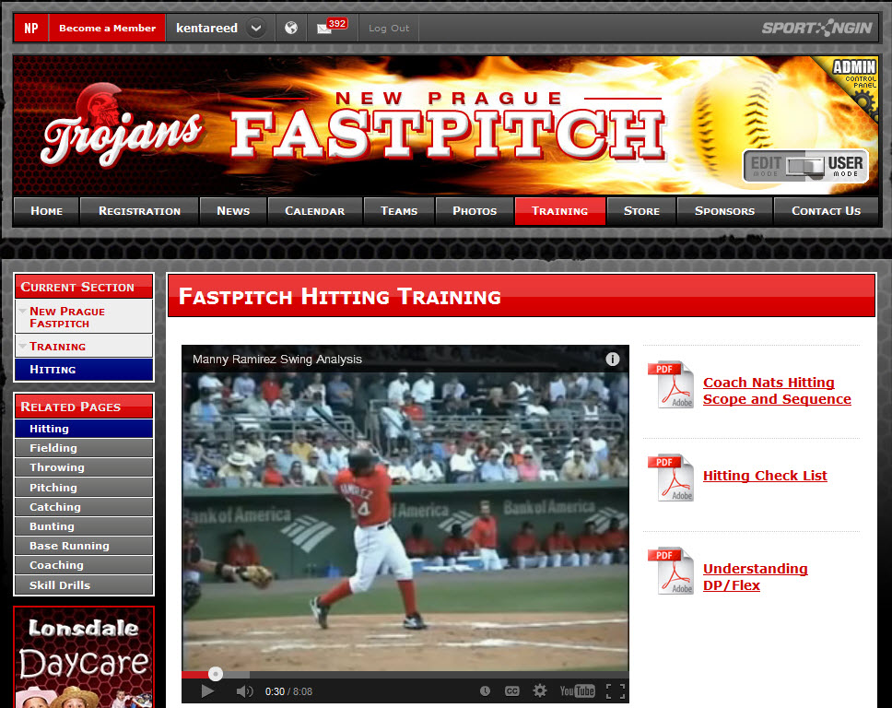
Player Homework Training Videos & More

Slide 7
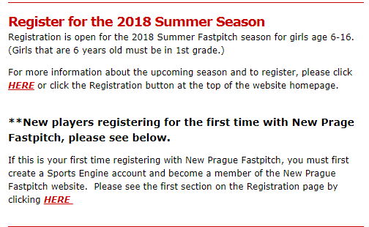
NewPragueFastpitch.com
Member Registration (NPGFA email notifications)

Slide 8

Uniform Guidelines
NPGFA Uniforms
NPGFA Jersey (NEW Design 2018)
Pants (black)
Sliding shorts
Sliding pad
Socks Custom New Prague
Helmet
NOCSAE Certified Helmet with face shield (dark blue/black)
Softball Bats
NPGFA will provide bats for each team
Batting Gloves
Fielding Glove
Player’s Gear Bag

Slide 9
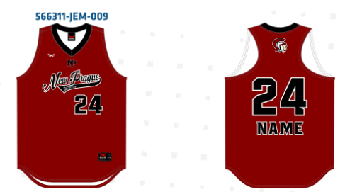
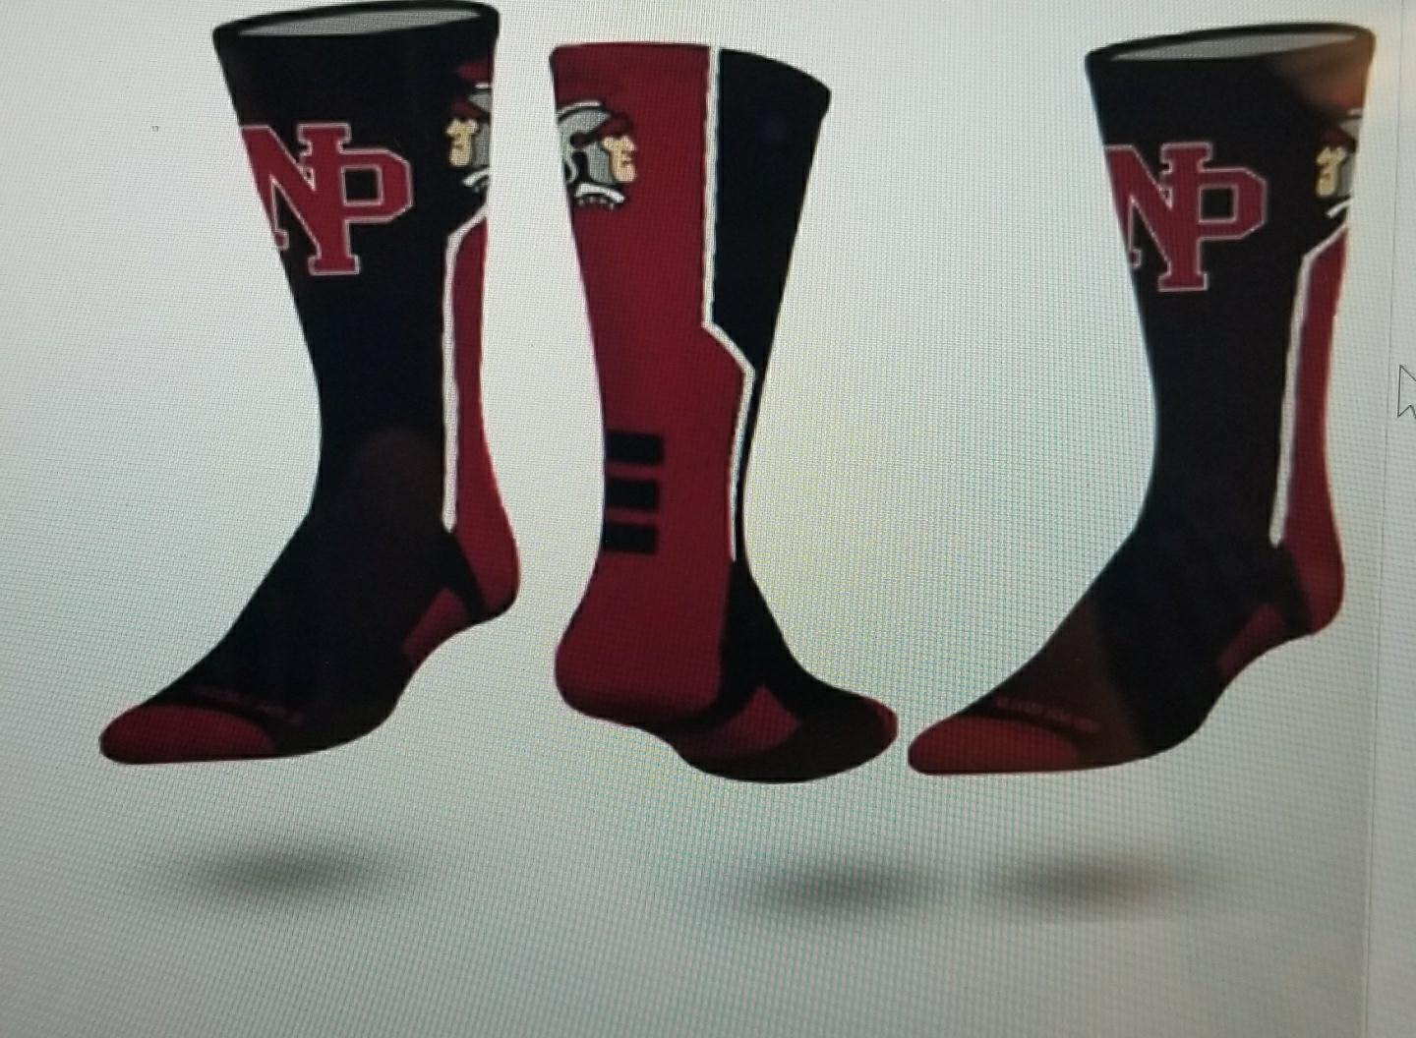
New Look

Slide 10
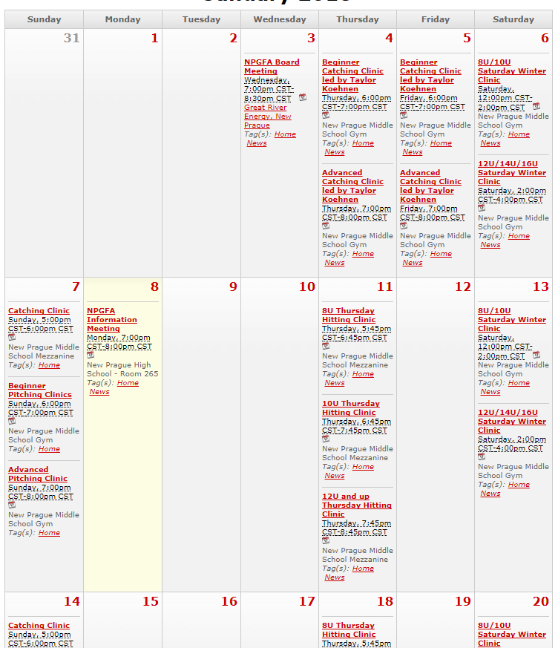
NewPragueFastpitch.com
Calendar (The Latest Schedule for Clinics, Try-outs, and more)

Slide 11

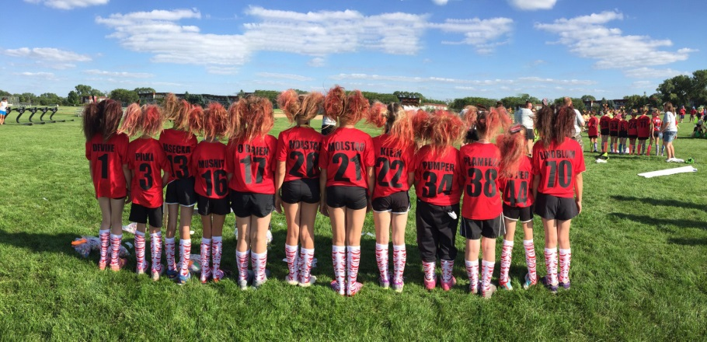
Player and Team Commitment
Participating in NPGFA is a commitment for you, your player, and your team. This commitment includes attending all practices, games, and tournaments!
Please keep your player’s schedule OPEN
NOTE: Your player will also be playing games on weekends for local tournaments, Qualifiers, State, and possible Nationals.
If your player need a ride to and/or from games or tournaments – this can always be arranged with the team parents. We are a BIG Fastpitch Family!

Slide 12
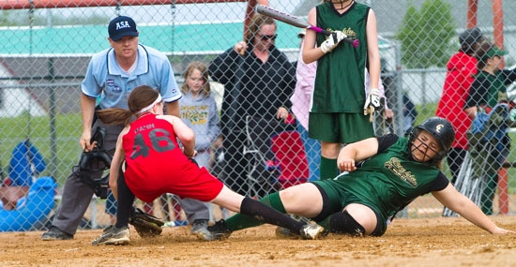
Team Practices, League Play, and Tournaments
Outside Practices
League Games: Double Headers
FIVE (5) NP Softball Fields – Travel to other fields
8U & 10U Play ONE (1) day per week
12U/14U/16U Play TWO (2) days per week
TWO (2+) Extra Weekend Tournaments (1 and 2 Day + Poss. Friday)
8U (1+) Extra weekend tournament
League State Qualifier Tournament
State Tournament (must qualify)
National Tournament (must qualify)

Slide 13



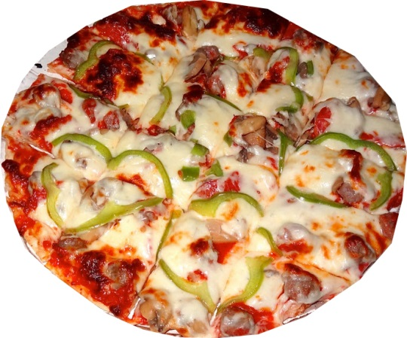

Fundraising
Required Fundraising: To ensure NPGFA can continue to provide a high quality program and equipment, all players will be required to participate in fundraising.
Gertens Mother’s Day Flower Baskets: Minimum 2 Baskets
Heggies Pizza: Minimum 10 Pizzas
Prizes and Awards: Players will awarded for top sales efforts.
Buy-out Option Fee: $120 TOTAL or $60 Each
NOTE: NPGFA offers a low cost program compared other programs.

Slide 14
Facility Improvements
Tractor
Shed
Fencing

Slide 15

Online Registration
OPEN NOW! Closes February 19th. (NPGFA member email notice)
2018 Player Registration Fees 8U-$150 includes game shirt, 10U-$250, 12U-$275, 14U/16U-$300;
Jersey Cost: $55 (New/Reuse)
Fundraising Buy-out: $120 ($60 each)
Birth certificate (PDF or JPG)
Picture/ID (PDF or JPG)
Code of Conduct Policy
Attendance Policy
Payment: VISA/MC

Slide 16
Volunteer Hours
Board has decided 15 hours or you may opt to buy out of these house for $150
This is to ensure all parents are assisting with the program.
We want help

Slide 17

Volunteer Opportunities
The success of NPGFA is determined by our volunteers!
Committee chair/work
Trojan softball day
Field prep/finish
Executive board
Clinic helper
Coach
Manager
Grounds crew
Etc… anything approved to benefit the NPGFA

Slide 18

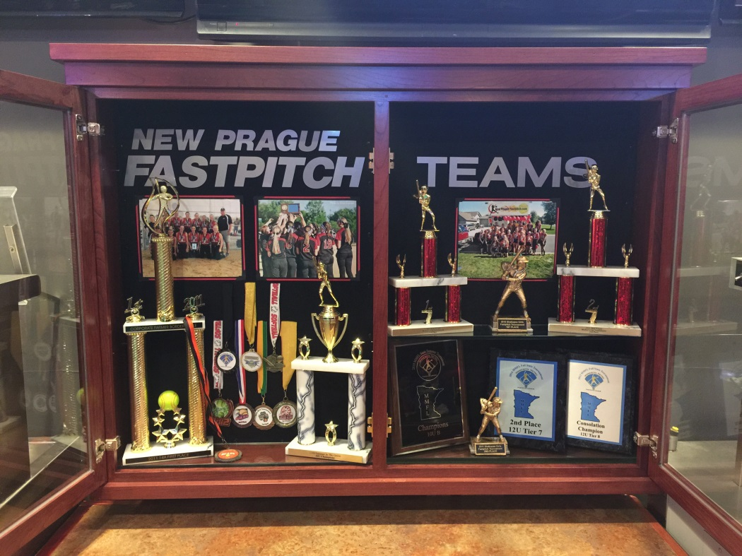

NPGFA Carbone’s Cabinet
Thanks to Vivant Custom Woodcraft and Carbones in New Prague; NPGFA is proud to display New Prague Fastpitch team photos, trophies, and awards.
In addition, a special thanks goes to Alex Henkel for her design and layout.
www.VivantWoodcraft.com

Slide 19

What is the Softball Development Committee (SBDC)
The SBDC was established in 2016
Members are:
Joel Munson, Chair; Daylin Johnson, Tina Jacobson, Secretary; Todd Pietsch, Angie Sticha, Kelsey Munson, Kent Reed, Fred Marek, Colleen Ambroz (NPGFA board member), Anna Borwege (Varsity softball coach)

Slide 20
SBDC priorities
Clinics coach/player
Coaching requirements
Tryouts (3 Days)
Team selection
Coach selection
Coach handbook
Continued support

Slide 21
Coaching Requirements
Participate/assist with 3 Saturday morning softball clinics
Participate/observe 1 hour of Sunday pitching and 1 hour of Sunday catching clinics
Complete a Criminal Background Study
Concussion protocol training
Attend SBDC Coaching and Basic Training Fundamentals Course (2 hours)

Slide 22
Coordinator positions
1. Fundraiser Coordinator: Michelle Fisher.
2. Volunteer Coordinator: Lisa Johnson
3. Equipment Coordinator: Michelle Fisher
5. Webmaster: Todd Pietsch
6. League Representative: Joel/Pat
7. Field Coordinator: Michelle Fisher
8. Umpire Coordinator: Pat Perkinson
9. Uniform and Apparel Coordinator: Chad Kramel
10.Softball Development Committee Coordinator: Joel
Coordinators may be requested to attend NPGFA board meetings to report committee status.

Slide 23
Questions

