Slide 1

Menasha Youth Sports
2026 Parent’s Informational Meeting

Slide 2



THANK
YOU!
Your involvement & support makes this happen!
Check us out! MenashaYouthSports.org
FB: Menasha Youth Sports

Slide 3
AGENDA
Introductions
Fundraiser Kick-Off
Conduct Reminders for players & families
Ways you can help! And have some FUN!

Slide 4
MYS Board Members
Board Meetings are 3rd Monday each month
President: Jennifer Dahlman 3rd year
Vice President: Mike Van Beek 4th year
Secretary: Jess Burns 1st year
Treasurer: Hannah Terrel/Michelle Draheim 4th year/1st year
Concession Director: Heather Keller
Grounds Director: Craig Korth These positions are supported by fields
Fields Director: OPEN subcommittees led by head coaches.
Sponsorship Committee: Heather Smarzinski & Sarah Sell
Registration Director: Eric Cates
Volunteer Coordinator: Vanessa Kuhn
Fundraising Director: Vanessa Kuhn
Communications Director: Victoria Cates
Boys Tournament Director: Eric Cates
Girls Tournament Director: Jennie Satzer
Tball/Intro Director: OPEN
Recruitment Opportunities!
Hometown Halloween
Back to School Bash

Slide 5
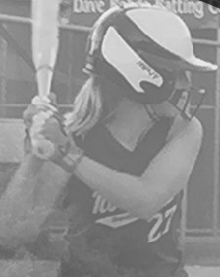
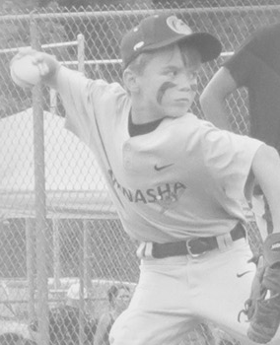
Fundraiser Kick-Off
Each player is expected to sell 10 tickets - $10.00 tickets
  May sell more if willing/able - prizes available!
  Families with multiple players will not be asked to sell more than 25 tickets
Ticket and money turn-in at Menasha Public Library – Date TBD
TOP SELLER PRIZES! 1st place - $200.00 cash
2nd place - $150.00 cash
3rd place - $100.00 cash
4th place - $50.00 cash
BONUS PRIZES! 1 chance for a $50-150 gift card for every 20 extra tickets sold!!

Slide 6
2025-2026 Improvements
Fencing around fields and grounds – Miron and GNC
Repaved parking lots & more signage
Built bins for grounds materials
Rebuild Raaths dugout
Adding shaded areas near Raaths and GNC outfield for spectators
Purchased new UTV with turf tires to protect fields & make maintenance more efficient
Purchased new riding lawn mower for ease of use & efficiency for volunteers
Rebuilt baseball mound on Miron field
Upgraded concessions with new beverage refrigerators, awning and enclosed grill for safety
Had MOST SUCCESSFUL fundraising season 2025! Let’s top it!
  3rd Annual Celebrity Fundraiser at Tony’s Bar in Menasha in January 2027!
  Obtained 2-year sponsorship for Menasha Classic adult softball tournament

Slide 7
Conduct Reminders
Facility Rules – Help us keep our grounds safe & clean!
No smoking!
Parking clearly marked!
Check FB and our website on a regular basis for communication
  Reach out to coaches or Board members with questions
  Weather can be tricky!
Code of Conduct
  All parents and coaches sign this as part of registration
  Please read through this carefully – expectations will stand.
  We have a 2-strike policy that begins on the field – may involve Board for 3rd strike
    Applies to players AND their families
    Honor a 24-hour rule to discuss concerns
    STAY CURIOUS!
  All head coaches complete a background check
  Start with coach for concerns, but you are welcome to contact the Board if concern persists

Slide 8
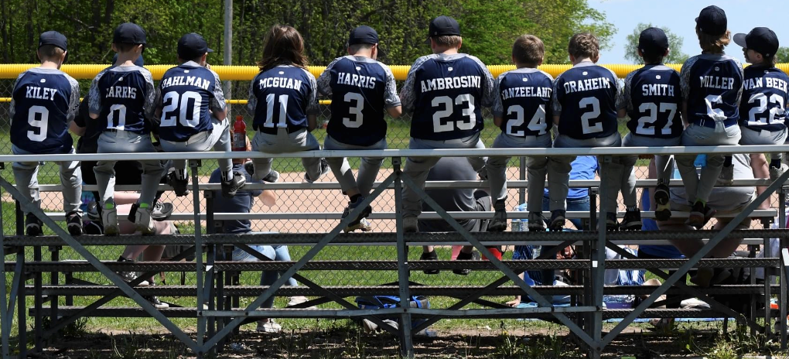
Tournament vs League
Competitive
  Enter tournaments to win ☺
Put teams into action
Show off our teamwork
Builds on previous experience
Affords a higher level of play
Travel
Less competitive
Fundamentals
Learning opportunity
Build teamwork/dynamics
Local

Slide 9
Concessions/Volunteer Hours
All league concessions are provided by MYS
Tournament concessions are assigned 8 hours PER CHILD
Coaches serve as tournament director and back-up duties for ALL tournaments
If you need to switch with a parent, please use your coaches email chain to do so
  AGE MINIMUM IS 14
  BEER COUNTER AGE MINIMUM IS 18

Slide 10
Home Tournaments
10U/12U/14U softball will have a scrimmage 5/2/26
Opening Day for MYS is May 9! Please join us! ☺
Frehley Tournament for 10 and 12U softball is May 16-17
Softball Senior/Parent Night 5/19 (back-up 5/21)
Boys 9/12/14U Tournament 6/5-6/7
Boys 10/11/13U Tournament 6/12-6/14
Boys 8/13U and Girls 8U Tournament 7/10-7/12
Rudy Tour 14/17U Girls and 14U Boys 7/24-7/26
Menasha Adult Softball Classic 8/8/26
End-of-year Celebration 8/15/26
Fall Ball
Sept-Oct
Picture Dates:
June 9-10
Rain 16-17

Slide 11


Spring Back into MYS: April 19 @ 8 am
Picture Days: June 9 & 10 (Backup 16th & 17th)
Timber Rattler Family Appreciation Night August 15th
Menasha Adult Softball Classic August 8, 2026

Slide 12
Meet Your Coaches!
Verify size of uniform
Discuss practice times/fields
Discuss game times/fields
Pick up your raffle tickets/calendars

