Slide 1
Park High School Bowling 2022

Slide 2
Varsity Regular Season
Match record – 19 wins/2 losses
Overall record – 84 wins/17 losses/4 ties
192.00 average (10th highest in state)
High game/series 279 (twice)/1071
Metro Southeast Conference Champions
JV Green Regular Season
Match record – 8 wins/6 losses
Overall record – 40 wins/30 losses
141.89 average (33rd highest in state)
High game/series 207/813
JV Black Regular Season
Match record – 5 wins/9 losses
Overall record – 31 wins/38 losses/1 tie
123.49 average (60th highest in state)
High game/series 184/668

Slide 3
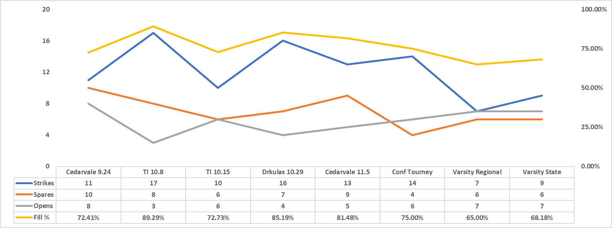
Adam Kritzky

Slide 4
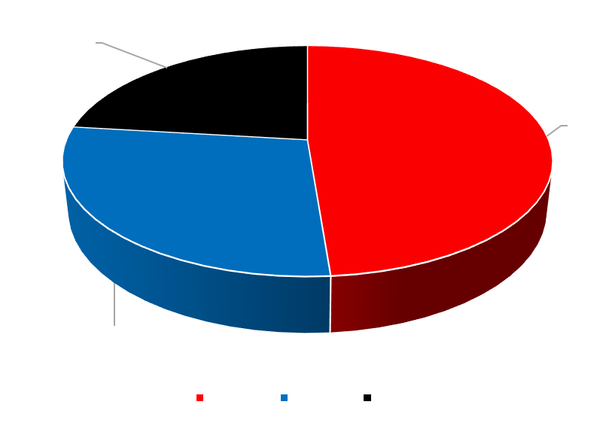
Adam Kritzky
Regular Season: 80.45% Fill Rate (91st in Varsity state)
Post Season: 69.70% Fill Rate

Slide 5
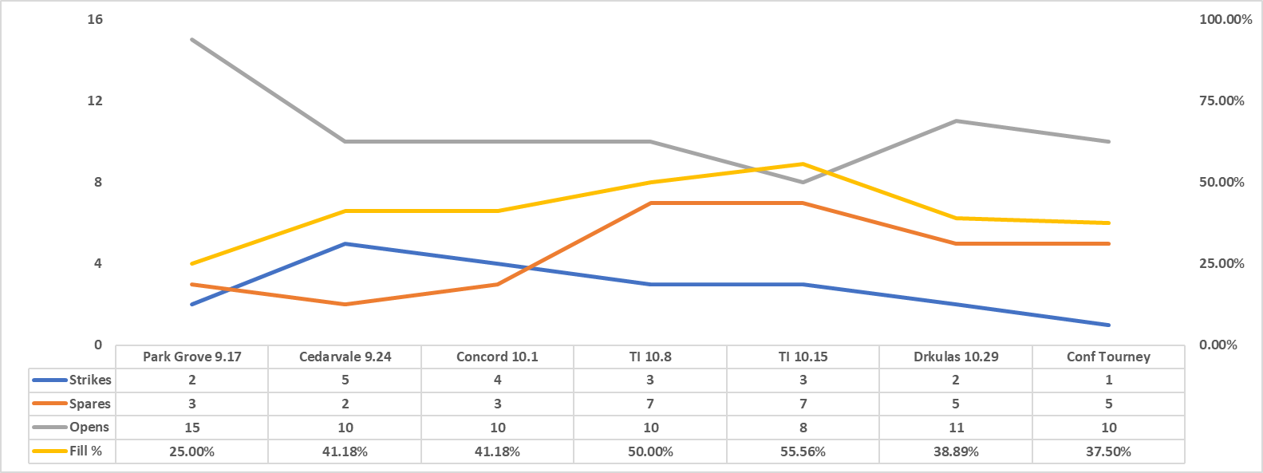
Landon Barnard

Slide 6
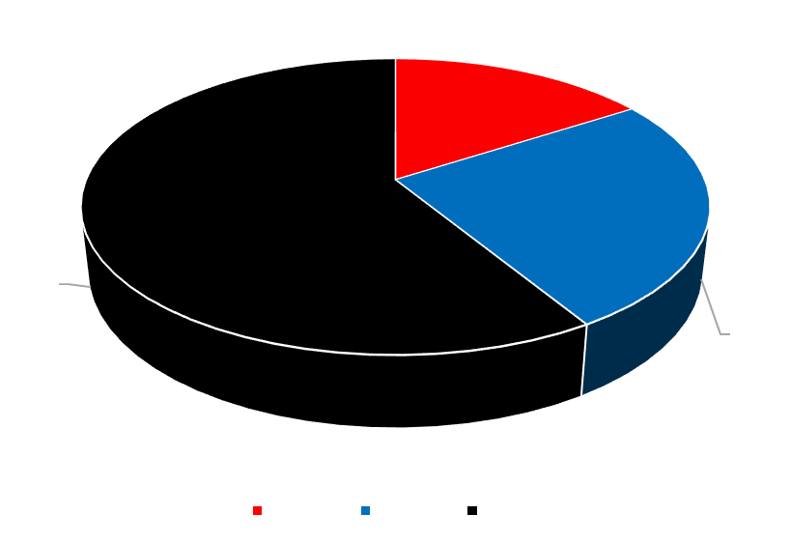
Landon Barnard
Regular Season: 41.82% Fill Rate
Post Season: 37.50% Fill Rate

Slide 7
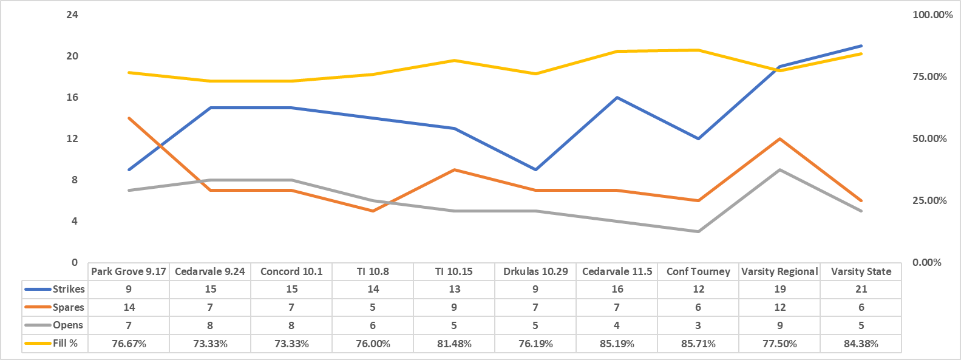
Lincoln Blanchard

Slide 8
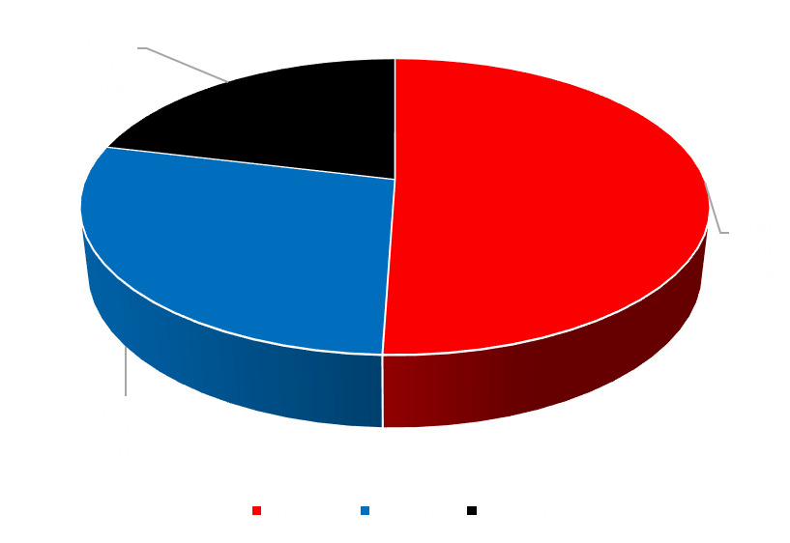
Lincoln Blanchard
Regular Season: 77.37% Fill Rate
Post Season: 81.72% Fill Rate

Slide 9
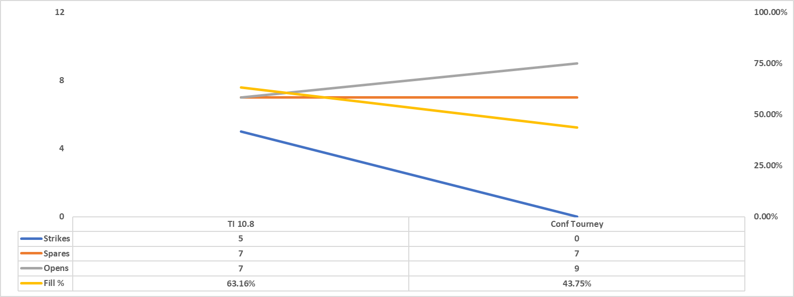
London Blanchard

Slide 10
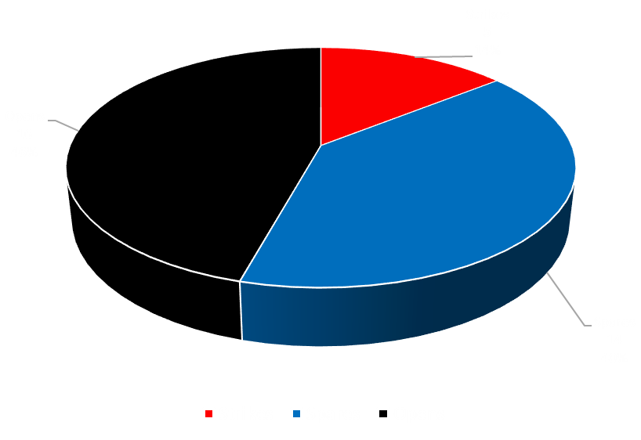
London Blanchard
Regular Season: 63.16% Fill Rate
Post Season: 43.75% Fill Rate

Slide 11
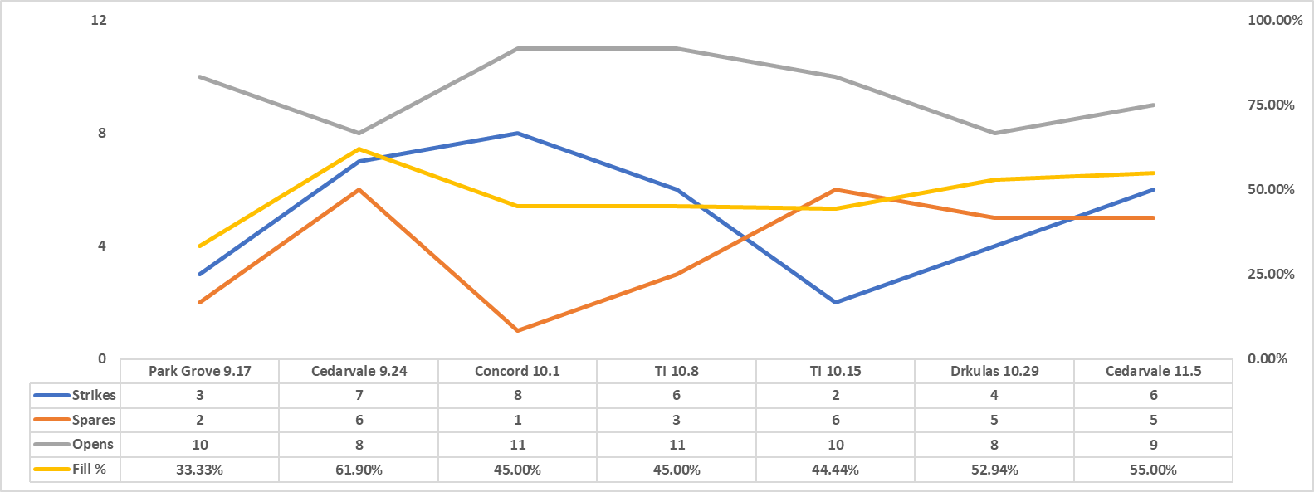
Jeff Elliot

Slide 12
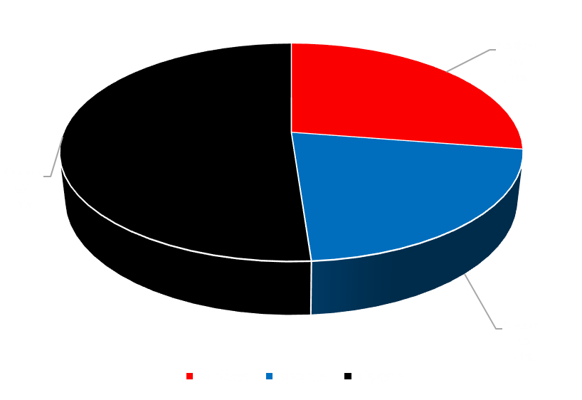
Jeff Elliot
Regular Season: 48.85% Fill Rate

Slide 13
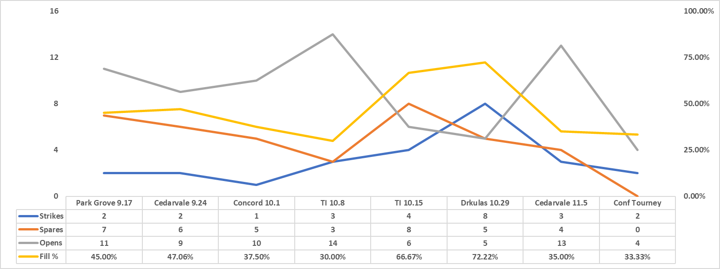
Logan Robinson

Slide 14
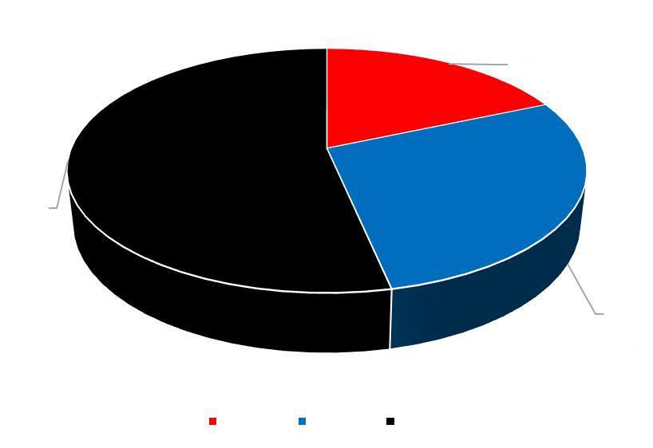
Logan Robinson
Regular Season: 47.29% Fill Rate
Post Season: 33.33% Fill Rate

Slide 15
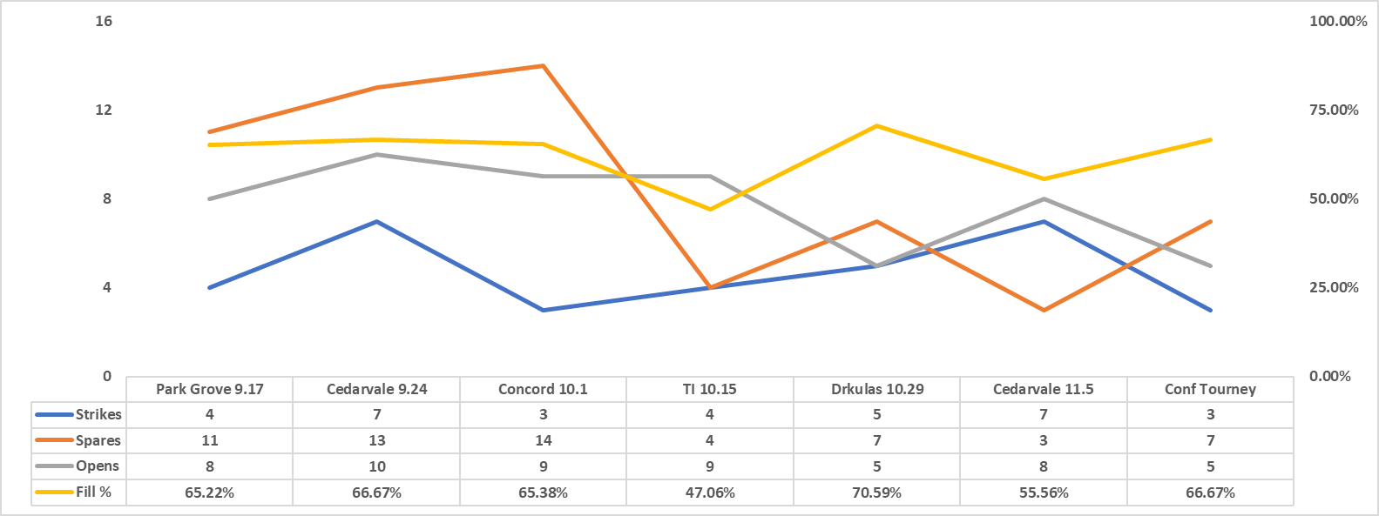
Lauren Korth

Slide 16
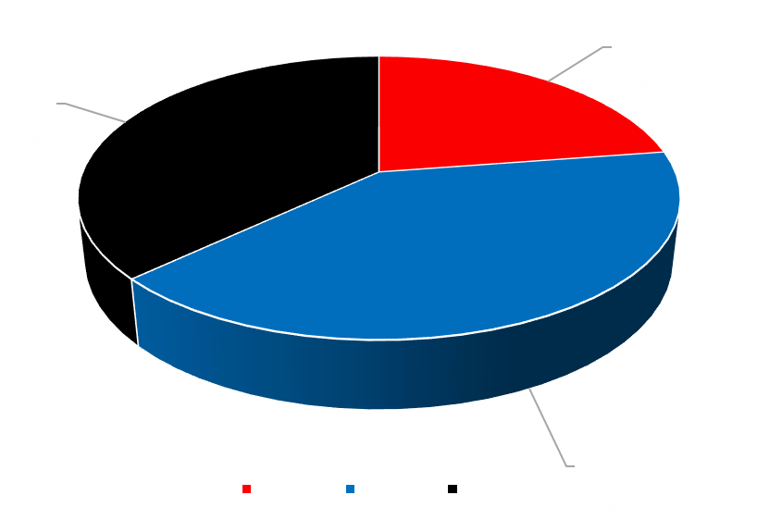
Lauren Korth
Regular Season: 62.60% Fill Rate
Post Season: 66.67% Fill Rate

Slide 17
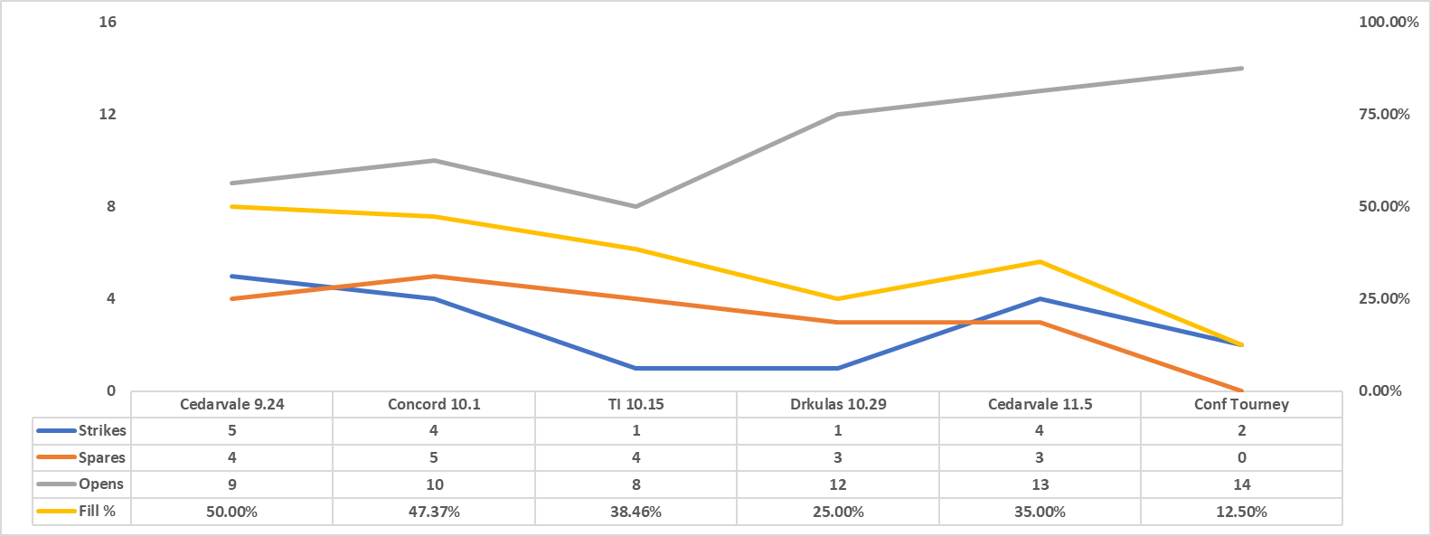
Sam Korth

Slide 18
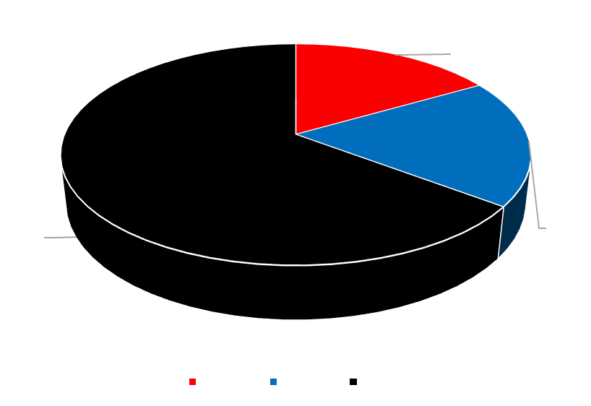
Sam Korth
Regular Season: 39.53% Fill Rate
Post Season: 12.50% Fill Rate

Slide 19
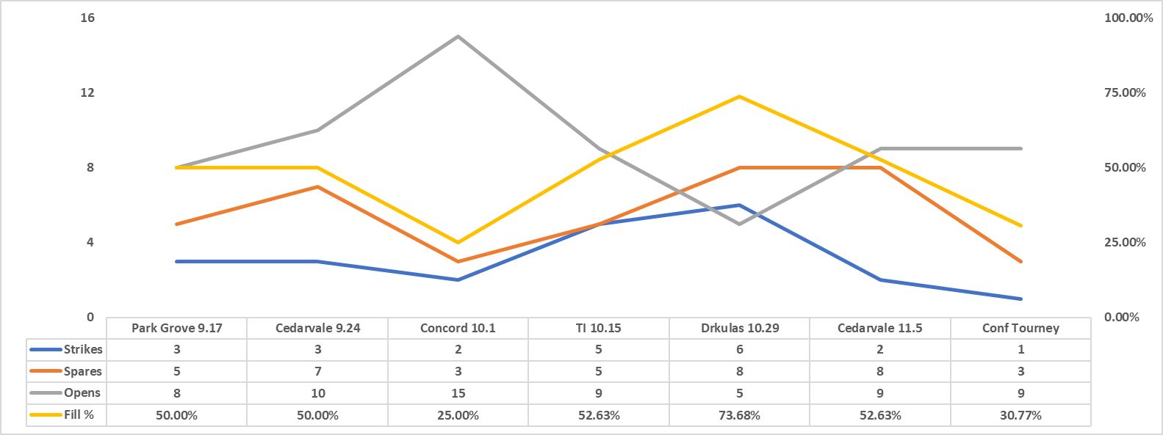
Matt Etten

Slide 20
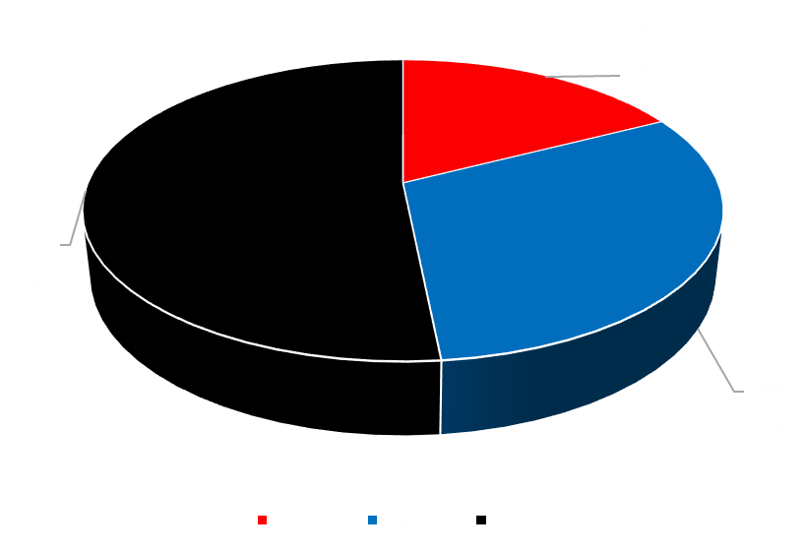
Matt Etten
Regular Season: 50.44% Fill Rate
Post Season: 30.77% Fill Rate

Slide 21
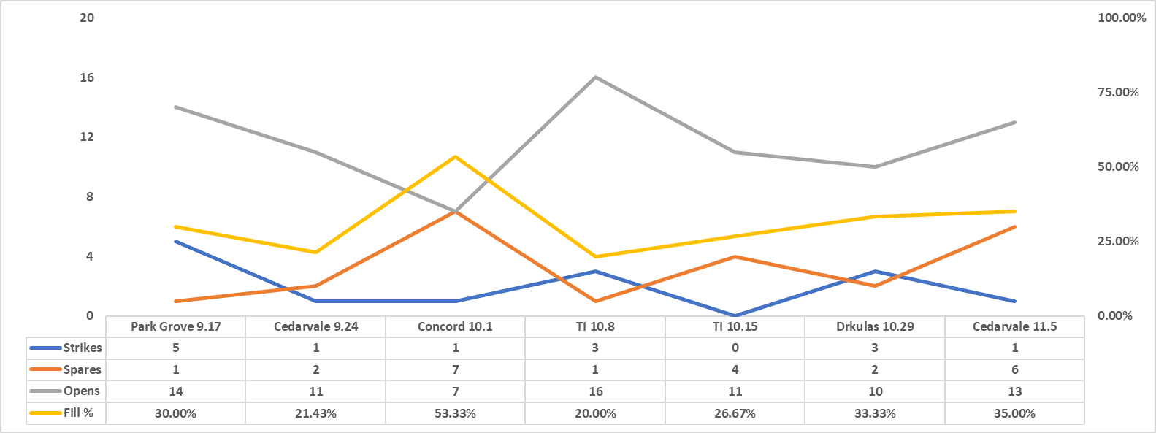
Lexi Bauler

Slide 22
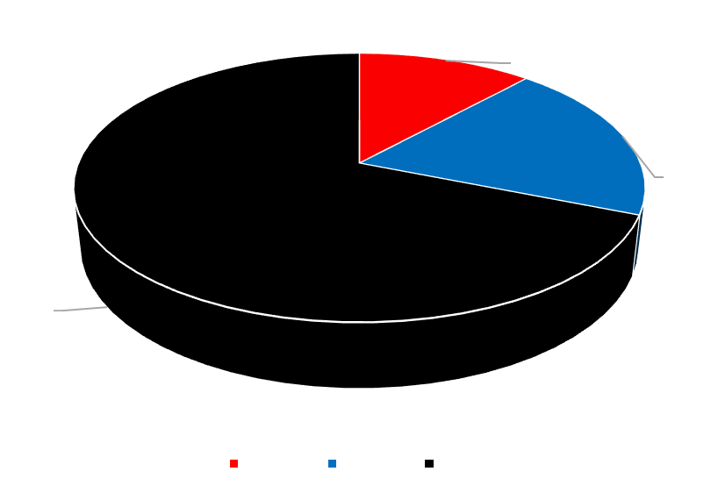
Lexi Bauler
Regular Season: 31.09% Fill Rate

Slide 23
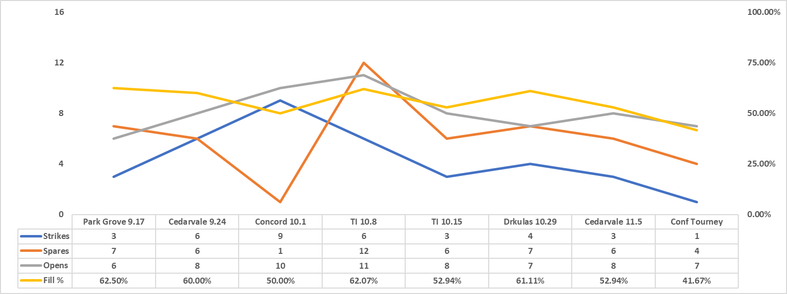
Cameron Picasso

Slide 24
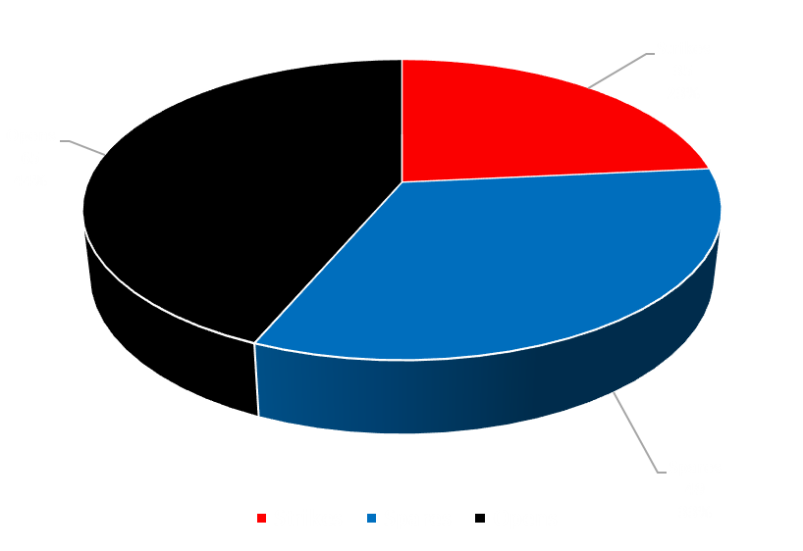
Cameron Picasso
Regular Season: 57.66% Fill Rate
Post Season: 41.67% Fill Rate

Slide 25
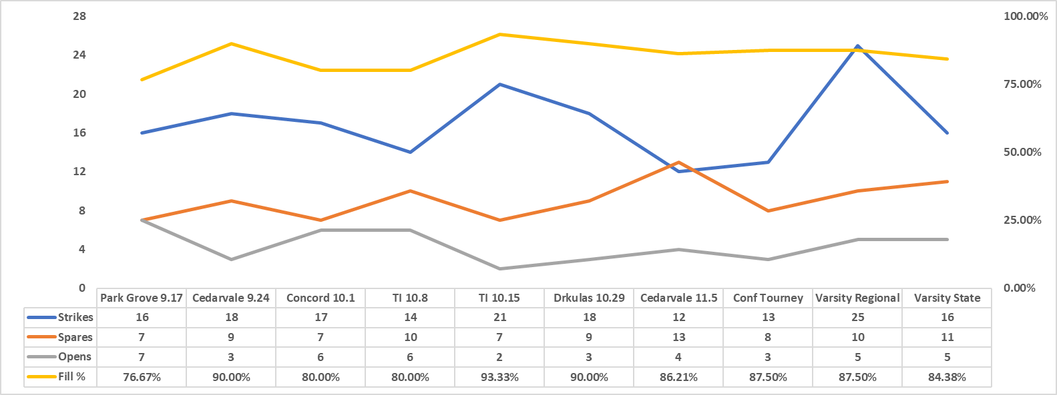
Joey Aase

Slide 26
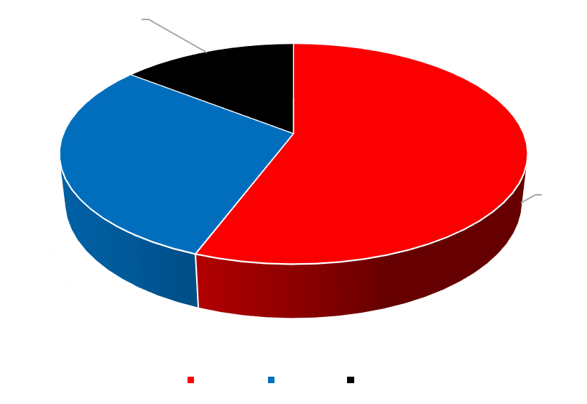
Joey Aase
Regular Season: 85.17% Fill Rate
(36th in State)
Post Season: 86.46% Fill Rate

Slide 27
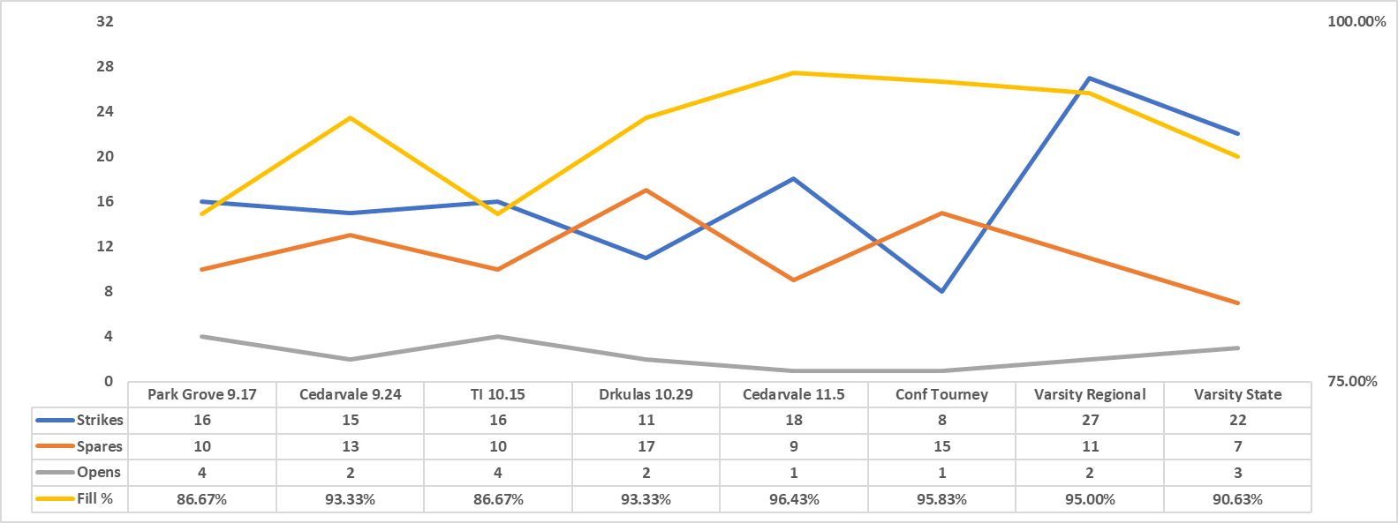
Brady Drkula

Slide 28
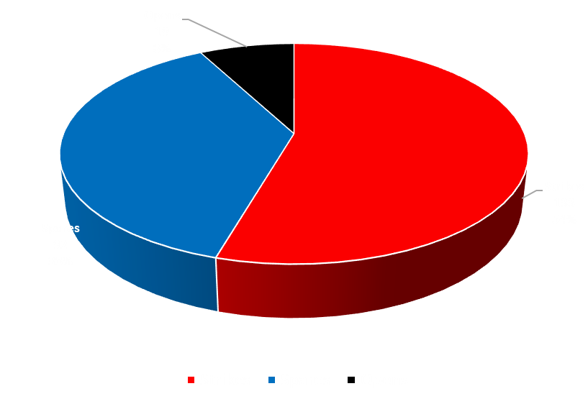
Brady Drkula
Regular Season: 91.22% Fill Rate
(6th in State)
Post Season: 93.75% Fill Rate

Slide 29
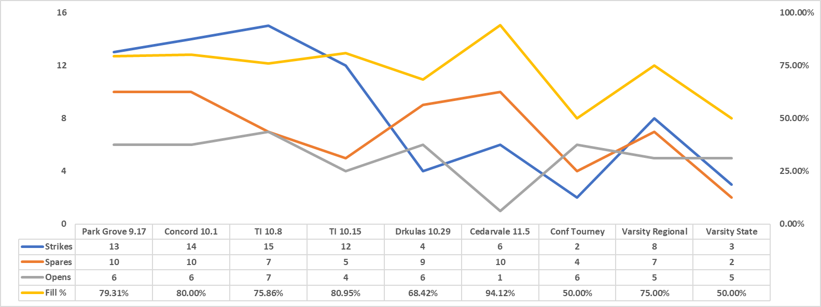
Christian Meyer

Slide 30
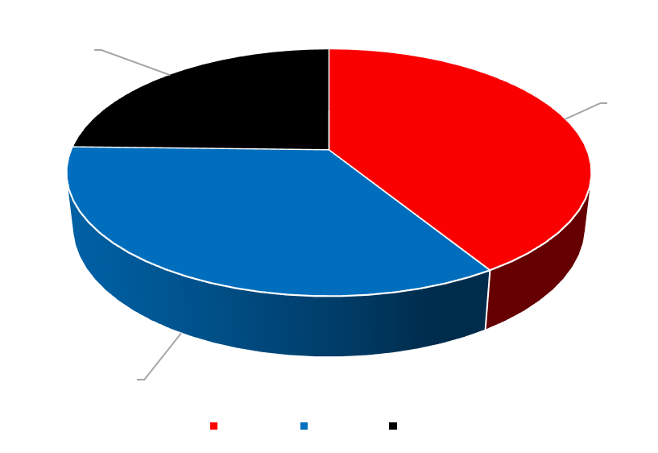
Christian Meyer
Regular Season: 79.31% Fill Rate
77th in State
Post Season: 61.90% Fill Rate

Slide 31
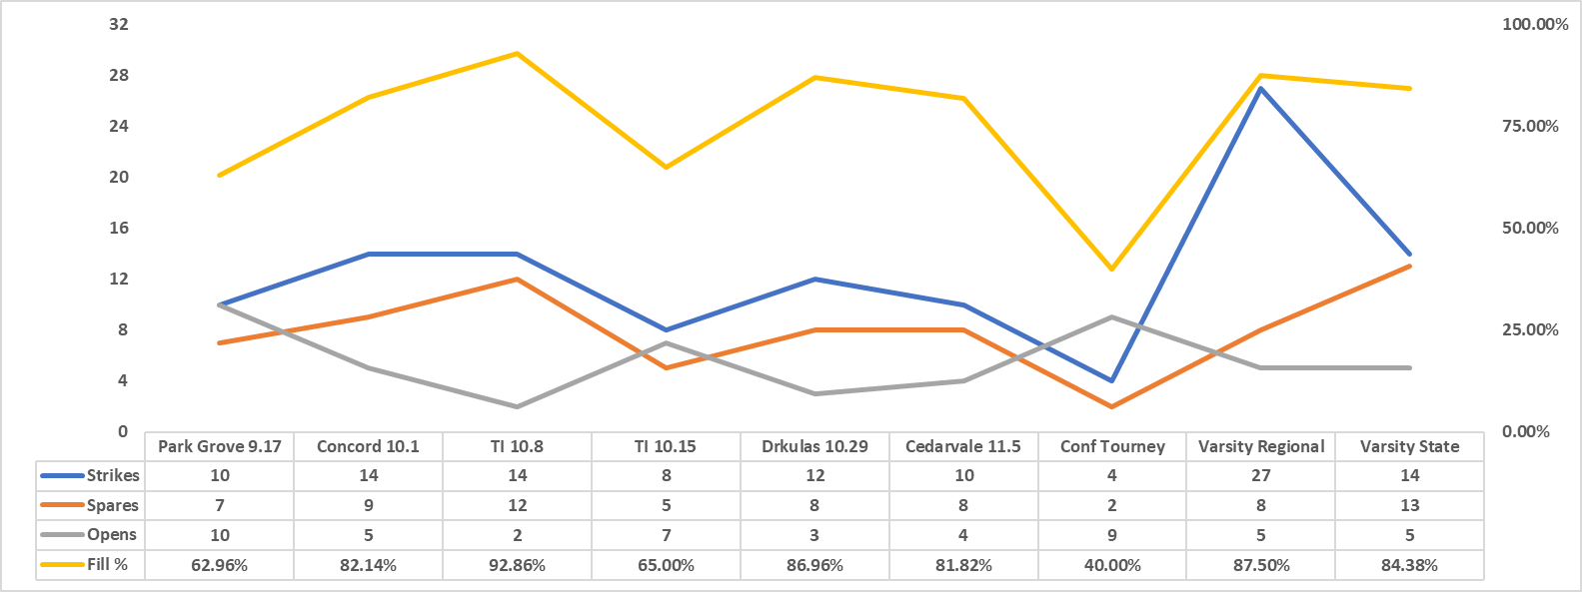
Austin Schick

Slide 32
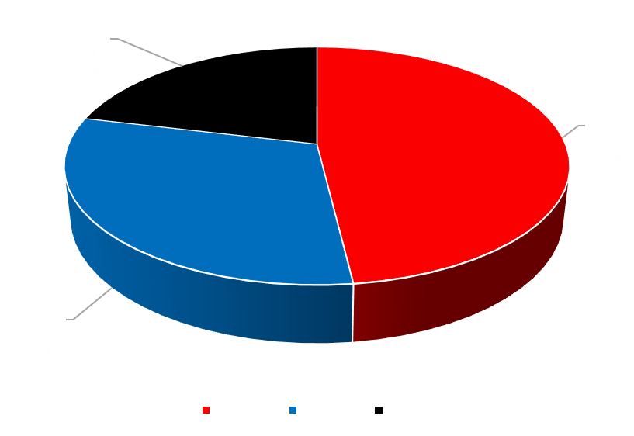
Austin Schick
Regular Season: 79.05% Fill Rate
Post Season: 78.16% Fill Rate

Slide 33
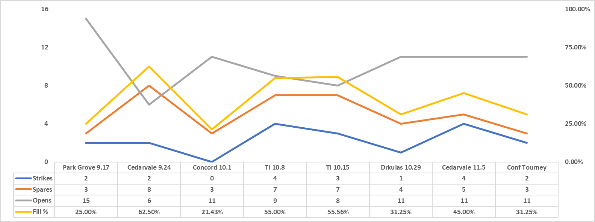
Emersun Weirauch

Slide 34
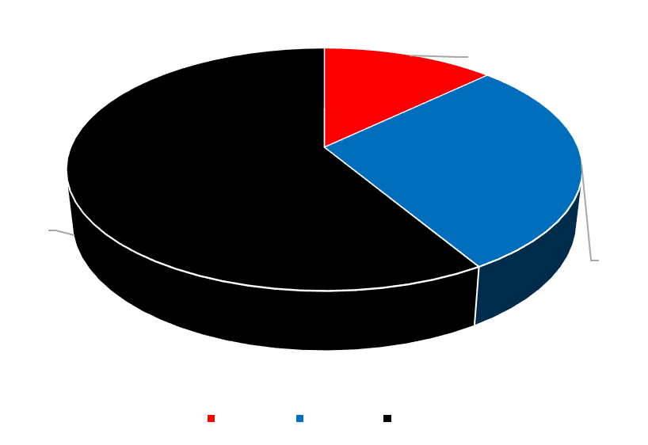
Emerson Weirauch
Regular Season: 42.74% Fill Rate
Post Season: 31.25% Fill Rate

Slide 35
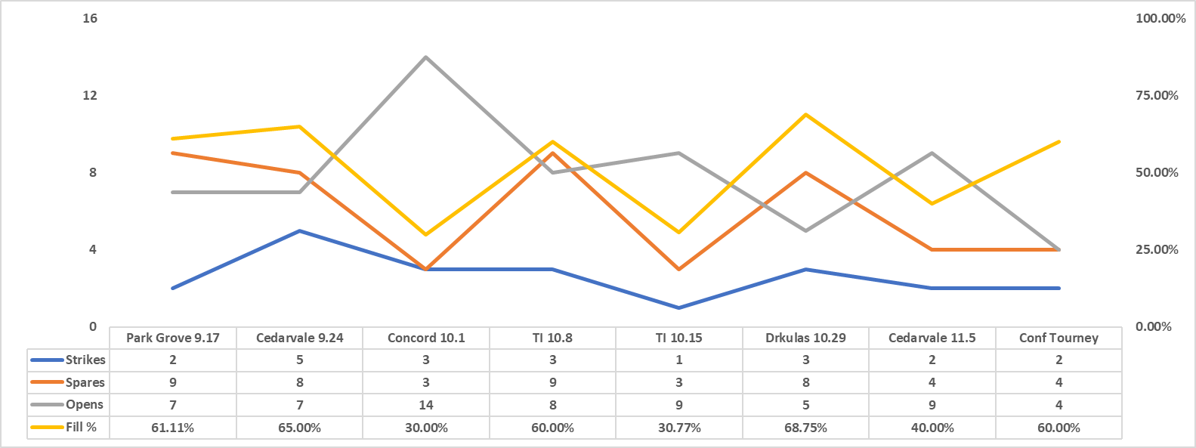
Hannah Olson

Slide 36
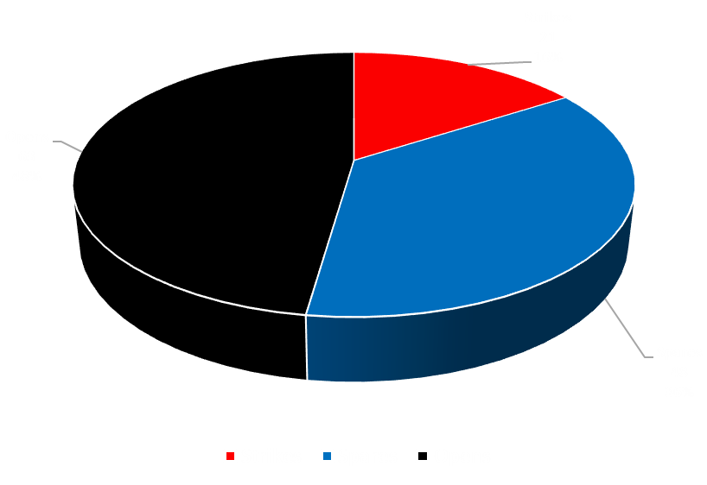
Hannah Olson
Regular Season: 51.64% Fill Rate
Post Season: 60.00% Fill Rate

Slide 37
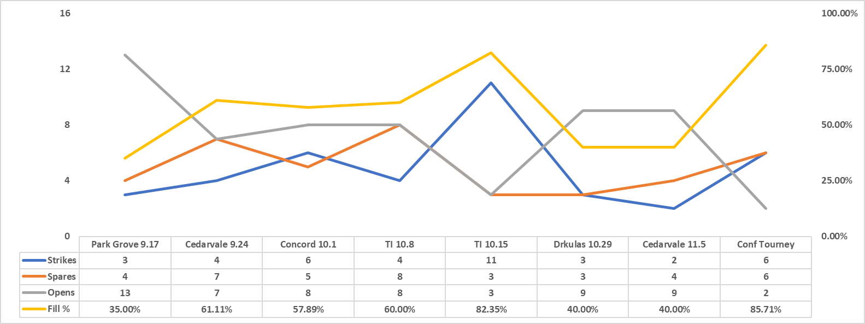
Colton Karnes

Slide 38
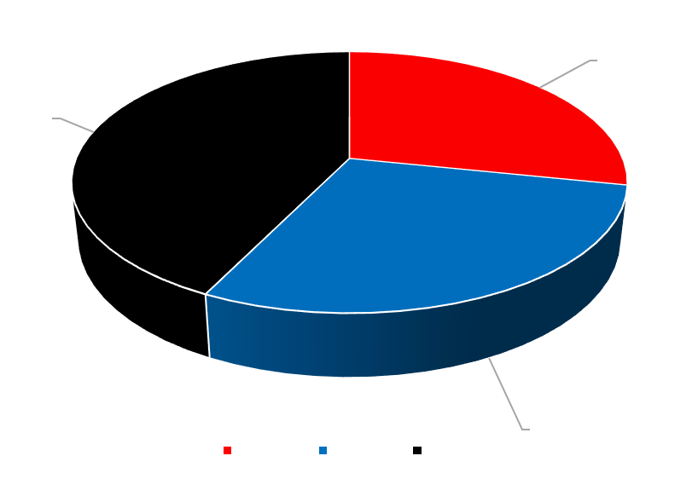
Colton Karnes
Regular Season: 54.03% Fill Rate
Post Season: 85.71% Fill Rate

Slide 39
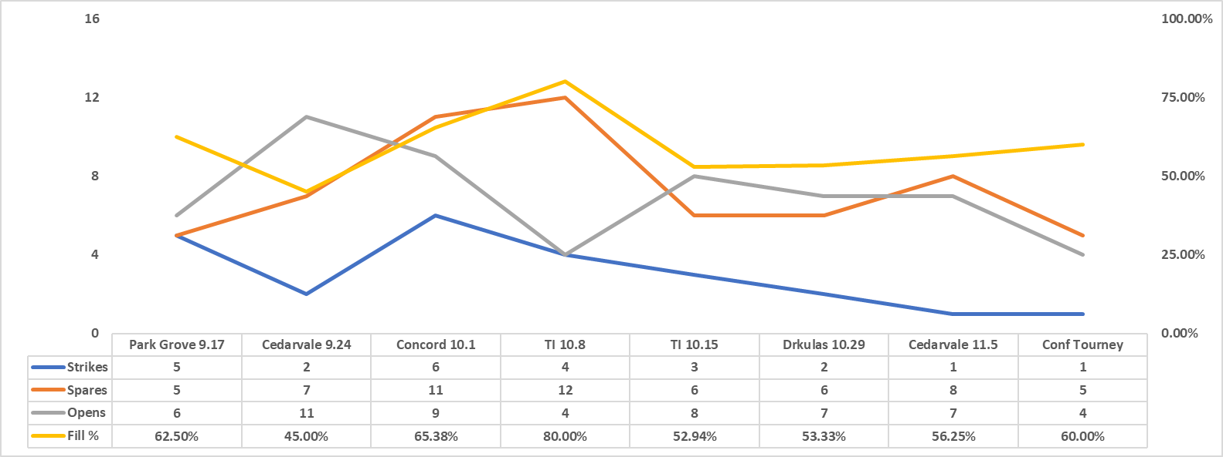
Jacob Drkula

Slide 40
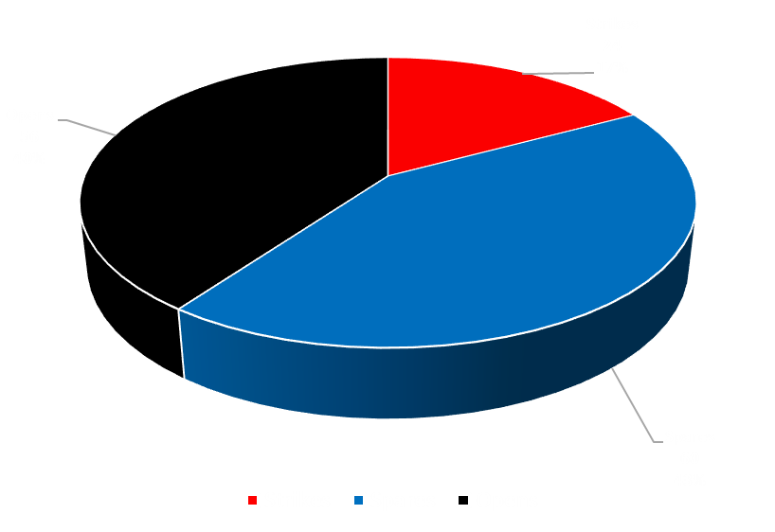
Jacob Drkula
Regular Season: 60.00% Fill Rate
Post Season: 60.00% Fill Rate

Slide 41
Postseason
Varsity South Super Regional
208.29 average in qualifying (#1)
Champions of the South Super Regional (AA)
Quarterfinals - Park 460/New Prague 341
Semi-Finals – Park 444/Rochester Mayo 364
Finals – Park 440/Lakeville South 417
224.00 average in match play
Overall Tourney average 213.00
Varsity State Tourney
208.10 average in qualifying (4th seed)
280 game (new high)
195.67 average in match play (missed advancing by 0.5 points)
Finished top 16 in the state tourney (AA)

Slide 42
Individual Awards
Brady Drkula – Conference MOP (Most Outstanding Player) Varsity All Conference, Individuals Tourney Invitee, Conference All Honors, All State 3rd Team & Team Captain
Joey Aase – Varsity All Conference & Individuals Tourney Invitee
Adam Kritzky– Varsity All Conference
Christian Meyer - Varsity All Conference & 2nd Most Improved Fill % (+14.87%)
Austin Schick – Varsity All Conference & Team Captain
Lincoln Blanchard – Varsity All Conference
Lauren Korth – JV Conference All Honors & Team Captain
Logan Robinson– JV Conference All Honors & Team Captain
Landon Barnard– Rising Star & 3rd Most Improved Fill % (13.89%)
London Blanchard– Rising Star
Emersun Weirauch – Rising Star
Sam Korth– Rising Star
Cameron Picasso – Most improved Fill % (+17.06%)
Hannah Olson – 4th Most improved Fill % (+13.54%)
Jacob Drkula – 5th Most Improved Fill % (+8.48%)

