Slide 1
Coaches’ Clinic and
Player Development
Lowell Youth Baseball and Softball
2025

Slide 2

2024
Spring and Summer League Update

Slide 3
Highlights
Spring Season
  Incredible growth by the kids
  Engaged fan bases
  Entertaining games
  Learning and getting better
  Competitive Atmosphere
  Focus on development and growth
Park Champions:
    Rookie Division (7/8)—Yard Goats
    Minor Division (9/10)—White Sox
    Junior Division (11/12)—Rays
    Senior Division (13-16)— Giants
Summer League
  Unbelievable Enrollment and Development of MVC Level teams
  8U District Champions, State Semi-Finalists
  9U District Champions, State Semi Finalists, Baystate TOC Semi-Finalists
  10U BayState TOC Champions
  11U District Champions, State Semi-Finalists, BayState TOC Champions
  12U District Champions, State Champions, and NE Regional Finalists
  13U Lou Tompkins League 17-1 Record

Slide 4
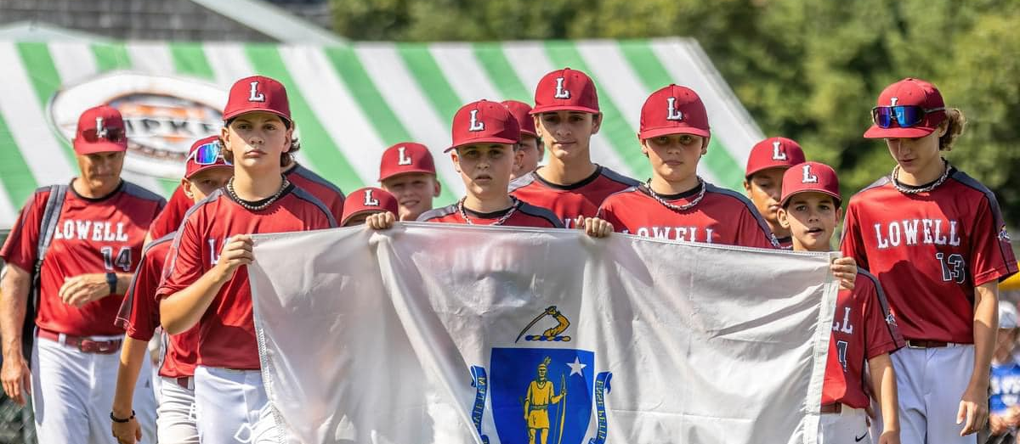

12U Representing Massachusetts at the New England Regionals in Acushnet, Massachusetts

Slide 5
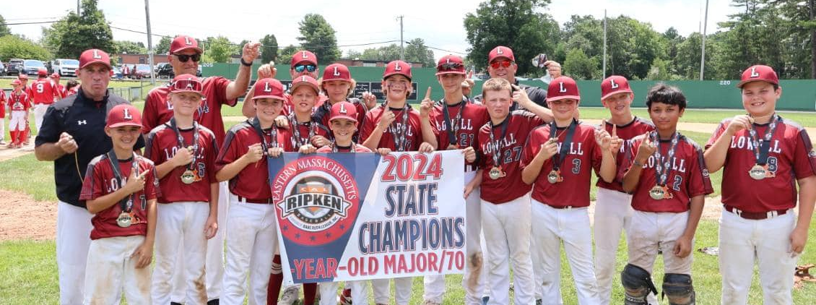
LYBSL 12U—District Champions, State Champions, New England Regional Finalists

Slide 6
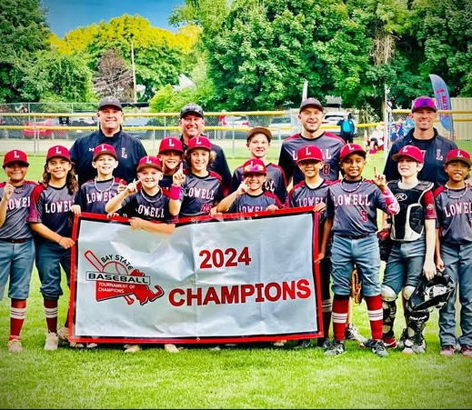
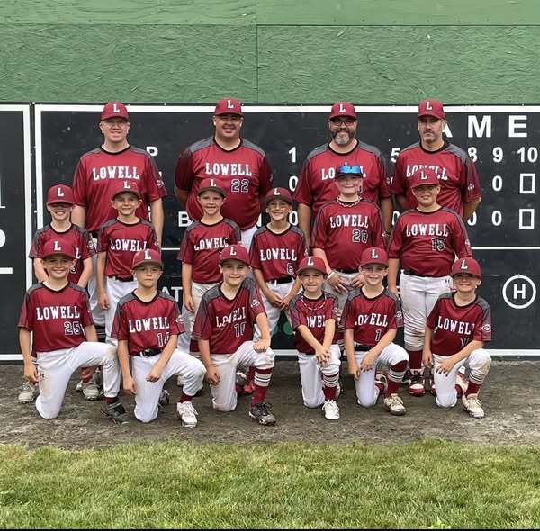
8U and 10U Baseball Squads
8u Conway Champions, District Champions, and State Semi-Finalist
10U Baystate TOC Champions

Slide 7
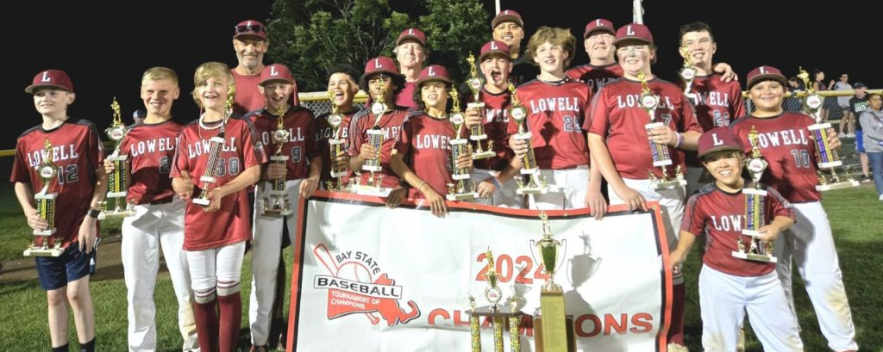
11U Baystate TOC Champions, District Champions, and State Semi Finalists

Slide 8
DID YOU KNOW?
Lowell has had a State Champion three years in a row at various levels
2022: 11U State Champions
2023: 9U State Champions, NE Regional Semi-Finalists
2024: 12U State Champions, NE Regional Finalists

Slide 9

Coaching Perspective

Slide 10

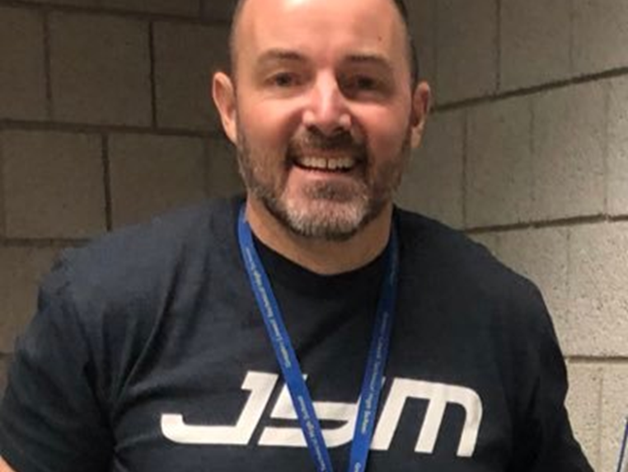
Why is Number 4 hanging in all fields at Shedd Park and on our uniforms?
The Number 4 hangs and is worn in honor of Steve Botto. Steve was a well known player and coach in the City of Lowell. In 2020, while a coach and member of the Shedd Park Board, Steve passed away after a long battle with cancer. He was known for his belief in hard work, hustle, determination, and respect. The LYBSL board shares Steve’s belief in the importance of these player attributes and they are what we want our players to strive to embody as they progress through our programs. His number reminds us all of Steve’s legacy and we display it proudly at all Shedd Park fields and our uniforms.

Slide 11
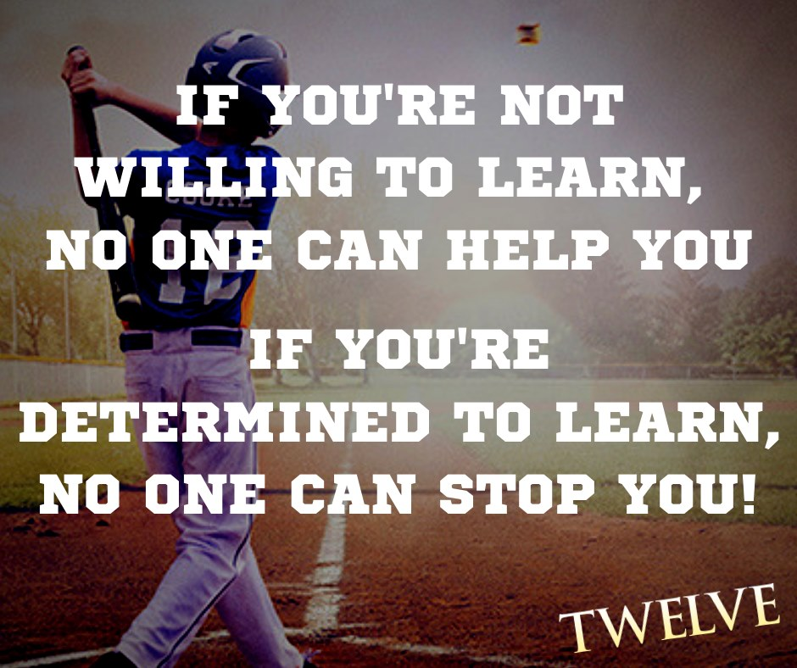

Slide 12
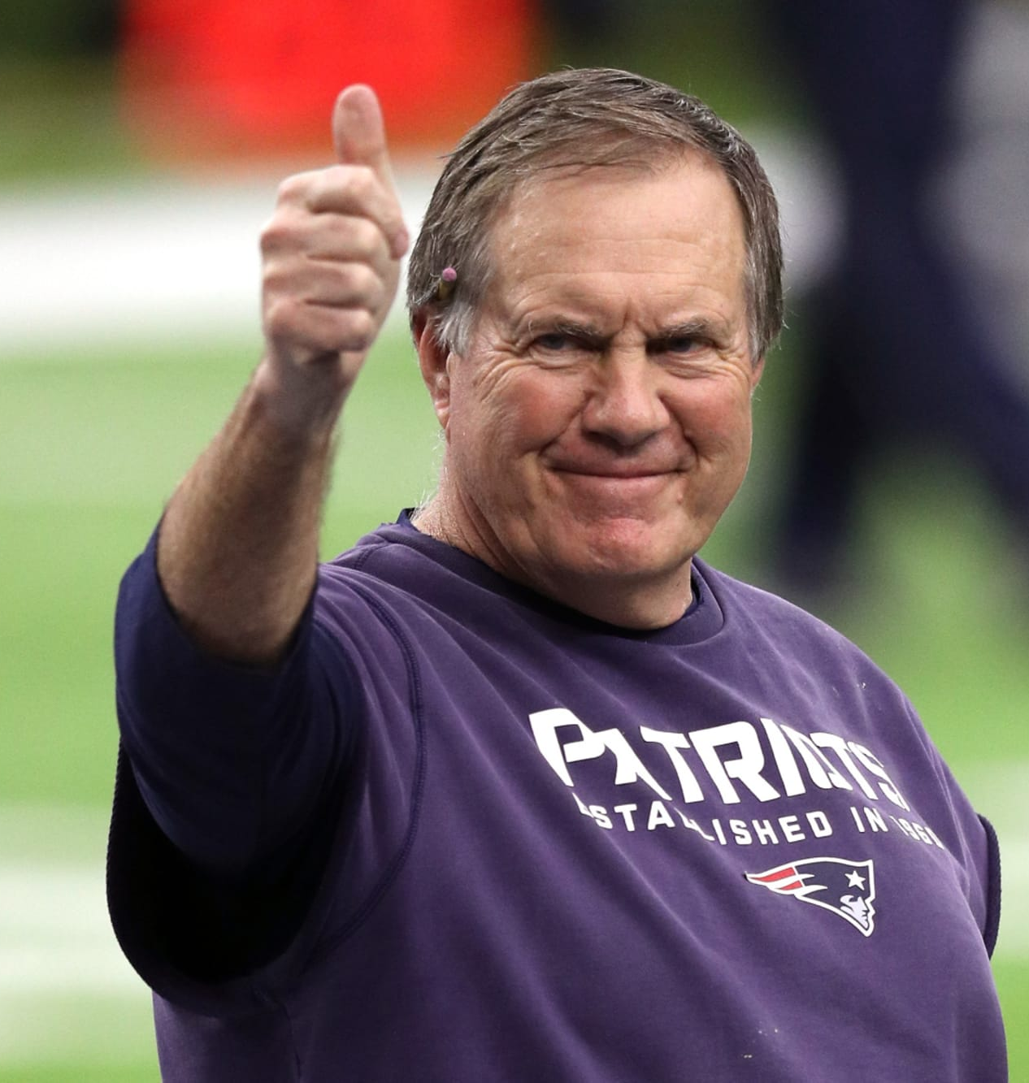
COMMON MYTHS ABOUT COACHING
Your skill as a child baseball/softball player determines what kind of coach you will be…
  Coach Belichick and his eight Super Bowl rings would tell you otherwise.
There is only one way to teach the game.
Wins and Losses are the only measuring stick of success.
  Connie Mack has the most managerial wins of all time with 3,731 wins
  Connie Mack lost 3,948 times

Slide 13
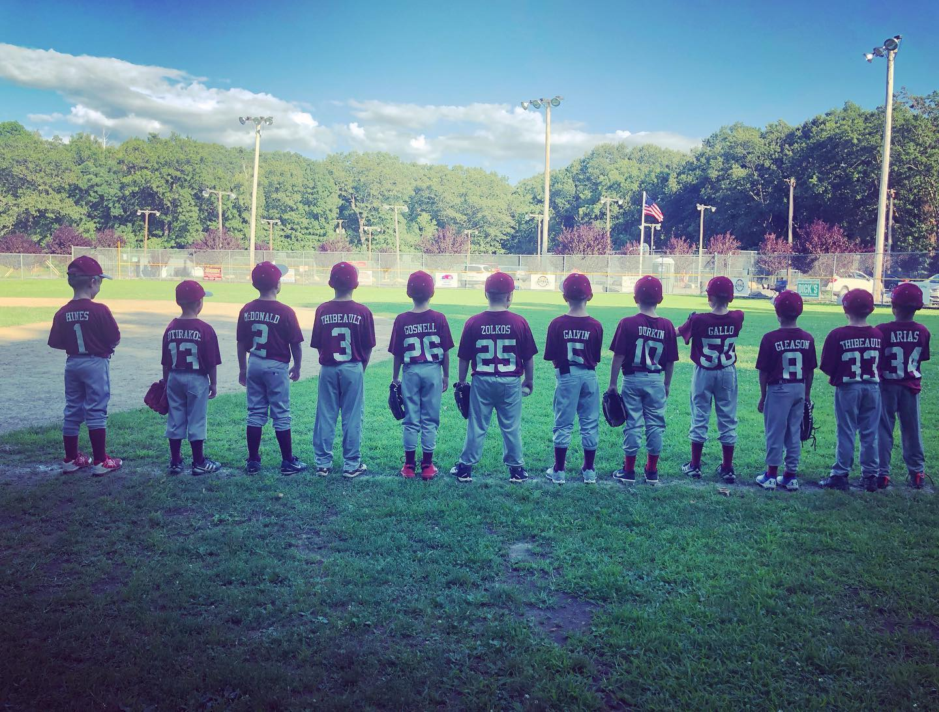
All kids learn the same
What it is all about

Slide 14

Mandatory Background and CORI Checks for all volunteers
Make sure to register to be a volunteer. Only volunteers that have had their background and CORI checks completed can be on the field.

Slide 15
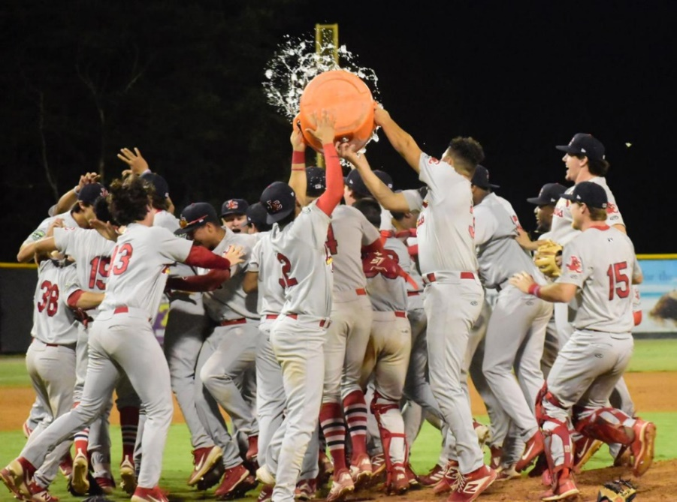
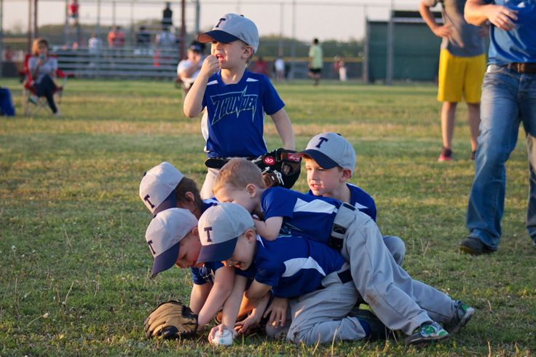
T-Ball
Expectation v. Reality

Slide 16
What to Teach—The Basics
Hitting
Fielding
How to hold a bat
Where to stand in the batter’s box
Help them figure out if they are a righty or a lefty
Where to run once they hit the ball
How to wear a glove
How to properly throw a ball
How to catch a ball with their glove
Where to stand on the field
What to do with the ball once they get it.
Try not to all chase the ball.

Slide 17
MAKE IT FUN
Hitting
Fielding
Have the kids pretend they have to hit their least favorite food away from them. Make it fun for them to want to get up and hit.
Play “floor is lava” once they hit the ball. Helps them get out of the box fast and run to the base.
Do base running practice and race against them. They love beating adults.
Constantly rotate positions. For example, don’t let one player stand on the pitcher’s mound for the game.
Walk around and engage them. Don’t stay in the dugout and coach.
Talk to the kids, get them to interact, talk, and laugh.

Slide 18
WHAT TO DO IN GAME
T-Ball Games Should be No More than an Hour for your Sanity and Theirs
Batting
Fielding
Play five kids in the infield and have the remaining players out in the outfield with a coach working on drills.
Examples of drills: soft toss, tee work, throwing drills, and fly balls with tennis balls or pom poms.
Basically, anything that helps grow skills. Rather than have kids stay still and bored in the outfield, engage them.
Kids can be working on skills one inning and playing the field the next. We would rather see growth and development instead of who can build the best dirt pile in left field.
At this age level, skills in the outfield is not taking away from the game. It is enhancing the experience. Encourage parents to volunteer to help so you can handle it all.
Be organized
Every player will hit, every inning. The goal is to make the process as efficient as possible.
One player up, one player on deck in a designated area, and the third player ready to go with their helmet on in the dugout.
Absolutely NO BATS in the dugout.

Slide 19
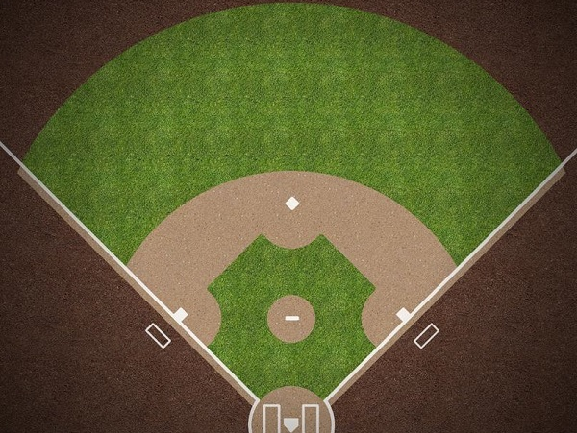
Make it a place they want to be…not have to be
The same goes for parents. Engage them and seek help from assistant coaches. The more people invested, the more ability you have to seize teachable moments. They might be able to teach you something about reaching kids better. Don’t be too proud to learn, we all are in it together.

Slide 20
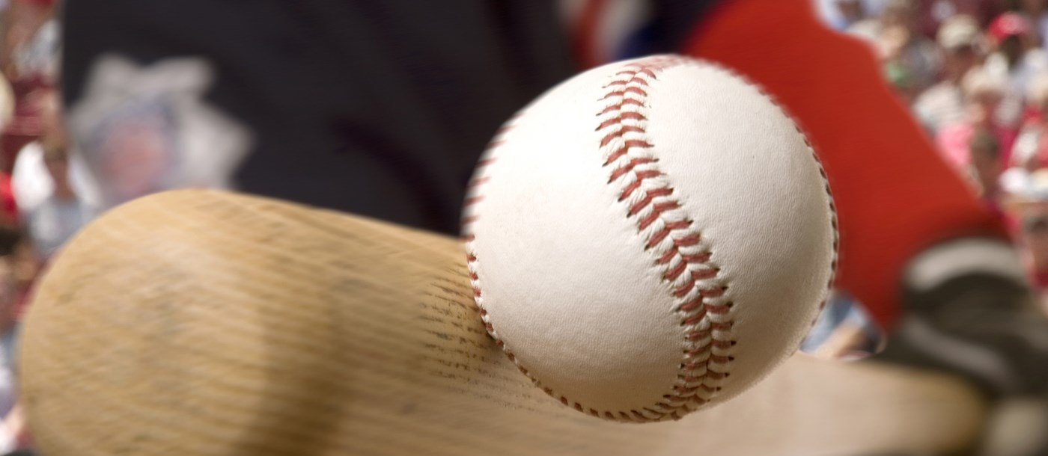
INSTRUCTIONAL LEAGUE
Ages 5-6

Slide 21
Instructional League Rules
Batting Rules
Fielding and Base Running
BATTERS HIT BALLS PITCHED BY A COACH.
THE BATTING ORDER IS COMPRISED OF ALL PLAYERS ON A TEAM. NO NINE PLAYER BATTING ORDER.
EACH BATTER MAY ONLY ADVANCE TO FIRST BASE AFTER HITTING A FAIR BALL EXCEPT FOR THE LAST BATTER OF THE HALF INNING WHOSE HIT SHALL ALWAYS BE A "HOME RUN.“
THERE ARE NO STRIKE OUTS. EACH BATTER SHALL REMAIN AT BAT UNTIL HE/SHE HITS A FAIR BALL. AT THE COACHES' DISCRETION A TEE MAY BE UTILIZED AFTER THE FIFTH PITCH.
EVEN IF THE FIELDING TEAM CATCHES THE BATTER'S HIT BALL IN THE AIR, TAGS A BASE FOR A FORCE PLAY, OR TAGS A RUNNER THE BATTER/RUNNER SHALL BE AWARDED THE BASE.
IF DESIRED, A TEAM MAY CHANGE ITS BATTING ORDER EACH INNING SO THAT DIFFERENT PLAYERS MAY BAT IN DIFFERENT POSITIONS IN THE ORDER.
ALL BASE RUNNERS SHALL ADVANCE ONE BASE PER AT BAT EXCEPT WHEN THE LAST BATTER OF THE HALF INNING HITS THE BALL FOR A "HOME RUN" AT WHICH TIME ALL RUNNERS SHALL ROUND ALL BASES.
BASE STEALING IS NOT ALLOWED.
LEADS ARE NOT ALLOWED.
ALL PLAYERS ON EACH RESPECTIVE TEAM PLAY IN THE FIELD EVERY INNING. EXTRA PLAYERS SHOULD BE EVENLY DISTRIBUTED ACROSS THE OUTFIELD.
THE PITCHER AND FIRST BASEMAN MUST WEAR HELMETS WITH FACEMASKS WHILE IN THE FIELD.
THERE IS NO CATCHER. COACHES SHALL CATCH AND BE SET UP WELL BEHIND THE BATTER.

Slide 22
Focus Points
Hitting
Control What you Can
Encourage kids to get into the batter’s box alone.
Stress proper batting stance and hand position on the bat.
Coaches are pitching so that should help ease the fear of being hit by the ball.
Celebrate contact!
Encourage hustle on and off the field.
Stress organization—know where your equipment is.
Be a good teammate and pay attention when not up at bat.
Pick each other up, not put each other down.

Slide 23
Fielding
Fielding Fundamentals
Catching
Ground balls
  Two Approaches:
    Alligator style technique
      Glove hand is the lower part of the jaw
      Top hand is the top part of the jaw.
      The ball is food.
      Top hand brings the food into the glove (alligator’s mouth) and the hands come to the belly to feed the alligator.
      Simplest way to demonstrate technique and kids love to pretend they are alligators.
    Gather Technique
      Active Footwork
      Hands out front, gather the ball
Less than 75% of the players will effectively catch the ball. Use different ways to practice like whiffle balls, tennis balls, or soft snow balls made of cotton.
You must reduce their fear of getting hit or hurt to help them get better at the skill.
For balls in the air, encourage them to use their glove to catch and their throwing hand to help trap it in their glove.
BE PATIENT with this as it involves the player overcoming the fear of being hit or hurt.

Slide 24
WHAT TO DO IN GAME
Batting
Fielding
Be organized
Every player will hit, every inning. The goal is to make the process as efficient as possible.
One player up, one player on deck in a designated area, and the third player ready to go with their helmet on in the dugout.
Absolutely NO BATS in the dugout.
Play five kids in the infield and have the remaining players out in the outfield with a coach working on drills.
Examples of drills: soft toss, tee work, throwing drills, and fly balls with tennis balls.
Basically, anything that helps grow skills. Rather than have kids stay still and bored in the outfield, engage them.
Kids can be working on skills one inning and playing the field the next. We would rather see growth and development instead of who can build the best dirt pile in left field.
At this age level, skills in the outfield is not taking away from the game. It is enhancing the experience. Encourage parents to volunteer to help so you can handle it all.

Slide 25
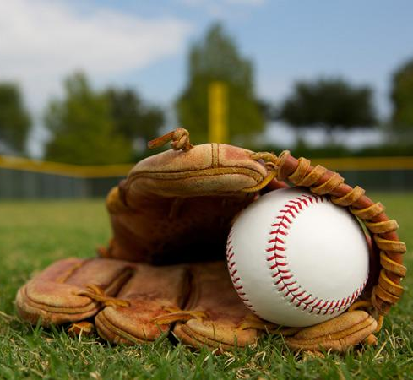
Reminder for Instructional
It is supposed to be a learning and teaching experience. Teach now so the basics become natural and development is easier.

Slide 26
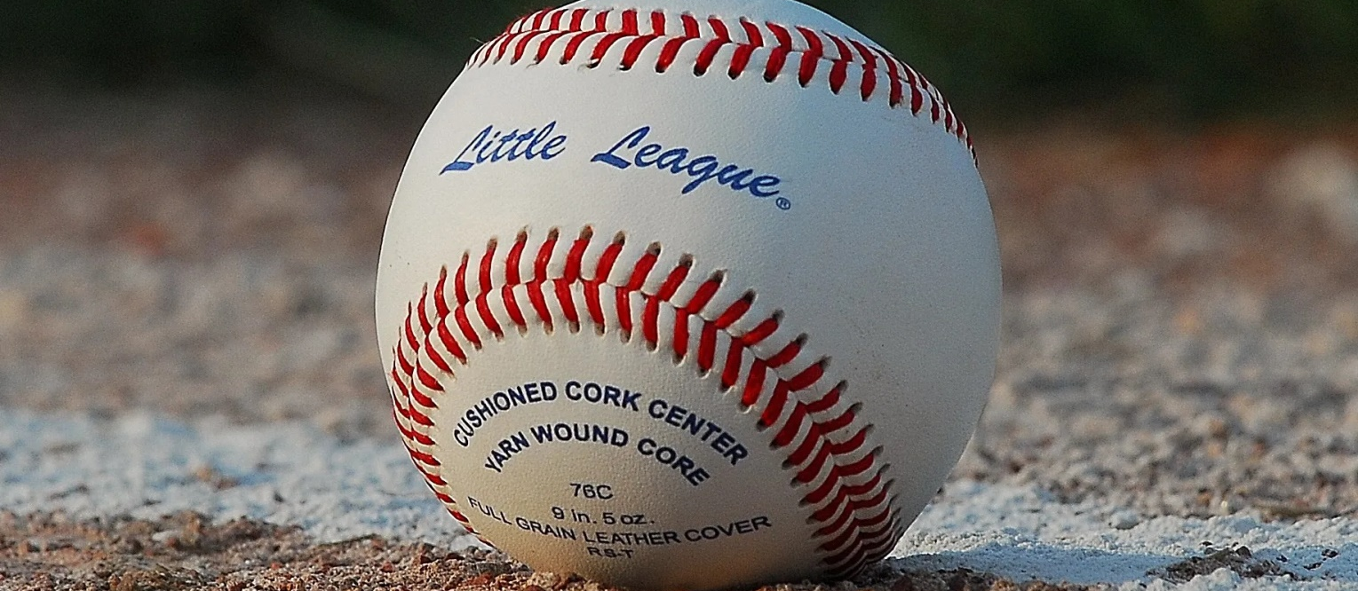
ROOKIE LEAGUE
AGES 7-8
Rookie League is still a developmental league. Players are learning how to now apply the skills they have been taught in T-Ball and Instructional to real game situations.

Slide 27
Coaching Rookie Baseball
How it is different from Instructional League
How it is similar to Instructional
-The score is kept.
-Outs are counted with standard scoring of three outs per side.
-Games will be six innings or two hour maximum.
-Lineups (batting orders) will be kept and exchanged prior to the games. The order does not change during the course of the game.
-A pitching machine is used to pitch to the kids. This takes getting used to by coaches and players. Practice calibrating the machine before the first game.
-Kids will be pitching at this level starting at game 5 with a staggered roll out set forth in the league rules.
-Umpires will be calling balls and strikes with strikeouts.
-The pace is faster and for some more competitive.
There will be varying levels of talent on every team. Some kids will be able to do everything necessary to play. Some will be able to do a little bit of everything. Some will be able to do very little at all.
Coaching is critical because the team’s success is dependent on the success of not a few, but the whole.
Keep everyone involved.
Everyone must play.
It will be up to the coaches to decide where players go in the field taking into account skill levels, but also safety considerations.

Slide 28
Sample Practice
5 Minute Introduction (Kids don’t like long speeches)
15 minutes base running
  Have them run out a single.
    Rep 1: Run through the bag as fast as possible turning right into foul territory
    Rep 2: Rounding the bag towards second and returning.
  Run through doubles, triples, and homeruns
  Can talk about tag ups and the importance of freezing on line drives. At this level, kids can now catch the ball and outs matter.
20 Minutes (Throwing/Catching)
  (10 Minutes)
  Have one group on the foul line and the other in the outfield. Don’t play catch on the infield.
  Identify who can catch and throw effectively—likely infielders and possibly pitchers.
  Progression can be after five minutes of catch, the kids in the outfield back up by one step. If each partner catches the ball and throws it accurately, take one step back. If not, repeat the rep.
  (10 Minutes)
  Have the players close in to ten feet from each other and roll ground balls. Encourage proper fielding technique
    10 reps straight on, 10 to the left, ten to the right, and 10 short hops
Batting practice (45 min)
  Break into stations (15 minutes per station)
  1 group live on the field
  1 group soft toss/tee work
  1 group playing the field shagging
An hour and thirty minutes is usually enough for instruction
If kids are still engaged:
Play some sort of competitive game reinforcing the lessons of the practice. Kids love to compete and don’t realize they are benefiting from the games you are playing if they are having fun. It reenergizes them for the next time they come.
Always finish on a HIGH note.
Encourage your 8 year old returners to be leaders. Let them show the 7s how to play the right way.

Slide 29
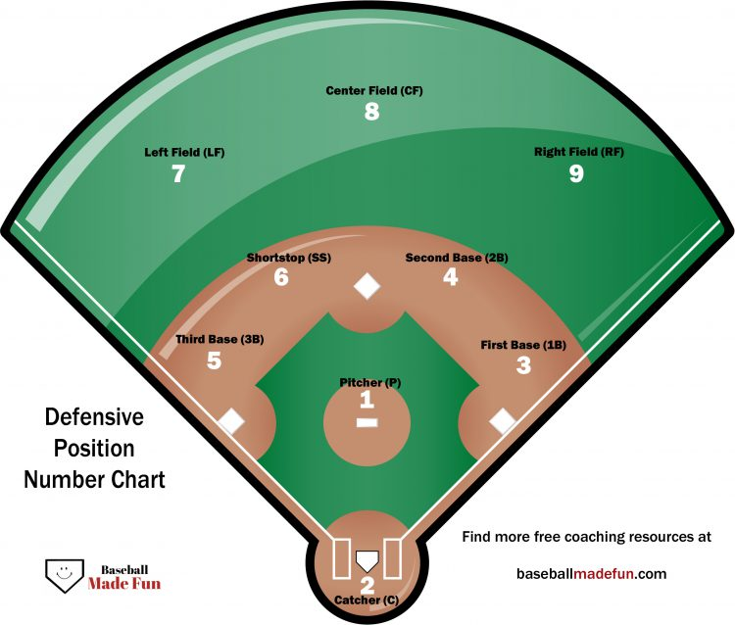

Slide 30
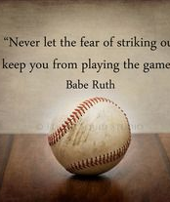
Don’t be Afraid to
Ask for Help
Remember:
You are volunteers.
We are here to help and can assist with creating drills or a practice plan if necessary. This isn’t supposed to be stressful.
Surround yourself with people that can help and know the game.
Rely on the support systems in place because one day you will be on the other end helping someone out.
Remember…everyone is learning, from the kids, to the umpires, to the coaches. Focus on the positives and not the bad part of the experience.

Slide 31
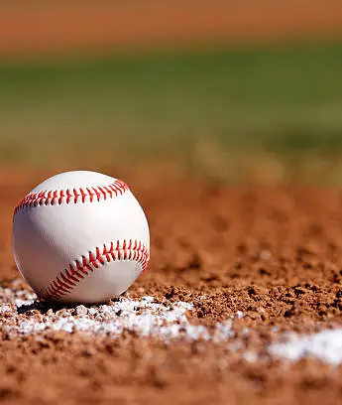
Baseballs cost money
LYBSL does everything in its power to keep the costs down for registration and participation in baseball/softball.
The average cost of a baseball is between $3-$6 per ball.
We distribute practice balls and game balls to each team. Do not use game balls for practice and do not be afraid to reuse balls.
Do not give game balls from your actual “game ball” allotment. Those are meant to last the season and be used for games only.

Slide 32
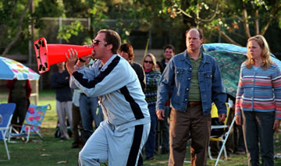
DON’T BE THAT PERSON

Slide 33
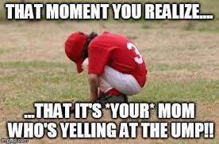
Kids see it…they don’t like it
LYBSL Administrators see it too. We don’t like it either and have a zero tolerance policy for abuse of umpires, coaches, or kids.

Slide 34
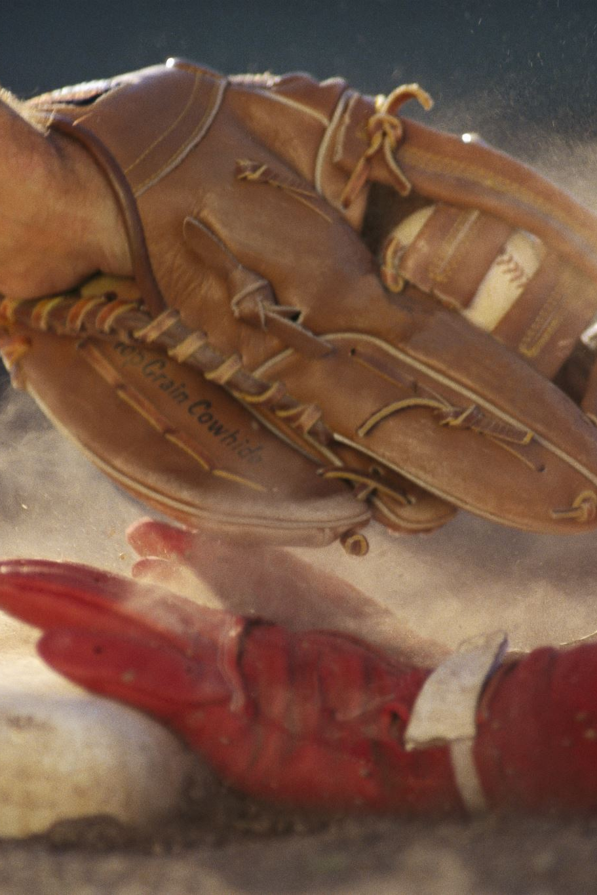
UMPIRES
11-12 and up will Patched umpires.
  This means umpires will be trained on all rules and regulations of baseball. They know the game better than most.
  If you choose to speak them about a call, be respectful. They will not hesitate to remove a belligerent coach or fan from the game. If that happens, it will be referred to the LYBSL Executive board for review and discipline.
10 and under will have kids umpiring.
What does this mean?
  Kids 12-16 will be umpiring your games.
  They have played and know the game better than most adults. They are bailing the league out of a HUGE umpiring shortage.
  They have been instructed on how to handle a game as well as unruly coaches. They will eject you. If you continue to disrupt, your team will forfeit.
  You will then be called before the LYBSL board where your coaching credentials will be evaluated and likely terminated.

Slide 35
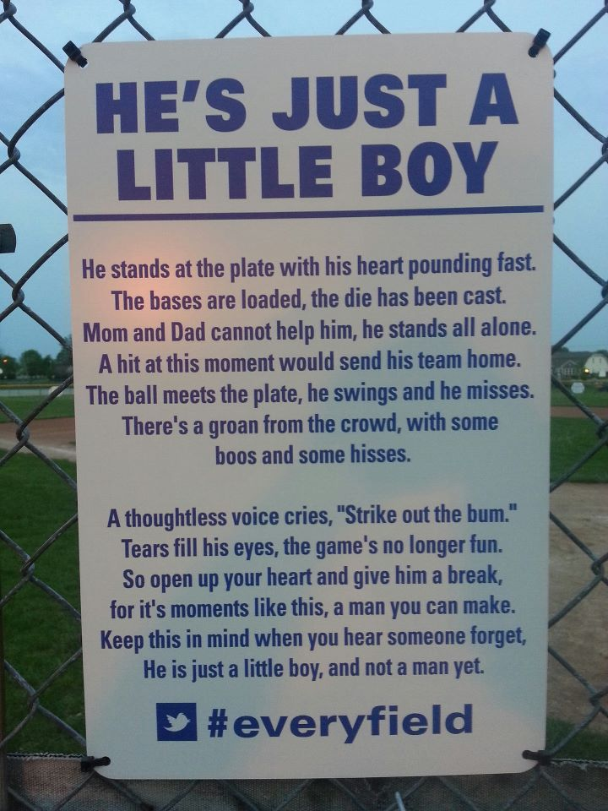
PERSPECTIVE
This applies to all kids. Believe it or not, you can cheer for your own child without making another kid feel terrible about themselves or their ability.
LYBSL Administrators can’t be everywhere and at all games. BUT…common sense and decency can be. If you hear about or witness conduct that negatively impacts the game, reach out so it can be addressed.

Slide 36
MINOR AND JUNIOR LEAGUE
Stress fundamentals and continue to hone basic skills.
The game starts to flow easier and the competition intensifies.
Practices start generic with throwing, fielding, and hitting.
Eventually practices progress to game situations and specific skills.
You can use Youtube and Google to help supplement your drill arsenal. Just remember, simple is better so if you struggle to understand the drill, don’t teach it.
Pitch Counts are NOT suggestions, they are the rule. Winning a park league game versus a lifelong injury is not worth it and won’t be tolerated.

Slide 37

VOLUNTEERS
Every parent should be asked if they can help in some way. If not on the field, there is always something to do. LIKE:
  Raking the field before or after the game
  Controlling the dugouts
  Manning a station during skills and drills
  Collecting balls in a bucket to speed up the game
  Literally ANYTHING is helpful, people need to be asked.

Slide 38


Health and Safety

Slide 39

First Aid at the Park
Identify the injury
Notify the parent
Involve other Adults
If you have any concerns about severity, call 911

Slide 40

City of Lowell and
PrideStar EMS First Aid Resources
LYBSL has partnered with the City of Lowell and PrideStar EMS to provide training on appropriate first aid responses.
Please review any information provided by PrideStar and/or the City of Lowell prior to the start of the season.
Remember, if you aren’t sure, call 911 and let the experts decide.

Slide 41

Lowell Police
If you see something, say something.
If there is any concern over the health and/or safety of the parents, the kids, or the spectators at the park call the police.
For emergency, dial 911.
For non-emergency calls, you may call 978-937-3200.

Slide 42
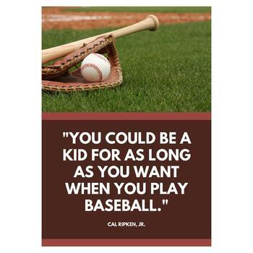
REMEMBER WHY WE ARE HERE!

