Slide 1





Seacoast United
Home Workout Plan -
April 20th- 24th 2020

Slide 2

Seacoast United & Nike

Slide 3
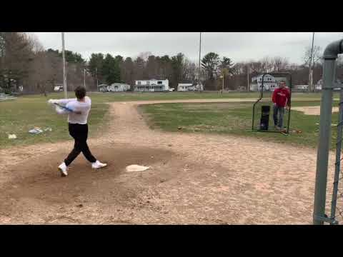
Seacoast United - #InThisTogether

Slide 4
Seacoast United Home Workout Plan
The Seacoast United Home Workout will consist of a 5-Day Plan to keep our players active in this time away from Team Training Sessions. The activities we have are all designed so players can perform on their own in a limited space, so should be accessible for all our players.
The Home Workout Weekly Plan will consist of the following:
Dynamic Warm Up
Cool Down
Aerobic Workout
Technical Based Workout
Core Workout
Upper Body Workout
Lower Body Workout
Yoga Workout
Soccer Homework
This presentation will include a weekly schedule, plus descriptions of the activities we would like the players to perform in each of the workouts.

Slide 5
Weekly Schedule (4/20-4/24)
Monday 20th April | Tuesday 21st April | Wednesday 22nd April | Thursday 23rd April | Friday 24th April
Dynamic Warm Up | Dynamic Warm Up | Yoga Workout | Dynamic Warm Up | Dynamic Warm Up
Technical Workout | Technical Workout | Tactical Homework | Technical Workout | Technical Workout
Aerobic Workout (Cooper Test) | Core Workout |  | Aerobic Workout (35 Min Interval Run) | Core Workout
Cool Down | Upper Body Workout |  | Cool Down | Lower Body Workout
 | Cool Down |  |  | Cool Down

Slide 6
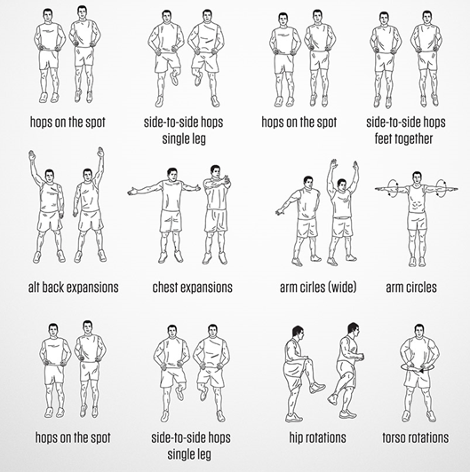
Dynamic Warm Up
~ Mon, Tues, Thurs and Fri ~
***Players should perform each exercise for 10 seconds, before moving onto the next one.
Repeat the exercises for a total of 2 sets***

Slide 7
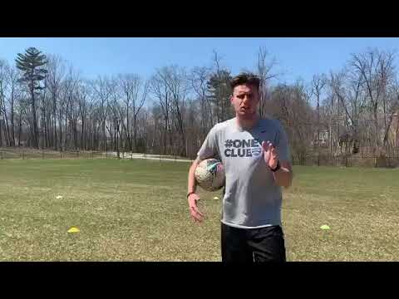
Technical Workout #1
~ Monday, Tuesday, Thursday, Friday ~

Slide 8
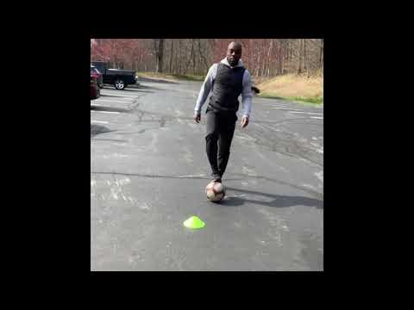
Technical Workout - #2: Back to Goal Moves
~ Monday, Tuesday, Thursday, Friday ~

Slide 9

12 Minute Cooper Test
~ Monday ~
Repeat of Test from Week 2:
The Cooper 12 minute run is a popular maximal running test of aerobic fitness, in which participants try and cover as much distance as they can in 12 minutes.
Players should run continuously for 12 minutes and see how far you get.
Please carry this whilst abiding by government guidelines and in your preferred environment.
Send a screenshot of your distance to your Head Coach once completed.
***Make sure you download the Nike+ running app to track your score***

Slide 10
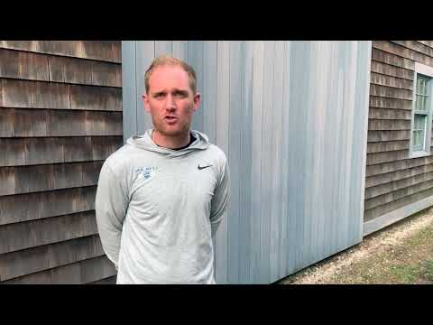
Physical Workout: Interval Training
~ Thursday~

Slide 11

Physical Workout: Interval Training
~ Thursday~
Interval Training, also known as Fartlek Training is an effective training method to improve your running speed & endurance, as well as your VO2 Max Rating. Interval Training puts a higher stimulus on the working muscles.
35 Minute Interval Run
8 minutes jog to warm up at moderate pace (Medium Jogging Pace)
7 minutes at your max pace (Fast Jogging Pace)
5 minutes at a gentle jog (Slow Jogging Pace)
7 minutes at your max pace (Fast Jogging Pace)
8 minutes jog to cool down at moderate pace (Medium Jogging Pace)
Please email your Head Coach a screenshot of your 35 minute interval timed run.

Slide 12
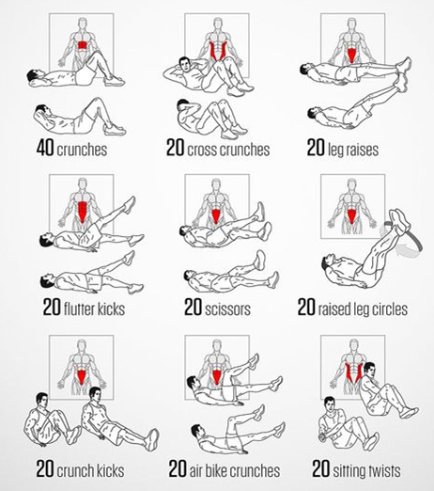
Core Workout
~ Tuesday & Thursday ~
***Players should complete 1 set of all 9 activities, before taking a 3 minute rest.
Repeat this process for a total of 2 times**

Slide 13
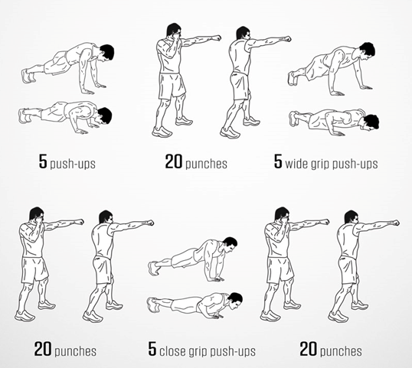
Upper Body Workout
~ Tuesday ~
***Players should complete 1 set of all 6 activities, before taking a 2 minute rest.
Repeat this process for a total of 3 times***

Slide 14
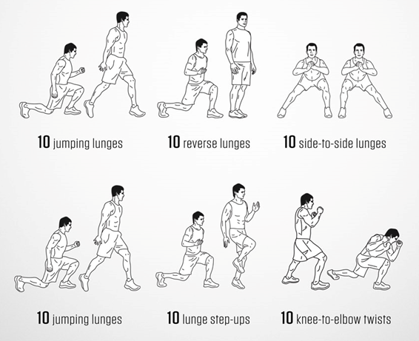
Lower Body Workout
~ Thursday ~
***Players should complete 1 set of all 6 activities, before taking a 2 minute rest.
Repeat this process for a total of 3-4 times***

Slide 15

Yoga for Soccer Players
~ Wednesday ~

Slide 16
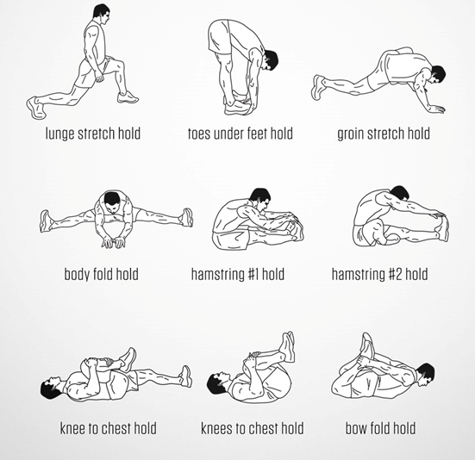
Cool Down
~ Mon, Tues, Thurs and Fri ~
***Players should hold each stretch for 40 seconds before moving onto the next one.
Repeat the exercises for a total of 2 sets***

Slide 17
Tactical Homework
~ Wednesday ~
For this week’s homework assignment, you are going to create a club & write up your desired style of play. You can’t be wrong, so feel free to have your team play exactly as you wish.
To complete this assignment:
1. Create a Club and give it a Name
2. State your Preferred Formation
3. Create Tactical Principles that your club will look to execute in the 4 phases of the game
4. Come up with 10 ‘Key Values’ that you believe that players at your club should display at all times
Please use a template similar to the one on the following slide to complete this assignment.
This must be typed up and sent electronically via email to your Head Coach by Friday.

Slide 18
Your Name:
Club Name:
Formation:
Tactical Principles of Play
Attacking | Defending
Transition: Defending to Attacking | Transition: Attacking to Defending
10 Key Values:

Slide 19

Stay Safe & Stay Fit

