Slide 1



EKVC
ANNUAL GENERAL MEETING
(AGM)
Tuesday, November 25, 2025 @ 7:00pm
College of the Rockies, Room 205

Slide 2

MEETING CALLED
TO ORDER
Motion to adopt agenda
Motion to approve Minutes from previous year

Slide 3
INTRODUCTIONS
Board Members
Directors at Large
Technical Director
Operations Manager

Slide 4
DIRECTOR REPORTS
President
Vice-President/Regional
Treasurer
Secretary
Directors – Governance, Fundraising, Communications, Equipment/Uniform
Technical Director

Slide 5
2025-26 Fees
Fees include:
EKVC Registration (Same as last year)
Jerseys (2/athlete)
Volleyball Alberta Tournament Fees
New for 2026! – Payment Plan
5 Equal Payments
1st payment due at registration (Dec)
Automatic payments the 1st of each month (Jan-April)

Slide 6

2025 Monthly Payment Fees
13U
$220/
month
14U
$235/
month
15/16U
$275/
month
17/18U
$280/
month
VA Youth Recreational Player Registration is Separate from EKVC Registration Fees

Slide 7
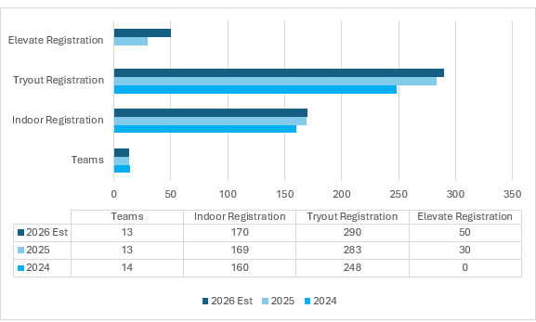
3 YEAR COMPARISON

Slide 8
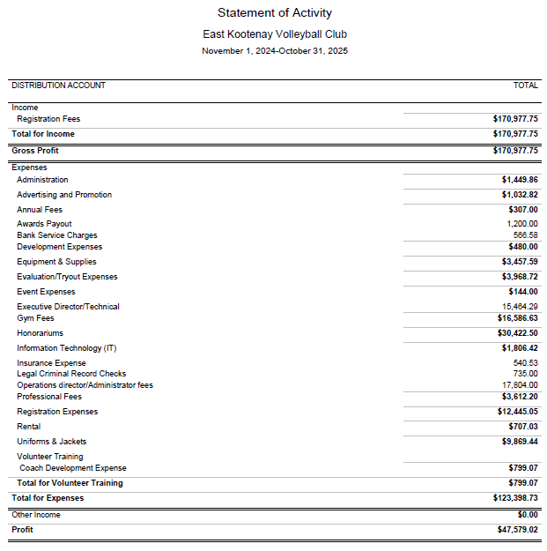
TREASURER’S
REPORT

Slide 9
ELECTION –AGM PROCESS
All positions are one-year terms
Incumbents may let names stand
Chair calls for nominations 3 times per position
Nominations close
If unopposed – elected by acclamation
If more than one nomination – board only vote (show of hands)
Motion to accept elected & appointed board members

Slide 10
ELECTION – POSITIONS
Executive (Elected)
President – Nominee: Tarra Hanson (executive member; eligible per bylaws)
Vice President/Regional – Sue Bradley (incumbent standing)
Treasurer – Marifer Lam (incumbent standing)
Secretary – Vacant
Directors at Large (Elected)
Governance/Policy Coordinator – Brett Reiben (incumbent standing)
Fundraising Director – Jennifer Johnson (incumbent standing)
Communications Director – Christia Molnar-Martens (incumbent standing)
Equipment/Apparel Director – Lisa Reed (incumbent standing)
Volunteer Director – Vacant
Awards & Alumni Director – Vacant
Athlete Program Development Director - Vacant
Non-Elected Supporting Role
Past President – Lanna van der Velden

Slide 11
NEW EKVC PRESIDENT
We’d like to acknowledge that Tarra Hanson has been nominated for the position of President and is the only eligible Executive member, as required by our bylaws.
Thank you to Lanna van der Velden for 11 years of dedicated service to EKVC, including the past five years as President.

Slide 12
QUESTIONS??

Slide 13
MOTION TO ADJOURN

Slide 14
THANK YOU!
MEETING ADJOURNED

