Slide 1

2021 Century Boys Lacrosse Pac Meeting

Slide 2
The Coaching Staff

Slide 3
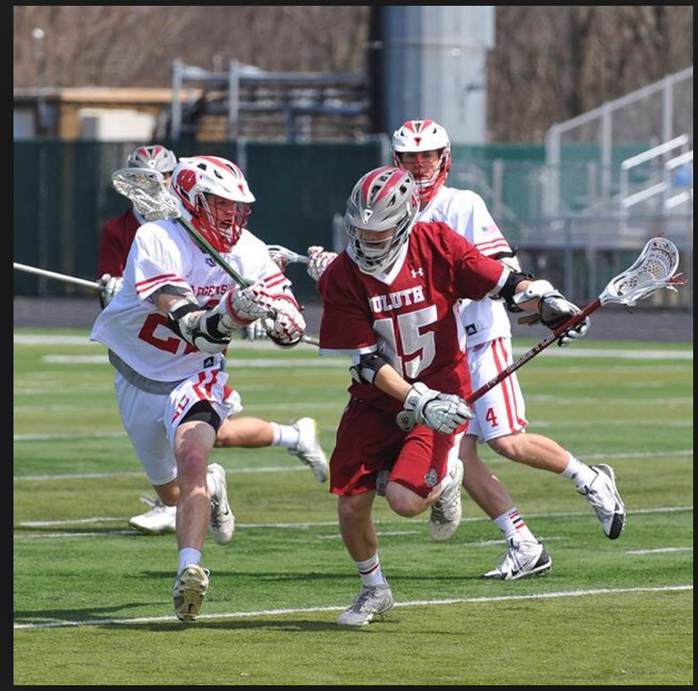
Brett Applegath
Head Coach
UMD Lacrosse 2011-2015
Century Assistant Coach 2016, 2017
Century Head Coach 2018 - Present
2011 Century High School Graduate
Awards: 2013 UMLC D1 All conference D mid, 2014 UMCL D1 All Conference D Mid

Slide 4
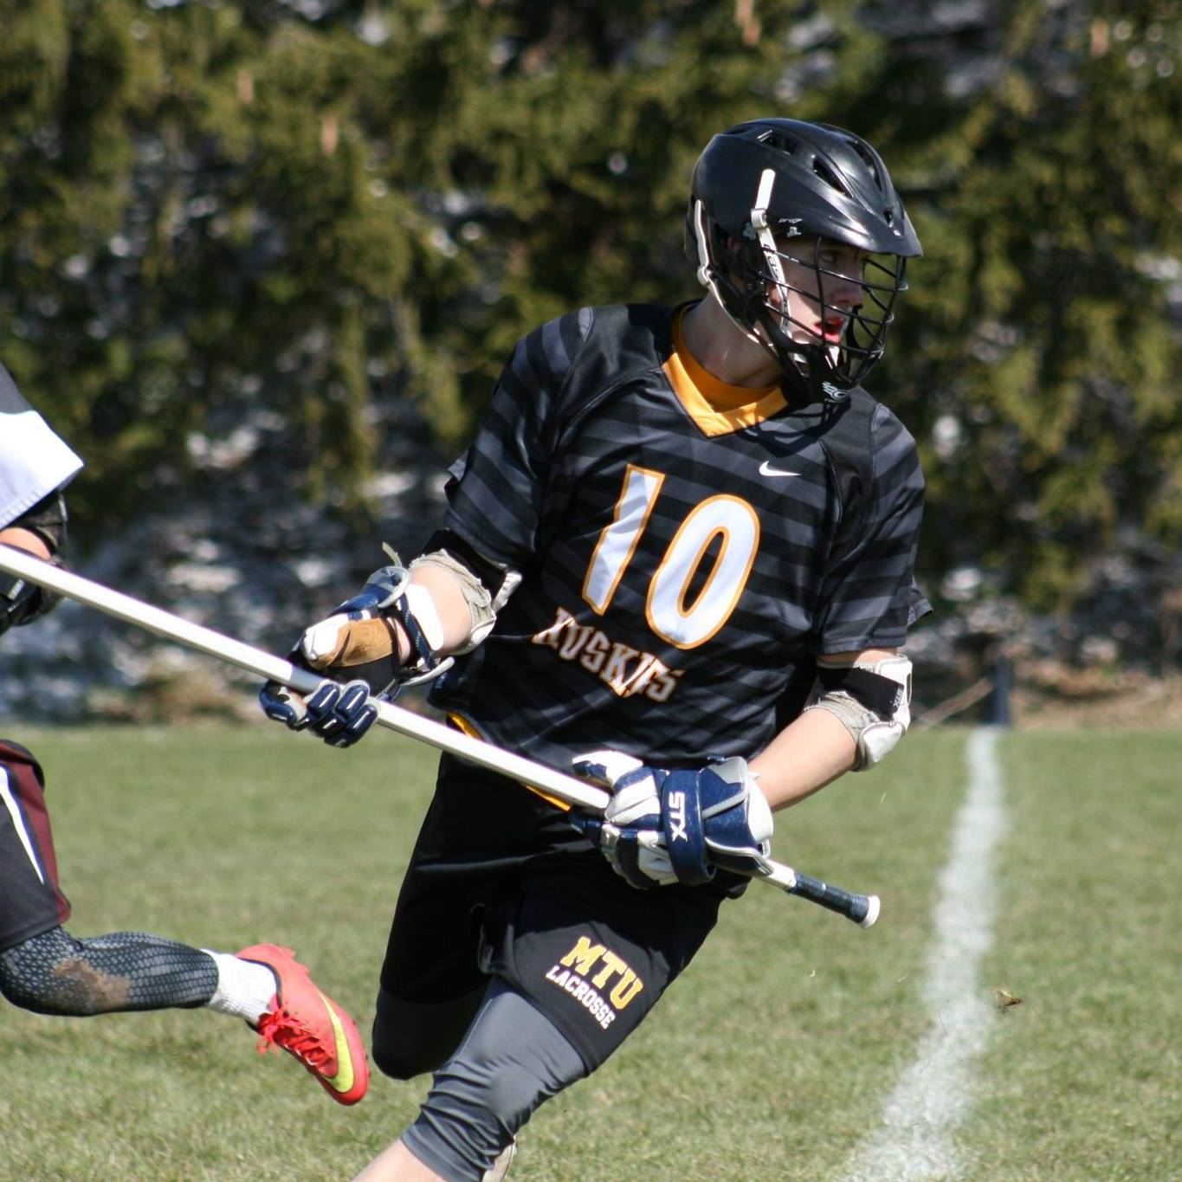
Nick Waara
Michigan Tech Lacrosse 2013-2017
- Vice President 2015-2017
2018- Present Century Lacrosse Assistant Coach
2014 Century Lacrosse Volunteer Coach
2013 Century High School Graduate
2013 Homegrown Lacrosse Community Leadership Award
Century Graduate 2013

Slide 5
General Info
Practice Begins (4/5)
Practice Regular Season Century High school
  Century High School (3:30PM-5:15ishPM) If weather is bad practice will be called by 2:15PM
  Weight room Schedule Tuesday and Thursday 245PM to 3:25PM
Cuts/Jv and Varsity teams will be decided in the first 2 weeks of practice.
Issues with Playing time or team placement should be addressed with the coaches by the Players. (We will not return emails from Parents in regards to playing time)
Seniority does not guarantee playing time (Deserving players will Play regardless of age)

Slide 6
General COVID Info
No Food allowed on buses
Please have hand sanitizer in your bag
Bring own Water bottle filled prior to practice
Masks required at all times
Students must check in every day for attendance via QR Code (More to come)
If you have symptoms, please let one of the coach's know. If a student does test positive for COVID 19 the student will go into return to play protocol.

Slide 7
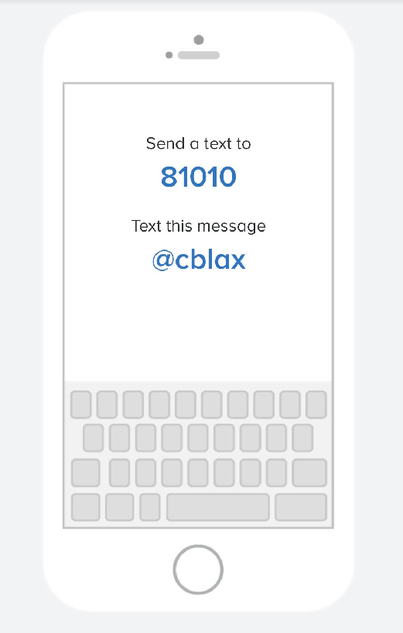
General Info Cont.
Communication
Remind App Link – Http://www.remind.com/join/cblax
How to join

Slide 8
Game Day
Century attire, Bring backup sticks, Water bottles, Jerseys, shorts. (Pack your own bag)
  JV show up 30 min before, Varsity be at the field by start of JV game.
Refer to school Website to check for weather related changes
Players Grades (9-12) are dismissed 15 min prior to bus departure. Kellogg will dismiss 30min prior to bus departure at century. Kellogg students need permission slips for each game.
Busses will return at the Century High school volleyball center
We will not stop for food (bring your own) and no eating on the bus
Travel Release Forms (If fans are allowed to come to games)
  Traveling to and from events with the team is an important part of overall athletic participation. The team building and socialization is a necessary part of this educational experience. Travel release forms should be used only for special family situations that require an exception. Travel release forms are available in the activities office or online & must be submitted 48 hours before an event. No exceptions.

Slide 9
Spring Priorities
Family
School
  will monitor grades and expect players to follow guidelines set by School and MSHSL.
Lacrosse
Everything else

Slide 10
Lettering Criteria
You must complete the season in good standing with the MSHSL, no violations within the past year.
Be academically eligible to play.
Play in half of the quarters available during the regular season at the varsity level(13 games = 52 quarters).
Goalies and limited playing time due to injury may be given special consideration by the coaching staff.
Attendance at practice is expected to earn a letter, more than one unexcused absence may result in a player not lettering.
A player needs to demonstrate sportsmanship throughout the season. Game ejections will result in a player not lettering.
Volunteering with fundraisers/Charities
Coaches’ discretion will be used in all cases

Slide 11
Upcoming events
Practice Starts April 5th
If you do not have your concussion tests completed it is required to be completed before the season starts. Please reach out to Kayla our athletic trainer to get this done.

Slide 12
Club Business
If you are not getting emails be sure to send your information to Kari jk3bbj@hotmail.com
Please fill out a contact sheet and email it to Coach Applegath https://www.centurypanthers.org/page/show/6257298?subseason=739813&tab=content

Slide 13
Contact information
Brett Applegath
Cell (507-269-2256)
Email BRAPPLEGATH@rochester.k12.mn.us
Nick waara
Cell (507-993-4269)
Email nwaara4@Gmail.com

Slide 14
Questions?

