Slide 1
2025-2026 PLSC Manager Meeting
Melissa Becken – Director of Operations

Slide 2
Introductions
Melissa Becken, Lead Administrator
Started in 2021 with PLSC as Lead Admin. I have been with the involved with the club since 2005. I was the Rec Administrator for 5 years and have managed competitive teams for 8 + years. My two kids have been through with the Club from age 4 through U19 and well as Prior Lake High School graduates and Varsity soccer team players.
Aidan is a 3rd year Medical Student at Creighton University School of Medicine. He graduated from St John’s University in 2023 and was a 4-year member of the Varsity Soccer Team earning 2 All-American Awards. Ellen graduated Gustavus Adolphus in 2025, was a 4-year member of the Varsity Women’s Soccer team and is a current coach here at PLSC as well as the Operations Coordinator at Twin Cities Soccer League.

Slide 3
Team Manager Code of Conduct
Prior Lake Soccer Club Managers Code of Conduct
• Always keep the best interest and wellbeing of the player/child as the highest priority.
Extend a welcome to all parents and get them involved.
• In both victory and defeat, the behavior of the manager shall model grace, dignity and composure.
• Treat referees with respect. Adhere to PLSC’s Zero Tolerance Policy regarding yelling/abusing referee.
• During the game you are to sit on the parent sidelines (not on the team bench-unless directed by the coach).
• Managers must develop an appropriate working relationship with the coach(es) based on mutual trust and respect. Meet with Coach to discuss your role and their expectations.
• No coaching the players from the sidelines. Let the coach(es) do their job and not confuse the players by “sideline coaching”.
• Adhere to all rules and policies set forth by the club.

Slide 4
Zero Tolerance Policy Referee Abuse Referee Shortage
Zero Tolerance Policy
All individuals responsible for a team and all spectators shall support the referee. Failure to do so will undermine the referee's authority and has the potential of creating a hostile environment for the players, the referee, and all the other participants and spectators. Consequently, PLSC has adopted the following rule:
1. No one is to speak to the referee during or after the game. Exceptions: Coaches may ask questions before the game, call for substitutions and point out emergencies during the game, or respond to the referee if addressed.
2. Absolutely no disputing calls, during or after the game, no remarks to the referee to watch certain players or attend to rough play. NO YELLING at the referee, EVER, and no criticism, sarcasm, harassment, intimidation, or feedback of any kind during or after the game.
3. Violators at PLSC games may be ejected and are subject to disciplinary action by the PLSC Executive Board.
4. If coaches have questions regarding particular calls, rules, or a referee, or wish to give feedback regarding a referee, please contact Tyler Dalsin at MAT assigning – tyler@matassigning.com

Slide 5
Safe Sport and Background Check Requirements
What is the Safe Sport Act? Created in 2017 in reaction to the abuse found in various youth sports, including USA Gymnastics, the SafeSport Authorization Act creates a new standard of care that expands existing mandated reporter laws to all youth sport organizations across the nation. 4 annual requirements
Background Check- We purchase these for you. Use code given when submitting your background check
Safe Sport training has a refresher yearly in both MYSA and US Club. This is done under the Safe Sport Organization. It is a video presentation with a short quiz after each section
Adverse Eligibility List Review
Staff Registrant Annual Certification

Slide 6
Two Adult Policy Practice Parent
In keeping up with the Safe Sport Act of 2017 all outside practices need to have at least two adults present including the coach
Set up a sign-up genius or RSVP through Sport Engine to send out to parents to sign up if a team only has one coach
If you are not able to get a 2nd adult to attend the practice, the practice must be canceled
Does NOT count towards the Club volunteer requirement.

Slide 7
Soccer League
All of our teams play in the Twin Cities Soccer League ( TCSL). 45 teams are playing in 2025-2026 TCSL league U8 through U19.
TCSL was formed in 2017 from a desire to have more options for metro teams to play each other. This league was formed with the requirement that all team games will reside within a 35-mile radius of the MN United FC stadium in St. Paul.

Slide 8
Soccer Technology
US Club Soccer – uses Got Sport as the National Database for all US club soccer players. Staff ( adults) & Players will all need approval through this system before playing in league.
Got Sport – this is the administrative and scheduling platform for all TCSL leagues and events. You will have an individual account. This is where you manage schedule, access schedules and club pass players. You will use your own Got Sport personal log in to access team – not team log in. DO NOT CHANGE TEAM NAME IN GOT SPORT!
SportsEngine- Team Calendar and Communication Sports Engine App
Athlete One – Team Management for ECNL-RL (inaugural leaue2025)

Slide 9
Player Documentation & Info Needed
Birth Certificates – we have contacted all players families at this point. Players need this on file to play with the club.
Pictures for player and coach/managers – Please load in got soccer. Most should be up to date. Please upload your own photo, if you have not submitted one.
US Club Medical Release forms - a copy for you and a copy for coach. A full set should be with coach and manager in case of an emergency. This is private data - please do not share info. I will email these to you soon.

Slide 10
Check your access to your team page. All players families should be able to see team page. They need to be logged into the Sport Engine account that they signed their player up with for this season.
Must use Sport Engine for team management. The calendar is used for all player RSVPs and field reservations. Keep up to date as we look weekly for season field management.
Keep as much info on this site to reduce your workload
Show parents how to set up easily to use RSVP & download to their phones- SportEngine App
Managers can grant guardianship on their accounts so that other adults can follow the team.
Use the blue help button on SE to ask all help – live help and lots of articles.
SportsEngine

Slide 11
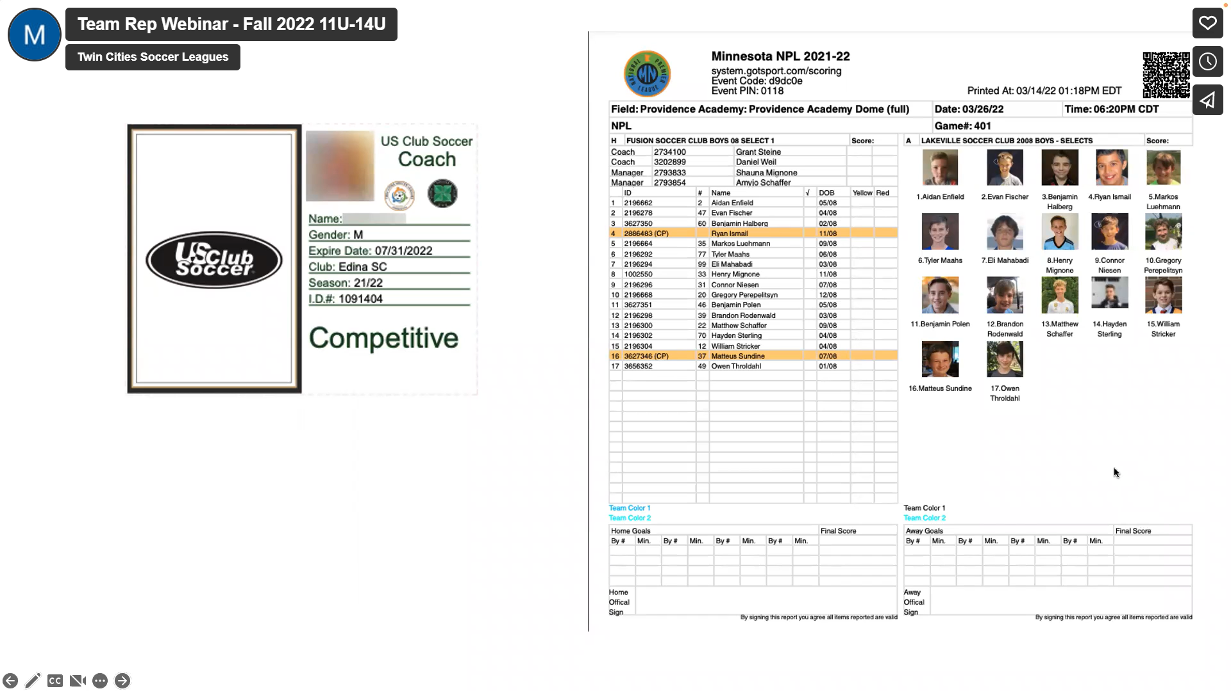

Slide 12
Volunteer
Requirements
Volunteer deposit is $200.00 This will be charged on 6/15/26, unless you complete your volunteer hours.
We will credit those that fulfill their hours after 4/15/26
We will have had opportunities with Fall Recreational Clean up, ADT, Futsal and F3 Tournament. Most of these opportunities are less than 3 hours, but will cover the requirement. It is 3 hours per player, so some families with multiple players will have to volunteer more than once.

Slide 13
Uniforms & Optional Apparel
We have new full uniform kits for 2025-2026 (same style).
Players for spring will receive one kit . Blue & White Jerseys, Navy Shorts and 2 pairs of socks – white and navy.
New players that have just joined us will get uniforms from our extra inventory.
We will maintain extra inventory of jerseys, shorts and socks. These are available for an extra fee.
Uniform Numbers – will need to be updated in Got Sport.
HOME Kits are NAVY JERSEY/NAVY SHORTS/NAVY SOCKS
AWAY Kits are WHITE JERSEY/NAVY SHORTS/WHITE SOCKS

Slide 14
There are links to Tournaments on the Manager Page of our Website.
Manager Page is under “My Role” on main tabs
Players/Families will split any tournament(s) fee. Will need to collect from families. Collecting upfront may help with these payments.
Out of Town Tournaments - Your Coach(es) do get a travel stipend for Out-of-Town tournaments. Coach hotel accommodations and airline ticket should be covered by the team. If Coach is driving themselves by car, gas used to and from should be covered by the team. On top of accommodations, Coach also receives $45/day, regardless of when they arrive. You should collect this from families as part of the out-of-town tournament fee. This is for Out-of-Town tournaments only.
Please review all Check In requirement for all tournaments and what they need to see when you check the team in. We will not need laminated player cards for league games. Some tournaments will want laminated player cards. You are able to download your own PDF of player cards from Got Sport, if you need to upload them. If you need laminated cards, I can laminate them for you. Please look over requirements with plenty of time before the tournament, so we can get those items produced and picked up.
$250 Fall and $500(u9/u10) and $800(u11-u19)Tournament Stipend to use to cover Tournament fee. Please fill out Tournament Reimbursement form.
Tournaments
Travel Stipend

Slide 15
Finances
There is a Tournament stipend. The Reimbursement form is on the Manager page under the “My Role” tab.
Plan ahead – collect from families at the beginning of the season.
Use Venmo or PayPal.

Slide 16
League Schedule
TCSL League Schedule -
Got Sport is league software for game management– schedules and rosters will be handled here. You will find your team under your individual account. No more team pages or team log in.
March 24th - teams will get their schedules via Got Sport
You will have until April 8 to reschedule your regular league games . Wes will send an email regarding procedure. Try not to reschedule! If rescheduling, try and stay on playing night as set forth by TCSL.
Got Sport is where you score games and communicate with opposing team. Need up to update the pictures in here with new headshots of players. Most have been updated.
TEAM BLACKOUTS - have already been entered for Spring 2026
League Webinars – April 2 – see email to RSVP
WEATHER- Announcements will be made by 3pm. Storms that pop up after that time will most likely mean a gametime decision on playing or not, which means team will still go to the field.

Slide 17
Upcoming Events
Spring League – can begin April 27th TCSL U9-U19 Games to be done by July 2 (per initial schedule) ECNL- June 15, NPL – June 22
TCSL Summer Festival U8/U9/U10 June 27-28 Final Four – U11-U19 by invitation July 10-July 12 may opt out
^{Summer Camps}
^{Tryouts} ^{U8-U12 July 13-15} ^{U13-U19 July 25-29}

Slide 18
Make sure parents are can see calendar and getting communications, remind them to RSVP to practices and games.
Set up calendar in Sports Engine.
Get the practice parent schedule set up if you are a single coached team.
Coaches have been informed not to reschedule if at all possible and, if you need to, stay on your playing night.
Print game sheet for each game and bring to game.
Optional ideas – End of Season event, Team photos.
Things to do

Slide 19
Helpful Links
Twin Cities Soccer League Team Manager Page
https://www.tcslsoccer.com/resources/team-managers/
This link will bring you to the TCSL Team Manager Page where you will find information on:
Game Day Procedures
Reschedule Procedure
Club Pass Procedure (adding a guest player to your game sheet)
How to print a Game Sheet/Match Card
How to print official US Club passes/roster – not needed for TCSL League games

Slide 20
Questions?
Questions:
Wayne Metcalfe fields@priorlakesoccer.org
Fields, Reschedules
Kari Ornes ExDir@priorlakesoccer.org
Coaching/ Team related questions and concerns Sub players for games
Melissa Becken admin@priorlakesoccer.org
Team & Player Administration, Got Sport, SportsEngine, Registration, Volunteers, Uniforms

