Slide 1
Rocket Spirit Award
Yearlong competition among NHS teams

Slide 2
Goals
Increase team unity
Improve NHS culture--students supporting each other
Incentivize participation at NHS and SALT events (reduce code violations--give kids things to do)

Slide 3
Point categories
Rocket Spirit Events (1 per team/activity)/Rockets Supporting Rockets
Academic achievement--team GPA, etc
Community Service
Team performance
SALT events--participating in SALT events as a team, and winning competitive SALT events

Slide 4
Fall Rocket Spirit Events
9/6 Cross Country Invite
9/9 Boys Volleyball
9/12 Girls Tennis
9/17 Girls Volleyball
Any home playoff games
10/4 Football
10/13 Seussical the Musical
10/15 Boys Soccer
10/22 Girls Swim/Dive

Slide 5
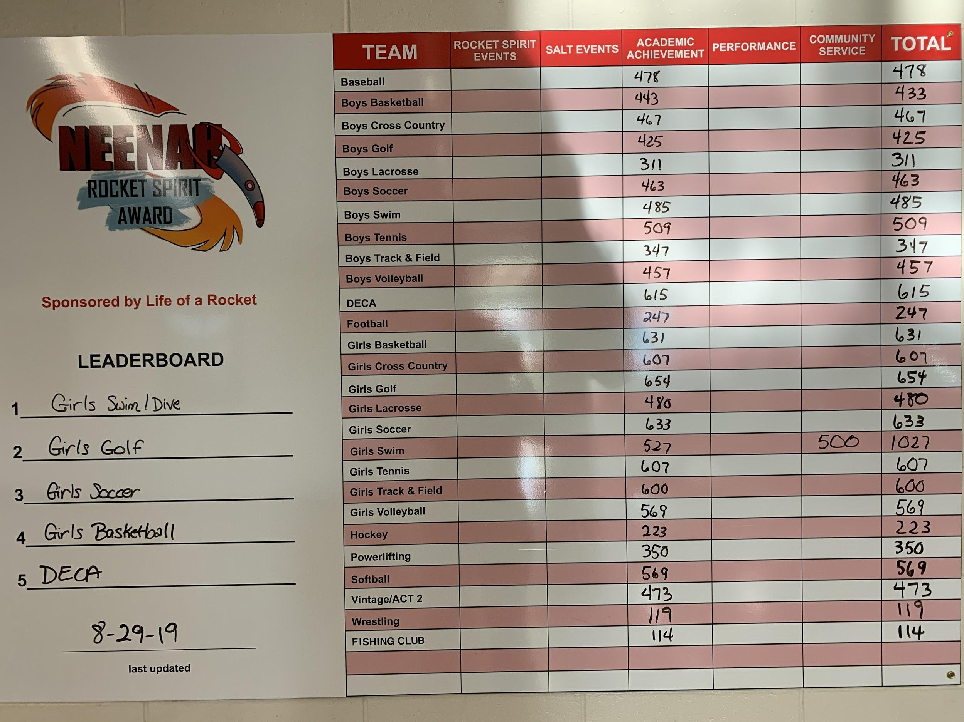
Leaderboard (outside Activities office)
Updated weekly
or as needed

Slide 6



Bulletin Board--coming ASAP

Slide 7

Next steps
Send email to your teams to download the Spirit App
  Link for Android phones
  Create account, Join ONLY groups you are IN
  For students, not for parents
If you would like access to the App to see your team’s points, individual points, or send messages, let me know.
Pictures for posters--FB group or email to me?
Community Service Google form to complete--on Schoology page
Send Tracy your rosters ASAP if they are not yet in IC.

