Slide 1
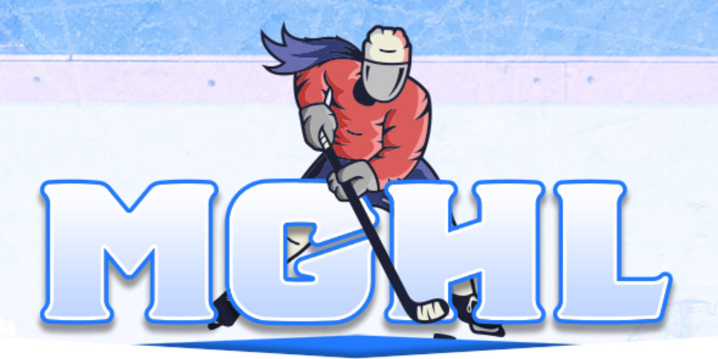
MGHL 8U Getting Started
Mike Buell – MGHL 8U Director
Late Jan 2025

Slide 2
The Need for 8U Part 1
Coed programs are largely “boys” programs
A girl may start at 6U (mini mites) and enjoy the game
Moving up to 8U as the younger age group can be very difficult
Older age group boys may have 3 years of experience
Many focused / well-behaved boys move on to travel (AAU), remaining boys may be disruptive and play especially rough
Not all boys like playing with girls on their team
Not many girls will be on the team
It can be especially tough for a girl that starts in 8U, as she’s playing against boys that often have much more experience
Will likely lose some girls through this route (my 2015 daughter would have stopped playing)

Slide 3
The Need for 8U Part 2
Many organizations struggle to start all-girls at 10U
Without a feeder program, start with only a few players (coach’s kid) and need to steal from existing programs (coed + all-girls)
Teams often end up without enough players and need to fold, leaving families scrambling for a team
Other times, need to “fill in” numbers with 8U (and in some cases 6U) girls, which puts those players and the team in a situation where they are unlikely to succeed
Example – There may be some 2017 (first year 8U) playing 10U Tier 3, which probably isn’t the right fit.
Girls will have the most fun and find the most success playing at their age group, where the skill and maturity levels align

Slide 4
Building 8U
Building 8U has many benefits and is relatively easy to do
Cost – allows ice sharing, which saves cost for all
Coaching – 8U players require all basic skills
Scheduling – MAHA + MGHL allows for easy scheduling of season
Pipeline – building 8U sets your 10U teams up for success
One knowledgeable hockey coach with a little parental assistance can easily run an 8U program.
A couple new coaches can run a program with USA Hockey help (CEP Level 1) plus a hockey director / veteran coaching guidance.

Slide 5
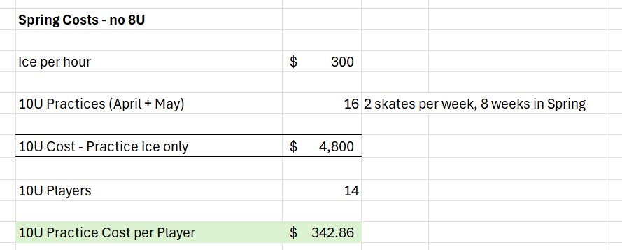
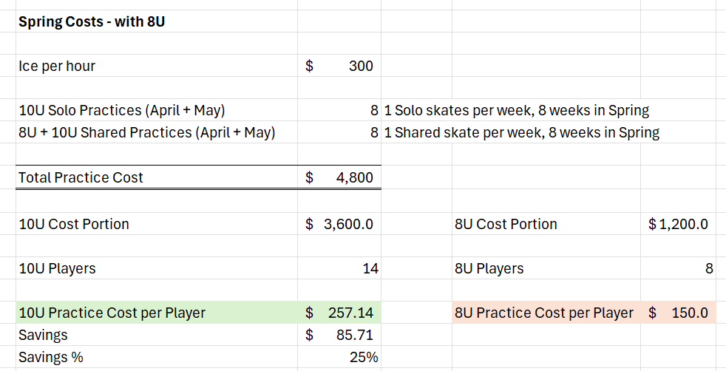
Start in the Spring!!!
You can build an affordable 8U Spring that also saves 25% for your 10U program

Slide 6
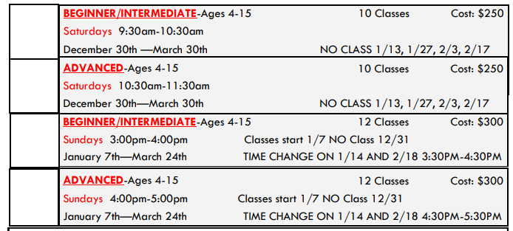
Cost, cont.
$150 for 8 spring practices is very comparable to off-season alternatives (here, Future Wings in Troy). Plus, cost per player goes down as you add more girls!

Slide 7
Coaching
8U is easy to coach, as the girls need work on all basic skills and there are fewer rules / positioning concerns.
Mike’s 8U skill focus (in priority order)
Skating
Skating with puck
Loose puck battling
Passing
Shooting
Positional play
Not Needed
Faceoffs
Offsides
Icing
Power Play / Penalty Kill

Slide 8
Spring Schedule
Spring is light at 8U, not very much is established (no tournaments or jamborees historically)
Practices
Controlled scrimmages where they need to learn line changes, etc.
Established teams are likely willing to host you (even if you don’t have ice for a home-and-home)
MGHL is working on an 8U showcase this spring that will allow full team, partial team, and individual signups
Established teams should try to budget for and support so that this can become an annual event

Slide 9
Fall Season Scheduling (Metro Detroit)
Aug | Sep | Oct | Nov
Practices | Practices Exhibition games Queen City Showcase (Cincy) or Working with MAHA for a Gaylord multi-day jamboree | Practices Exhibition games MGHL Season Start | Practices MGHL Games MAHA Jamboree (some years)
Dec | Jan | Feb | Mar
Practices MGHL Games MAHA Jamboree Holiday 3v3s | Practices MGHL Games MAHA Jamboree Windsor Wild tournament | Practices MGHL Games / Playoffs Traverse City Jamboree Royal Oak Outdoor tourney | Practices MGHL Championship Weekend MAHA States (if they don’t kick you out)
** Out of Town / Hotel Required

Slide 10
Fall Season Scheduling (Outside Metro Detroit)
Aug | Sep | Oct | Nov
Practices | Practices Scrimmage (boys) Queen City Showcase (Cincy) or Working with MAHA for a Gaylord multi-day jamboree | Practices Scrimmage (boys) MGHL Season Start | Practices MGHL Games MAHA Jamboree (some years)
MGHL Affiliate Weekend
MGHL Affiliate Weekend
Dec | Jan | Feb | Mar
Practices MGHL Games MAHA Jamboree Holiday 3v3s | Practices MGHL Games MAHA Jamboree Local: Windsor Wild tournament | Practices MGHL Games / Playoffs Traverse City Jamboree Royal Oak Outdoor tourney | Practices MGHL Championship Weekend MAHA States (if they don’t kick you out)
Early in season – work with Metro Detroit teams to come down for Affiliate Weekends to get full weekend of games Saturday / Sunday
Dec – Mar already fairly full with scheduled events

Slide 11
Scheduling (Alt View)
With MGHL and MAHA events, an 8U schedule is pre-made and affordable
MGHL: $300 entry fee
Oct – Jan Regular Season: Home and Home – 14 games this year
Feb Playoffs: Not Needed this year
Mar: Championship + Consolation for both Upper & Lower Division (all teams)
16 games total
MAHA jamborees: $25 - $35 per player (single day vs. multi-day)
Nov – Chelsea (single day) – Did not have for girls this year
Dec – Plymouth (single day)
Jan – Lansing (single day)
Feb – Traverse City (multi-day)
Mar – Mite State Cup (multi-day)
Other Events my 8U played in this year:
Sep: Queen City Showdown (Cincinnati)
Jan: Windsor Wild tournament (Windsor)
Feb: Royal Oak Outdoor Tournament
All these events plus 2.5 hours ice time per week + jerseys, socks, warmups, helmet stickers, team parties, etc.
$1,800 per girl

Slide 12
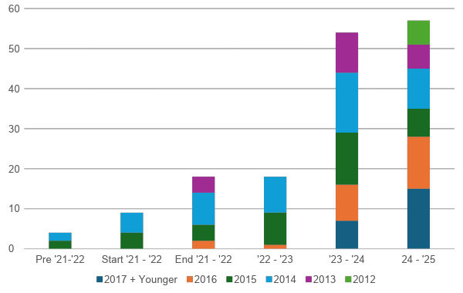
Pipeline
Large growth Year 3 as our initial core 2014 group moved up to 10U.
Speed bump in Year 4 when our 10U Tier 2 team had to fold after Spring due to goalie being poached by Boys Team, leading to loss of 14 girls BY 2014 and 2015 (thanks MAHA for all the help)
Next Year expect 14U (1 team), 12U (2 teams), 10U (2 teams), 8U (2 teams)
YEAR 3
YEAR 4
YEAR 1
YEAR 2

Slide 13
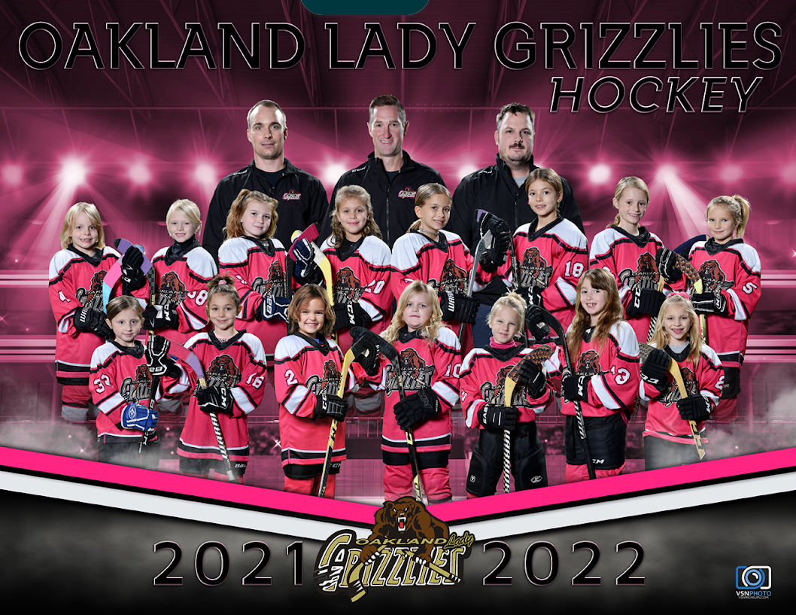
How It Started
Cool stat: 13 of these 15 girls are still playing

Slide 14




How It’s Going
Cool stat: 100% of these girls rock!

Slide 15
MGHL 10U Quick Topic
Mike Buell – MGHL 8U Director
Late Jan 2025

Slide 16
10U Tryouts
Tryouts / Interest Skates for 10U begin March 17th
10U Tier 2
Has competitive tryout where cuts are allowed
Likely about 70% older girls (2015s) / 30% younger girls (2016s)
Almost all have prior full ice experience (10U Tier 3 or AAU)
Goalies can be a challenge as many boys teams are in need of a goalie
Competing with boys travel and 12U teams for players
10U Tier 3
Cuts are not allowed, have interest skates and should accept players until team is full
Likely 30% older girls (2015s) and 70% younger girls (2016s)
Most are brand new to full ice
Goalies can be a challenge as they move to big nets
Competing with boys house and 10U Tier 2 teams for players
Ideally you should not pull up girls from 8U to fill out 10U numbers, that leaves gaps in your association.
Example – Shores pulled girls up to 10U Tier 3 last year and did not have an 8U team. This year, they did not have a 10U Tier 3 team or an 8U team (pipeline depleted)

Slide 17
10U Landscape This Year
Tier 2 Only | Tier 2 + Tier 3 | Tier 3 Only
Fox Motors Biggby Belle Tire St. Claire Shores | Midland Honeybaked Kensington Valley Mt. Clemens Livonia Eastside | Sylvania (Ohio) OJG (2 teams at Tier 3) Grand Rapids Trenton IYHL Shamrocks (South Bend)
Ideally every association would get to the point of having a Tier 2 and a Tier 3 team, although with dual birth year this can lead to hurt feelings that need to be managed

Slide 18
Coaching
10U Coaching is much more difficult than 8U. Reminder that many girls are “rule followers” and over-emphasis on positions will result in girls going exactly where you told them (at the expense of aggressiveness). It will be very hard to re-teach aggressiveness for many of these girls.
Tier 3 - blend of brand-new players (need all skills) and experienced players (have basic skills but need to improve). Keep things simple and avoid judgement calls (i.e. quick defense pinch vs. back out of zone decision will lead to hesitation / doing neither for many players). Must have patience and less emphasis on results.
Tier 2 - you have more skills in place and more full-ice knowledge, so these teams can be coached more like non-beginner teams. However, patience is still needed. Note that for long stretches of the season having the best girl skate the puck will produce better results than passing / teamwork, but eventually that will not work so you should accept the tradeoff early in the season and reinforce passing and puck movement.
Things to Balance:
Skill development (skating, with puck, battles, passing, shooting)
Positional Learning
Minor Structure Systems (breakout, forecheck, face offs, power play / penalty kill, neutral zone play)
Rules (icing, offsides, penalties)
Situational awareness
Goalie Coach will be needed to develop goalies properly

Slide 19
Spring Schedule
There is no league for Spring, but should be easy to build a full spring schedule
Practices
Controlled scrimmages where they need to learn changing on the fly, offsides, face-offs, etc.
Most teams are willing to do home-and-home scrimmages (some weekends ice gets pulled for tourneys)
Tournament options:
Grinder “Pink the Rink” May 2 - 4 … new this year
Elite Amateur Sports “Hockey Fights Cancer” May 9 - 11 … historically very large
MGHL may be working on a showcase for older teams as well

Slide 20
Fall Season Scheduling (Metro Detroit) ** Based on my Tier 3 teams
Aug | Sep | Oct | Nov
Practices | Practices Exhibition games Queen City Showcase (Cincy) | Practices Exhibition games MGHL Season Start Grinder Holland | Practices MGHL Games Silver Sticks Elite Amateur Sports (Muskegon)
Dec | Jan | Feb | Mar
Practices MGHL Games Holiday 3v3s | Practices MGHL Games Windsor Wild tournament Various MLK tournaments | Practices MGHL Games MGHL Playoffs | Practices MGHL Championship Weekend MAHA States (if they don’t kick you out)
** Out of Town / Hotel Required

