Slide 1

400 Meter Training for the High School Coach
Derek Leininger, Ph.D.
Wisconsin Clinic • February 2025

Slide 2

Warm Up and Cool Down
Importance of daily speed development
Ins and outs
Active v. static stretches/drills
Accelerations
Shock the body in warm up

Slide 3
Training Definitions
Percentage Training
Swing downs
Flying runs
Ladders

Slide 4
Slow Down to Run Faster
Decrease speed
Increase volume
Speed progression
Balanced: aerobic and anaerobic development
Myths and misunderstandings

Slide 5
Workout Types
Speed Endurance
Tempo Endurance
Strength Endurance
Aerobic Running
Event Running

Slide 6
200 Meter Repeats
Start high, progress down
Steady progress in speed
Over the course of 2-3 months
Aerobic to anaerobic progression

Slide 7
Overdistance Intervals
Start with 1000s
Progress down to 600s
Steady progress in speed
Over the course of 2 months
2 sets, 10 minutes rest

Slide 8
450 Meter Repeats
Culmination of overdistance intervals
Running fast beyond race distance
Longest interval during the competitive season

Slide 9
350 Meter Repeats
Train to run beyond 40 seconds
Adjust distance for slower runners
350 works for elite male runners
3 sets, 5 minutes rest

Slide 10
Event 300s
300/100, 1 minute rest
Pace through 200, position 200-300, poise 300-400
Start line to finish line
Simulate the race
Practice in different lanes

Slide 11
Hare and Hound
4x300, 5 minutes rest
Hare and hound, two reps of each
15 meters – steady catch by the homestretch
Great practice for 4x4 relay

Slide 12
30/30s
Run a 200 in 30 seconds, standing rest 30 seconds
Most often incorporated into cool down (2 sets)
As a standalone workout -- 3 sets of 3, 3 minutes rest between sets
Adjust time based on 2/3 of 400 race pace

Slide 13
Speed Endurance
Speed Makers
Progressives
100s on the track
Avoid 150s -- prolonged sprinting, no man’s land

Slide 14
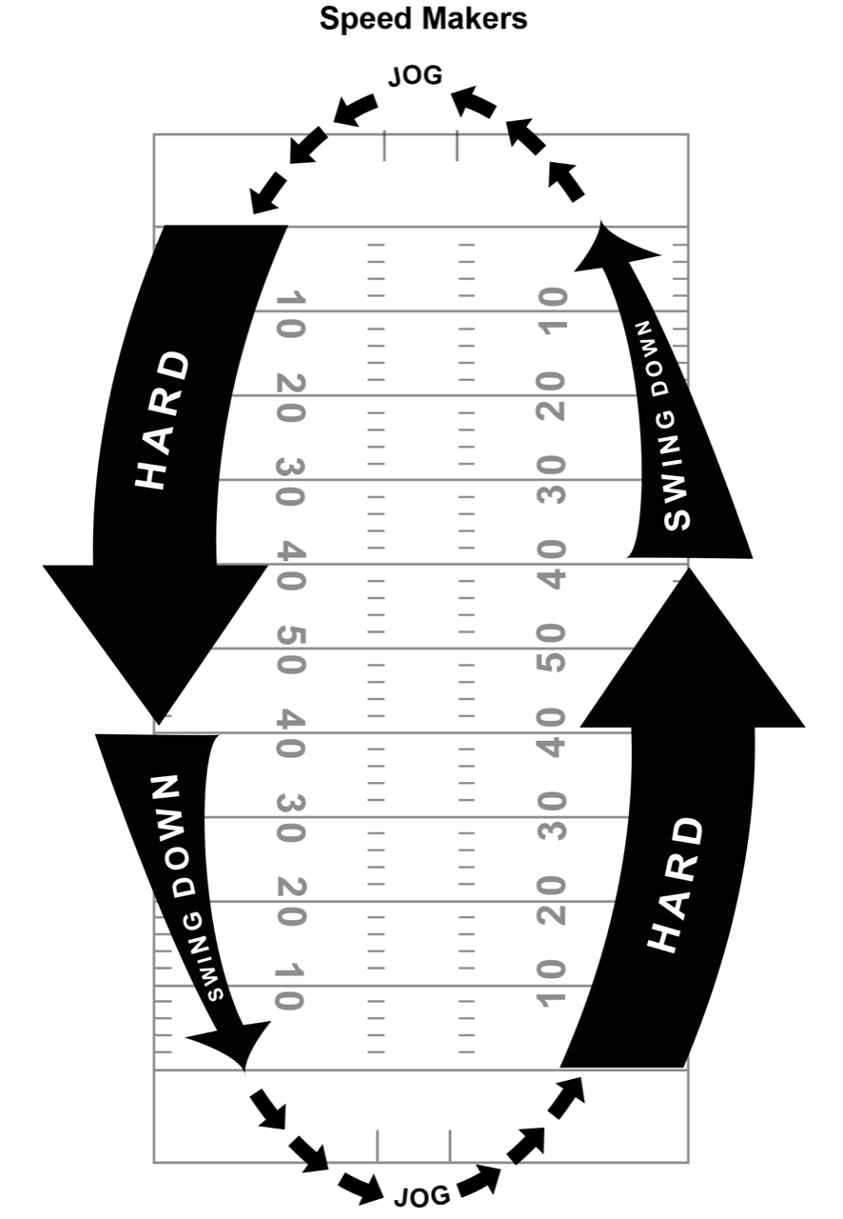

Slide 15
High School Modifications
Late Starters
Reloading Weeks
200s -- start with 10-12
Overdistance intervals -- 800s
30/30s … 2/3 time

