Slide 1






WELCOME BACK TO OUR 2026 SEML SOFTBALL SEASON!
Coach’s Meeting

Slide 2

SEML Leaders
Tom Yungbauer - WAA
softballinhouse@waawoodbury.org
Patrick Anderson - WAA
softballequipment@waawoodbury.org
Alex Tucci - CGAA
Alexandra.tucci@cgaasoftball.com
Amanda Albert - CGAA
Amanda.albert@cgaasoftball.com
Dave Kruschke - ERAA
recsoftball@eraamn.com
Molly Klein - OAA
fastpitch@oaaonline.com
Kyle Kraemer - SAFA
kyle.t.kraemer@gmail.com

Slide 3

Schedules
Released at all age levels by Monday 4/25/26
Home team identified on the schedule
PB1 will have games two (2) times per week after 6/1/26
Make Up Games
Coaches are responsible for rescheduling games
Please work with your Association leaders to determine field availability
Umpires for Make Up Games
Contact Ashley Penniman Softballumpire@waawoodbury.org

Slide 4

Game Cancellations
Coaches will be notified ASAP when Cities close the fields
If a game is cancelled for a reason outside of weather, the coaches must notify Ashley (umpire coordinator) ASAP
Associations will be billed umpire costs for failure to notify Ashley for reasons outside of weather

Slide 5
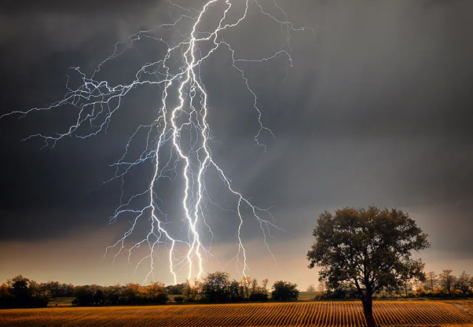
Weather Cancellations
If lighting is present, teams must wait 30 mins and may proceed if there is no lighting present
At MHealth Fairview, Lamar and Grey Cloud, play may begin only after the siren sounds 3 times to indicate an all clear

Slide 6
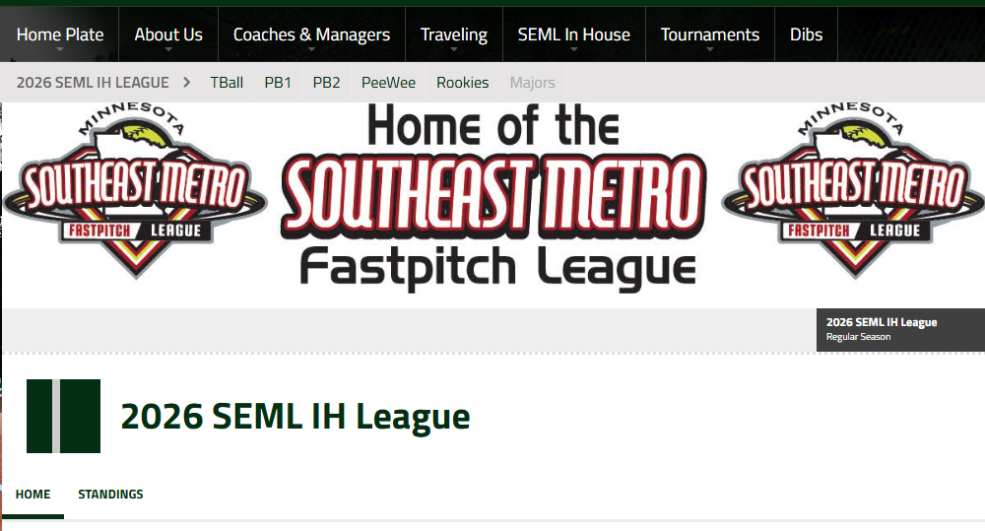
Schedules
SEML hosted at cgaasoftball.com
SEML In House
2026 SEML IH League
All Divisions are listed
To find your team, click your Division
TBall/PB1/PB2/PW/RK
Find your team by Coach Last Name or Color
When schedules are loaded it will be under Game Schedule on your team's page
Unable to access your team page to edit or need to add another Coach? Reach out to Amanda Albert - CGAA

Slide 7
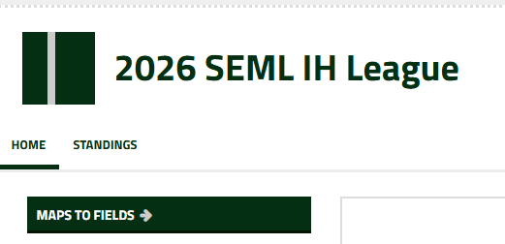
Fields & Scores
Scores for PB1 and up MUST be entered into SE within two (2) days of game completion
How to enter scores -
Sign in enter EDIT mode
Navigate to team page
Select the Game on the Schedule
Far right of screen QS
Update Game Status to FINAL
Enter Scores of both teams
Click SAVE
ANY rescheduled games MUST be completed by 7/8/26!
EDIT the game in SE do NOT create a new game
Field Locations and Maps
Found on the main SEML page

Slide 8
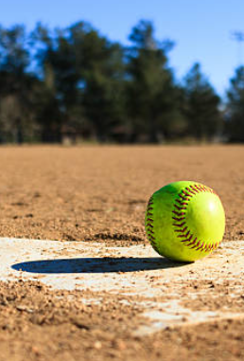
Fields
Contact your Association leader if there are issues with the field or equipment
Chalk: most (if not all) fields will need to be chalked by you before the game, instructions will be sent out for those who do not know how
Make sure all garbage, bottles, equipment, etc. are cleaned up after each practice/game

Slide 9

Umpires
Very Young/New!!
No arguing, no disrespectful conduct or comments
If there is an issue, coaches can talk to the ump between field changes. If the conversation is deemed to be escalating, the ump will end the meeting.
1st issue = warning
2nd issue = out for offending team
3rd issue = an ejection
4th the ump will walk off the field and a forfeit deemed for the offending team
UMPIRES

Slide 10
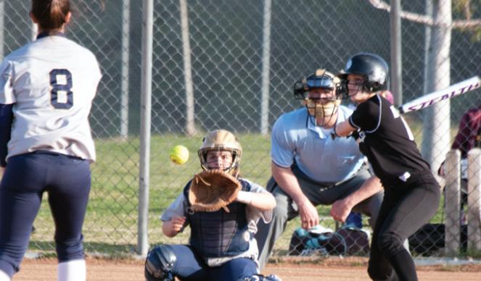
If the assigned umpire does not report their presence within 10 minutes before game time, contact Ashley
If there is misconduct by the ump, please call Ashley right after the game
If bad weather rolls in, take care of the umps please!
If the ump observes lightning, a 30 minute game pause will be initiated
If it continues, the game will be called
Ashley Penniman 651-442-9944
UMPIRES

Slide 11
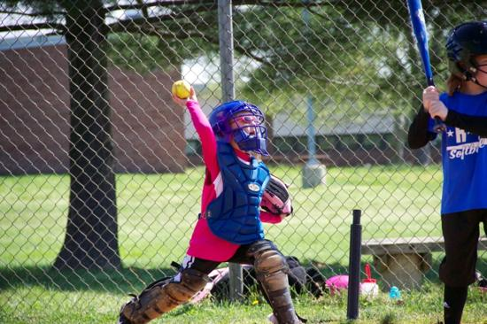
Tball end of season tournament
Saturday June 20th, 2026 at Ojibway Park
^{Games will be in the morning}
Each team will have 1 – 2 games
^{ALL TBall teams participate}
Trophies handed out to all players

Slide 12
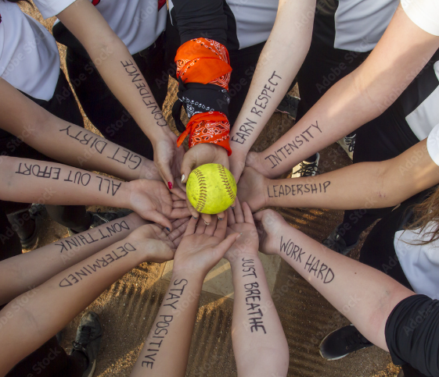
All Star Games
Thursday July 9th at Lamar Fields
Games start @ 5:30 p.m.
Each coach will select 2-4 players (TBD)
Teams will be a mix of players from each Association
1-2 games
Coaches can be nominated or volunteer

Slide 13
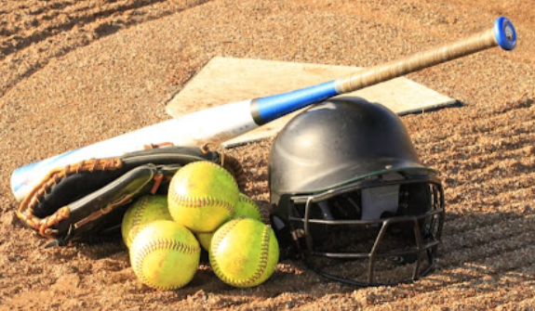
End of Year Tournament
July 10th - 12th, 2026
All makeup games must be done by July 8th!!!
Held at M Health Fairview Sports Center in Woodbury
Games start Friday night
Seeding based on season record
Umpires picked based on coach reviews/feedback during season
PB1 & 2 Semi-Final and Championship game(s) will have umps
Structure PB1 – Double Elimination PB2 – Pool Play to Single Elimination PW – Double Elimination RK – Double Elimination

Slide 14

Rules
General Reminders
TBall
Pitchball 1
Pitchball 2
Peewees
Rookies

Slide 15

General reminders
Rotate Players
Batting order as well as in the field
This is a developmental league
As long as it's safe, players should be given the opportunity to play all positions
Players must be on the assigned roster
Good Sportsmanship
On and off the field
Fielders' Masks
Batters' Helmets
Tennis Shoes/Cleats

Slide 16
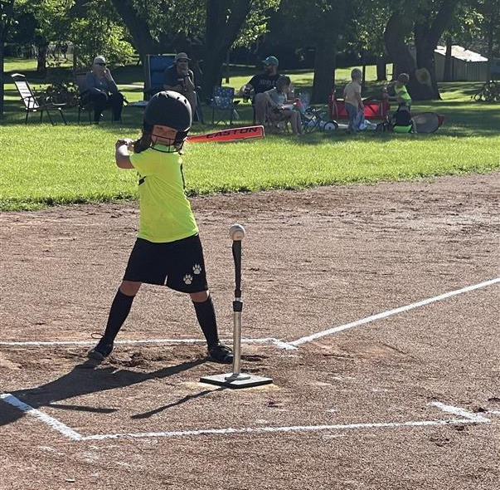
TBall
All players may play in the field at the same time
Players must be rotated in the field
Hit off the tee
Bat the lineup
Can have every player bat
"Home Run Hitter"
Toward the end of the season, it is encouraged to have the coach pitch to players – based on your discretion
REMOVE 10’ arc rule from home plate
Game Start Time: 6 p.m.
Game Duration: 1 hour*
Home team has final at bat
Planned Schedule – 1 game per week for the season

Slide 17
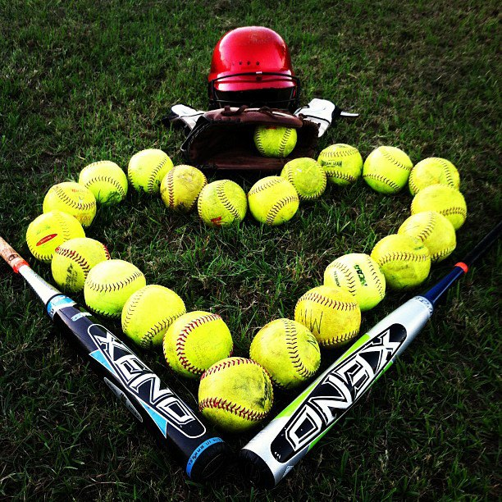
Pitchball 1
10 fielders
Players must be rotated
Outfielders start in the grass
Familiarize yourself with the pitching machine PRIOR to the start of the game
Pitches
First three (3) pitches from the pitching machine
Up to two (2) pitches can be from the coach
Bat the roster (round robin)
No advancement on overthrows
Extra bases only if ball is hit to the outfield
Runner must stop when the fielder MAKES AN ATTEMPT to throw the ball to the infield
MAX of 5 runs per ½ inning
REMOVE 10’ arc rule from home plate
Game Start Time: 6 p.m.
Game Duration: No new inning after 1 hour of game play
Planned Schedule: 6 weeks 1 game/week; transition to 2 games/week after 6/1/26

Slide 18
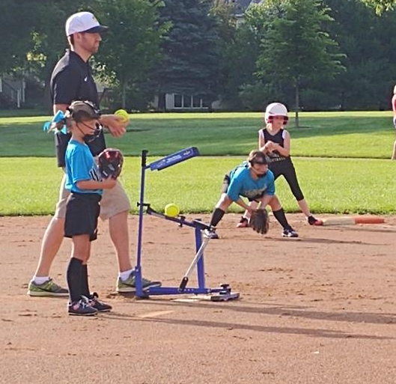
Pitchball 2
10 fielders
Players must be rotated
Outfielders start in the grass
Familiarize yourself with the pitching machine PRIOR to the start of the game
Pitches
Five (5) pitches from the pitching machine
Bat the roster (round robin)
No advancement on overthrows
Extra bases only if ball is hit to the outfield
Runner must stop when the fielder MAKES AN ATTEMPT to throw the ball to the infield
MAX of 5 runs per ½ inning
REMOVE 10’ arc rule from home plate
Game Start Time: 6 p.m.
Game Duration: No new inning after 1 hour of game play
Planned Schedule: 6 weeks 1 game/week; transition to 2 games/week after 6/1/26

Slide 19

Peewee
9 fielders
Players must be rotated
Outfielders start in the grass
Pitcher and Catcher have a max of two (2) innings per game
At least two (2) Pitchers and two (2) Catchers used in each game
Coach pitch after four (4) balls from pitcher
Three (3) pitches from coach unless fouled; no ball in play = batter is out
Coach must pitch using windmill motion
No stealing on a coach pitched ball
Bat the roster (round robin)
Bunting allowed – only one (1) bunt/player/game
Overthrows - Runners cannot advance beyond they base they are running towards
MAX of 5 runs per ½ inning
Game Start Time: 6:30 p.m.
Game Duration: Drop Dead at 8:30 p.m.
Inning not complete; revert to last completed inning
No new inning after 8 p.m.
Planned Schedule: 2 games/week

Slide 20

Rookies
9 fielders
Players must be rotated
Not allowed to play the same position 2x in a game *exception of Pitchers and Catchers
At least two (2) Pitchers and two (2) Catchers used in each game
Outfielders start in the grass
Bat the roster (round robin)
Bunting allowed – only two (2) bunts per ½ inning
Stealing allowed
No stealing on overthrow from catcher to pitcher
Lead off after ball leaves the pitcher’s hand
Can advance home on an overthrow pick-off attempt at 3rd
Batters: must make an attempt to avoid being hit by the pitch
MAX of 5 runs per ½ inning
Game Start Time: 6:30 p.m.
Game Duration: Drop Dead at 8:30 p.m.
Inning not complete; revert back to last completed inning
No new inning after 8 p.m.
Planned Schedule: 2 games/week

Slide 21

Questions?
Reach out to your Association leaders

