Slide 1

MYHA Annual Membership Meeting
2018-2019

Slide 2
Agenda!!
Welcome
LTS/Mite Team Recognition
Scholarships and Donations
Team Recognition & Awards
Annual Meeting

Slide 3
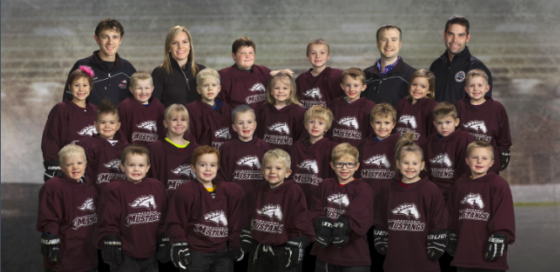
LTS
Coach: Jake Cimino
Assistant Coaches: Travis Olson, Nate Richartz, Dave Schwedler
Brian Gowling, Megan Cummings, Adam Kramschuster
Team Manager: Kate Kramschuster

Slide 4
LTS
Liam Arvold
Emmitt Bailey
Oliver Benedict
Jase Chevatal
Korbin Chevatal
Micah Cimino
Drew Closson
Molly Cummings
Sammie Curtis III
Spencer DeVries
Mason Douglas
Lillian Dowd
Augustus Elkin-Growe
Nora Gowling
Zuma Hazwood
Alex Houle
Bree Houle
Charli Jax
Gauge Johnston
Malachi Kirby
Jack Kramschuster
Noah Kramschuster
Kasey Krueger
Zoey Lomen
Finley Marincel
Braxton Mortiz
Collin Phillipps
Mallory Phillipps
Liam Pierson
Kira Pierson
Hudsen Richartz
Kaylee Roodell
Kenneth Schalte
Ethan Scheler
Lincoln Schemenauer
Issac Schwedler
Lucas Smith
Ethan Williams
Roman Wirtz
Jacoby Young

Slide 5
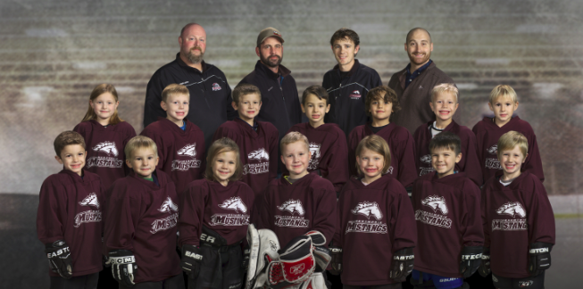
Mini Mites
Coach: Jacob Cimino
Assistant Coaches: Russ Bahr, Josh Delaney, Jesse Andrist
Team Manager: Janelle Johnson

Slide 6
Mini Mites
Steven Andrist
Graysen Bahr
Talon Baillargeon
Baron Blaisdell
Kian Brewe
Madelyn Cimino
Cayden Cummings
Samuel Czechowicz
Lexi Delaney
Hannah Hansen
Kolten Hintzman
Maddux Johnson
Zeke Skoug
Bryson Wayne

Slide 7
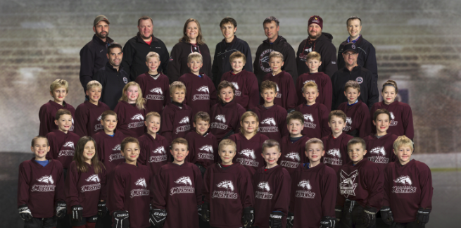
Mites
Coach: Nolan Dowd
Assistant Coaches: Ashleigh Cody, Lewis Bjork, Jacob Cimino, Josh Delaney,
Geoff Pogorelski, Dave Schwedler, Brian Gowling, Bob Weir
Team Manager: Sara Holcomb

Slide 8
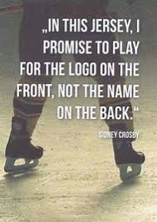
2010 Mites
Leo Foss
Matthew Bertetto
Brekkin Cody
Cashton Steinmeyer
Jaxon Giertz
Scott Holcomb
Landon Delaney
Jack Czechowicz
Remington Wayne
Dillion Kopaczewski
Pearl Swaenepoel
Kaden Farrah
Camden Berthiaume
Sam Smith

Slide 9
2011 Mites
Caz Jax
Aiden Wamboldt
Ashton Wamboldt
Kynlee Hintzman
Issac Cimino
Westen Weir
Eli Schwedler
ZoA Skoug
Franklin Pogorelski
Kinzleigh Cody
Oliver Bjork
Mason Freeland
Tyler Pember
Henry Dowd
Tatum Giertz
Joseph Gowling
Clayton Slupe

Slide 10
Special Recognition
Dale and Fisher Families

Slide 11
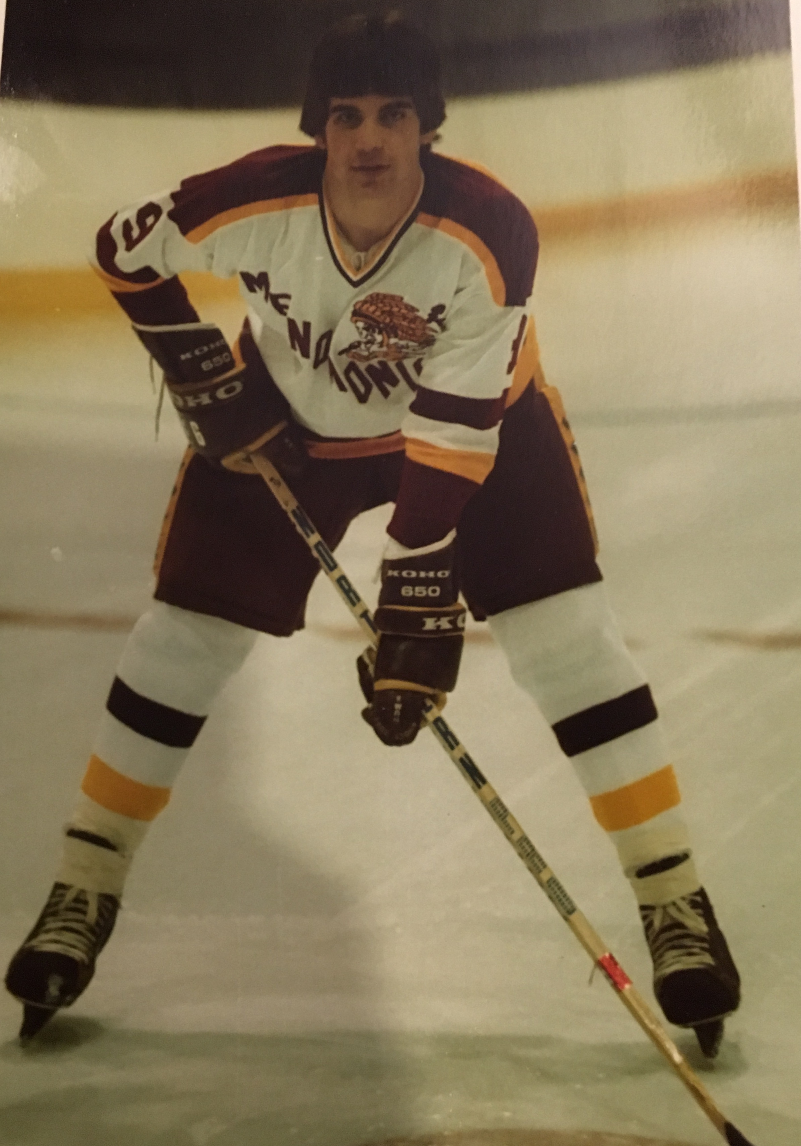
John R Dale Memorial
Youth Hockey Squirt
Scholarship Fund
2018 Recipient
AJ Lawrence

Slide 12
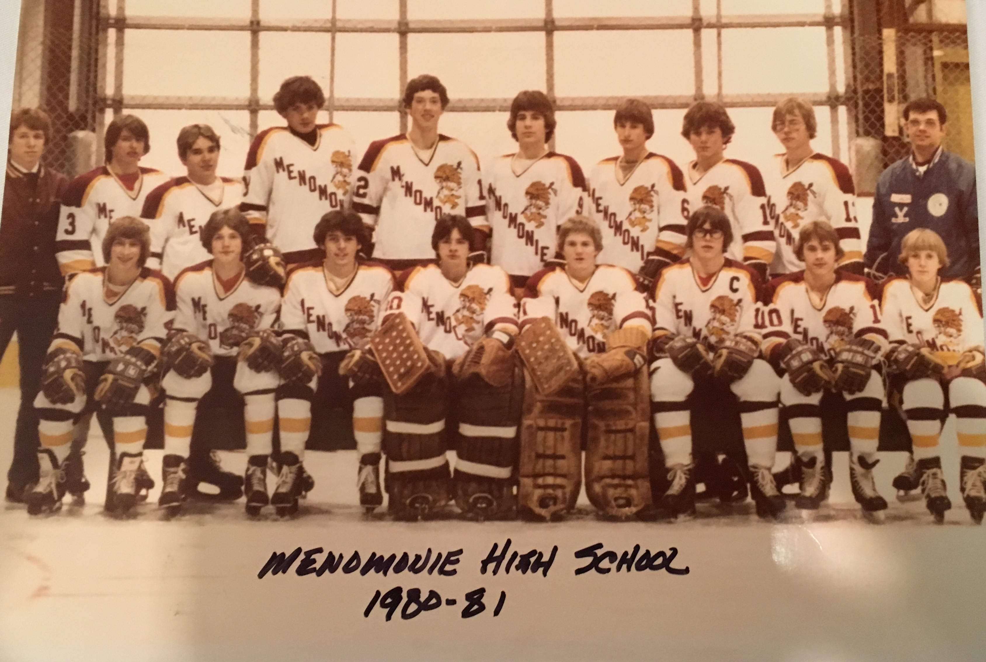
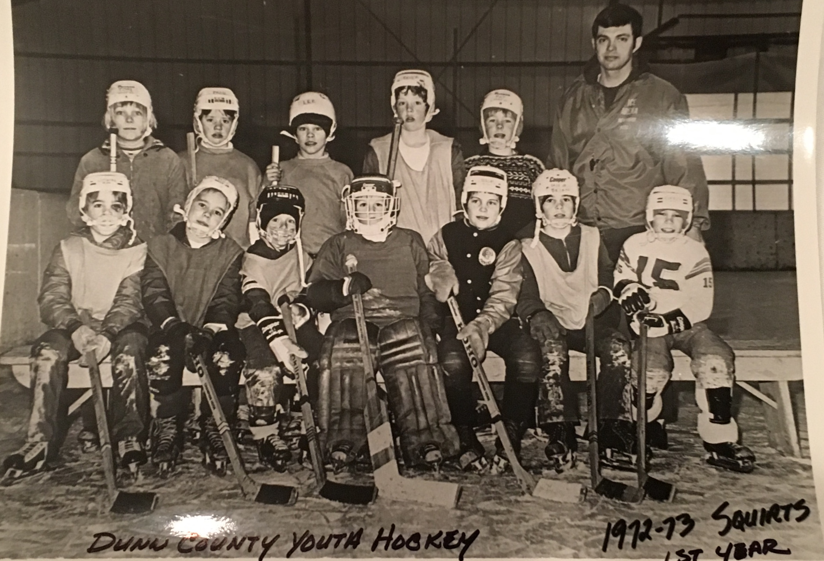

Slide 13
Thank you!
For your continued support of MYHA!
Mike Fisher Family

Slide 14
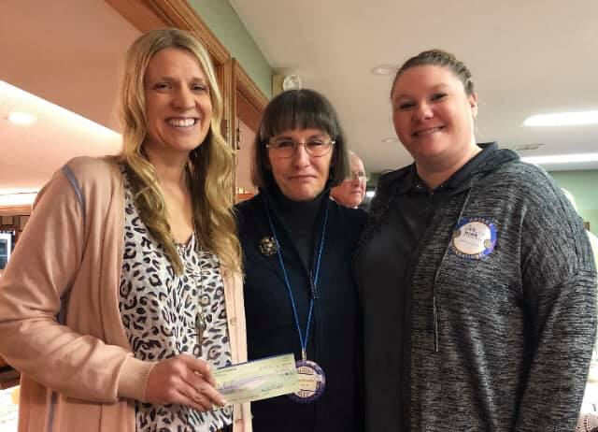


THANK YOU
MENOMONIE ROTARY & MENOMONIE CHAMBER OF COMMERCE!!

Slide 15

Team Recognition & Awards

Slide 16

Squirt, Peewee, and Bantam Awards
Patches
Most Improved Award
Leadership Award
Sportsmanship Award

Slide 17
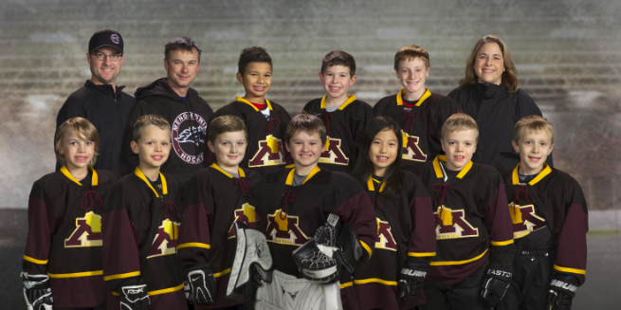
Squirt B
Head Coach: Rhonda Messerschmidt
Assistant Coaches: Nolan Dowd & Brent Pember
Team Manager: Joyce Dahms

Slide 18
Congratulations…
Hat Trick:
  Corbin Cockeram
  Ben Dahms
  Aiden Mork
  Allison Xu
Play Maker:
  Ben Dahms
Zero Patch:
  Edmund Dowd

Slide 19
Squirt B Awards
Most Improved: Aiden Mork
Leadership: Ben Dahms
Sportsmanship: Allison Xu

Slide 20
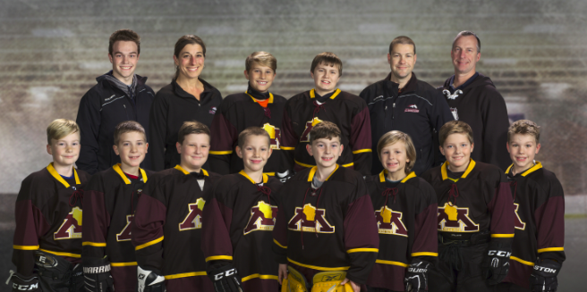
Squirt A
Head Coach: Tom Niska
Assistant Coach: Kyle DeVries, Kalani Swaenepoel, Casey Tilkins
Team Manager: Cassandra Ellis

Slide 21
Congratulations…
Hat Trick:
  Jett Lenfant
  Cooper Marincel
  Oliver Prechel
  Wren Swaenepoel
Play Maker:
  Blake Niska
Zero Patch:
  Davin Ellis

Slide 22
Squirt A Awards
Most Improved: Liam Wachewicz
Leadership: Davin Ellis
Sportsmanship: Wren Swaenepoel

Slide 23
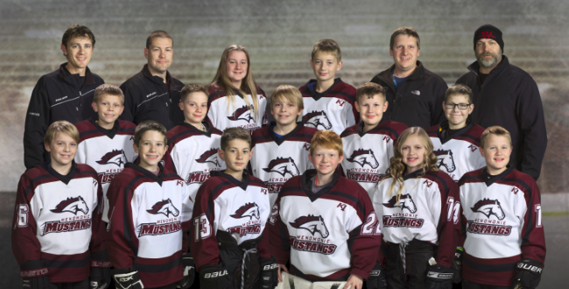
Peewee B
Head Coach: Chad Ayres
Assistant Coaches: Bruce Neverdahl, Kyle DeVries & Jacob Cimino
Team Manager: Margo Neverdahl

Slide 24
Congratulations…
Hat Trick:
  Logan Cockeram
  Mitchell Kopaczewski
  Peter Cimino
Zero Patch:
  Caleb DeVries

Slide 25
Peewee B Awards
Most Improved: Bryce Neverdahl
Leadership: Logan Cockeram
Sportsmanship: Deven Ayres

Slide 26
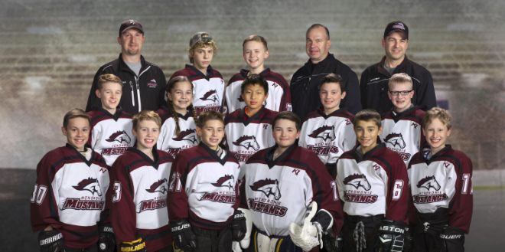
Peewee A
Head Coach: Greg Slupe
Assistant Coaches: Shawn Slind & Bob Weir
Team Manager: Luke Welch

Slide 27
Congratulations…
Hat Trick:
  Parker Marincel
  Colton Szotkowski
  Ryan Xu
  Alex Slind
Play Maker:
  Cody Dahms
  Rex Drout
  Hayden Weir
Zero Patch:
  Carl Rabeneck

Slide 28
Peewee A Awards
Most Improved: Ryan Xu
Leadership: Cody Dahms
Sportsmanship: Parker Marincel

Slide 29
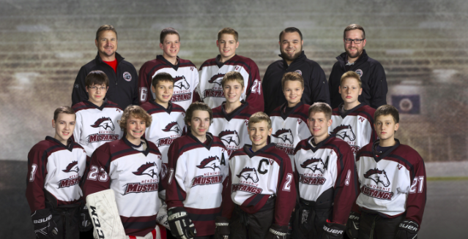
Bantam
Head Coach: Paul Wurtz
Assistant Coach: Max Steuer & Mike Sullivan
Team Manager: Joyce Dahms

Slide 30
Congratulations…
Hat Trick:
  Waylon Rogers
Play Maker:
  Reid Fenton
  Caleb Schneider
  Connor Dean
Zero Patch:
  Jack Drout

Slide 31
Bantam Awards
Most Improved: Caleb Schneider
Leadership: Connor Dean
Sportsmanship: Jack Drout

Slide 32
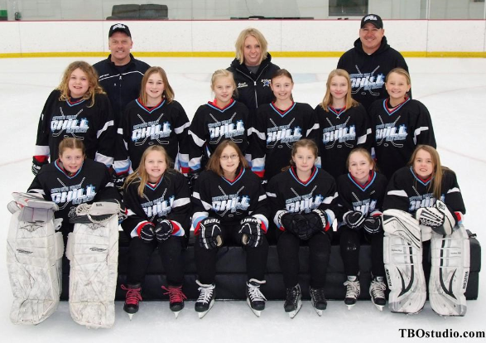
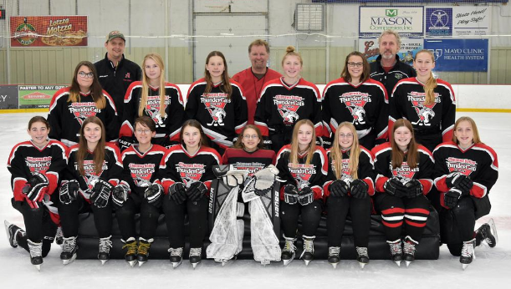
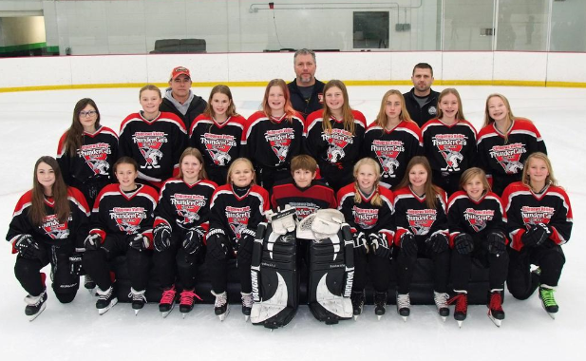
Girls Co-op
10U
  Aubrie Dowd
  Brooke Fenton
12U
  Tessa Leisses
  Addison Sobota
14U
  Rhyenne Furstenberg

Slide 33
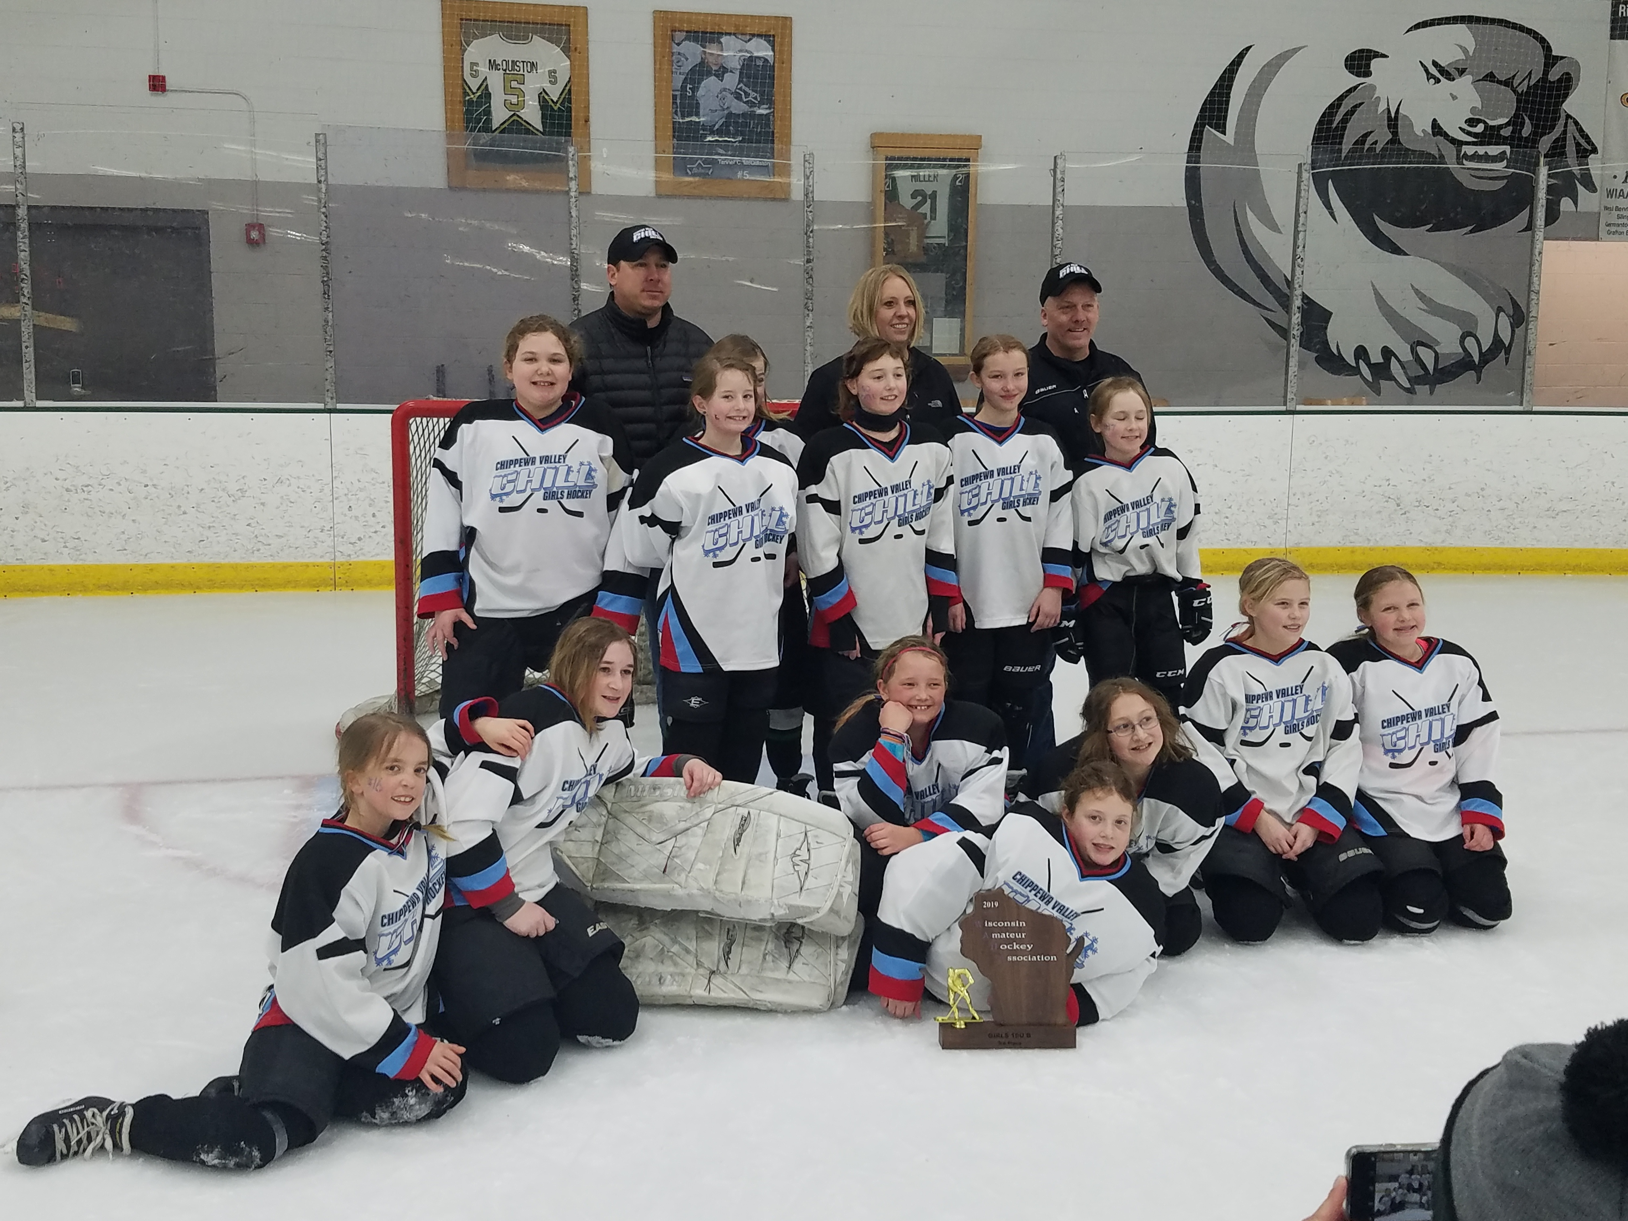
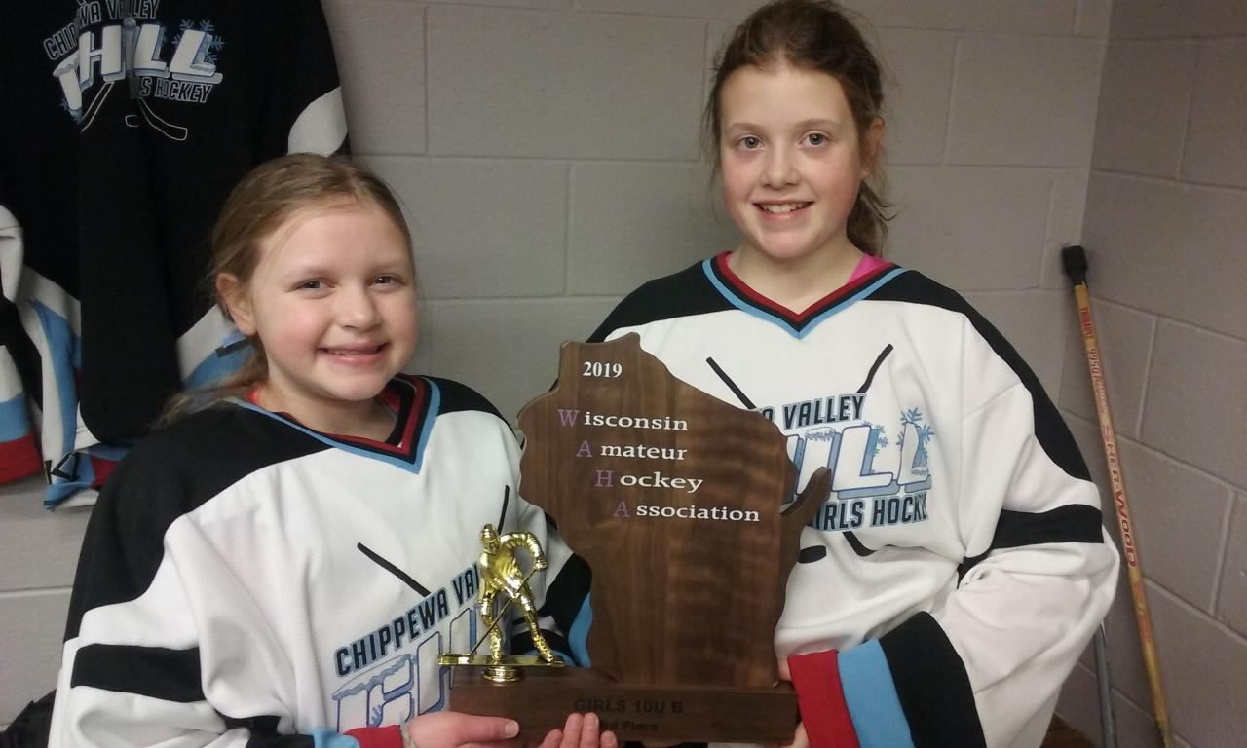
CONGRATULATIONS….

Slide 34

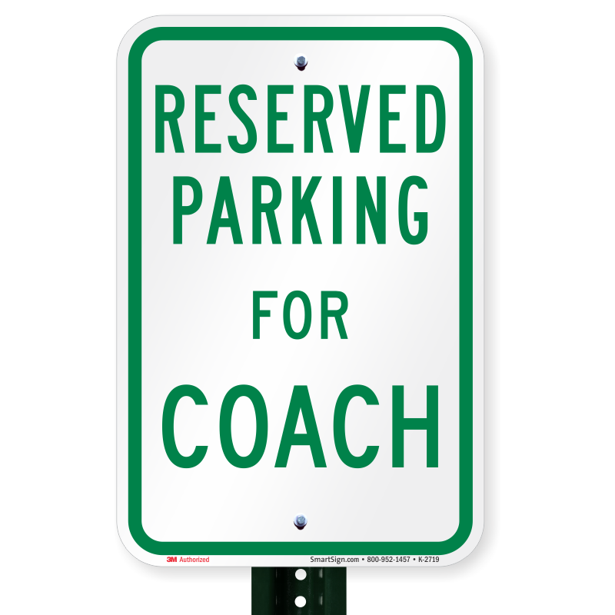
Reserved For…

Slide 35
Member of the Year Nominations
Cassandra Ellis
Glenna Family
Kate & Adam Kramschusters
Heidi Neverdahl
Dave Schneider
Jason Wayne
Troy Wilkens
Congratulations & Thank You to
Dave Schneider
Notes:
Russ

Slide 36
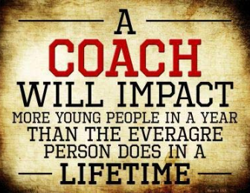
Coach of the Year Nominations
Congratulations & Thank You to
Paul Wurtz
Notes:
Russ

Slide 37

Rob Smith Memorial Award
Rob Smith, who played youth hockey from 1977-1987 and was a gifted and committed athlete.
The criteria used to select the recipient best describe Smith’s ideals on the ice, and include:
  1.) Appreciate and respect your coaches
  2.) Develop an understanding of organized sports
  3.) Learn the importance of team play
  4.) Represent team spirit and good sportsmanship
  5.) Be the best that you can be

Slide 38
Congratulations…
Ashley Slupe

Slide 39
Annual Meeting
March, 2019

Slide 40
MYHA Board Update and Recognition
Coaches & Team Managers
Committees
Register
Board
  Past President – Keila Drout
  Treasurer – Gary Messerschmidt
  Secretary – Adam Wamboldt
  VP General Operations & Registration – Brent Pember
  VP Scheduling & Tournaments – Mike Jax
  VP Concessions – Sara Bahr
  VP Hockey Operations & Equipment – Bob Weir
  VP Communications & Recognition – Kari Berthiaume
  VP Fundraising – Chelse Cockeram
Thank
You!!

Slide 41
Voting:
Board Members
  Welcome Back…
    Stacy Hintzman (President)
    Sara Bahr(Concessions)
    Mike Jax (Scheduling)
  VP of Fundraising Remains Vacant
By-Law Changes
  Terminology
  8 Voting Members (vs 7)
  New Board Positions/Titles (Equipment/Marketing)
  Three Year Term (vs 2)
  <40% Turnover
  Ice Board:
    Voting Rights
    Additional Representative

Slide 42
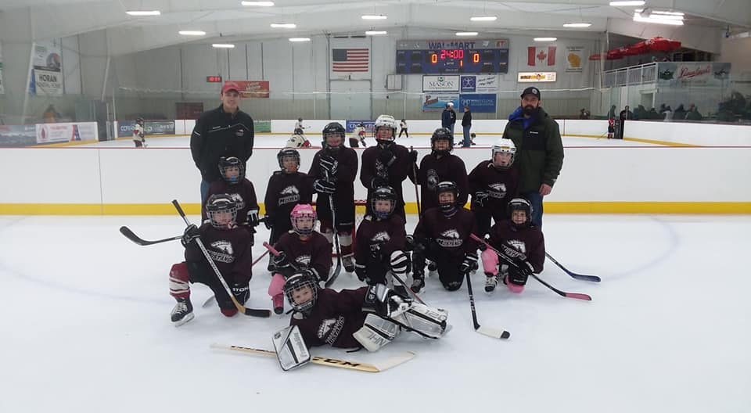
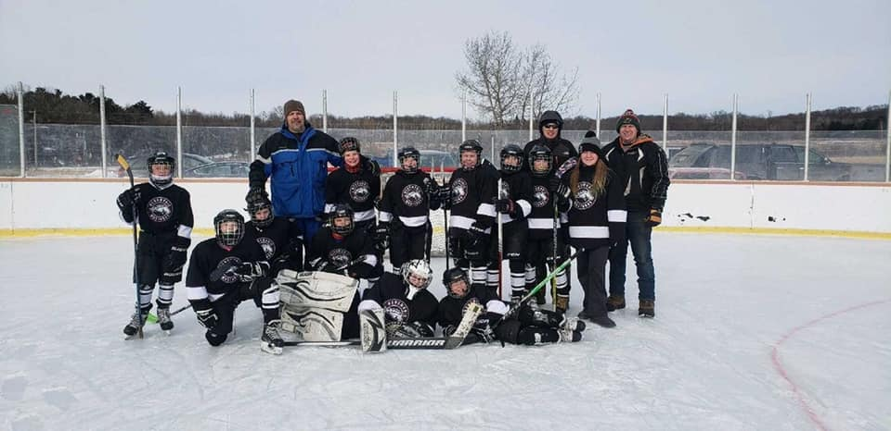
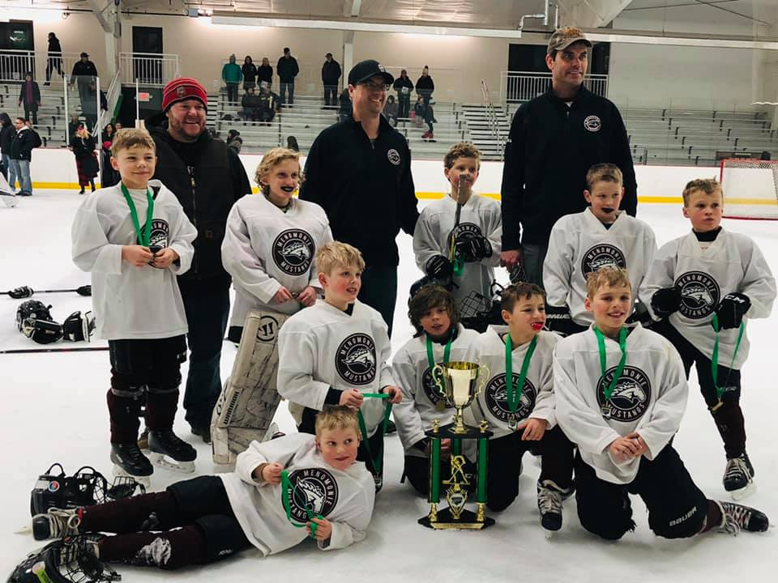
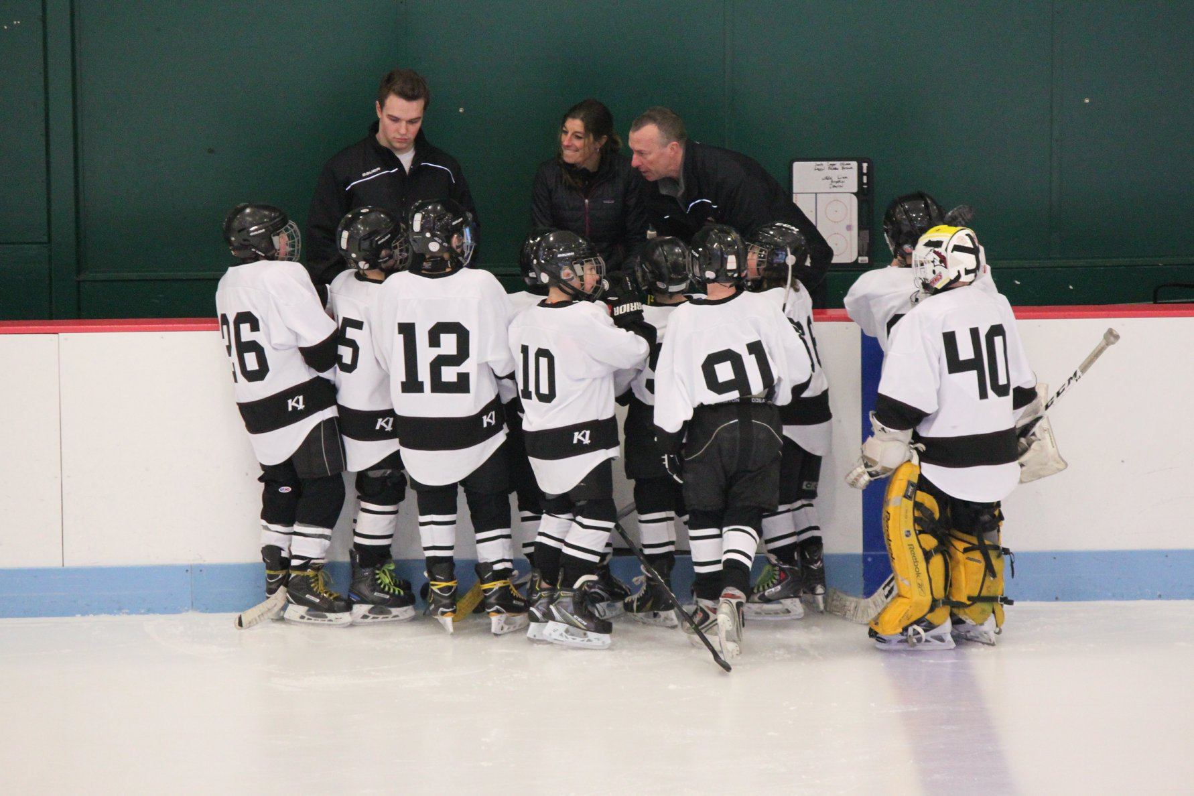
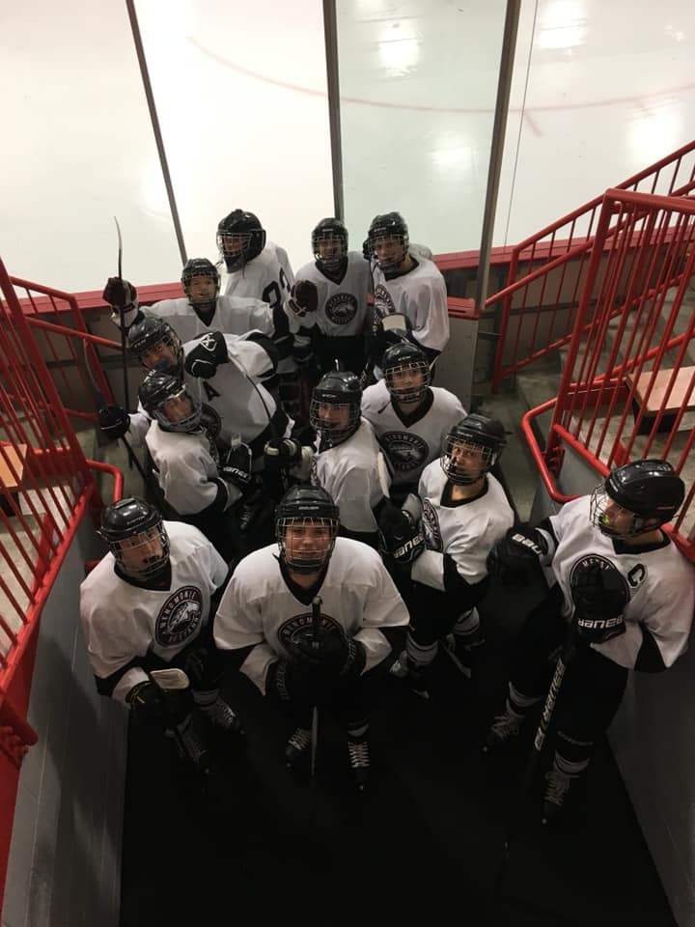
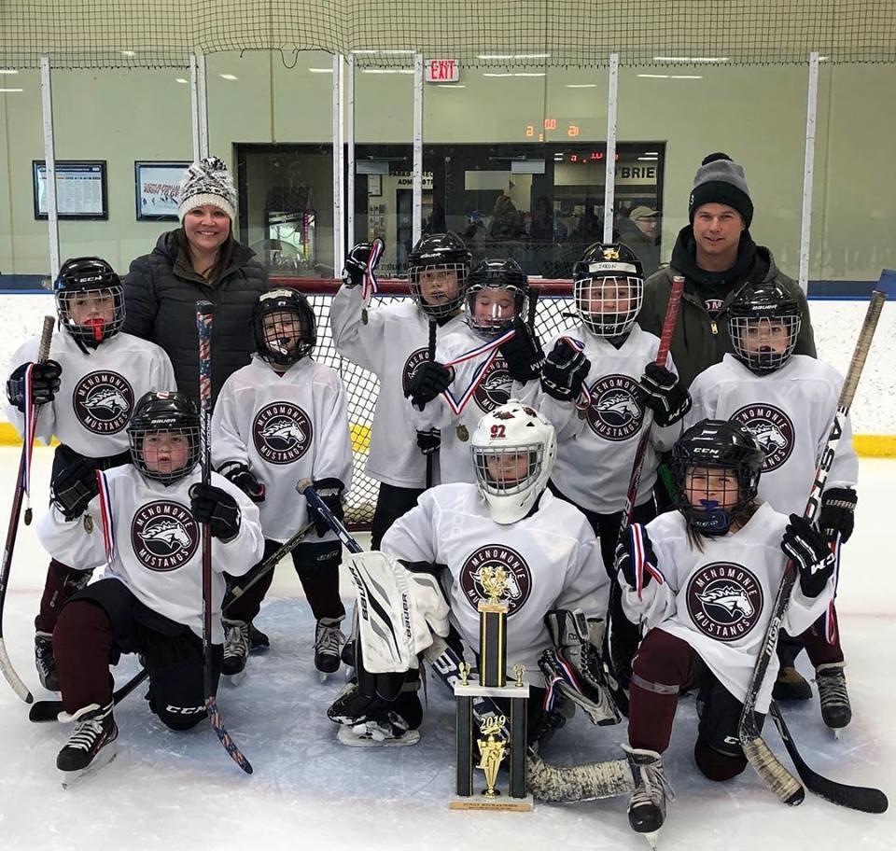
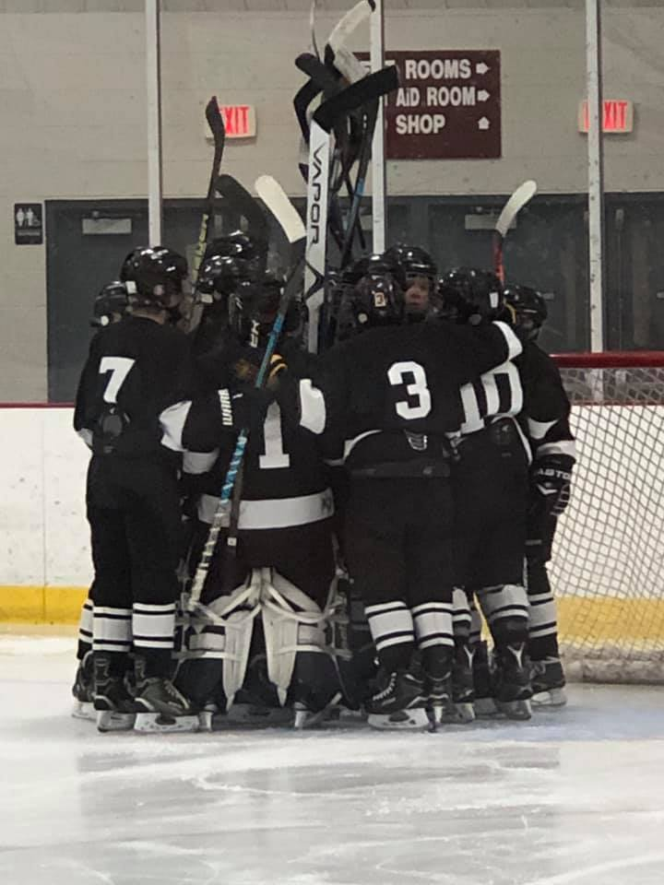
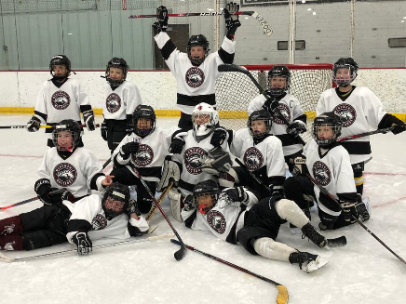
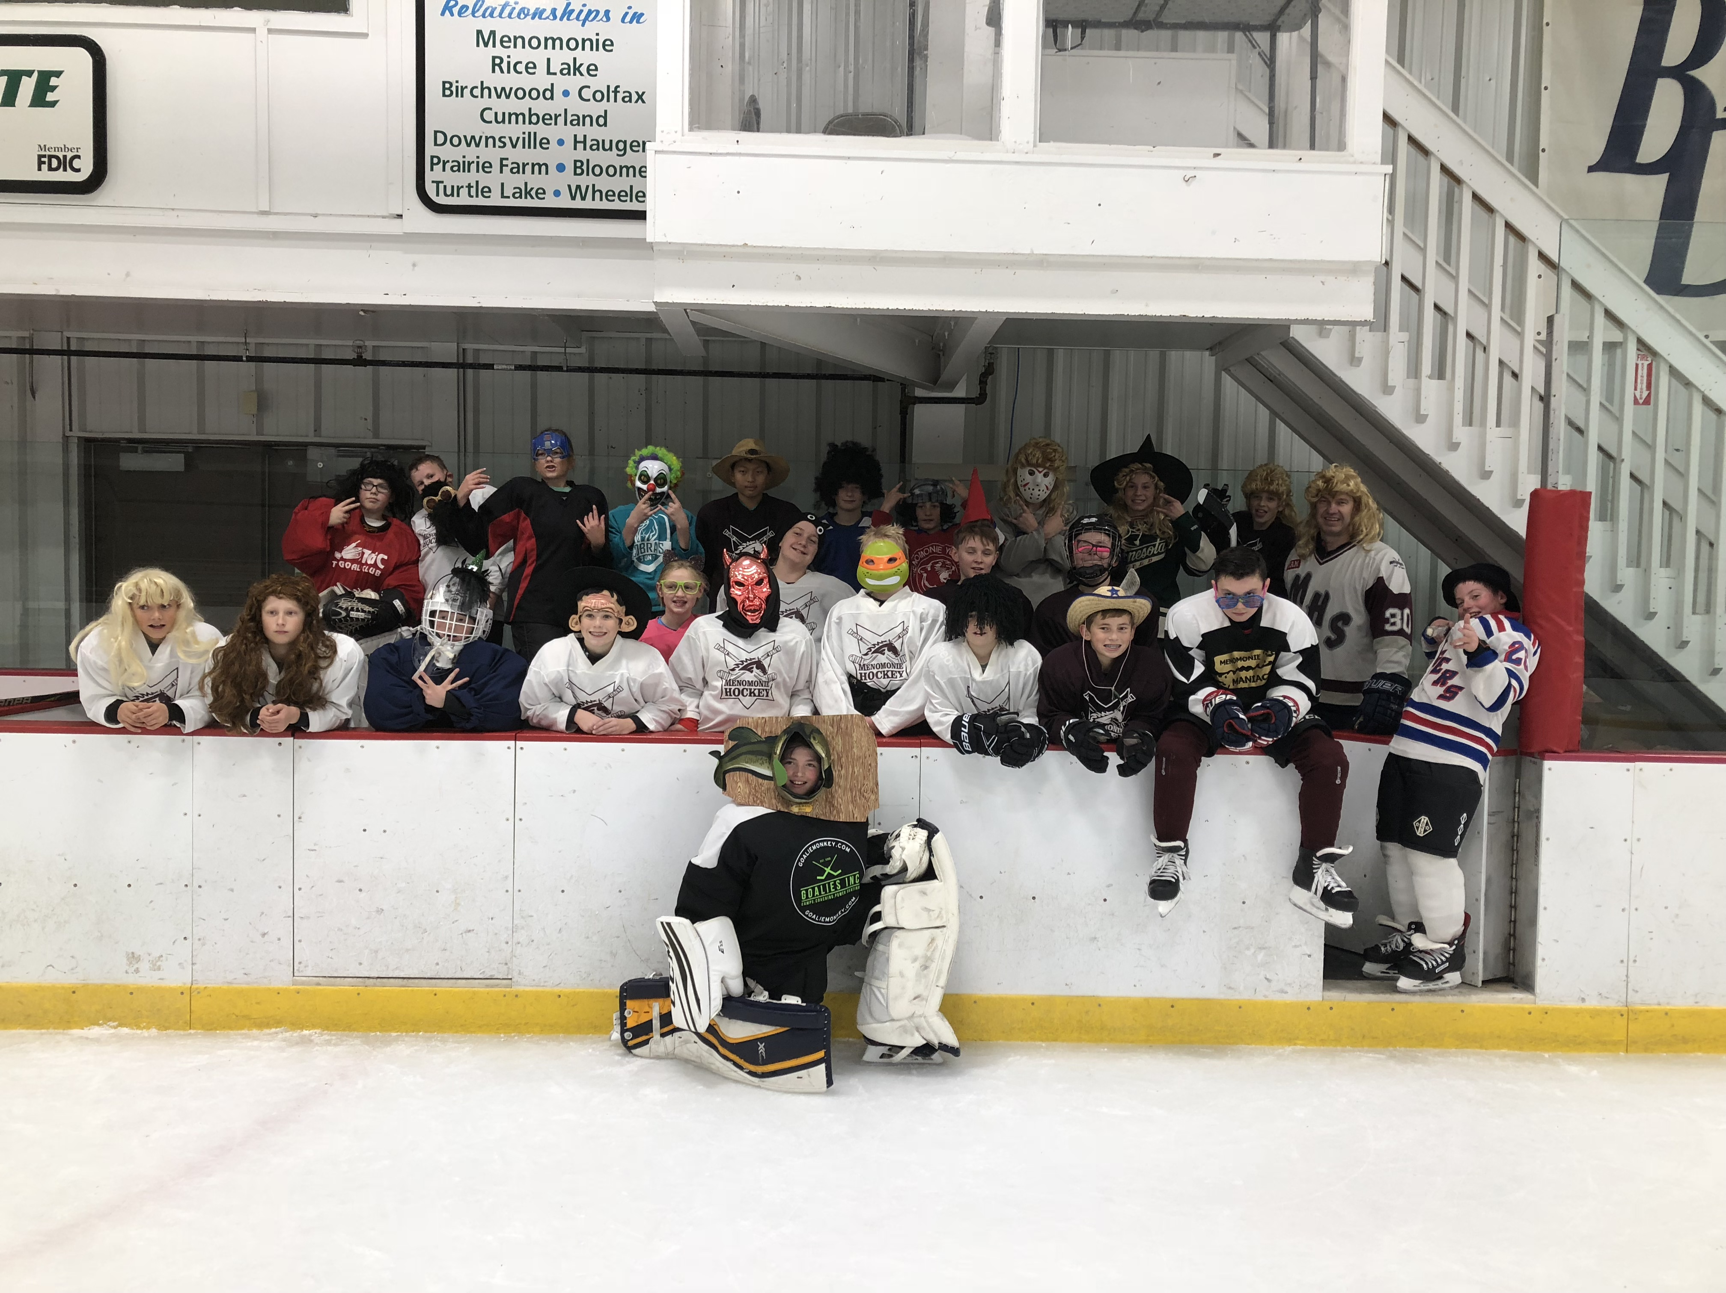
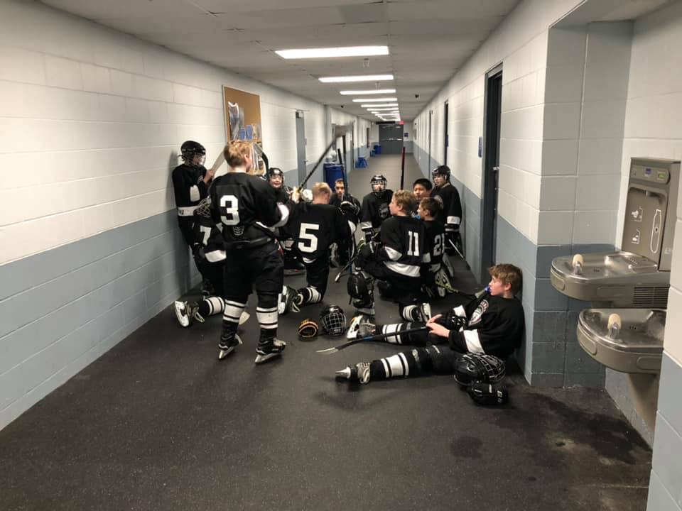
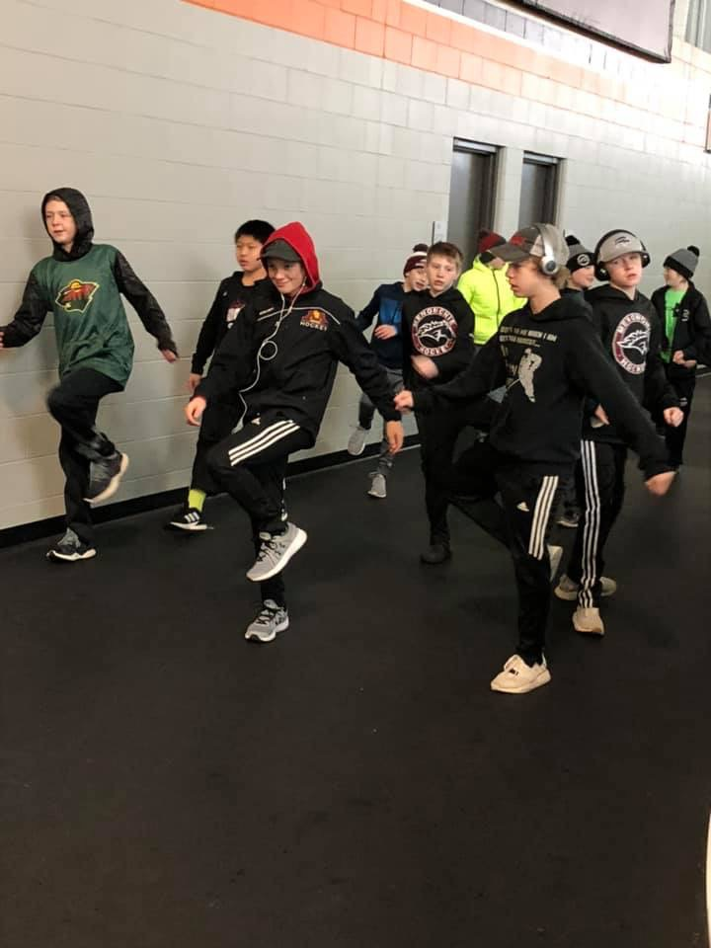
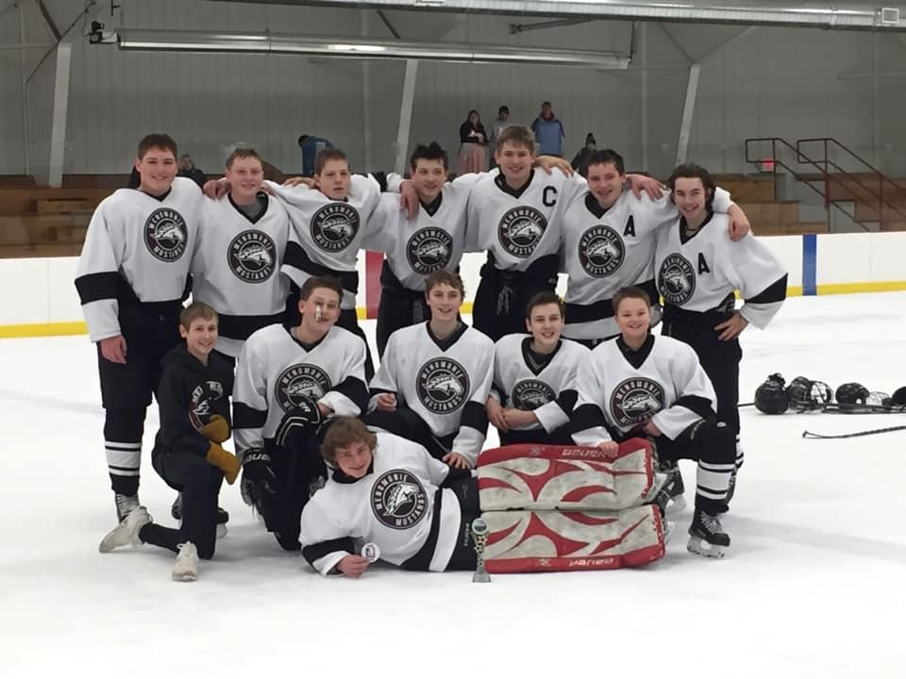

Slide 43
MYHA 2018-2019 Recap
GOALS:
  Revenue Growth
  Membership Growth & Retention
  Utilization & Maximization of Volunteer Hours
  Increase Skill & Competition Level
  Create a FUN & positive culture
CHALLENGES:
  Weather
  Ice Time
  Practice Times
  Fundraiser Timing

Slide 44
2018/19 MYHA Goals Updates
Revenue Growth
  Increased Ice Utilization
  Concession Stand
    Gift Cards added
    Skate Rental
  Continued Beer Sales
  Fundraising
    New Wreath Company
    Skate-a-thon
  LiveBarn Updates
  3 on 3 tournament
Membership Growth & Retention Continued First Year FREE program
  Recruitment of top talent coaches
  Stout Research Project
  Increase Marketing
    Sports Expo, Kids Night, Community Cookout
Utilization/Maximize Volunteer Hours
  Continue to evaluate
Increase Skill & Competition Level
  Scheduling (w/in conference)
  Goalie Program/Coach
  ETS Dryland Program Off-Site
  Paid Non-Parent Coaches
  MYHA Paid On-Site Camps
Create a FUN & Positive Culture
  Communication to Membership
  Culture Shift
  By-Law Update/Board Position
  Fun & Safe Environment
    High School Collaboration
    Open House/Kick Off Meeting
    Transition Meetings
    Conduct Committee/Policy Updates

Slide 45

Surviving, Not Thriving.

Slide 46
Registration Trends:
113
Notes:
155 2018 - 2019

Slide 47
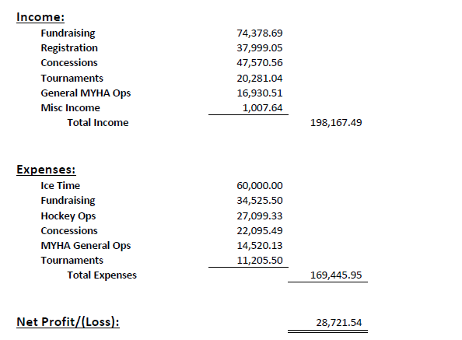
2018/2019 Financials
Notes:
Expenses:
Ice Bill: $90,112.50
Tournament Expenses (Fees, Trophies/Medals): $8,994.66
Hockey Operations (Equipment, Fees, Coaching, ETS): $22,546.92
TOTAL: $121,654.08 ($1,193 per skater)
Income:
Registration: $35,506.13
Fundraising: $47,853.75
Tournaments: $1,9811.41
Concessions: $21,889.91
TOTAL: $125,061.20

Slide 48
WAP Hours – 2018/2019

Slide 49
Surviving, Not Thriving.
Awareness…$15,000-$25,000
Improvements made:
    ETS Off-Site
    Jerseys Program
    Nonparent Coaches
    Equipment
    New Lighting
    On-Site Camps
    Security Cameras
    Outdoor rink with Boards
    Increased Ice Utilization
Improvements Coming:
    Divider Boards
    Second Scoreboard
    Press Box Renovations
    Continued Jersey Program
    Updated Shooting Area
    Outdoor Rink Updates
    Concession Stand Updates
Notes:
Expand
Renovated Press Box
Score Board
Divider Boards

Slide 50
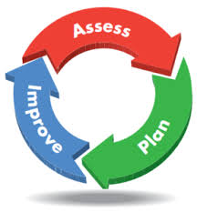
Surviving, Not Thriving.
Action…
Improve operational practices
  Improve membership education & engagement
  Strengthen relationships with all user groups
    Ice Board By-Law Changes
    High School/Athletic Director Collaboration
    Sports Advisory Group
  Ownership and updating of policies
    Conduct Committee Improvements
    Policy Review
    By-law Updates

Slide 51

Surviving, Not Thriving.
Action…
Drive financial growth and sustainability
  Execution of MYHA annual budget
  Continue to quantify hours needed to operate
  Increase revenue and manage expenses
  Revamp sponsorship and fundraising program
    Look at new/different fundraising opportunities
    Fundraising meeting for all membership
    NEED New VP and committee members/team
Notes:
2018 Strategic Initiatives
Improve Operation Practices: Conduct Committee and Form

Slide 52

Surviving, Not Thriving.
Action…
Develop comprehensive growth and retention program
  LTS/Mite structure/program
    Free First Year
    Mini Mite Program
    Competitive Mite Program
    Transition Program
  Increase competition level of players, teams and coaches
    ETS
    Paid Non Parent Coaches
    On-Site Camps
    Off-Season Incentives
  Develop positive marketing campaign
  Development of FUN/GROWTH Committee
  Continued culture shift
  Increased communication

Slide 53
  VP Hockey Operations – Player Assessments
Process Improvements?
  The assessments took to long!
  They were to detailed.
  Updates some drills.
Key Takeaways:
  Now have data points to drive improvements.
  We reaffirmed our largest development gaps.
  Independent feedback to coach per level
Player Development Trends:
  Skills Assessments
    Shooting
    Stickhandling
    Passing (Giving and Receiving)
    Puck Control
  Timed Assessments
    Straight line speed
    Skating agility
    Speed is with puck
Individual feedback is coming!

Slide 54
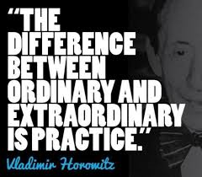
Off Season
Incentive Program Coming
Instructions/Idea sheets coming
  Website Page
Summer Hockey Program: Mites and Older
  Deadline May 31st
  Contact Russ Bahr for questions

Slide 55

THANK YOU!!
Special Thank You…
  Keila Drout
  Chelse Cockeram
Thank you Parents!!!

Slide 56
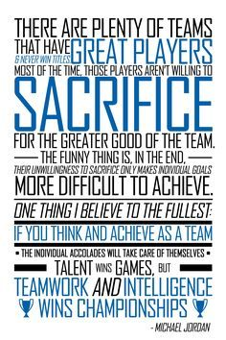
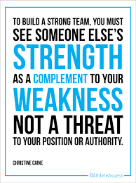
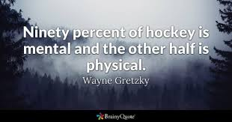
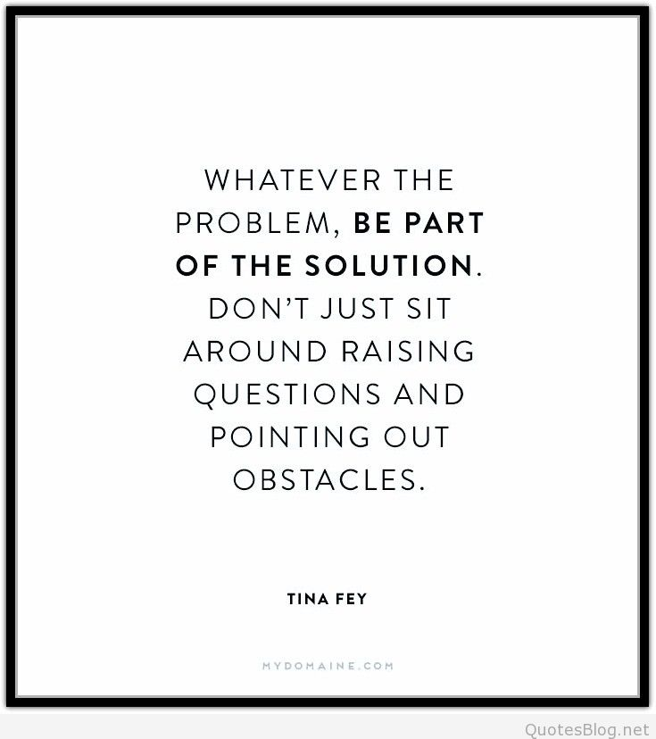
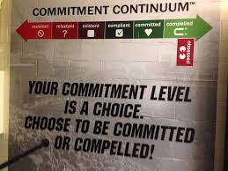

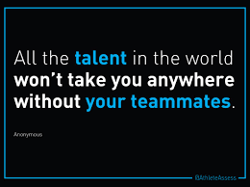
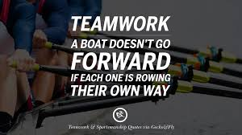
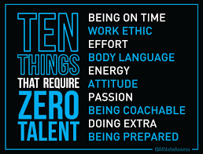


Slide 57

Questions, Ideas, Suggestions…

