Slide 1

BPAA Baseball
House Coaches Meeting
April 21, 2025

Slide 2
Welcome and Thank You for Coaching!
Meeting Agenda:
BPAA Contacts
Coaching Coordinator Role
Meet your fellow Coaches
Review Coaching Expectations
Share ‘What you need to know’ information
Review Rules
Volunteers/DIBS
Answer Questions

Slide 3
BPAA Contacts
House Commissioner – Chris Barton (chris.m.barton@outlook.com)
Coaching Director – Melissa Strong (melbunnell@gmail.com)
Equipment Director – Jenny Noyes (jnoyes7@yahoo.com)
DIBS Director (Volunteers) – Michelle King (michelleking10308@gmail.com)
President – Tammy Hoff (tammy.hoff@hotmail.com)
Vice President – Isaac Seiling (isaacsieling@gmail.com )
Field Director - Brian Oxborough (quicksl1@aol.com)
Notes:
Melissa

Slide 4
Quick Intros

Slide 5
BPAA Baseball Program Goals
Have fun!!
Teach baseball fundamentals
Prepare the kids for the next level of baseball
Develop players’ love of the game
(returning players is a great indicator of a successful season)

Slide 6
Coaching Application
If you haven’t submitted your application yet, please do so ASAP.
Step 1: Background Check and Concussion Training
(if you have a Concussion Certificate from July 2021 or later, you can submit that)
Step 2: Coaching Application
https://bpaasports.sportngin.com/register/form/153389482#_ga=2.147415223.1265341729.1617461473-2120565188.1612138886

Slide 7
Coaching Expectations
Create a fun and positive environment for ALL players to flourish.
Primary focus is on player development, not win/loss record.
Be prepared for practices and games.
  Practice at least 1x/week (allowing opportunities to improve skills and bond with players and coaches)
Clear communication with families (SportsEngine is a great app for teams)
Be an example! Treat umpires, opposing teams, parents, players and fans with respect.

Slide 8
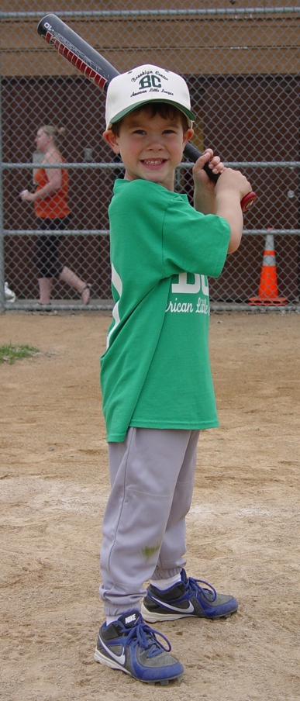
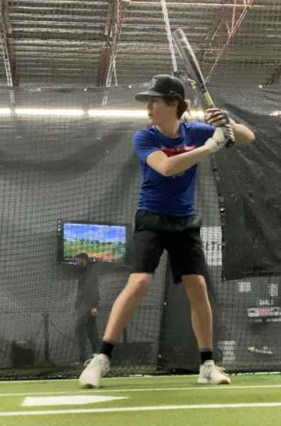
Umpires
We’re in a major umpire shortage!
  Young athletes are quitting umpiring within 1-2 yrs because of adults’ behavior.
  Please do your part to keep them around.
Please also share with families.
1st year playing ball
1st year ump’ing

Slide 9
Team Communication
When you received your roster, ensure you sent an email out to your team.
  Ask for help that you would like! Team Managers, additional coaching/parent help, etc
  Share first practice time, consider short parent meeting then if you’d like too.
Designate a Team Manager to help (counts towards 3 volunteer hours)
(ex. volunteer check collection, schedule events, arrange snacks for younger teams)
SportsEngine is a great tool!
  Find your team via the BPAA Baseball page and/or download the mobile app
  Request Admin Access from Tammy Hoff for anyone who will schedule events (Coaches/Managers)
  Make sure parents are connected as ‘Guardians’
    Go to Roster--> Select your player--> Click on pencil icon in lower right→
    Select 'Add Guardian'
  Use SE to schedule team events (practices, games, etc)
  Use the chat feature to communicate with families

Slide 10
Important Dates
Now | Baseball fields open for practice
May 3 | Opening Day
May 30 – June 1 | Mid Season Tournament
June 27 – 29 | End of Season Tournament
June 30 | All Star Game (8/9, 9/10, 11/12)
Typical Game Days:
Mon/Wed: 8/9, 9/10
Thursday: T-ball
Tues/Thurs: 6/7, 11/12

Slide 11
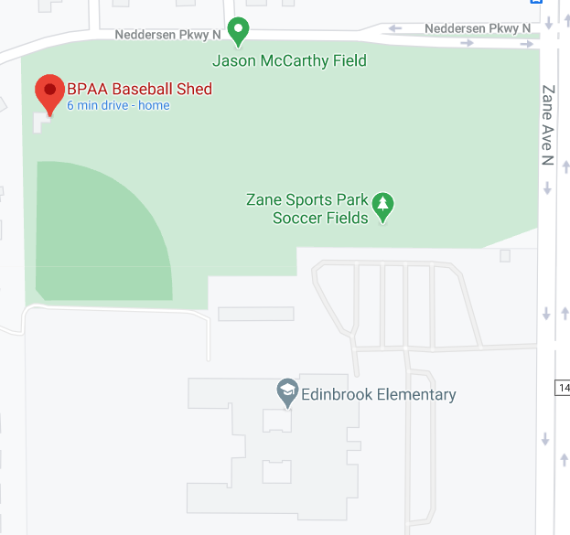
Equipment
Contact: Jenny Noyes (jnoyes7@yahoo.com)
Teams may receive:
  Equipment bag
  Practice balls and game balls
  Scorebook
  Tee
  Bases
  First aid kit
  Catchers gear (8/9, 9/10, 11/12)
  Combination to Northwoods and Brookdale sheds (9/10, 11/12)
Jenny has coordinated with head coaches for equipment pick up
  Didn’t pick up your equipment yet – please reach out to her to do so!
Shed located by diamond NW of Edinbrook Elementary,
On Neddersen Pkwy

Slide 12
How to Schedule Practices
Practice time and location at the coach’s discretion
Contact: Brian Oxborough (quicksl1@aol.com)
Scheduling on DIBS: https://www.bpaasports.org/dib_sessions
DIBS will display fields for baseball
  There are other fields in BP. These may be designated for softball.
Play on appropriate sized fields
  Zane fields (around Edinbrook Elementary) are designated for 12-14s
  Northwoods is not ideal for tball or 6/7 and needed for older ages
Limits on reserving Northwoods Mon - Thurs
  9/10 and 11/12 ONLY. Younger divisions should select different fields

Slide 13

Practice Planning
Utilize parent help where you can!
Keep kids moving - multiple stations
Resources: https://www.bpaasports.org/page/show/1093592-coaches-corner
  Twins Coaching clinic
  Videos on drills, practice plans
mobile app

Slide 14
Coaching Coordinator

Slide 15
Why Coach Coordinator
Create a consistent, and elevated coaching experience for all of the kids and teams
Grow the program wholistically to compete at all levels (more teams and competitive teams at all levels)
Bring kids closer to the program and keep them engaged for the long term
Provide guidance on best practice coaching techniques to enhance coach performance
Increase coaches awareness of extra opportunities and create collaboration
Promote comradery and coordination between the coaches

Slide 16
Coaching Coordinator
Coach consistency and elevation
  Hold a meeting to provide coaching and technique guidance to the coaches
  Set expectations with the coaches to ensure kids are getting consistent coaching experience
  Help new coaches with a practice plan and best practices
Coach collaboration
  Hold gathering with coaches to create a sense of comradery and get to know each other
  Meet with the coaches to receive and give feedback helping to remove barriers
  Inform and coordinate non-core season baseball involvement (fall ball, off season activities)
Player engagement
  Engage with the players during the season and find ways to connect in the offseason
  Coordinate with parents on outside activities or training opportunities
Notes:
Isaac

Slide 17
Break Outs

Slide 18
T-ball Rules Highlights
6 games per season.
All players play the field each inning - no catcher position.
No Outs, play continues until offensive team is through batting line up. Players tagged out or thrown out will remain on the base and continue playing.
All defensive players playing the position of pitcher will be required to wear a batting helmet.
Player may only advance one base at a time. Final batter clears the bases.
Distance between the bases is 50 feet.
Game Length: No new inning will start after 1 hour.
No score kept.
T- ball

Slide 19
6/7 Goals
Very, very basics—the right direction to run when the ball is hit; runners must touch the bases; scoring a run; three outs constitute an inning.
Next basics - how to record outs (catch the ball in the air, throw to first, or tag the runners); running past first base;
Throwing mechanics—introduce the four-seam grip; turn the body so that the front shoulder points toward the target; keep the elbow above the shoulder; step toward the target with the non-throwing foot and release the ball.
Tracking—follow the ball with the eyes into the glove, whether on the ground or in the air (use softer balls); use two hands to catch and field; try to catch the ball out in front of the body.
Hitting—how to hold and swing the bat; batting safety (when not to swing bats, wearing batting helmets); hitting off a tee; hitting softly tossed pitches.
Learning positional play—if the ball is hit to your buddy, let him or her field it
Exerts adapted from From Coaching Youth Baseball the Ripken Way
by Cal Ripken, Jr., Bill Ripken, Scott Lowe, Ripken Baseball

Slide 20
8/9 Goals
See also 6/7 Goals
Continue the basics—force outs; tagging up; baserunning (when you don’t have to run; not running into or past teammates on the basepaths); balls and strikes.
Throwing mechanics—four-seam grip; point the front shoulder, step, and throw; introduce the concept of generating momentum toward the target and following the throw.
Introduce pitching mechanics - balance, break, throw
Catching and fielding—thrown and hit balls; fingers up versus fingers down; see the glove and the ball; use two hands; forehands and backhands; introduce the underhand flip; first-base fundamentals; crossover and drop steps.
Hitting—choosing the right bat; proper grip; hitting pitched balls; introduce drill work (tee, soft toss, short toss).
Learning positional play—learn the positions and the areas each player should cover; cover the nearest base when the
ball is not hit to you; basics of cutoffs and relays.
Exerts adapted from From Coaching Youth Baseball the Ripken Way
by Cal Ripken, Jr., Bill Ripken, Scott Lowe, Ripken Baseball

Slide 21
9/10 and 11/12 Goals
Build off of 8/9 Goals. Reinforce as needed.
Learning the basic rules—infield fly rule; balks (11/12).
Baserunning:
  Introduce stealing (9/10)
  Leadoffs (11/12)
Pitching and throwing mechanics—wind-up versus stretch; four-seam grip; shuffle, throw, follow; pitcher covering first.
Hitting—repetitions; drill work (tee, soft toss, short toss, stick¬ball, lob toss, one-arm drill); bunting.
Catching - blocking, primary and secondary stances, throwing down to bases
Learning team fundamentals—cutoffs and relays; basic first-and-third situations; underhand flip (box drill) and double plays; defending the steal; infield and outfield communication and priorities, basic bunt defenses (11/12).
Exerts adapted from From Coaching Youth Baseball the Ripken Way
by Cal Ripken, Jr., Bill Ripken, Scott Lowe, Ripken Baseball

Slide 22
League Rules

Slide 23
6/7 Rules Highlights
Playing time:
  No player will sit on the bench one inning more than any other player; this includes games shorter than six complete innings
  No player can play a position more than 2 innings
  Minimum 1 inning at an IF position. Inning must occur within the first 4 innings.
  Minimum 1 inning at an OF position. Inning must occur within first 5 innings.
Defense:
  No Catcher position
  4 OF
  Up to 2 coaches may be in OF on defense
Hitting
  Coach Pitch (overhand, with exception for 2 players/game)
  5 run limit/inning except 6th inning (unlimited)
  Bats: USSSA or USA approved bats only. Big barrel bats allowed.
  Continuous batting order
  Each player gets 3 strikes. Strikeouts enforced, no walks.
Runners may advance on:
  Hits to the OF until balls reaches the IF dirt
Runners may NOT advance on:
  Hits within the IF
  Overthrows
6/7

Slide 24
8/9 Rules Highlights
Playing time:
  No player will sit on the bench one inning more than any other player; this includes games shorter than six complete innings
  No player can play a position more than 2 innings
  Minimum 1 inning at an IF position. Inning must occur within the first 4 innings. (Does not include catcher)
  Minimum 1 inning at an OF position. Inning must occur within first 5 innings.
Defense:
  4 OF
Hitting
  Machine Pitch through Mid-season Tournament
  Machine (1st 3 innings), Kid pitch (2nd 3 innings) after Mid-season Tournament
    Machine: Each player gets 3 strikes. Strikeouts enforced, no walks.
    Pitch: 4 balls/3 strikes
  5 run limit/inning except 6th inning (unlimited)
  Bats: USSSA or USA approved bats only. Big barrel bats allowed.
  Continuous batting order
Runners may advance on:
  Hits to the OF until balls reaches the IF dirt
Runners may NOT advance on:
  Hits within the IF
  Overthrows
Please pay attention to pitching count limits and arm care
8/9

Slide 25
9/10 Rules Highlights
Playing time:
  No player will sit on the bench one inning more than any other player; this includes games shorter than six complete innings
  No player can play a position more than 2 innings
  Minimum 1 inning at an IF position. Inning must occur within the first 4 innings. (Does not include catcher)
  Minimum 1 inning at an OF position. Inning must occur within first 5 innings.
Defense:
  3 OF
  Ball is live!
  IF Fly rule in effect
Offense
  5 run limit/inning except 6th inning (unlimited)
  Bats: USSSA or USA approved bats. Big barrel bats allowed.
  Continuous batting order
  Stealing after crossing home plate
    No stealing home
    Delayed steal after mid-season
  No bunting
Please pay attention to pitching count limits and arm care
  You’ll need to upload pitch count when posting scores
9/10

Slide 26
11/12 Rules Highlights
Playing time:
  No player will sit on the bench more than 2 innings/game
  No player can play a position more than 3 innings
  Minimum 1 inning at an IF position. Inning must occur within the first 4 innings.
  Minimum 1 inning at an OF position. Inning must occur within first 5 innings.
Defense:
  IF Fly rule in effect
Offense
  5 run limit/inning except 6th inning (unlimited)
  Bats: USSSA or USA approved bats. Big barrel bats allowed
  Continuous batting order
  Bunting allowed
  Leadoffs allowed
  Stealing after ball is released from pitcher’s hand
    Only 1 base may be stolen at a time
    No delayed steals
Pitching
  No balks
  Please pay attention to pitching count limits and arm care
  You’ll need to upload pitch counts when posting scores
11/12

Slide 27
Collecting Volunteer Checks & Waivers
Great job to give your Team Manager!
Volunteer tracking:
  Indicate who has paid ($200 OR the $175 buyout check).
  Indicate the check number.
  Parents with completed hours will be marked (If a parent thinks they should be on there, have them email Michelle).
  Cash: If anyone needs to pay in cash please ask them to put it into an envelope with their PLAYER’S name on it. Prefer not to – only for buyouts
Bring both to uniform pick up. No forms/checks = no uniforms
Questions? Contact DIBS Director,
Michelle King (michelleking10308@gmail.com)
Notes:
Michelle

Slide 28
Questions??

