Slide 1
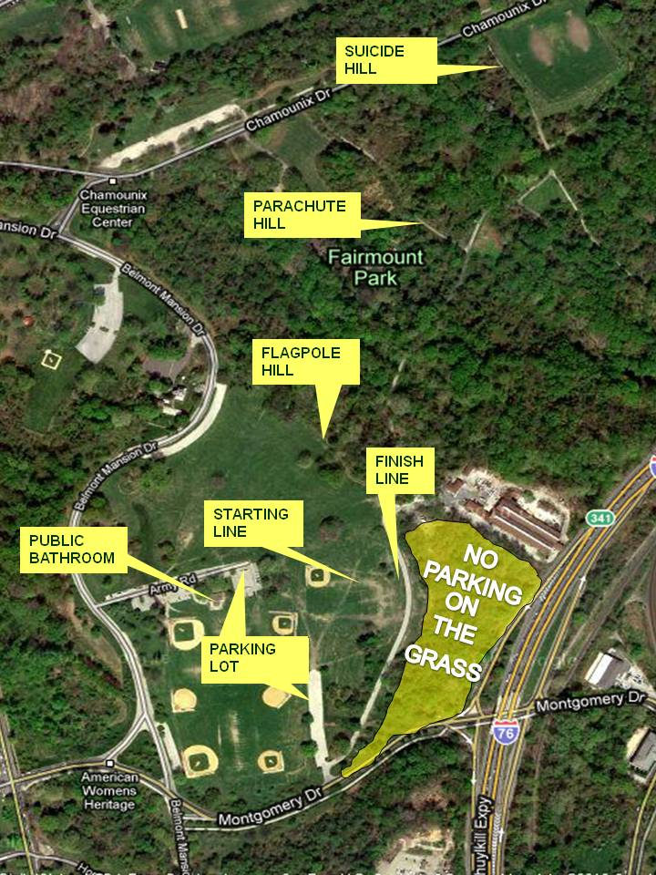
Philadelphia CYO
Belmont Plateau Overview

Slide 2
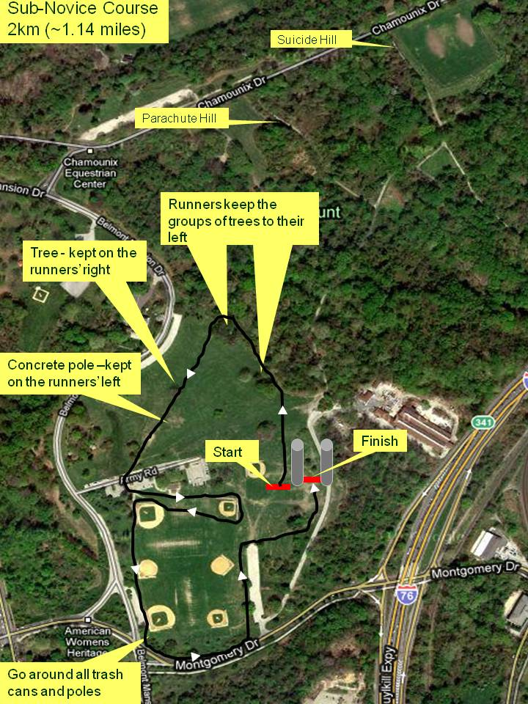
Philadelphia CYO Sub-Novice Course Map
2 km (~1.14 miles)
Map has an error on the route and distance see yellow line for correction
Marshall Position
Marshall Position
Marshall Position
Marshall Position

Slide 3
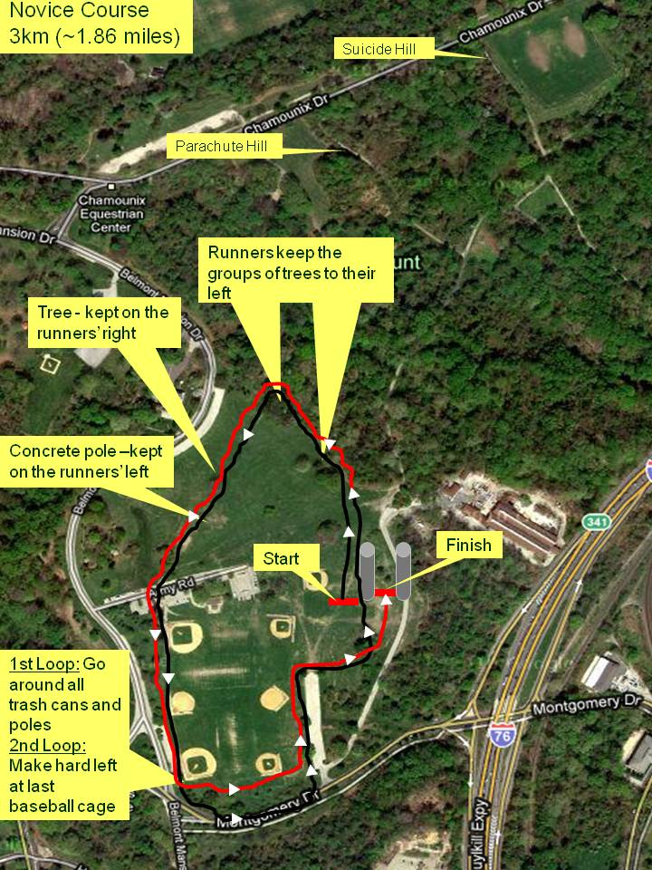
Philadelphia CYO Novice Course Map
3 km (~1.86 miles)
Marshall Position
Marshall Position
Marshall Position

Slide 4
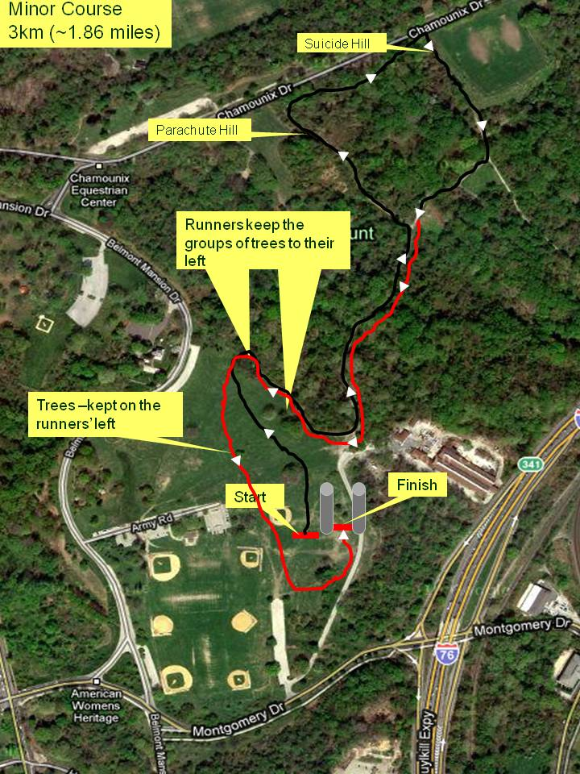
Philadelphia CYO Minor Course Map
3 km (~1.86 miles)
Marshall Position
Marshall Position
Marshall Position
Marshall Position
Marshall Position
Marshall Position

Slide 5
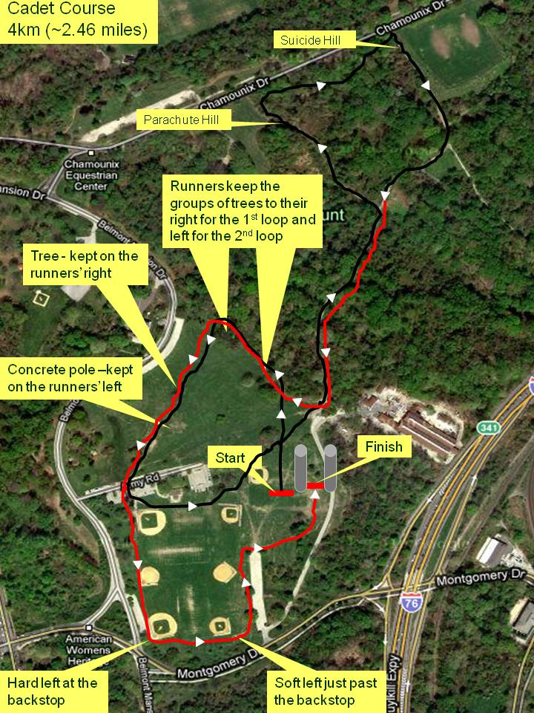
Philadelphia CYO Cadet Course Map
4 km (~2.46 miles)
Marshall Position
Marshall Position
Marshall Position
Marshall Position
Marshall Position
Marshall Position
Marshall Position
Marshall Position

