Slide 1





Seacoast United/Exeter Hawks
Home Workout Plan -
April 13th- 17th 2020

Slide 2

Seacoast United & Nike

Slide 3
Seacoast United Home Workout Plan
The Seacoast United Home Workout will consist of a 5-Day Plan to keep our players active in this time away from Team Training Sessions. The activities we have are all designed so players can perform on their own in a limited space, so should be accessible for all our players.
The Home Workout Weekly Plan will consist of the following:
Dynamic Warm Up
Cool Down
Aerobic Workout
Technical Based Workout
Core Workout
Upper Body Workout
Lower Body Workout
Yoga Workout
Soccer Homework
This presentation will include a weekly schedule, plus descriptions of the activities we would like the players to perform in each of the workouts.

Slide 4
Weekly Schedule (4/13-4/17)
Monday 13th April | Tuesday 14th April | Wednesday 15th April | Thursday 16th April | Friday 17th April
Dynamic Warm Up | Dynamic Warm Up | Yoga Workout | Dynamic Warm Up | Dynamic Warm Up
Technical Workout | Technical Workout | Tactical Homework | Technical Workout | Technical Workout
Aerobic Workout (2 x 1 Mile Sprints) | Core Workout |  | Aerobic Workout (Timed 5 km) | Core Workout
Cool Down | Upper Body Workout |  | Cool Down | Lower Body Workout
 | Cool Down |  |  | Cool Down

Slide 5
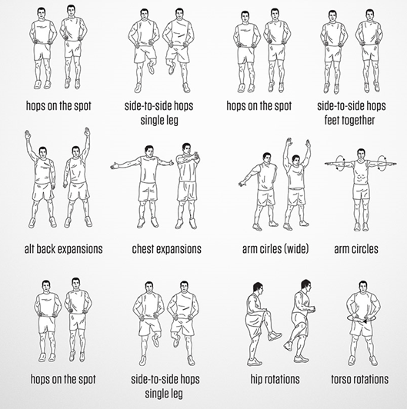
Dynamic Warm Up
~ Mon, Tues, Thurs and Fri ~
***Players should perform each exercise for 10 seconds, before moving onto the next one.
Repeat the exercises for a total of 2 sets***

Slide 6
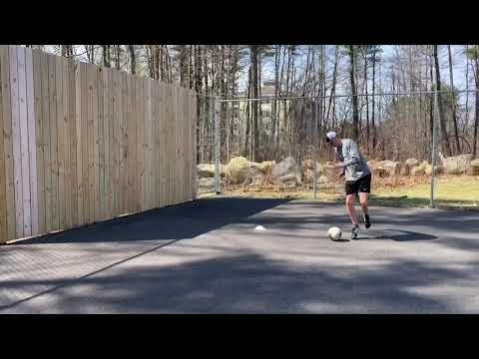
Technical Workout #1
~ Monday, Tuesday, Thursday, Friday ~

Slide 7
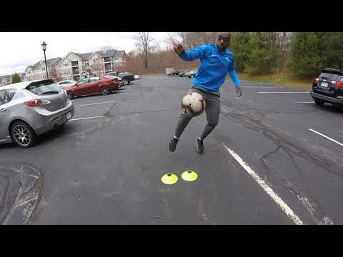
Technical Workout - #2: 1v1 Escape Moves
~ Monday, Tuesday, Thursday, Friday ~

Slide 8
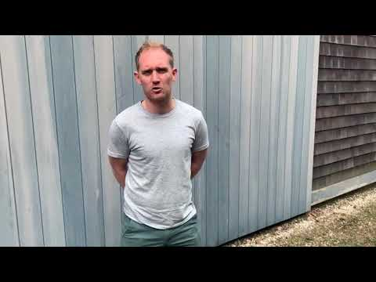
Physical Workout: Aerobic Fitness
~ Monday & Thursday ~

Slide 9
Sprint Endurance Workout: 2 x 1 Mile Sprints
~ Monday~
Sprint 1 x Mile as fast as you can (Screenshot on App)
Active Rest Period (2 Minutes):
30 seconds - Push Ups
30 seconds - Sit Ups
30 seconds - Plank
30 seconds - Rest
Sprint 1 x Mile as fast as you can (Screenshot on App)
Please email your Head Coach a screenshot of both your mile times.

Slide 10
5km Challenge
~ Thursday~
Aim:
To beat your previous time from last week
Push yourself
You should now have a route mapped out so should help you pace yourself and maximize your time.
Treadmill is of course acceptable if you have one.
Please email your Head Coach a screenshot of your 5 km time.

Slide 11
Seacoast United 5 km - Recommendations
Age Group | Recommended Time for SU Club Player
U12 | Under 29 minutes
U13 | Under 28 minutes
U14 | Under 26 minutes
U15 | Under 25 minutes
U16 | Under 23 minutes
U17 | Under 23 minutes
U19 | Under 22 minutes

Slide 12
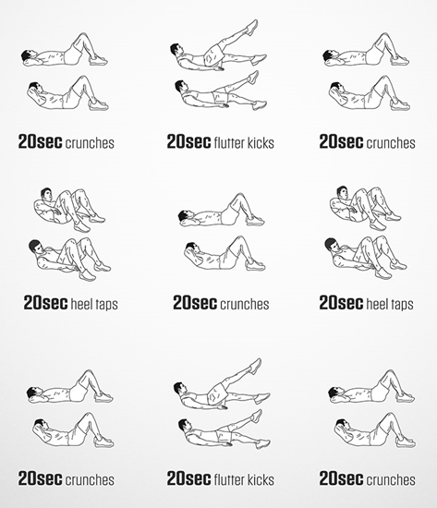
Core Workout
~ Tuesday & Thursday ~
***Players should complete 1 set of all 9 activities, before taking a 2 minute rest.
Repeat this process for a total of 3-4 times**

Slide 13
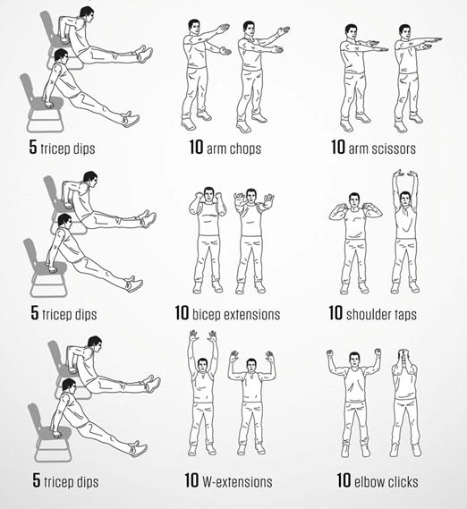
Upper Body Workout
~ Tuesday ~
***Players should complete 1 set of all 9 activities, before taking a 2 minute rest.
Repeat this process for a total of 3 times***

Slide 14
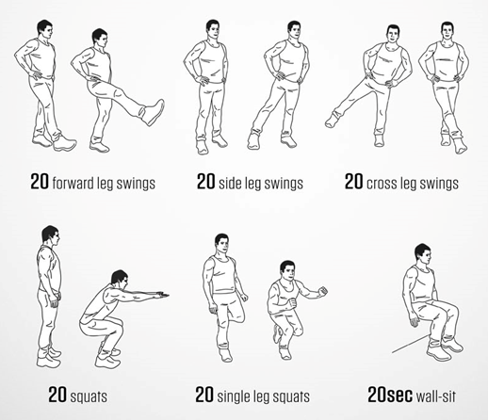
Lower Body Workout - Plyos
~ Thursday ~
***Players should complete 1 set of all 6 activities, before taking a 2 minute rest.
Repeat this process for a total of 3 times***

Slide 15

Full Body Stretch
~ Wednesday ~

Slide 16
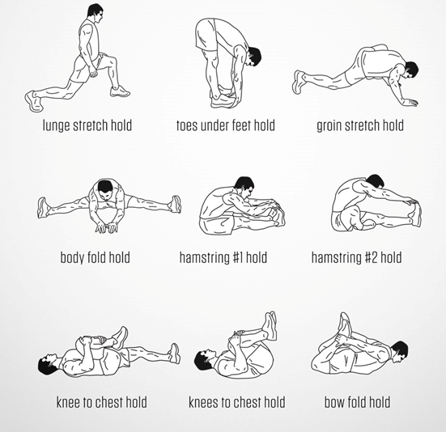
Cool Down
~ Mon, Tues, Thurs and Fri ~
***Players should hold each stretch for 40 seconds before moving onto the next one.
Repeat the exercises for a total of 2 sets***

Slide 17
Tactical Homework
~ Wednesday ~
Assignment:
Create an Idealistic ‘Position Specific Profile’ for the position you play in soccer
To Complete this Assignment:
State in which Position you are designing the ‘Position Specific Profile’
State Key Technical & Tactical Characteristics needed for your position in the following phases of the game:
Attacking (In Possession)
Defending (Out of Possession)
Transition
State Key Physical Characteristics required for your position
State Key Psychological Characteristics required for your position
Please type your ‘Position Specific Profile’ on a form similar to the example on the following slide. Please take time with this and go into detail as you break down all aspects of the position you play. This must be typed up and sent electronically via email to your Head Coach by Friday.

Slide 18
Position Specific Profile - Template
Name: |  | Position:
Technical Profile |  |  | Physical Profile
Attacking | Defending | Transition
Tactical Profile |  |  | Psychological Profile
Attacking | Defending | Transition

Slide 19

Stay Safe & Stay Fit

