Slide 1


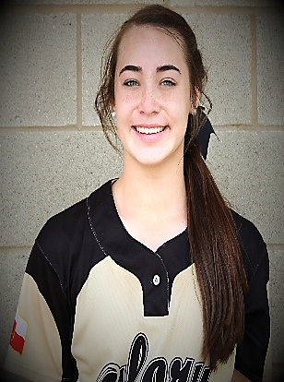
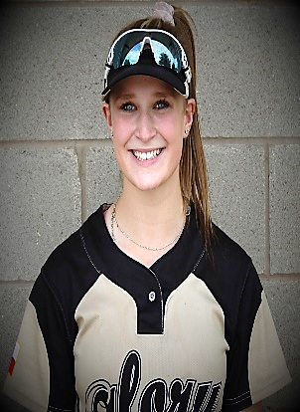
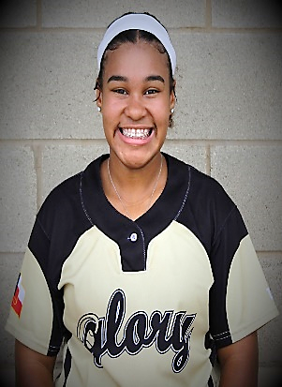
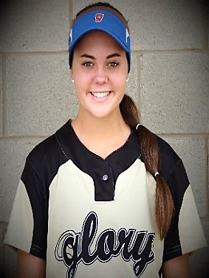
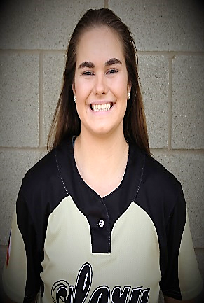
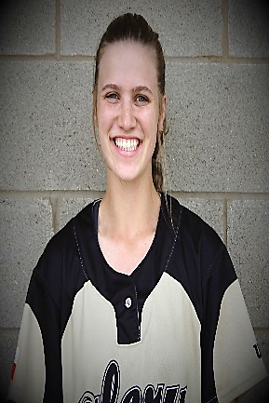
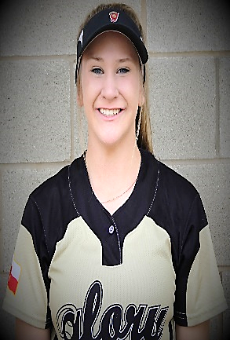
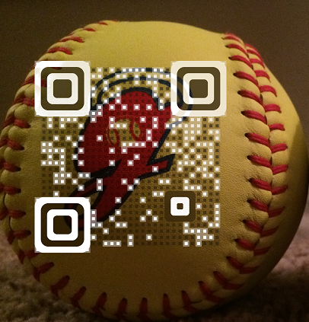
Glory Adkins 16U Gold
Head Coach Jack Fultz
214-557-7722 jsfultz@txglory.com
2020 - #4
Tatum Seith
Pitcher / Util GPA 4.0 of 4.0
Rank 103 / 625
HT 5’ 10” National Junior Honor Society
_____________
2020 - #7
Gracie Ewing
CF / SS / 2B GPA 4.9 of 5.0 Rank 6 / 91
HT 5’ 4” A Honor Roll National Junior Honor Society
2020 - #12
Taylor Thompson
3B / 2B / Util GPA 3.7 of 4.0 Rank 81 / 674
HT 5’ 5”
_____________
_____________
2020 - #17
Brooke Bingham
RH Pitcher GPA 4.8 of 4.0
HT 5’ 8”
NFCA All-America Scholar-Athlete
_____________
2020 - #21
Katelynn Larkin
RH Pitcher 1st Team All-District 14-5A
HT 5’ 7”
_____________
_____________
Notes:
_________________________________________________________________________
_________________________________________________________________________
_________________________________________________________________________
_________________________________________________________________________
_________________________________________________________________________
_________________________________________________________________________
_________________________________________________________________________
________________________________________________________________________
2020 - #42
Kara Lee
Outfield GPA 3.7 of 4.0
HT 5’ 6” Slapper – 2.85
_____________
2020 - #52
Hallehannah Hale
SS / 2B / 1B GPA 3.5 of 4.0 HT 5’7”
_____________
_____________

Slide 2
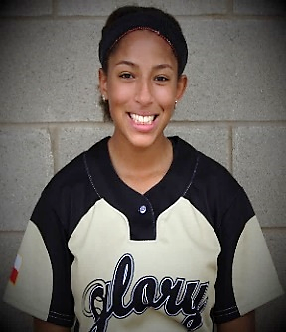
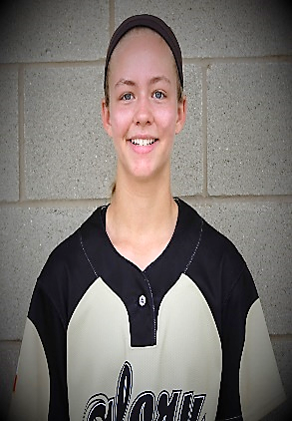
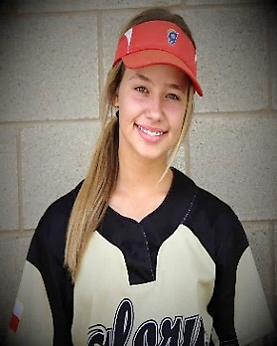
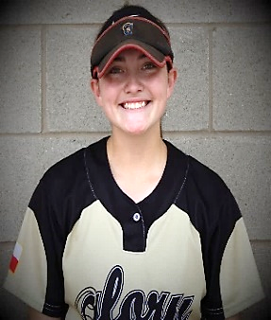
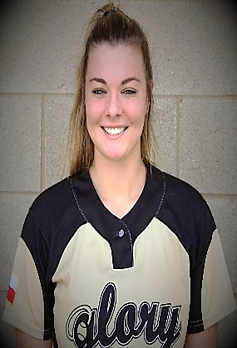
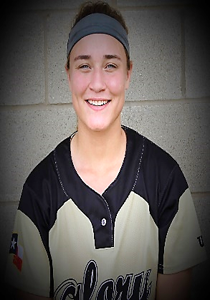
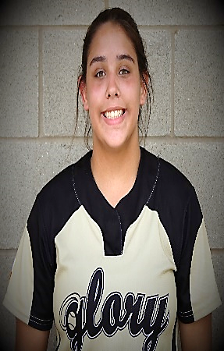
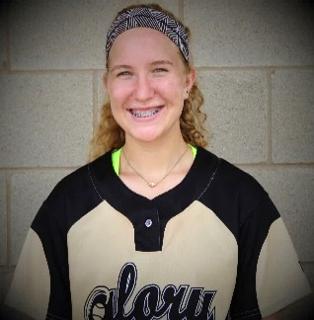
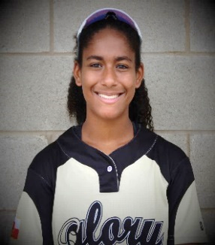
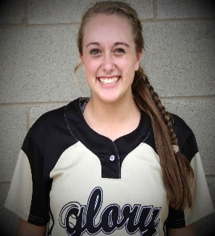
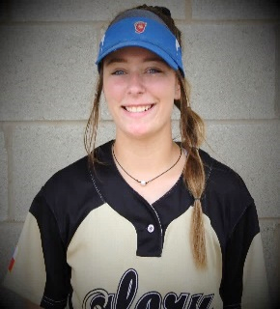
Glory Adkins 16U Gold
Head Coach Jack Fultz
214-557-7722 jsfultz@txglory.com
2021 - #00
Simonne Sanders
OF / 1B GPA 3.5 of 4.0
HT 5’ 4” TAPPS All-District Softball
_____________
2021 - #1
Alexa Neilon
CF / OF / 1B GPA 4.0 of 4.0 PSAT 1060 HT 5’5”
Slapper - 2.75 National Junior Honor Society
2022 - #5
Sydney Olschefski
RHP / SS / CF GPA 3.9 of 4.0
HT 5’ 5”
Slapper - 2.77
_____________
_____________
2021 - #13
Grace Cantu
CF / OF / 1B GPA 3.8 of 4.0
HT 5’ 6”
Lefty Hitter FloSoftball 2021 Ranking #216
2021 - #14
Missy Wise
Catcher / 1B GPA 3.5 of 4.0
HT 5’8” Pop 1.75
National Junior Honor Society
__________________
2021 - #20
Rylee Seymour
3B / 2B / OF
GPA 3.8 of 4.0
HT 5’ 5”
National Junior Honor Society
_____________
2021 - #22
Brieanna Michelli
Catcher / 3B GPA 4.0 of 4.0
HT 5’ 3”
_____________
_____________
2022 - #23
Annie-Klein Allgood
RHP / 1B
GPA 3.8 of 4.0
HT 5’ 8”
Rank 23 / 274 FCA Leader National Junior Honor Society
2021 - #29
Dorian Brown
CF / OF GPA 3.9 of 4.0
HT 5’ 6”
_____________
_____________
2021 - #33
Brooke Nauman
OF / Catcher
HT 5’ 5”
_____________
_____________
2021 - #44
Jalie Neff
SS / C / 3B GPA 3.1 of 4.0
HT 5’ 5”
_____________
_____________

