Slide 1

KEEPING A LINE-UP CARD
In Accordance with High School Rules

Slide 2
…line-up card shall include the name, shirt number, position and batting order of each starting player, the name and shirt number of each eligible substitute should also be listed.
NOTE 1: IMPORTANT! If the Plate Umpire sees there are no substitutes on the line-up card he should ask the coach to list them. If he states he has no subs, then accept the card as is.
THERE IS NO PENALTY if a substitute comes into the game and was not listed on the line-up card; coach inadvertently left him off, or player arrived late, etc. One year an umpire did not know this rule and ejected the coach when he argued that the substitute did not have to be on the line-up card.
NOTE 2: It is important to keep a line-up card correctly. Batting out of order, illegal substitution, etc., may have to be ruled on. An improperly kept line-up card can create havoc for the umpire. This presentation gives an example on how to keep the card. Each umpire, however, may develop his/her own way of keeping the card that makes sense to them.
RULE 1-1-2

Slide 3
UMPIRE-IN-CHIEF
Keep a written record of defensive and offensive team charged conferences for each team and notify the respective coach each time a conference is charged to his team. He shall also be responsible for keeping a line-up card and recording all substitutes, courtesy runner participation, and team warnings.
RULE 10-2-3j

Slide 4
STARTERS
Any of the starting players may be withdrawn and
re-entered once, including a player who was the designated hitter*, provided such player occupies the same batting position whenever he is in the lineup.
*Starting Designated Hitter is considered a STARTER; has re-entry status.
NOTE: If the starting pitcher does not face one batter, he may play another position, but not return to pitch. Rule 3-1-1 Penalty
READ: 3-1-2 about allowing a pitcher to be removed and then return as pitcher.
RULE 3-1-3

Slide 5
SUBSTITUTES
A SUBSTITUTE who is withdrawn MAY NOT re-enter.
NOTE: If a team is on offense and the coach gives you several substitutes and one or more of those substitutes does not hit that ½ inning, THEY ARE CONSIDERED IN THE GAME. The coach may think because a player didn’t actually hit, that the substitution is not in effect. That is not correct. Therefore, if he chooses to remove one of those subs when they go back on defense, they are out of the game.
RULE 3-1-3

Slide 6
SUBSTITUTES (continued)
Should there be no announcement of substitutions, a substitute has entered the game when the ball is live and:
a. a runner takes the place of a runner he has replaced.
b. a pitcher takes his place on the pitcher's plate,
c. a fielder reaches the position usually occupied by the fielder he has replaced, or
d. a batter takes his place in the batter’s box.
NOTE: It is a common misconception that a substitute must be announced or he is illegal. THAT IS NOT CORRECT.
RULE 3-1-3

Slide 7
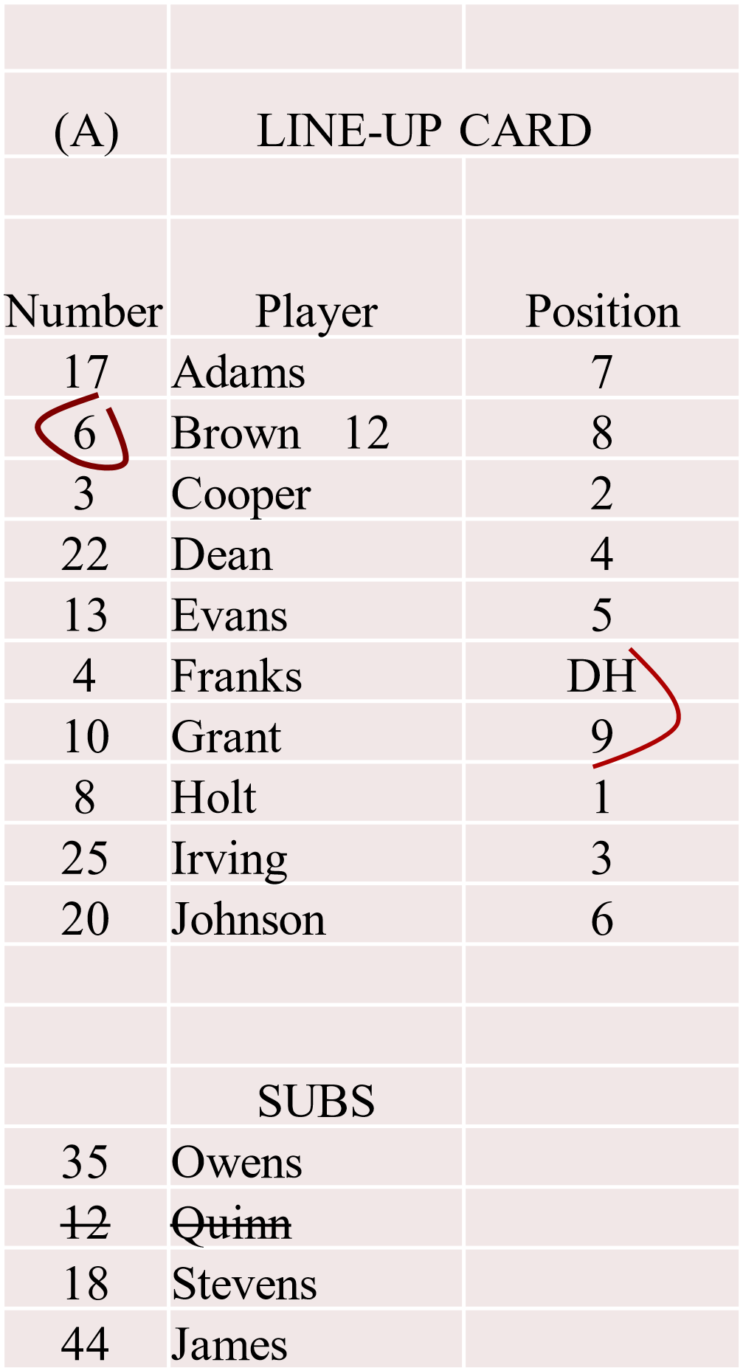
LINE-UP CARD ‘A’
Suggested ways to mark substitutions.
• Quinn substitutes for Brown.
Cross line through Quinn on sub list.
Write Quinn’s # next to Brown’s name.
Circle Brown’s #. Think of circle as the letter ‘O’ representing he’s Out of the line-up.
Brown is eligible to re-enter.
CONTINUED:

Slide 8
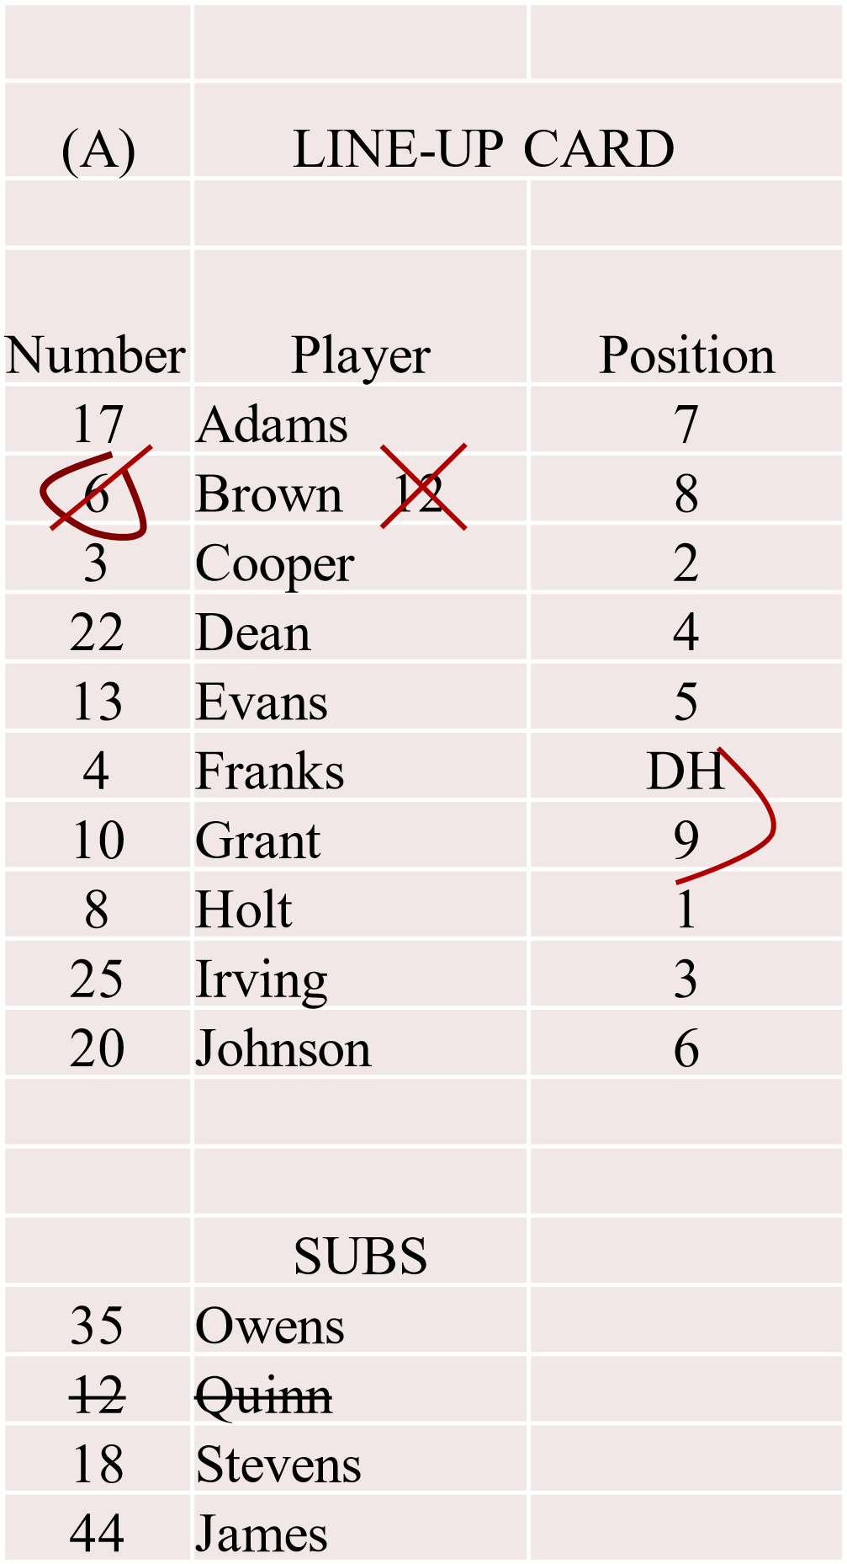
LINE-UP CARD ‘A’ (continued)
• Brown re-enters.
1. X through 12 next to Brown.
2. Quinn is out of the game. He was not a starter,
he cannot re-enter.
3. Put a line IN circle, through Brown’s number.
Line represents Brown is back IN the line-up.
CONTINUED:

Slide 9
LINE-UP CARD ‘A’ (continued)
• Owens enters the game.
Cross line through Owens on sub list.
Write Owens’ number next to the ‘12’.
Put another line through Brown’s number making an X. The X through Brown’s number represents that he is out of the game.
Also put a line through Brown’s name once he is out of the game.
NOTE 1: Don’t obliterate numbers or names in case you have to refer back about a change.
NOTE 2: Reminding the coach when one of his starters becomes ineligible to re-enter (out of the game), can help prevent an illegal substitution later.

Slide 10
DESIGNATED HITTER
(DH)
A hitter may be (NOT MANDATORY) designated for any one starting player (NOT JUST PITCHERS) and all subsequent substitutes for that player in the game.
A designated hitter, DH…shall be selected prior to the start of the game.
RULE 3-1-4

Slide 11
P/DH (Pitcher/DH)
FHSAA has added an additional position called the Pitcher/Designated Hitter or P/DH.
There is a separate PowerPoint on PBBUA web site for the P/DH. You are encouraged to fully understand the NFHS DH rule before learning the FHSAA P/DH rule.
NFHS = National Federation of State High Schools
FHSAA = Florida High School Athletic Association
NOTE: A team may use the DH or the P/DH or neither. A team CANNOT use both DH and P/DH in a game.

Slide 12
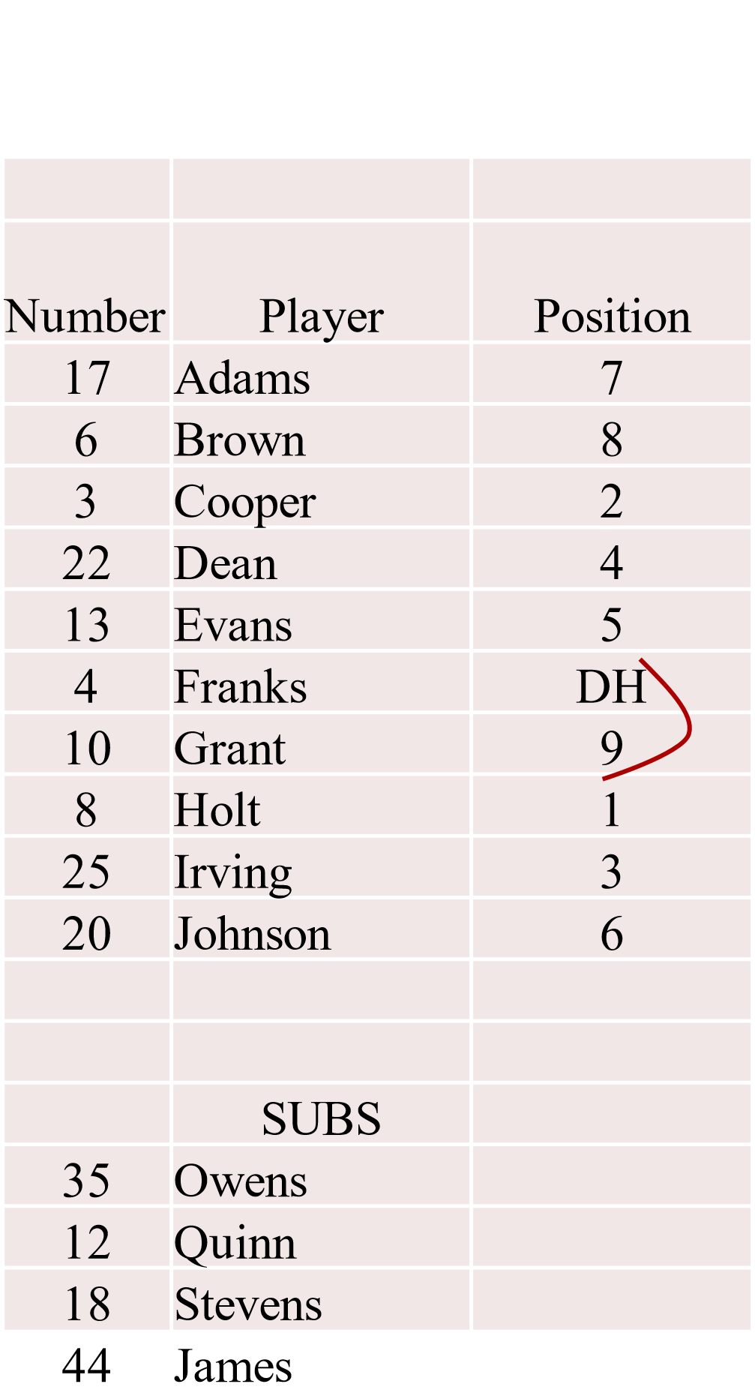
DH Designated Hitter
LINE-UP CARD
Confirm with the coach at the plate meeting when a DH is being used:
“Franks is hitting for Grant, correct?”
Be sure the card is marked clearly (bracketed), understanding who the DH is and who he is hitting for.
High School rules allows the DH to hit for any position so the umpire cannot assume it is for the pitcher as in pro and college.
A coach may put the DH above or under the name of who the DH is hitting for.
At times a coach who is not use to the HS rule will list the DH in the line-up and put the pitcher’s name at the bottom…the way pro and college do. The umpire should politely ask the coach in the future to put the names together on the card.

Slide 13
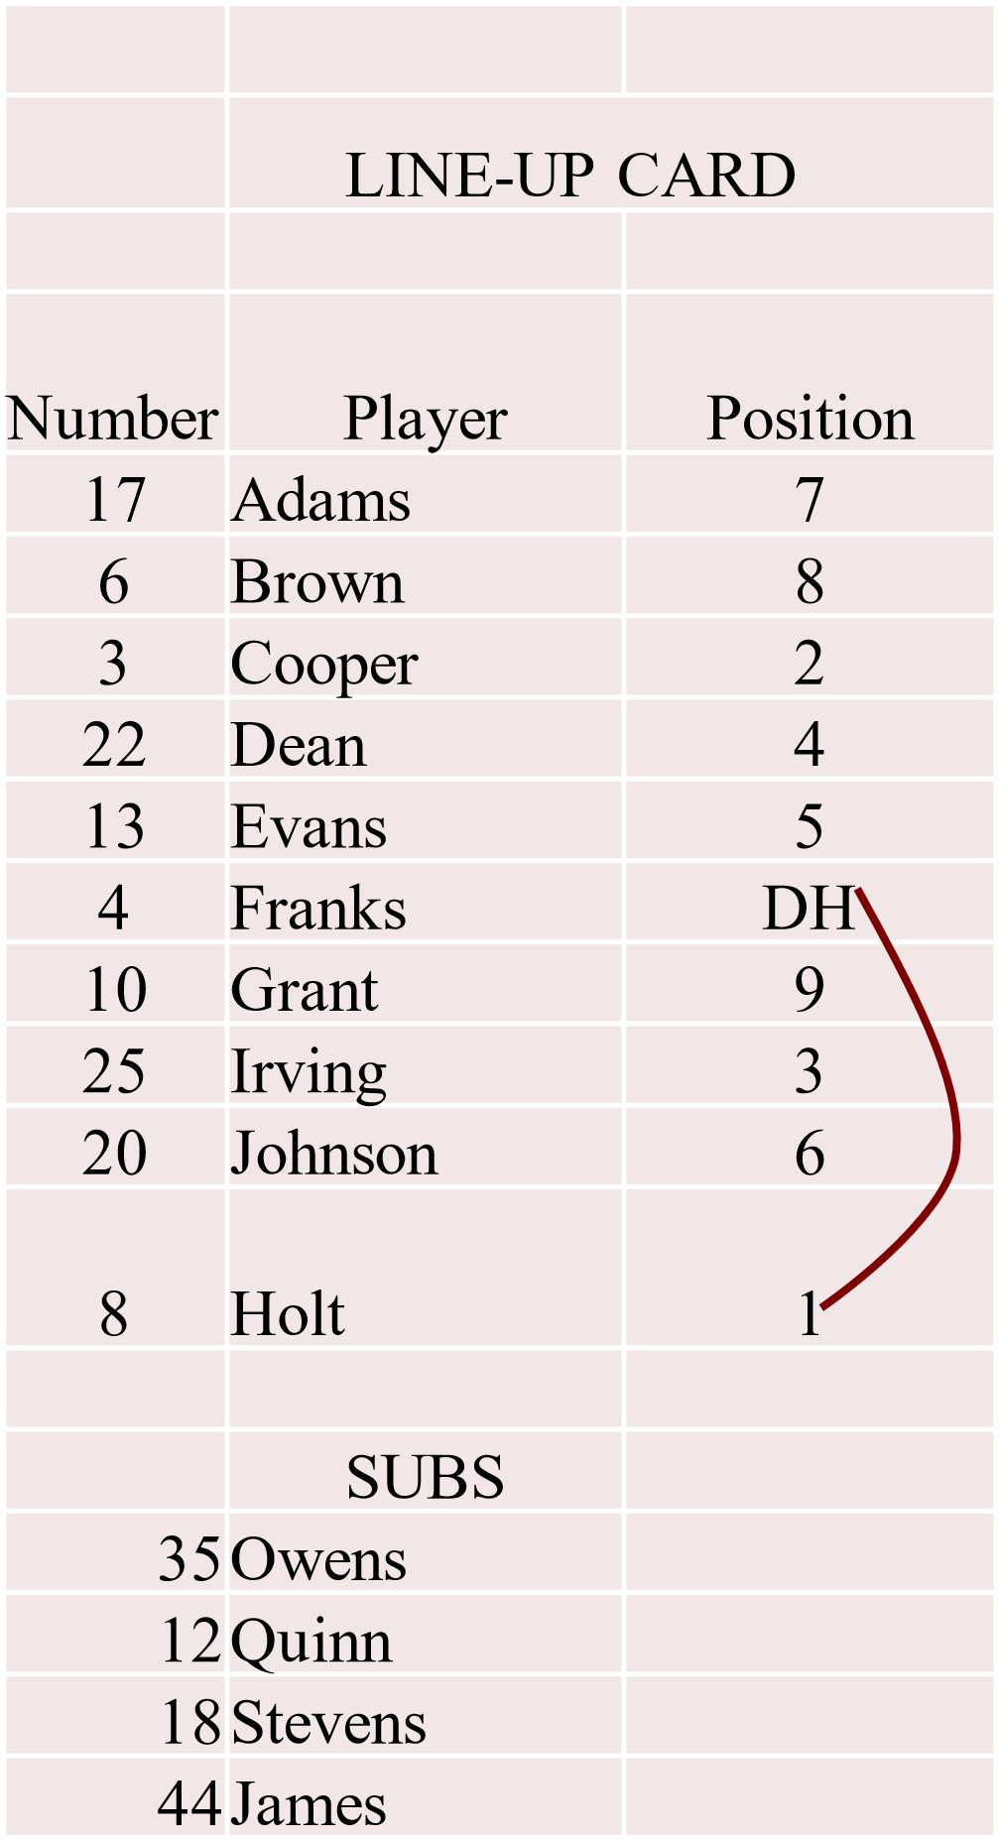
DH Designated Hitter (continued)
If the line-up card is presented with a DH listed yet no bracket, look below to see if the pitcher is listed at the bottom. CONFIRM who the DH is hitting for and if hitting for the pitcher, then bracket it as shown here.
It is possible that the coach put the DH and whom he is hitting for on one line and there is no bracket. Once the DH and defensive player he is hitting for is confirmed, it is a good habit to bracket even if written on the same line.

Slide 14
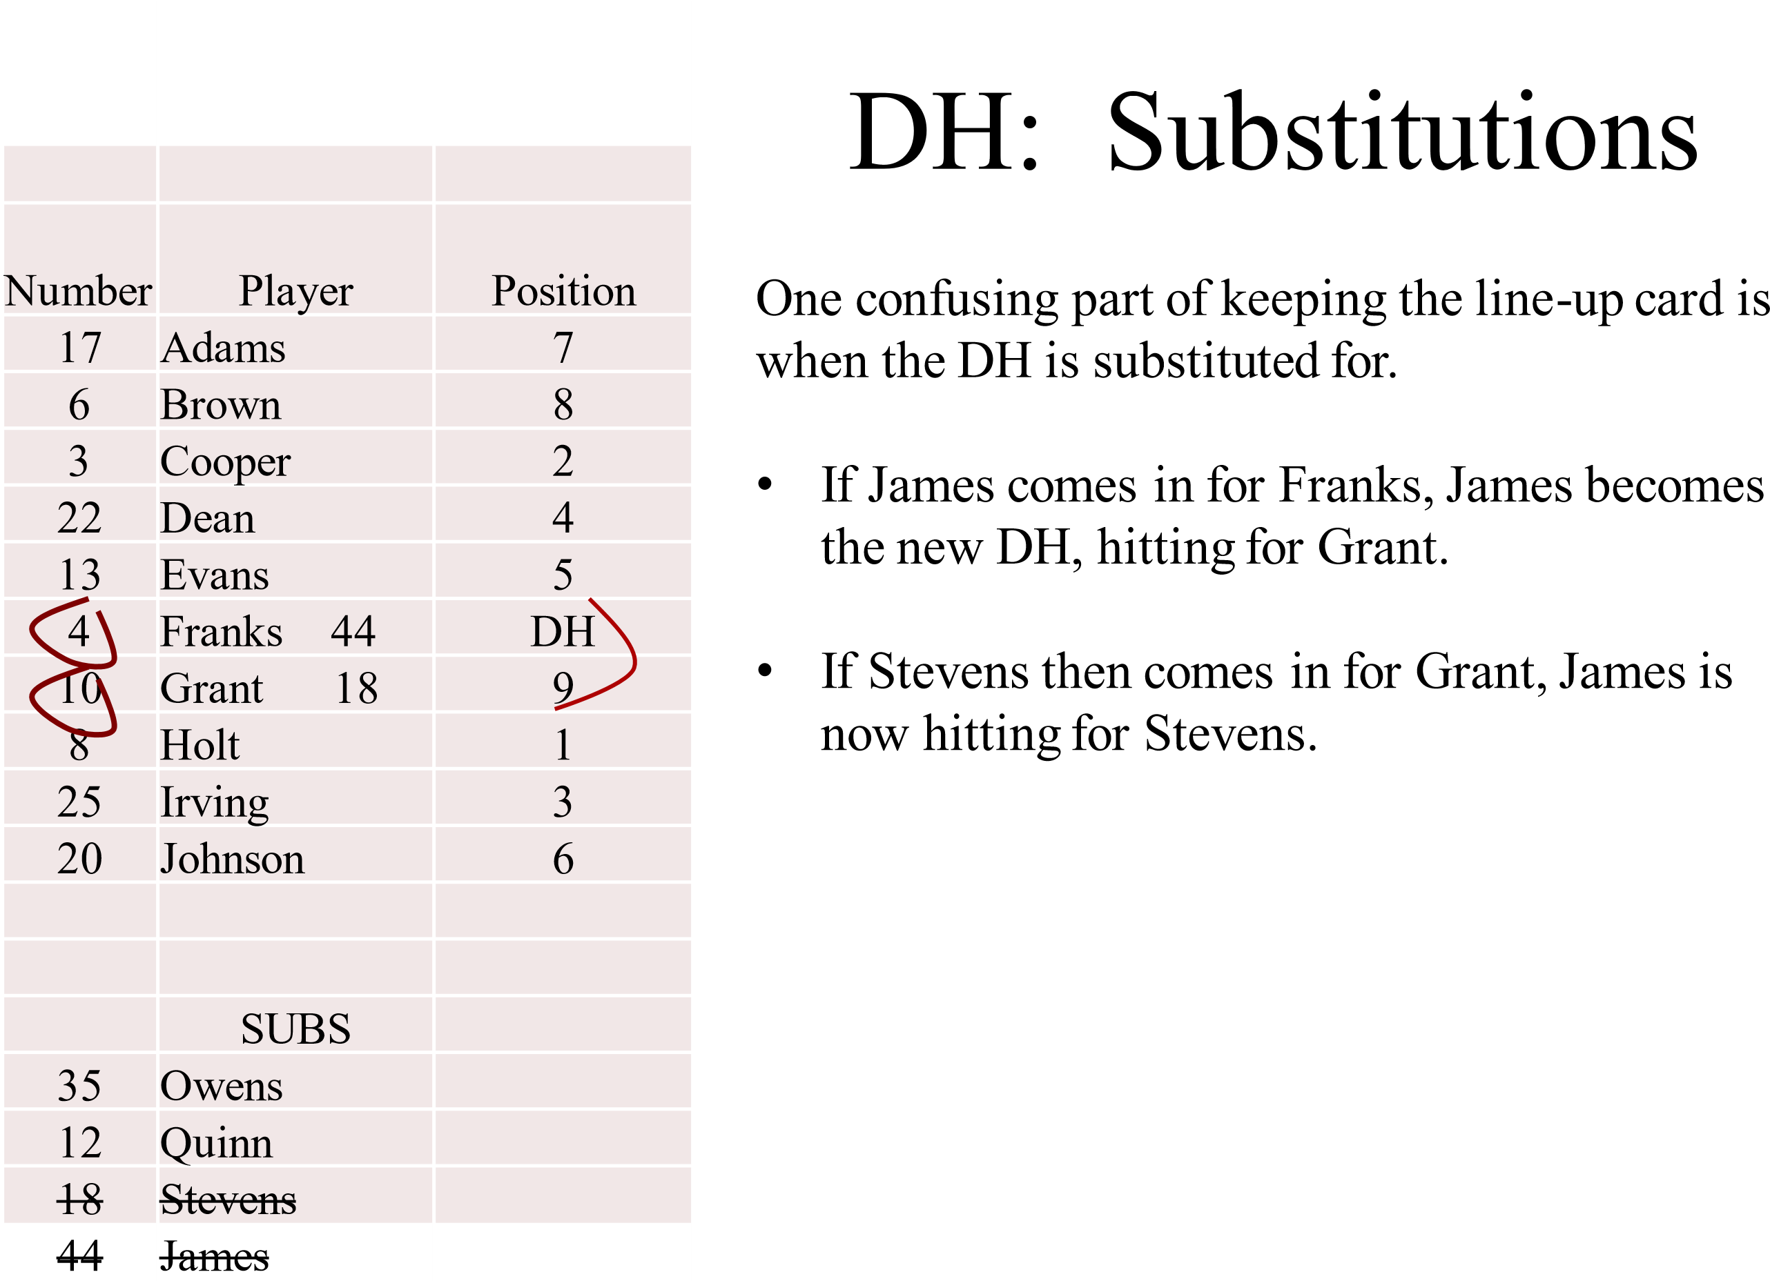
LINE-UP CARD

Slide 15
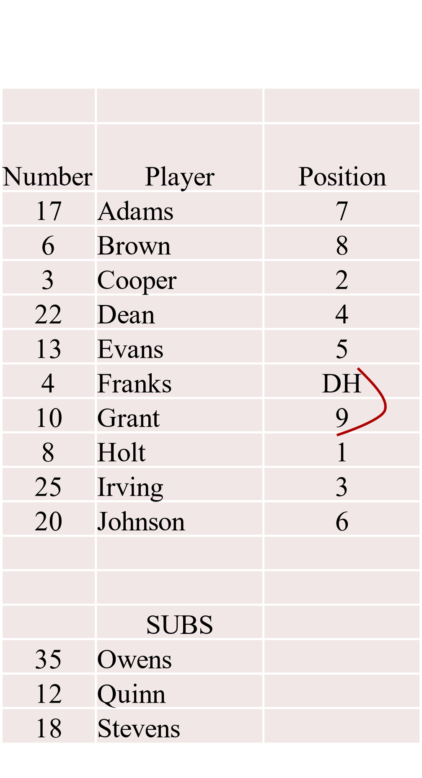
DH: Role of Terminated
LINE-UP CARD
…another confusing part in keeping the line-up card is when the role of DH is terminated.
_{IF}
Any DEFENSIVE player whom the DH has hit for enters the game on OFFENSE.
OR
Any player who was the DH (OFFENSE) enters the game on DEFENSE.
THE ROLE OF THE DH IS LOST.
NOTE 1: The DH and defensive player he is hitting for cannot both be on offense or defense at the same time.
NOTE 2: The starting DH and starting defensive player he was hitting for do not lose re-entry status (if status remains) when the role of DH is lost.
44 James

Slide 16
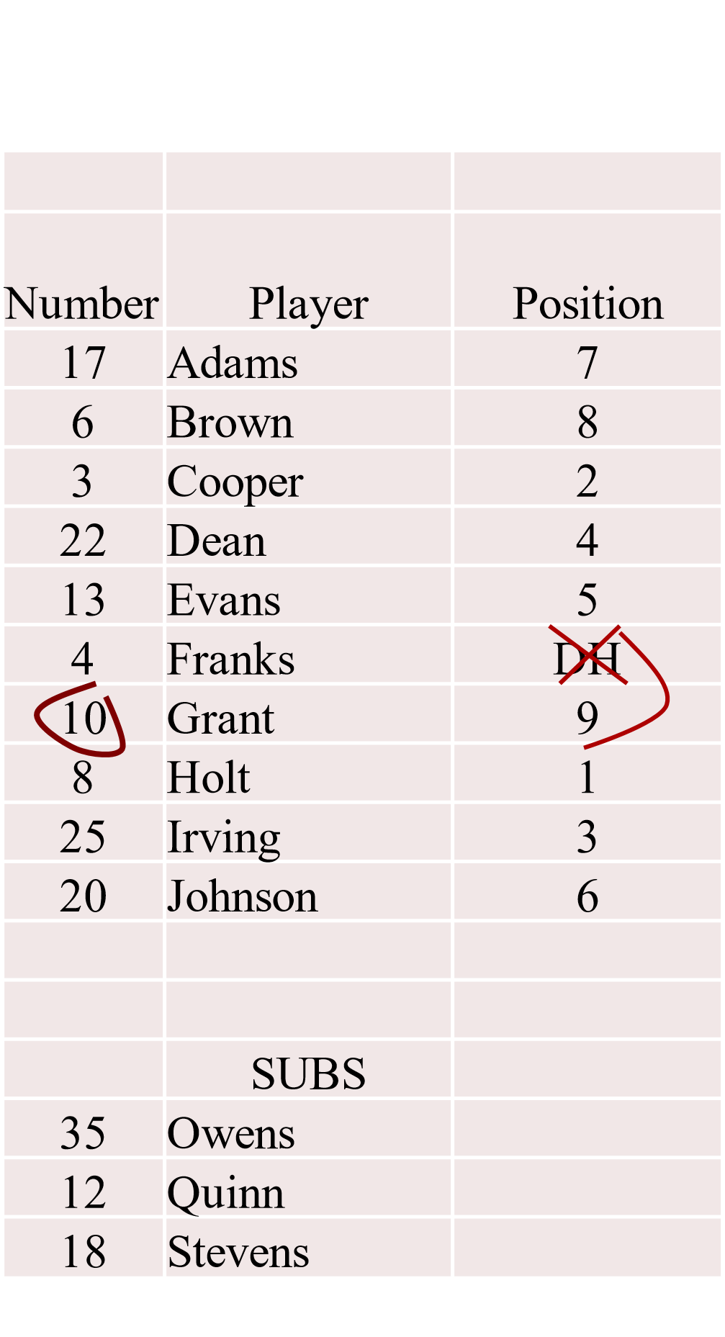
Role of DH is Terminated
LINE-UP CARD
Franks enters the game defensively. He remains as the hitter in the #6 slot.
The ROLE of DH is terminated meaning Grant must come out of the line-up. Circle Grant’s number.
X through DH on line-up card.
NOTE: It is NOT important to change defensive positions on line-up card unless it is a new pitcher or catcher; so to know who CR (if used) can run for.
44 James

Slide 17
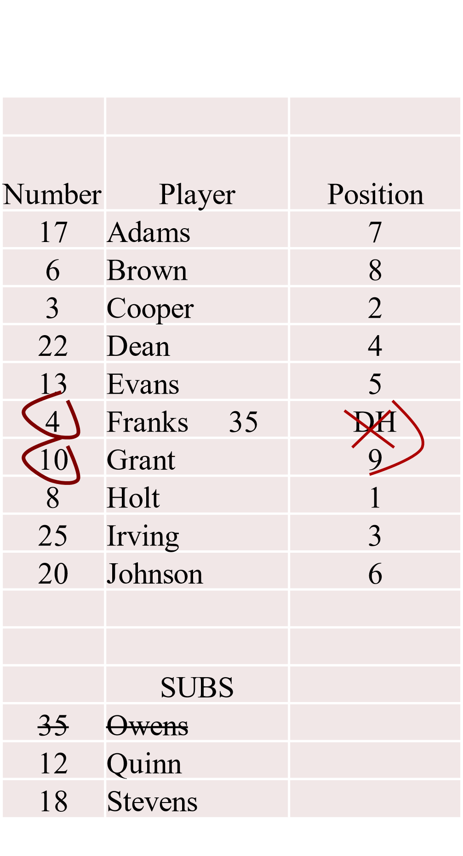
After Role of DH is Terminated
(B)
LINE-UP CARD
• Owens substitutes for Franks.
NOTE: By looking at this line-up you can easily see that Franks and Grant are ‘out’ of the line-up but not out of the game…they have re-entry because their numbers or names aren’t crossed out.
It is clear that there is no longer a DH and that Owens is hitting in the #6 slot.
CONTINUED:
44 James

Slide 18
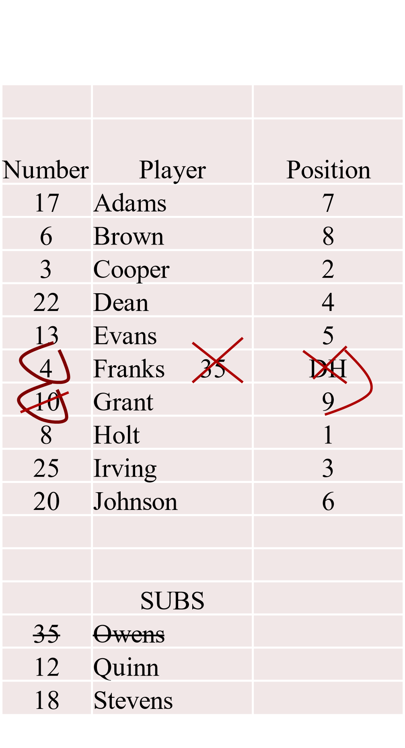
After Role of DH is Terminated
(continued)
(B)
LINE-UP CARD
• Grant re-enters.
NOTE: By looking at this line-up you can easily see that Franks is ‘out’ of the line-up but not out of the game, yet Owens is out of the game. With the line through or IN Grant’s number; this signifies that Grant is back IN the line-up hitting in the #6 slot.
CONTINUED:
44 James

Slide 19
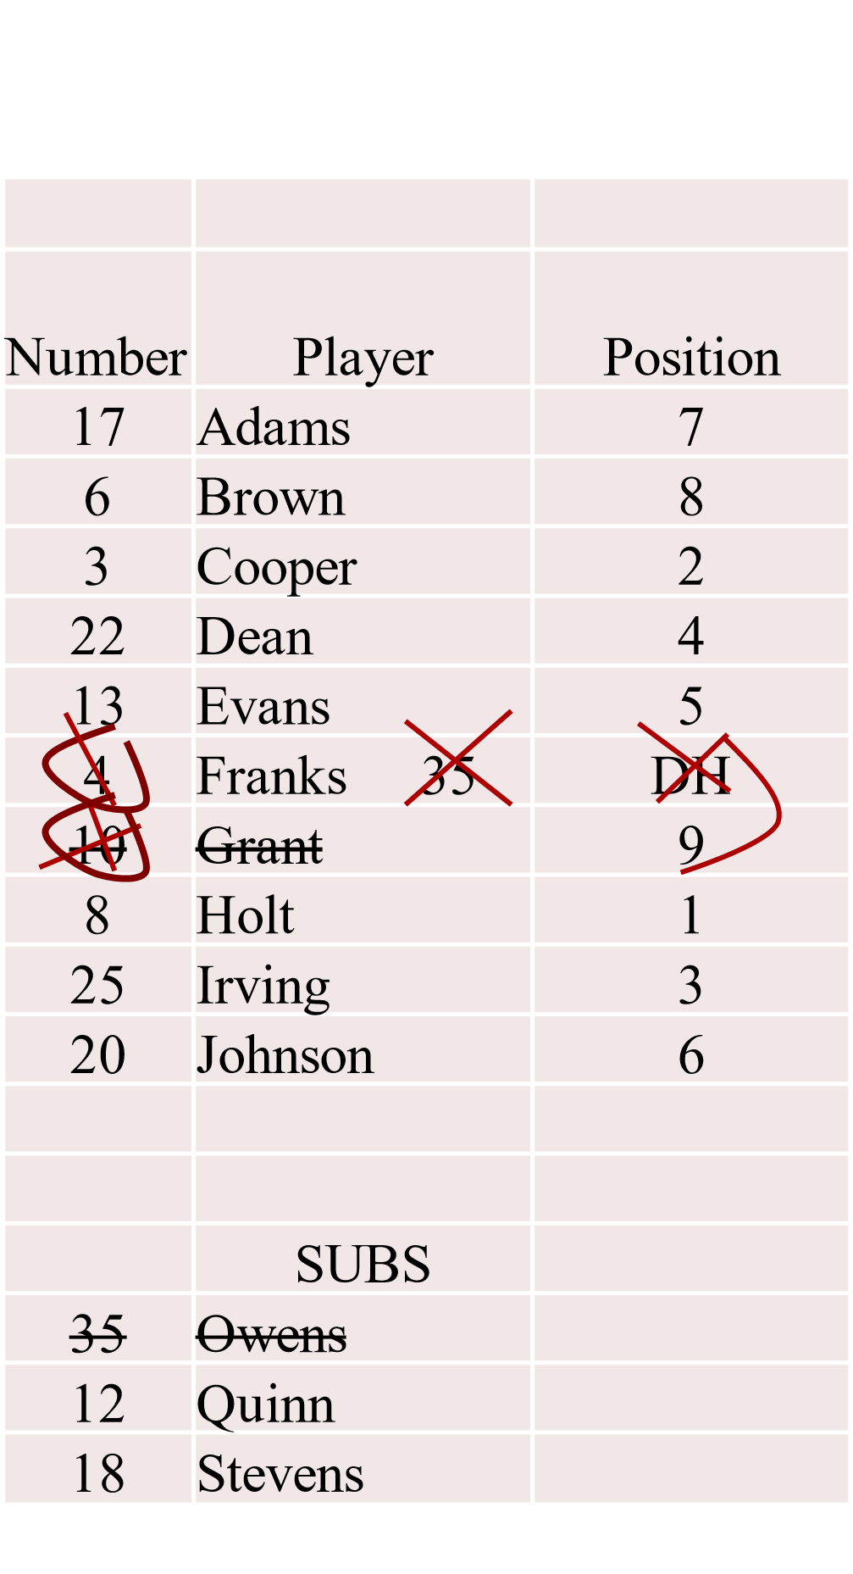
After Role of DH is Terminated
(continued)
LINE-UP CARD
• Franks re-enters.
NOTE: By looking at this line-up you can easily see that Grant is now out of the game. There is a second line through his number creating an X. Once Grant is out of the game, a line should be put through his name. With the line through or IN Franks’ number; this signifies that Franks is back IN the line-up and hitting again in the #6 slot.
44 James

Slide 20
SPEED-UP RULES
Located in the back of the Rules Book after Rule 10
COURTESY RUNNER(S) – CR
OPTIONAL at any time.
Used for PITCHER(S) and/or CATCHER(S) only.
CR must be a player who has not been in the game.
There is no limit on how many Courtesy Runners can be used.
Cannot use the same CR during the game for both positions; catcher and pitcher.
CR is running for POSITION, not PLAYER.
(Smith runs for Jones who is pitching. If Jones comes in to catch, Smith cannot run for Jones as the catcher. Smith can only run for a pitcher.)
CR cannot come into the game as a substitute to pinch hit or pinch run in the same ½ inning that he was used as a CR.
Exception: If injury, illness or ejection happens and there is no other substitute to come in, the CR may enter the game as a substitute.

Slide 21
COURTESY RUNNER
Projected Substitution
Projected substitutions are NOT ALLOWED
Example: F8 (right fielder) gets on base. Coach calls time and tells the umpire that F8 will come in as catcher when the team goes back on defense and wants to use a CR for F8. This is considered a ‘projected substitution’. This is not allowed. A CR may only be used for the pitcher or catcher that played the last time their team was on defense.
At times coaches, while on offense, will give a change - a pinch hitter or pinch runner, then say, “#12 will re-enter”. (meaning when the team goes back on defense.) That is considered a projected substitution. Let the coach know that he should tell you when #12 actually re-enters the game – when team is back on defense.
RULE 3-1-1

Slide 22
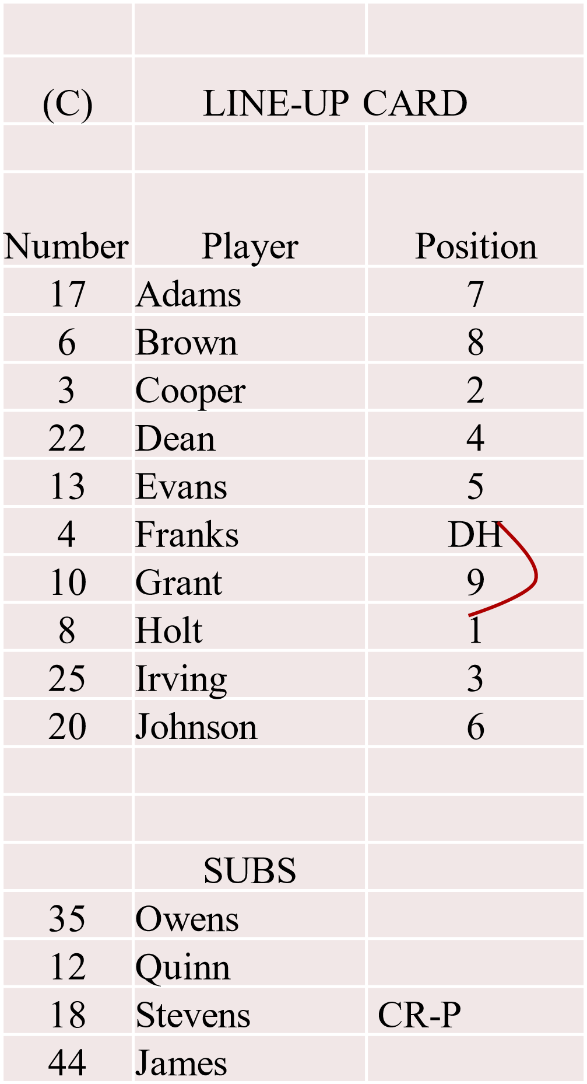
LINE-UP CARD ‘C’
Recording Courtesy Runner(s)
• Stevens runs for the pitcher, Holt.
1. Write next to Stevens’ name;
CR-P (Courtesy Runner for Pitcher)
NOTE: a) The umpire calls ‘time’ when a CR enters the game. b) Some coaches make the mistake by saying they have a ‘pinch runner’. Be sure to clarify that he means a CR. A pinch runner is a substitute. c) Some umpires wait to write CR down at the ½ inning to save time. This is fine, but glance at your line-up card to be sure that player is eligible to run… otherwise it is an illegal substitute situation.
CONTINUED:

Slide 23
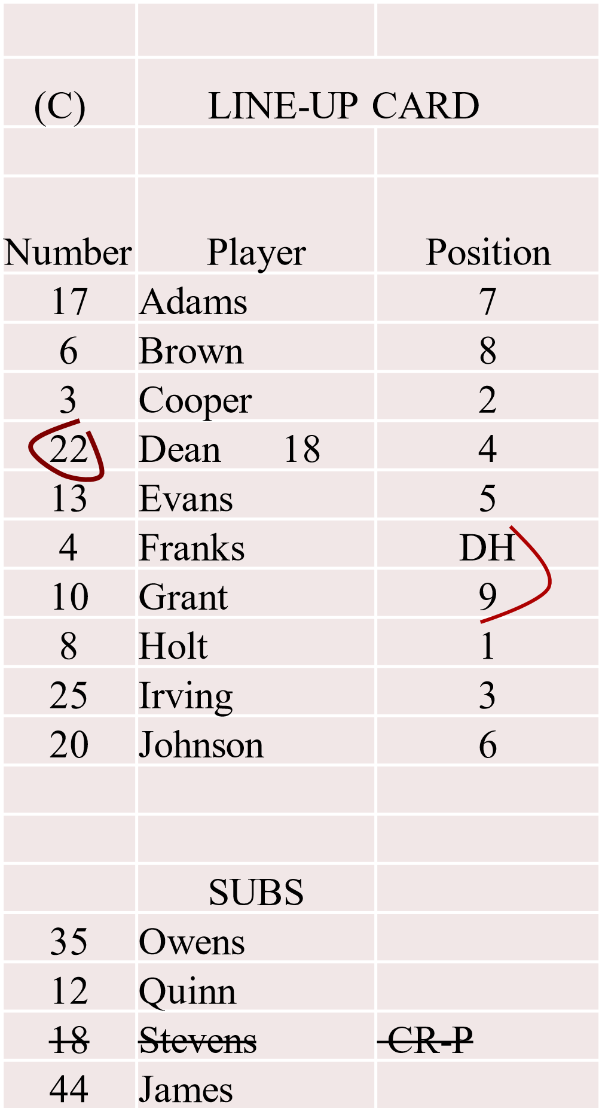
LINE-UP CARD ‘C’
Recording Courtesy Runner(s)
• Stevens enters the game.
Write Stevens’ number on line-up and cross out Stevens’ name in sub list.
Cross out CR-P…he can no longer be used as a CR once he enters the game.

Slide 24
CHARGED CONFERENCES
Each team, when on defense, may be granted not more than three charged conferences during a seven-inning game , without penalty, to confer with a defensive player or players. (Not just the pitcher.) This is a High School rule difference from pro and college. ‘Trip to the mound’ is not High School terminology if coach goes to the mound; charged defensive conference is correct.
In an extra inning game one defensive conference is allowed in each extra inning. Unused conferences from the first seven innings cannot be carried over into the extra inning(s). Each team is allowed one offensive conference per inning throughout the game.
The umpire keeps written record of the conferences. Defensive especially must be kept. Many officials don’t record Offensive conferences since only one per inning; easy to remember. (It is important an official develops an efficient way to record conferences so not to delay the game.)
NOTE: A team is not limited to how many of the three conferences are used in one inning.
READ entire rule for complete information on charged conferences in regard to: a) when a conference ends b) when a conference is not charged c) when a pitcher is removed.
RULE 3-4 (1-5)

Slide 25
TEAM MAY FINISH GAME WITH 8 PLAYERS
Rule 4-1-3 Each team’s line-up card shall list a minimum of nine players to
START the game.
Rule 4-4-1f A game shall be forfeited to the offended team by the umpire when a team: is unable to provide at least nine players to start the game or cannot provide eight players to FINISH the game.
NOTE 1: (When playing with 8) an OUT will be called each time that spot in the batting order comes to bat. If the offensive player must be substituted for after reaching base, the most recent batter not on base is allowed to run for that player.
NOTE 2: A team playing with fewer than nine players MAY RETURN to nine players.

Slide 26
WARNINGS
EJECTIONS
RULE 3-3 Penalty
Florida now applies this rule as written.
Warnings: (Rule 10.2.3j Plate umpire keeping written records.)
Verbal warning.
Written warning. ‘Written’ simply means ‘restriction to the dugout’…NOT a literal warning that is ‘written’ and given to coach.
Third ‘warning’ requires the coach to ejected.
NOTE: A coach may be ejected without warning or after a verbal warning if violation is judged to be severe. Once a coach is restricted…any other violation the coach is to be ejected.

