Slide 1



Luke Pingel
Email: Luke.pingel22@gmail.com
Financial Advisor @ Legacy Investments
4th season as Assistant Sprints/Hurdles
Freedom High School 2019 – 4x2, 300h, 4x4
University of Minnesota – 400h

Slide 2
Training Pyramid
Technical Training
Running & Weights
Flexibility Training
Nutrition & Mentality
Physical Health

Slide 3
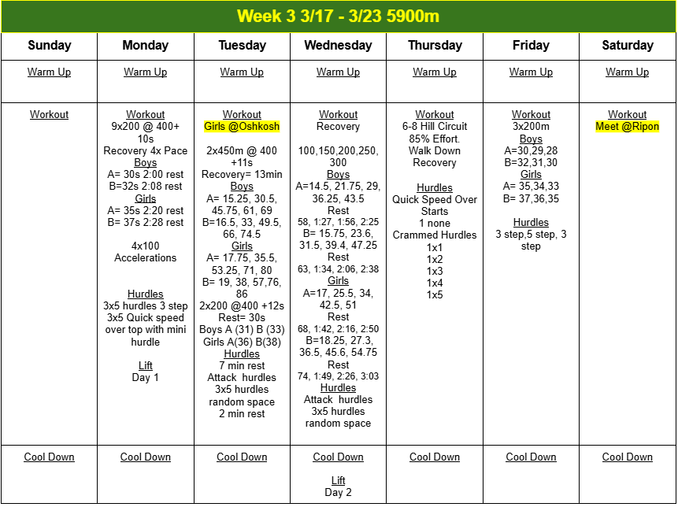
Planning out your Practices/Weeks/Season
Athletes only have so much energy to expend in a day
Less can be more
Make sure your hurdle plan correlates with your running program
Multi Event Athletes

Slide 4

Train Based on the Athlete
Not evert athlete is at the same skill base and not every athlete has the same problems
Not every athlete can do both hurdles

Slide 5
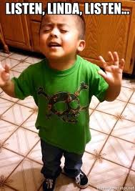
Communication
Need to know what is going on with your athletes so you aren’t doing a drill that is making an injury worse
Listening is just as important as speaking
It does not matter what you know if you can not get the kids to understand and execute
Cues

Slide 6

Record Races & Practice
Beneficial for coach and athlete
Able to see things you can’t see the first time or in full speed
Showing Athletes what you are seeing

Slide 7
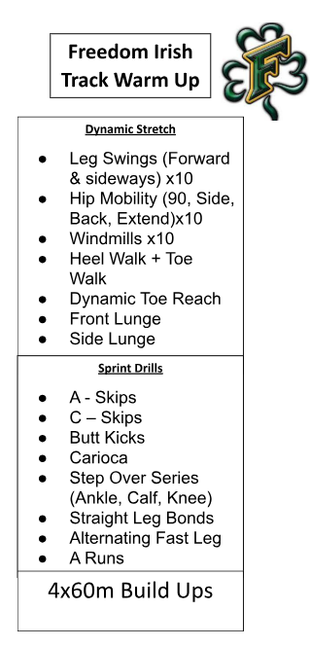
Warm Up
Practice
  Set base warm up drills
  Change the drills slightly based on what you are working on that day
  Competition
  Set a warmup that makes the athlete feel the readiest for competition
  Needs to be consistent for every race

Slide 8
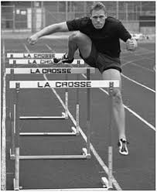
One Step
Run the side of hurdles to work trail leg
Girls 7-9 steps
Boys 8-10 steps

Slide 9

Cramming Hurdles
Discount the hurdles 1-4 steps
Allows them to 3 step
Works rhythm
Start

Slide 10
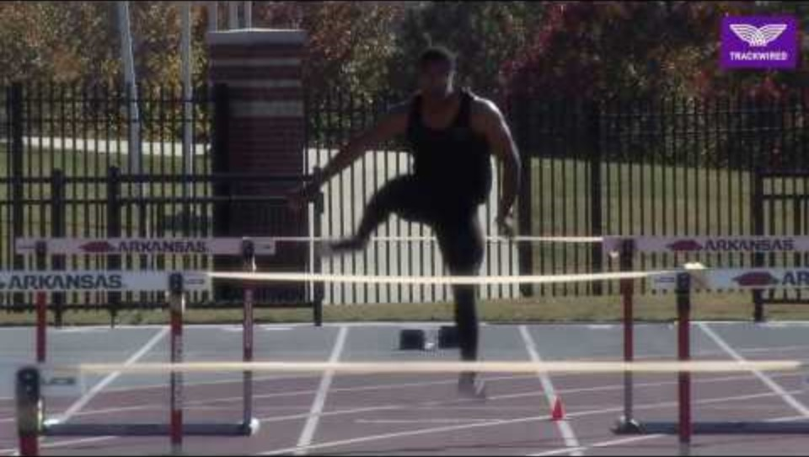
353
Normal starts then a 3 step then a 5 step back to a 3 step
Overspeed training into hurdles
Girls – 12m
Boys – 13m

Slide 11
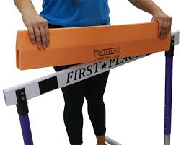
Starts with a Foam Top
Athlete can attack lower into the hurdle without concern of hitting
1x1
1x2
1x3
1x4

Slide 12
Set Expectations & Goals
Holds accountability
You and the athlete can be on the same page on what they want to get out of the season

Slide 13

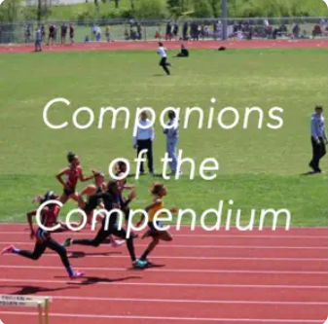

Be a Student of the Game
Clinic
Podcasts
YouTube
Coachtube
Books
Twitter

