Slide 1


Kicking Off Your Season
Provided by the MHSA, the NWCA, & FloSports

Slide 2
IMPORTANT DATES IN THE MHSA SEASON
First assessment date: November 21, 2024
Last assessment date: January 31, 2024
Minimum wrestling weight deadline: Decmeber 24, 2024
Minimum wrestling weight lock date (if applicable): February 16, 2025
Growth allowance date: January 1, 2025 and February 1, 2025

Slide 3
KICKING OFF YOUR SEASON: YOUR ROSTER
-You will be sent your login directly from TrackWrestling. These logins go out once the gives the team list to TrackWrestling.
-Always start with importing your roster from last season
-Video Link: How to Import Your Roster from last season
-Then add new additions
-Video Link: Adding New Wrestlers to your Roster
Rosters must be completed by January 31, 2025.

Slide 4
KICKING OFF YOUR SEASON: ASSESSMENTS
Assessor Practice Transactions: How to Video
Approving or Denying Weight Assessments: How to Video
Viewing a wrestler’s Alpha Master: How to Video

Slide 5
KICKING OFF YOUR SEASON: YOUR SCHEDULE
To Add a Dual Meet: How to Video
To Add an Individual Tournament: How to Video
To Add a Multi-Dual Event: How to Video
-Please note: Once you add a team to an event, it shows up on their schedule to “accept.” You can accept events versus adding a second one to avoid duplicate events and results.

Slide 6
KICKING OFF YOUR SEASON: WEIGH-INS
Creating a Weigh-In Sheet: How to Video
Entering and Committing Weights: How to Video

Slide 7
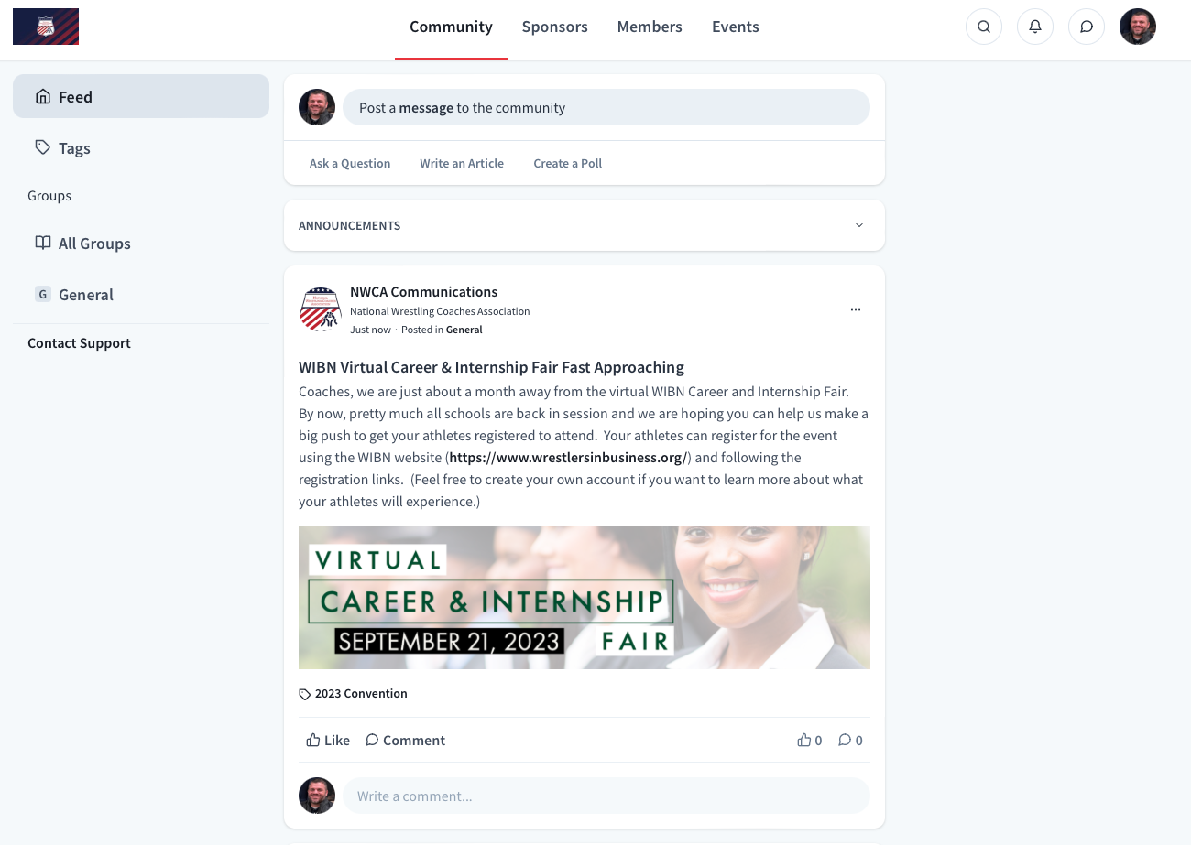
KICKING OFF YOUR SEASON: YOUR BENEFITS
-LIVE Dual Meet scoring is FREE on TrackWrestling: How to Video
-All OPC Subscribers are also
NWCA Members!
-Please go to
NWCAonline.com,
navigate to MEMBERSHIP
in the top right and explore
our members-only portal.
GOOD LUCK this season!

