Slide 1

NTB TEAM BOOKS 101
EVERYTHING YOU NEED TO KNOW TO ASSEMBLE AND SUBMIT YOUR CREDENTIAL BOOK.

Slide 2


TEAM BOOK OVERVIEW.
Tips:
Don’t panic! This looks like a lot of information, but it is broken down into easy to digest sections.
If you have questions, your Affiliate Registrar will be happy to help! If you are not sure who your Affiliate Registrar is, your Association Registrar point you in the right direction.
AS TEAM MANAGER YOU ARE RESPONSIBLE FOR ASSEMBLING YOUR TEAM’S CREDENTIAL BOOK. THIS GUIDE WILL LET YOU KNOW WHAT NEEDS TO BE INCLUDED, IN WHAT ORDER YOUR BOOK NEEDS TO BE ORGANIZED, HOW TO CONVERT FILES TO PDF, HOW TO SUBMIT YOUR BOOK TO YOUR AFFILIATE REGISTRAR, AND WHAT TO HAVE ON HAND AT NATIONALS.
A Few Things To Note:
All books must be submitted electronically in the format described in this guide as the Affiliate Registrars must forward the books to the District Registrar in the stated format as teams advance to Nationals. No physical books will be accepted for credential checks.
You must have a physical book on your person at Nationals.

Slide 3

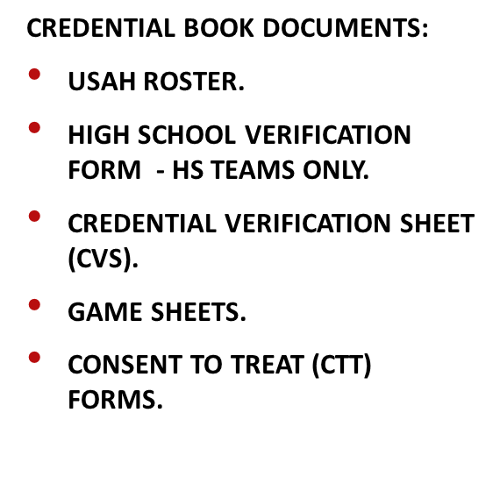
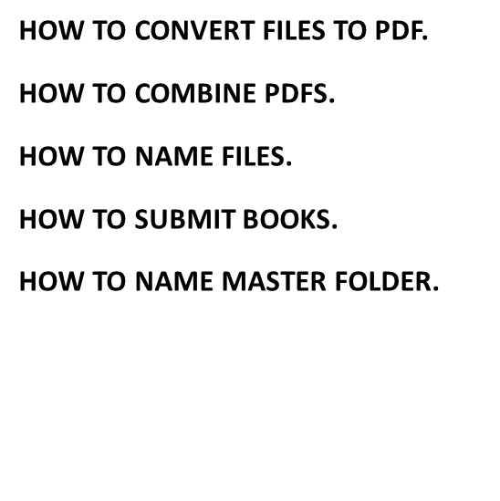
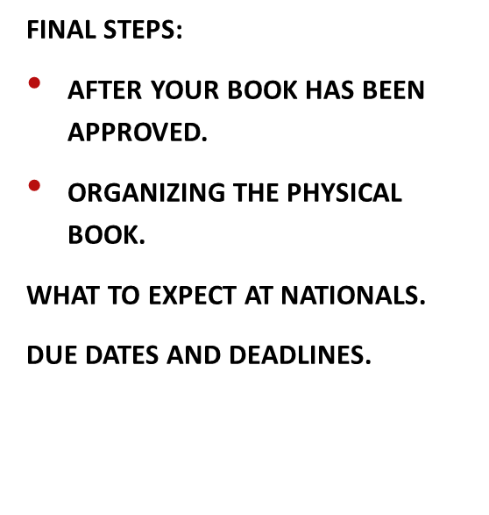

Slide 4
TEAM DOCUMENTS
PLEASE SEE THE FOLLOWING PAGES FOR EXPECTATIONS, EXAMPLES AND INFORMATION
ABOUT EACH DOCUMENT REQUIRED.

Slide 5
You will need a printed roster (roster links and handwritten rosters cannot be used) for your book.
Before downloading your roster please ensure it is up to date.
Includes an accurate list of players, coaches, managers, volunteers, and at least two non-coach designated locker room monitors.
Draw a line through anyone who will not be proceeding to Districts and/or Nationals.
Official USAH 1-TRoster.
Tips:
Don’t cross off players due to injury unless 110% certain they will not attend! They may end up playing and it’s easier to scratch them off a game sheet than add them on!
You only need to send your final roster –registrars can see any add/drop history in the USAH portal.
If your team has an Athletic Trainer who will attend States, Districts, and/or Nationals make sure they are listed on the roster.
All players’ DOB and Citizenship is verified.
All players’ jersey #s (home and away, even if they’re the same!) appear on the roster.
All players’ positions are indicated on the roster (forward, defense, goalie will suffice).
Reach out to your association’s registrar to add numbers or positions.
All have CEP requirements complete with an expiration date of 2026 or later.
Aside from crossing out those members that are not participating in Districts/Nationals you should NOT write/add anything on the roster.
The team members on the roster must be identical to the team members on the CVS.

Slide 6




High School
Verification Form.
Applies to High School Teams ONLY
The USAH High School National Championship Verification Form is available from your Affiliate Registrar.
Players must be full-time students in grades 9 – 12.
8th graders are not eligible.
Players graduating mid-year are no longer eligible for Nationals.
Players are only eligible for 8 consecutive semesters beginning their freshman year.
5th year students are not eligible.
The head coach must sign the Verification Form to indicate that he/she attests that all players on the roster are eligible for high school NTB teams.
This form must be included in the credential book for all high school teams.
The Affiliate Registrar will send the form to the host registrar (you should not do that) along with other required paperwork.

Slide 7
CVS –
Credential Verification Sheet
The CVS must include an accurate list of players, coaches, managers, volunteers, and at least two non-coach designated locker room monitors (LRMs).
Draw a line through anyone who will not proceed to Districts and/or Nationals.
Tips:
You can get your CVS from your association registrar.
Double and triple check everything is current and up to date before filling out the CVS.
Use black ink/editing tool to cross out anyone not participating in Districts/Nationals. Highlighter and pencil degrade if scanned.
An auto-populated CVS is needed for your book (a handwritten CVS cannot be used).
Before filling out the CVS please ensure it is up to date and matches the USAH roster exactly.
All players’ DOB and Citizenship are verified.
All players’ jersey #s (home and away, even if they’re the same!) appear on the CVS.
All players’ positions are indicated on the CVS.
Reach out to your association’s registrar to add numbers or positions.
All coaches show CEP with an expiration date of 2026 or later.
Expiration of 20** is acceptable for High School rosters.
Check if anyone’s SafeSport will expire in between playoffs and Districts and/or Nationals.
If the CVS does not have all these items complete/current it will need to be redone.

Slide 8
You will need to fill in game information for each player.
Add the game date at the top of the column and indicate which players participated in the game.
Players must have been on the USAH roster the date the game was played to count the game. (ie; a player added to the roster on 10/20 can not get credit for a game played on 10/19).
The Affiliate Registrar can see if/when players were added, dropped, and re-added to the roster in the registry portal.
For a player to get credit for a game they must also show as an active player on the game sheet.
Back up goalies DO get credit if on the bench.
Suspended players do NOT get credit.
If a player is short games due to injury let your Affiliate Registrar know. The player may qualify for a game count waiver.
Please indicate the total number of games listed for each player.
Check off the CTT for each person (including coaches, managers, volunteers, locker room monitors) on the roster.
Do NOT write in the “transfer” column. That will auto-populate for players with non-US citizenship.
Do NOT sign or date the CVS. The Affiliate Registrars do that once the book has been approved.
Filling out the CVS.
Tips:
Regular season, tournament, and non-league games can all count.
List games in chronological order. Do not split games up by type of game.
Add 2 more games than required in case there is an issue with a game sheet, but no more please.
Do NOT use more than ONE CVS to fit in your games. We do not need every game your team played.
Examples on how to mark games are on the next few pages.

Slide 9



Youth Tier One and Tier Two - 20 games per team and 10 games per player.
GAME COUNTS.
Girls Tier One and Tier Two – 14 games per team and 10 games per player.
High School – 10 games per team and 5 games per player.

Slide 10
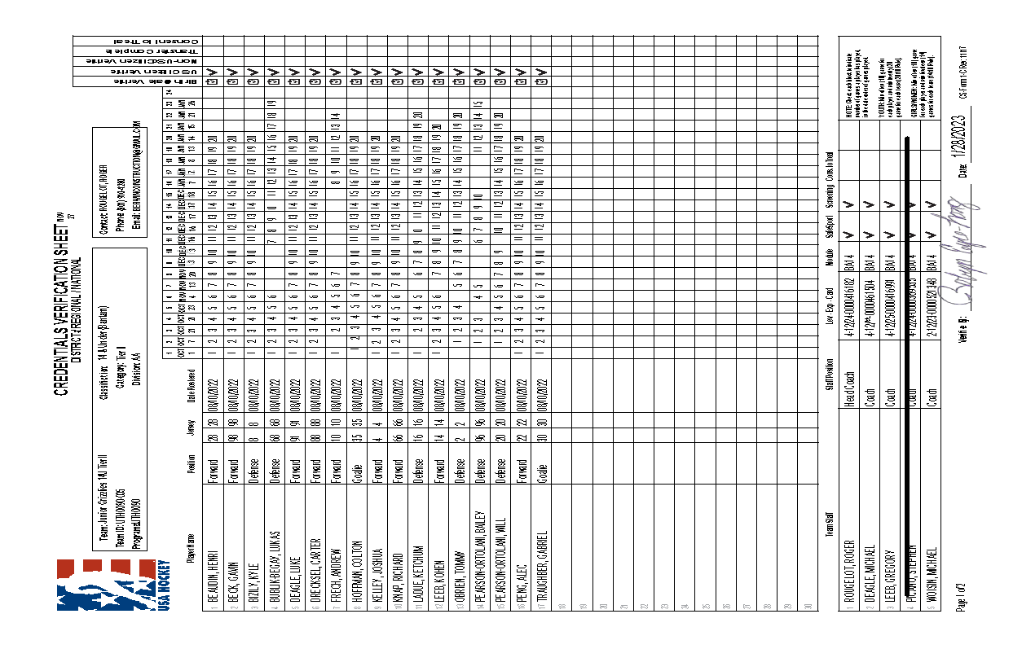
Game count totals are easy to see. Dates are legible. CTTs are checked. Coach that will not be in attendance is clearly
crossed out. If not attending CTT is not required and games for player do not need to be checked.

Slide 11
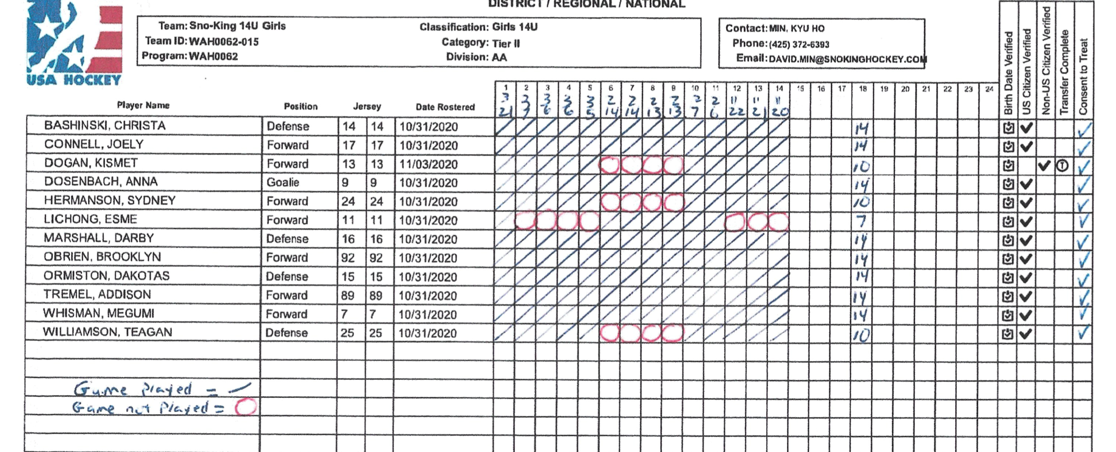

Slide 12
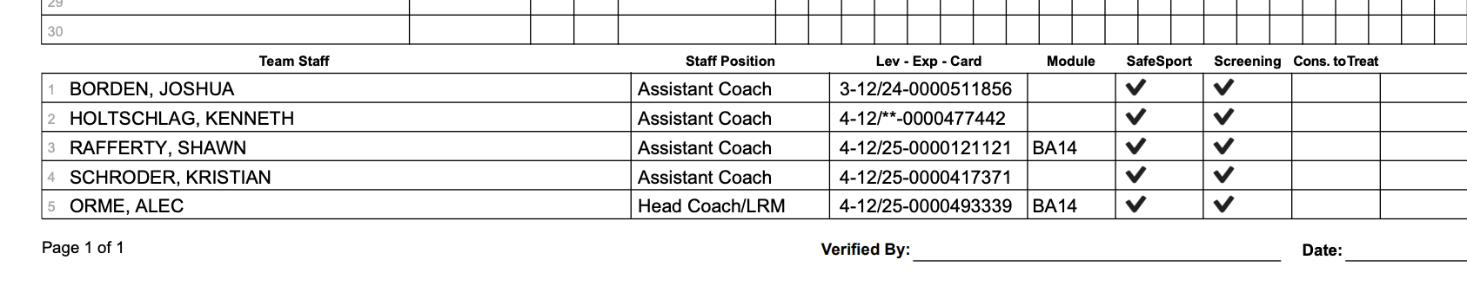
Staff information at the bottom of the CVS.
This roster does not have any non-coach LRMs or a team manager.
One coach still shows 2024 expiration for CEP.
CEP expiration of 12/** indicates a coach is grandfathered at level 4.
This is acceptable on a High School NTB roster, but NOT youth or girls NTB rosters.
Confirm 1T roster has the required age module and if doesn’t auto populate on CVS add it.
Check box for staff consent to treat.
Do NOT sign or date the CVS.

Slide 13
Game Sheets.
Game Sheet Musts:
Must be legible (even for those with old eyeballs).
Must be signed by head coach.
Must have referees’ signatures (preferred) or names visible.
Must include complete game information (date, location, team names, game roster for both teams, game data including goals, and penalties).
Must be submitted in .pdf format. No .jpeg, .png, etc. Consistent sizing please.
Must be submitted in chronologic and same exact order as on CVS.
Turn all gamesheets so they are upright and not sideways.
Game Sheet Must NOTs:
Must NOT have more than 20 players listed.
Must not have more than 4 coaches listed.
Must not have handwritten players added to computer-generated game sheets.
Do not submit any game sheets that are NOT on the CVS.
Game Counts:
Youth – 20 games/team; 10 per player.
Girls – 14 games/team; 10/player.
High School – 10 games/team; 5/player.
Tips:
Align all gamesheets in the upright position before submitting.
If your carbon copies are illegible when scanned, try adjusting the settings. If the sheets are too light or too dark to read they will not be accepted.

Slide 14
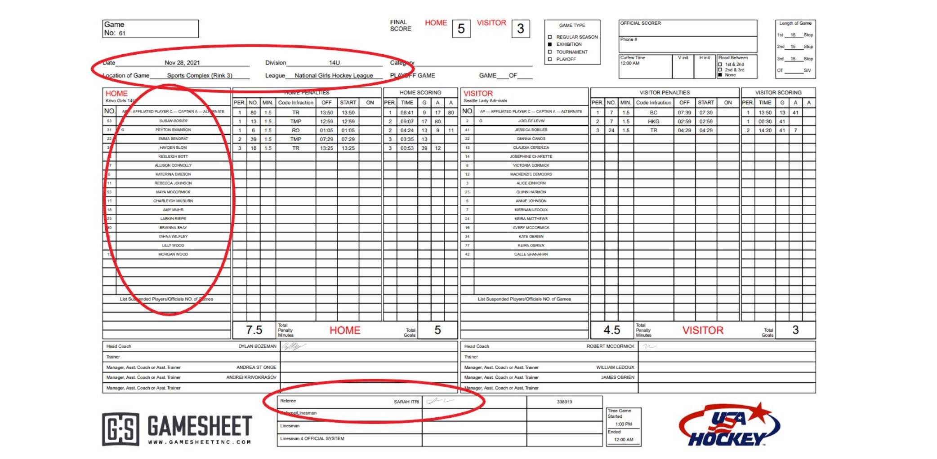

Slide 15
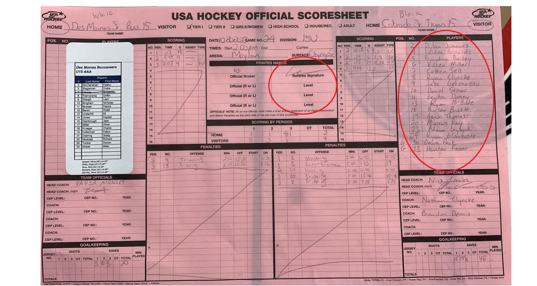
Another acceptable game sheet. Scanned carbon copy with a label (preferred) and legible handwritten roster. Referee and coach have signed. Make sure game sheets with labels do not cover up the coach signatures.

Slide 16
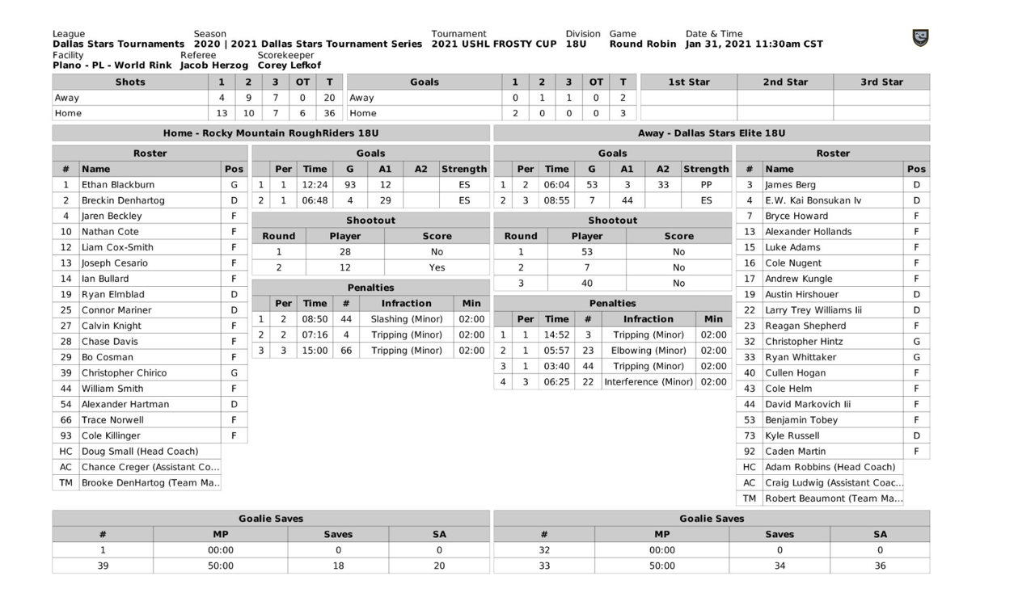
If attending a Dallas Stars tournament, you only need to submit the FIRST page (pictured above) of their multi page game sheet. There are no signatures on these. As long as names are listed they will be accepted.

Slide 17
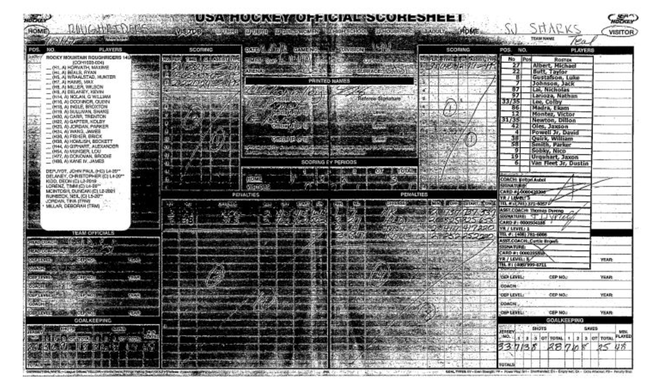
This would not be accepted. Game data, signatures are illegible.

Slide 18
Consent to Treats (CTTs).
Make sure you are using a current (rev. 6/21) CTT form.
The form must indicate excess accident insurance up to $50,000.
Everyone on the roster (players, coaches, managers, volunteers) who will attend Nationals must have a CTT in your book.
Submit CTTs in the exact order as the team members appear on your roster/CVS.
Players first, followed by staff.
Please do not mix staff in with players.
CTT forms must be filled out completely.
If no insurance the applicable section needs to be marked with NA.
Forms must be dated and signed (e-signatures are allowed) or will not be accepted.
All CTTs must be submitted in .pdf format. Please use consistent sizing. The entire form must be visible. No thumbnail photos!
Needed for everyone listed on the roster including:
Players
Coaches
Managers
Locker Room Monitors
Volunteers

Slide 19
CONVERTING AND CONSOLIDATING FILES:
AS TEAMS ADVANCE TO DISTRICTS AND/OR NATIONALS, YOUR AFFILIATE REGISTRAR IS REQUIRED TO SEND YOUR BOOKS IN THE FORMAT SPELLED OUT IN THE NEXT FEW PAGES.
ALL FILES MUST BE IN PDF FORMAT.
PLEASE TRY TO KEEP TO A UNIFORM SIZE. ABSOLUTELY NO THUMBNAIL SIZED ANYTHING.
ONCE YOUR DOCUMENTS ARE CONVERTED TO PDFS THESE WILL BE CONSOLIDATED INTO 3 OR 4 TOTAL PDFS AS FOLLOWS:
PDF #1 CONTAINS:
USAH ROSTER.
HS VERIFICATION FORM – HIGH SCHOOL TEAMS ONLY.
CVS. IF YOU DOWNLOAD THE FORM TO FILL IT OUT, PLEASE SCAN IT BACK IN. NO PICS OR SCREENSHOTS. DO NOT SCAN IN A PIC EITHER.
PDF #2 CONTAINS:
GAMESHEETS.
PDF #3 CONTAINS:
CONSENT TO TREAT FORMS.

Slide 20











How to Convert Files
to PDF on a PC.
Locate your image file on your PC (File Explorer is the best tool for this).
Right click on the file and select “Open with”. Select “Photos”.
In the top right bar, locate the printer icon and click on it.
From the Printer drop down menu select “Microsoft Save to PDF”, then click “Print”.
A save window should appear. Label your file clearly (best ways to label are addressed shortly).
Make sure you save your files so you can easily locate them!
How to Convert Files
to PDF on a Mac.
Locate your image file on your Mac (Finder is the best tool for this).
Double click to open the image in Preview (this is the default image viewing application on Mac).
If something other than Preview opens, close it, go to the “File” drop down (or right click on the image) to select “Open With” and select “Preview”.
In the ”File” drop down select “Export as PDF”.
A save window should appear. Label your file clearly (best ways to label are addressed shortly).
Make sure you save your files so you can easily locate them!

Slide 21
Online Conversion Tools
You can also use an online conversion tool such as the three below.
https://jpg2pdf.com/
https://www.adobe.com/acrobat/online/jpg-to-pdf.html
https://cloudconvert.com/png-to-pdf
File Naming.
For ease of organizing your documents once converted use these naming tips:
File naming helps when sorting the individual files into the correct order for the master PDF.
These are merely suggestions that can make it easier on you.
CTTs should be named with Last name, followed by First initial if needed so they can easily be ordered in the same order the team members appear on the roster.
Example:
Johnson CTT.
I suggest numbering game sheets in the order the games will be listed on the CVS or by the game date. Add opponent if multiple games on same date.
Examples:
10.14.24 Dallas, 10.14.24 Wyoming, 10.16.24, etc.
Game 1, Game 2, etc.

Slide 22
HOW TO ASSEMBLE AND SUBMIT YOUR BOOK

Slide 23
Now that your individual documents have all been converted to PDFs you will need to combine them into 3 master PDFs
Combining PDFs.
Please combine your individual PDFs into the 3 master PDFs.
Do NOT send individual PDFs for each game sheet, CTT, etc.
On Mac:
Open the PDF that will be the first page in Preview.
Click on the drop-down icon at the top left of the document and check thumbnails. This opens a sidebar showing the first page.
Now drag and drop the other pdfs into the sidebar. You can drop them in order or move them around once dropped in.
When done use “Save As” to update the file name as described on the prior page. You can go back later and add or delete pages as needed.
If you do not have a Mac and do not have Adobe Acrobat:
Check for free options on https://updf.com/merge-and-split/pdf-merger/.
Find a team member with a Mac or Adobe Acrobat willing to help.

Slide 24

Please name your PDFs as follows:
Team name, Age Level, Division, Team Information
For example – Jr Sun Devils 14U AA Team Information
Team name, Age Level, Division, Game Sheets
For example – Kachinas Girls 19U AAA Game Sheets
Team name, Age Level, Division, CTTs
For example – Bobcats 16U AA CTTs
The individual pdf’s need to be placed into 3 PDFs as follows:
**Be sure all docs are oriented upright and not sideways.
USAH Roster, HS Verification Form (HS teams only), CVS in FIRST PDF file.
Game Sheets in a SECOND PDF file.
CTTs in a THIRD PDF file.
NOTE – you need to submit 3 PDF files, NOT 3 folders containing numerous PDFs each.

Slide 25
Submitting Your
Team Book.
1
A shared google folder will be sent to each Association Registrar with district and national bound teams.
A shared google folder will be sent to each Association Registrar
The expectation is the Association Registrar has reviewed each team's credentials to ensure they are accurate and complete prior to submitting to the Affiliate Registrar
Do NOT create additional folders for your files or documents.
2
In each Association folder will be separate “team” folders for each of your eligible teams.
3
You will add your 3 PDF files to the “team” folder.
4
Please notify the Affiliate Registrar, melissa.Yubeta@usahockey.org once you have added your files to the team folder so the review process can begin.
5
Once each teams 3 PDF files have been reviewed and approved, the Team folder name will be labeled APPROVED, and an email will be sent to the Association registrar confirming the team is complete.

Slide 26
FINAL STEPS:
1
2
3
4
5
6
The Affiliate Registrar will review your book and let you know if anything is missing, needs a correction, or an update.
The Affiliate Registrar will send you a signed version of the CVS once your book is fully updated and complete. This CVS will replace the unsigned CVS in the physical book that will accompany you to Nationals.
As teams advance to Districts and/or Nationals their COMPLETE electronic book will be forwarded to the District Registrar and/or to the Nationals host registrar.
If advancing to Districts and/or Nationals be sure to have a physical book organized and on your person at all times.
It is often easier to spot check items on physical books rather than digital when at the event.
Instead of folders I recommend a binder with clearly marked tabs to correspond with the 3 PDF files in the electronic book. Organize the material for each tab in the same order as in the digital PDF.

Slide 27


What to Expect at Nationals.
Once a team advances to Nationals and their book has been verified the District Registrar will send the registration link and hotel information to the head coach and team manager.
Fee to register.
Team photo required as part of registration.
Stay to play.
Mandatory meeting for head coach/manager.
LRM’s will need to show a photo ID daily to receive a credential allowing access to locker room area.
Emergency Back Up Goalies.
If one goalie during regular season need to go through playoffs with one goalie.
Prefer local EBUG. Same association from same age level and same or lower division. From team no longer in playoffs.
Appeal to District Registrar (let us know) and provide explanation of extenuating circumstances.
If need arises during Districts/Nationals appeal to tournament committee. If team is unable to provide the goalie, it is possible the tournament host can locate one.

Slide 28
Deadlines
No further player changes after 12/31.
Vertical movement – Ends February 1st
Tier 1 youth - 15O, 16U, 18U Levels
Tier 1 Girls – 16U and 19U Levels
All staff changes and updates done, CVS, and roster updated at least one week prior to start of state playoffs.
Book Due Dates
January 15th for High School Teams
February 1st for Youth Tier 1
February 1st for Girls Tier 1, Girls Tier 2
February 1st for Youth Tier 2
Thank you for all your hard work throughout the season and yet to come.
Best of luck and enjoy the experience!

