Slide 1
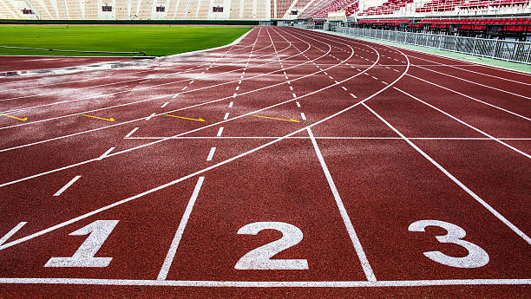
Evaluating Mental Performance
Post-competition Debrief

Slide 2
What
Gather as much information as we can about what happened prior to, during, and after the competition that we can use to then prepare for the next competition.
Debrief process fosters athlete accountability
Accountability leads to an increased sense of self-awareness.

Slide 3
Why
Gather as much information as we can about what happened prior to, during, and after the competition that we can use to then prepare for the next competition.
Debrief process fosters athlete accountability
Accountability leads to an increased sense of self-awareness.

Slide 4
When
  Timing
  It’s best to do this while the feelings and details of the comp are still fresh in the athletes mind
  24-48hrs post competition

Slide 5
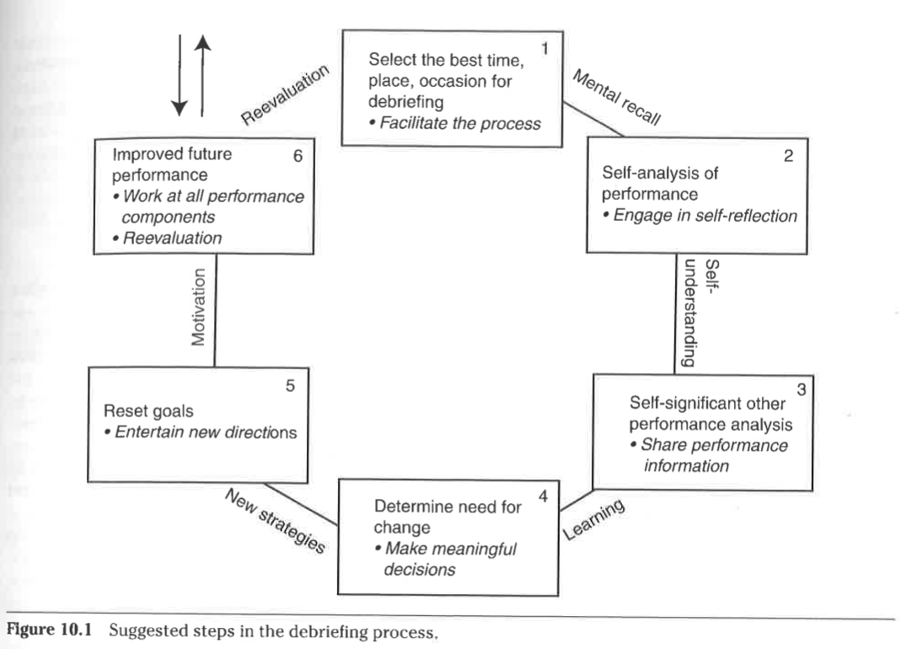

Slide 6
How
  Develop a routine so the athlete knows what is expected
  Feedback on effort/execution, not the person
  Strengths, what went well
  Areas for improvement and discuss specific plans to correct or make plans to discuss later, do not leave them hanging with no sense of how to get better
  Growth and learning as the goal
  Process oriented feedback
  Understand your context
    Find what works

Slide 7
How
1. What did you want to achieve?
a. What was your competition strategy (from both coach and athlete)
b. What was your mindset going in to the meet
2. What actually happened?
a. What were the details of what happened in the competition
b. Where would you grade the execution of your strategy (poor to good)
c. Where would you grade your mindset (poor to good)
d. Was there a gap between what you wanted to achieve and what actually happened?
3. What caused the gap?
a. How were competition tactics?
b. How was technique?
c. How was mindset?
d. How was nutrition?
e. How was overall health?
f. What other stressors?
4. What did you learn?
a. What did you do well?
b. What do you need to keep doing?
c. What needs to improve?
d. What did you learn that you would not have learned if you had not done the competition?

Slide 8
How
  Answer what they can based on the situation and what they have time for and are willing to answer
  The more accurate information you can get the better for them.
  Long term can help to see trends and identify what is effective

Slide 9
Post-competition, what is your protocol for debrief?
“We try to do a brief overview immediately after competing to gain information for a deeper, more detailed debrief to follow some days later. We do a series of debriefs after majors that lead to a very detailed and soul searching year debrief once the season ends.”
“I find it unproductive to do formal or deep debriefs immediately after the competition, as emotions are often way too hot by both parties. Often the post meet debrief does not happen due to drug testing, media duties, etc., so in that case it is late afternoon the next day if possible.”
-Dan Pfaff- Track and Field Coach of national, world and Olympic champions

Slide 10
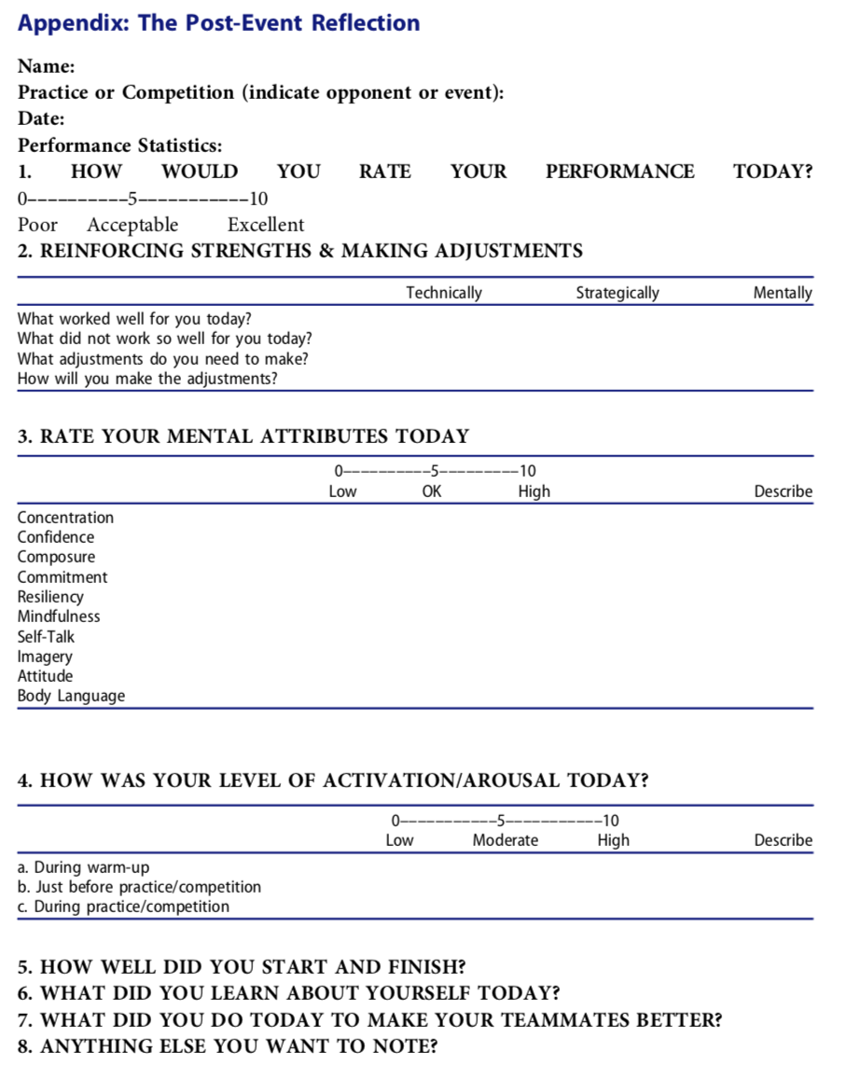
Chow & Luzzeri, 2019

Slide 11
5 Core Questions Post-Competition
Hoog, 2002, p.186
What Happened exactly?...for you… for the team?
What is the impact of your performance on you?...on the team?
How did your performance make you feel?
What did you learn- technically, physically, tactically and mentally?
What are you encouraged to repeat or do differently for the next meet/competition?

Slide 12
How did you feel about your performance today?
Unfulfilled 0 1 2 3 4 5 6 7 8 9 10 Satisfied
Tired 0 1 2 3 4 5 6 7 8 9 10 Energized
Uncommitted to my performance plan 0 1 2 3 4 5 6 7 8 9 10 Committed to my performance plan
Unsettled 0 1 2 3 4 5 6 7 8 9 10 Composed

Slide 13
How did you feel about your performance today?
Physically unprepared to compete 0 1 2 3 4 5 6 7 8 9 10 Physically ready for anything
Mentally unprepared to compete 0 1 2 3 4 5 6 7 8 9 10 Mentally ready for anything
Emotionally unprepared to compete 0 1 2 3 4 5 6 7 8 9 10 Emotionally ready for anything
Distracted and unfocused 0 1 2 3 4 5 6 7 8 9 10 Clear-headed and focused

Slide 14
What were you saying to yourself or thinking before and during your event?
What was your attitude going into your event and during today’s competition? Did you attitude help you or hurt you before and during your event?
Did you feel recovered and rested prior to this meet? Did you have the physical, mental, and emotional energy necessary to perform are your best? Why or why not?
What was your goal for this meet? Did you achieve it?

Slide 15
What was your performance plan? Where you able to listen to your body, mind and emotions during your event and execute your plan?
Were you able to focus and refocus before and during your event?
Where you in the moment during your event? Did you have a clear and present focus or were you distracted? If so, by what and whom, etc.?
If I could do it all over again, I would…?
What can you do to improve your performance ethe next time that you compete?

Slide 16
Dr. Brian Zuleger, CMPC
Adams State University
Arete Performance LLC
www.drzuleger.com

