Slide 1

Welcome to the Skyhawk Family
2025-26 Season
Notes:
Introductions and titles

Slide 2
DVHS FOOTBALL BOOSTER CLUB VISION STATEMENT
Deer Valley Football Booster Club is a non-profit 501©3 organization comprised of parents, volunteers and other generous individuals who are dedicated to supporting and representing our Deer Valley High School Football athletes. Our vision is to provide support by fundraising for our Deer Valley Football club student-athletes success on and off the field. Your generous sponsorship contributes to game day meals for players, athlete banquets, new equipment and much more!
Notes:
Our mission truly is to create a desirable football organization for DVHS by offering as much support as an organization for everyone involved in the program so that their experience is positive and memorable.
We strive to meet our mission by doing 4 things. We coordinate activities, we boost morale, we provide financial support, and we volunteer.

Slide 3


Register your student athlete with the Athletic Department
Deer Valley Skyhawk Athletics Link
https://dvskyhawksathletics.com/
Aktivate is the new Register My Athlete.
https://registermyathlete.com/login/
Notes:
This QR code will take you to Register My Athlete which is required by the school. Here you can complete all the necessary forms by signing them electronically & uploading your physical.
Complete the steps in the website as soon as possible to be able to participate in the 1st practice.
If you don't have it completed by then just get it done as soon as possible

Slide 4

Player Fees
Football Player Fee $200.00
Square QR Code
https://square.link/u/lqQGxTxA
Player Fees can also be paid in Bookstore to Athletic Department
Covers new equipment, helmets, turf upkeep

Slide 5


WE NEED VOLUNTEERS!
The Best way to get involved is to VOLUNTEER!
Spring and Summer events
Pre-game meals for all games
Concession stand
Homecoming Parade
Senior events
Awards banquets & year end celebrations
Fundraisers & sponsorships
Students & parents
Notes:
We are activity & event coordinators. We work closely with the coaching staff. We do not operate in our own separate agenda or plans.
There are so many things that need to be organized, prepared, and constructed to make all of the different events in this season a success.
Help prepare for and fund Spring and Summer events. Coordinate drinks & snacks for players.
Coordinate and facilitate ordering, delivering, and serving of pre game meals for each game for both teams
BC manages, stocks, and operates concession stands
Lots of preparation that goes into game day. We assist coach in ensuring announcer has the most updated roster, make sure we have videographers & photographers for every game, ensure there's enough volunteers to set up & take down the tunnel, run concessions, fan gear, chains.
Work with STUGO for Homecoming, Military Appreciation night, Senior night
Purchase end of season awards, coordinate the end of season banquets
Coordinate Fundraisers & actively seek sponsorships
Ensure there's enough volunteers for pre-game meals, game day set up & take down the tunnel, run concessions, fan gear, chains. Fill in when not enough volunteers.

Slide 6



Your Contributions are appreciated!!
Amazon Wish List
Frys Community Rewards
Sponsorship

Slide 7
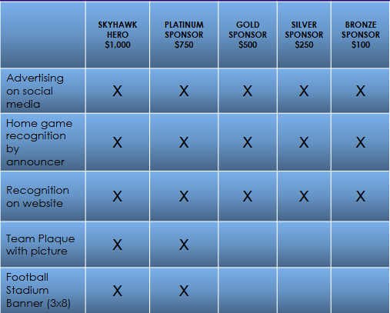
SPONSORSHIPS
Notes:
The $200 player registration fee as soon as possible. We take all forms of payment. Cash, check, Zelle, online via Square. You can also obtain sponsorships from businesses and receive 20% credit towards your registration fee for each sponsorship.

Slide 8

Sponsorships & Fundraising
Organization gets 100% of the money that is donated from Sponsorships
20% of each Sponsorship obtained goes towards player registration fee
  Player gets $500 in Sponsorship player gets $100 credit towards registration fee
Sponsorships are tax deductible!
Who to ask to Sponsor you?
  Employer, Barber, Hair Stylist, Landscaper, Family members, Family members employers, Local businesses
Fundraising
  80/20 Text Message Fundraiser
Notes:
Details are explained in the packet. Email us if you have questions or stay after a little bit and talk to one of us.
The majority of the teams funds are obtained from Sponsors. We as a school are competing with other schools in the area for the donations of our local businesses. It is best for players to obtain sponsors as early on in the season as possible. In the past players have even done this over the summer break.
We need players to be actively seeking sponsorships.
Personal Sponsorships are tax deductible. Ask your family members if their employers are willing to donate. Their donation is tax deductible!
Righ

Slide 9
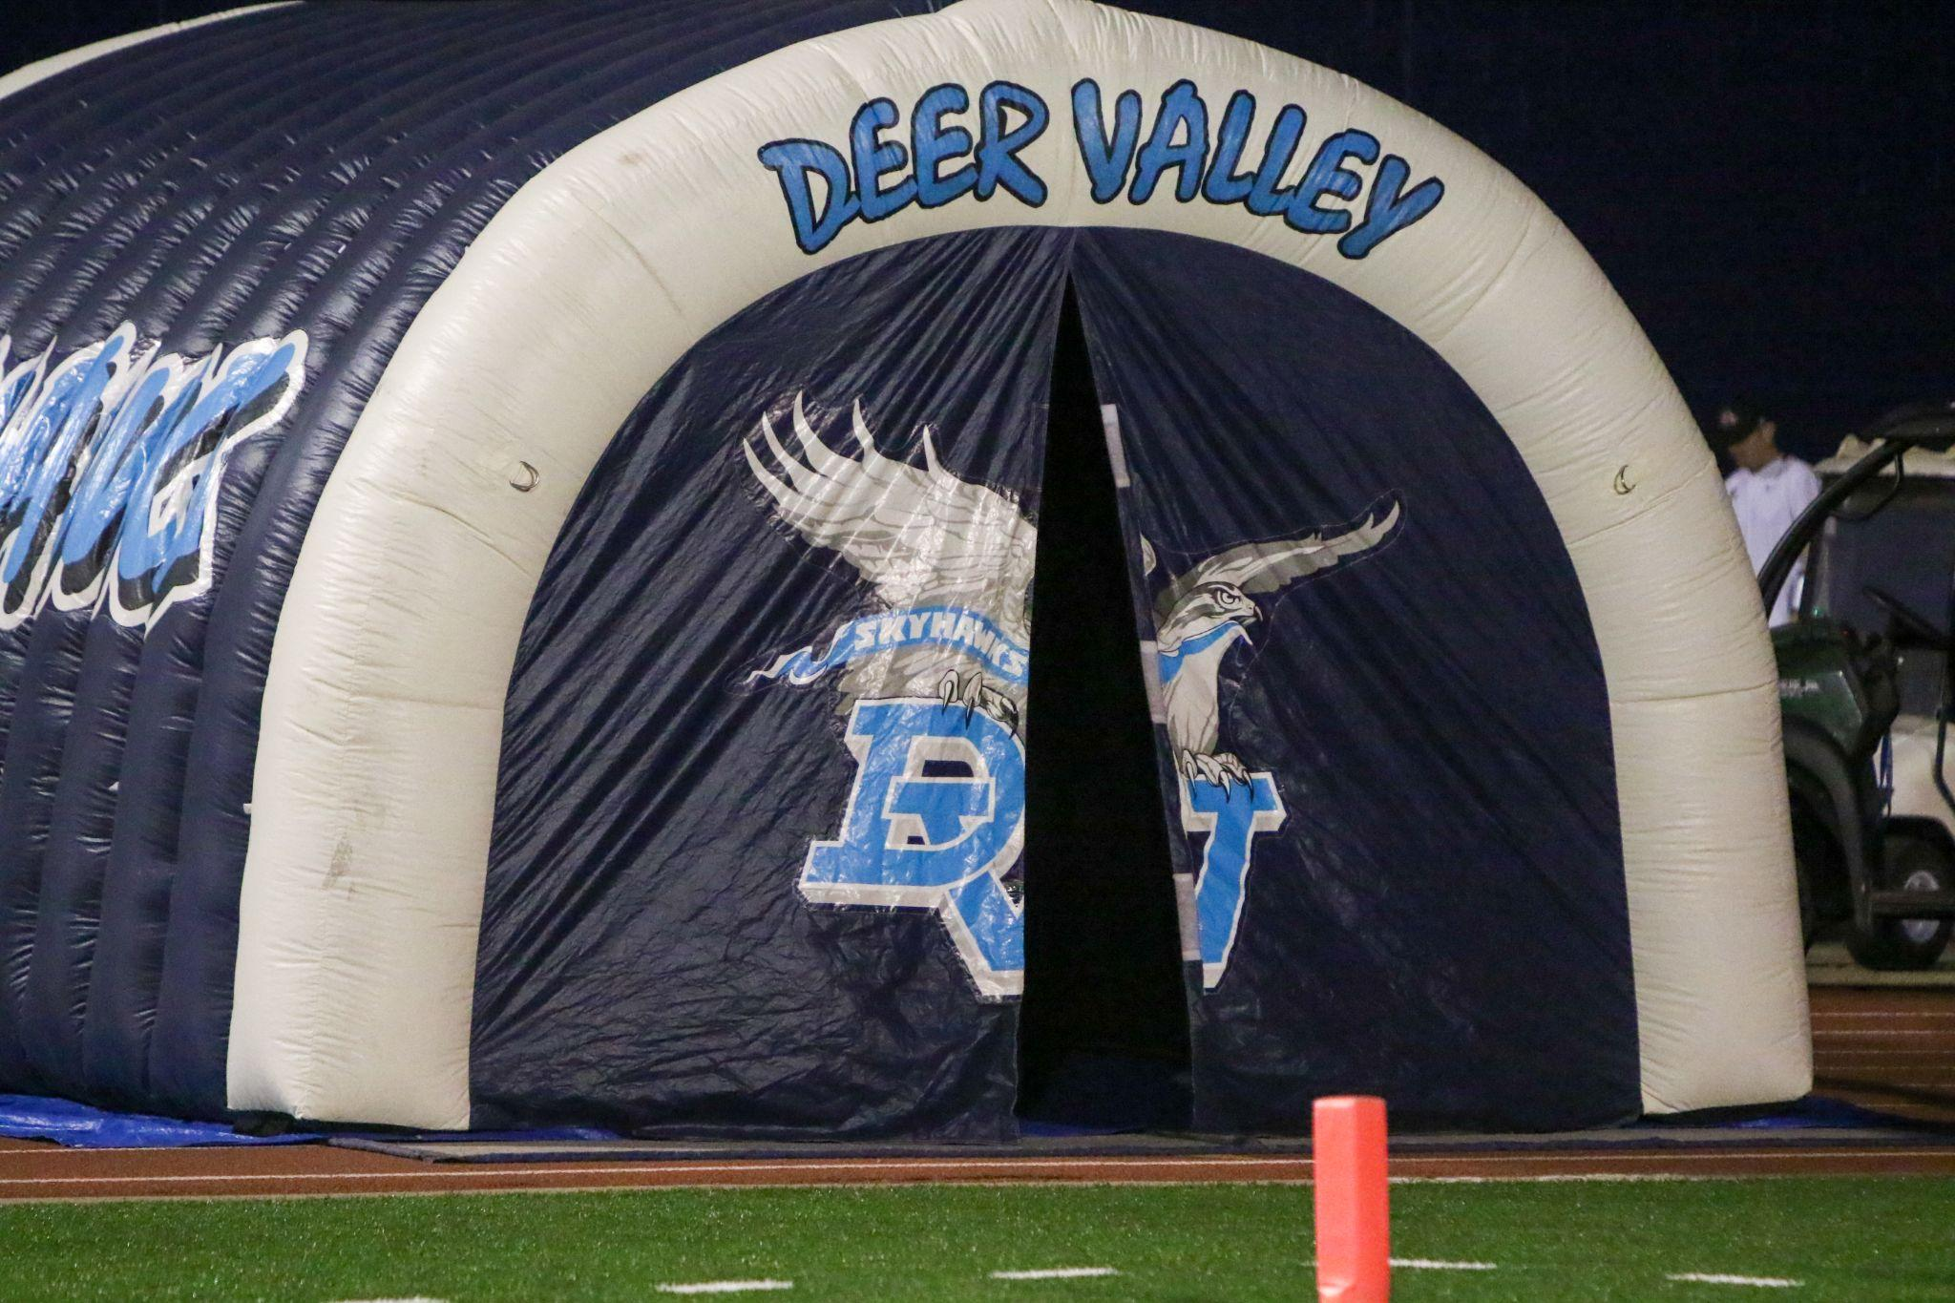

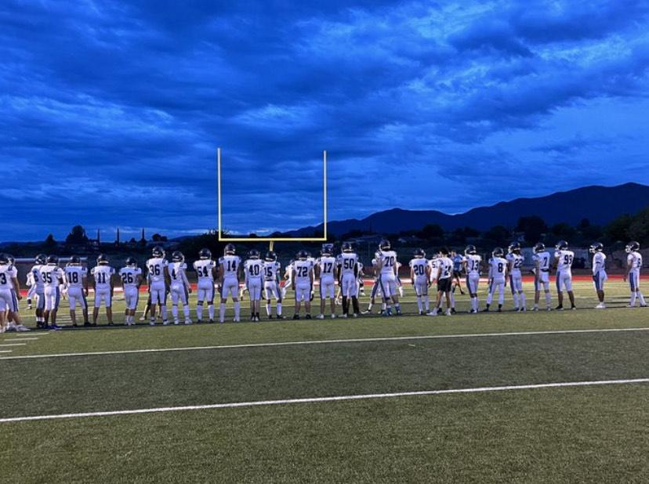
Where does the money go?
  Summer & Spring tournaments $1,000.00
  Summer Camp contribution $1000.00
  Pre game meals $1,000.00
  Athletic Trainer expenses $400.00
  Huddle $1,650.00
  Game videographers $2000.00
  Concession stand inventory start up $3000.00
  Homecoming Parade $500.00
  Banquets $3500.00
  Fan Gear Merchandise $2000.00
  Senior Banners $950.00
  Upgrading video equipment for coaches
  Lots lots more more!
  Average cost for a regular football season is about $35,000.00
  End of year our balance should be around $16,000.00 to use as start up for the next season
Notes:
All money that comes in from sponsorships, fundraising, concessions, fan gear, etc goes directly back into the football program to keep it running from year to year. These are just some of the annual expenses.

Slide 10
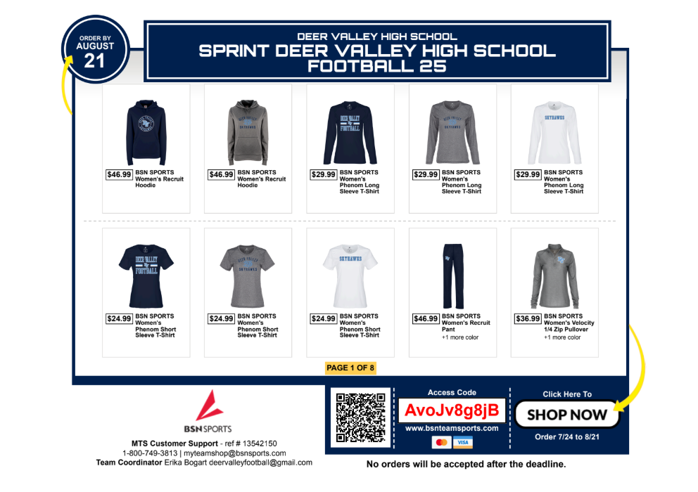

NEW FAN GEAR SHOP LAUNCH
Orders shipped directly to your home
Various Sizes available
Replacing Fan Gear Booth at games
We will sell remaining Fan Gear at Pancake Breakfast
2025 FAN GEAR SHOP

Slide 11

UPCOMING EVENTS
Saturday August 23, 2025
  Season Kick-Off Pancake Breakfast @ DVHS Cafeteria
  8am-10am
  $10 Tickets at the door OR SCAN QR CODE
Friday August 29
  First game (HOME) of the Season
    7pm vs. Peoria Panthers
Friday September 12
  9/11 Tribute Game (HOME) vs. Greenway

Slide 12



Follow Us on Social Media
@DV_Skyhawks
@DV_skyhawksfootball
DVHS FOOTBALL BOOSTER CLUB
Notes:
Stay informed! Use our website as your main source for information! We try to update our social media outlets as frequently as we can. Email us with questions, ideas, or concerns. Thank you!!

Slide 13

WE WANT TO HEAR FROM YOU!
Scan the QR Code and Fill out the form so we can keep you in the loop!
We will send updates for upcoming events, banquet information, fundraising events, and more!

Slide 14

Thank you for
joining us!
Looking forward to a successful Season!
Go skyhawks!

