Slide 1
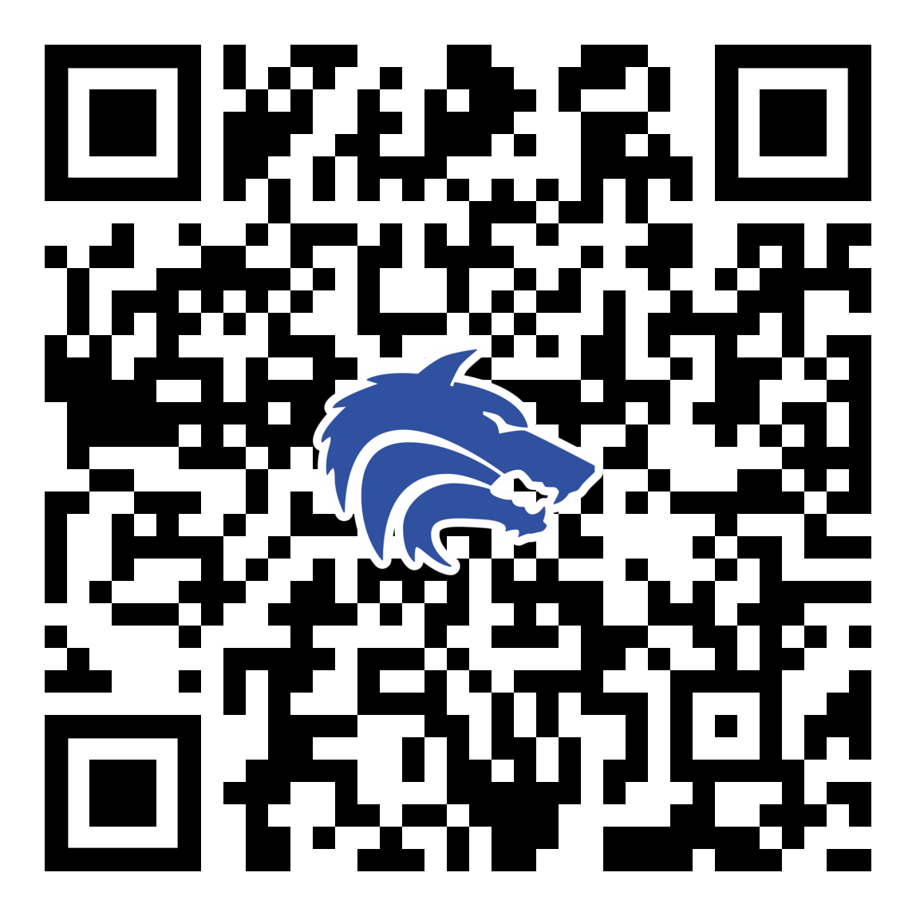
2025-2026 Booster Club Meeting
December 15 , 2025
PLEASE SCAN THIS CODE TO CHECK IN

Slide 2
Agenda
Approve November Meeting Minutes
Treasurer Report
Poker Night Fundraiser
Pack Funding
Spring Dates
Coach’s Corner
Join the Baseball Booster Club

Slide 3
Booster Club Votes
Approve November 2025 Meeting Minutes
Meeting Minutes can always be found on the website (https://www.planowestbaseball.org/) under BOOSTER CLUB\FORMS AND MEETING MINUTES
Each meeting we will ask for someone to make a motion to approve the minutes and then we will ask for someone to second that.

Slide 4
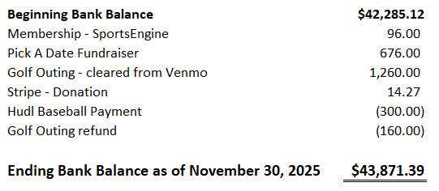
Treasurer’s Report: November 2025

Slide 5
Treasury Information
Reimbursable Expenses
  Because we are a non-profit, we do not pay taxes; therefore, you cannot be reimbursed for them. Please ask for our Tax Exemption Form before purchasing items.
  When requesting a reimbursement, you will need to fill out the Reimbursement Form. I will have these at every meeting or I can email it to you.

Slide 6
Upcoming Spring 2026 Fundraisers
Pack Funding
Poker Tournament-Date 1/31/2026- Save the Date

Slide 7


Slide 8
Spring 2026 - DATES TO REMEMBER
Media Day - Saturday, January 24th @ 9:00am
First Pitch Dinner - Wednesday, February 18th @ 6:30pm
Spring Baseball Banquet - Sunday, May 3rd @ 6:30pm

Slide 9
Committees Assembling
Start thinking of where you will want to lend a hand!
It will take everyone’s participation to really make Spring season successful:
First Pitch Dinner
Theme/Community Nights
Senior Night
Social Media
Game Engagement (JV2, JV, & Varsity)
Pre-Game Meals
Banquet
Scholarship Review
Audit

Slide 10
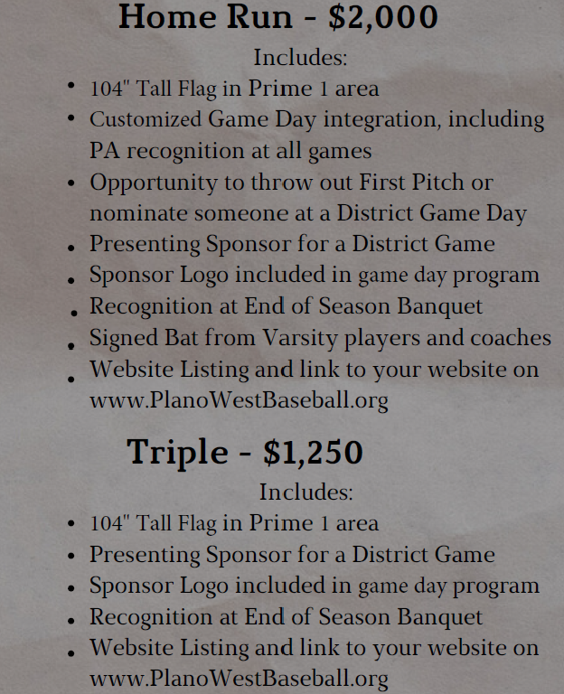
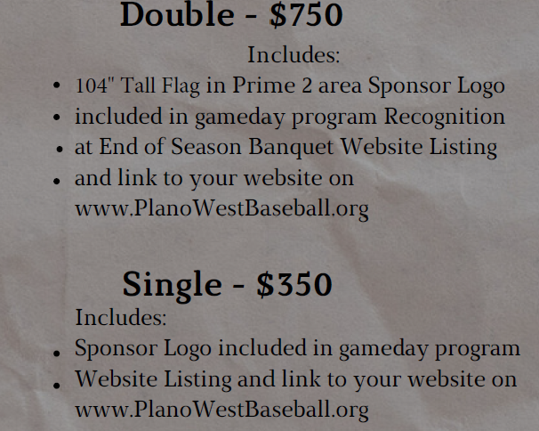
Sponsorship Information

Slide 11
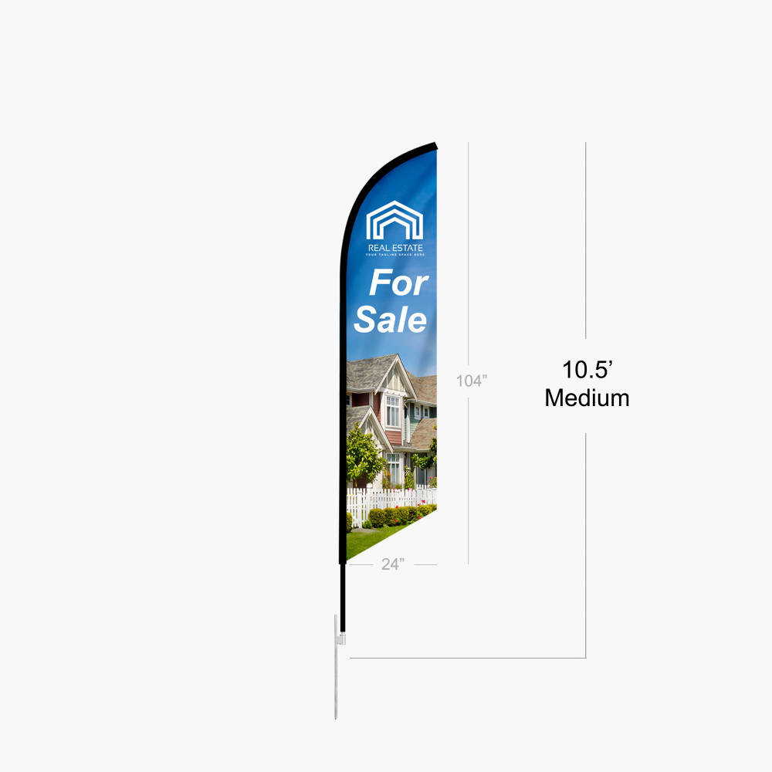
Sponsor Flags

Slide 12
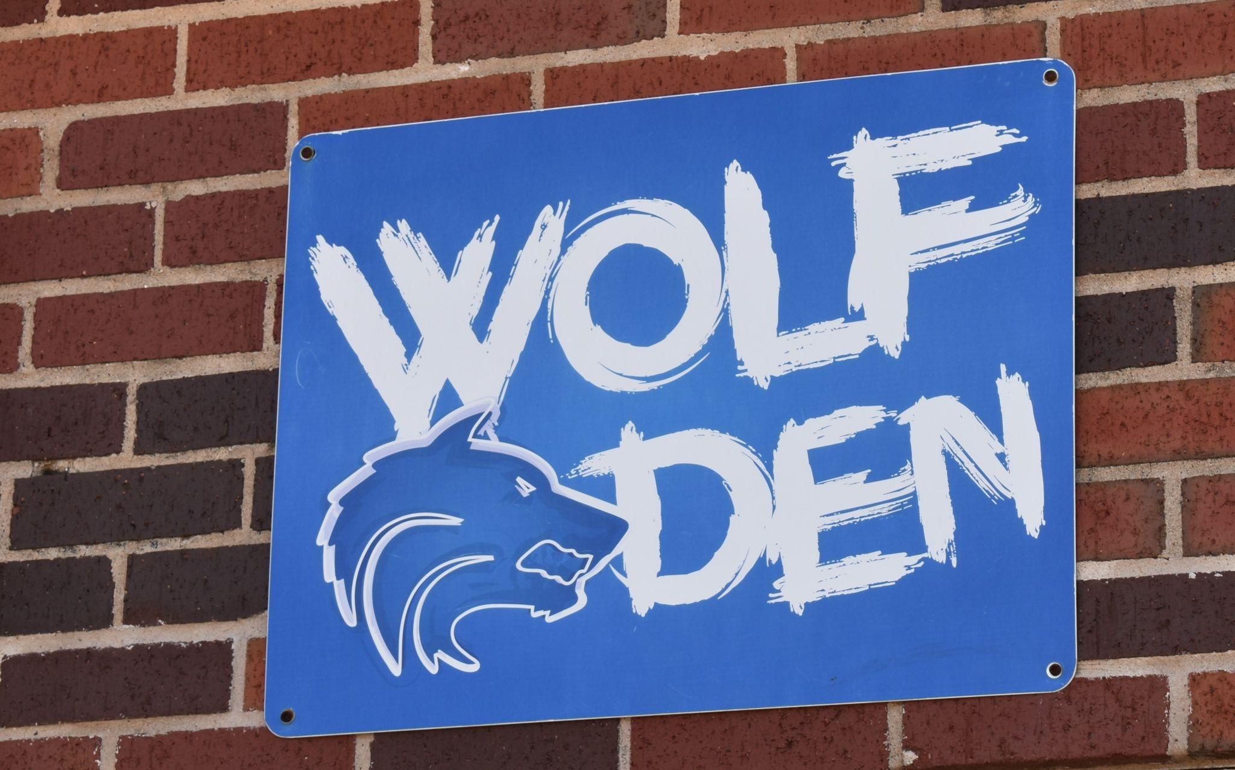
Coach’s Corner

Slide 13
Checklist
Join the Booster Club
Fundraising Ideas
  who do you know - business owners, tax deductions, Plano based firms
  what is working with other organizations?
Join a Committee
  we welcome all to participate/contribute in any way they can
Thanks for coming!

Slide 14
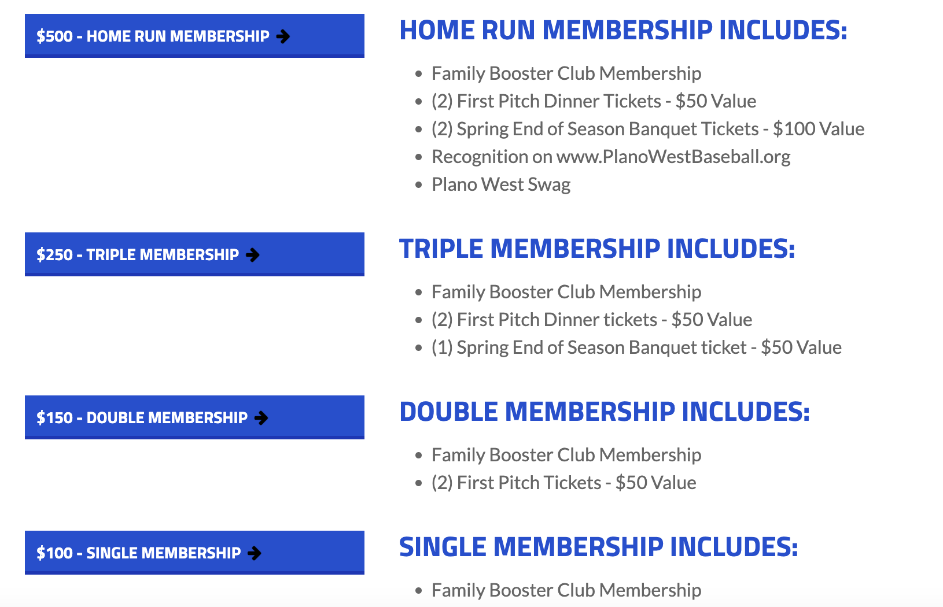
Join The Booster Club
www.planowestbaseball.org/join

Slide 15
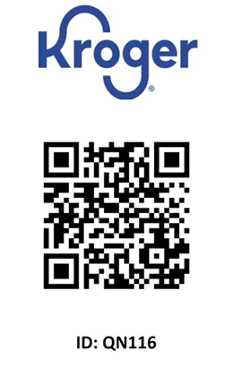
Kroger Rewards Card
Please be sure to link your Kroger card to Plano West Baseball.
$36.92 in donations from May 24 to August 24, 2025.
19 households participated during this time period.

Slide 16
Don’t Forget to Check In!

Slide 17
Thank you!

