Slide 1
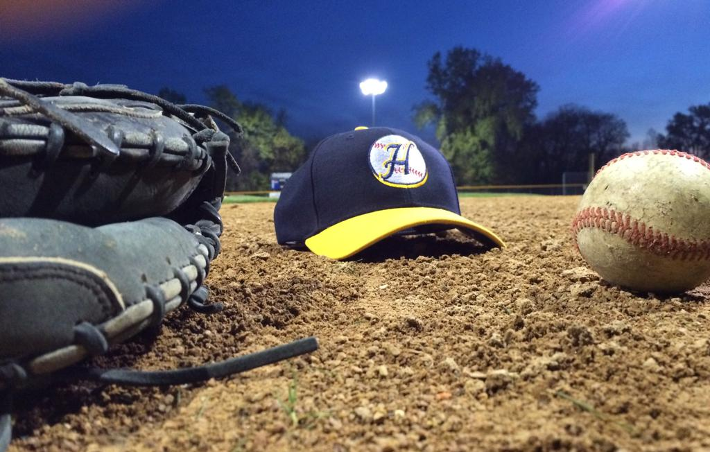
St. Paul Highland Ball
Drills for Catching the Baseball

Slide 2


Basic Catch
Drill #1 – No Glove Catch

Slide 3
Basic Catch
Drill #2 – Catch While Moving

Slide 4
Basic Catch
Drill #3 – 4 Corner Drill - Throwing

Slide 5
Basic Catch
Drill #4 – No Glove Groundballs

Slide 6
Basic Catch
Drill #5 – 4 Corner Drill - Grounders

Slide 7
Basic Catch
Drill #6 – Pop Fly/Fly Ball Drill

Slide 8
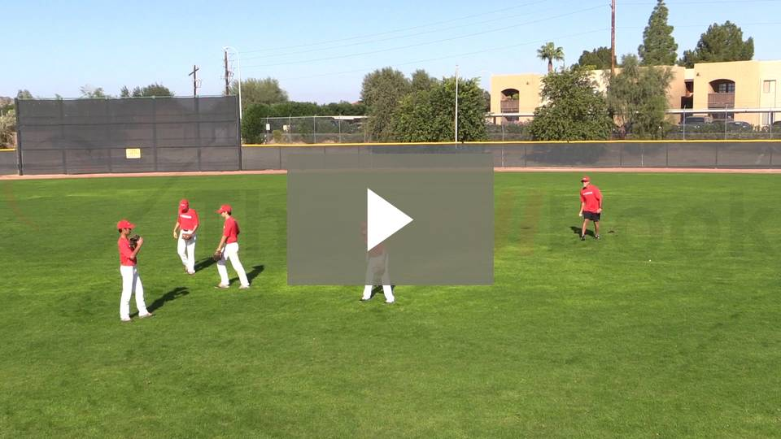
Basic Catch
Drill #7 – Back Facing Fly Ball Drill

Slide 9
Basic Catch
Drill #8 – Outfield Drop Step

