Slide 1

2025 Annual General Meeting
February 1, 2025– 10:00 AM

Slide 2
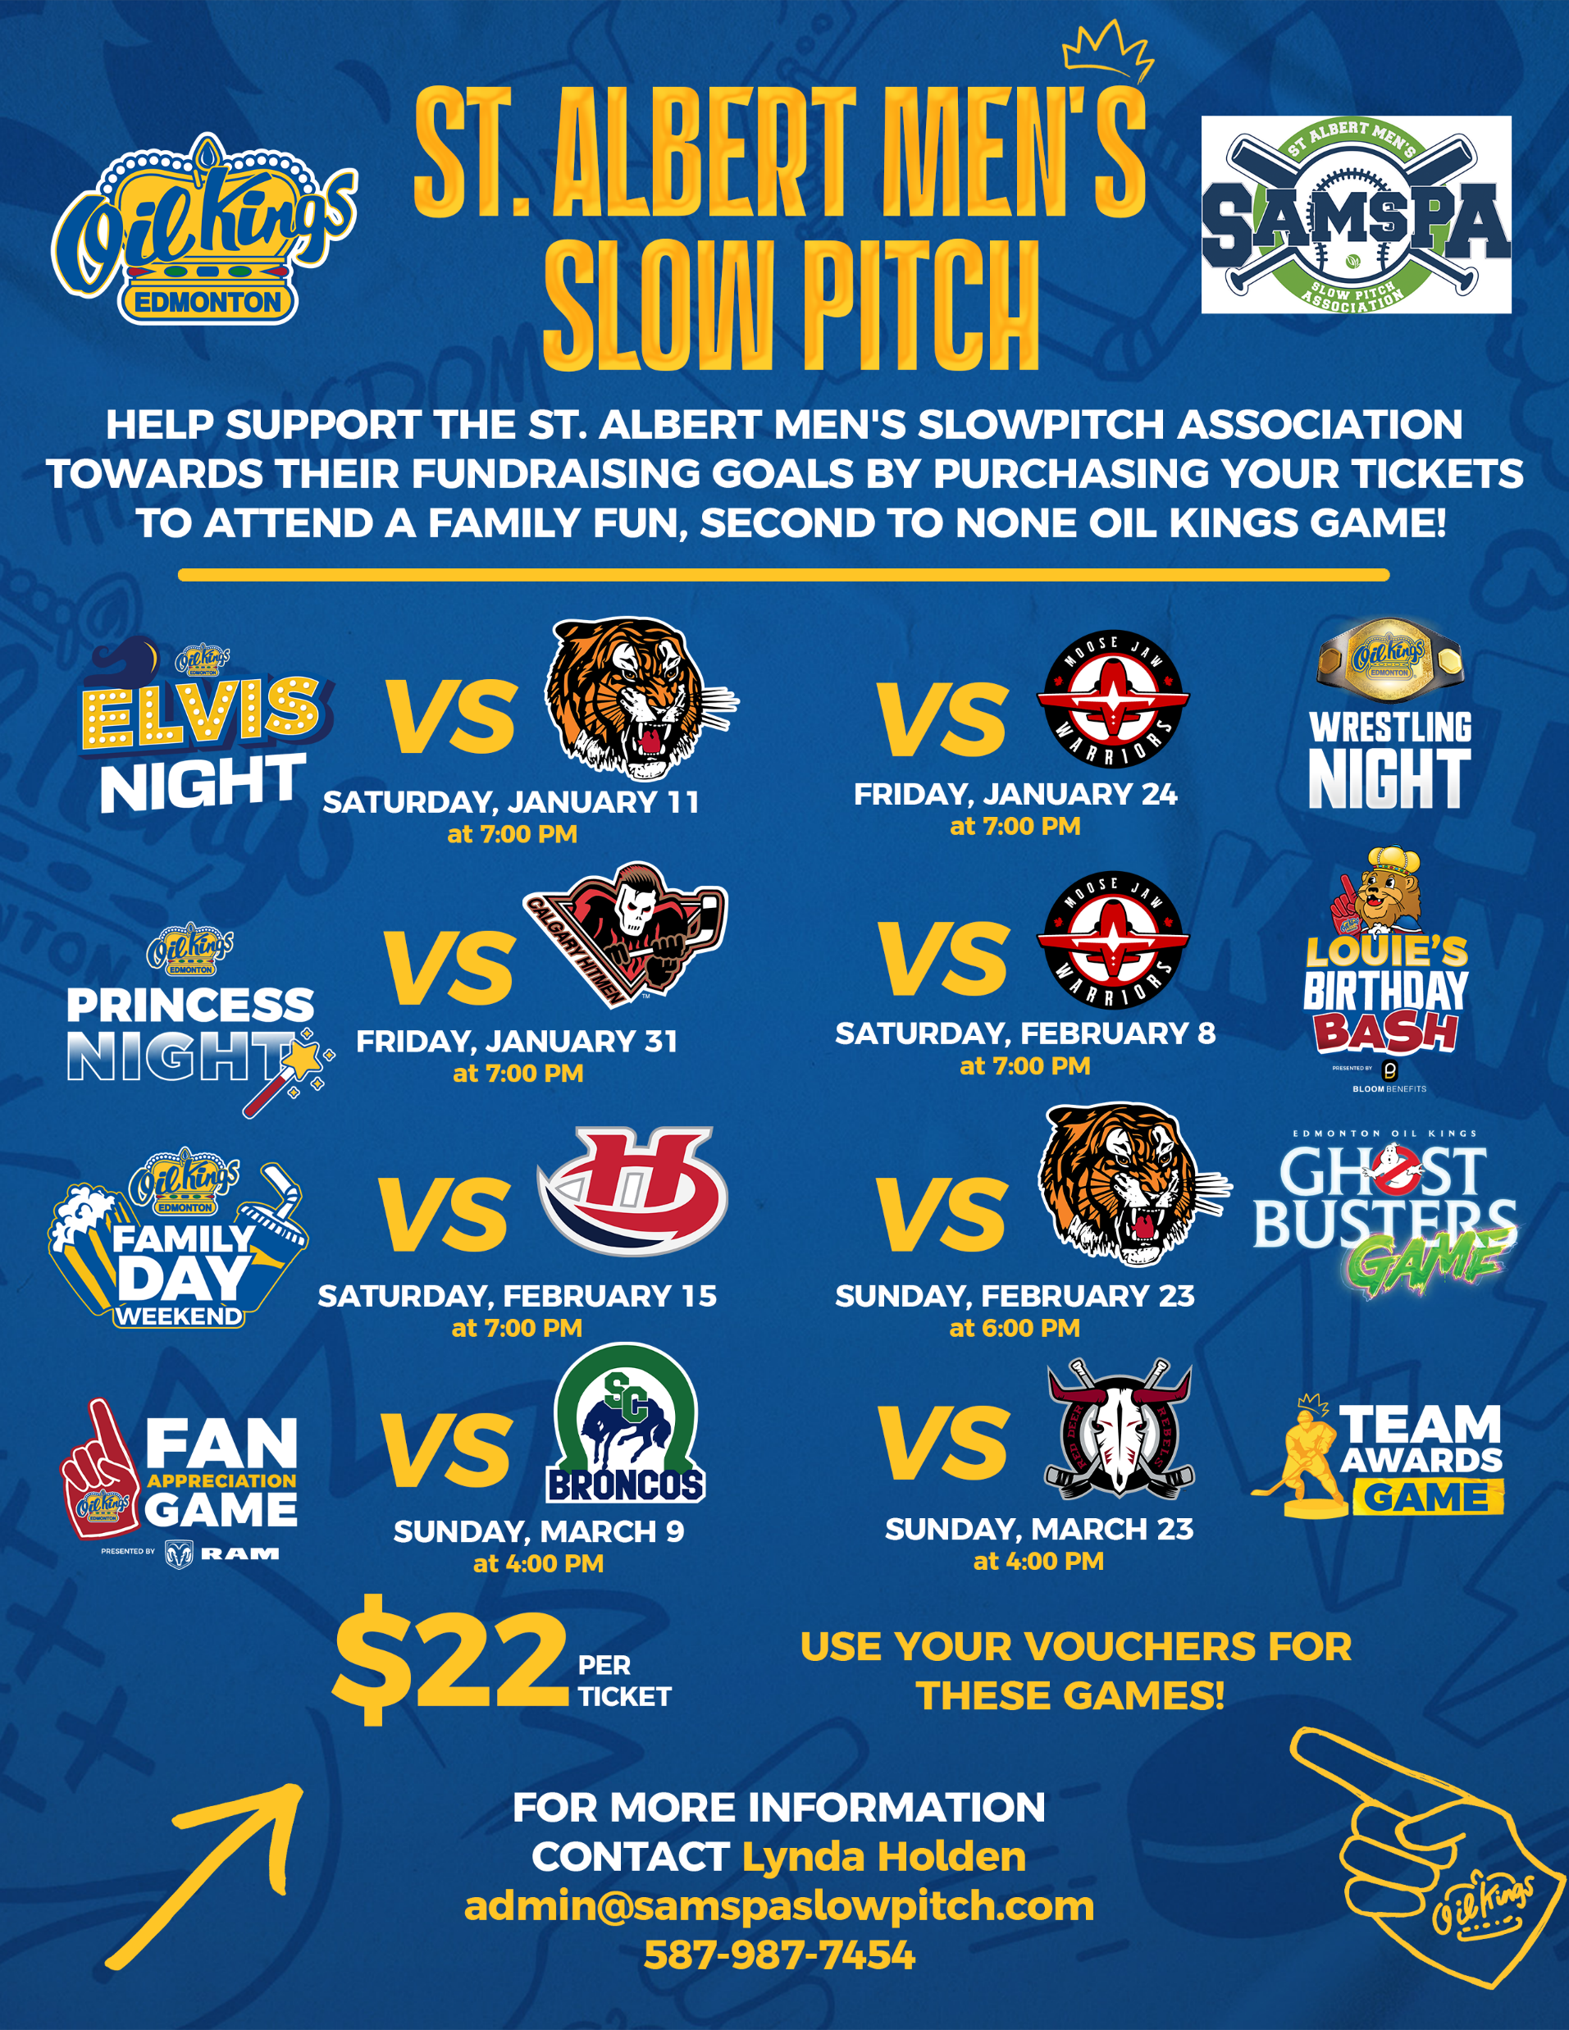
SAMSPA AGM - NOTICES
28 Oil King Tickets Left!
Get yours today from Lynda
ALSO
The Annual On-line Auction will be starting soon.
If you have an item to donate, reach out to Lynda. Lots of great items this year again.
Bid lots and bid often!
Notes:
Introductions
Diane Taylor – City of St. Albert – acknowledge and recognize.

Slide 3
2024 – Year In Review
Congratulations!
Open Division Winners:
Open A Winner Elite Selects
Open A Consolation Diamond Kings
Open B Winner Thirsty Beavers
Open B Consolation Big League Boys
Open C Winner Alchoballics
Open C Consolation C-Section
Open D Winner Railcore X
Open D Consolation Sturgeon River Swallows
Age Restricted Winners:
Plus 40 Winner Slick 50
Plus 50 Winner Classics 50+
Plus 60 Winner Redline
Plus 60 Consolation Silverbacks
Plus 60 B-Side Bad Company
Plus 60 C-Side The Crush
Plus 70 Winner Rockers
Plus 70 Consolation Old Buzzards
Plus 70 B Winner Raiders 70+

Slide 4
AGENDA
Call to Order
Quorum / Minutes / Agenda
Updates
  2024 Year in Review
  Board Elections
  Signboard Advertising Program
Financial Presentation and Audit Update
Looking Ahead
  Website
  Forfeits / cancellations
  Game ball distribution policy
  SAMSPA policy on player emails
  Tournament facility rentals for SAMSPA members
  Fundraising Initiative – SAMSPA Tourney
New Business
  Divisional Alignment
  Tracker Survey Update
Adjourn
Joel 10:00
Darren 10:05
  Joel 10:10
  Brian 10:50
  Kelly 11:25
Kelly 11:50
Kelly 12:00
Notes:
Introductions
Diane Taylor – City of St. Albert – acknowledge and recognize.

Slide 5
Quorum / Minutes / Agenda Approval
Call to Order
Roll Call (Quorum = 27)
Motion (1) to Adopt Minutes of April 13, 2024 General Meeting
Motion (2) to Adopt Agenda for this Meeting
Notes:
Introductions
Diane Taylor – City of St. Albert – acknowledge and recognize.

Slide 6
2024 – Highlights
Challenges
The Water Problem ☹ | The Batting Cage
The New Website | Groundskeeping Crew
The SAMSPA Phone Line | Equipment Failures
Point of Sale System Problems | Plumbing Not to Code (Concession)
The Break-in ☹ | D2 Weed Control Malfunction
Sprinkler System Issues
Notes:
2025 Notes
Challenges
Water
New Website
Plumbing Not to Code
Phone System
Point of Sale System problems
Break-in
Groundskeepers
Sprinkler Lines
Several Pieces of Equipment Issues – led to issues with infield quality
Weed Control malfunction on D2

Slide 7
2024 – Highlights (Perseverance!)
Successes | Facility Improvements
Spring Work Bee ☺ | The Batting Cage
Fall Work Bee ☺ | Dugout Repairs
New Groundskeeper | Painting Projects
Epic Fundraising! ($30k) | Pole Barn (wind/weather shades, lighting, picnic table covers)
New Mower | Concession Upgrades (plumbing, fridges, new tables & cabinetry, flooring, painting)
New Maintenance Equipment | Security System, HVAC System, POS System
Notes:
2025 Notes
Positives
Intense Perseverance against Innumerable Challenges
Tremendous work from our Board to step up and address the challenges
Also big help from league members which started with the Spring Work Bee
Fall work bee to empty concession
Income Statement was strong despite challenges
Begam Facility Improvements via CFEP Grant
Dugout Repairs
Painting Projects
Pole Barn Maintenance including Lighting, Picnic Table Covering, and Wind/Weather Screens
Numerous Concession Upgrades (plumbing, fridges, cabinetry, flooring)
Security System
POS System
HVAC System
Excellent Fundraising Performance ($30k) (led by Lynda Holden)
Silent Auction ($4k)
Crowd Funding with Government 50% Match ($8k)
Oil Kings ($6k)
Tourney ($12k)
New equipment for diamond maintenance (SandPro’s and Mower)
Batting Cage – Phil
New Groundskeeper
Challenges
Water
New Website
Plumbing Not to Code
Phone System
Point of Sale System problems
Break-in
Groundskeepers
Sprinkler Lines
Several Pieces of Equipment Issues – led to issues with infield quality
Weed Control malfunction on D2
Focusing on the operations of the organization.
Wilco – Art Maat
Challenges
- discuss
Successes
Planned Projects – talk about later
SAMSPA Tourney – talk about later
Dean Klemmer – replaced the washroom hot water tank, hooked up the ice machine and fixed some of the facility water lines.
Umpires – we have entered into a new 4-year agreement with the Umpires starting this season. Big thanks to Malcolm Parker for his leadership on this initiative.
We will be having a brief presentation later in the meeting by the VP of EDSUA (Edmonton and district softball umpires association)
Strong operations despite a number of setbacks. We will hear more of that in the Financial presentation

Slide 8
2025 – Elections – Important Information
Bylaw Review
New business: from the floor requires 2/3rds support (Article 8.2)
Voting: Each member team gets one vote only
Voting: Close votes will be counted by the Secretary.
Elections: Article 9.4 - 2/3rds based on number of members present at meeting
Board Principles for Elections
Healthy boards need regular rotation which brings new ideas, energy and engagement
Article 9.4 addresses this by placing limits on number of terms
We do have an exemption provision to address issues of under-volunteerism
Nominations are welcome from the floor as each position is called.
Notes:
Per Article 9.4 of SAMSPA Bylaws, “The maximum number of terms served by a Board member will be three and the Board member will not be eligible for election again until they have been inactive for a two-year term unless otherwise authorized by a two thirds majority vote of the members at the Annual General Meeting.”
Honour System
Spoiled Ballots and Implications

Slide 9
2025 – Board Election
Returning Board Members – One Year Remaining
Joel McGovern (*) Past President
Brian Dickson Treasurer
Phil Presakarchuk Director, Concession
Earl Sloan Director, Facility
Marc Savard Director, Maintenance
Bryan Shields Director, Plus 40/50 Divisions
Glen Dolynchuk Director, Health & Safety
* Past President term ends in 2027. The remaining terms end in 2026.
Notes:
This year, I will transition to the Past President roll. An election is not required for that appointment.

Slide 10
2025 – Board Election
Outgoing Board Members
Trevor Zilm Director, Grants
Bobbie Weitzel Director, At Large

Slide 11
2025 – Board Election
Board Nominations for Eligible Positions
Kelly Porter President (2nd Term)
Dustin Sloan Vice President (2nd Term)
Darren McBride (*) Secretary (5th Term)
Bob Franks Director, Plus 60/70 Divisions (2nd Term)
Jessy Beley Director, Open Divisions (1st Term)
Brayden Hollett Director, at Large (1st Term)
* Will require a 2/3rds approval of members in attendance to stand for another term
Notes:
Per Article 9.4 of SAMSPA Bylaws, “The maximum number of terms served by a Board member will be three and the Board member will not be eligible for election again until they have been inactive for a two-year term unless otherwise authorized by a two thirds majority vote of the members at the Annual General Meeting.”

Slide 12
Signboard Advertising Program
Issue: - No Director or employee responsible for signboard sales
- Large supply of unallocated signboard space
- Current incentive program not adequate for sales growth
Opportunity: - Encourage sales through higher incentives
50 / 50 split of net revenue after costs
Available to:
  SAMSPA Teams (Money in your Mitt Program)
  Local Community Groups
Applies to:
  Fence boards, bleacher signs, picnic tables and diamond naming rights

Slide 13
Signboard Advertising Program - Examples
Single Signboard
(3-year term)
$1,275 per board
(-$475) costs
Four Signboards
(3-year term)
$4,800 for boards
Bleacher Board / Picnic Table
(3-year term)
$2,075 per board
$800 shared
$400
to Team/Group
(-$1,675) costs
$3,125 shared
$1,562.50
to Team/Group
(-$725) costs
$1,350 shared
$675
to Team/Group
Diamond Naming
(5-year term)
$10,000 diamond
$8,000 shared
$4,000
(-$2,000) costs
to Team/Group
Notes:
Mention Picnic tables may be coming in the future

Slide 14




SAMSPA Diamond Naming Sponsors
SAMSPA Diamond-Naming Sponsors
D2
D1
D3
D4

Slide 15
SAMSPA Signboard Sponsors (Review)
4-Fence Board Sponsors
Bleacher/Picnic Table Package
Fence Board Signage
Top Hat Advisory
Sturgeon Auto Body
Brokerlink
MFP Resources
St. Albert Inn & Suites
Canadian Fence
Musco Lighting
Southview Acura
Alley Kat Brewery
Sparklean Restoration
St. Louis Bar and Grill (*)
Fortis Alberta (*)
Sherwood Dodge (*)
Canadian Brewhouse
Labatt Breweries
Mission Fun and Games
Phoenix Fence
Core Networks
Sturgeon Animal Hospital
Re/Max
Ross Storoshenko
ReMax
River Valley (*)
Tri-Tec Project Mgmt.
Notes:
If you get the opportunity to support any of these companies, we would encourage members and players to support them. They are also shared on our website with links to their sites.
Lastly, mention Wilco again. That we are looking to do something meaningful to recognize the philanthropy he has shown to SAMSPA this past season.

Slide 16

Financial Report
Auditor’s Report for 2024
Appoint auditors for 2025
Review Financials
  Capital Projects
  Balance Sheet
  Income Statement
Economic Outlook

Slide 17
Financial Review - Audit Report
  2024 Auditor - André Hebert
  Auditor’s Report
  I have audited the financial statements and financial transactions of the St. Albert Men’s Slowpitch Association for the year ended October 31, 2024.
  I reviewed details of material financial transactions (deposits, payments, backup documentation, deposit and payment allocations and spreadsheets) and found them to be properly approved, recorded, reconciled and accounted for. All regulatory filings have been done and were properly documented.
  I have reviewed the financial statements of the organization and in my opinion, the statements present fairly the financial position and the results of its operations for the year then ended.
  André Hebert
  January 31, 2025
    Board nominates Andre Hebert for 2025 Audit
    Call for further nominations from floor
    Motion to appoint 2025 Auditors

Slide 18
Financial Review – Capital Projects
Capital projects/ expenses | $104,641
Pole barn roof painting* | $6,069
Kitchen upgrades – flooring, tables, picnic table surfaces* | $14,511
Screens - shade/ wind awnings* | $9,828
Dugout refurbishment* | $2,625
Lighting upgrade* | $1,486
Batting cage repairs – electronics, wiring, netting | $15,263
New mower and infield groomers | $32,340
Website conversion | $11,025
New POS and Security systems* | $12,484
* Grant funded projects. 80% of project costs are funded for a total of $42,471 in 2024.
Notes:
These items are now being amortized according to specific depreciation schedules.

Slide 19
Balance Sheet
SAMSPA Current Assets $181,480
less Accounts Payable ($ 62,615)
SAMSPA Reserve w/ Grant funds $118,865
Unused Grant funds ($ 71,559)
Operational reserve $ 47,306
2023 Operational reserve $ 97,675

Slide 20
Income Statement
Budgeted Earnings - $95.1k | Actual Earnings -$91.3k
before amortization $10.7k | before amortization $17.5k
Principal income statement factors to 2024
Sec/ Chair: Call for motion to adopt 2024 financial statements.
Revenue factors | Key Expenses over/ under budget
Fees on target; one team folded $2k | Repair costs over budget $20k
Aggressive fundraising/ Ads/ rental $62k | Beverage rebate over budget $6k
Beverage room revenue missed $8k | Food Costs under budget $7k
 | Bev room costs under budget $27k
Notes:
Revenues from fees were mostly on target.
Revenues from Fundraising Ads diamond rentals were on target. A huge increase from $35k in 2023.
Beverage room missed revenues by $8k, but mix helped.
Repair costs were over budget due to plumbing, irrigation, lights, failing equipment, HVAC, refrigeration
Food costs were under budget (mostly supplies) while sales were up $2k
Bev room costs under budget by $27k

Slide 21
2025 Bev Rebate
Board approved 2025 Bev rebate at 45%.
  The 2023 rebate averaged $439 per team
  The 2024 rebate averaged $540 per team
  At 45% the 2024 rebate would have been $28,189; $486 per team
  The 2025 rebate is expected to be $28k to $30k
2023 Rebate $22,852
2024 Rebate $31,322

Slide 22
Economic Outlook for 2025
Extra Costs Forecasted
Added Revenue Objectives
Additional screens* | +$29k
Flooring* | +$3k
POS* | +$2k
Security* | +$3k
Dugout upgrades* | +$3k
Kitchen* | +$8k
TOTAL | $48k
Concession menu | +$5k
1 More Team | +$2k
More Tournaments | +$10k
TOTAL | $17k
Forecasting a modest positive variance and
increase in our reserves for 2025.

Slide 23
Economic Outlook – Strategic Reserves
SAMSPA Financial Reserve Program
$25k – Operational Reserve (to start up league) $25k
$50k – Operational Contingency Reserve $22k
$25k – Equipment Fund* $ 0k
$50k – Capital Improvement Fund* $ 0k
Equipment fund was depleted with the purchase of 3 major pieces of equipment in 2024.
Capital required to match grants, up to $14k, will need to come from 2025 revenues.
Notes:
It’s worth mentioning that our reserves are right now in line with historic reserve targets from the Board. Since COVID, the Board has raised our target to $150k to cover for an aging facility and increased operating costs.
So we are in an OK position, but we will have work to do over the next five years to improve our reserve position to desired levels.

Slide 24
2025 Return to Play
Website
  Sports Engine
  Involved process - gradual rollout
  Every player must register – will open soon
Facility and Fields
  Early Spring Work Bee – planned for March (Concession)
  Later Spring Work Bee – planned for April (fences, repairs, etc.)
  Emphasis on improved field conditions
    The new equipment will help with this
Concession Operator Update
Notes:
KELLY
Website
The transition from League Athletics to Sports Engine was not a smooth one
While the mobile app was really useful for tracking RSVPs to games, the tool was not good for allowing managers to administer their own rosters.
This created a great burden on Lynda throughout the year, but heavily at the start of the season.
Facility and Fields
Early Spring Work Bee (8 people)
Setting up new tables / cabinets in concession
Moving equipment, fridges, etc.
Late Spring Work Bee (40 people)
- Repairs to fencing / netting
- Minor repairs here and there
Field Conditions
Recent SandPro purchases will allow us to properly groom infields
Concession
- Announce the new operator and the process undertaken in the search

Slide 25

2025 Return to Play
Notices
  Reminder – AGM/GM Attendance Policy
  Umpire game charges, forfeits, cancellations
  Game balls distribution policy
  Player Safety - Injury Report
  SAMSPA Policy on player emails
  SAMSPA Policy on capturing birthdates
  Bat Testing – dates are already published on web, schedule coming soon
  Tournament Facility Rentals for SAMSPA Members
Notes:
KELLY
AGM/GM Attendance Policy (New for 2024) – Teams missing both the AGM and the GM will be issued a $50 fine that will be added to their league fee. This policy is to incent members to show up. Key information is disseminated through these two general meetings and some teams have repeatedly failed to attend.
o Umpire game charges, forfeits, cancellations - Reminder that if a team forfeits a game, they are required to notify the opposing team (Team Coach/Manager emails and phone numbers are listed on website), and an appointed person within the league via email or text/phone(to be announced later) a minimum of 24 hours in advance. If they do not provide this notification within the time limit, a $250.00 fine will be assessed, with $150.00 of the fine being allocated to the opposing team. This is a change from $100/$50 in prior years.
o Game balls distribution policy - SAMSPA policy is that each team will be provided a maximum of 2 cases of balls per season. Teams will be distributed one case at that start of the season and may request a second case as needed. Any additional balls beyond two cases will be charged at the retail cost for balls.
o Player Safety/Injury Report - has been created and should be completed anytime there is an injury that may potentially require submission to insurance. Available on the website.
o SAMSPA Policy on player emails. - It is SAMSPA policy that all players in the League provide an email on their player profile. If players do not want to receive emails from the league, they have to manage their notification from within their own profile. We cannot do this on our end.
o SAMSPA Policy change on capturing private member info (Birthdates) - On team roster in divisions that require birth dates, under player profiles, SAMSPA no longer requires day and month, just year must be entered. The website does require entry of birth month and day so you can use 0101 then correct birth year.
Tournament Rentals for SAMSPA Members
Board looking into potential incentives for our team members to operate tournaments at SAMSPA

Slide 26
SAMSPA Mixed Tournament 2025
SAMSPA is continuing to host this event in 2025, to help raise funds for the league.
July 18 - 19 - 20
Mixed Tournament
$450 Entry Fee, CASH Payouts, 5 GG
Pre-register at admin@samspaslowpitch.com
Please help us get the word out and get teams registered.
We are also looking for volunteers for this weekend so please reach out to the email address above and volunteer!
Notes:
KELLY
Reminder about the SAMSPA tourney. A BIG PART OF OUR FUNDRAISING OBJECTIVES!
Always looking for teams and volunteers.

Slide 27
New Business
    Divisional Alignment
Welcome New Teams to SAMSPA!
Latinos (C) Caribooze (D) Breaking Bats(D)
Shottas ?(D) Slammin Grannys (D) Silverbacks 70 (70)
2024
58 Teams
2025
59 Teams (*)
Notes:
KELLY
2025 we currently have 59 registered teams – up from 58 last year
6 are new teams
2 teams are renamed
5 teams have left

Slide 28
New Business – Divisional Alignment
Open Divisions (32 teams)
Open A
Mafia
Mediocre Sluggers
Elite Selects
Kamikazes
Wolf Pack
Sherwood Dodgers
Cobra Kai
Pound
Open B
Tailgaters
Alchoballics
The Chefs
Broke Bat Mountain
Admirals
Big League Boys
Ballers
Thirsty Beavers
Open C
Big Dickeys
VooDoo
Young Guns
Thirsty Pigeons
Railcore X
Furies
SOX
Latinos
Open D
Sturgeon River Swallows
Caribooze
Breaking Bats
Ram Ranchers
Pudgy P’s Pirates
Riverside Mariners
Shottas ?
Slammin Grannys
Notes:
KELLY
Just show this and move on. We should avoid discussion about open division placement. Lynda has talked to all teams that were moved.

Slide 29
New Business – Divisional Alignment
Age Restricted Divisions (27 teams)
+40
Rummies
Grizzlies
Pedlars
Slick 50
Strikers
+50
Diamond Bears
Ravens
Naturals
Raiders 50
Classics 50+
+60
Silverbacks
Auto Selects
Bad Company
Classics
Buzzards
Older Bulls
Redline
Naturals 60+
The Crush
+70
CanAlta Sox
Old Buzzards
Old Vets
Dynasty Relics
St. Albert 70’s
Old Buzzards 74+
Rockers
Silverbacks 70
Notes:
KELLY
Just show this and move on.

Slide 30

New Business – Implementation of Survey
    Tracker Survey
    Collect feedback across a range of topics
    Annual survey
    All players
    Standard set of questions
    Now Targeting March/April of 2024
Notes:
KELLY
The Board has resolved to implement an annual Tracker Survey of all the players in our association.
The overarching goal is to collect broad feedback from our players on how they view SAMSPA and the various components of our operations.
From diamond maintenance, to concession, to scheduling, to umpiring, to board performance, etc. We want to establish a baseline and have
something to trend against going forward.
With all the calamities of the past year, we did not make progress on this activity as planned. The good news is that we have re-engaged in the process.
We have started down that path again. We are hopeful to have a survey out in the next several weeks and report results at the April General Meeting.

Slide 31
Adjourn
    Motion to Adjourn?
    Thank you!
    Next Meeting:
    SAMSPA General Meeting
    April 5, 2024 (tentative)
Notes:
KELLY
Mention next meeting and Motion to adjourn.

