Slide 1

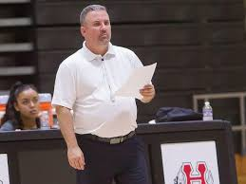
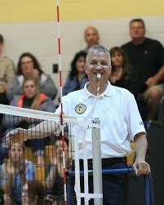
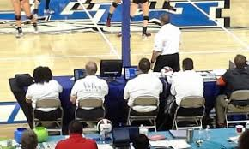
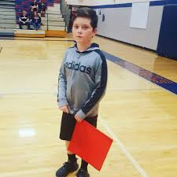
2020 Work Team Training
Here’s what you need to know…
Officiating crew for each match consists of:
LEAGUE will provide:
          R1 (“up ref”) – 1 needed
HOME team will provide:
R2 (“down ref”) – 1 needed
Scorer – 1 needed
Libero Tracker – 1 needed
Visual Scorer – 1 needed
VISITING team will provide:
Line Judges – 2 needed
Notes:
Walt

Slide 2
2020 Work Team Training
R1 Responsibilities
The R1 directs the match from the referee stand
Though players and coaches will not serve in this positon, it is helpful to be familiar with responsibilities this referee has during the match. Some include:
Conduct coin toss and warm-ups
Start each rally; award point at conclusion
Judge ball contacts (i.e. for caught/thrown faults)
Determine back-row attack/block & positional faults
Take assistance from LJ’s and R2, but can overrule
Communicate with the captain, when necessary
Initials scoresheet at conclusion of match
Notes:
Walt

Slide 3
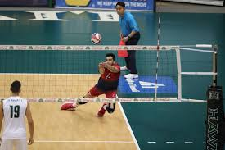
2020 Work Team Training
Line Judge responsibilities
Line Judges assist with determining in/out/touch calls as well as ensuring the path of the ball and the servers take-off point are legal.
The acronym of “S.A.L.T.” can be applied to cover most of the Line judge responsibilities.
Let’s look at what each of these letters stand for and then we’ll talk about some techniques to implement while carrying them out.
Notes:
Walt

Slide 4
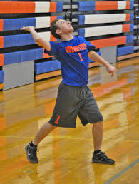
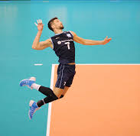
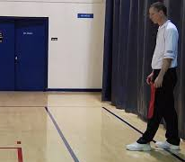
2020 Work Team Training
“ S ” is for Server
The server must contact the ball with both feet completely behind the end line. When they contact the ball if they are touching, or over, any part of the end line, it is a “foot fault”.
However, if the server does a jump serve, their “take off point” (when they jump from) is what is judged. Therefore, they may cross the line in the air, as long as they contact the ball before they land and touch the floor.
If the server is near LJ’s area (within about 6-8 feet), the Line judge should back up (staying even with the end line extended) to view for a foot fault. Returning to their “base” position as soon as the serve is completed.
Notes:
Walt

Slide 5
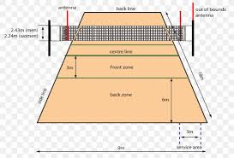
2020 Work Team Training
“ A ” is for Antenna
When the ball goes from one side to the other, it must pass completely within the “crossing space”. This is the area between the two antennas and above the net.
Should a ball go over or outside the antenna (pretend it extends all the way to the ceiling) the ball is “out” and the antenna fault signal should be used.
If the ball hits the antenna, the net outside the antenna or any other equipment (net post, rope, ref stand) the ball is also out and should be signaled immediately by the line judges.
Notes:
Walt

Slide 6
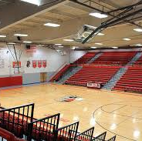
2020 Work Team Training
Antenna continued…
If the ball hits the ceiling or other object hanging from the ceiling (i.e. basketball hoops) that are 15 feet in the air or higher, play may continue. However, this contact has to be on the same side as the team playing the ball, and they must also have a player contact it again before it goes over.
If the ball hits an object less than 15 feet in the air, the rally is stopped. The R1 will award a reply if they determine play could have continues had the object not been there. If play could not have continues, the ball is out and a point goes to the opposing team.
Notes:
Walt

Slide 7
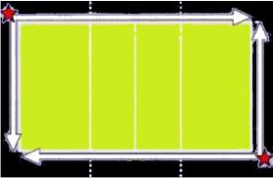
2020 Work Team Training
“ L ” is for the Lines
The lines are considered in. Therefore, any ball that hits the line or the court should be signaled as “IN”. This is used regardless of whether a team has contact it or it directly goes to the floor.
Line judges are positioned right on the corner and are responsible for balls landing near BOTH of their lines. Thus, for the sideline, they will call balls on both their side of the net and the opponents.
When players attempt to “pancake” the ball, the line judge should signal “IN” if they see the ball hit the floor.
Notes:
Walt

Slide 8
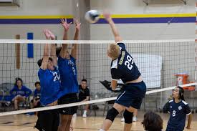
2020 Work Team Training
“ T ” is for Touches
During the rally, line judges will watch for touches, both off the blockers and the diggers. However, they will not signal any touches until the rally is completed.
At the end of the rally, when the ball is not “IN”, the line judge will need to select between “TOUCH” and “OUT”.
“TOUCH” is signaled when the side of the court the ball lands on is the same side as the team that last contacted the ball.
“OUT” is signaled when the team that touched the ball last is on the opposite site of the court.
Notes:
Walt

Slide 9
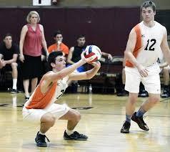
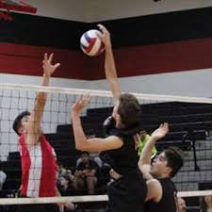
2020 Work Team Training
Touches continued…
TEAM B (Sides) TEAM A
Example #1
Team A serves the ball. Team B shanks the ball backwards, off the court. LJ should signal “TOUCH”
(Ball landed on Side B; last touched by Side B)
Example #2
Team A attacks the ball over the net and it lands past the end line. LJ should signal “OUT”
(Ball landed on Side B; last touched by Side A)
Example #3
Team A attacks ball into the block of Team B. Ball rebounds back over the net and lands out. Signal is “OUT”
(Ball landed on Side A; last touched by Side B)
Notes:
Walt

Slide 10
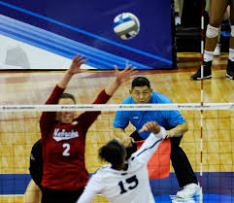
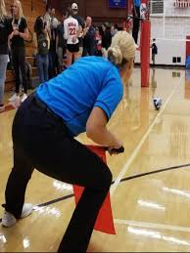
2020 Work Team Training
Line Judge – General Info
“Base” position is the intersection end line and sideline. Be attentive and prepared to move to avoid players coming your direction and to get a better view of potential “pancake” attempts or the ball crossing near the antenna.
During an attack, focus your vision 1st on the blockers fingers/hands to determine if there is a touch at the net. 2nd is to see if there is a touch by a back-row player.
Then, determine about where the ball will land and get your eyes to look at that location before the ball hits the floor. This allows the lines to stay clear. Following the ball all the way to the floor will blur the lines making it more difficult to make an accurate call.
Notes:
Walt

Slide 11
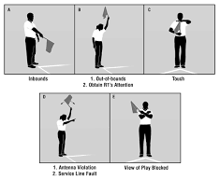

2020 Work Team Training
Line Judge – Signals
ANTENNA FOOT
IN OUT TOUCH FAULT FAULT
(Point at the antenna) (Point at the end line)
Notes:
Walt

Slide 12
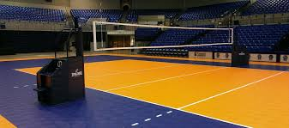
2020 Work Team Training
Line Judge – final words
Remember, your body language is seen by teams, spectators and the official. Be engaged, attentive and focused.
At the end of each rally it’s likely you’ll need to make a signal. While doing this, make eye contact with the R1. The up ref may or may not look at you after each play.
During time-outs, hold the ball and come to the intersection of the sideline and 10’ line on the R1 side of the court.
Between games, take the ball to the scorer table. If you are working the next set, it’s okay to sit and rest. If someone else will take your spot, make sure this occurs in time for them to be in place at the start of the next set.
Notes:
Walt

Slide 13

2020 Work Team Training
Moving to the Score Table
Ideally the R2 is positioned on the same side of the court as the team benches and scorer table.
3 positions need to be covered during the match:
Scorer (completes the official score sheet)
Libero Tracker (tracks substitutions and libero entery/exits)
Visual Scorer (operates electronic or manual score board)
These 3 individuals should be communicating and assisting each other throughout. Especially during substitutions and also often checking the score is correct on the score board.
Having a trained coach, or approved adult, at or near the table is helpful in case assistance is needed by the work crew.
Notes:
Walt

Slide 14
2020 Work Team Training
That finishes the training portion dedicated to Line Judges.
Next up…. Libero Tracking
Notes:
Walt

Slide 15
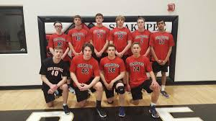
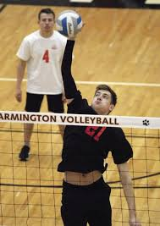
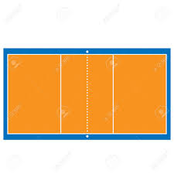

2020 Work Team Training
Libero – getting started
The Libero position was created to allow a defensive specialist to replace back-row players without using a substitution. Because of this, we use the term libero “exchange” when they enter/exit the court.
The libero wears a jersey that clearly contrast that of the regular players.
When the libero exchanges occur, there is no whistle by the referee. Instead, the two players swap in the area between the end line and the 10 foot line. This occurs when the ball is out of play (between points) and can even take place by both teams at the same time – making it important to keep an eye out between every rally.
Notes:
Walt

Slide 16
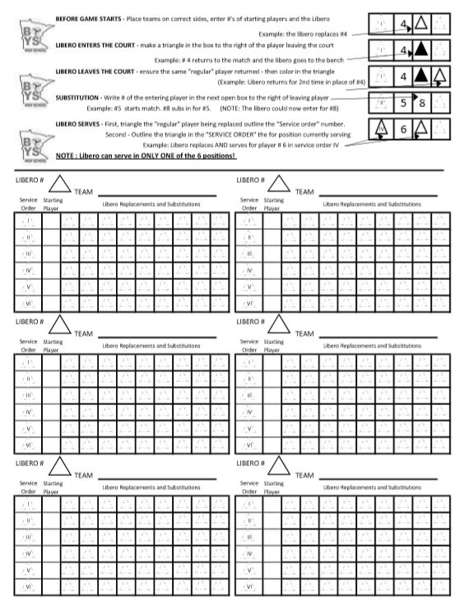
2020 Work Team Training
Libero Tracker
The Libero tracker will document all substitutions by both teams as well as mark each libero entrance onto the court and off the court.
To the left is the sheet that will be used. The top section includes a brief tutorial to assist while working the matches.
Each sheet has room to fit 3 sets. For Varsity matches, multiple sheets may need to be used.
(Note: if the JV match only goes 2 sets, the remaining unused portion can be utilized to start the Varsity match)
Notes:
Walt

Slide 17
2020 Work Team Training
Libero Tracker
The libero tracking details:
Brief tutorial and instructions section
Sheet is set-up with each set being arranging horizontally. The Red, White and Blue sections each represent a separate set.
When writing in the team names, the libero tracker should place the team on the left as they look out at the court, on the left side of the sheet. Same for the right.
Notes:
Walt

Slide 18
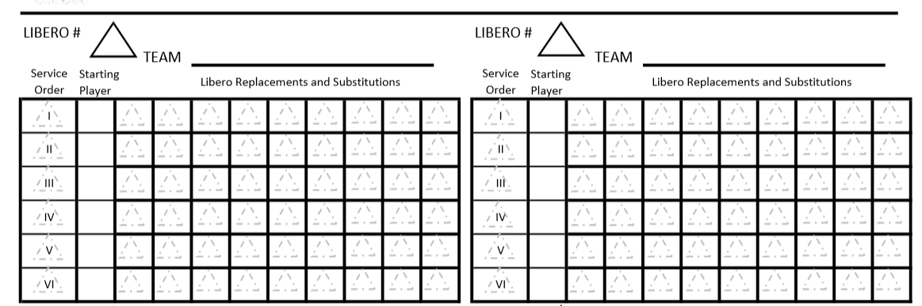
2020 Work Team Training
Pre-match items
Place teams onto the side of the sheet they are located on the court.
Let’s have Tigers on the left and Lions on the Right
TIGERS
LIONS
Notes:
Walt

Slide 19
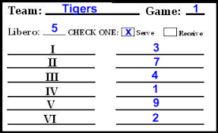
2020 Work Team Training
Entering line-ups
When line-ups are turned in by the coaches, both the libero tracker and the scorer will write them in using the “Starting Player” column. This is done by matching up the service order (roman numerals) on both sheets.
5
TIGERS
3
7
4
1
9
2
Don’t forget to also put the LIBERO # on the sheet
Notes:
Walt

Slide 20
2020 Work Team Training
Match start – libero enters
The same would be completed for the Lions team on the right.
A referee will use the line-up sheets to check the
player positions on the court before the match starts.
The scorer and libero tracker should also ensure
the right 6 players are on the court during this time.
Often, a libero will enter before the match, as soon
as the line-ups have been checked.
5
TIGERS
37
4
1
9
2
Let’s have the libero (#5) replace regular player #9
(This is done by making a triangle in the appropriate position)
Notes:
Walt

Slide 21
2020 Work Team Training
Libero leaves the court
If the Lions also had their libero enter, you’d mark that on their side of the tracking sheet, in the row of the appropriate player.
When the libero leaves the court, we MUST ensure
the same regular player returns to the court.
For our example, #9 MUST be the player that returns
to the court for the libero.
5
TIGERS
37
4
1
9
2
When this occurs, darken in the triangle.
Once the libero sits out for a completed rally (a point)
they are free to replace any other back-row player.
Notes:
Walt

Slide 22
2020 Work Team Training
Libero serves
The libero may enter for multiple players during the match.
Additionally, the libero may SERVE in 1 position.
In our example, the libero will replace #7 and serve.
5
TIGERS
1st – mark the libero replacement by outlining the
the next triangle to the right of #7
37
4
1
9
2
2nd – mark the position the libero served in
by outlining the “Service Order” triangle (by #7)
Notes:
Walt

Slide 23
2020 Work Team Training
Substitutions
The libero tracker will also document all team substitutions.
Let’s have #10 replace #9
5
TIGERS
37
4
1
9
2
This is marked by using the next open box to the
right of the player who is being subbed out.
10
Notes:
Walt

Slide 24
2020 Work Team Training
Libero continued
At this point, we know ONLY #7 can return for the libero.
Should any other player come in, let the R2 know.
If necessary, the R1can also assist.
Let’s fast-forward in the set a little further, to see
what the libero sheet might look like once a
few more substitutions and libero replacements
have taken place.
5
TIGERS
37
4
1
9
2
8
4
#7 returns, libero exits
#8 subs in for #4
10
Libero replaces #10
#4 subs back in for #8
Tigers call a time-out
…there is nothing to mark
Notes:
Walt

Slide 25
2020 Work Team Training
The “Double” switch
Looking at our sheet, we see the libero is in for #10.
The libero must sit out for 1 completed rally before
replacing another player, with 1 exception…
If the libero is already on the court they will be the
next server, they do not need to sit out a rally.
5
TIGERS
37
4
1
9
2
8
4
In this situation, we would observe regular players #10 returning to the court (for the libero) and #7 going to the bench (replaced by the libero)
10
This IS the correct service position for the libero so we will make both the return (of #10) and exit (of #7)
When the libero serves, verify the service order position is correct (same row as the player they replaced). There is no need to “re-mark” the triangle for their 2nd or 3rd time serving.
Notes:
Walt

Slide 26
2020 Work Team Training
Last look at Libero tracking
When teams make substitutions the following
rules need to be kept in mind:
Each service order position may be played by multiple players. (Example: #8 and #4 are both in service order III. A team could still put other players into this service order position)
However, If #8 were to come back in, it could ONLY be in the service order position III.
Similarly, #9 may only return in service order V
5
TIGERS
37
4
1
9
2
8
4
10
Notes:
Walt

Slide 27
2020 Work Team Training
That finishes the portion dedicated to Libero Tracking.
Next up…. Scorer duties
Notes:
Walt

Slide 28
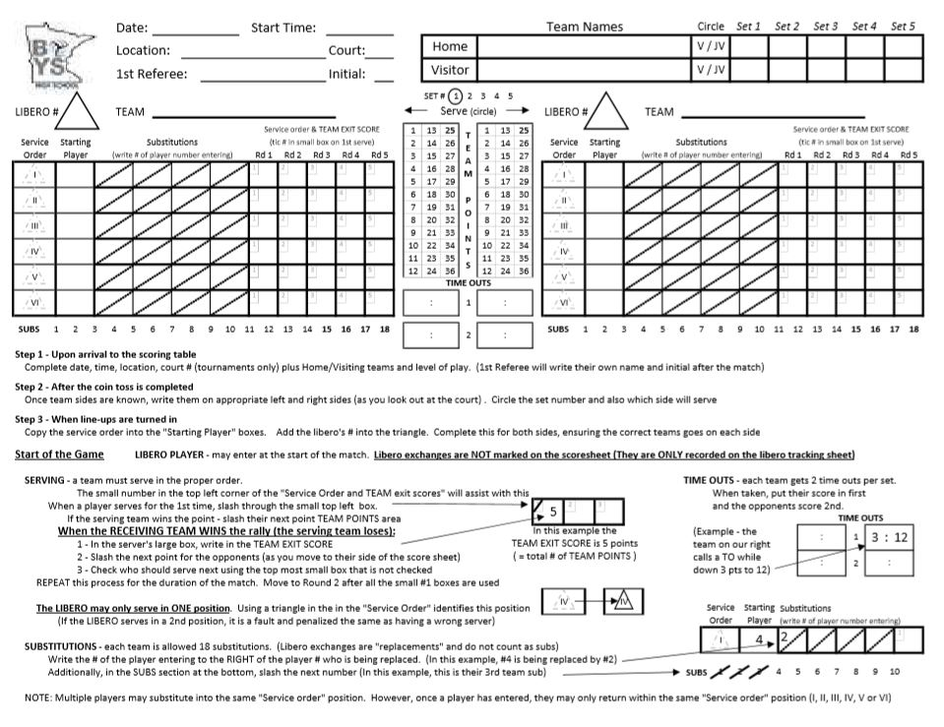
2020 Work Team Training
The Scorer
The Scorer is the “record keeper” during the match.
They will keep track of several items, including:
Points scored
Service Order
Substitutions
Time-outs taken
When it comes to the Libero, the scorer only has two items to document:
Write the number of the libero (in the triangle above the starting players)
Mark the service order position when the libero serves
Notes:
Walt

Slide 29
2020 Work Team Training
Quick look at the score sheet
Site information
Home and Visiting Teams
(including level and set scores)
Team on your left
Team on your right
Tutorial/Instructions for using the
score sheet
Notes:
Walt

Slide 30
2020 Work Team Training
Zooming in….
Let’s get a closer look at the score sheet.
We’ll focus in on just one side, to make things a little easier to see.
This will be set # 1 and we are looking at the team on the left side of the court….
Notes:
Walt

Slide 31
2020 Work Team Training
Zooming in….
Put team names on the side of the court they appear as you look out from table
Area the starting players (and libero) are entered onto the score sheet
Marking which team will serve first and which set they are playing
Marking team points
Marking time-outs
Notes:
Walt

Slide 32
2020 Work Team Training
Additional areas...
Individual substitutions
“Exit” scores (what the team score is when the server is finished)
Service order tracking
Tracking the service order position the libero serves in during the set
Tracking total # of team substitutions (Be sure to tell teams when they have taken their 15th, 16th, 17th and 18th sub)
Notes:
Walt

Slide 33
2020 Work Team Training
Let’s get started...
We’ll pretend it’s March 14th, 2020
We are at Holyoke High School
The match is starting at 6:30 pm
There is only 1 court (not a tournament)
The 1st referee is William Morgan
For the next slide, we’ll zoom out a little on the score sheet….
3/14/20
6:30 pm
Holyoke HS
1
William Morgan
Notes:
Walt

Slide 34
2020 Work Team Training
More pre-match info
The Home team is the Holyoke HS and the Visitors are Tigers HS. It’s a Varsity match.
3/14/20
6:30 pm
Holyoke HS
Holyoke HS
1
William Morgan
Tigers HS
Holyoke
Tigers
Holyoke picked the left side of the court for their bench. Tigers won the toss and chose to serve.
Notes:
Walt

Slide 35
2020 Work Team Training
Getting started with line-ups
As warm-ups are going on we should end up getting line-ups turned into us by each team.
3/14/20
6:30 pm
Holyoke HS
Holyoke HS
1
William Morgan
Tigers HS
Holyoke
Tigers
Let’s use the next slide to take a look at the line-up from the Tigers team and how this is entered.
Notes:
Walt

Slide 36
2020 Work Team Training
Enter starting players
Match the roman numerals to copy the players numbers into the proper service order.
Holyoke HS
Tigers HS
5
Tigers
3
7
4
1
9
2
Ensure you also enter the libero number with the starting players.
Notes:
Walt

Slide 37
2020 Work Team Training
Complete both teams
The same would be done for the opponents….
In this set, the Holyoke team is NOT using a libero.
Their starting players, in service order are:
4, 8, 2, 1, 3, 9
3/14/20
6:30 pm
Holyoke HS
Holyoke HS
1
William Morgan
Tigers HS
Holyoke
Tigers
X
5
4
8
2
1
3
9
3
7
4
1
9
2
Since Holyoke will receive, #9 will start in right back and # 4 in right front.
Notes:
Walt

Slide 38
2020 Work Team Training
Ready for our 1st serve
The scorer should check the right players are on the court at the same time as the referee.
Tigers 1st server should be #3.
If either team has a libero enter, there is not anything marked on the score sheet for this exchange.
3/14/20
6:30 pm
Holyoke HS
Holyoke HS
1
William Morgan
Tigers HS
Holyoke
Tigers
X
5
4
8
2
1
3
9
3
7
4
1
9
2
/
When #3 serves for the 1st time, slash the small #1 in the Rd 1 service order/EXIT score tracking
Notes:
Walt

Slide 39
2020 Work Team Training
1st Server scores points
While a team is serving, if they score the point, just slash the next team point in their area.
We’ll have #3 for the Tigers score 4 straight points.
The next slide will look at what is needed when the non-serving team wins the rally
3/14/20
6:30 pm
Holyoke HS
Holyoke HS
1
William Morgan
Tigers HS
Holyoke
Tigers
X
5
4
8
2
1
3
9
3
7
4
1
9
2
/
Notes:
Walt

Slide 40
2020 Work Team Training
1st “side-out”
Now that Holyoke has won the rally, we’ll have 3 items to complete:
Write number of points the Tigers have (“Exit score”) in the R1 box for their server.
Give the opponents their “side-out” point
Check who should be the next server
3/14/20
6:30 pm
Holyoke HS
Holyoke HS
1
William Morgan
Tigers HS
Holyoke
Tigers
X
5
/
4
8
2
1
3
9
3
7
4
1
9
2
4
Notes:
Walt

Slide 41
2020 Work Team Training
Other team’s 1st server
Determine the next server by using the “Rd 1” column. First open box, then follow to the left
When #4 serves, place a slash in the top left-corner of the “exit score” box.
If their team scores, just slash team points
Let’s have #4 get points 2 & 3
3/14/20
6:30 pm
Holyoke HS
Holyoke HS
1
William Morgan
Tigers HS
Holyoke
Tigers
X
5
/
/
4
8
2
1
3
9
3
7
4
1
9
2
4
Notes:
Walt

Slide 42
2020 Work Team Training
Another side-out
Determine the next server by using the “Rd 1” column. First open box, then follow to the left
Exit score will be 3 for Holyoke
Tiger’s get their 5th point with the side out
#7 should serve next for Tigers
3/14/20
6:30 pm
Holyoke HS
Holyoke HS
1
William Morgan
Tigers HS
Holyoke
Tigers
X
5
3
/
4
8
2
1
3
9
/
3
7
4
1
9
2
4
Notes:
Walt

Slide 43
2020 Work Team Training
Continuing along…
Repeat the same sequence for the remainder of the set…
With each player’s first serve, slash the top left corner of the exit score
If their team win the rally, slash next team point
If opponents win, write exit score, give side-out point
3/14/20
6:30 pm
Holyoke HS
Holyoke HS
1
William Morgan
Tigers HS
Holyoke
Tigers
X
5
3
/
4
8
2
1
3
9
/
3
7
4
1
9
2
4
and determine who the next server should be
Notes:
Walt

Slide 44
2020 Work Team Training
Moving ahead…
Follow the animations and we fast-forward through the match
Tiger’s #7 serves
(points 6, 7, 8, 9 & 10)
Holyoke’s #8 serves
(served into net)
Tiger’s #4 serve
(points 12 & 13)
Holyoke’s #2 serves
(serves out long)
Tiger’s #1 serves
(points 15 & 16)
Holyoke’s #1 serves
(get’s point number 7)
3/14/20
6:30 pm
Holyoke HS
Holyoke HS
1
William Morgan
Tigers HS
Holyoke
Tigers
X
5
3
/
4
8
2
1
3
9
/
3
7
4
1
9
2
4
/
/
4
10
/
/
5
13
/
/
16
Let’s look ahead to the next slide for some additional score keeping items…
Notes:
Walt

Slide 45
2020 Work Team Training
Time-outs
Holyoke #1 is still serving. He scores points 8, 9 & 10 and then the Tigers call a Time-out
When a time-out is called, we’ll write the current score in the rectangle.
First, select the side of the team calling the time out, and select whether it’s their 1st or 2nd time-out.
Score of the team calling the time-out (Tigers) is written first (16 pts) and the opponent’s 2nd (10 points)
3/14/20
6:30 pm
Holyoke HS
Holyoke HS
1
William Morgan
Tigers HS
Holyoke
Tigers
X
5
3
/
4
8
2
1
3
9
/
3
7
4
1
9
2
4
/
/
4
10
/
/
5
13
/
/
16
16 10
Notes:
Walt

Slide 46
2020 Work Team Training
Another Time-out
After the time-out, Holyoke #1 is still serving and gets points 11-14. Tigers call a 2nd Time-out
We’ll use the 2nd time-out box for the Tigers.
Again, the score of the team calling the time-out is written first (Tigers - 16 pts) and the opponent’s 2nd
(Holyoke - 14 pts)
3/14/20
6:30 pm
Holyoke HS
Holyoke HS
1
William Morgan
Tigers HS
Holyoke
Tigers
X
5
3
/
4
8
2
1
3
9
/
3
7
4
1
9
2
4
/
/
4
10
/
/
5
13
/
/
16
16 10
16 14
When a team’s 2nd time-out is over, have the R2 tell the coach (&R1) that was their 2nd time-out
Notes:
Walt

Slide 47
2020 Work Team Training
Substitutions
After the 2nd time-out, the Tigers want to put #6 for #3.
As the scorer, you will find the # of the player that is LEAVING the court. (#3)
Then, to the right of this, you will place the # of the player ENTERING. (#6)
Also, mark the next number in the count of the total team subs taken
3/14/20
6:30 pm
Holyoke HS
Holyoke HS
1
William Morgan
Tigers HS
Holyoke
Tigers
X
5
3
6
/
4
8
2
1
3
9
/
3
7
4
1
9
2
4
/
/
4
10
/
/
5
13
/
/
16
16 10
16 14
Notes:
Walt

Slide 48
2020 Work Team Training
Substitution rules
A non-starter may enter into any service order position
This allows for multiple players to enter within the same service order position
However, a starter (or any substitute that enters the game), may only return to the SAME service order position.
3/14/20
6:30 pm
Holyoke HS
Holyoke HS
1
William Morgan
Tigers HS
Holyoke
Tigers
X
5
3
6
/
4
8
2
1
3
9
/
3
7
4
1
9
2
4
/
/
4
10
/
/
5
13
/
/
16
16 10
16 14
In short, multiple players can play in single spot. But, a single player cannot play in multiple spots!
Notes:
Walt

Slide 49
2020 Work Team Training
Back to the game…
Holyoke has 14 pts and #1 is still serving. The Tigers just used both time-outs and subbed in #6
Holyoke #1 serves and gets points 15 & 16 before the Tigers side-out.
1) Exit score 2) Side-out pt
3) Determine next server
As you look and see it should be #9 for the Tigers, you see the Libero back with the ball, ready to serve.
3/14/20
6:30 pm
Holyoke HS
Holyoke HS
1
William Morgan
Tigers HS
Holyoke
Tigers
X
5
3
6
/
4
8
2
1
3
9
/
3
7
4
1
9
2
4
/
/
4
10
/
/
5
13
/
/
16
16
16 10
16 14
The libero is allowed to serve in 1 rotation, so let’s mark this spot with a triangle (and slash Rd 1)
Notes:
Walt

Slide 50
2020 Work Team Training
Libero scores on their serve
If the team wins a point while the libero is serving, this can be marked with a triangle
The Tigers earn team points 18 & 19 with the libero (#5) serving.
Using a triangle, these are marked in the team points column.
When Holyoke sides-out:
Exit score
Side-out point
Determine next server
3/14/20
6:30 pm
Holyoke HS
Holyoke HS
1
William Morgan
Tigers HS
Holyoke
Tigers
X
5
3
6
/
4
8
2
1
3
9
/
3
7
4
1
9
2
4
/
/
4
10
/
/
5
13
/
/
16
16
19
16 10
16 14
Notes:
Walt

Slide 51
2020 Work Team Training
More Substitutions
Holyoke subs in #11 for #3 AND #7 for #2
Find the player # that is leaving and write the player # entering in the next opening to the right
First, #11 (for #3)
Second, #7 (for #2)
Mark the next 2 subs in the total team subs area
3/14/20
6:30 pm
Holyoke HS
Holyoke HS
1
William Morgan
Tigers HS
Holyoke
Tigers
X
5
3
6
/
4
8
2
1
3
9
/
3
7
4
1
9
2
4
/
/
4
10
7
/
/
5
13
/
/
16
16
11
19
16 10
16 14
Notes:
Walt

Slide 52
2020 Work Team Training
Returning to the game
With the last substitution, #11 will now serve for Holyoke.
Upon #11 serving the first time, slash the service Rd 1
box (top left corner)
#11 serves the ball out
Write the Exit score
Award the side-out point
Determine the next server for the Tigers
3/14/20
6:30 pm
Holyoke HS
Holyoke HS
1
William Morgan
Tigers HS
Holyoke
Tigers
X
5
3
6
/
4
8
2
1
3
9
/
3
7
4
1
9
2
4
/
/
4
10
7
/
/
5
13
/
/
16
16
11
17
19
16 10
16 14
Notes:
Walt

Slide 53
2020 Work Team Training
Continuing with the game
Tigers # 2 serves, but they don’t score any additional points.
Upon #2 serving the first time, slash the service Rd 1
box (top left corner)
Holyoke earns the point
Write the Exit score
Award the side-out point
Determine the next server
3/14/20
6:30 pm
Holyoke HS
Holyoke HS
1
William Morgan
Tigers HS
Holyoke
Tigers
X
5
3
6
/
4
8
2
1
3
9
/
3
7
4
1
9
2
4
/
/
4
10
7
/
/
5
13
/
/
16
16
11
17
19
16 10
20
16 14
Notes:
Walt

Slide 54
2020 Work Team Training
Returning to the game
Before #9 serves, Holyoke subs #3 and # 2 back into the game.
Ensure the substitutions are coming back into the same service order position…
#3 for #11 (that works!)
#2 for#7 (that works, too)
Cross off two additional team substitutions
When#9 serves, slash the top corner of exit score box
3/14/20
6:30 pm
Holyoke HS
Holyoke HS
1
William Morgan
Tigers HS
Holyoke
Tigers
X
5
3
6
/
4
8
2
1
3
9
/
3
7
4
1
9
2
4
/
/
4
10
7
/
/
2
5
13
/
/
16
16
11
3
17
19
16 10
20
16 14
Notes:
Walt

Slide 55
2020 Work Team Training
Returning to the game
#9 for Holyoke serves and scores points 19 & 20 before the Tigers win a rally.
Mark points 19 & 20 for Holyoke
Enter Exit Score
Award Side-out point
Determine next server
In this case, Round 1 is complete and servers will be attempting their 2nd round of serves….
So, we start at the top again
3/14/20
6:30 pm
Holyoke HS
Holyoke HS
1
William Morgan
Tigers HS
Holyoke
Tigers
X
5
3
6
/
4
8
2
1
3
9
/
3
7
4
1
9
2
4
/
/
4
10
7
/
/
2
5
13
/
/
16
16
11
3
17
19
20
16 10
20
16 14
Notes:
Walt

Slide 56
2020 Work Team Training
Returning to the game
We can see it should be #6 (farthest right number) to serve for the Tigers…
However, before the beckon for serve, the Tigers send #8 up to sub in for #6
Remember, MULTIPLE players can play in any of the service order spots.
But, each INDIVIDUAL player is only allowed in ONE service order position per set.
3/14/20
6:30 pm
Holyoke HS
Holyoke HS
1
William Morgan
Tigers HS
Holyoke
Tigers
X
5
3
6
/
4
8
2
1
3
9
/
3
7
4
1
9
2
8
4
/
/
4
10
7
/
/
2
5
13
/
/
16
16
11
3
17
19
20
16 10
20
16 14
This sub is LEGAL, so let’s write #8 in for #6 (and slash the 2nd team sub)
Notes:
Walt

Slide 57
2020 Work Team Training
Almost over…
When #8 serves, slash the Rd 2 within the exit score box.
#8 serves and scores points 22, 23 and 24
Holyoke calls a time-out
Use the box on their side and write their score 1st, opponents 2nd
Time-outs for High school are 60 seconds long.
A warning is given with 15 seconds remaining
3/14/20
6:30 pm
Holyoke HS
Holyoke HS
1
William Morgan
Tigers HS
Holyoke
Tigers
X
5
3
6
/
4
8
2
1
3
9
/
3
7
4
1
9
2
8
4
/
/
4
10
7
/
/
2
5
13
/
/
16
16
11
3
17
19
20
20 24
16 10
20
16 14
Notes:
Walt

Slide 58
2020 Work Team Training
We have a winner!
After the time-out, the Tigers win the last rally.
At the first potential “set point” the scorer (and R2) may signal to the R1
This is done by placing your index finger, on the opposite shoulder, pointing towards the winning team.
We’ll mark the 25th team point in and then use the next slide to finish things…
3/14/20
6:30 pm
Holyoke HS
Holyoke HS
1
William Morgan
Tigers HS
Holyoke
Tigers
X
5
3
6
/
4
8
2
1
3
9
/
3
7
4
1
9
2
8
4
/
/
4
10
7
/
/
2
5
13
/
/
16
16
11
3
17
19
20
20 24
16 10
20
16 14
Notes:
Walt

Slide 59
2020 Work Team Training
We have a winner!
The TIGERS have won the 1st set and we’ll enter the 25-20 score at the top of page 1
Mark the final EXIT score & circle them on both sides
If a team wins on a side-out, write their final team score in their next available EXIT score box
For the 3rd set in JV and 5th set in Varsity, you’ll need to wait to see the team sides and who will serve. But, for all other sets, you know the teams will switch sides
3/14/20
6:30 pm
Holyoke HS
Holyoke HS
25 20
1
William Morgan
Tigers HS
Holyoke
Tigers
X
5
3
6
/
4
8
2
1
3
9
/
3
7
4
1
9
2
8
4
25
/
/
4
10
7
/
/
2
5
13
/
/
16
16
11
3
17
19
20
20 24
16 10
20
16 14
Any unscored points, for both teams, will be lined through
Notes:
Walt

Slide 60
2020 Work Team Training
That finishes scoring for set 1!
Repeat for the process for the additional sets of the match
Notes:
Walt

Slide 61
2020 Work Team Training
We’ll skip training you on how to flip points on the scoreboard…
So, that just leaves the R2 (down ref) training
Notes:
Walt

Slide 62
2020 Work Team Training
R2 Responsibilities
R2 is on the opposite side of the court from the R1
For MN Boys HS VB, the R2 will focus on the following :
Net violations
Centerline violations
Assisting with substitutions
Getting teams back onto court after time-outs
For R2’s with lots of experience, they can also:
Assist in answering coaches questions
Ensure players are in proper serve receive positions
R1 (on the stand)
R2 (on the floor)
Notes:
Walt

Slide 63
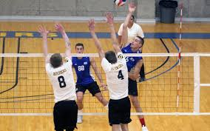
2020 Work Team Training
Net Faults
It is a fault for a player to touch the either antenna or any portion of the net or cables.
When a NET violation occurs, the R2 should immediately AND loudly blow their whistle (must get play to stop) and then move to the team’s side that was in the net.
Notes:
Walt

Slide 64
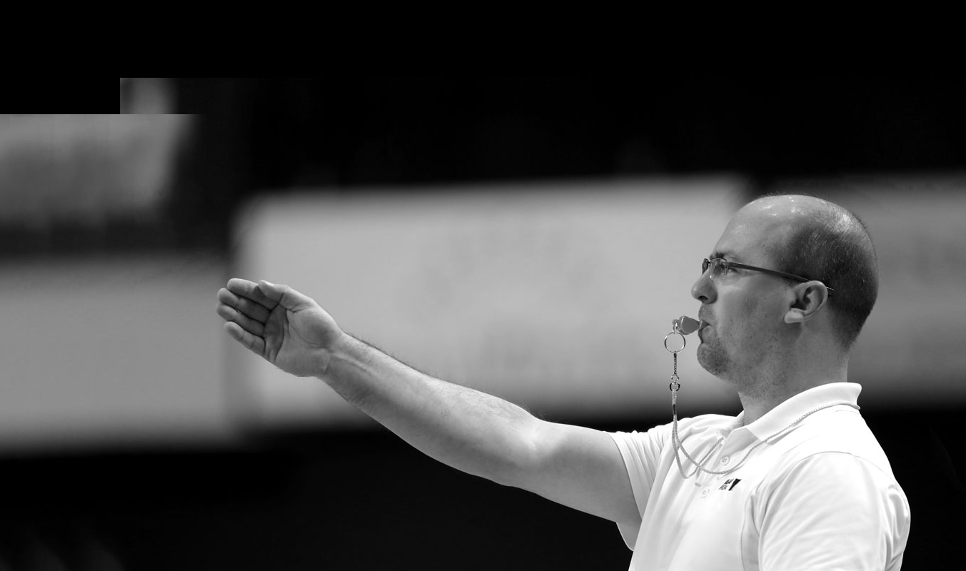
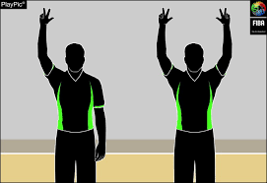
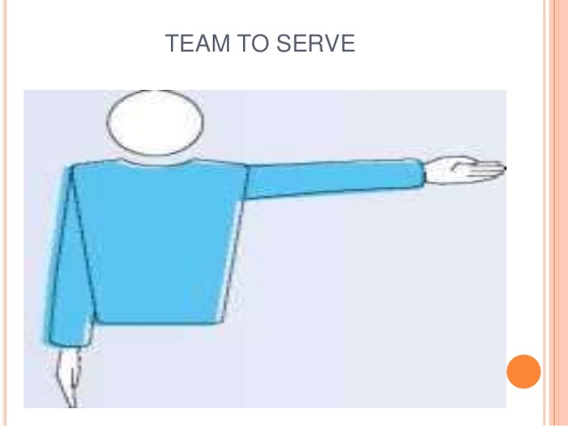
2020 Work Team Training
Net Fault Signals
With play stopped and you now on the team’s side committing the fault, the R1 will be looking at you.
First – Signal “net fault”
Second – Show the players # (i.e. #3) that was in the net towards the R1 (you may also need to visually, or verbally tell the coach)
Third – Once the R1 has awarded a point, you will also signal which team will serve next
Notes:
Walt

Slide 65
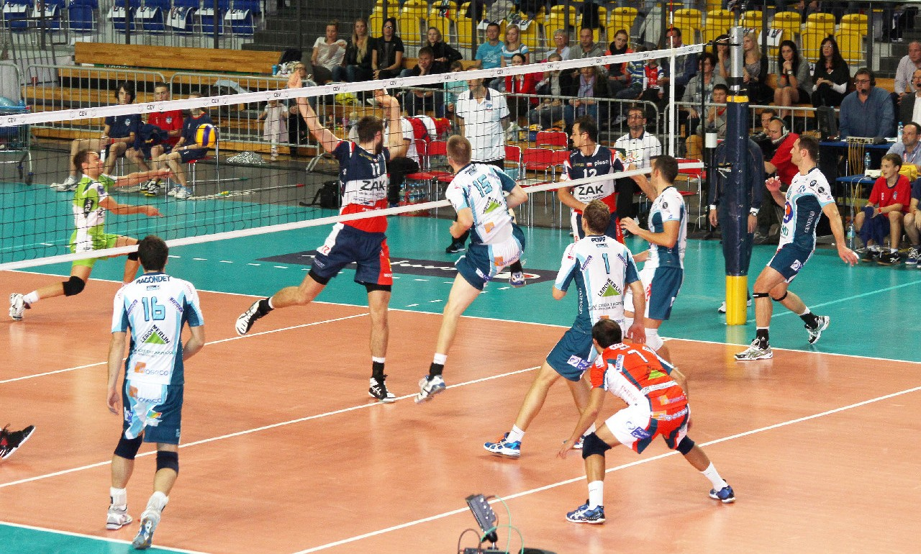

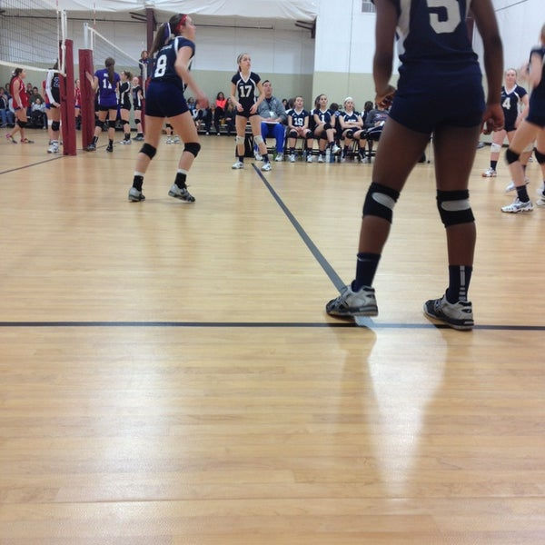
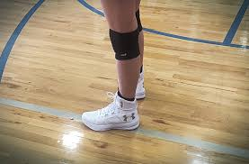
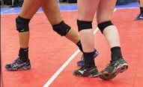
2020 Work Team Training
Centerline Faults
Players must stay on their half of the court with the following exception:
Their hands and/or feet may touch the opponents court as long as some of the hand or foot is also touching (or directly above) the centerline.
If any other body parts touch the opponents courts, there is interference, or the players foot/hand is no longer on or above the centerline, it is a fault.
When a fault occurs the R2 must loudly blow their whistle (to stop play) and move to the team’s side at fault.
Notes:
Walt

Slide 66
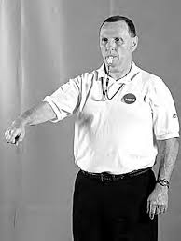
2020 Work Team Training
Centerline Fault Signals
With play stopped and you now on the team’s side committing the fault, the R1 will be looking at you.
First – Signal “centerline fault”
Second – Show the players # (i.e. #3) that was in the net towards the R1 (you may also need to visually, or verbally tell the coach)
Third – Once the R1 has awarded a point, you will also signal which team will serve next
Notes:
Walt

Slide 67
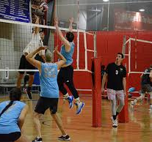
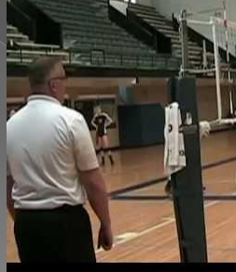
2020 Work Team Training
Base position for R2
R2 should be ~ an arms length back from the net pole.
During play, they will move from on side of the pole to the
other, always trying to be on the side WITHOUT the ball.
This provides the best angle to view net and centerline faults.
R2 must stay focused at the net and centerline durting attacks. Do NOT follow the ball with your eyes! Instead, watch the attacker and blocker(s) until they’ve landed without committing a fault.
Then, efficiently move to the other side (the one w/o the ball)
Notes:
Walt

Slide 68
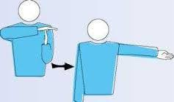
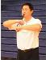
2020 Work Team Training
Additional R2 duties
The R2 will repeat the R1 signals at the end of each play.
(They will not repeat the service beckon signal before each rally)
When the rally is finished and the signals are complete, look in the direction of both benches to see if there are any time-out or substitution requests.
For time-out is requests, blow your whistle and signal time-out, then point to which team requested it.
For substitution requests, blow your whistle, make subs signal (same as “traveling” in basket ball), ensure the score table has gotten the #’s, then wave the new player(s) onto the court.
Notes:
Walt

Slide 69
2020 Work Team Training
R2 final comments
The R2 should always keep the whistle in their mouth, with a couple exceptions:
The set is over, or hasn’t started yet
During time-outs
While talking with the score table members, a player/coach or the R1
The R2 does NOT blow their whistle for libero exchanges or ball-handling faults (including 4 hits)
The R2 DOES blow their whistle for the following items:
Time-out and substitution requests
Net Faults
Centerline Faults
Notes:
Walt

Slide 70
2020 Work Team Training
The officiating duties are complete!
Just a couple more slides with warm-up procedures and league rules
Notes:
Walt

Slide 71
2020 Work Team Training
Warm-ups
For both the JV and the Varsity match, warm-ups will be 10 minutes.
Visitors will be on for the first 5 minutes
Home will have the second 5 minutes
There is no shared serving or hitting during this 10 minutes
There will likely be a few minutes between matches as the R1 finalizes the JV score sheet and conducts the Varsity captains meeting for the teams to “pepper” with balls and/or stretch on their own side of the court.
Notes:
Walt

Slide 72
2020 LEAGUE FORMAT
RULES OF PLAY
The MSHSL girls volleyball rules will be the basis for competitive play.
To increase the number and length of rallies, create excitement, and improve overall technique long term, the MN Boys HSVB Association determined the following modifications will apply to the 2020 Boys High School Club Season:
  The ONLY allowed “DOUBLE” contact call will be when a player contacts the ball 2 times in a row.
  THERE WILL BE NO BALL HANDLING, “DOUBLE” CONTACT CALLS.
  A “LIFT” will be called without leniency for ANY touch having a prolonged contact where the ball came to
  rest before traveling in another direction.
  The R1 will be patient and explain calls in depth with no yellow cards used for delays in game until April 17.
  The R1 will be responsible to check line-ups and watch overlapping instead of the R2. The R1 will
  correct overlapping situations without calling a violation until April 17.
  R2 responsibilities will be limited to calling Net and Centerline Fouls ONLY. R2 will assist with touch
  and line calls.
Notes:
Krista

Slide 73

And finally…
NO CELL PHONES during officiating assignments!
HAVE A GREAT SEASON – GOOD LUCK!
www.mnboyshighschoolvolleyball.com

