Slide 1
BILT Foundation
By American Youth

Slide 2
What is the BILT Foundation
The BILT Foundation is listed and approved with the State of Arizona
as a Qualified Charitable Organization (QCO #20917)
BILT offers parents and other Arizona residents a way to help
programs pay for their out of season Expenses and Activities.
These include; Summer Camps, Field trips, Cheer Competitions etc.
Anything outside of the regular season can qualify.
Example; Saguaro Orchestra went to Carnage Hall. AZ Football Teams attended Summer Camps in
Arizona and California, attended 7X7 Tournaments, summer weight training, etc.
The best part is, this support, is then refunded back to the donor through
the Arizona QCO Tax Credit program.

Slide 3
What is a Tax Credit
This program is a TAX CREDIT, NOT a tax donation. It’s a $1 for $1 tax credit OFF your owed AZ State taxes or REFUNDED from your paid AZ State taxes.
Which is different than a TAX DEDUCTION - A tax credit is a dollar-for-dollar reduction of the money you owe or have paid, while a tax deduction will decrease your taxable income, leading to a slightly lower tax bill.

Slide 4
How does this work?
You go to BILTFoundation.org and make a donation to your athlete/program. This will give the $1 for $1 tax credit for your AZ State taxes. The selected program receives 75% of that donation.
The remaining portion of your donation is then granted to other programs with extreme financial needs. This is required by the State of Arizona to maintain our QCO status, for you to benefit from this tax credit program.

Slide 5
Who can Donate?
Parents
Relatives
Neighbors
Any AZ resident looking to take advantage of the AZ Tax Credit and redirect state funds to your program.

Slide 6
How much can you Donate?
Tax year 2024
$470 ($352.50) for Single Individual Filing 2024
$938 ($703.50) Filing Jointly. Filing before April 15, 2025
Tax Year 2025
$495 ($371.25) for Single Individual Filing 2024
$987 ($740.25) Filing Jointly. Filing before April 15, 2025
Another tidbit of info is that Parents can also donate to the Public-School tax credit on top of this donation to save even more money. On top of your $938 QCO donation, you can donate an additional $200/$400 for a maximum benefit. (if you qualify)

Slide 7
Reasons WHY people don’t take advantage of BILT or Tax Credits
They simply don’t understand it or think it is too good to be true.
We suggest spending 10-20 minutes talking with a tax professional about the QCO Tax Credit to see if this will work for you/them.
They don’t realize they may qualify. However, most people do qualify!
They don’t have the money at the time to make the donation.
You can make your donation with a Credit Card right before you file your taxes, and you should receive the refund before receiving your credit card statement.

Slide 8
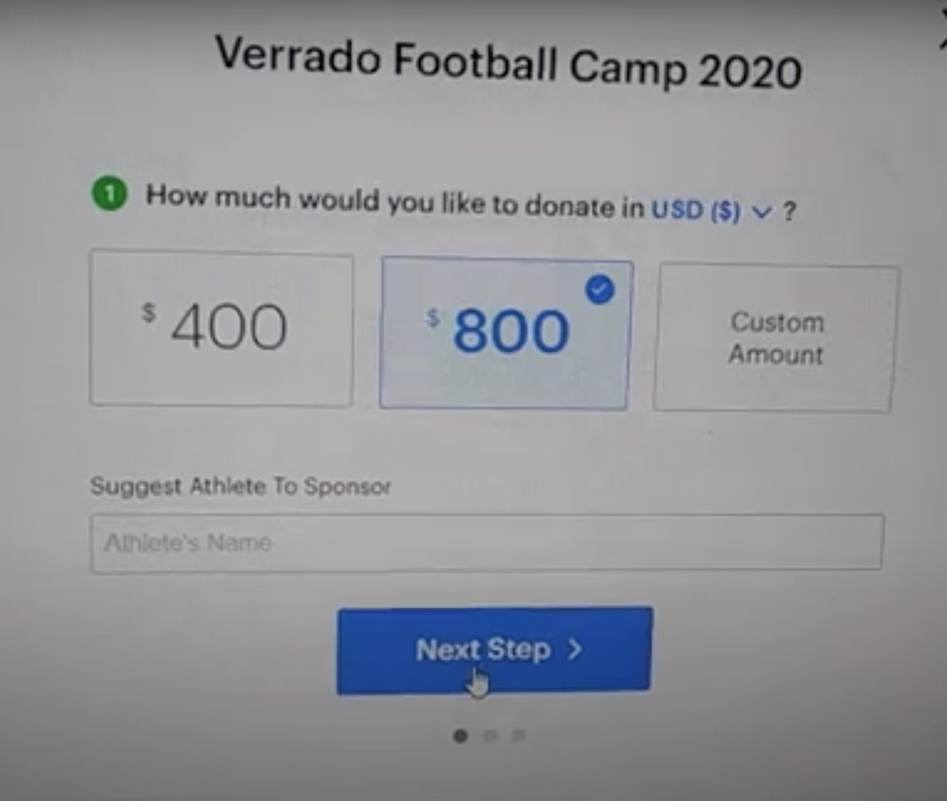
Example Video
Disclaimer: This is an optional program, and your participation is not required. This is simply a way to get your kids to camp for free!
Through the BILT Foundation, we have helped raise almost $2M and sent over 5,000 athletes to a Team Summer Camp and or Field Trips

