Slide 1
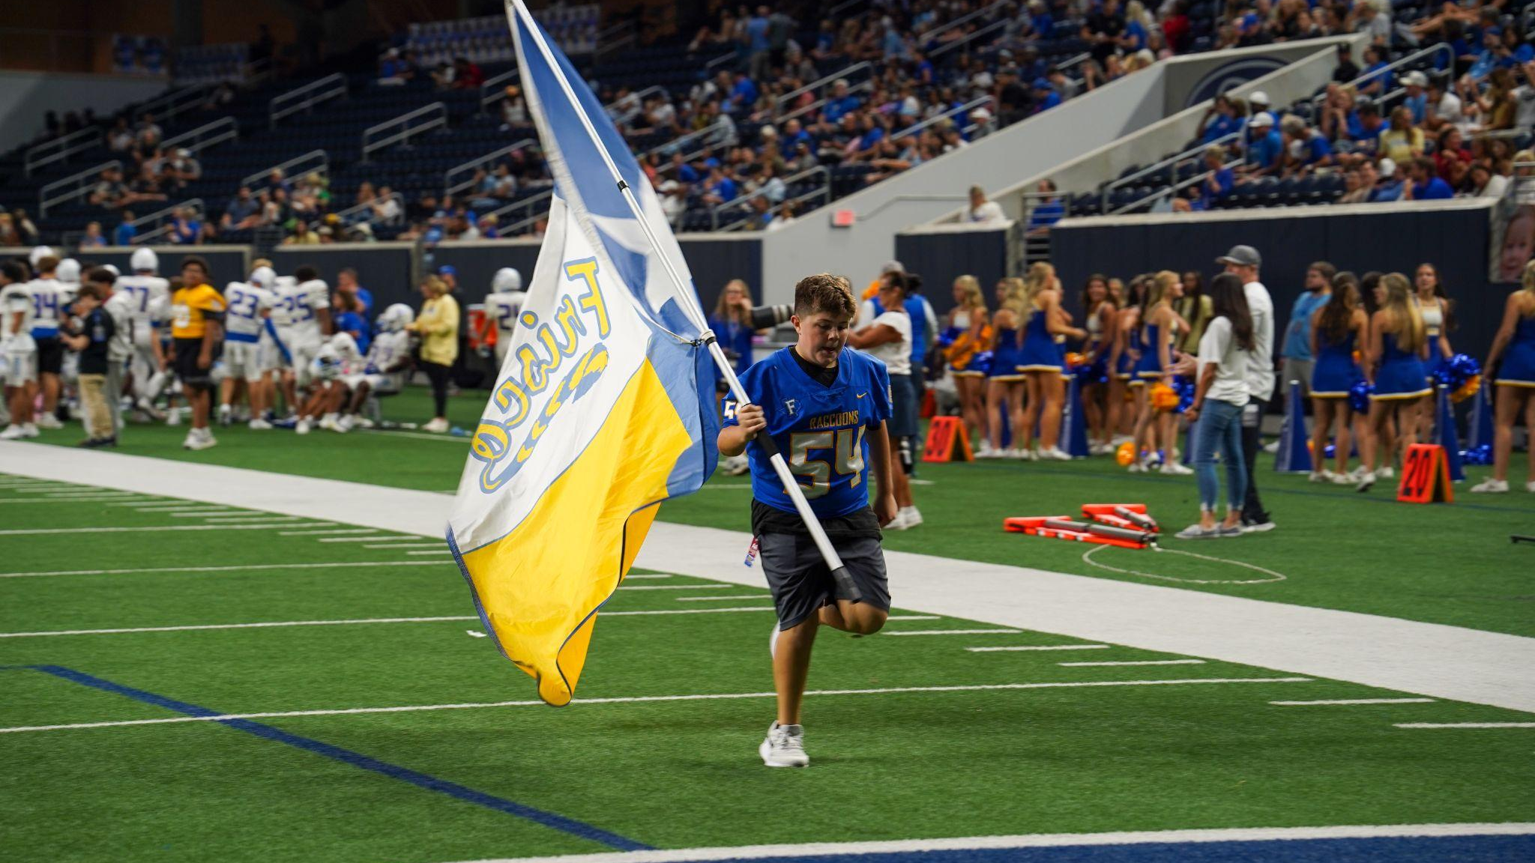

RECRUITING IN TXHSFB IN 2026 AND BEYOND
Navigating the process of recruiting in the transfer portal era

Slide 2
MYTHBUSTERS
Myth: With the transfer portal there are fewer opportunities to play college football
Fact: The number of spots in college football remains the same, there’s still the same number of players every year who run out of eligibility.
THE POINT OF ENTRY TO COLLEGE FOOTBALL HAS CHANGED!
Myth: Talent alone will get me offers!
Fact: Although talent is vital to receiving scholarship offers, there are thousands of talented football players nationwide, you are competing against all of them.
WHAT SEPARATES YOU?

Slide 3
STUDENT ATHLETE 101
Compete! Compete! Compete!!
88% of the 2025 NFL Draft Picks played more than one sport in HS; 30 of 32 first round picks were multi-sport athletes! Run track (VITAL); Play basketball; play baseball; wrestle, powerlift, play as much as you can!
Attendance is CRITICAL
Being present is absolutely vital, if you miss a day of school in the off-season you are potentially missing a chance to meet the college coach who will offer you a scholarship! BE AT WORKOUTS!!
When it comes to summer workouts, school 7-on-7, etc attendance is key the goal is to get better for Friday night. If you have to miss for vacations, work, etc that’s OK. Just talk to your coach ahead of time so you can work on a plan to get the work in. Communicate with your coaches!
Have an honest conversation with your HS Coach
Your HS coach is a free resource when it comes to recruiting, have an honest conversation about what level prospect you are and be open to that. Do your research and look up the average size of a Division I player for your position, Your HS coach isn’t going to sell a D3 kid to a D1 school, he’ll lose credibility for all the current and future players, they’ll give it to you straight. They WANT you to be successful!

Slide 4
SOCIAL MEDIA TIPS AND TRICKS
Your social media is your public resume. Don’t put anything on any social media you wouldn’t want your grandmother to see!
Put your government name in your bio somewhere! If a coach looks you up or needs to pull a transcript they need your government name! If you have a nickname (that’s appropriate for social media) you can list that too ex. Julian “Deuce” Reese II
List your CLASS YEAR + POSITION + HIGH SCHOOL. Your “URL” should be your Hudl highlights link.
List your verified height, weight and 40 time, no need in lying… THEY WILL FIND OUT.
DO NOT post too many training videos and repost your highlights over and over. Make it easy for coaches to find relevant information.

Slide 5
HIGHLIGHT VIDEOS
Work with your coaches to create the best possible highlight video.
Put your best plays first. Most college coaches will watch for 2-3 plays and you want to grab their attention immediately.
Use a spotlight or arrow to identify yourself BEFORE the play, preferably 2-3 seconds before the snap of the ball. NEVER slow down or speed up your highlight tape.
Music is not recommended, but if you want music make sure its not distracting, the focus of the video should be you and your ability.
3-5 minutes is the perfect length for your highlight reel.

Slide 6
TRAINING
THE NUMBER ONE GOAL OF EXTRA WORK IS TO IMPROVE FRIDAY NIGHT PERFORMANCE… FRIDAY NIGHT PERFORMANCE IS THE BEST WAY TO GET A SCHOLARSHIP!
All extra work isn’t created equal. Research trainers, do they work with your HS coaches to come up with a plan for improvement? Are they using already established recruits to “clout-chase”? Are they in it to help kids or are they more interested in their brand or YOUR brand.
DO NOT miss school activities for outside of school work, you should never miss a practice or game for a school team to attend a workout outside of school. Be a team guy first! Your trainer should be in touch with your school coaches to set a schedule that works for everyone involved!

Slide 7
CAMPS
Have a gameplan on what camps you will attend. Know what you are getting into before you sign up!
All camp invites are not created equal. Who invited you?
If you are a incoming junior or senior you should have already had a talk about what level of prospect you are and attend camps based on that feedback. That’s where you’ll get the most bang for your buck, if you are a D2 kid and you attend a mega-camp with 1,000 kids, you may not get the attention you are looking for.
If you are a high-level prospect and invited to a free invite only camp, attend it especially if it’s with a reputable outlet like Next Level Athlete, UnderArmor, Nike, Rivals, etc.
If you are being asked to pay for a camp, do your research, will college coaches be there? Check the NCAA calendar and verify dates, don’t be a donation!
Don’t hang at the back of the line! Be ready for your reps.

Slide 8
HOW DO RECRUITING RANKINGS WORK?
What Recruiting Rankings Are (and Aren’t)
Recruiting rankings were originally created for college football fans to understand who is coming into their programs. They are not strictly based on high school performance.National services like 247Sports and Rivals often rank players based on:
Long-term potential
Physical measurables (size, speed, length)
NFL upside Five-stars are projected first-round NFL talent
The DCTX Difference
At DCTX, we take a college-focused approach. Our goal is to evaluate How a player projects and performs at the college level.
Top 50 players in Texas = Four-stars
Top 5 players in Texas = Five-stars

Slide 9
HOW RECRUITING RANKINGS WORK (CONT)
DCTX Rankings
Dave Campbell’s rankings are built using 3 components:
Input from TXHSFB Coaches
In-Person Evals (Games, Camps, Practices, 7-on-7)
Film Study
What the DCTX Stars Mean
Five-Star Prospect = a player who has separated on the field, projects as elite at the college level, and has the potential to earn national recognition with NFL upside
Four-Star Prospect = player who has the ability to compete for all-conference honors in college
Three-Star Prospect = a player who has P4 upside
Bottom Line
Rankings are a tool but development and fit matters more!

Slide 10
PARENTS DO’S AND DONT’S
Do: Be involved!! Coaches love supportive and involved parents and channeling that energy. Attend parent meetings, join the booster club, help on the tunnel crew, assist in fundraising, everyone can do their part to make the kids experience worthwhile!
Don’t: Compare your child’s experience to any other athlete, your child’s journey belongs to your child and keep the focus there.
Do: Understand that your child’s coaches have to keep the best interest of the team in mind, they have 50 children and have to do what’s best for the collective.
Don’t: Run your child’s social media pretending to be your child. Coaches and media can tell! If you are running your child’s social media make that clear in communications.
Do: Support the team and the team’s goals.
Don’t: Talk poorly about other players, coaches, parents or PLAY CALLING from the stands.

Slide 11

Q/A

