Slide 1

Twins Community Fund
2025 Minnesota Mr. Baseball & Ms. Softball Awards Finalists

Slide 2

MR. BASEBALL
FINALISTS

Slide 3
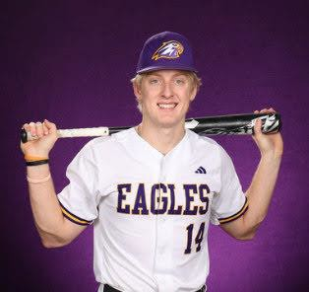
Nick Bowron
Rochester Lourdes

Slide 4
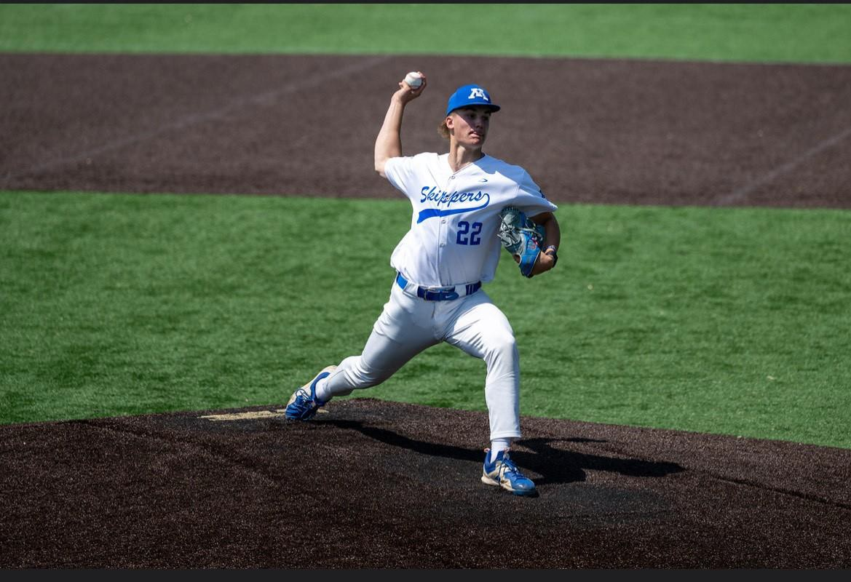
Jack Butterworth
Minnetonka

Slide 5
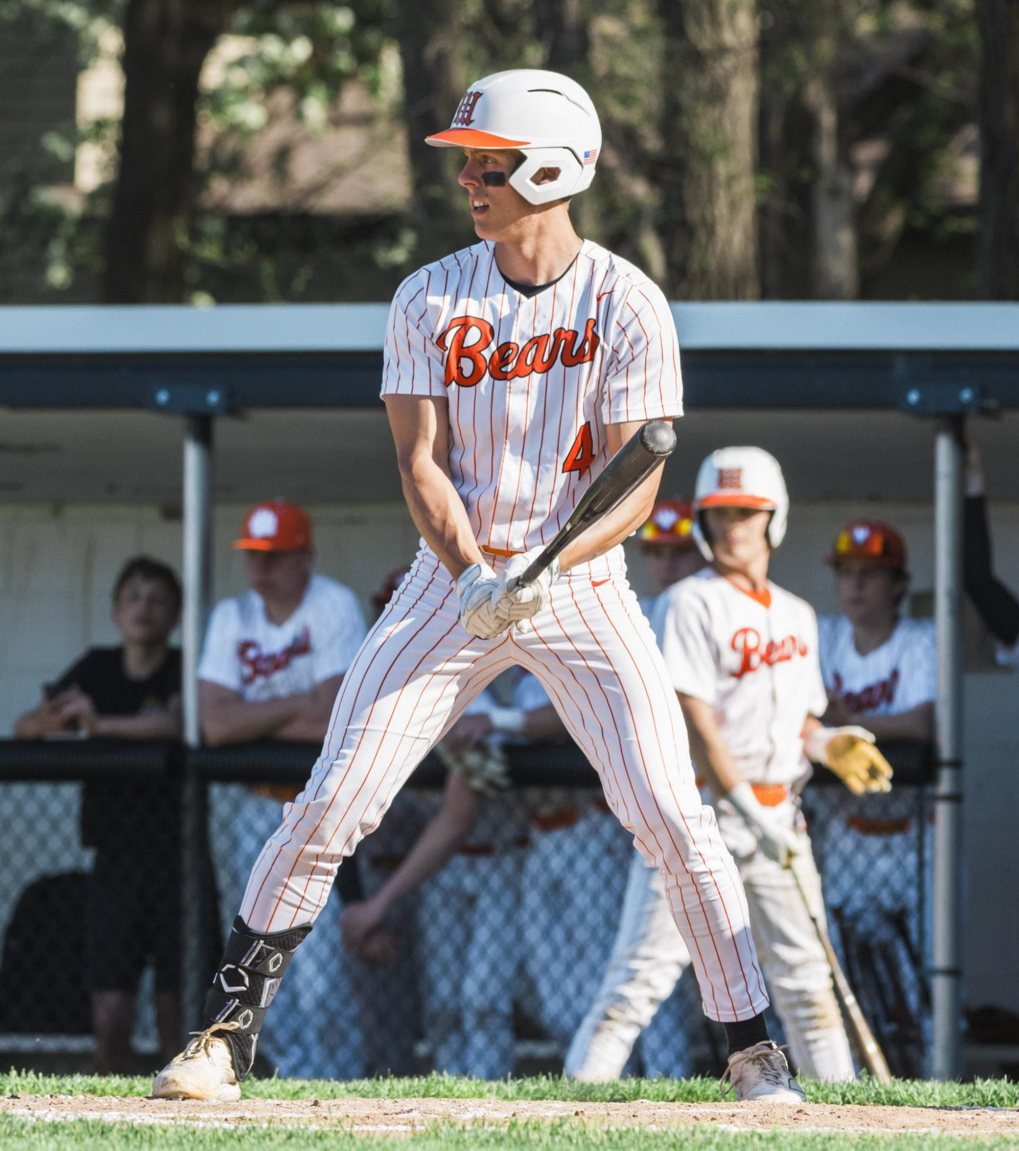
Blake Eckerle
White Bear Lake

Slide 6
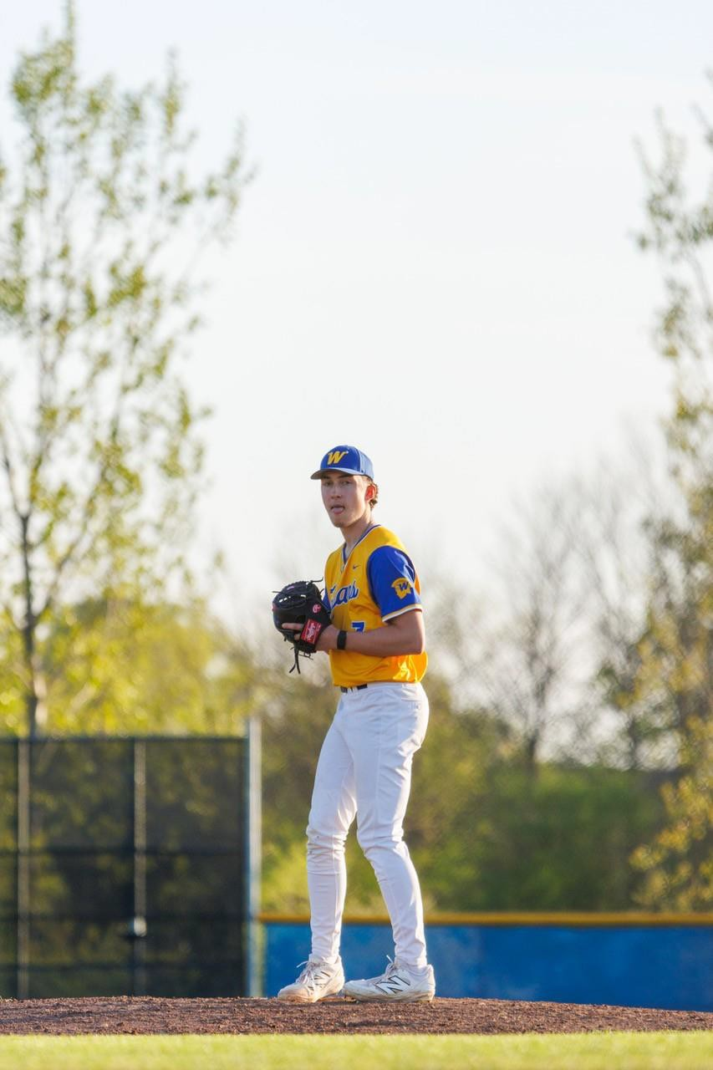
Noah Filer
Wayzata

Slide 7
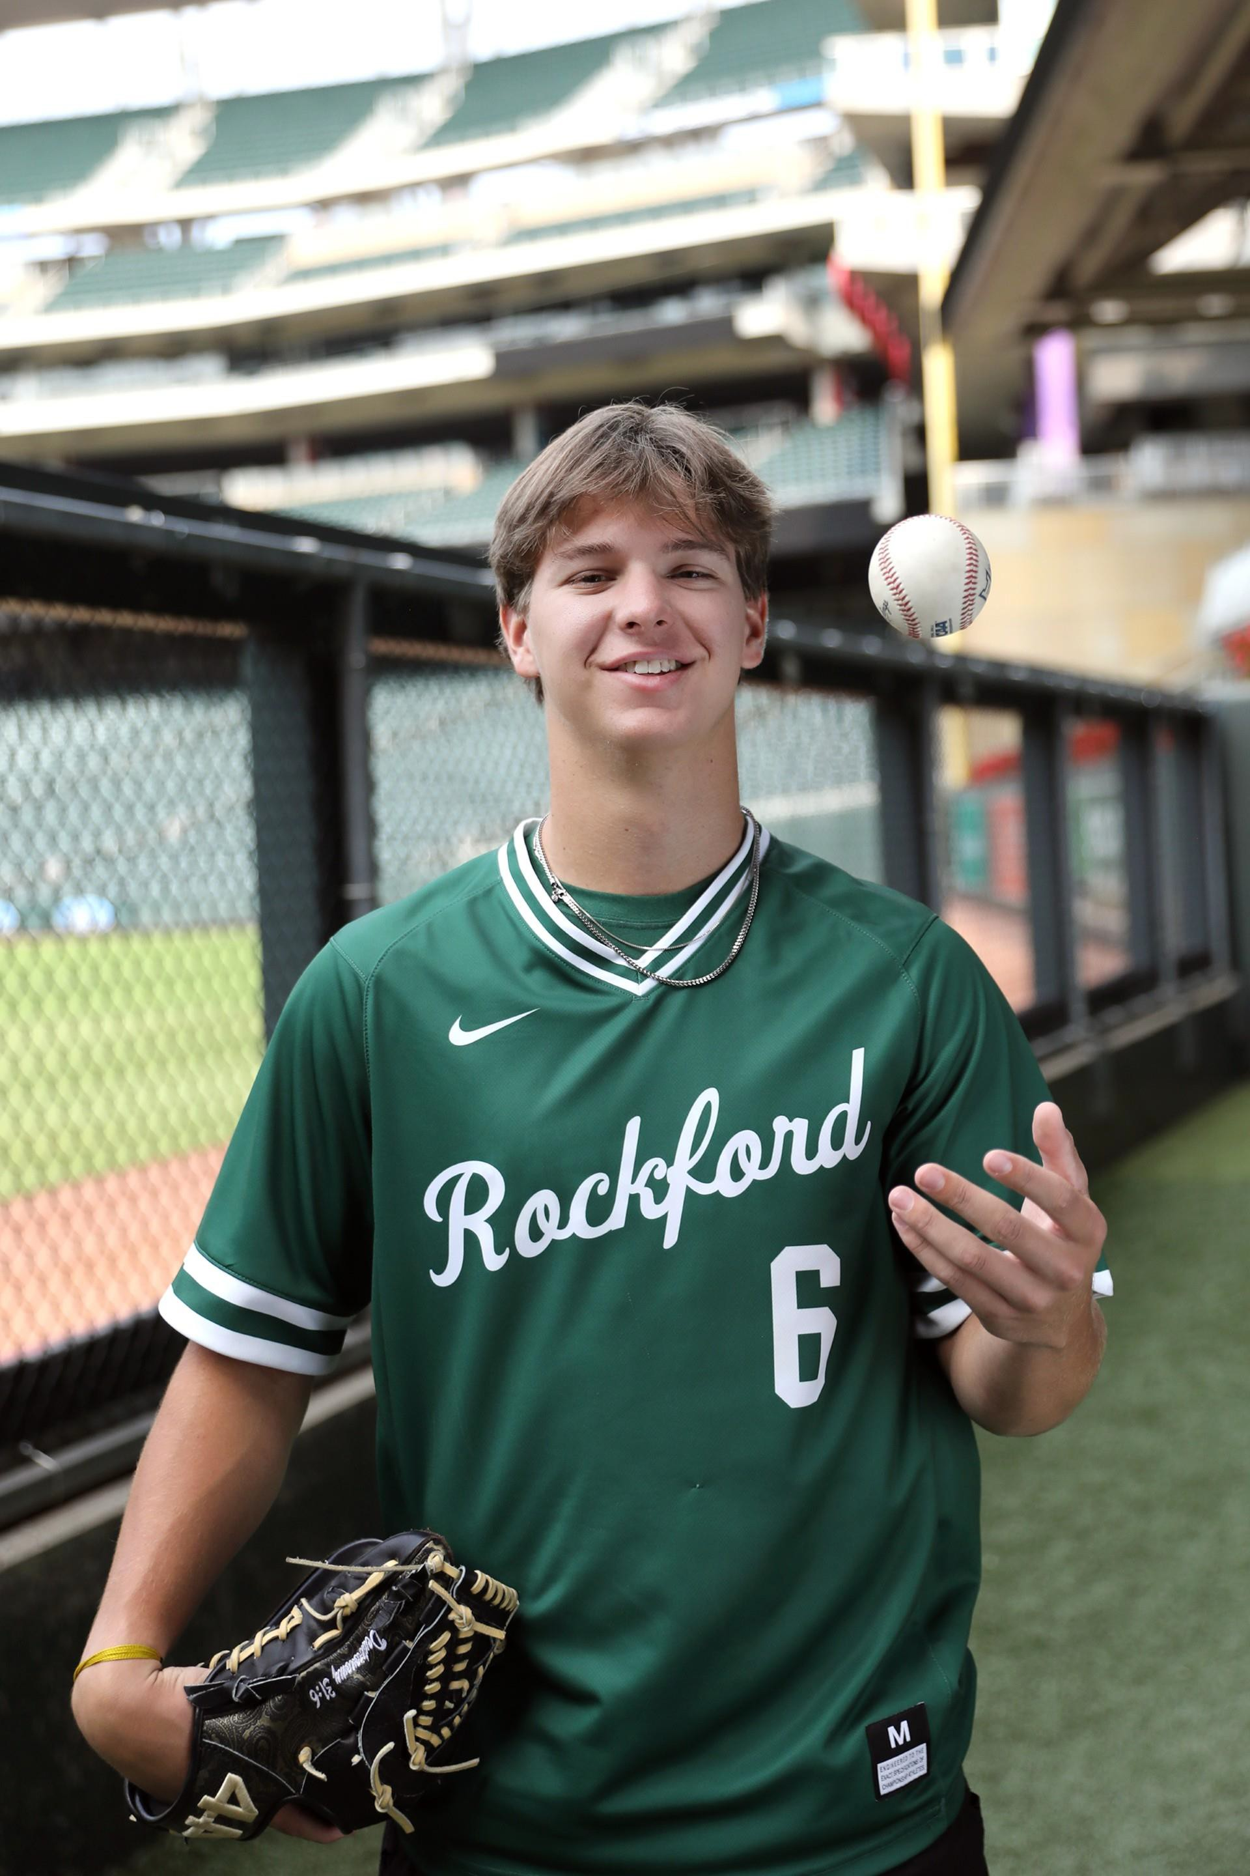
Will Haas
Rockford

Slide 8
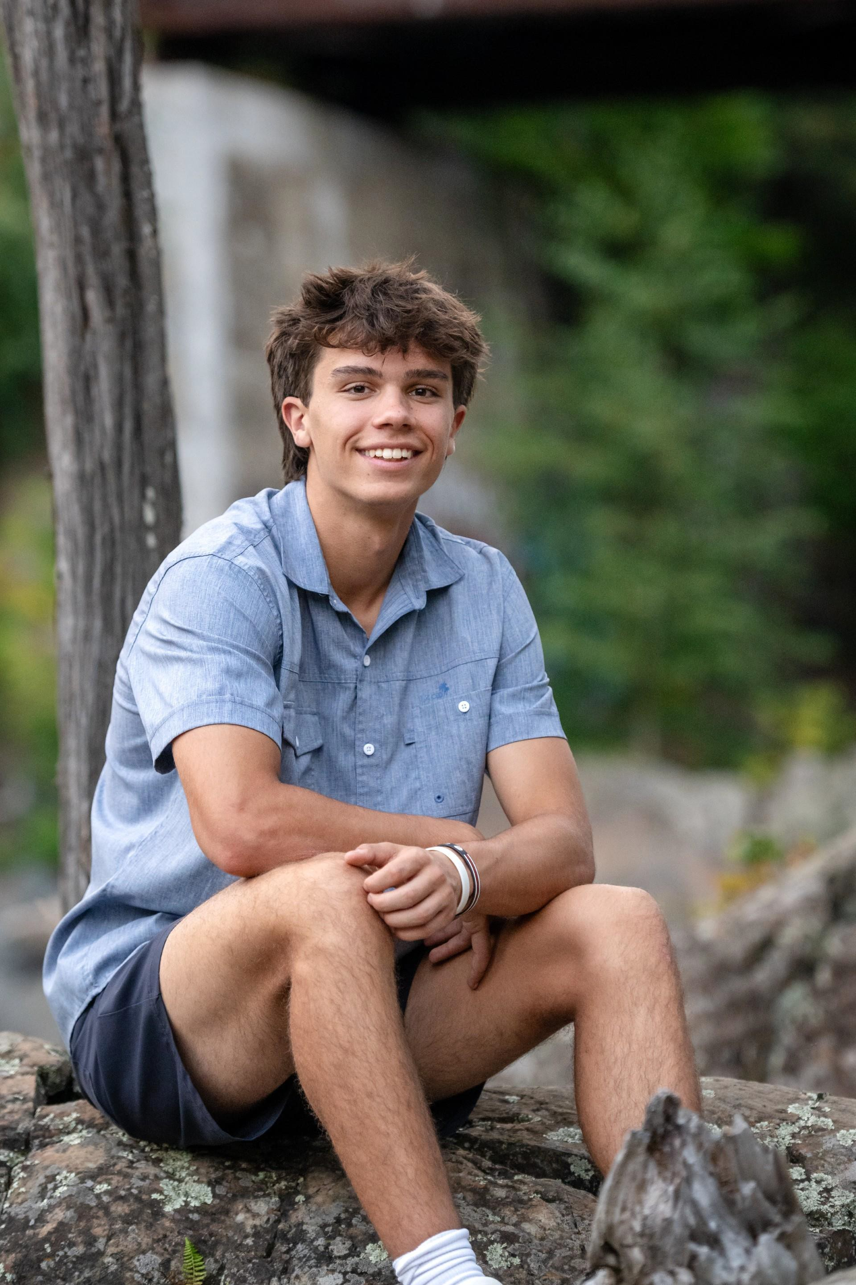
Sam Haugen
Esko

Slide 9
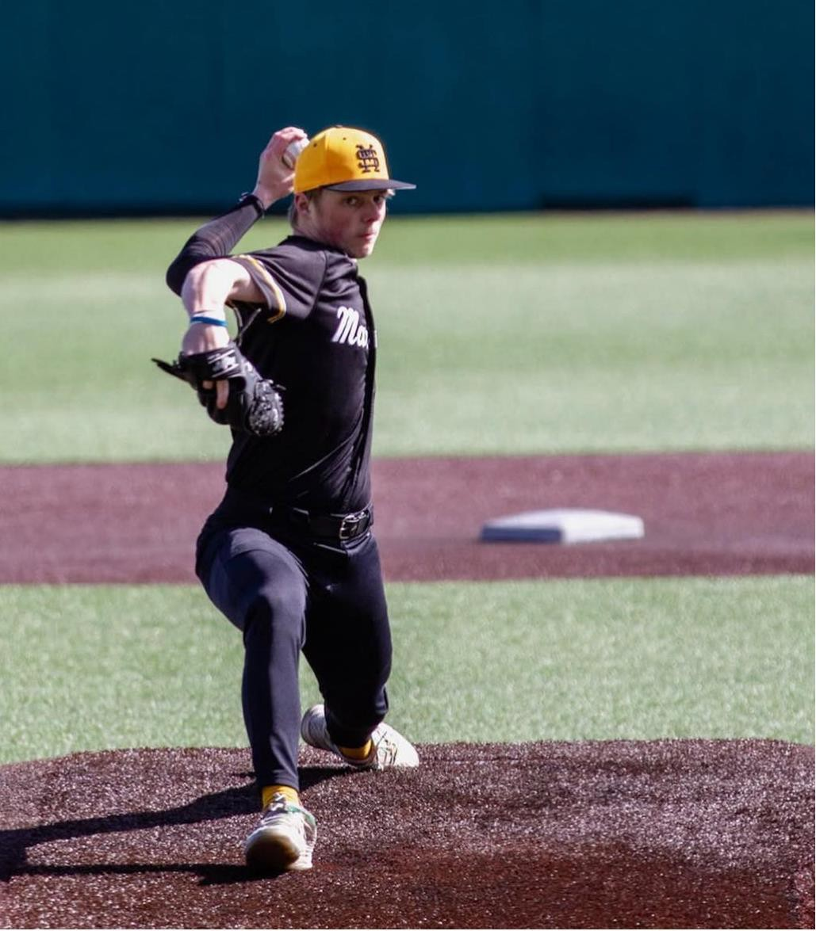
Owen Marsolek
Duluth Marshall

Slide 10
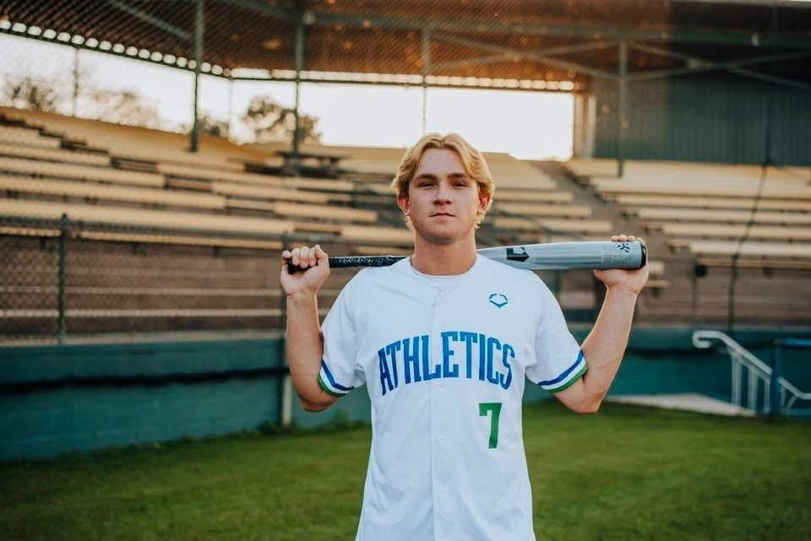
Hunter VaDeer
Lyle-Pacelli Austin

Slide 11

MS. SOFTBALL
FINALISTS

Slide 12
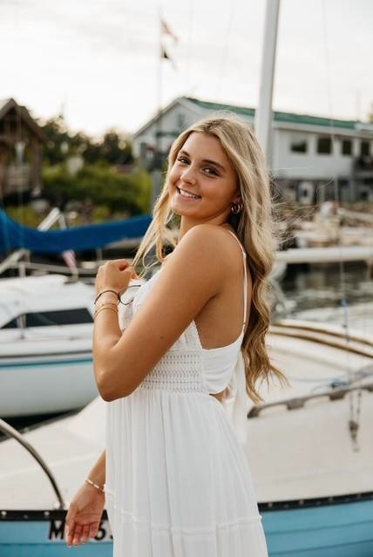
Kendall Kotzmacher
White Bear Lake

Slide 13
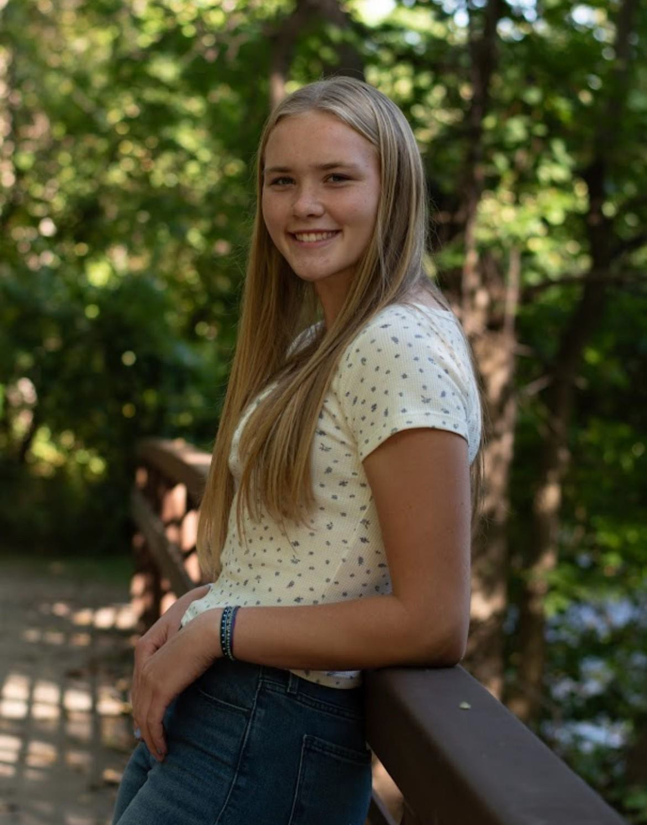
Maddy Freking
Anoka

Slide 14
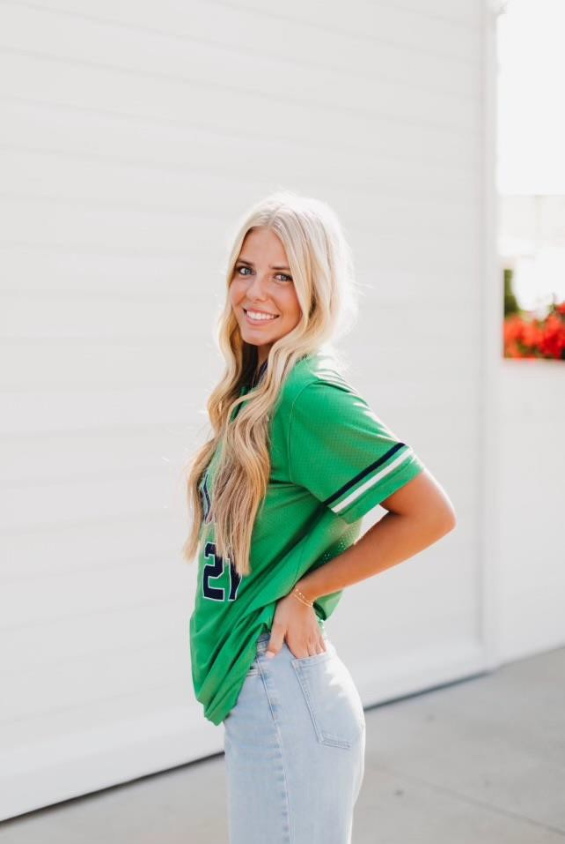
Jorey Fry
Rosemount

Slide 15
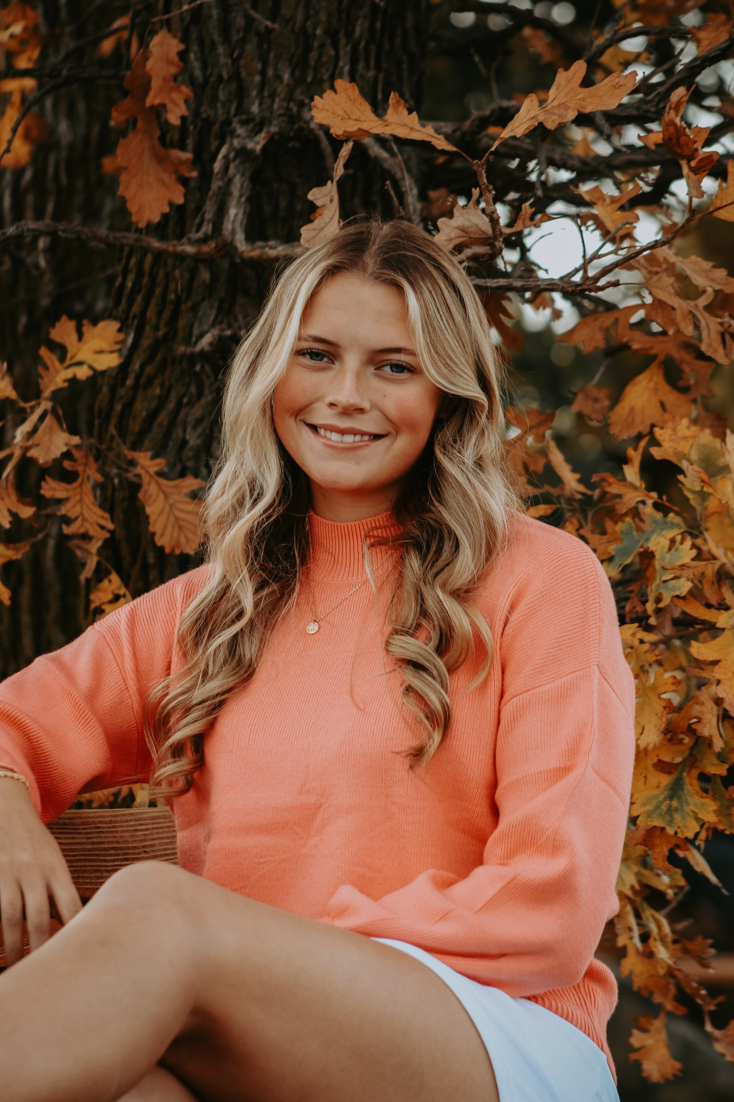
Avery Lerfald
Tri-City

Slide 16
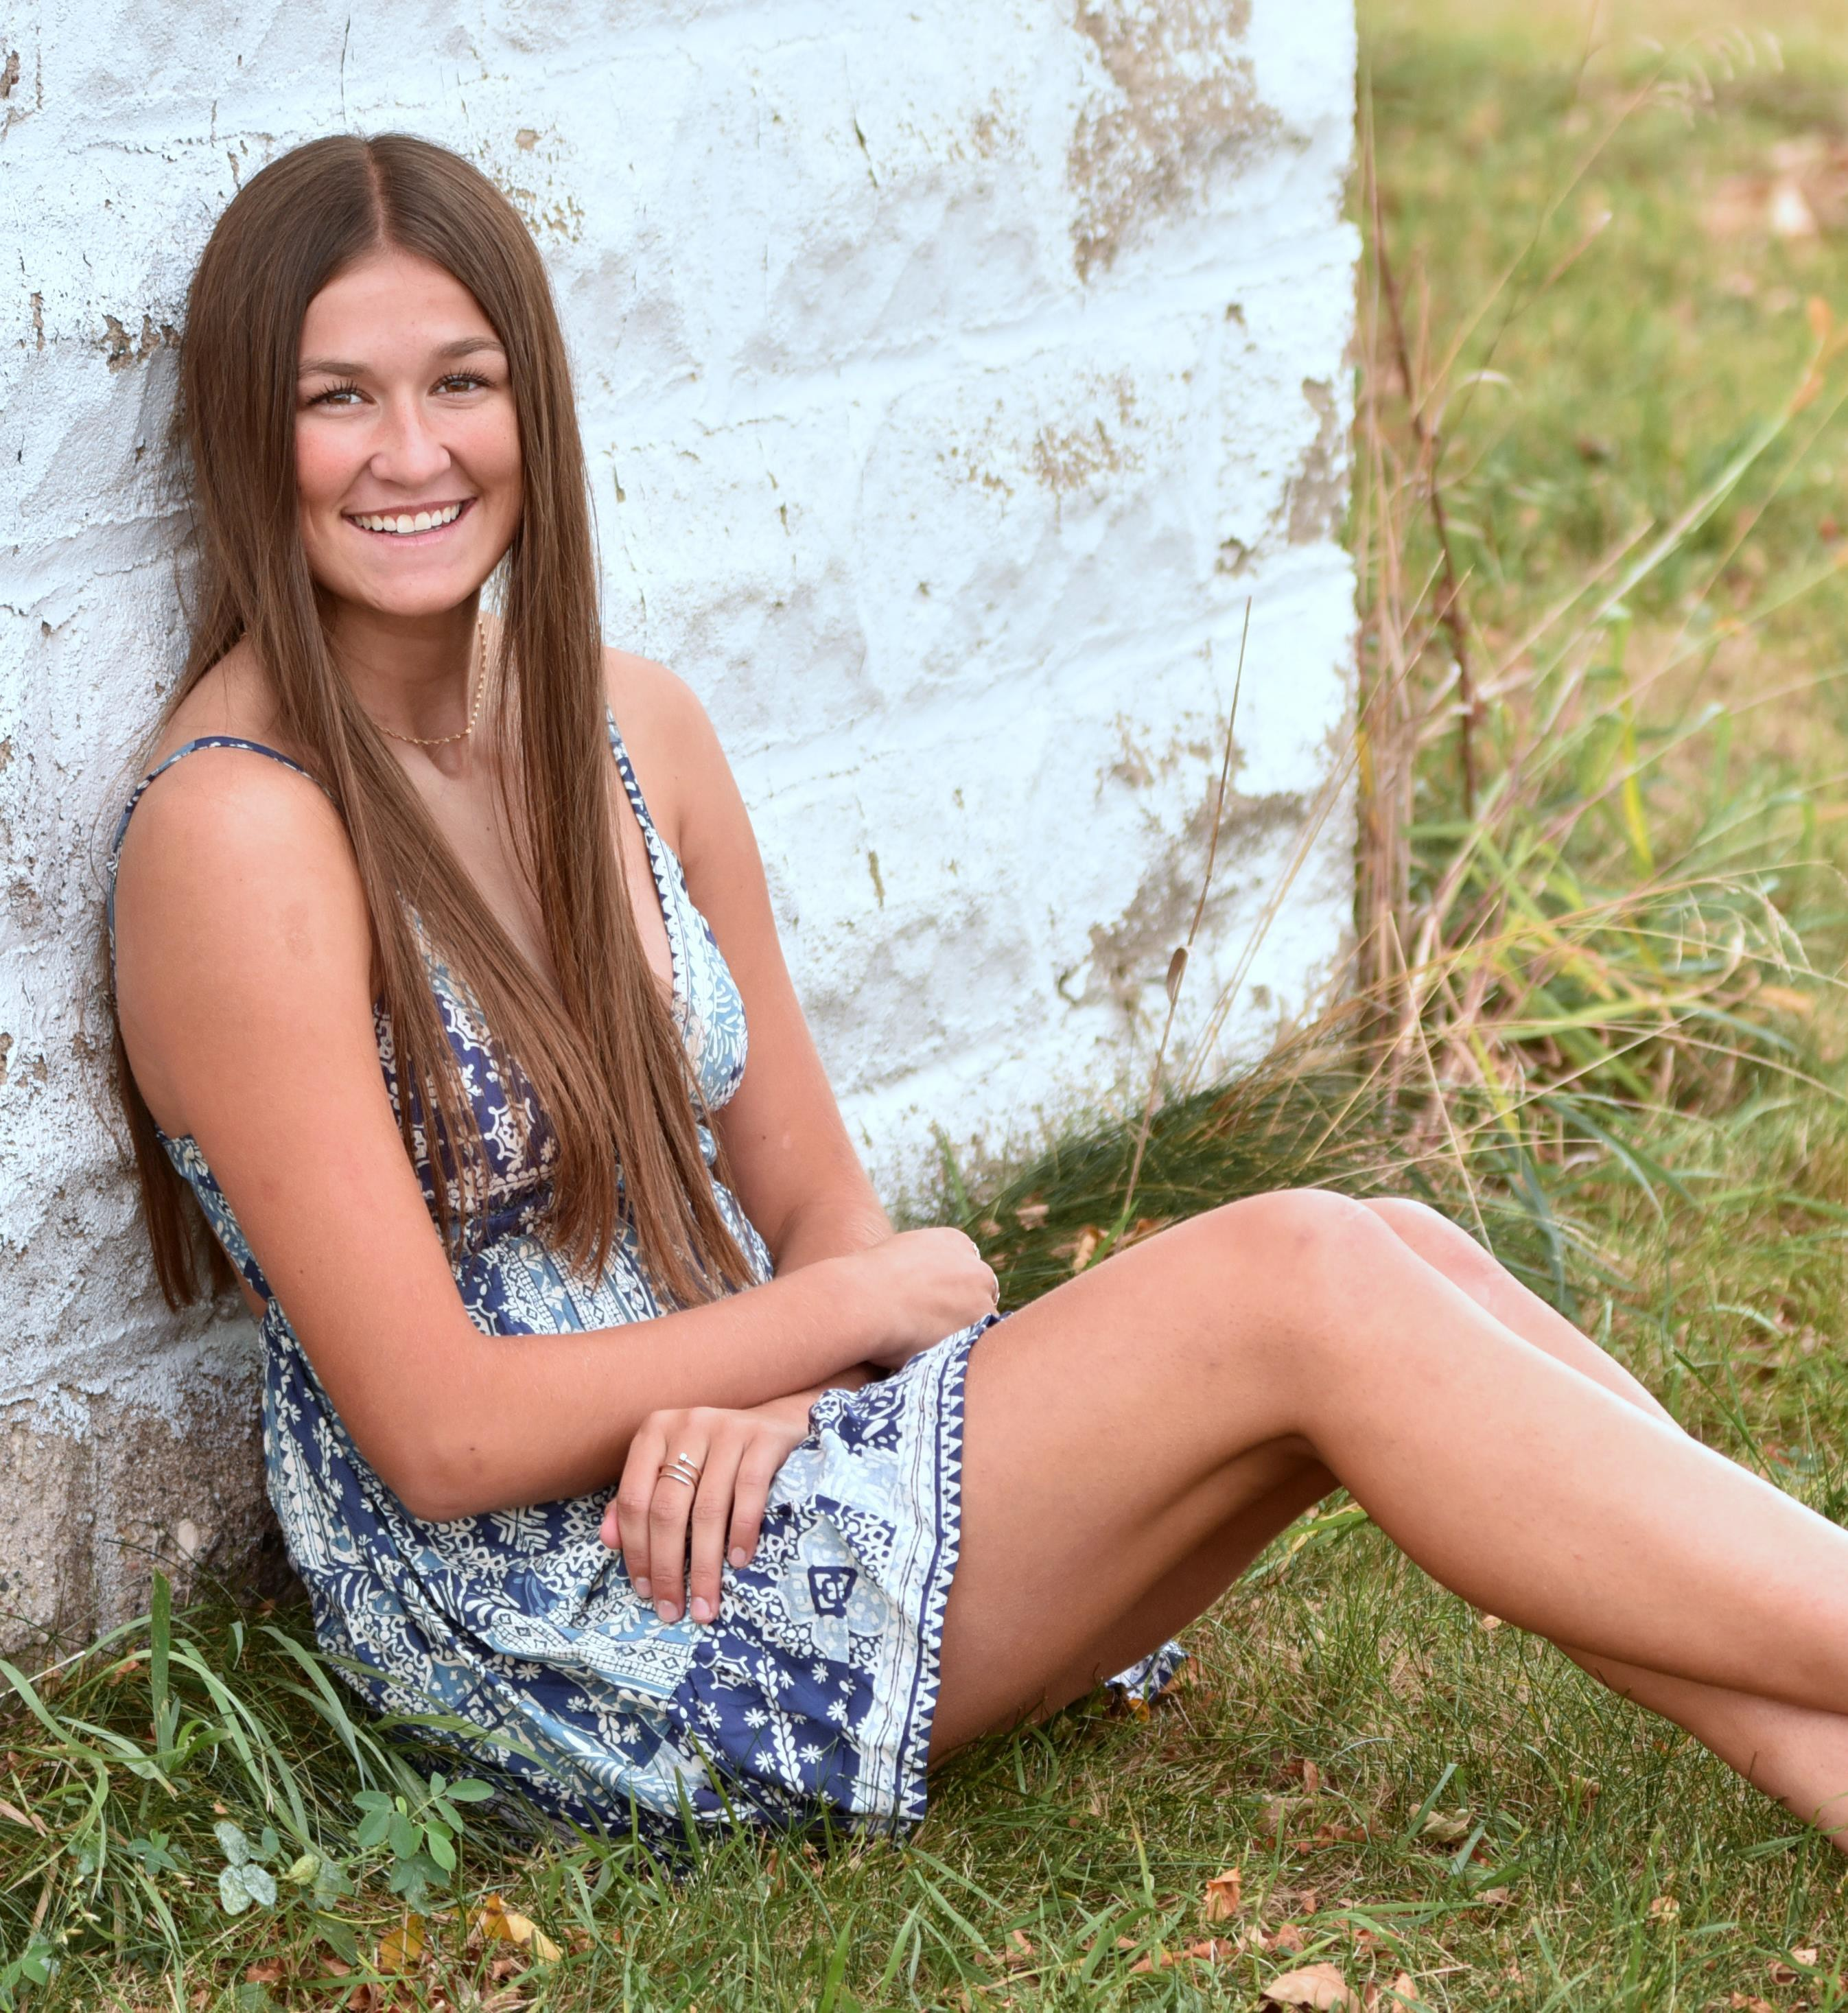
Carter Raymond
Randolph

Slide 17
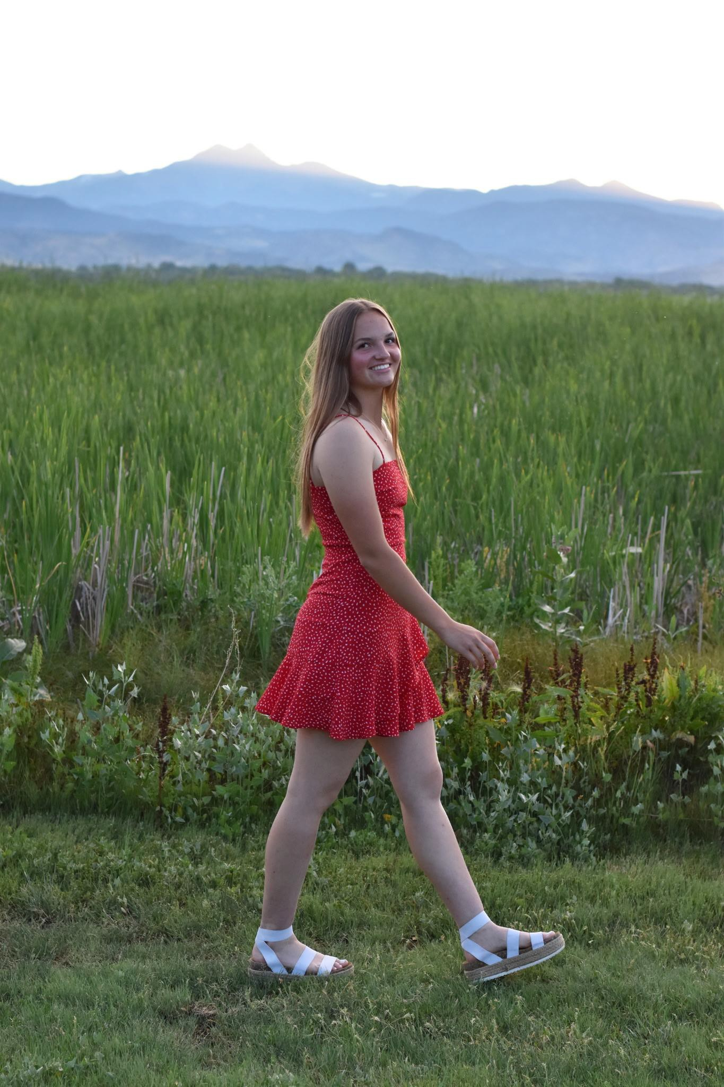
Caitlyn Rosha
St. Anthony

Slide 18
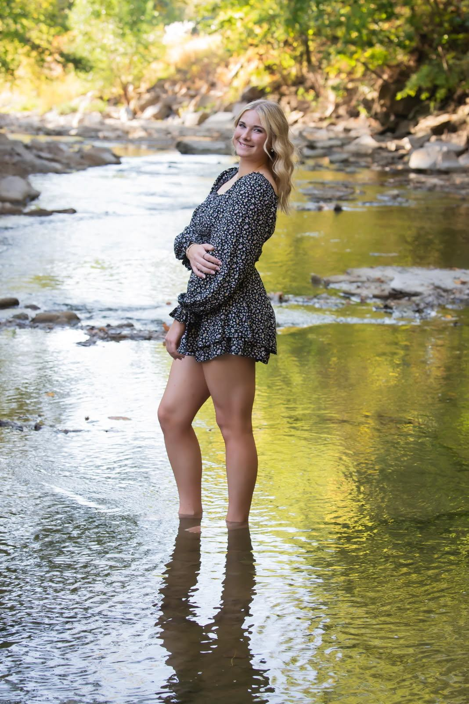
Kylinn Stangl
Mankato East

Slide 19
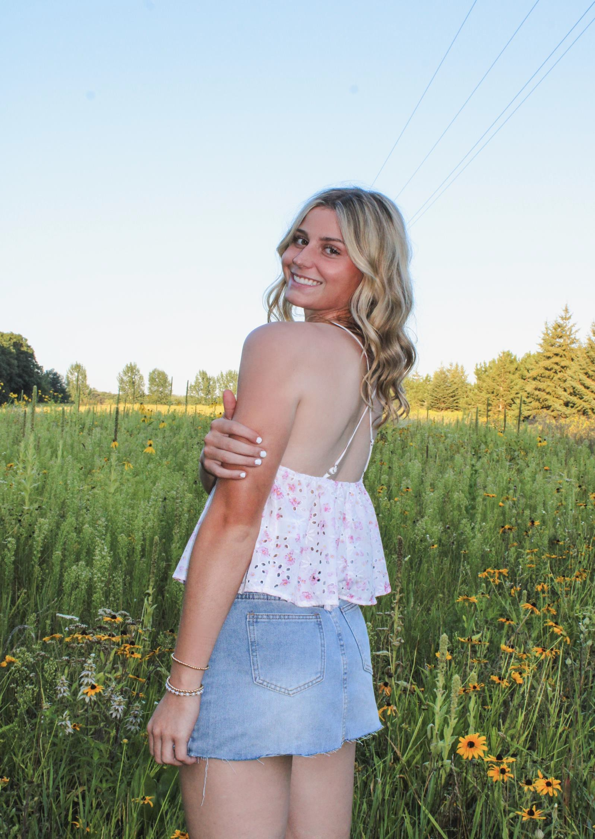
Mya Tautges
Brainerd

Slide 20
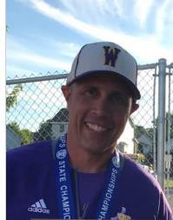
BASEBALL COACHES LIFETIME ACHIEVEMENT AWARD:
Mark Grundhofer

Slide 21
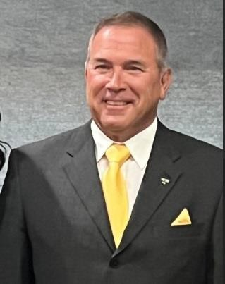
SOFTBALL COACHES BOB MERTZ AWARD:
Jeff Annis

Slide 22

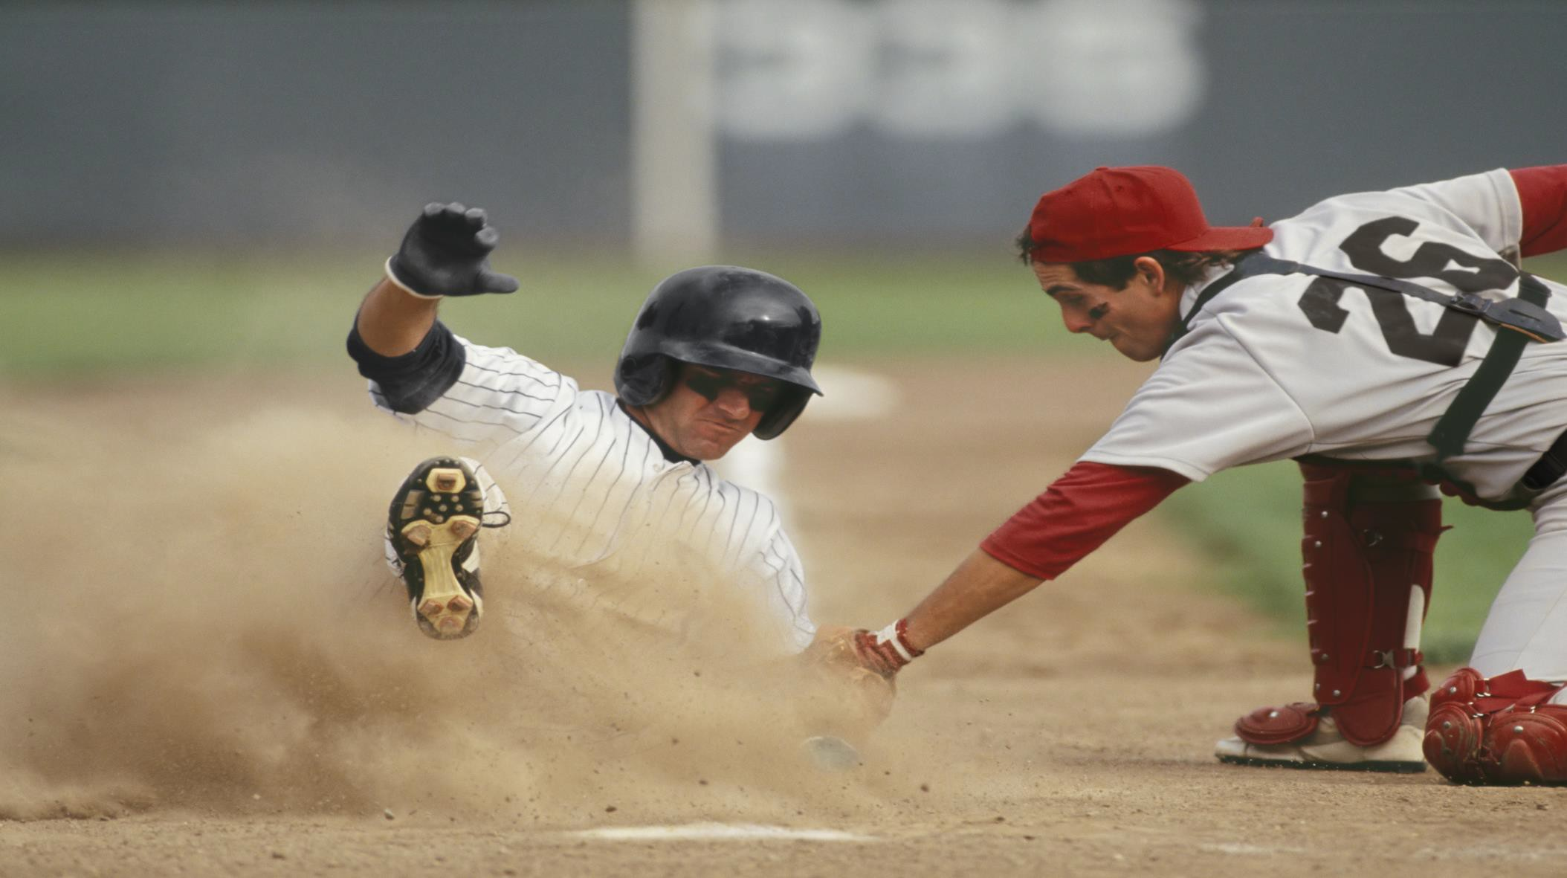
Baseball PAST WINNERS THROUGHOUT THE YEARS

Slide 23
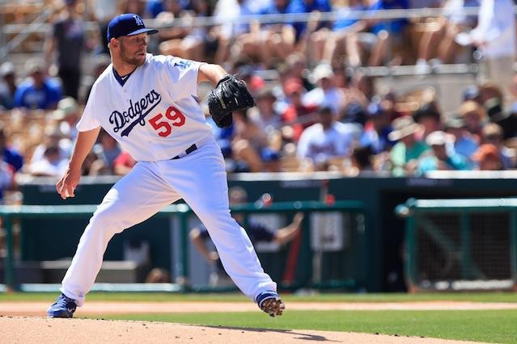
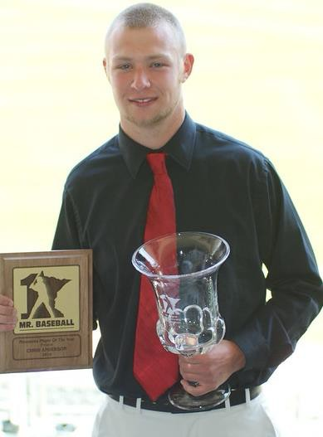
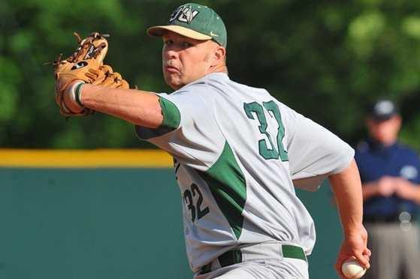
Baseball PAST WINNERS
Chris Anderson
Centennial High School
Jacksonville University
Dodgers/Twins Org.
Complete games Director of Player Development

Slide 24
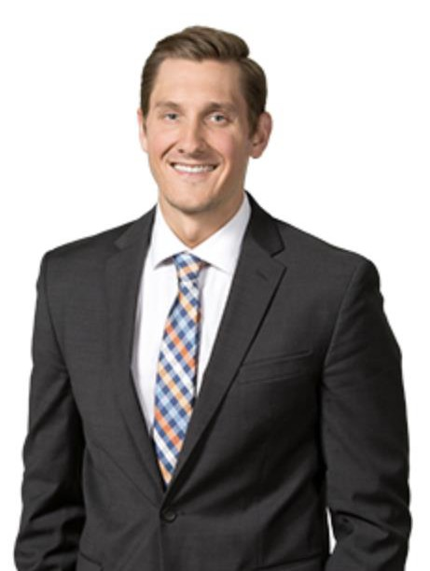
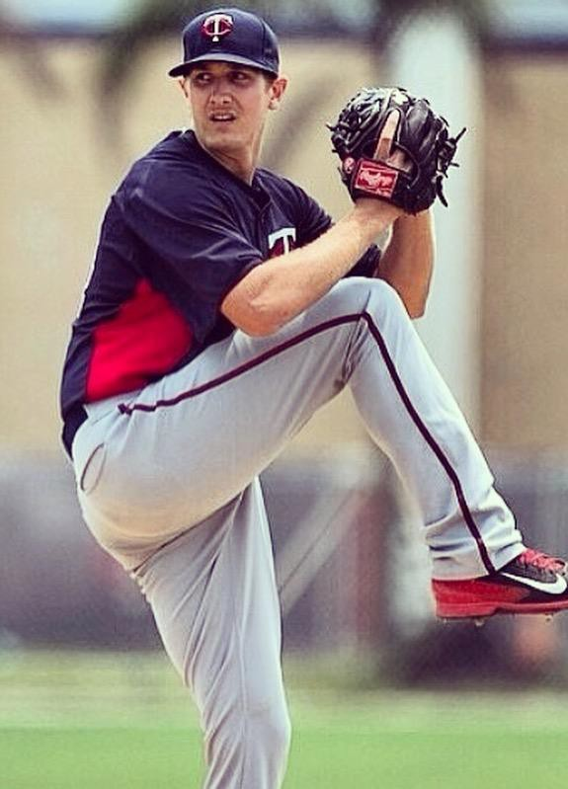
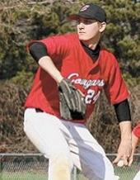
Baseball PAST WINNERS
Austin Malinowski
Centennial High School
Minnesota Twins
Civil litigation lawyer

Slide 25
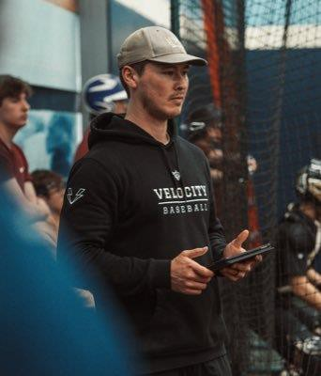
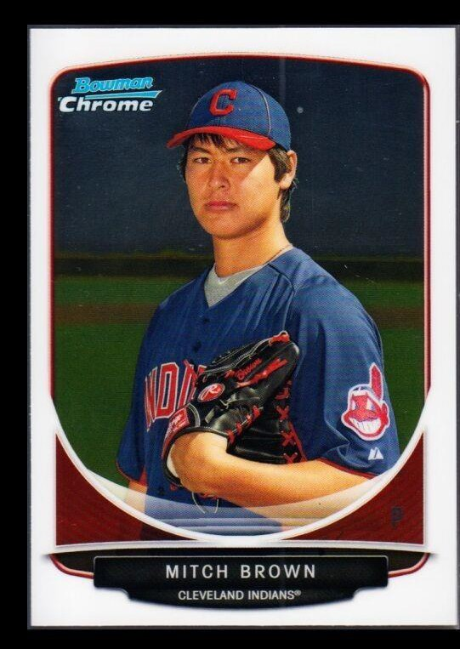
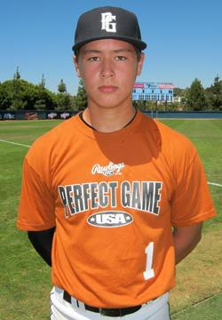
Baseball PAST WINNERS
Mitch Brown
Rochester Century
Cleveland Indians
Owner/Operator of Yard Sports Training

Slide 26
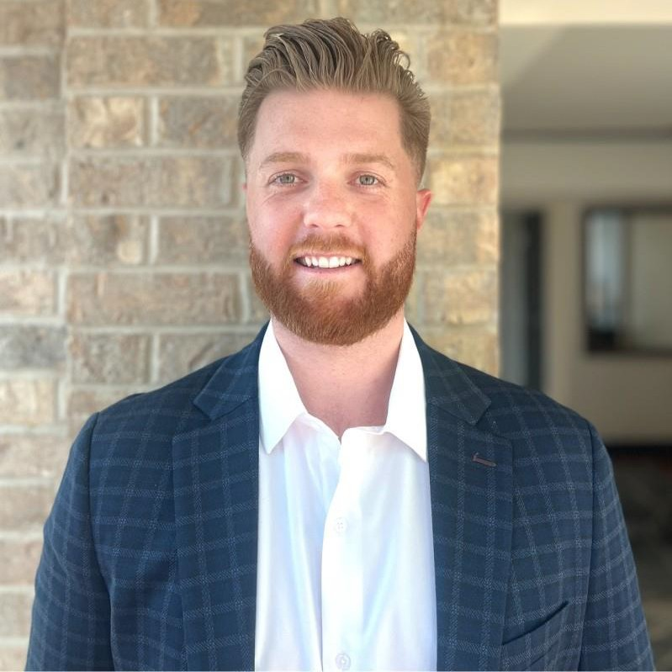
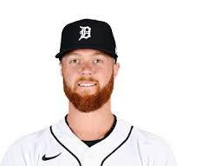
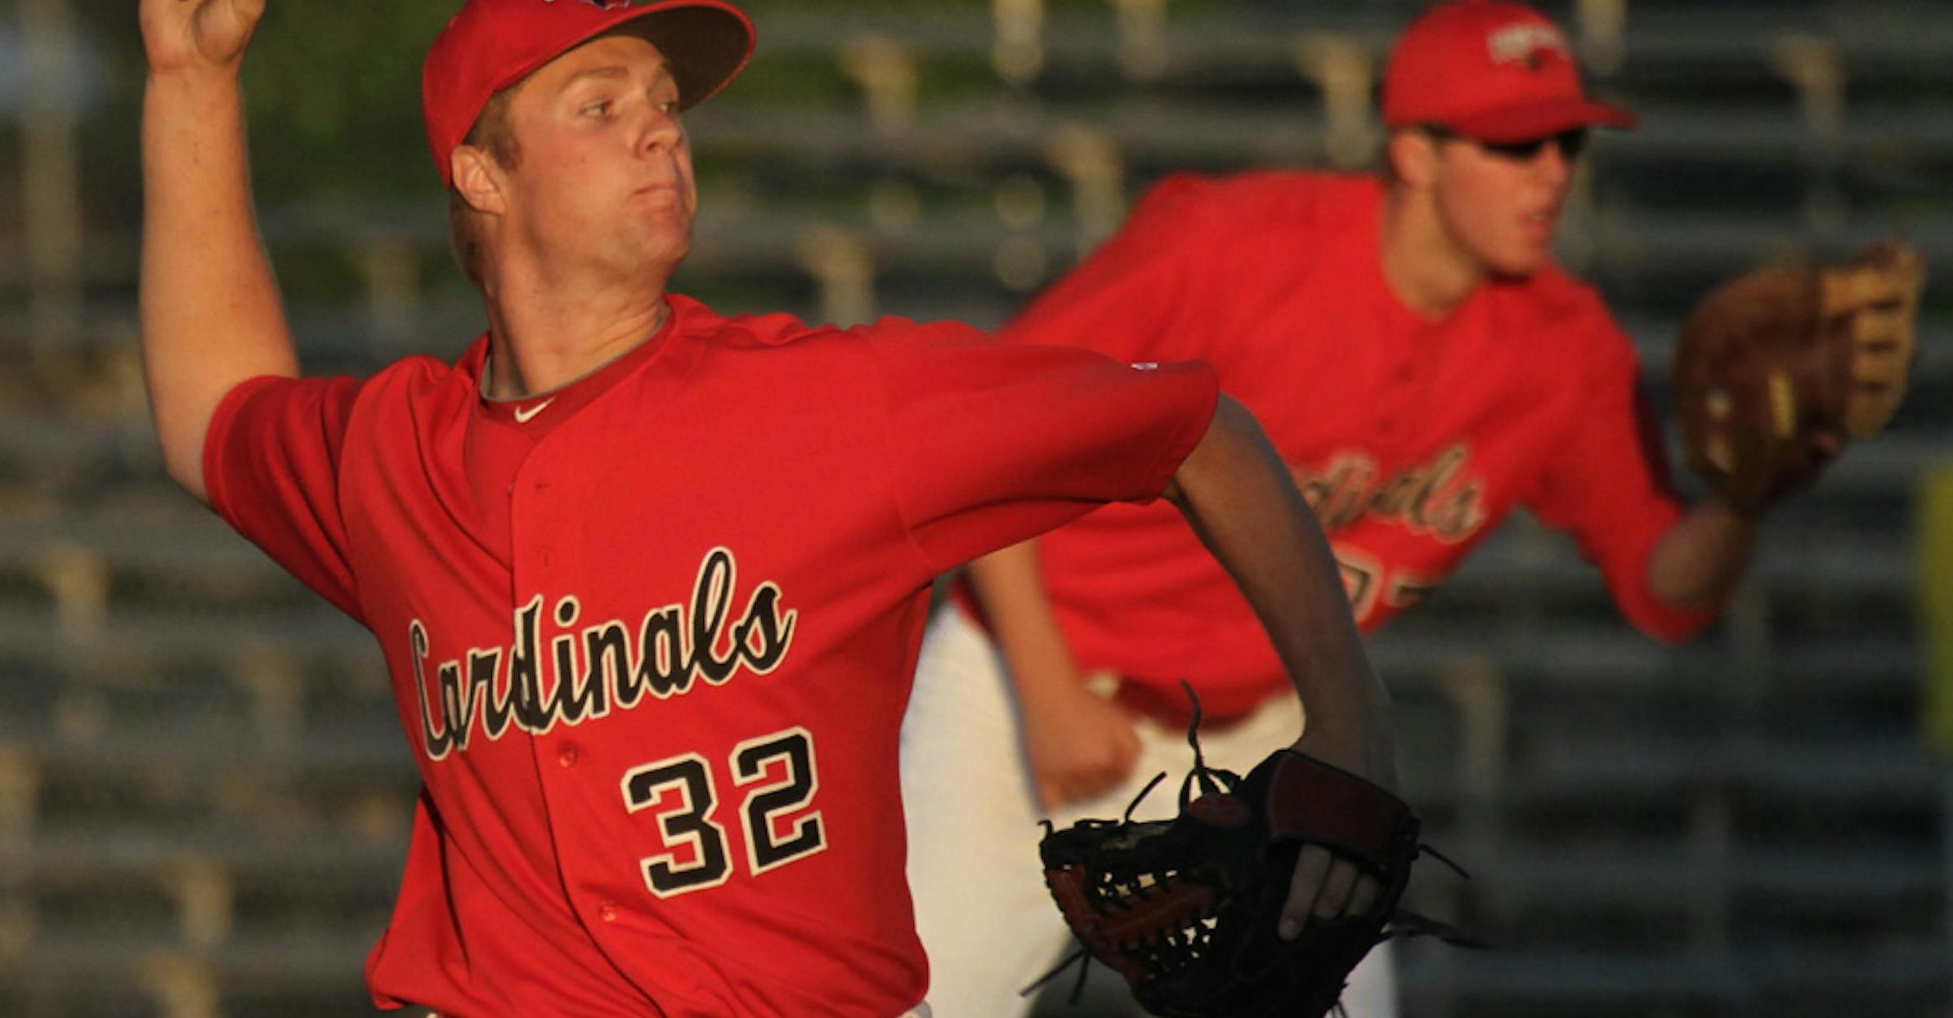
Baseball PAST WINNERS
Logan Shore
Coon Rapids
University of Florida
Free agent – Retired 2023
Account exec at Payground

Slide 27
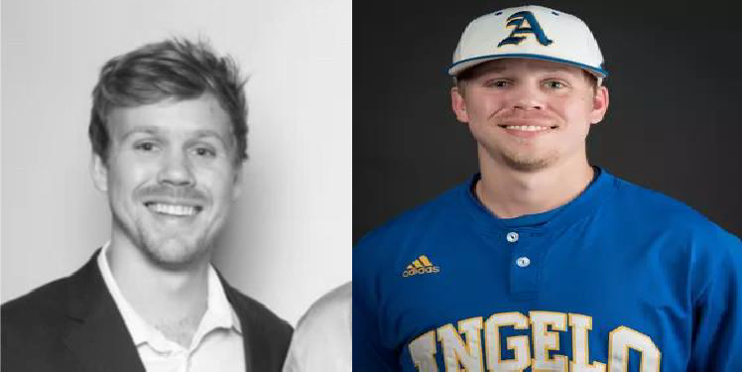
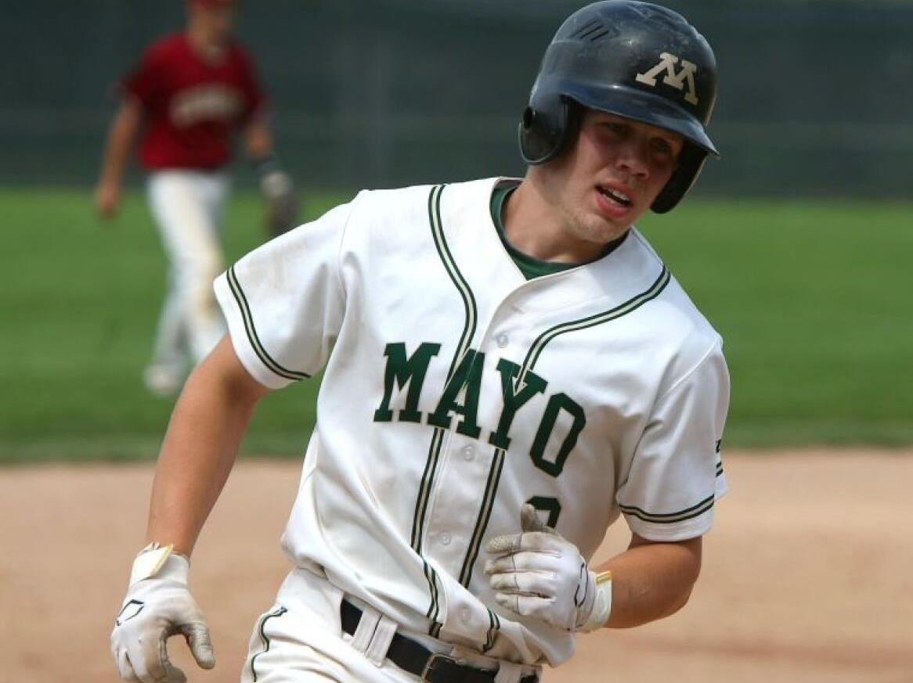
Baseball PAST WINNERS
Brad Mathiowetz
Rochester Mayo HS
Angelo State University
Project Controls Manager

Slide 28
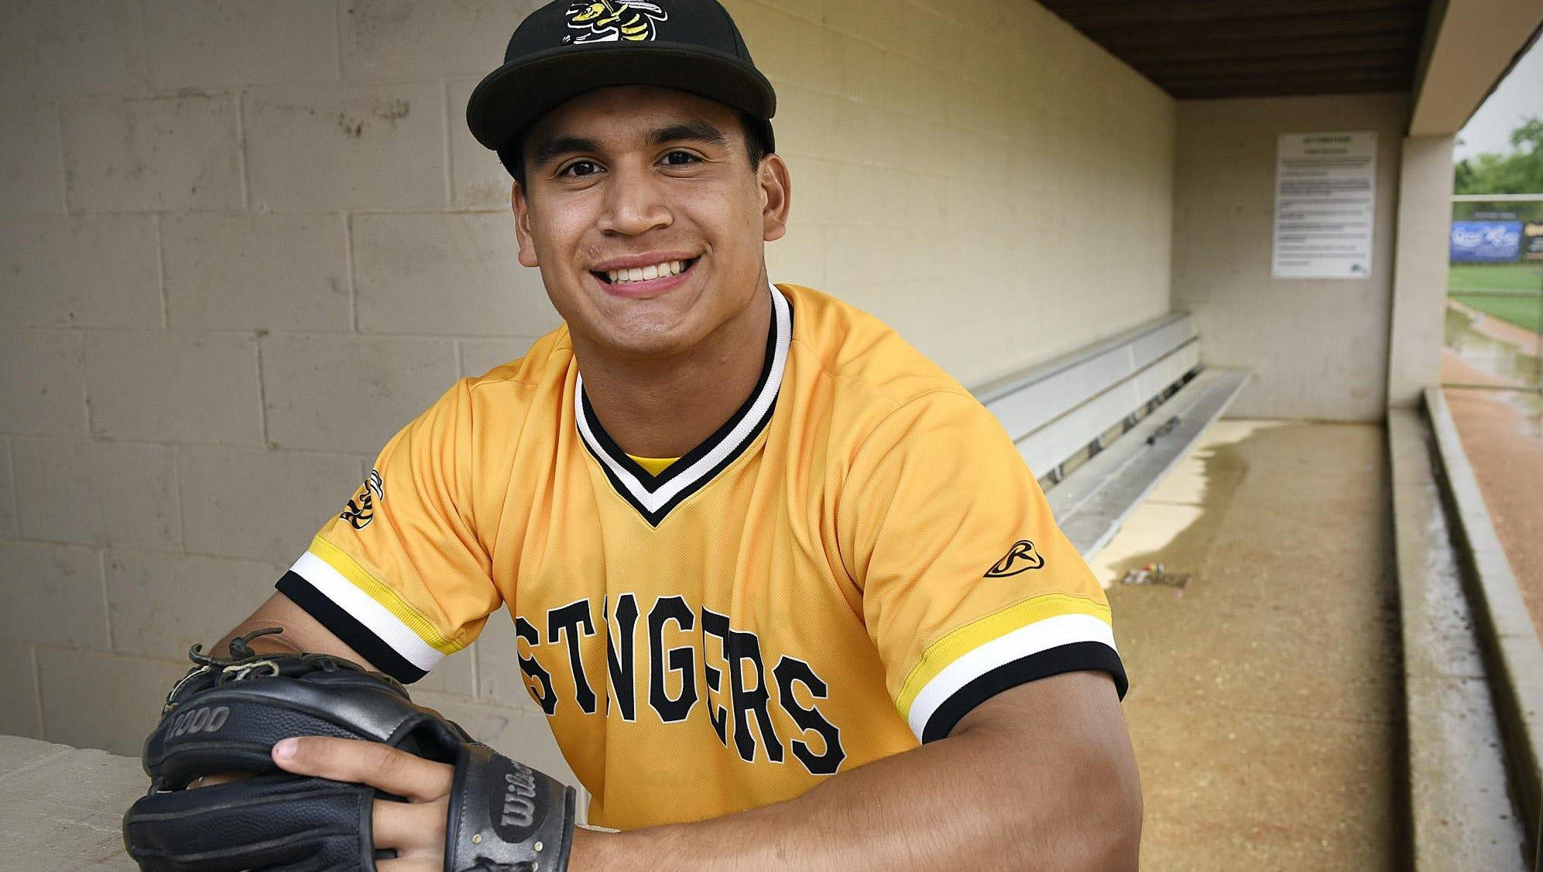
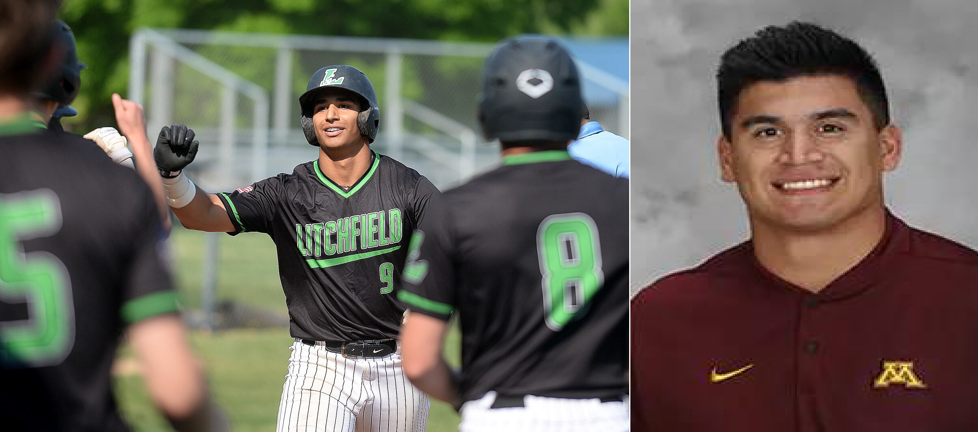
Baseball PAST WINNERS
Eddie Estrada
Litchfield HS
University of Minnesota
Baseball Coach - St. Cloud

Slide 29
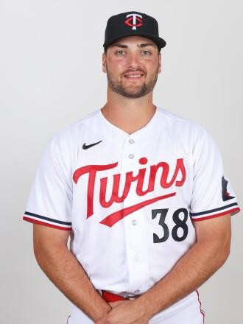

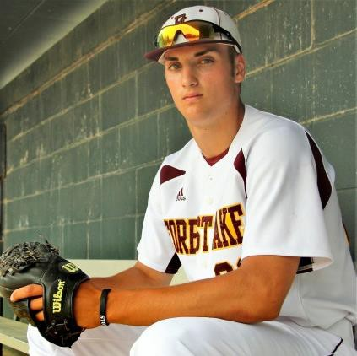
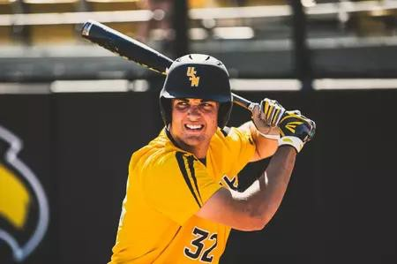
Baseball PAST WINNERS
Matt Wallner
Forest Lake HS
U Of Southern Mississippi
Minnesota Twins

Slide 30
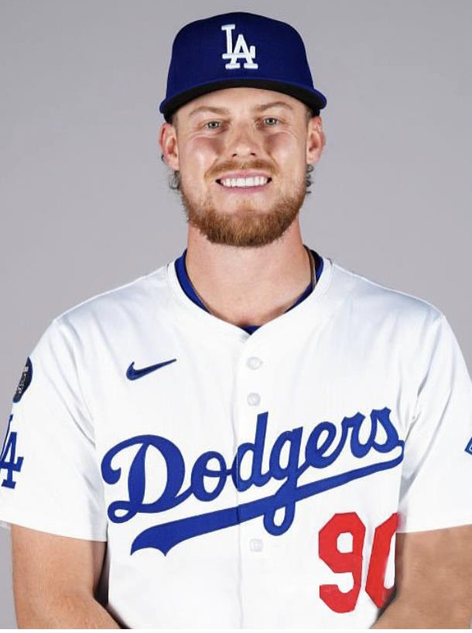
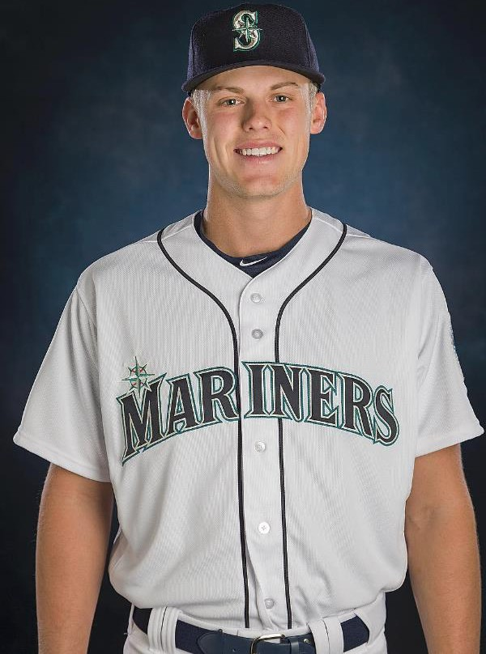
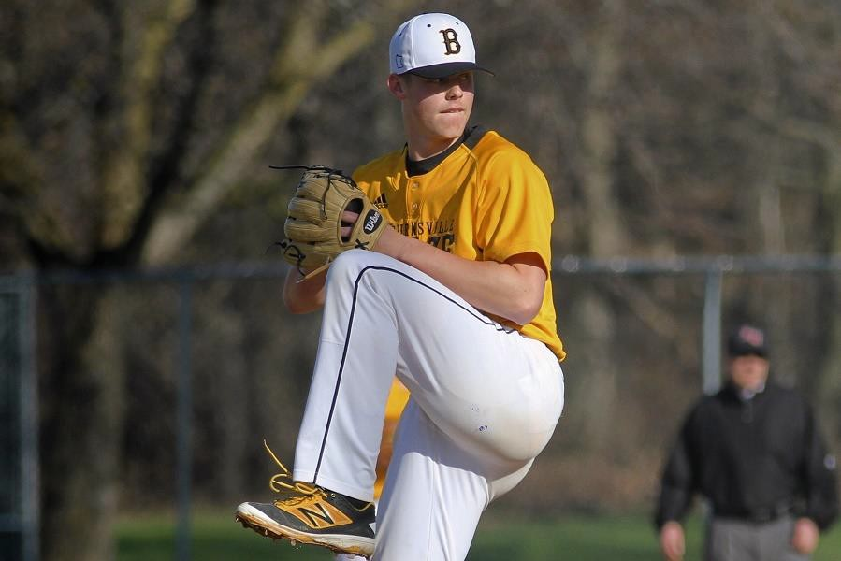
Baseball PAST WINNERS
Sam Carlson
Burnsville HS
Arizona State University
Seattle Mariners
Free Agent - LA Dodgers

Slide 31
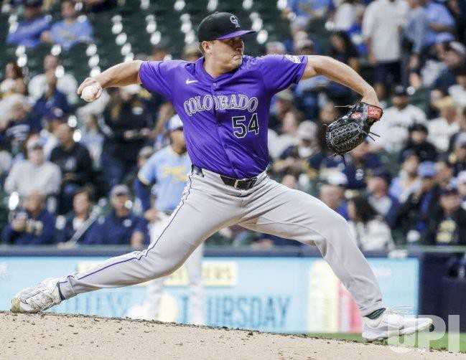

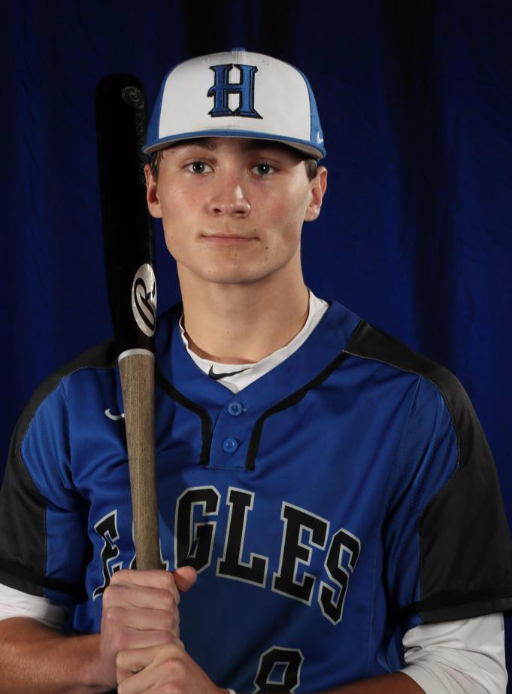
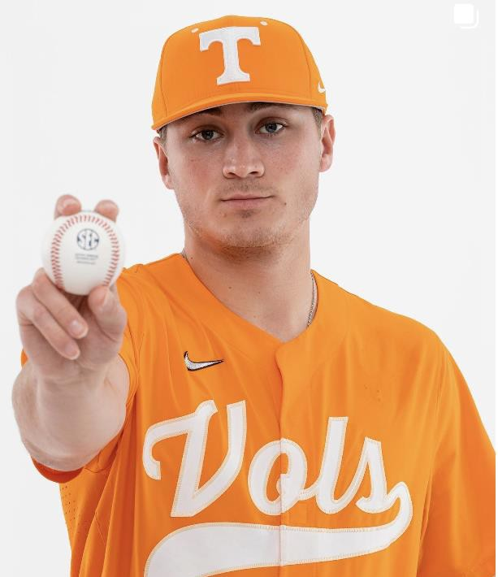
Baseball PAST WINNERS
Seth Halvorson
Heritage Christian HS
University of Missouri
Colorado Rockies

Slide 32
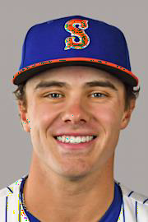
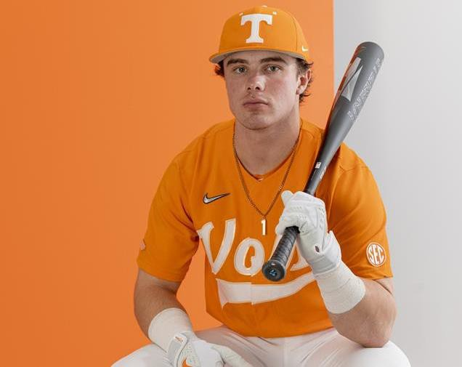
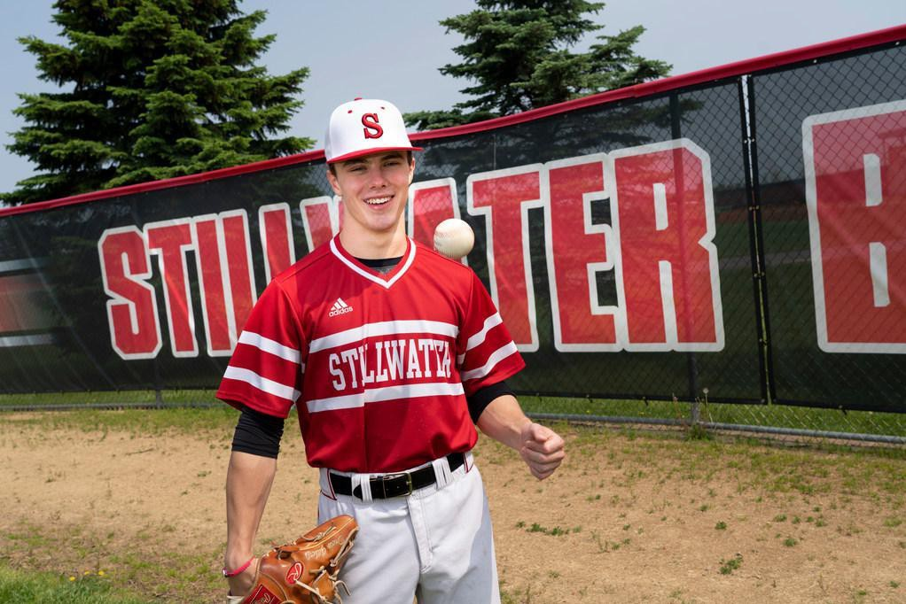
Baseball PAST WINNERS
Drew Gilbert
Stillwater HS
University of Tennessee
Syracuse Mets

Slide 33
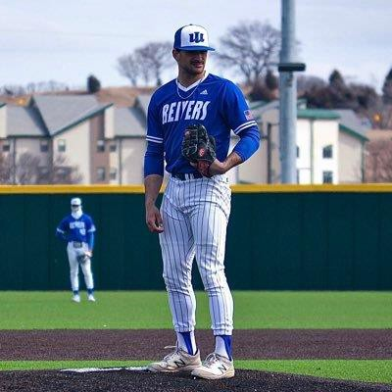
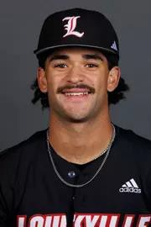
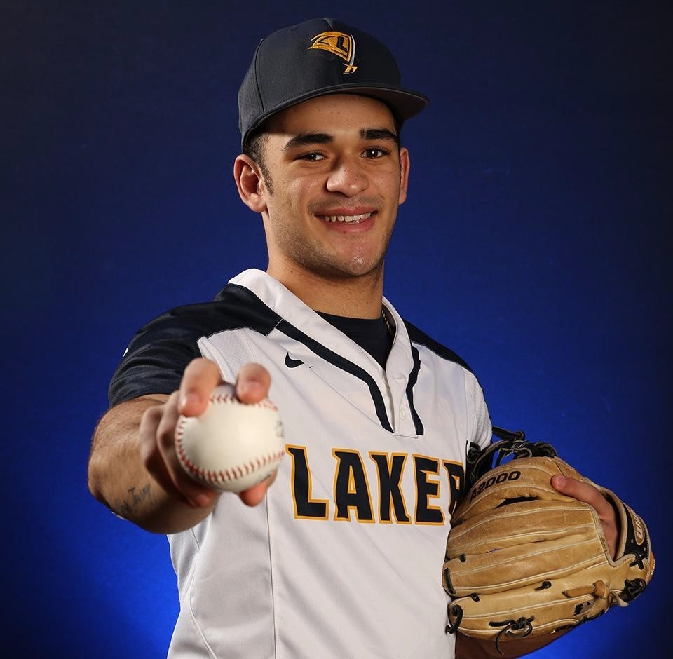

Baseball PAST WINNERS
Noah Bush
Howard Lake-Waverly-
Winsted HS
Iowa Western
University of Louisville

Slide 34



Baseball PAST WINNERS
Maddox Mihalakis
Hopkins
University of Arizona

Slide 35



Baseball PAST WINNERS
Easton Breyfogle
Benilde-St. Margaret's
Arizona State University

Slide 36



Baseball PAST WINNERS
Riley Leatherman
Wayzata High School
University of North Carolina

Slide 37


Softball PAST WINNERS THROUGHOUT THE YEARS

Slide 38



MS. SOFTBALL PAST WINNER
Sara Moulton
Eagan
University of Minnesota
MN Waves Pitching instructor

Slide 39



MS. SOFTBALL PAST WINNER
Kelsey Anderson
Burnsville HS
MN Waves head coach

Slide 40


MS. SOFTBALL PAST WINNER
Nikki Anderson
Brainerd HS
University of Minnesota

Slide 41



MS. SOFTBALL PAST WINNER
Samantha Hartmann
Orono HS
UMN Duluth
Volunteer Coach Duluth

Slide 42



MS. SOFTBALL PAST WINNER
Erika Rozell
Lakeville North HS
University of Minnesota

Slide 43




MS. SOFTBALL PAST WINNER
Maddie Damon
Kasson- Monterville HS
University of Purdue

Slide 44




MS. SOFTBALL PAST WINNER
Katelyn Kemmetmueller
Rogers HS
University of Minnesota
Nursing

Slide 45




MS. SOFTBALL PAST WINNER
Amber Elliott
Anoka HS
Augustana University

Slide 46



MS. SOFTBALL PAST WINNER
Emily Hanson
Buffalo HS
University of Minnesota

Slide 47



MS. SOFTBALL PAST WINNER
McKayla Ambruster
Faribault HS
University of Minnesota
Lutheran College
Assistant coach Bethany

Slide 48



MS. SOFTBALL PAST WINNER
Brynn Hostettler
North Field HS
Augsburg University

Slide 49


MS. SOFTBALL PAST WINNER
Sydney Schwartz
Chanhassen High School
University of Minnesota

Slide 50



MS. SOFTBALL PAST WINNER
Jessa Snippes
Rosemount HS
University of Minnesota

Slide 51



MS. SOFTBALL PAST WINNER
Cece Hanson
Rosemount High School
South Dakota State

Slide 52

Professional Mr./Ms. MLB Throughout the years!
Baseball/Softball

Slide 53

Professional Mr./Ms. MLB Throughout the years!
Baseball/Softball
Will Frisch
#47 Chicago Cubs

Slide 54


Professional Mr./Ms. MLB Throughout the years!
Baseball/Softball
Adam Mazur
Florida Marlins, AAA team

Slide 55

Professional Mr./Ms. MLB Throughout the years!
Baseball/Softball
Matt Wallner #38 Twins

Slide 56

Professional Mr./Ms. MLB Throughout the years!
Baseball/Softball
Max Meyer Marlins- Miami

Slide 57

Professional Mr./Ms. MLB Throughout the years!
Baseball/Softball
Michael Baumann #53 Orioles
Various other MLB teams

Slide 58

Professional Mr./Ms. MLB Throughout the years!
Baseball/Softball
Jake Irvin
#27 Washington Nationals

Slide 59


Professional Mr./Ms. MLB Throughout the years!
Baseball/Softball
Sean Hjelle
#64 San Francisco Giants

Slide 60

Professional Mr./Ms. MLB Throughout the years!
Baseball/Softball
Michael Busch #29 Chicago Cubs

Slide 61




Professional Mr./Ms. MLB Throughout the years!
Baseball/Softball
Drew Gilbert
#1 Syracuse Mets
#1 Tennessee Astros

Slide 62

Professional Mr./Ms. MLB Throughout the years!
Baseball/Softball
Sam Hentges
#31 Cleveland Guardians

Slide 63

Professional Mr./Ms. MLB Throughout the years!
Baseball/Softball
Seth Halvorsen
#54 Colorado Rockies

Slide 64

Professional Mr./Ms. MLB Throughout the years!
Baseball/Softball
News! MLB is investing In Professional Softball!

Slide 65


Slide 66


















••••••••••••••................
LUBE ·TECH.
Powcrodby ASCENTEK
PROUD SPONSORS OF THE
MINNESOTA ALL SPORTS ALLIANCE
lubetech.com J1-800--636-7990
 | • |  | ....
 | EdinaRealty. 11..-.w,�..,_{•l'IU.Mle 0} ••• fO!tttUUh fONdfectOCts HOU+Utl198
If
Chadd Johnson
CRS/HIS/CRI
'9-ROOF
tj@theweathe,masterinc.c,im
930\ BryantAve.So.Suite f108
Minneapoos,flN55470
laMitui'
Bl
lt CHAR HOUSE & LOUNGE
w t�
ti:1 Sllf:f tc
MIiBld9lic.# HC57967J
\ John and Pat Mancini
651 224-7345
IMPROVING HOMES SINCE 1954
Jax Cafe
1928 Unl..,..iry Avenue NE
Mlnneopol�. MN 55418
www.jaxcofe.com (612) 789-7297 Exr. 1
rwiner@joxmpls
Emoil: blll@joxcofe.com
Dill Kozlak
Mr. Baseball & Ms. Softball
June 15th, 2025 • Target Field
I
FM92.1 FM103.7 FM1t7,1HDA2M740
Brent Borgen, President
P.O. Box 25130,Soint Poul. MN 55125
Phone: 651-436-4000 • brent@wdgyradio.com
Hosted and Coordinated by
NES
*
MARIEAVENUESERVICE &GLASS
8RIAN HANDWERK
0wfter/Manager
fOltMHLY THl
MINNESOTA MINUTE MEN LTD.
•
HER_{TO}E■
MARIE AVENUE SERVICE & GLASS
103 5th Ave. No.
South St. Paul, MN55075
651-451·0911
M@i>IID
PARRISH FAMILY FUND
A StateFarm"
Marty MJelleli Agent
10501 Wayzata Blvd #7
Locally Owned for almost50Yura
FLOOR • ••
CREATING GOODWILL
COPV►RIGHT
YOU: .'.
QualityFlooring
ExpertAdvice

Slide 67


















Special thanks for making it all happen!
David and Jennifer Christians
Pat Cruikshank
Jeff Dahler
April Davis
Michael Dawson
Chelsey Falzone
Loren Feldkamp
Lauren Harvey
Kendall Hughson
Ryan and Christina Kiley
Nick and Sarah Maxwell
Reece Meyer
Hunter and Sarah Qualls
Scott Radzak
Chris Sailors
Katie Storms

