Slide 1
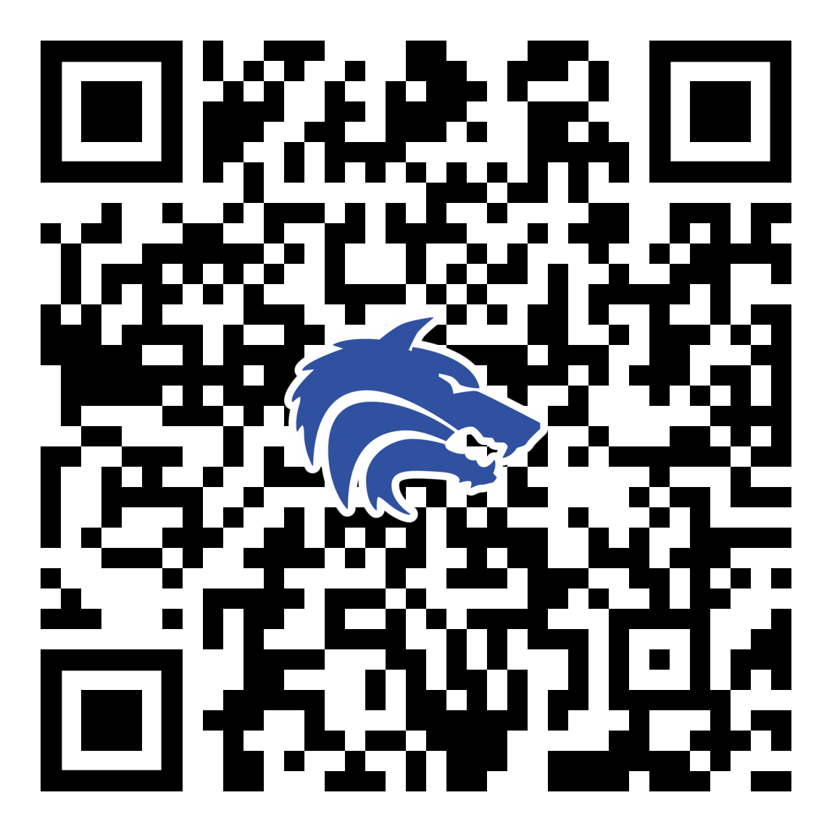
2025-2026 Booster Club Meeting
September 15 , 2025
PLEASE SCAN THIS CODE TO CHECK IN

Slide 2
Agenda
Approve August Meeting Minutes
Treasurer Report
  2025-2026 Budget
Discuss OPEN VP Position
Golf Outing Update
Fall Fundraising Efforts
Coach’s Corner
Join the Baseball Booster Club

Slide 3
Booster Club Votes
Approve August 2025 Meeting Minutes
Meeting Minutes can always be found on the website (https://www.planowestbaseball.org/) under BOOSTER CLUB\FORMS AND MEETING MINUTES
Each meeting we will ask for someone to make a motion to approve the minutes and then we will ask for someone to second that.

Slide 4
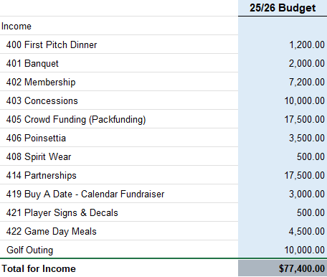
Treasurer’s Report: Budget for 2025-2026

Slide 5
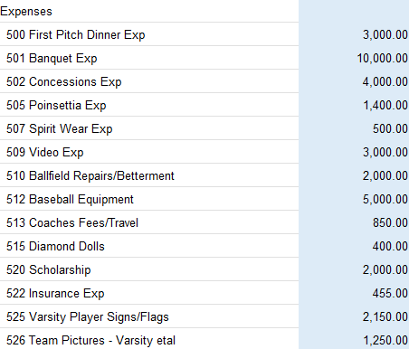
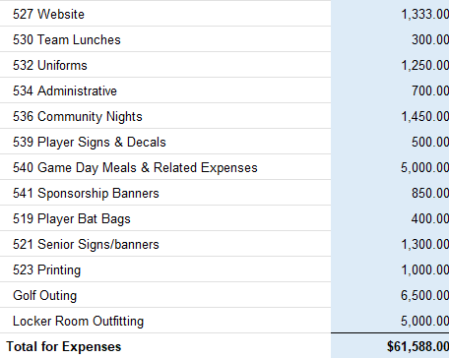
Treasurer’s Report: Budget for 2025-2026

Slide 6
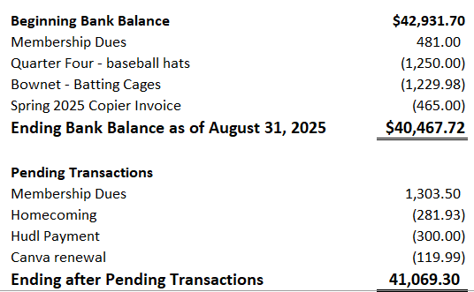
Treasurer’s Report: September 2025

Slide 7
Treasury Information
Reimbursable Expenses
  Because we are a non-profit, we do not pay taxes; therefore, you cannot be reimbursed for them. Please ask for our Tax Exemption Form before purchasing items.
  When requesting a reimbursement, you will need to fill out the Reimbursement Form. I will have these at every meeting or I can email it to you.

Slide 8
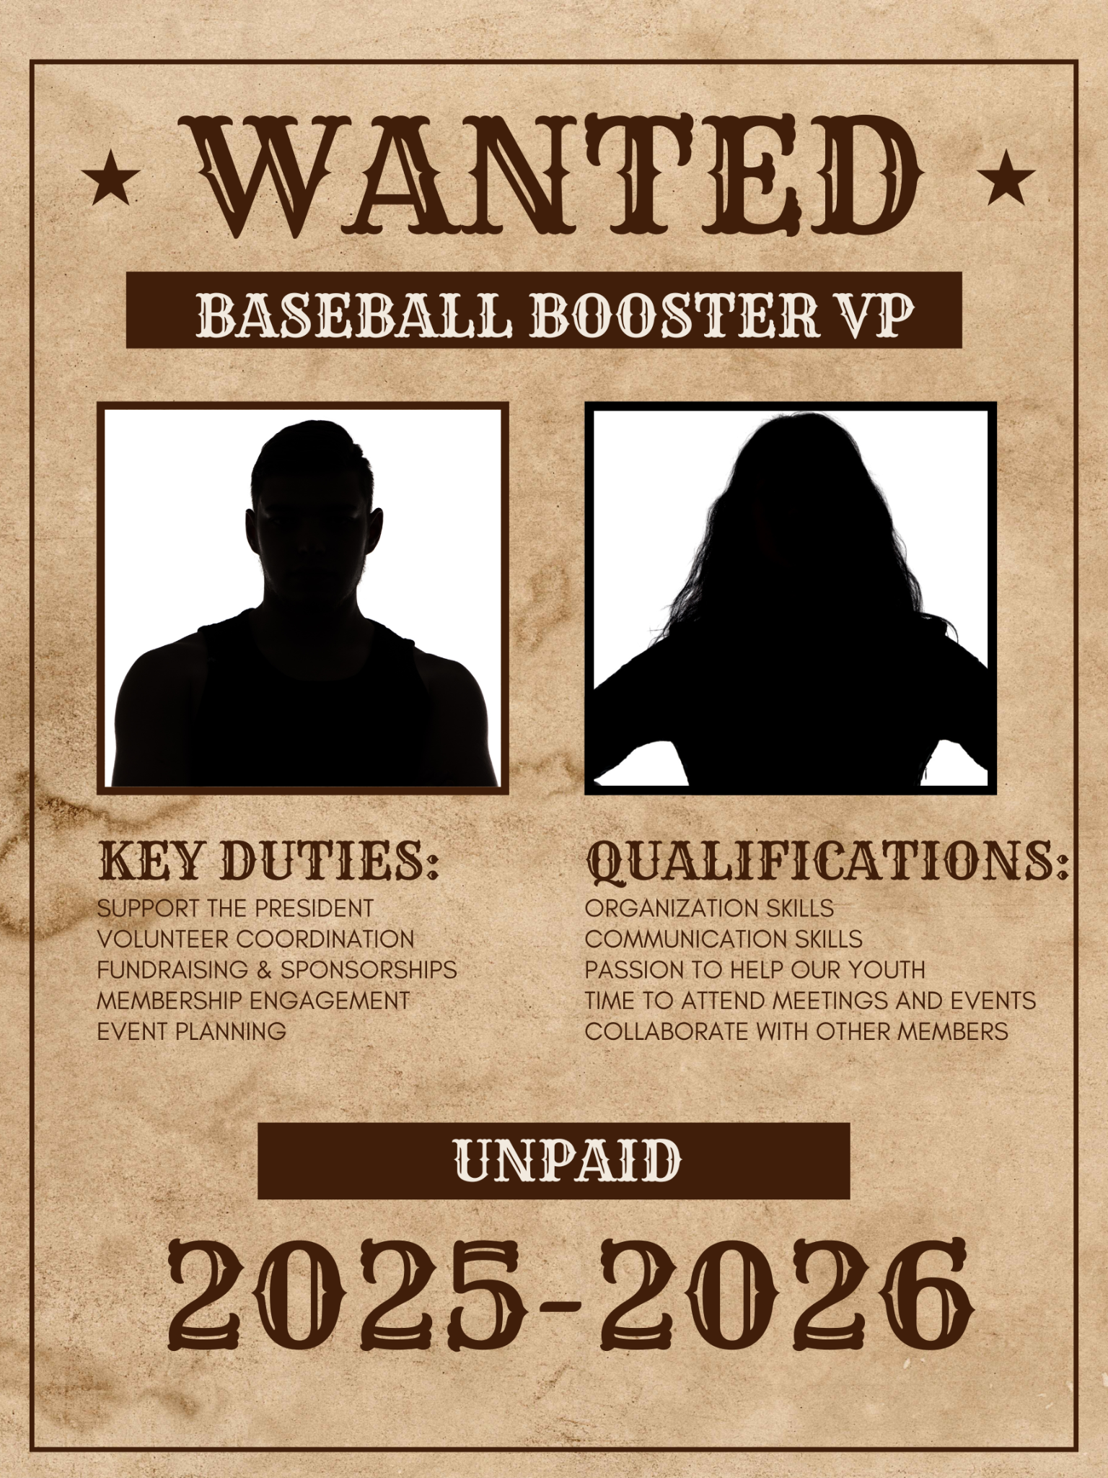
OPEN Position VP of the Booster Club

Slide 9

GOLF OUTING
Notes:
Redistricting & Implications (MAKE A SLIDE)
Fall Ball and Process

Slide 10
Upcoming Fall Fundraisers
Fundraising
  Buy A Date - Calendar Fundraiser -October
  Poinsettia Fundraiser Sales –November
  Sponsorship Fundraising For Spring Season ongoing
  27th Annual Denny Garver Golf Outing - Postponed to Spring

Slide 11
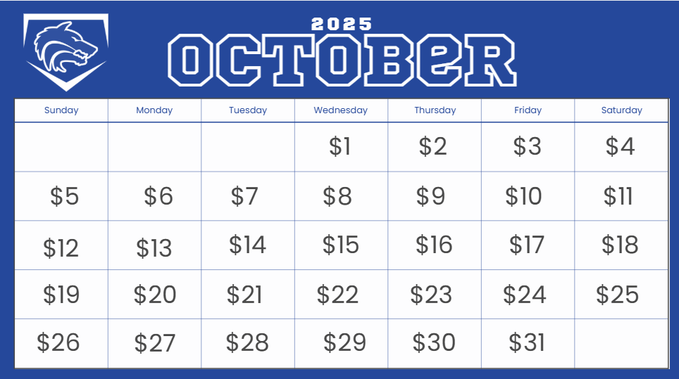
OCTOBER - Calendar/Buy A Date Fundraiser

Slide 12

Possible Fundraiser - Football Concessions
Home Side: 2 Adults & 7 students
Visitor Side: 1 Adult & 4 students
September 26th vs Rock Hill Prosper (MS Football; Mini Cheer Night)
October 10th vs. McKinney (Pink Out; Mini Drill)
October 24th vs. Princeton (Senior Night)

Slide 13

Coach’s Corner

Slide 14
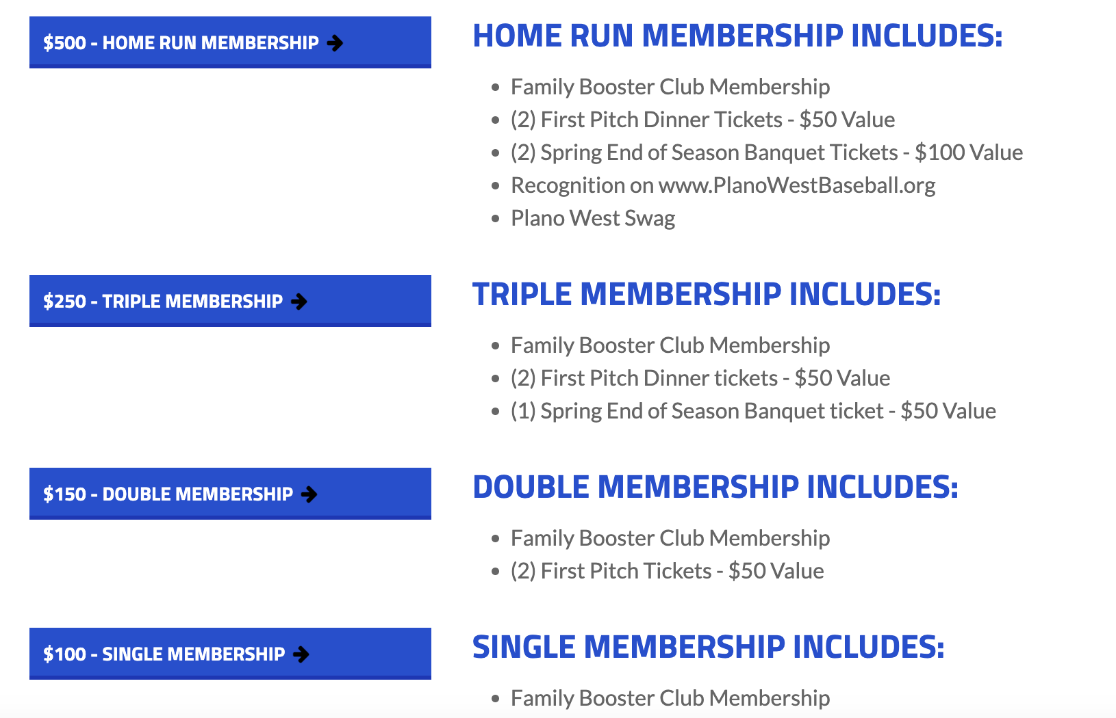
Join The Booster Club
www.planowestbaseball.org/join

Slide 15
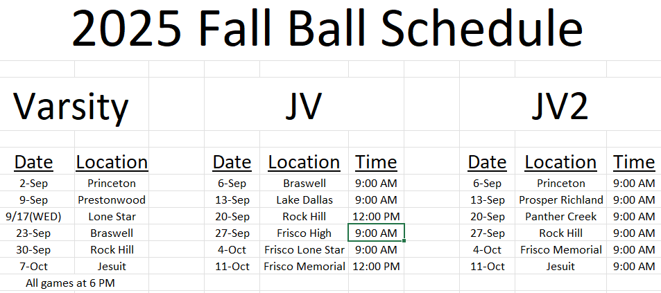
Fall Baseball Schedule

Slide 16
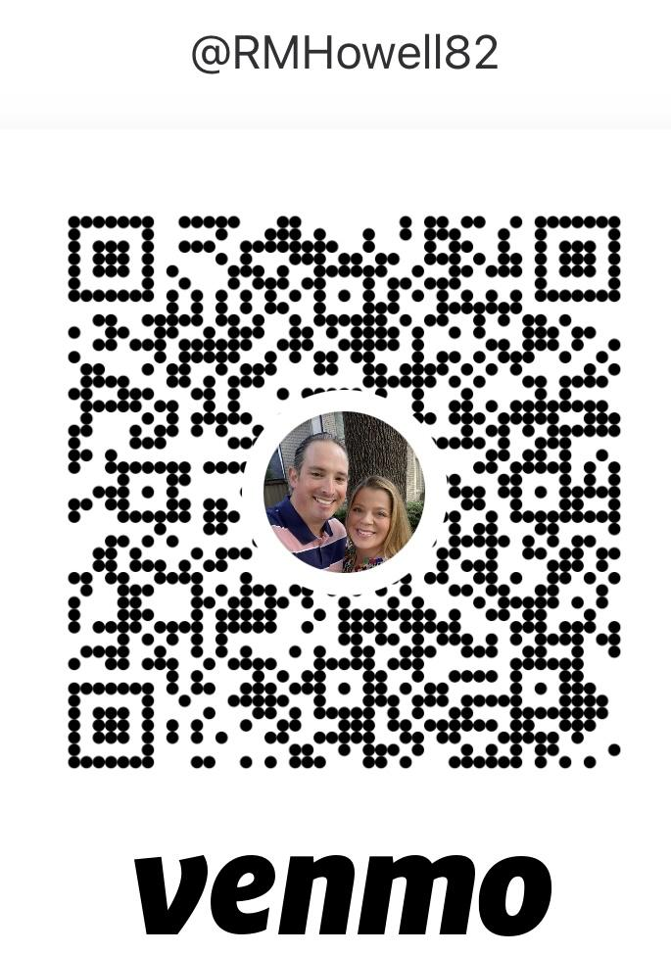
Fall Baseball Dues
Fall Ball Dues
  Please don’t forget to pay your fall dues
Fall Ball Dues $250
  These dues cover the uniform and league
payments
  Please send your fee to Rebecca Howell as
soon as possible.
  Venmo @RMHowell82
  Zelle 817-228-1995
  Check

Slide 17
Checklist
Join the Booster Club
Fundraising Ideas
  who do you know - business owners, tax deductions, Plano based firms
  what is working with other organizations?
Join a Committee
  we welcome all to participate/contribute in any way they can
Thanks for coming!

Slide 18
Committees Assembling
Start thinking of where you will want to lend a hand!
Fall committees and volunteer opportunities include:
Sponsorship & Fundraising
Social Media
Spring will have additional committees.

Slide 19
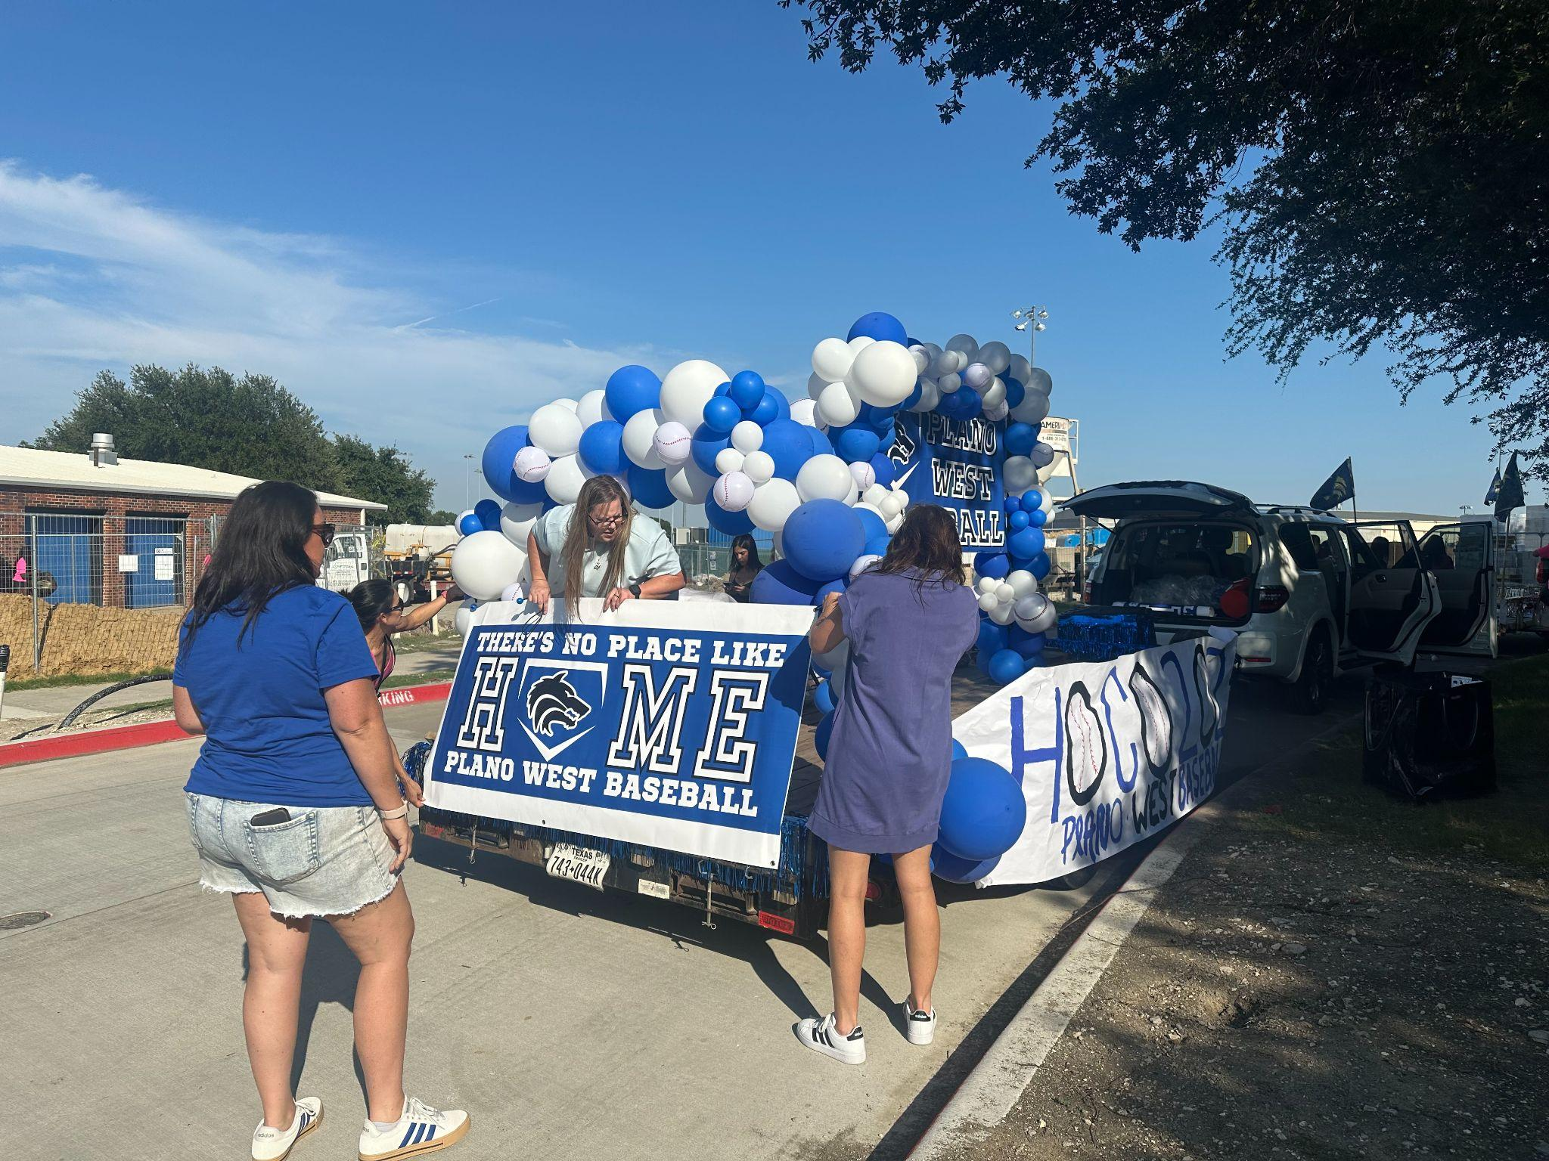
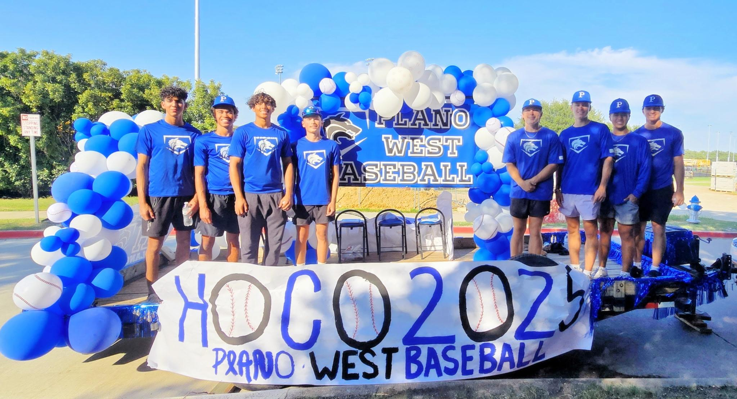
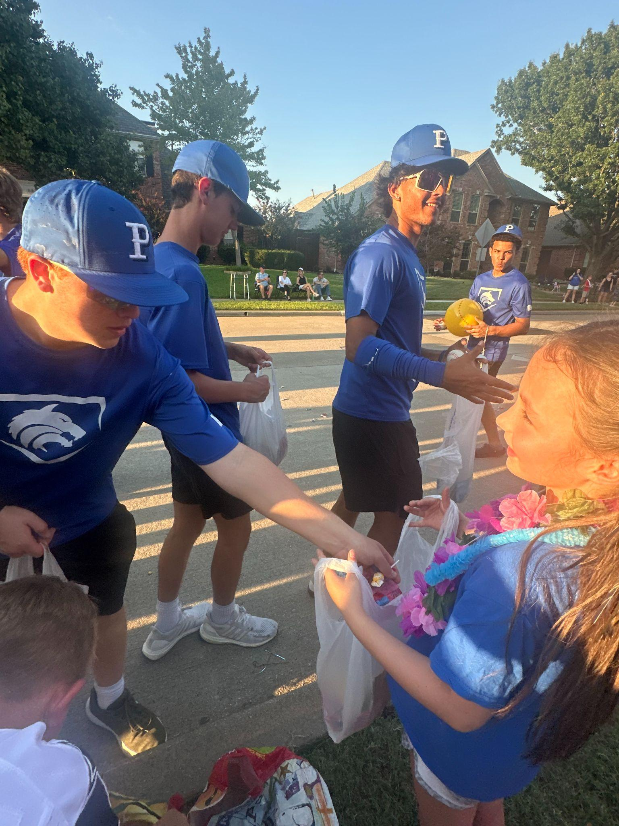
HUGE THANK YOU!!!!!!
HOMECOMING 2026

Slide 20

SportsYou
DCMN-ZE9D

Slide 21

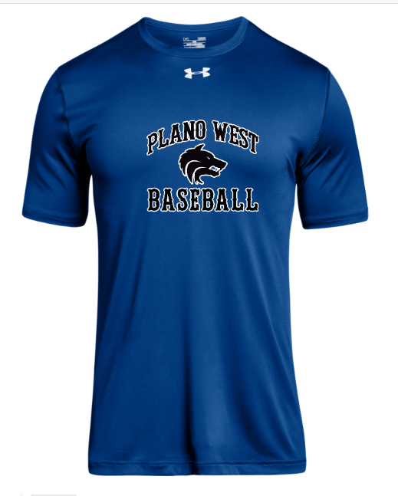
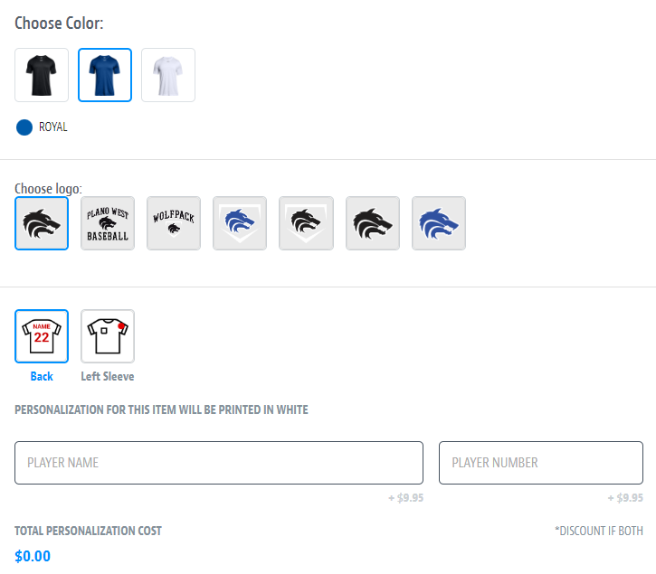
Spirit Wear – powered by SQUADLOCKER
aaaaa
SHOP NOW and enter code SUMMERSAVING10 at checkout for 10% OFF!

Slide 22
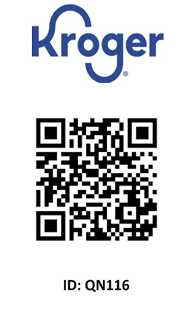
Kroger Rewards Card
Please be sure to link your Kroger card to Plano West Baseball.
$36.92 in donations from May 24 to August 24, 2025.
19 households participated during this time period.

Slide 23
Don’t Forget to Check In!

Slide 24
Thank you!

