Slide 1
Girls Forum
Robin Bilsborough
Region 5 Director
WAHA Girls & Women Section Director
Stacy Hintzman
Region 6 Director
WAHA 12U-14U Girls coordinator
Becky Hildebrandt
Region 4 member
WAHA 8U-10U Girls coordinator
WAHA Association Collaboration

Slide 2
How to grow WI Girls Hockey starting at 8U
Plan for Success
Trend analysis
Set your Goals
Objective
Leverage Resources
Wisconsin Overview
Now is the Time
Target your market

Slide 3
We are Glad you are here!
Who Are You?
Find a new face, share your name and role role(s) in your association.
What Do You Want to Accomplish?
What are your goals for the upcoming season?
One Take-Away You Want From Today
What is one thing you want to take away from today’s forum?

Slide 4
Objective
Help Associations increase the number of female players in Wisconsin starting at 8U
Investing in their playing future
Growth increases opportunity

Slide 5
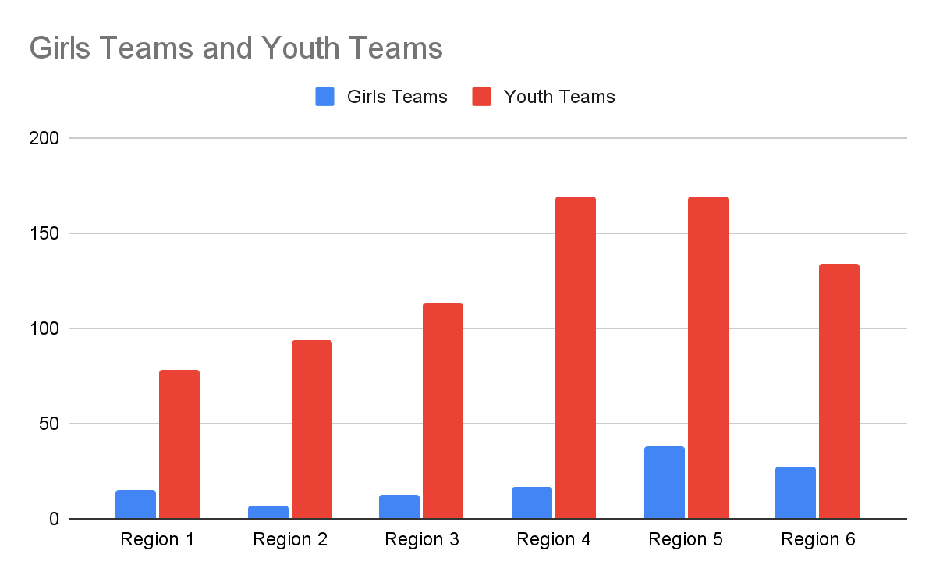
Wisconsin Overview 2023-24
7th Largest Affiliate in USAH in total youth registrations
5th Largest Affiliate in USAH in female registrations
3rd ranked Affiliate in USAH in ratio of female to male players
Number of Teams in Regions Girls vs Youth : State Total 13% Girls teams 87% Youth teams
Region 1 16% Girls Teams
Region 2 7% Girls Teams
Region 3 10% Girls Teams
Region 4 9% Girls Teams
Region 5 18% Girls Teams
Region 6 17% Girls Teams

Slide 6
Highlights of 2023-24 Season
Girls team growth spurs Pilot of 3 Division Girls State Tournament for ‘24 & ‘25 Gold/Silver/Bronze
2 WI Tier 1 Girls Teams progressed to USAH Nationals
4 WI Tier 2 Girls Teams progressed to USAH Nationals - 19U WI Selects Tier 2 National Championship team
1 Women’s Team represented WI at USAH Adult Nationals
WI hosted Women’s World Para Challenge in Green Bay WI
WAHA endorsed WEHL Girls in 7th season providing expanded number of teams - over 350 girls participated
WAHA / WHOA collaboration provides 3rd annual female officials training camp in conjunction with WAHA 12U Girls Development Camp - All counselors were WI female D3 or D1 players * see it to be it!
15 Wisconsin female players attended USAH National Camps in July 2024
Expansion of Girls & Women’s committee to include 14U-12U & 10U-8U coordinators to facilitate growth

Slide 7

NOW IS THE TIME
How do we get to the destination we want to reach?
Roadmap to success

Slide 8
What do you need to attain success?
A Person of Passion -
Every organization needs a champion for girls hockey and an advocate for working through challenges and successes
Events & Outreach -
Don’t wait for players to find you. Find your players
1
3
2
A North Star -
What is your goal - short term and long term and make a plan to achieve them
4
Smart use of resources-
Being resourceful with the resources you have - ice, coaching, finances

Slide 9
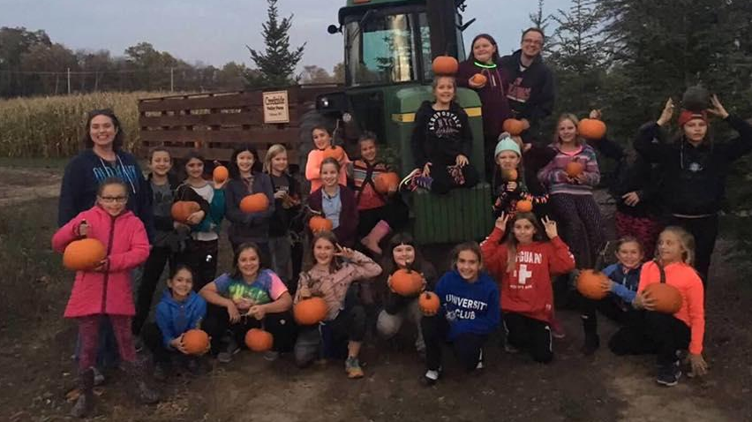
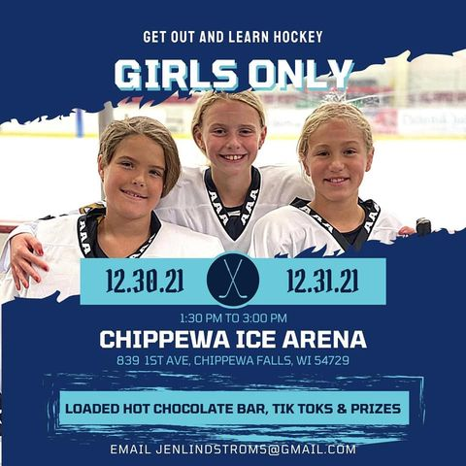
Leverage Current Resources
Girls Try Hockey For Free Events
8U Girls Jamboree Grants
WAHA THFF Grants
Mite equipment Grants
Grass Roots Grants
Breanna Decker Girls Grant -USAH
Foundation
Social Media - get the word out that you have Girls teams. Tag brands - use hashtags
Internal “media” - Make sure your rink is using representational signage
1
3
4
Invite players back to the game - pull registration data from previous years and invite those players back to join girls hockey
2
World Girls Hockey Weekend - 2nd weekend in October
Girls hockey movie - pizza party - dance party - outings or activities

Slide 10
8U Girls Jamborees
Grants for 5-6 per Region $300 each
Add Jamborees to other female focused events
Older girls teams games: Association - High School - College
Partner with outside organizations - Milwaukee Admirals in Region 5

Slide 11

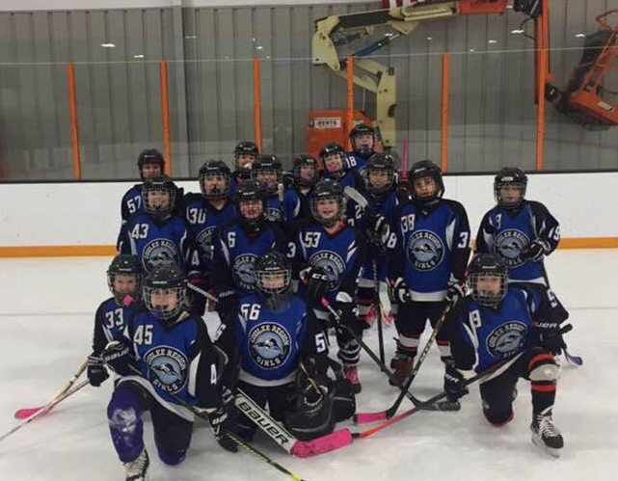
8U/10U Girls Grant Program
WAHA 3 Year Grant Program to kick start Girls Growth at the 8U level in ALL associations
Associations that field an 8U Girls Part Time team will receive a $300 grant (up to 2 years)
Associations that field an 8U Girls Full Time team will receive a $500 grant (up to 2 years)
Associations that field an 8U Girls & 10U Girls Full Time team will receive a $1000 grant (1 time)
Recognition banner to be awarded to Associations that have Full Time 8U Girls teams 3 consecutive years
USAH roster & schedule submitted for grant disbursement.

Slide 12
Understanding the market

Slide 13
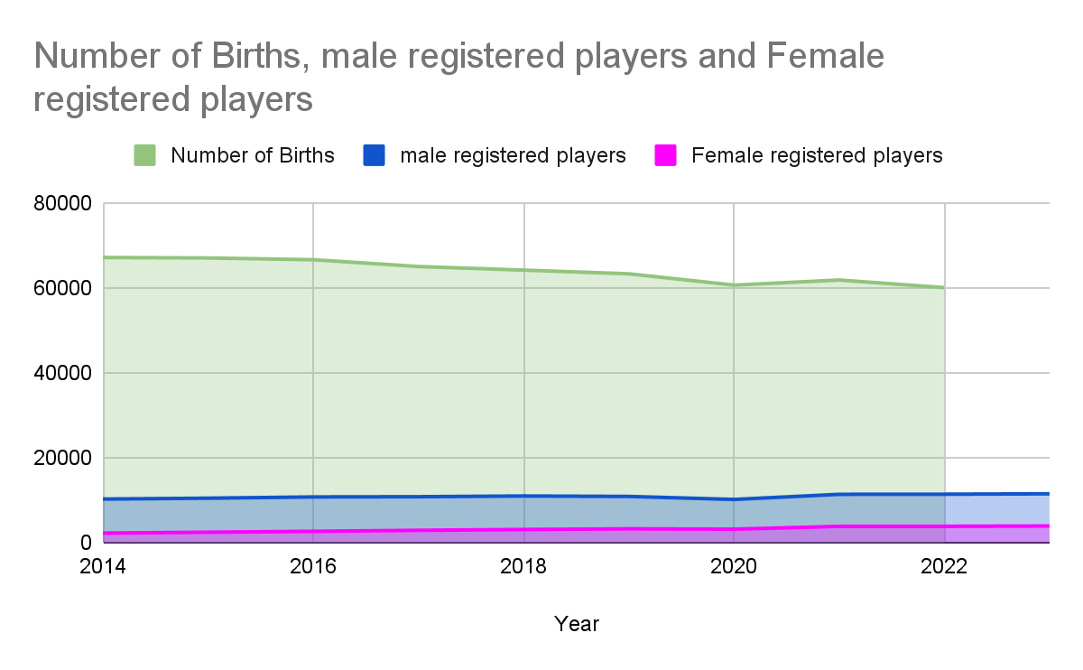
Birth Rates are Declining
Wisconsin Birth Rates are below the National Average
While our overall registrations are seeing a year to year
increase, we will continue to have fewer players than ever
before to recruit from
IT’s TIME to focus on 50% of the population that has been under recruited

Slide 14
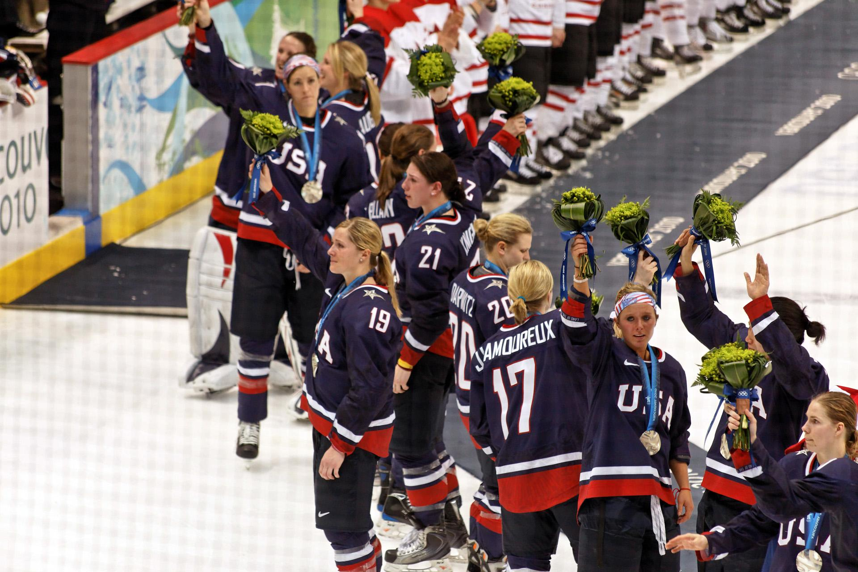
Market trends
Female Focused
Utilize all USAH and IIHF marketing resources

Slide 15
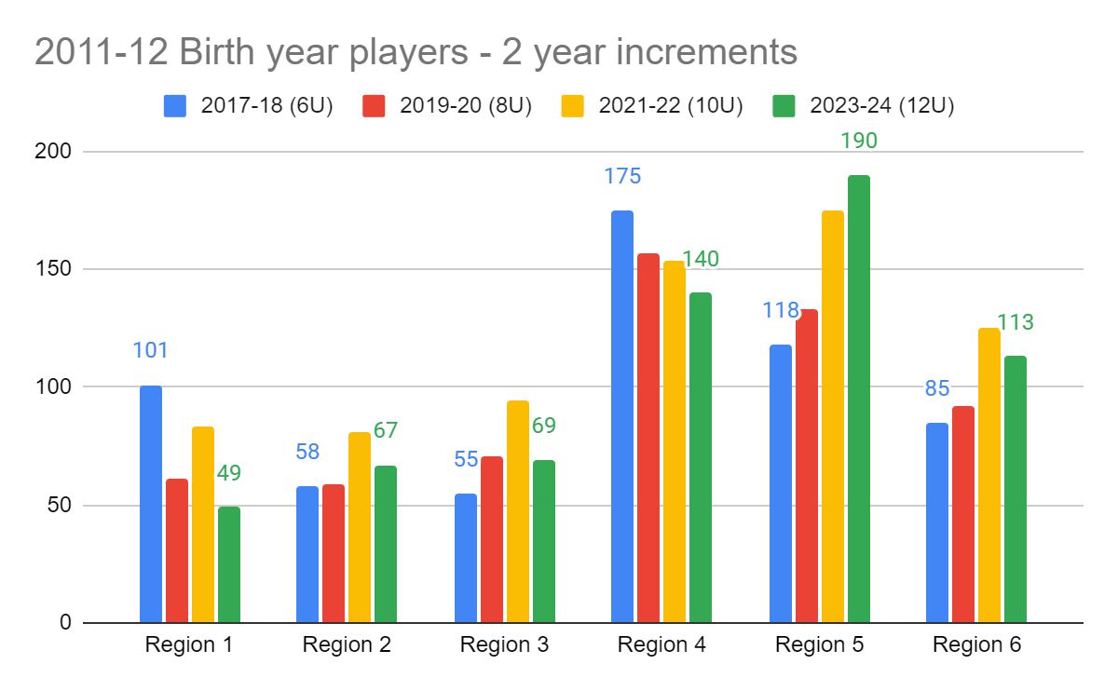
Trend analysis
Over a 8 year period in 2 year increments - Tracked the 2011-12 birth year female cohorts in each Region
Number of 12U teams last year
Region 1 - 4
Region 2 - 3
Region 3 - 4
Region 4- 6
Region 5 - 11
Region 6 - 7

Slide 16
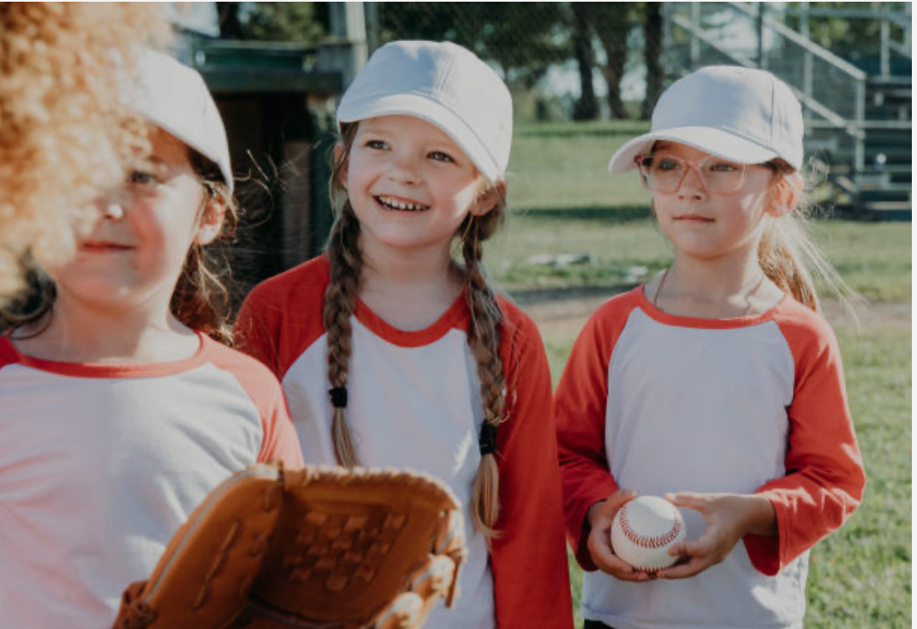
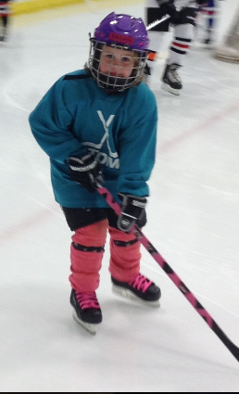
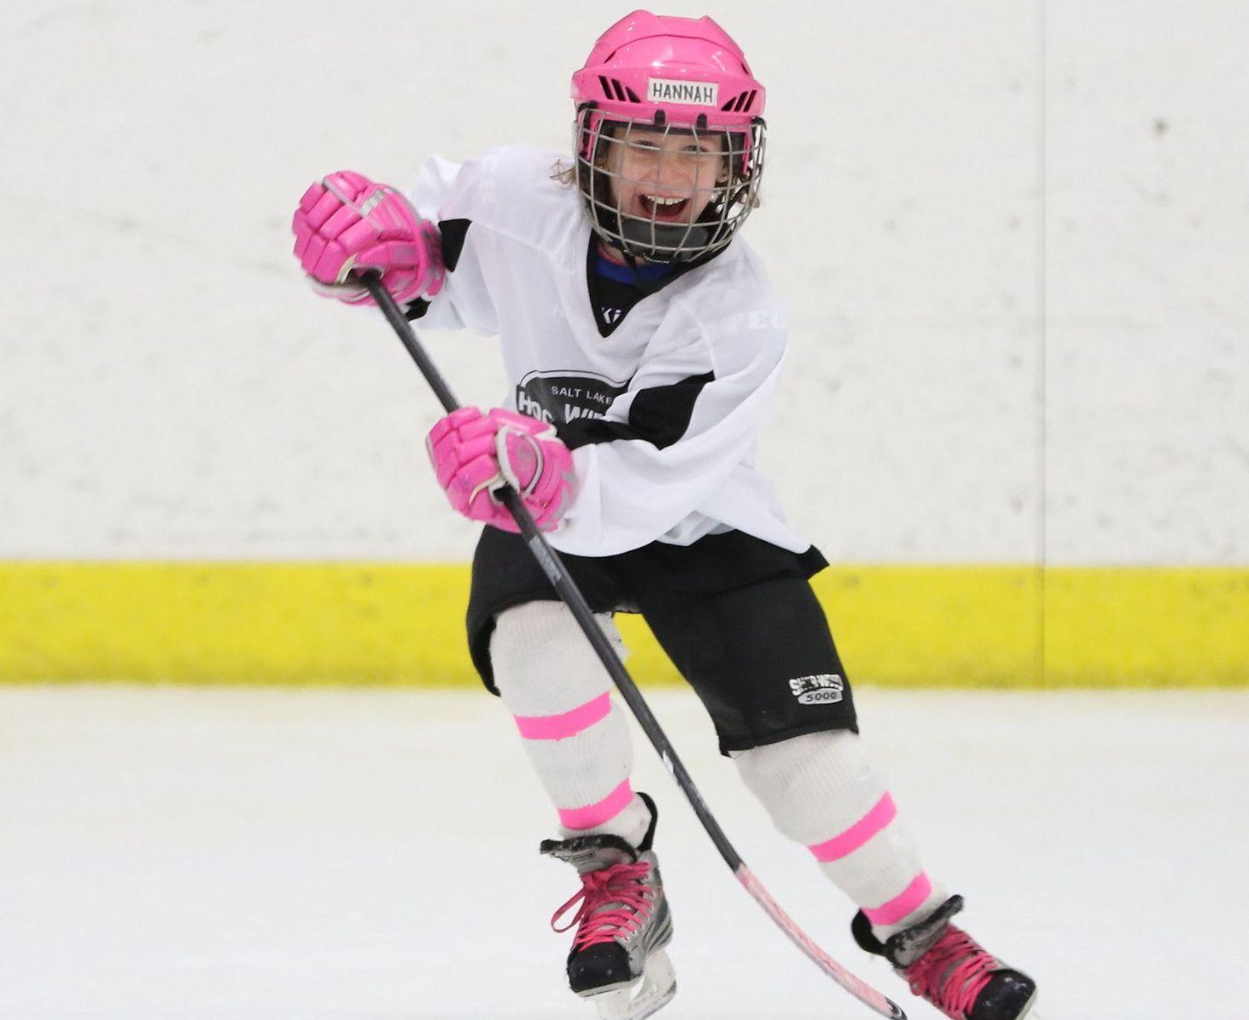
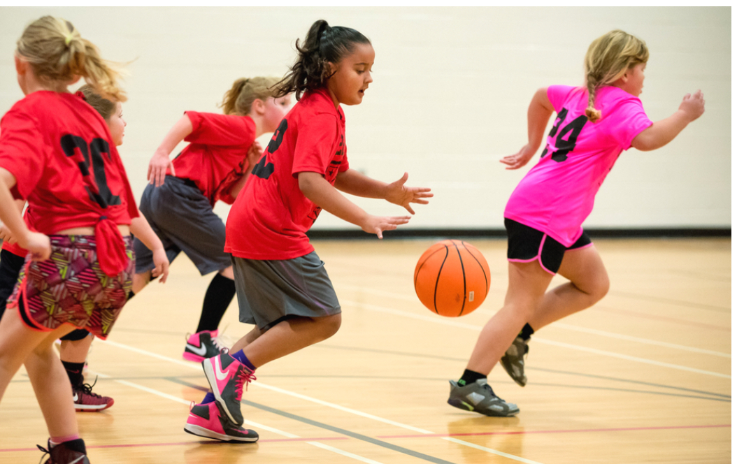
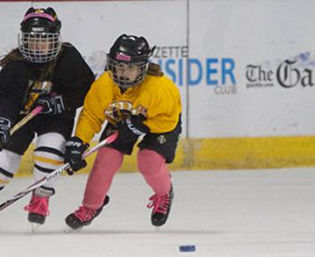
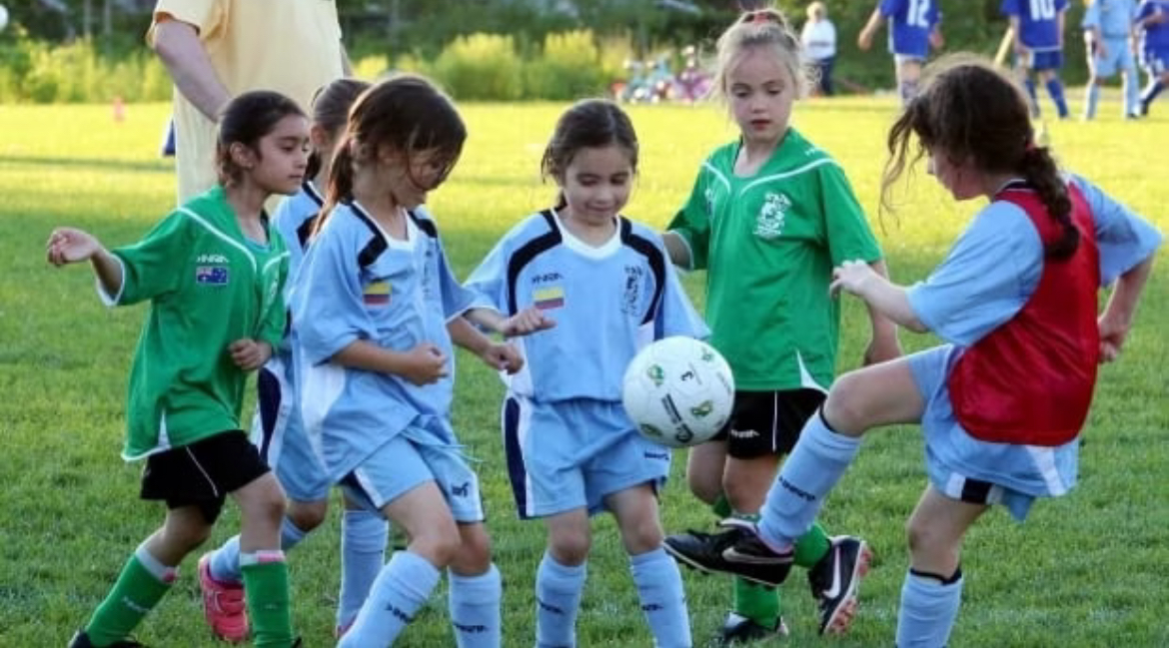
Target audience
Hockey doesn’t need to be so different

Slide 17
Vision / Goals
8U Girls USAH rosters in WI
There were 38 10U Girls teams in WI in 2023-24
Entry Point Teams draw girls into the sport
Number of USAH registered 8U females
A player can’t develop if they aren’t playing
There were 23 8U girls USAH rosters submitted in WI: Goals 2024-25 - 35 2025-26 - 40 2026-27 - 50
.
Goals: 2024-25: 40 2025-26 :45 2026-27 :55
GOALS
2025-26
2023-24
2024-25
2026-27
There were 1829 8U girls registered in WI: Goals 2024-25 :1950 2025-26 : 2090 2026-27: 2250
Kids have to be having fun to want to come to the rink.

Slide 18
Resources
USAH - Hat Trick Challenge
WAHA website - Girls Division
Grant applications - WAHA & USAH

