Slide 1

APPLE VALLEY BURNSVILLE HOCKEY 2024-25
PARENT MEETING

Slide 2
AVBHA Leadership
Executive Team
Mite Coordinators
Andrew Spencer (President)
Joanie Baltes (Vice President)
Luke Korkowski (Treasurer)
Jodi Oster (Secretary)
Other
Luke Korkowski
Ginger Lemke (Intro Coordinator)
Jeffrey Lantz
Chuck Rosenfield (DIBS Coordinator & SafeSport Coordinator)
Emily Hindal (Tournament Director)
Ginger Lemke (Communications – Recruiting & Retention)
Chris Sikich (Hockey Development)
Jeremy Pries (Hockey Development)

Slide 3

Needed to Play
Birth Certificate
All 1st year players must provide a copy of a government issued birth certificate to the Registrar
Email a pdf copy to: registrar@avbhockey.com

Slide 4
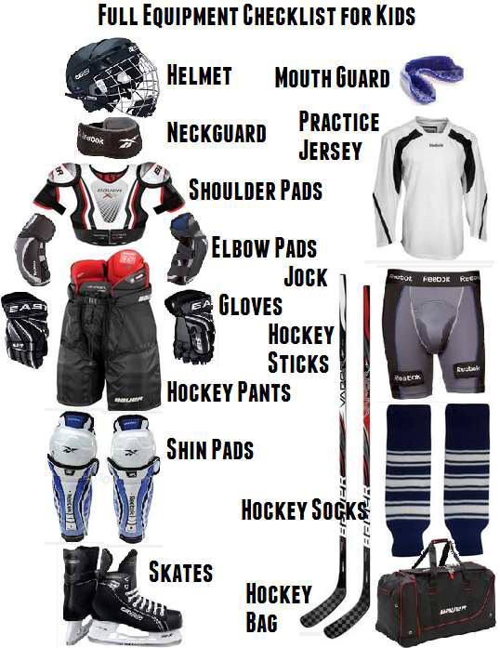
Hockey Equipment Checklist
Must have or cannot skate
LABEL ALL YOUR GEAR!

Slide 5
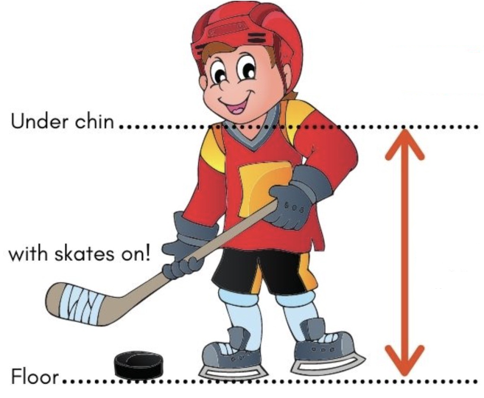
Hockey Stick Length

Slide 6
Hockey can get expensive…
Take advantage of used equipment
Equipment doesn’t make the player
Volunteer
(DIBS)
https://www.minnesotahockey.org/page/show/1269347-budget-tips

Slide 7
Apple Valley Burnsville Hockey Dib Sessions
DIBS for the 2024/25 season
All families are required to complete 10 hours of DIBS for the season.
Families not completing their DIBS may be charged $50 per unfulfilled hour, which will be reviewed throughout the season by the board and make a final determination on required payment.
If families choose NOT to participate in DIBS, payment of $500 can be made to the Association.
Chuck Rosenfield (DIBS Coordinator & SafeSport Coordinator)
www.avbhockey.com/dib_sessions

Slide 8
Main Ice Arenas
Apple Valley High School (Sports Arena) “AVSA”
Hayes Ice Arena
Burnsville Ice Center “BIC1 & BIC2”
251 Civic Center Parkway, Burnsville
14452 Hayes Road, Apple Valley
14595 Hayes Road, Apple Valley

Slide 9
Training Center
Apple Valley training Center
14760 Pennock Ave Apple Valley
Burnsville Training Center
The Burnsville Training Center is located across the parking lot from the Burnsville Ice Center to the West. It is housed in part of a former city public works building. The door is next to the Skate Park.

Slide 10
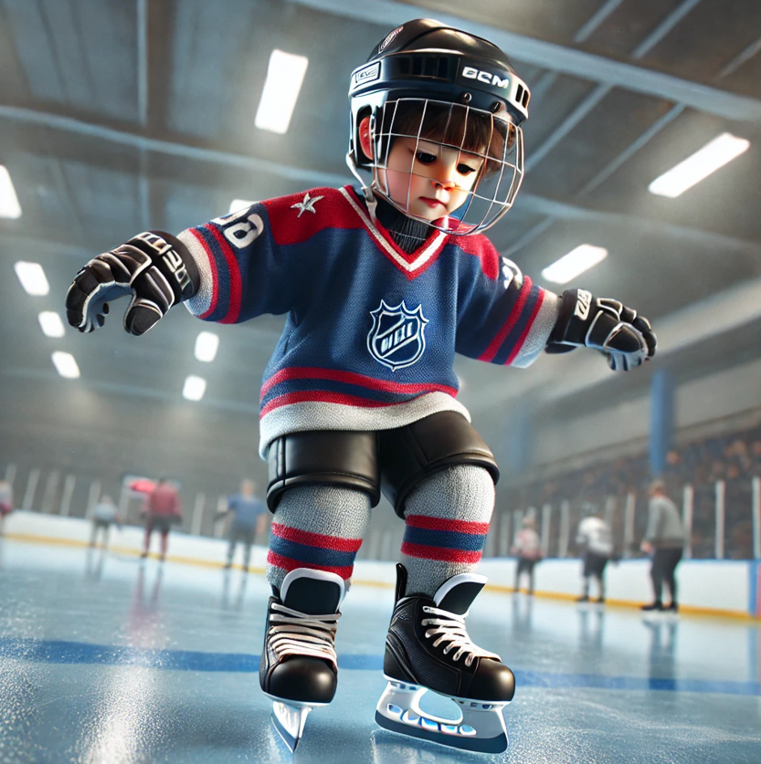
Mini-Mite 1 (MM1)
Skill level: 1st year skaters
Grade level: Pre-K and Kindergarten

Slide 11
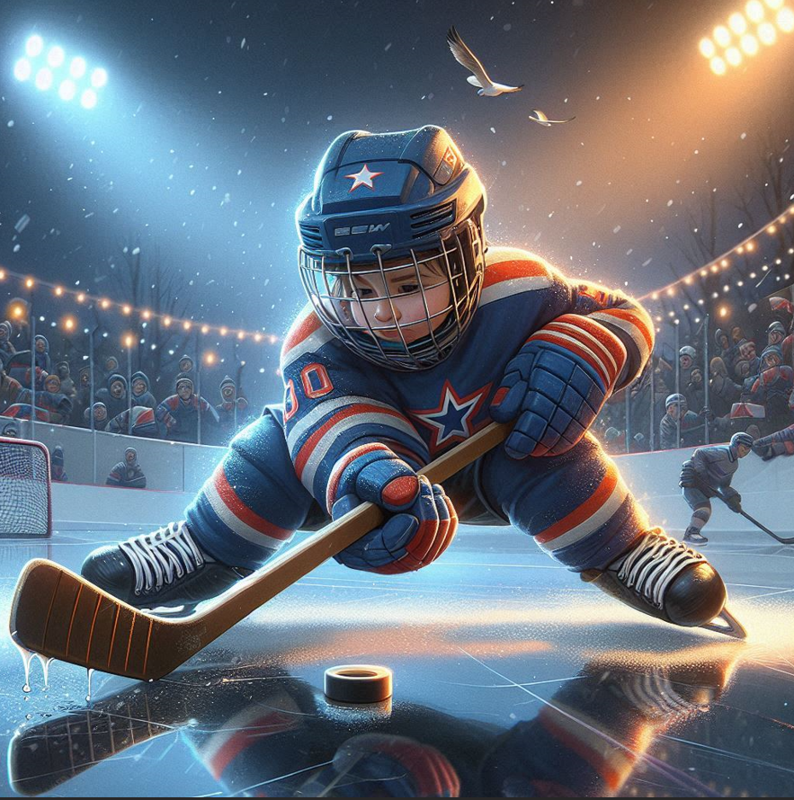
Mini-Mite 2 (MM2)
Skill level: 2nd year skaters
Grade level: 1st Grader

Slide 12

Mite Minor
Skill level: 3rd year skaters
Grade level: 2nd Grader

Slide 13

Mite Major
Skill level: 4th and 5th year skaters
Grade level: 3rd Grader

Slide 14
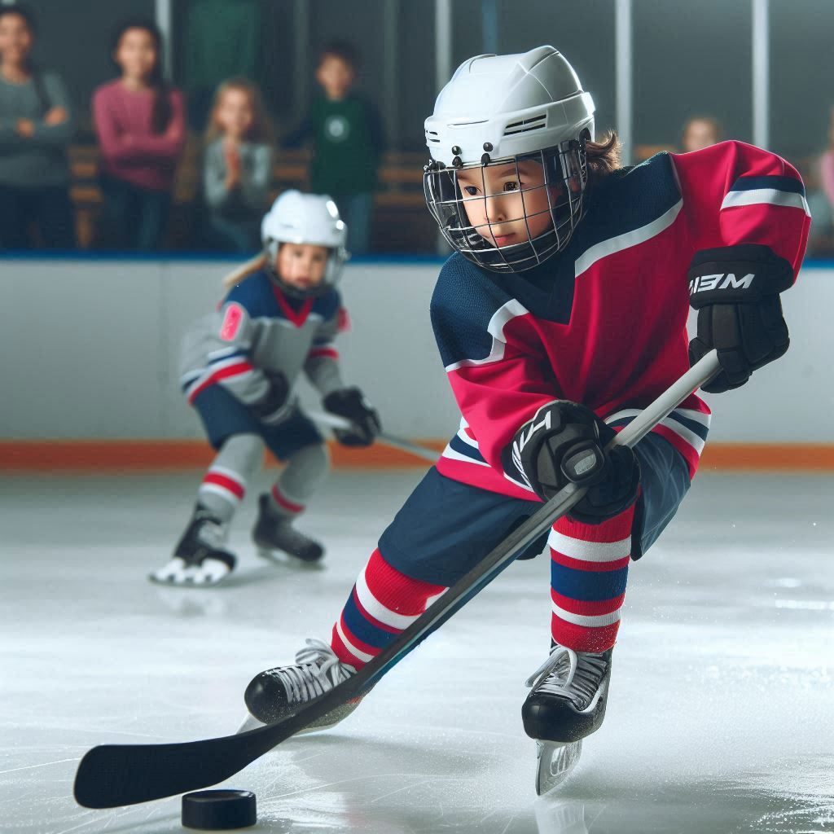
Mite Plus
Skill level: 2nd year returning skaters
Program is in addition to Mini-Mite 2, Mite Minor, and Mite Major
Expectation is to attend all practices and scrimmages for both
Mite Plus Levels
Determined by Try-Outs
Boys: Advanced, Intermediate, Beginner
Girls: Advanced, Intermediate, Beginner
Co-Ed: U6
Parent Expectations
Use SportsEngine if your skater will be attending or missing a practice or a game
Helping with on and off ice activities during scrimmages

Slide 15
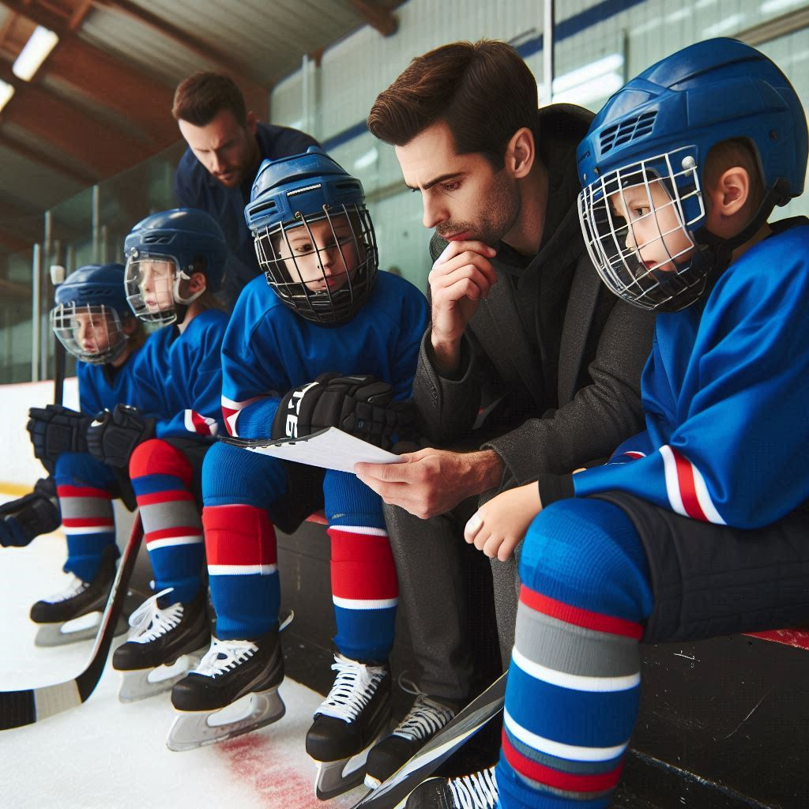
Evaluations
Format:
Skill Stations Evaluations (Day 1)
Scrimmage & Game Play (Day 2)
If opting for U6 team you do not need to do tryouts
Rosters will be announced after tryouts
Roster will be posted on avbhockey.com website and uploaded to SportEngine
Final team roster decisions will be made by a consensus from Mite Coordinators, Board Evaluators, and Age
Please note:
What team you think your child should be on is not as important as what team they are evaluated at and placed on. Developing at the appropriate level is the most important.

Slide 16
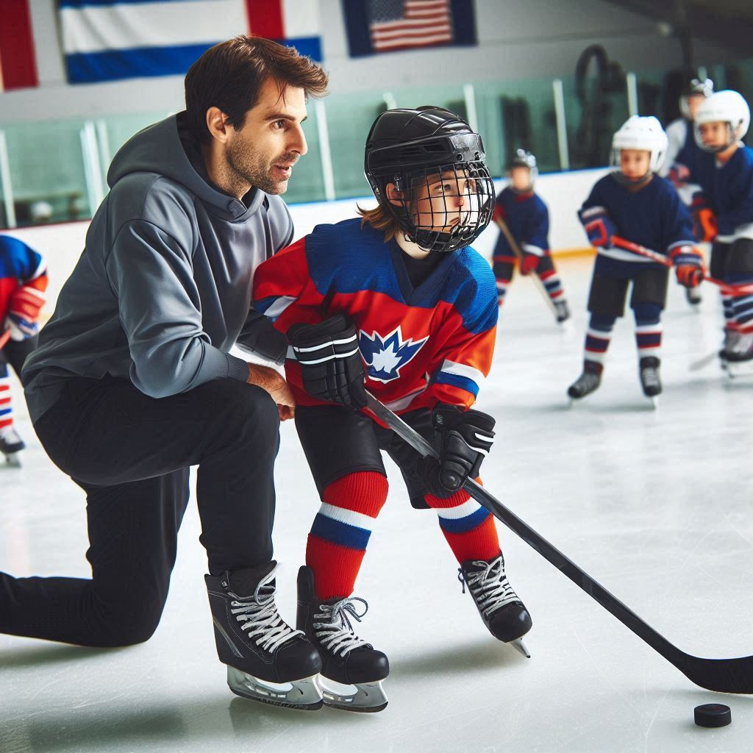
Coaching
Coach Application: https://www.applevalleyhockey.com/coachapp
Volunteer Registration: https://www.avbhockey.com/volunteerregistration
Applevalleyhockey.com > resources > coaches corner
Coaches Resources
Coaches Application
Volunteer Registration (avbhockey.com)
If you can skate, please consider volunteering
Mite In-House Assistant Coach
Mite Plus Assistant Coach

Slide 17
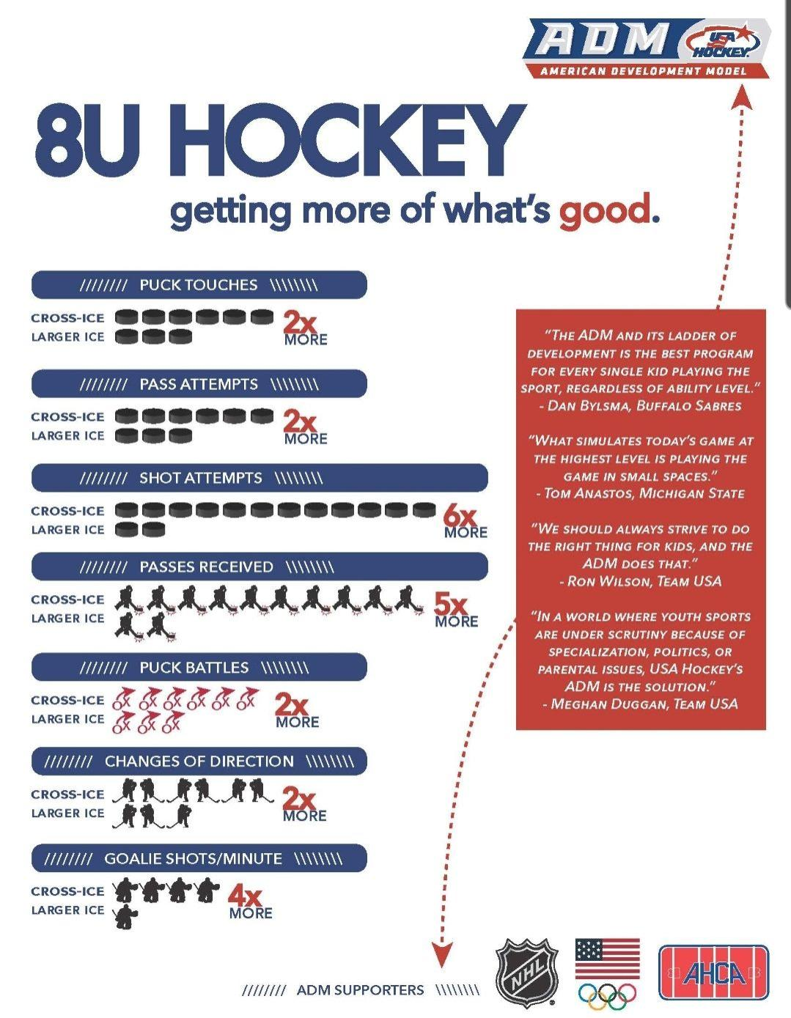

Slide 18

A platform for communications & team schedules
Once your child is rostered to a team you will be able to use the RSVP and team messaging functions.
It is important to RSVP for practices and games.
Check the TV monitors and use only assigned locker rooms
Calendar Update

Slide 19
District 8 Associations
Apple Valley
Cottage Grove
Eagan
Eastview
Farmington
Hastings
Inver Grove Heights
Johnson-Como/N St Paul
Lakeville
Red Wing
Rosemount
Sibley Area
South St. Paul
Woodbury
www.minnesotahockeydistrict8.com/connect
www.minnesotahockey.org/handbook

Slide 20












Our Sponsors - Show support and visit them

