Slide 1

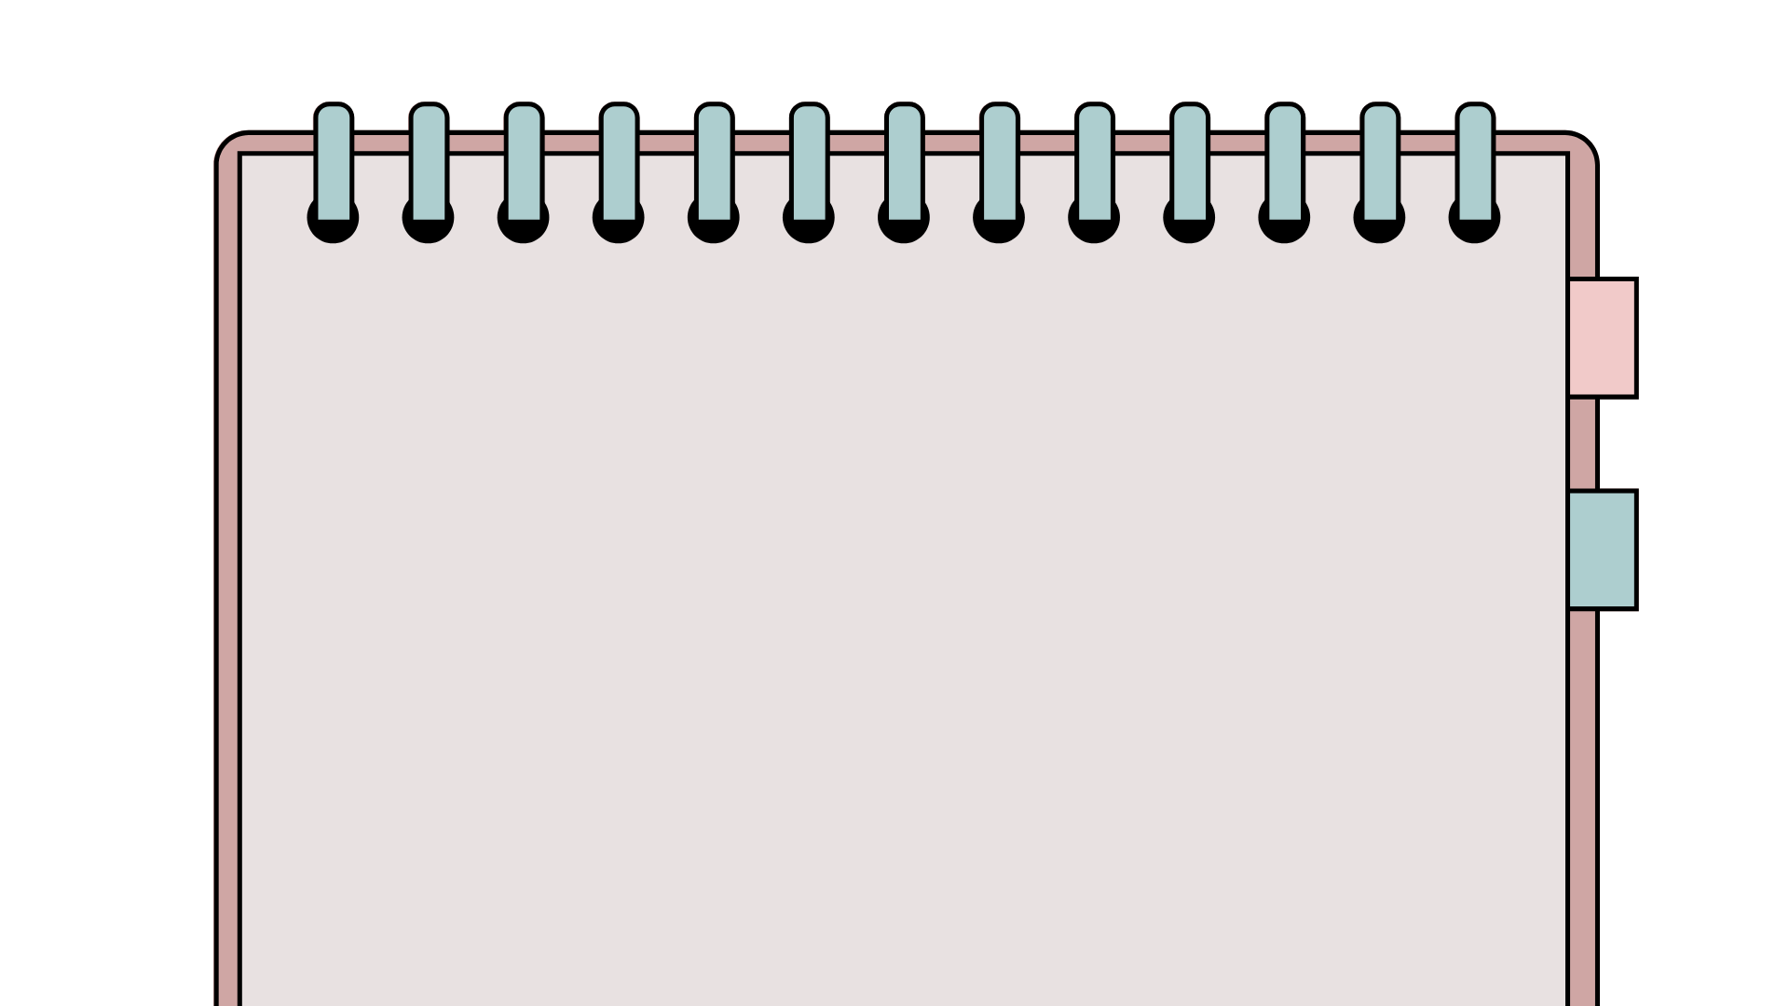
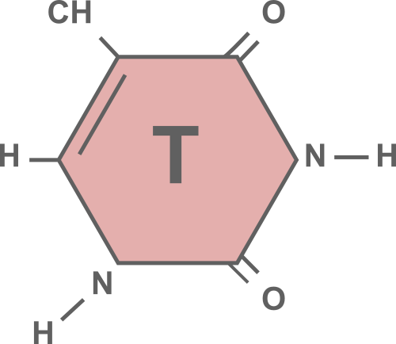
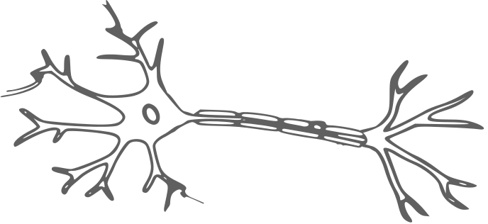
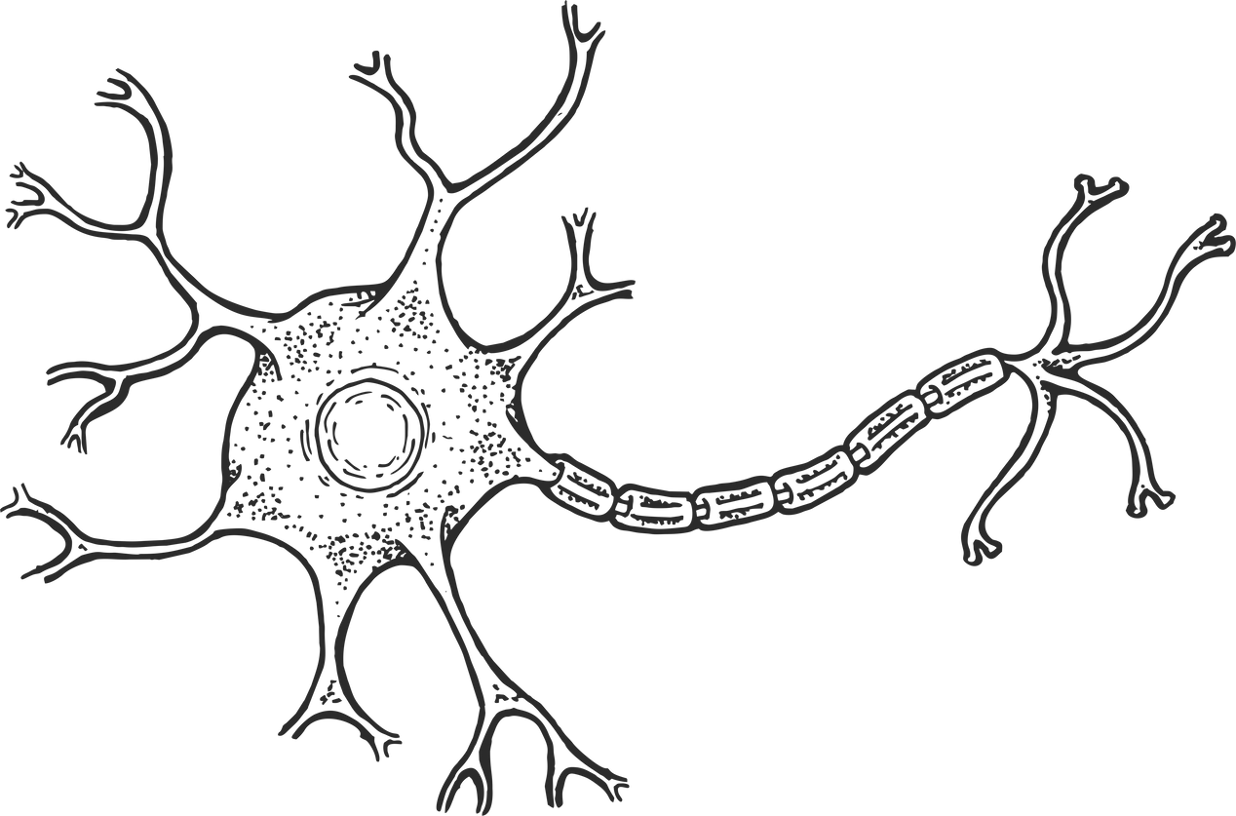
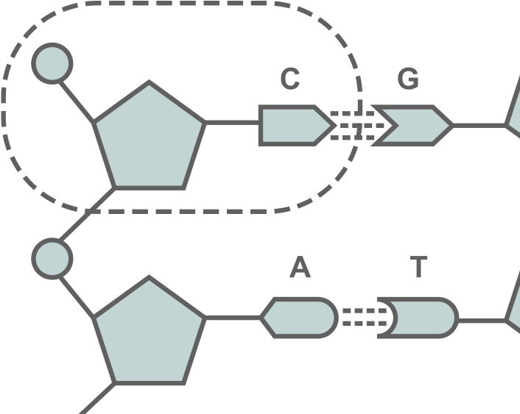

Physiology of Endurance Running
By: Thomas Bambach

Slide 2

Goals
01
02
03
To provide a high level overview of what happens ‘under the hood’ when training
To help develop a common understanding and language
Establish a training ‘Tool kit’ - Which sessions do what?

Slide 3

Exercise Physiology
How does the body work?
How the body responds to exercise.
How can exercise physiology help me?
- Identify training zones
- Link training sessions to specific adaptations
- Design of the overall training plan.
Notes:
What is Exercise Physiology - If you’ve done any coaching at all you are already working in “applied” exercise physiology. We are studying how the body adapts to exercise - specifically running! If we drop the “exercise” then a physiologist is attempting to ascertain how the body functions and adapts to its changing environment.
Now we have a decent bit of science to get through but I’m going to wrap it all up with some applicable takeaways. Remember everyone in this room is an applied exercise physiologist, that’s what you do every day when working with your athletes. What we are doing is taking a scientific approach to try to understand how / why the changes are happening in the body in order to try to be more efficient when we assign training.

Slide 4

It’s going to speed up your development as a coach.
Knowledge of how the body responds to stress both in the short and long term - allows us to pivot when things aren’t going how we planned.
Notes:
If you are like any of my athletes the first thing you are going to ask is “Why is this important?” And honestly it’s a great question. Do we Really need to know the in’s and outs of the chemical processes that are happening inside the muscles to be an effective coach? No. You don’t. I know and interact with some excellent coaches regularly who can barely scratch out the basics of Exercise Phys. But I believe firmly that there are some really large benefits to having a basic understanding of what’s going on under the hood.
#1 - It’s going to speed up your development as a coach. A basic understanding of what is happening within the body allows us to accelerate the learning process when it comes to creating workouts and training plans. We don’t just have to rely on what another program is doing and/or what we see on the internet.
#2- Exercise physiology at its base is studying how the body reacts to stress. When we have even a basic understanding of these principles then we start to be able to create a framework in which we can make training decisions.

Slide 5
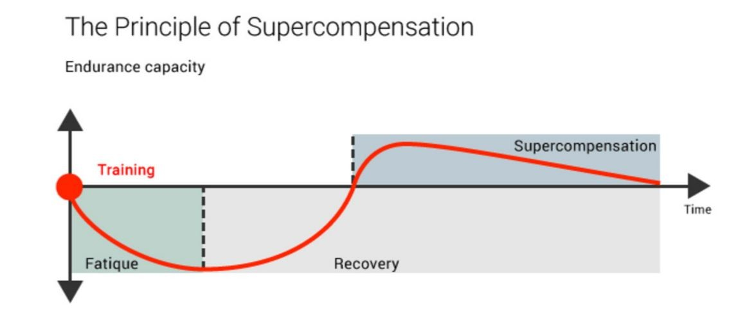
Adaptations
Notes:
Now we are going to talk about specific adaptations in a minute - but when we look at how the body adapts to the stress we give it. This graph shows how to body reacts to stress that we give it. It is our job as coaches to manage this curve in the athletes that we are working with. By manipulating the size and the frequency of stress we move the body forward on a pathway to getting better.
When we are writing training the way I like to look at it is that we are assigning a stress. We can’t just take into account the stress that the athlete is facing in training, but also the stress that they have in their day to day life. School stress, relationships, etc etc.
The body gets better at the things we ask of it.

Slide 6


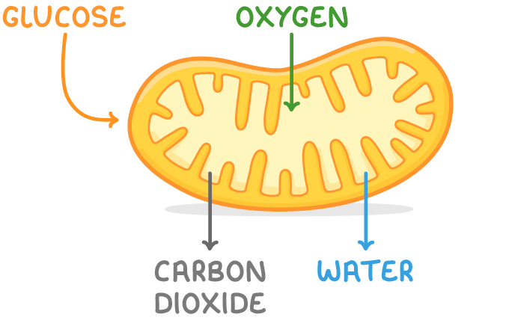

The Energy Systems
Aerobic System
(With Oxygen)
Anaerobic System
(Without Oxygen)
Notes:
There are three main pathways that the body uses but we are going to focus on the big two. Aerobic and Anaerobic energy pathways is the “how” of the body taking producing energy that we use to create movement. We need to understand these pathways because they interact and are. as far as we can tell, the primary limiting factor in endurance running.
On the left we have the aerobic pathway or the aerobic system and on the right we have the anaerobic system.

Slide 7
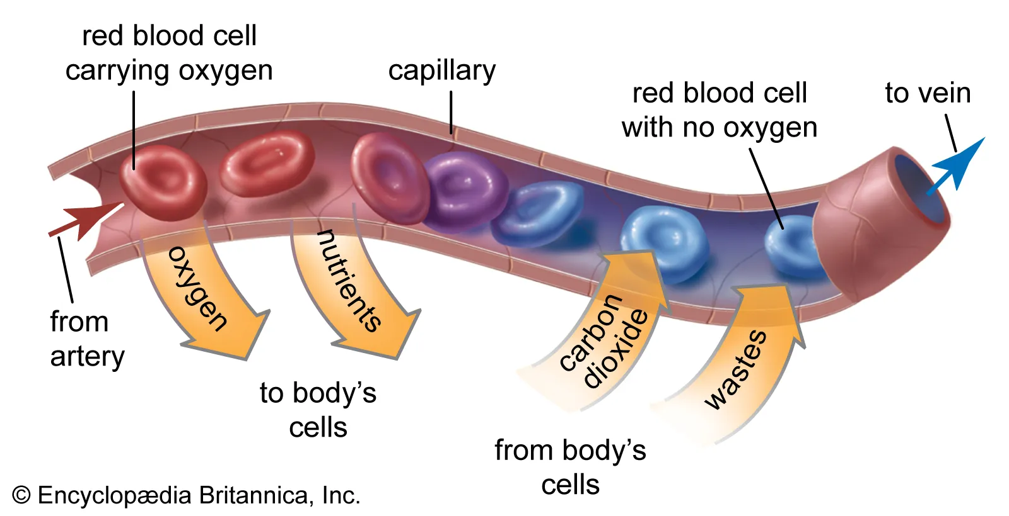
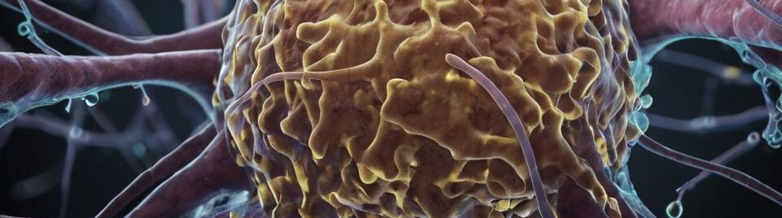
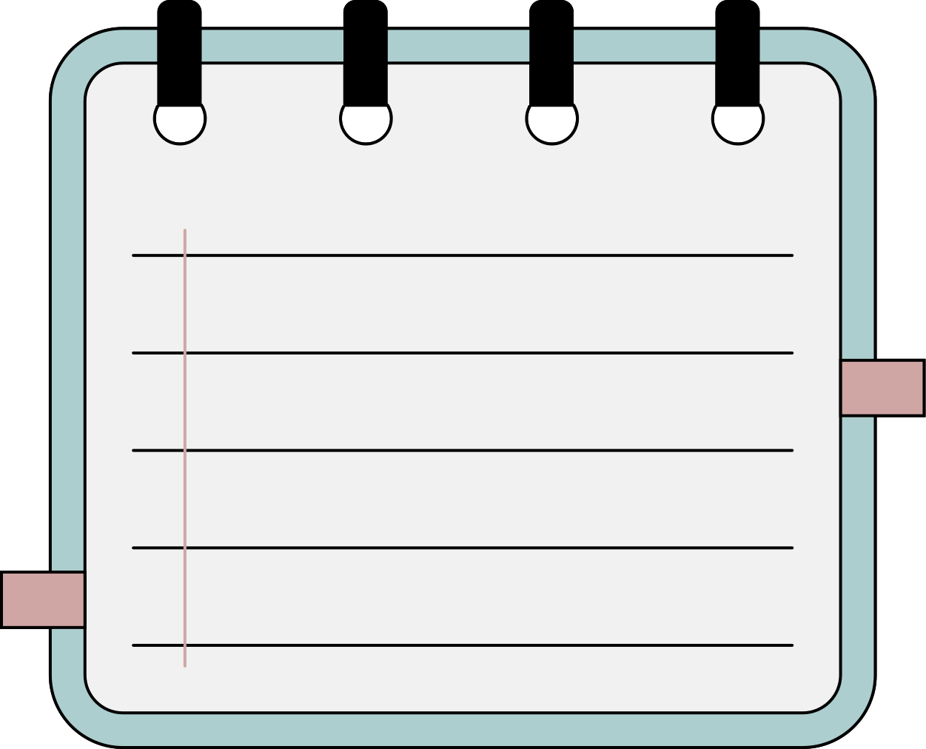
Aerobic Energy Production
Total Energy Contribution
Slow to adapt
70% + of total energy production in races 1600m+ comes from the aerobic system.
The Aerobic System takes time and consistent pressure to make adaptations, but can be trained constantly for long periods of time.

Slide 8
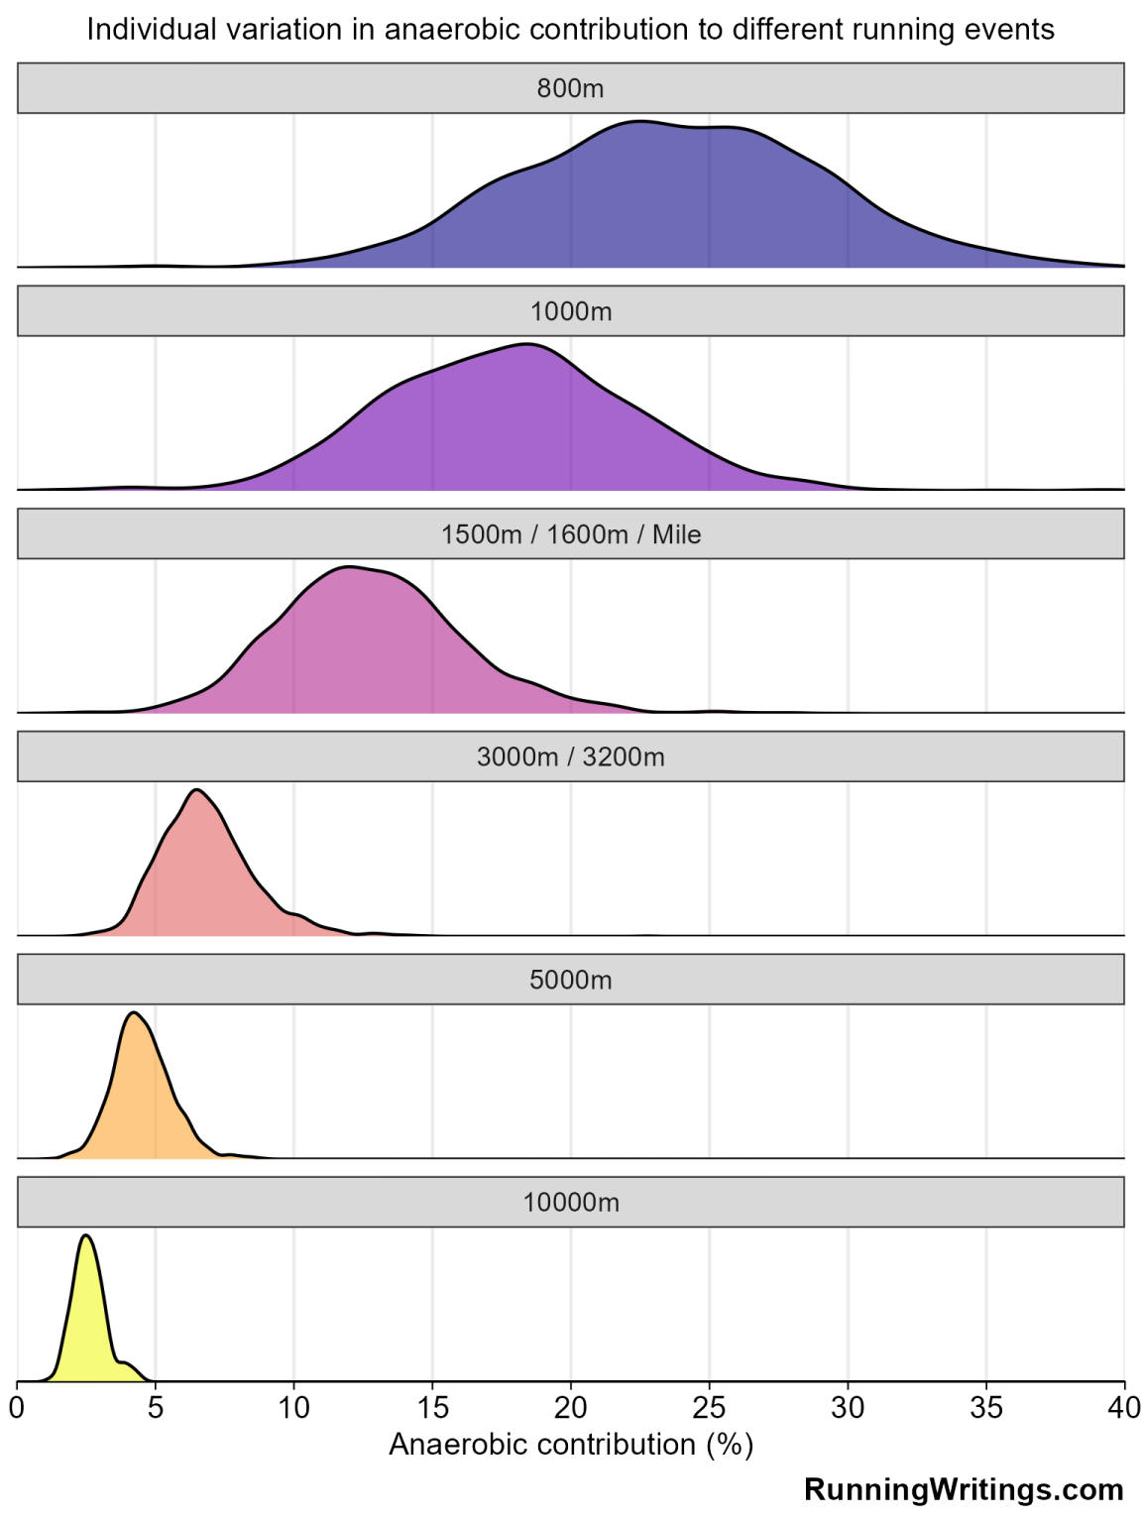

Slide 9

Adaptations to the Aerobic System
01
02
03
Higher Blood Volume
Capillarization
Larger / More Mitochondria
More Blood = More oxygen
06
05
04
Running Faster
Fatigue Resistance
Larger Heart Muscle

Slide 10
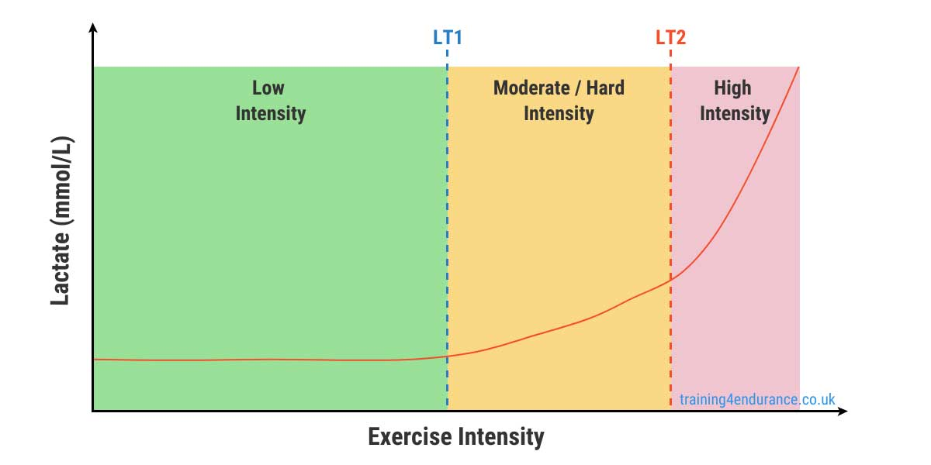
Threshold(s)
Notes:
Describe Lactate Chart
Respiration check / HR
Moderate Intensity creates large benefits for relatively low fatigue. Allows consistency.

Slide 11
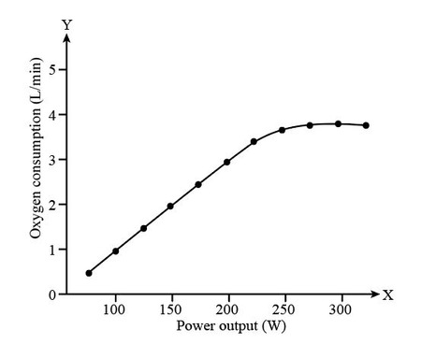
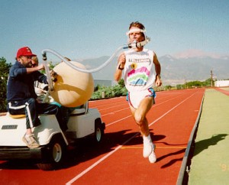
Vo2 Max

Slide 12
Anerobic Energy Production
“Fast energy”
Highly Trainable
Lots of energy, but it comes at a cost.
We can see anaerobic adaptations in as little as 48 hours. However, total capacity is limited. Further research is needed.
Notes:
The 2nd primary energy source for endurance races, specifically 800 / 1600 races is the anaerobic energy system. Now Anaerobic means ‘without oxygen’. What happens is that when the body needs to produce energy and there is no oxygen available. We aren’t going to go into the finer details but we skip the oxygen step and instead produce Lactic Acid.
Now when we are talking about energy systems, it’s not like a valve where one is turned on and another is turned off. They work in tandem all the time. If we could measure your blood lactate right now through a finger prick we would see that you have some ‘lactic acid’ floating around in the system even though you aren’t doing anything. Both systems work together to provide us with energy all the time, what changes is what % they are operating at. Once we reach a point where the Aerobic system can not satisfy the demand for energy then we start to see a ‘revving up’ of the anaerobic system to meet energy needs. Acidosis / Oxygen debt / fatigue is what we get past that point because of the byproducts.

Slide 13
System | Adaptation Speed | Adaptation Ceiling | Recovery Cost
Aerobic System | Slow | High / Unknown | Generally Lower
Anaerobic System | Fast | Relatively Low | Generally Higher

Slide 14
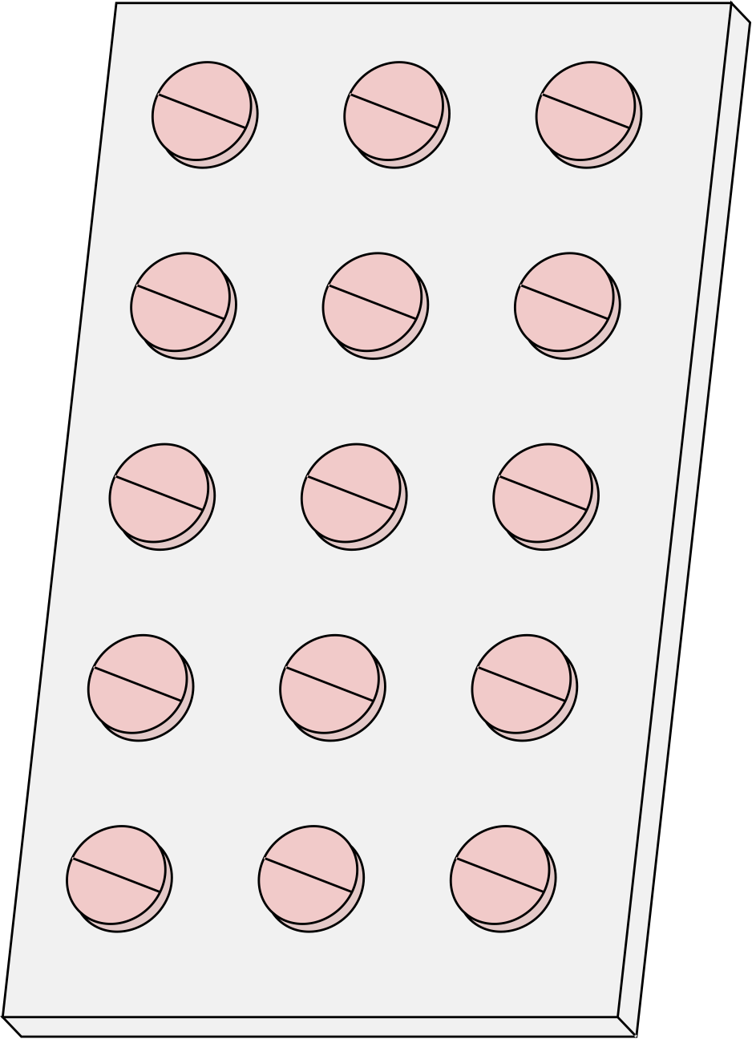
HOW?
All the science is great - HOW do we improve the Aerobic system?
Notes:
The expansion of the aerobic system is based on duration.
If duration is our PRIMARY factor then INTENSITY is the ceiling.

Slide 15

Examples
Easy Running
High(er) volume
Easy running / Low Intensity Training is the most cost effective way to improve the aerobic system
Volume is the primary driver of aerobic gains. Volume is individual in nature.
Consistency
Duration / Intensity
Adaptations come slowly - Perfect for offseason focus
Using certain intensities (Threshold) we can jumpstart the adaptation process.

Slide 16
Examples
Activity | Stimulus | Recovery Cost
Easy Running | * | *
Moderate Running | ** | **
Long Run | *** | ***
Threshold Training | *** | **
V02 Max Training | ***** | *****

Slide 17
6:10 1600m girl who runs 25-35 miles per week
Activity | Sample
Easy Running | 4-6 mile easy run (8:20+ per mile)
Moderate Running | 2-3 miles @ 7:40-7:55 per mile
Long Run | 6-8 miles at an easy pace
Threshold Training | 3 x 1 mile @ 7:20-7:30 per mile w/ 1’ recovery
V02 Max Training | 6 x 800 @ 3:20-25 w/ 2:00-3:00 recovery
10:20 3200m boy who runs 35-45 miles per week
Activity | Sample
Easy Running | 4-7 mile easy run (7:30+ per mile)
Moderate Running | 4-5 miles @ 6:10-6:25 per mile
Long Run | 8-10 miles at an easy pace
Threshold Training | 6-7 x 1000m @ 3:35-3:45 (5:48-6:00) w/ 1’ recovery
V02 Max Training | 6 x 800 @ 2:35-45 w/ 2:00-3:00 recovery

Slide 18
Anaerobic Training
Increased Fatigue Resistance
Low(er) volume
Fatigue resistance to paces around race pace.
Intensity is the primary driver of adaptations for anaerobic training. High volumes can be dangerous
Scalpel not a Sledgehammer
Racing is Training
Adaptations come quickly, can carefully dose workouts to achieve results.
Racing is Anaerobic Training. We can replace a good anaerobic workout with an 400/800/1600m race.

Slide 19
Anaerobic Training
Anaerobic Training should be connected to the SPEED of the event.
2:00 for 800m is :15 per 100m. Does not matter if you are short or tall, skinny or muscular. The SPEED of the event is constant.
Anaerobic Training should be used to ENHANCE, not to REPLACE foundational training.
“Aerobic Capacity determines anaerobic potential” - Al Carius
Anaerobic training is typically where we can see athletes getting “overcooked”

Slide 20
Anaerobic Training
Example - for 2:20 800m girl.
4 x 200 in 36-37 (recovery :45) - Rest 3’
4 x 200 in 35 (recovery 2’) - Rest 4’
4 x 200 in 33.5 (recovery 3’)
Example - for 2:00 800m boy.
4 x 200 in 31-32 (recovery :45) - Rest 3’
4 x 200 in 30 (recovery 2’) - Rest 4’
4 x 200 in 28.5 (recovery 3’)
For 800m -
3 sets of 300’s -> Increasing rest, decreasing pace each set.
Example - for 2:20 800m girl.
3 x 300 in 54-55 (recovery 1’) - Rest 3’
3 x 300 in 52-53 (recovery 2’) - Rest 4’
2 x 300 in 50-51 (recovery 3’)
Example - for 2:00 800m boy.
3 x 300 in 47-48 (recovery 1’) - Rest 3’
3 x 300 in 46-47 (recovery 2’) - rest 4’
2 x 300 in 44-45 (recovery 3’)

Slide 21
Volume Guidelines
Race Distance | Total Volume
800m | 1000m - 2500m
1600m | 1800-3200m
3200m | 2500-5000m

Slide 22




Thank
You
tbambach@uwsp.edu
(616) 644-4594

