Slide 1

2025 – 2026
Mite Program
Parent Meeting

Slide 2


Apple Valley Burnsville Hockey Association Leadership
Executive Board
Luke Korkowski
President, STP Coordinator, Branding
Mindy English
Vice President, Financial Aid, Girls Coordinator
Jeff Lantz
Treasurer, Mite Coordinator, Intro to Hockey Coordinator
Jodi Oster
Secretary, College Scholarships
Board Members
Ryan Goodmanson
Bantam Coordinator
Scott Roiger
Peewee Coordinator
Matt Czech
Squirt Coordinator, Grievance Chair
Kelly Jo Powerstorm
Girls Coordinator, HDC Player Development Coordinator
Brad Shear
Jr Gold Coordinator, Tournament Registrar
Board Members
Randy Olson
Gambling Manager
Chuck Rosenfield
SafeSport Coordinator, Dibs Coordinator, Fortis Coordinator, Grievance Chair
Justin Krech
Fundraising & Sponsorship Coordinator
Emily Hindal
District Tournament Director, Jersey Coordinator
Nick Schultz
D8 Representative, BVTC Manager, AVTC Manager
Holly Pemble
Registrar

Slide 3
Items Needed to Play

Slide 4

Birth Certificate
All 1st year players must provide a copy of a government issued birth certificate to the Registrar
Email a pdf copy to:
registrar@avbhockey.com

Slide 5
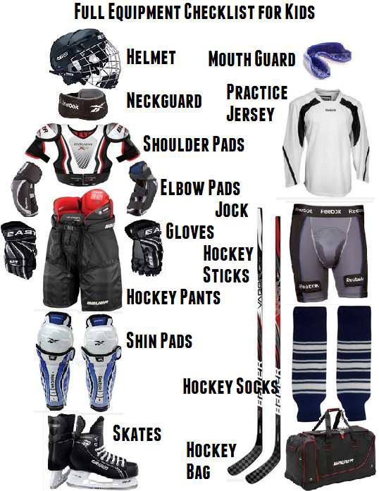
Hockey Equipment Checklist
Label All Your Gear
Take Advantage of Used Equipment
Play It Again Sports
Other Hockey Parents
Equipment does NOT make the player
Helmet
Preferred Color WHITE
Neck Guard
MUST be wearing to skate
Neck guard long sleeve shirt

Slide 6
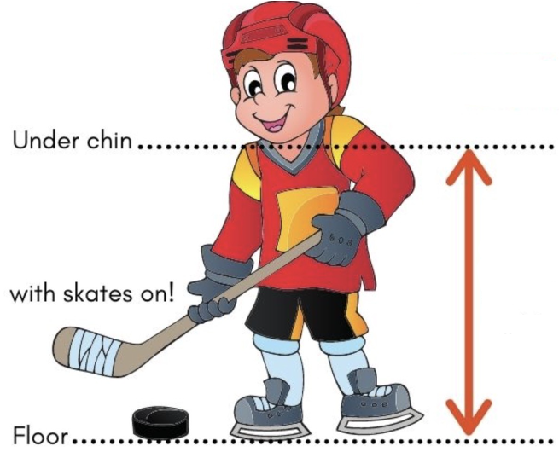
Hockey
Stick
Length
Stick Too Long
Harder puck control
Slower stickhandling
Less shooting accuracy.
Stick Too Short
Skaters hunch over causing bad posture
Weaker shot power
Less reach on defense

Slide 7
Mite Program

Slide 8
Mite
In-House Expectations
Skaters skate their grade level regardless of skill level
Practices are focused on individual skills
First Sunday practice of each month will be half ice scrimmages
Use SportsEngine if your skater will be attending or missing a practice (RSVP)
Helping with on and off ice activities DIBS

Slide 9
Mite
In-House Levels
Termites
Pre-K
Mite 1 (MM1)
Kindergarten
Mite 2 (MM2)
1st Grade
Mite Minor (Minor)
2nd Grade
Mite Major (Major)
3rd Grade

Slide 10
Mite
Plus Expectations
Skaters 2nd year returning skaters
Skaters skate their skill level determined in try-outs.
Rosters will be announced after tryouts on Nov 9th
Final team roster decisions will be made by a consensus from Mite Coordinator, Board Evaluators, and Age
Practices are focused on individual and team skills
Use SportsEngine if your skater will be attending or missing a practice (RSVP)
Helping with on and off ice activities DIBS

Slide 11
Mite
Plus
Levels
Hatchling Mites (Co-Ed Teams)
Low-end Kindergarten and low-end 1st Grade
Eaglet Mites (Co-Ed Teams)
Upper-End Kindergarten and Upper-End 1st Grade
Beginner Mites
Low-End 2nd Grade and Low-End 3rd Grade
Intermediate Mites
Upper-End 2nd Grade and Mid 3rd Grade
Advanced Mites
Upper-End 3rd Grade

Slide 12
DIBS

Slide 13

All families are required to complete 7.5 hours of DIBS for the season.
Families not completing their DIBS may be charged $60 per unfulfilled hour, which will be reviewed throughout the season by the board and make a final determination on required payment.
If families choose NOT to participate in DIBS, payment of $450 can be made to the Association.
Chuck Rosenfield (DIBS Coordinator & SafeSport Coordinator)

Slide 14

Looking for parent(s) that want to create and manage a Hockey Equipment Exchange just for our association.
Please email if you are interested.
Jeff.Lantz@avbhockey.com

Slide 15
Coaching

Slide 16
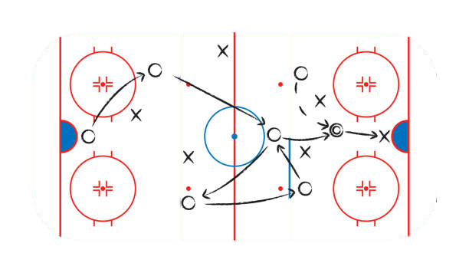
Coach Application: https://www.applevalleyhockey.com/coachapp
Volunteer Registration: https://www.avbhockey.com/volunteerregistration
Applevalleyhockey.com > resources > coaches corner
Coaches Resources
Coaches Application
Volunteer Registration (avbhockey.com)
If you can skate, please consider volunteering
Mite In-House Assistant Coach
Mite Plus Assistant Coach

Slide 17
Questions

Slide 18
Thank You Parents
Go EAGLES!!!
Mite Coaches Please Stick Around

Slide 19
Mite Coaches

Slide 20
Coaching Requirements
USA Hockey Registration – Register as a coach with USA Hockey for the 2025–26 season: USA Hockey Registration
Background Screening – Required for all coaches: Background Screening Info
SafeSport Training (if age 18+) – Complete the SafeSport online training: SafeSport Training
Age-Specific Module – Complete the 6U/8U Age-Specific Module before going on the ice: Age-Specific Modules
Coaching Education Program (CEP) Clinic – All 6U/8U coaches must attend a 6U/8U CEP clinic (you only need this one unless you move up to older levels): CEP Clinics – Clinics run from June 15–Dec 15 each year. Cost is $65.
– If you have already completed the CEP Level 1 from prior years you can stay at CEP Level 1 permanently if you coach only Mites.
Apple Valley Burnsville Eagles Requirements – Fill out the Coach Application: Coach Application – Register as a Volunteer: Volunteer Registration – Visit the Mite Coaches Corner for resources: Mite Coaches Corner

Slide 21
In-House versus
Mite Plus
In-House – Individual Skills with a strong emphasis on skating skills (Dryland with a strong emphasis on stickhandling and shooting)
Mite Plus – Further individual skill development and team and game-play skill improvement, with a strong emphasis on passing and playing as an unselfish team. (make sure parents are not paying their skaters for goals)

Slide 22
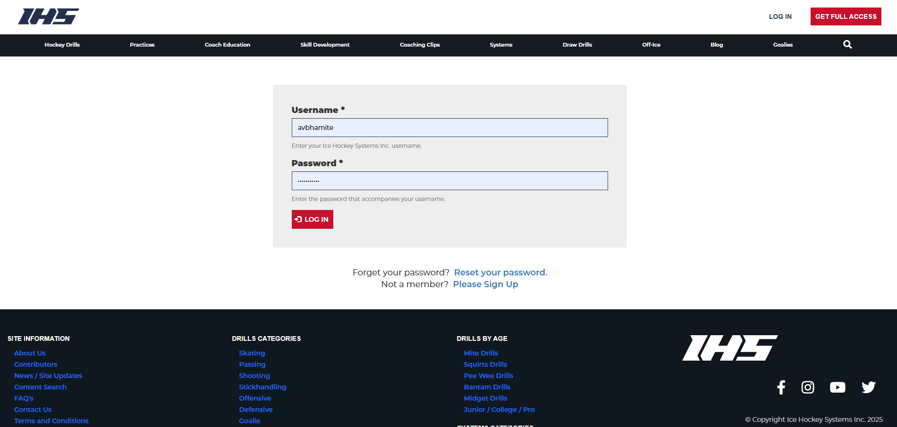
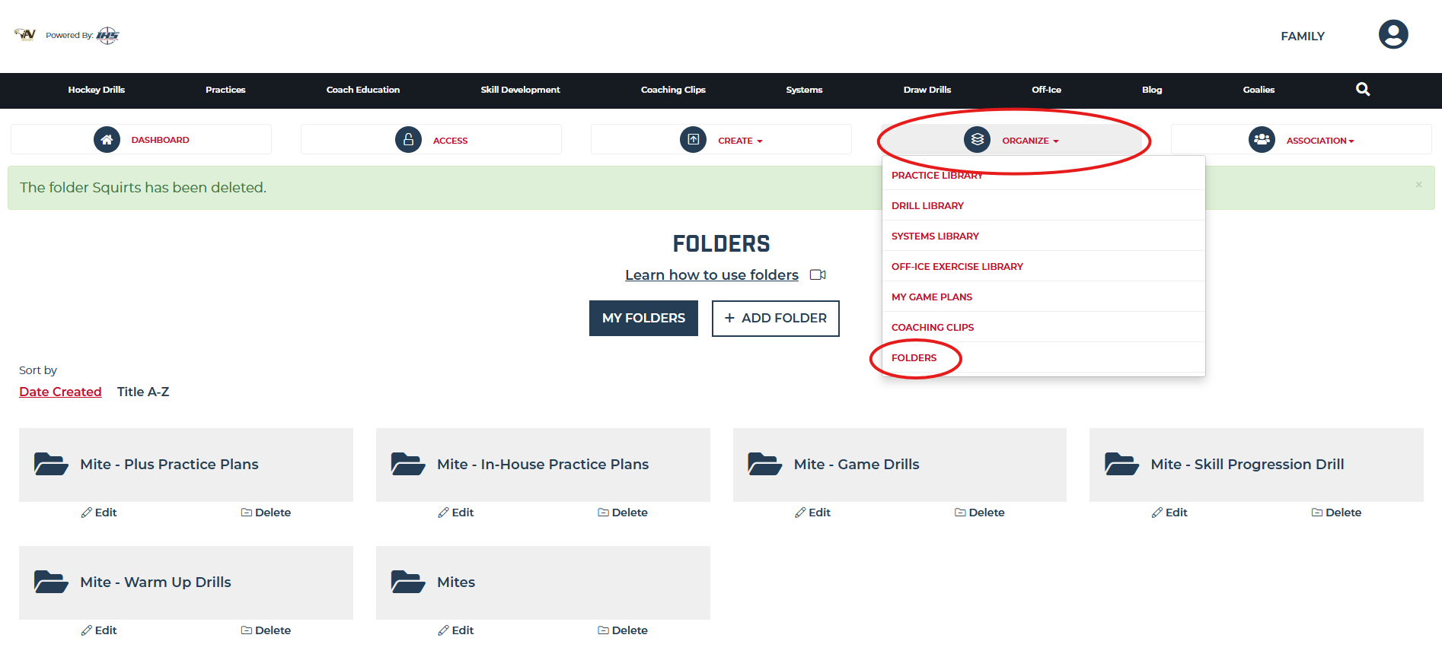
https://www.icehockeysystems.com/user
Practice Plans

Slide 23
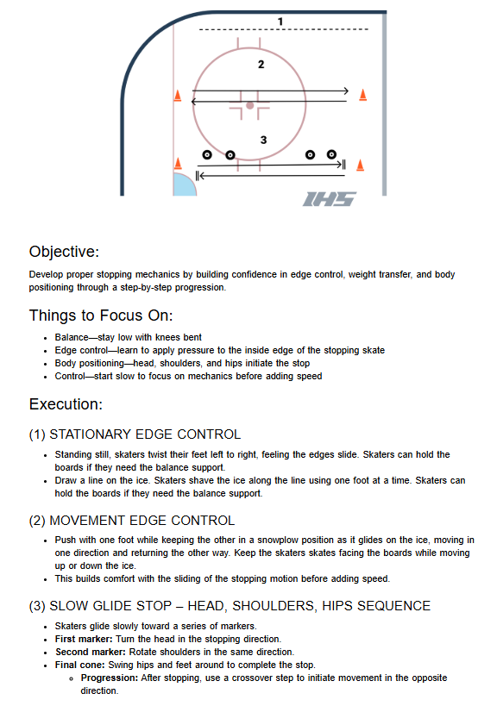
Full Practice Plan
https://www.icehockeysystems.com/share/practice/5955866

Slide 24
In House Mite Leads
Termite and Mini Mite 1
Jeff Covich
Nick Schultz
Chris Berbee
OPEN
OPEN
Mini Mite 2
Brandon Steege
Ryan Goodmanson
Kelly Jo Powerstorm
Aaron Baumgartner
OPEN
Mite Minor
Jeffrey Lantz
Jeff Covich
Nick Schultz
Scott Roiger
OPEN
Mite Major
Brandon Steege
Ryan Goodmanson
Kevin Krmpotich
Andy Klapperick
OPEN

