Slide 1
Redmond HS Boys Basketball Parent Meeting
2023-2024

Slide 2
AGENDA
Welcome/ Brief Introduction of Coaching Staff
Goals/ Program Philosophy/ Coaching Philosophy
Player, Parent, Coach Expectation
Season Schedule
Booster Club Information
Team Bonding Saturday
Website / Social Media

Slide 3
Coaching Staff
Varsity – Todd Rubin, Ashley Graham
Junior Varsity – Derik Detweiler
C Team – Scott Brown
JV/C Assistant – Chad Hui-Peterson

Slide 4
PROGRAM GOALS
All student-athletes will more successfully reach their full educational, personal and basketball potential and become positive, contributing members to society as the result of participating in this program
Seniors demonstrate positive servant leadership for the underclassmen and the future of the program
Develop and demonstrate life-long skills such as: strong work ethic, discipline, and a team-first attitude
Develop life-long friendships & memories
Win a KingCo title, a state basketball title & academic state title

Slide 5
PARENT and COACH EXPECTATIONS
We are ALL in this together for the benefit of the student-athletes that participate in our basketball program.
COMMUNICATION
*Parent Emails*
*Year Around*
*Players please come talk to us if they have questions or concerns*

Slide 6
TEAM COVENANT
COMPETE = Win at everything you control
FAMILY = Be a great teammate
ENTHUSIASM = Be passionate & have FUN
“CRYSTAL BALL”
“The power of we is greater than the power of me”

Slide 7
PRACTICE
IMPROVE, IMPROVE, IMPROVE
Set players up for success
Thought
Structure
Competitive, Enthusiastic, FUN
One open practice for parents. Please come and see what your son does every day during season on November 24th
“Most battles are won before they are fought”
- Sun Tzu

Slide 8
Injuries and GEAR
Concussion Baseline Testing (Done)
All injuries please see personal trainer
Student-athletes who visit a doctor for an injury must have written documentation clearing them to play.
Players must be consistent in wearing gear to prevent/treat injuries
Gear – All uniforms, practice gear, warm-ups are to be returned at end of season. Please wash the uniform before returning. Notify coach of any damage.
(Team jacket or shirts do not get returned)

Slide 9
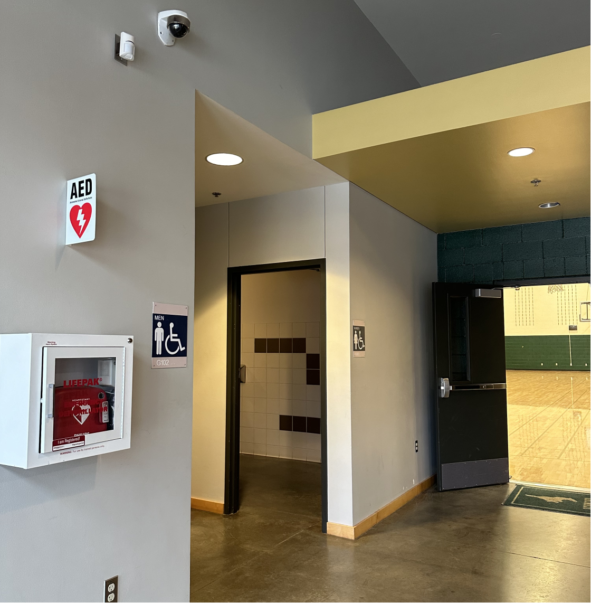
Automated External Defibrillator (AED)
An Automated External Defibrillator (AED) is used to rescue a person suffering from cardiac arrest.
Redmond High School has an AED located outside of the main gym.
Redmond High School coaches and athletic trainers are trained on AED use and CPR.
Look for the AED next time you are in the gym. Ask your athlete if they know where the AED is located if they were needed to assist in an emergency.
We encourage all parents to watch videos and learn more. Here is a video from the American Red Cross.
Main Gym Entrance
AED Device

Slide 10
PLAYER EXPECTATIONS
Player Contract (Handout)
Try to be your best at all times
Expectations are high…
NOTE: One down and back for every minute missed for practice that is not excused or if late. What is excused? Winter Break?

Slide 11
2023-24 SCHEDULE
Links to KingCo game schedules are posted on www.redmondboysbasketball.com
Please try and be as flexible as possible as schedule can change due to gym issues, team cancellations, etc.
We are a year-round program
High School Winter Season: November – February
Spring League: March - May
Fall League: September - October
Team Summer Camp + Jr Mustang Camp: June/July
WE DO NOT HAVE WINTER BREAK!
JV and C-Team will have practices and be participating in local area tournaments December 27-30. More details will be shared soon.
Varsity will also have practices and will be traveling to Los Angeles to play in tournament December 26-29. More details will be shared with varsity parents via email early next week.

Slide 12
GAME TRANSPORTATION
District will not provide transportation to most contests this season.
C Team a bus will be provided for the following games: Shorewood (Return Bus,) Mount Si , Issaquah, North Creek, Inglemoor
JV Team a bus will be provided for the following games: Shorewood (Return Bus,) Mount Si (Return Bus,) Issaquah, North Creek
Varsity a bus will be provided for the following games:
Shorewood (Return Bus,) Mount Si (Return Bus,) Issaquah

Slide 13
RHS Boys Basketball BOOSTER CLUB
John Paddleford (jpaddle@hotmail.com)
Alonzo Alvarez (aaddja@gmail.com)
Ben Perry (benperry@microsoft.com)
DeAnna Paddleford (dpaddleford@hotmail.com)
Non-Profit Corporation
501c3 Non-Profit Corporation, EIN #46-4039734
SOS UBI #603-342-052
Mission Statement
The RHS Boys Basketball Booster Club is a volunteer run, nonprofit organization with a mission to provide a positive and spirited environment that enhances the basketball experience for our student athletes, as well as coaches, parents and the Redmond community. We help raise money to provide financial support to supplement boys basketball operational expenses such as off-season training, equipment, and team building events, all to maintain a strong, competitive basketball program.
Next Steps
Register your athlete on team website by Saturday, November 18. This registration request is different than LWSD FINAL FORMS – please do that ASAP.
Program contributions are critical! Your time and money support and enhance the program!
20% of budget comes from donations. 80% are earned by fund raising via Jr. Mustang Camp and Benevity Causes.
Benevity causes (corporate matching programs) Search for Redmond Basketball Booster Club ID 840-464039734. Please be sure to submit, so we can take full advantage of your donation!
Suggested minimum donation is $250 per family.
Penny Miller (penjar55@msn.com)
Jodi Kuntz (kunzjodi@hotmail.com)
Patty Smith (pjseattle@hotmail.com)

Slide 14
RHS Boys Basketball BOOSTER CLUB
The Booster club now funds programs and events year round available to all players who make the team in November.
85% of our Budgeted Expenses are for activities and items that directly benefit the players averaging a value of ~$700 minimum for every player
What does my $250+ donation go towards?
SUPPLEMENTAL COACHING/TRAINING - $8K
Assistant coach stipend
Off season basketball coaching and open gyms – Year Round
Fall and Spring Strength/Fitness training (instructor, rentals)
FUNDAMENTALS and TOURNAMENTS - $6K to $15K
All tournament entry fees and referees – Holiday, Spring, Fall
Game taping / post game analysis service
Spring league fees
June Team Camp Transportation and Snacks
GEAR - $4.5K
Game Uniforms, Practice Uniforms, Team Jackets, Tshirts
Basketballs
Towels, Non-Slip Pad, First Aid
FUN $7K
Team Building Days
Season End Banquet + Awards – event, player and coach gifts, food
Senior Night, Teacher Appreciation Night, Select Night, Halftime Giveaways, Super Fan Theme swag
Season photographer – Available pictures online, Senior gym banners
Game Day Media Guide/Program
FUNDRAISING/MANAGEMENT $5K
Junior Mustangs Basketball Camps
Insurance, Website, Accounting/IRS fees
Team Website

Slide 15
Volunteers are critical
Parent Team Managers: Each team is responsible for organizing and providing volunteers to successfully support the team and ensure each team has staff to run the game.
Game Day Experiences
Scorekeepers for both HOME and AWAY games
Operators for game clocks and shot clocks for all HOME games
Varsity HOME Games: Video board operator; Half-time giveaways – any businesses that may want to support?
Senior Night: Coordination, execution
HOME and AWAY clean up crews!!! (This is really mandatory, not volunteer ☺)
If your company has a matching program for donations, please be sure to submit!
Picture Day: Friday 11/17 for ALL TEAMS 6-8pm. We also need everyone to collect and share team + player pictures over the season!
Team Building Day: Saturday 11/18. We need A LOT of snacks – bring to practice
C TEAM – dessert/sweet treats: ie: cookies/candy/brownies/fruit roll ups
JV TEAM – healthy protein snacks/individual packets of chips/crackers or boxes of bars
V TEAM – drinks: water, sport drinks (low or no sugar)
Team Dinners - Host/Coordinators: 3-4 team dinners over the season
“Proud Family Member” Buttons: Need to take orders and coordinate with Cheer Booster Club
End of the season banquet: 3-4 people to help coordinate a variety of event activities!
Junior Mustangs Summer Basketball Camp: 2-3 volunteers needed.

Slide 16
TEAM BUILDING DAY
ALL DAY SATURDAY, NOVEMBER 18th
9:00-12:00 Team practices at RHS (bring assigned foods/snacks below)
12:00-1:00 Go home to shower and eat lunch
1:15 Return to RHS gym (bring assigned food/snacks if forgot earlier)
1:45-3:45 Drive/carpool to team-building at Flatstick
4:15-6:15 Drive/carpool to team-building at Pacific Axes
6:30-7:00 Team Talks
7:00-7:30 Booster Club sponsored pizza dinner
7:30-10:00 Team Talks & Team Builder Activities
10:00ish Pick up at RHS. Players will text you when ready to be picked up.
COMPLETE WAIVER FOR PACIFIC AXES: https://www.escapewaivers.com/kj6IGTVUpU
DRESS CODE: Practices: Wear practice gear. Events: No open toe or open back shoes/sandals/slides/crocs
TEAM SNACK ASSIGNMENTS
C TEAM – dessert/sweet treats: ie: fruit, cookies/candy/brownies
JV TEAM –Snacks like jerky, protein bars, individual packets of crackers
V TEAM – drinks: water, sport drinks/juices/sparkling water

Slide 17

WEBSITE & SOCIAL
www.RedmondBoysBasketball.com
Team information shared
Calendar will be updated. IT IS SUBJECT TO CHANGE!!
Team Score
Team Photos and Videos
SOCIAL MEDIA
Facebook @RedmondBoysBasketball
Instagram @RedmondBoysBasketball

Slide 18
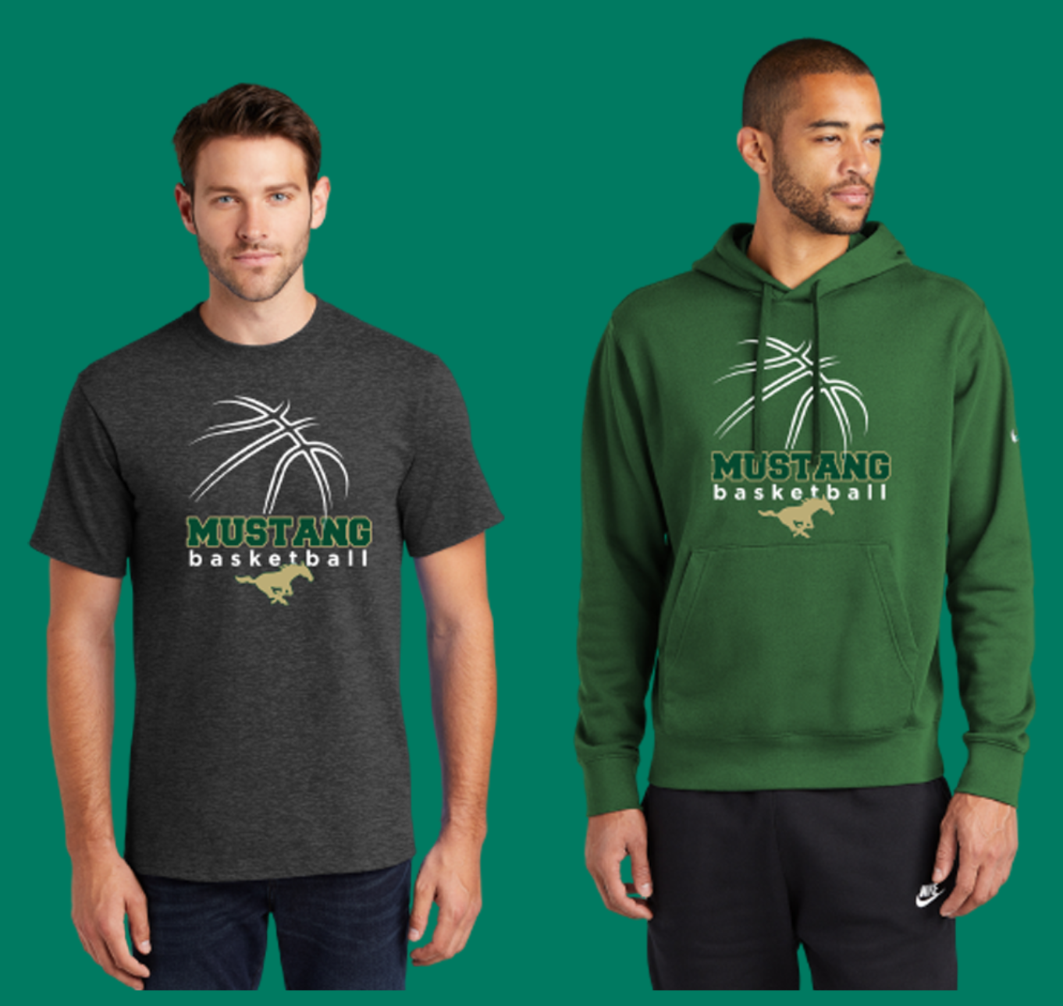
Spirit Wear – Order Now!
Spirit wear for players, friends, &family!
Here's the store link, it will also be available from our team website: kocreators.com/rhshoops.
Store is open NOW.
Store CLOSES on November 20

