Slide 1
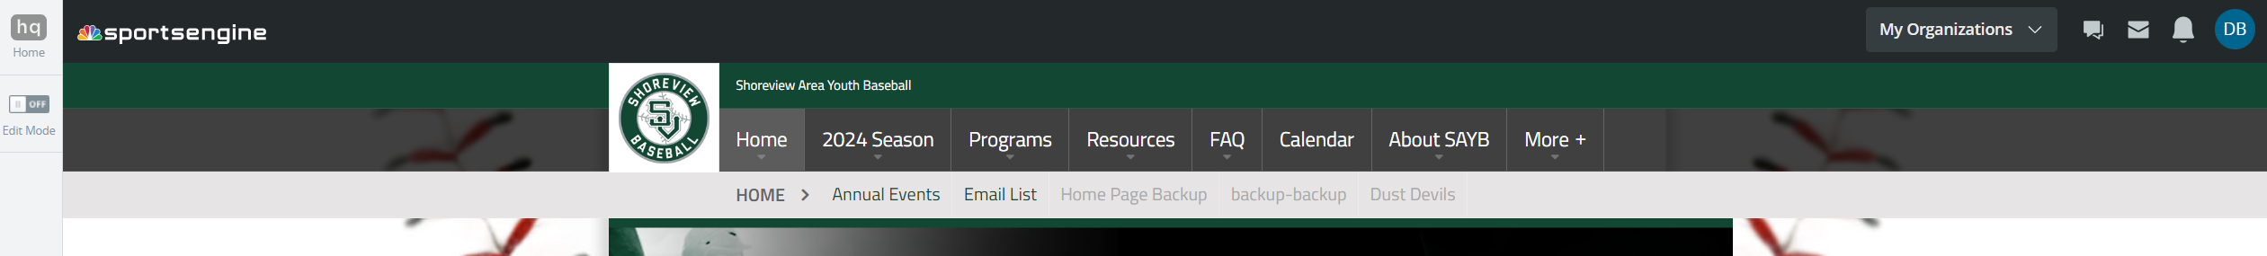
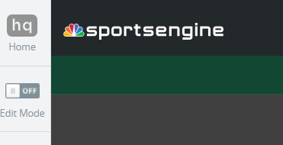
Sending messages to coaches through Sportsengine
You can only do this with sportsengine HQ admin access
Login to your account and look for the hq home button in the upper left
Click this to enter the hq home.

Slide 2
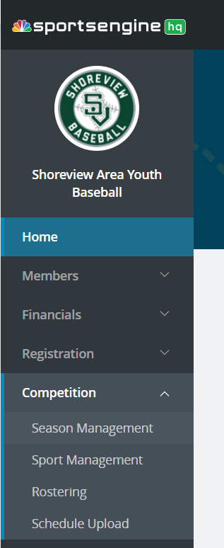
Season Management
Expand the competition section
  Click on season management

Slide 3
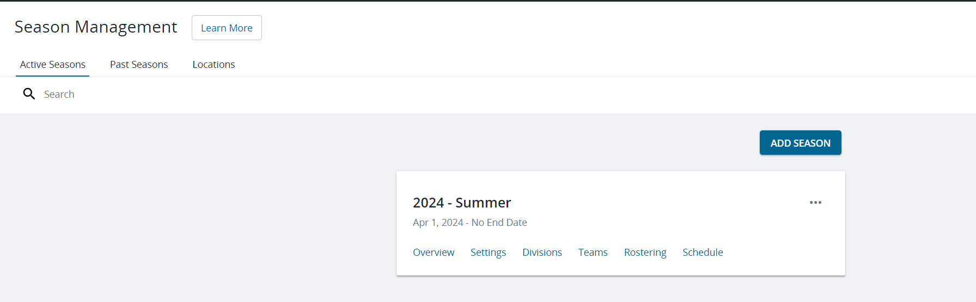
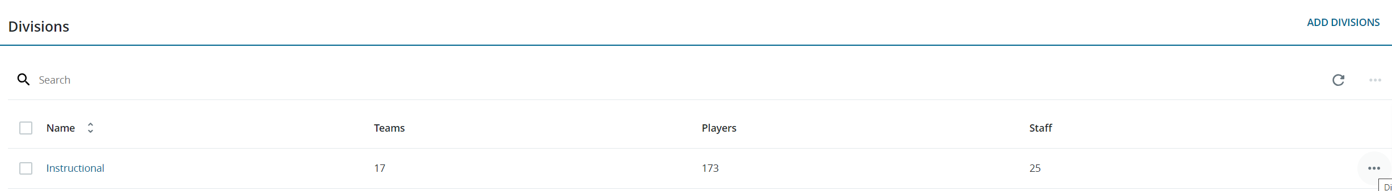
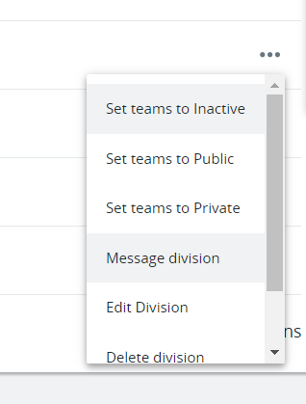
Divisions
Click on the division link in the current season
Within divisions, click on the three dots to the right
Select message division

Slide 4
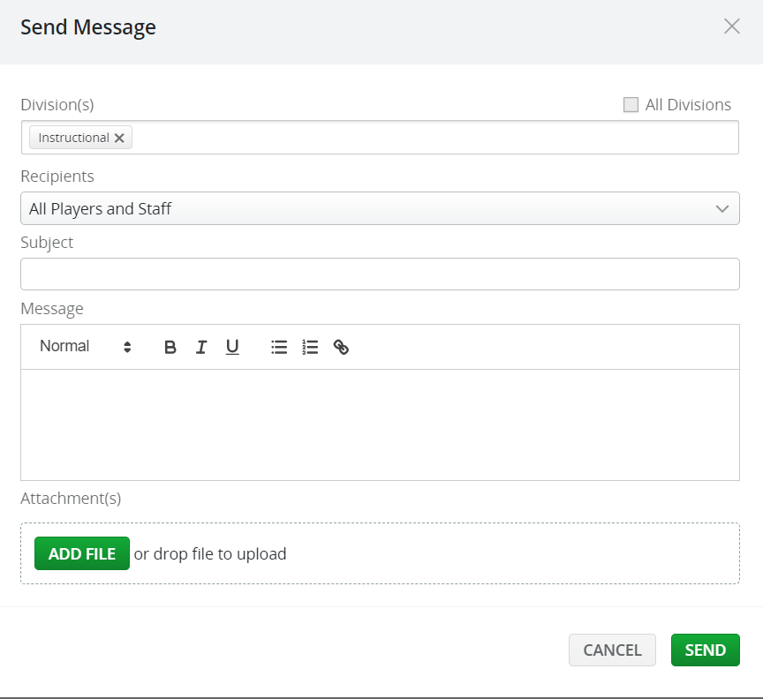
Message
Click “all divisions” to send it to every team
Change the recipients to all players and staff (or all staff) as required
Add message and send

