Slide 1

Comparison of Training Systems: Rationale and Analysis
Eric Heintz
Director of High Performance
eheintz@atlantatrackclub.org

Slide 2
^{What is a Training System?}
A general approach to conditioning an athlete
A philosophy of training that includes specific preferences and prioritization of paces for workouts, timing for workouts, and volume
An architecture for a season, periodization
How you plan a career, a season, a week or a session for an athlete or team
Not an analysis of drills, lifting, etc.

Slide 3
Why You Should Adopt a System as an Early Career Coach
Provides guidelines and boundaries, gives you a plan
Removes many questions, judgment calls and the panic of “what to do next”
Eliminates the “How I Did It” approach
Gives you confidence in the plan, so your athletes will have confidence in the training
In the long run, adapt it

Slide 4
^{Take a 45 second break}
Explain to the person next to you why there is value in having a training philosophy.

Slide 5


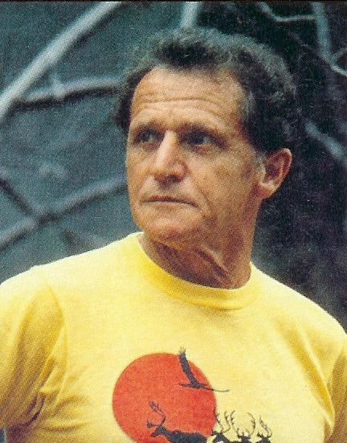
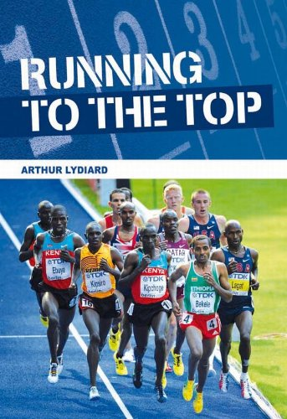

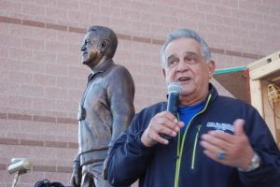

^{Examples of Training Systems}
Explanation, Pro’s and Con’s of each
Jack Daniels – St. Pius boys
Tinman – Marist
Joe Vigil – Woodlands, TX
Arthur Lydiard

Slide 6
^{Daniels System: Explanation}
Periodization: defined phases
Paces: chart-based, multi-pace system focused on R, I, T, M, and E paces
**~1m, 2m, 10k/15k, marathon and easy paces for elites
Volume: average, high density of workouts
WO Structure: % of weekly volume, 1-2 paces, paces based on races

Slide 7
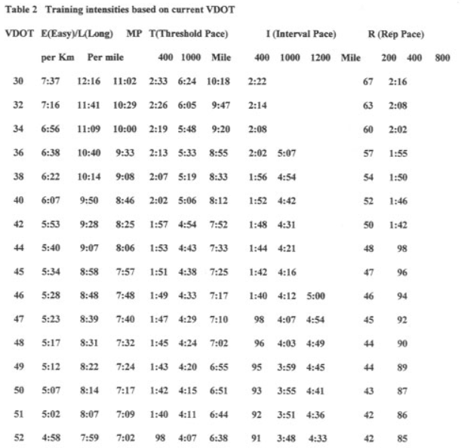
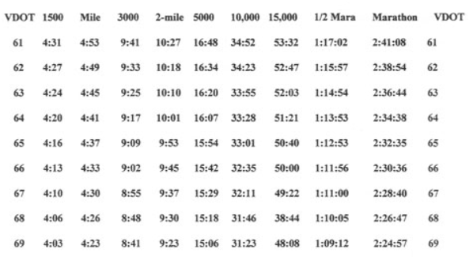
^{Daniels System: VDOT Paces}

Slide 8
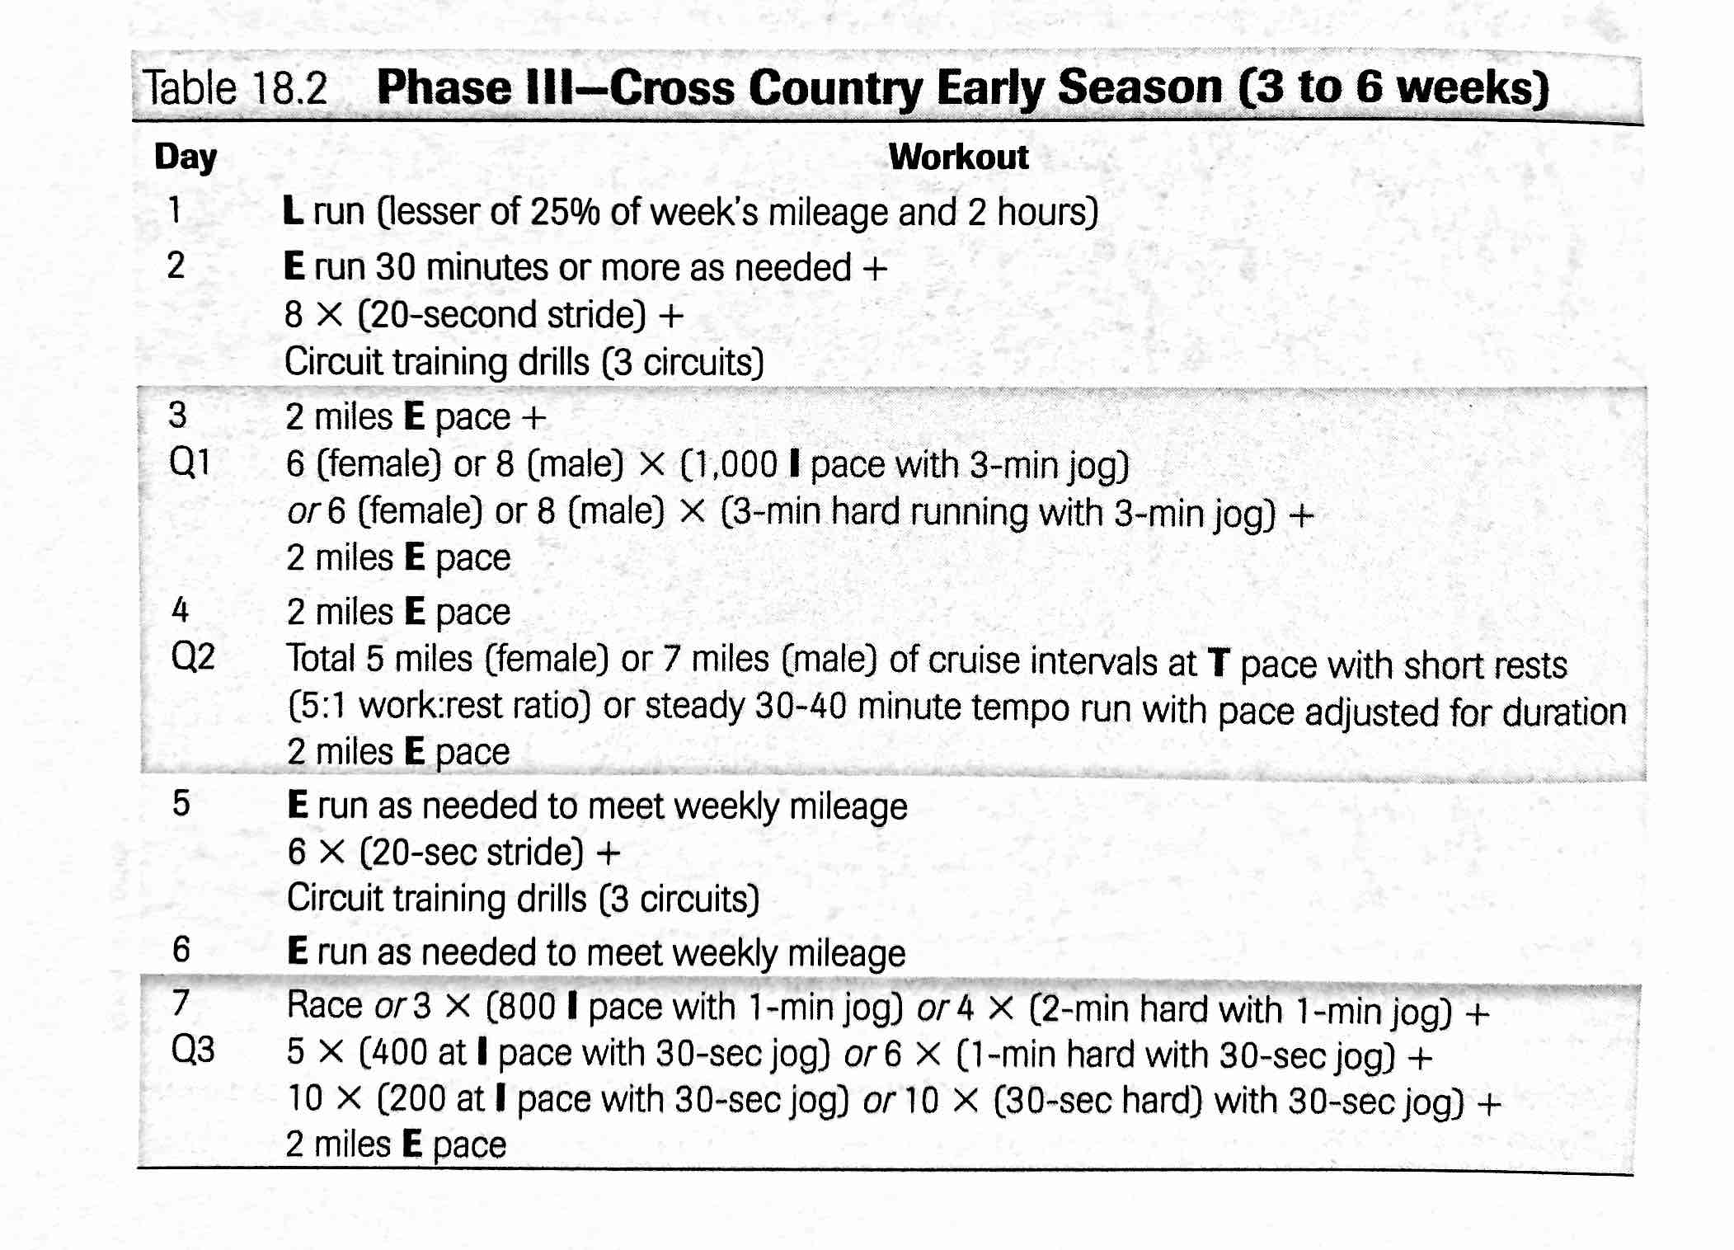
Daniels System: Sample Schedule

Slide 9
Daniels System: Pro’s and Con’s
Pro’s
Never have to “think”; paces, workout volume and weekly volume are essentially predetermined
Proven and ready to implement immediately
Con’s
Workout density is tough on high level runners if they cannot recovery fully
Elite-based paces, doesn’t consider undertrained or speed-side athletes
Beginner workout volume is almost non-existent
Difficult to adapt to school setting (numbers)

Slide 10
^{Take a 45 second break}
Reflect on how Daniels’s system influences your own training.

Slide 11
^{Tinman System: Explanation}
Periodization: continuous progression, loosely-defined phases, diamond model
Paces: chart-based, multi-pace system focused on 800m, 1m, CV**, Tempo and E paces
**~10k, 60min, and easy paces
Volume: average, low density of workouts, focus on consistency
WO Structure: 15-25min of CV in 2-4min chunks, hills at 1m, 1-200m reps at 800m, tempos; paces based on races

Slide 12
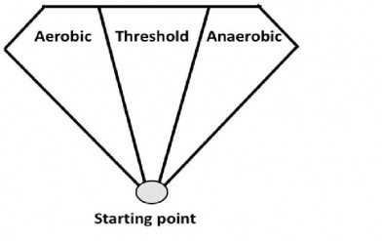
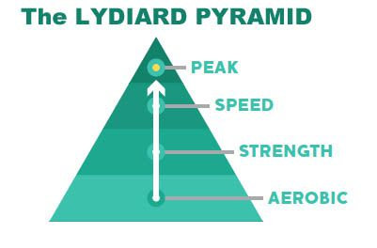
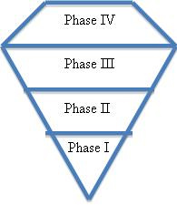
Diamond Model vs. Pyramid Model of Periodization
^{VS.}

Slide 13
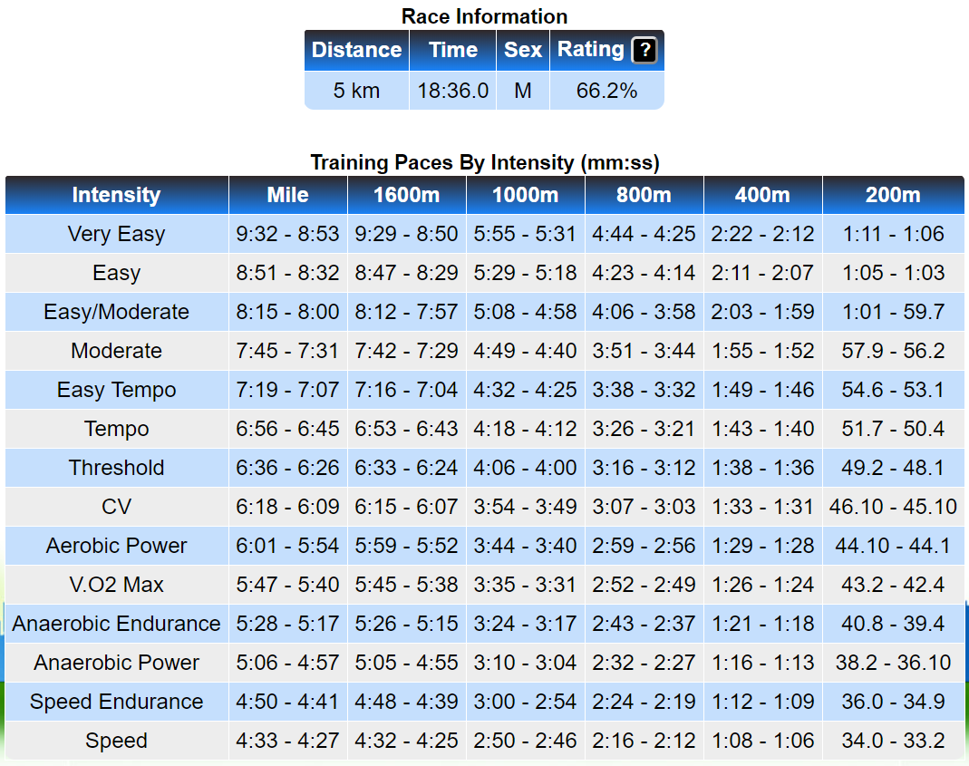

Slide 14
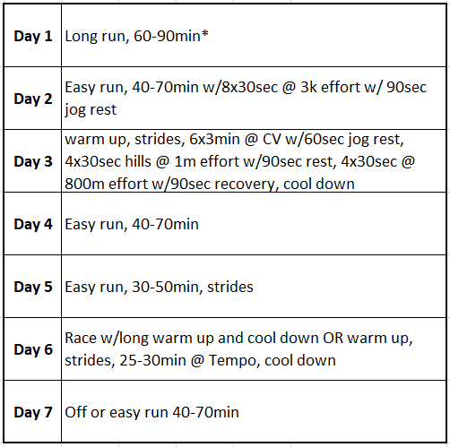
^{Tinman System: Early Season} ^{Sample Schedule}

Slide 15
^{Tinman System: Pro’s and Con’s}
Pro’s
Super easy to implement, esp. for large teams
Low injury risk
Meets you were you are at
Con’s
Little long term development if not running year round with deliberate progression
Concern you aren’t doing enough
Elite-based paces, doesn’t consider undertrained or speed-side athletes
Beginner workout volume is almost non-existent

Slide 16
^{Take a 45 second break}
Consider how a diamond model of training is similar or different to your own workout schedules.

Slide 17
^{Vigil System: Explanation}
Periodization: loose phases but defined progression, diamond model
Paces: chart-based, multi-pace system based on mile fitness (VO2) and %
**~1m, ~1m+40, ~1m+60, and easy paces for elites
Volume: average (preferred high), but HIGH density of workouts
WO Structure: single paces, build up to more reps, longer tempos and then faster paces over the season

Slide 18
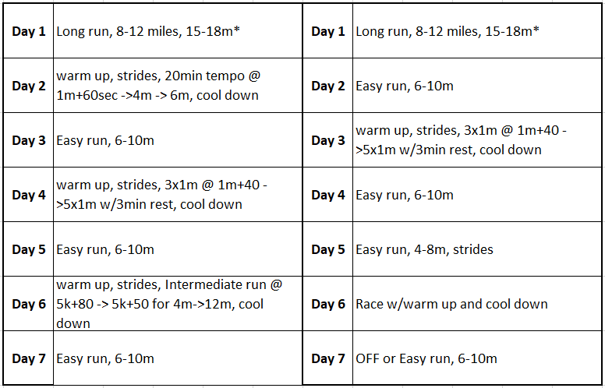
^{Vigil System: Early Season} ^{Sample Schedule}

Slide 19
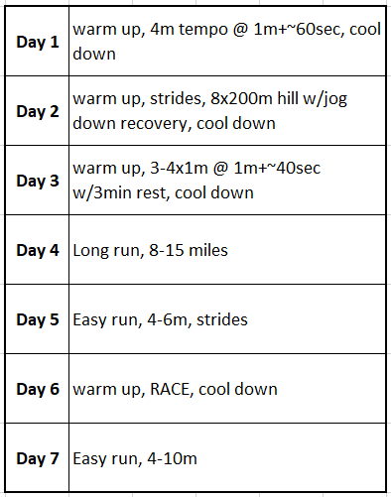
^{Vigil System: Early Season} Sample Schedule – Woodlands, TX

Slide 20
^{Vigil System: Pro’s and Con’s}
Pro’s
Several high schools have implemented with great success
Relatively simple, workouts rarely change
High intensity results in big improvements early on even in beginners
Con’s
Workout density is tough on all runners
Elite-based paces, doesn’t consider undertrained or speed-side athletes
Many “failed” workouts
Requires large base (100mpw+) to be “true” to system

Slide 21
^{Lydiard System: Explanation}
Periodization: clearly defined phases, classic pyramid
Paces: vague percentages of effort
**TT, 7/8, 3/4, 1/2, MAP/SS and easy paces and “hills”
Volume: high, low density of workouts initially but increases
WO Structure: strictly phase dependent

Slide 22
^{Take a 45 second break}
Stand up. Take a deep breath. Could Vigil’s simplicity add value to your program? Would his workout density fit your student population?

Slide 23
Diamond Model vs. Pyramid Model of Periodization
^{VS.}

Slide 24
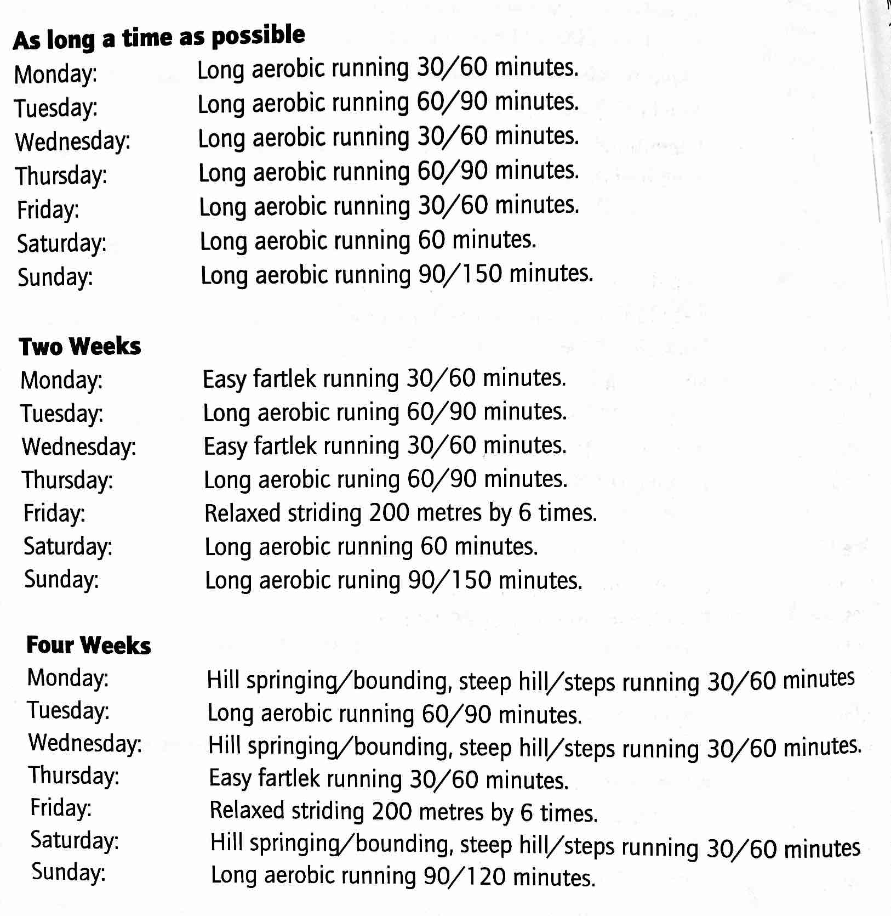
Lydiard System: Sample Schedule – Phase 1 and 2

Slide 25
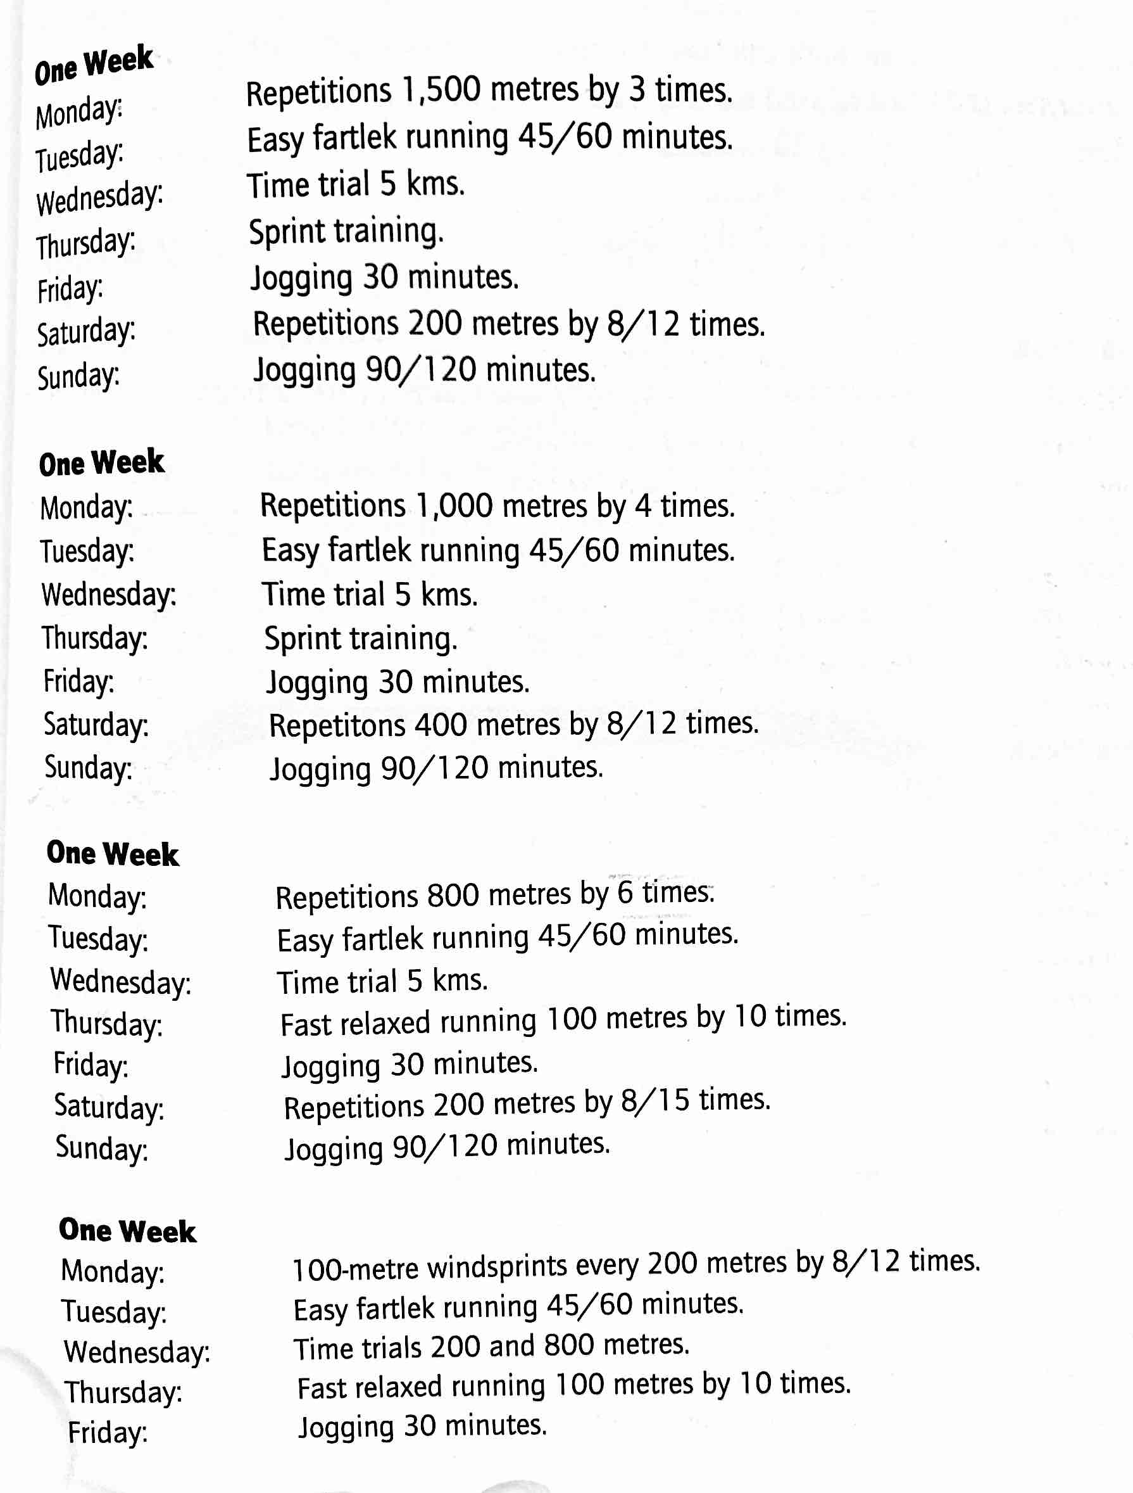
Lydiard System: Sample Schedule – Phase 3

Slide 26
Lydiard System: Pro’s and Con’s
Pro’s
Simplicity; one thing at a time
Proven successful at all levels
Essentially effort-based
Con’s
Volume is very high, a tough sell to many youngsters
Few high-level programs still utilize
Requires long term commitment, so not appropriate for “seasonal” athletes

Slide 27
^{Take a 45 second break}
In what ways has Lydiard influenced your methods and beliefs regarding training?

Slide 28
^{Summary}
Use Daniels if you like prescriptive, numbers based training for a smaller team
Use Tinman if you like simplicity and are committed to 12 months a year of coaching
Use Vigil if you like intensity and have committed athletes
Use Lydiard if you like tradition and your kids have a lot of time to recover/train

Slide 29
^{Summary}
A system gives you a PLAN and removes subjective decisions for new coaches
Consider your school and population
ADAPT it to fit your needs
Learn them all, never stop learning, never stop tinkering
Craft your own

Slide 30
Any Questions? Eric Heintz 770.722.1841 eheintz@atlantatrackclub.org

Slide 31
^{Resources}
Daniels System
Daniels’ Running Formula 3rd ed.
https://vdoto2.com/ and https://runsmartproject.com/
Tinman System (Tom Schwarz)
www.therunzone.com
Coaching clinics
Loudon Valley, Marc and Joan Hunter, clinics
www.letsrun.com

Slide 32
^{Resources}
Vigil System
Road to the Top
Coaching clinics across the country
Woodlands, TX (Coach Green) - clinics
Lydiard System
Running to the Top
Keith Livingstone’s Healthy Intelligent Training

