Slide 1

ISWA Tournament rules & regulations

Slide 2

Tournament preparation
Must be sanctioned through ISWA to be eligible for insurance coverage
Must be in compliance with local, state, and venue-specific mandates
Required officials-names must be submitted
Tournament Director
Head Mat Official
Head Pairing Official
Medical Trainer
Entry forms must include signed waiver and emergency medical treatment consent

Slide 3

USA Wrestling competitor’s cards
Valid for current season
Must be age-verified through ISWA
Out of state wrestlers welcome at local events if duly registered with USAW
State finals open to Indiana residents only

Slide 4
Age divisions/Weight classes
Wrestlers cannot move up an age division 1 exception:
Only 16U Cadets who are in high school can move up to Junior.
Mouthguards and headgear recommended at local/state events
They are required for 14u & under at USAW national events
Weight classes may be split or combined at discretion of tournament host
Combinations can include no more than 2 consecutive weight classes
Cannot wrestle in more than one weight class

Slide 5
WEIGH-INs
1 weigh-in and 1 immediate challenge
Cannot leave weigh-in room once entered
Must weigh in competition singlet
Weight must be recorded, cannot go to alternate weigh-in location or return at later time
Can only bump up one weight class (must declare at scale)
Can wrestle in ONE weight class only

Slide 6
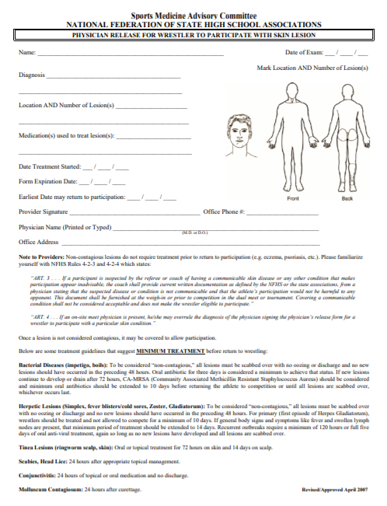
Skin checks
Mandatory for all tournaments and duals, even those with satellite weigh-ins
Cannot occur sooner than 24 hrs prior to event
Trainer/official decisions on participation are final
NFHS physician release form on ISWA website is only exemption form accepted

Slide 7
OFFICIATING
FOLKSTYLE
FREESTYLE/GRECO
15 min. rest between bouts
Error corrections settled matside with officials per NFHS rules
NO JUDGEMENT/VIDEO REVIEW
Line bracketing recommended for 4+, vertical pairing for 3 or less
15 min. rest between bouts
FILA rules from International Rule Book
Challenge bricks at state level
Protests: fees apply, handled by head official, proper documentation, reported to ISWA

Slide 8

Penalties
Failure to comply with ISWA/USAW Regulations can result in:
Fines
Sanctioning suspension
Membership suspension
Membership termination

