Slide 1
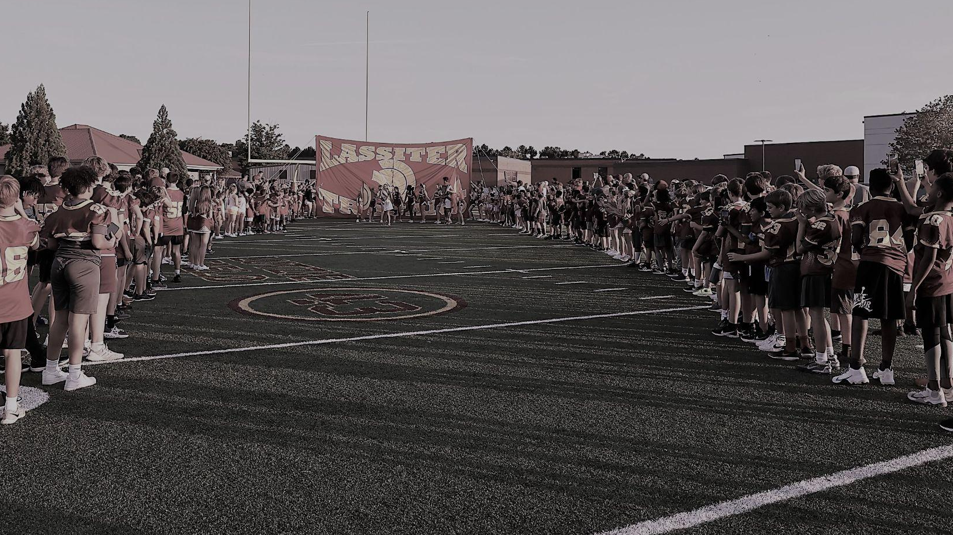

LASSITER HIGH SCHOOL FOOTBALL
SPRING PARENT MEETING
March 26, 2025 6:30 PM

Slide 2

135 DAYS TIL KICK-OFF
AT THE FRANK!

Slide 3
AGENDA
WELCOME
COACH THOM & PROGRAM
LASSITER TOUCHDOWN CLUB
REGISTRATION
SPONSORSHIP
PARENT INVOLVEMENT
QUESTIONS?

Slide 4
COACH THOM &
PROGRAM OVERVIEW

Slide 5
Our Program
Mission: To use the game of football to develop UNCOMMON MEN who demonstrate INTEGRITY first, serve others before themselves, & strive to become the best version of themselves daily!
Vision: To build a football program where relentless growth is the standard – where every player, coach, and team member COMMITS to being better today than they were yesterday.
*Through an environment built on accountability, perseverance, and selfless leadership, we will forge a legacy of excellence that extends beyond the field. Our program will be known for developing men of character who embrace life’s challenges, pursue greatness, and positively impact their communities.
UNCOMMON COMMITMENT & RELENTLESS GROWTH

Slide 6

Forget
About
Me
I
Love
You
Compete
My best everyday
Relentless – practice, weight room, classroom, etc.
You hold yourself to high standard – push past limits, embrace challenges
Compete with yourself first, then with teammates to become stronger
R
O
Pillars
of the
Program
“CORE VALUES”
J
Improve
A
Commitment to GROWTH!
Coachable, learn from mistakes!
Not perfection, consistent progress – no matter how small
Tough
N
Not just physical.. Mental, emotional, spiritual as well!
Face adversity head on & refuse to back down no matter obstacle
Do your job when tired, hurting, or doubted!
S

Slide 7

YEARLY PROCESS
COMPETITIVE
GREATNESS
1%
AMG
WE>ME
PHASE 1
PHASE 2
PHASE 3
PHASE 4
Jan-Apr
May
June-July
Aug-Dec
Winter Strength
& Conditioning
Spring Ball
Summer
Workouts
In-Season
COMPETE
IMPROVE
TOUGHNESS
“KAIZEN”

Slide 8
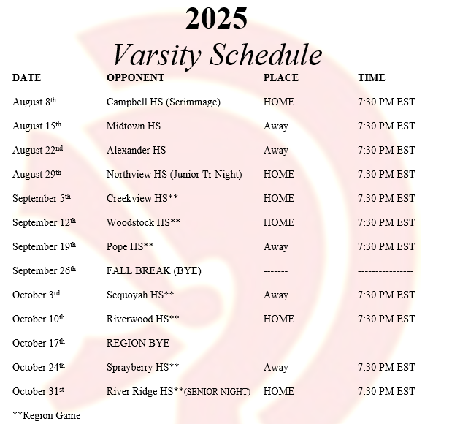
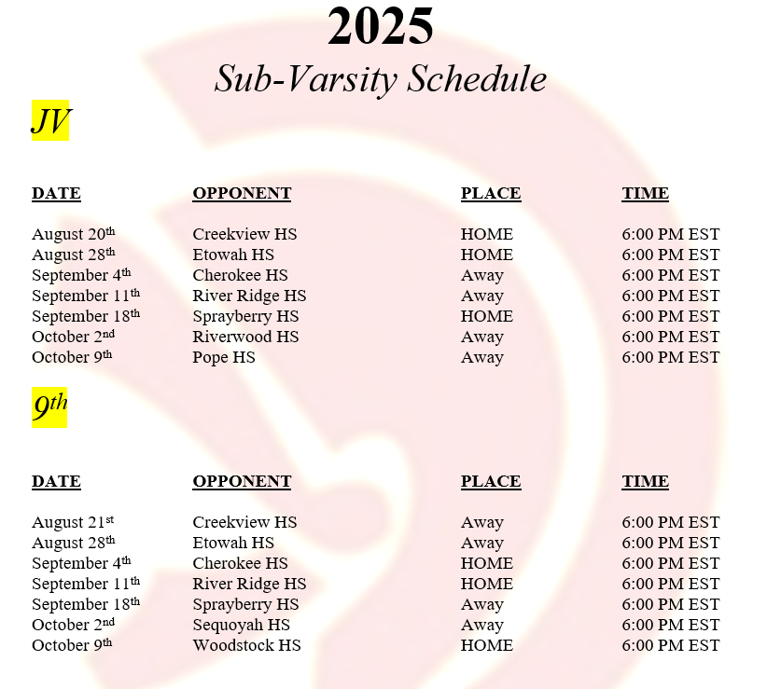

Slide 9
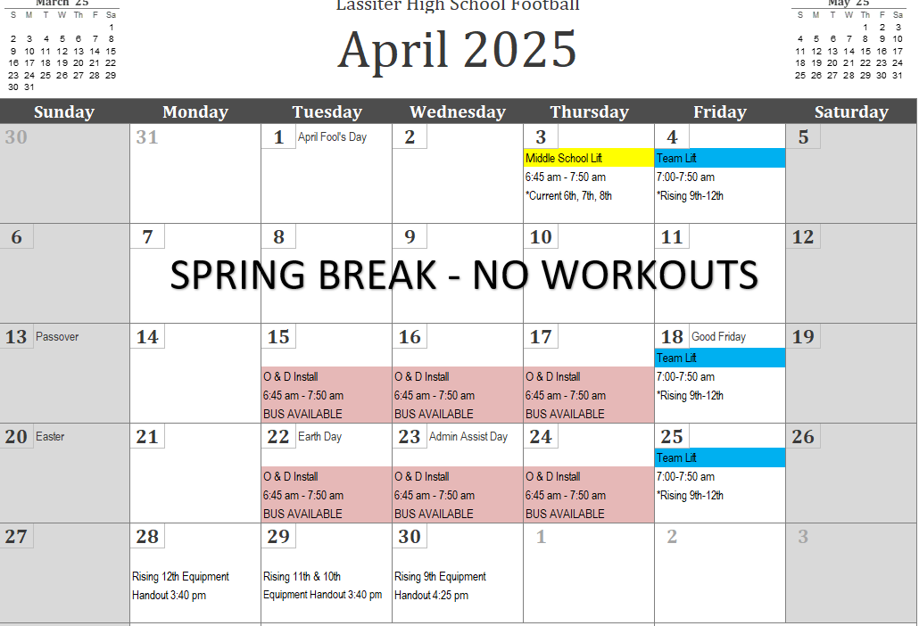

Slide 10
2025 Calendar Overview
Spring
Equipment Handout: April 28, 29, 30
Practice 5pm May 1 – May 14
Game May 15
Fall
After school Monday, Tuesday, Thursday
Wednesday mornings before school
Film and meetings as position groups
Fall Break practice Thursday (PM) - Saturday
Bye Week practice Tuesday - Thursday
Summer
Dead Weeks 5/26-5/30 and 6/30-7/4
Monday-Thursday Lift/Speed/FB
Friday Lift Only
7v7: Every Tuesday, Mt Bethel, Lutzie
Team Camps 6/16 & 18 and 7/??
Lift-a-Thon June 7th

Slide 11
Trojan Standards
DO THE RIGHT THING!!
TREAT PEOPLE THE RIGHT WAY!!

Slide 12
College Recruiting
The Process
Step 1 - Coach, Player, and Parent must be on the same page. This process starts when transitioning to high school. The eligibility process starts as soon as the student/athlete starts taking high school credit classes.
Step 2 - This step is the most important step! When film is ready to send out the coach will send to the appropriate schools. The student athlete will start developing a resume. During this time, the student athlete must be working toward A’s and B’s in the classroom, as well as preparing for and taking the SAT and/or ACT. They also must be working on getting bigger, faster and stronger to perform at a high level on the field. Prospect camps, showcase camps, and on campus 1-day camps are a must to attend.
Step 3 -This is the last step in the process. This is where the student-athlete has to figure out where they would like to go to school. The student-athlete may have choices, or they may have to work harder to get to where they would like to go. You must have Plan A, B, and C!

Slide 13
College Recruiting
What can you expect from our staff?
Coaching staff will be a major part of the process by setting the standard for each player to be successful in the future beyond the student/athletes years at Lassiter High School. We feel that if your son follows the values and standards set by the program that he can be successful at the next level.
We will be honest with your son and college recruiters.
We will advocate for your son.
We will call, send film, and do whatever it takes to allow for the success of your son.
Film, transcripts and letters will be sent to colleges at all levels from NCAA to NAIA schools.
Contact will be made by recruiters visiting the school, by e-mail, by text messages, by phone, and by social media.

Slide 14
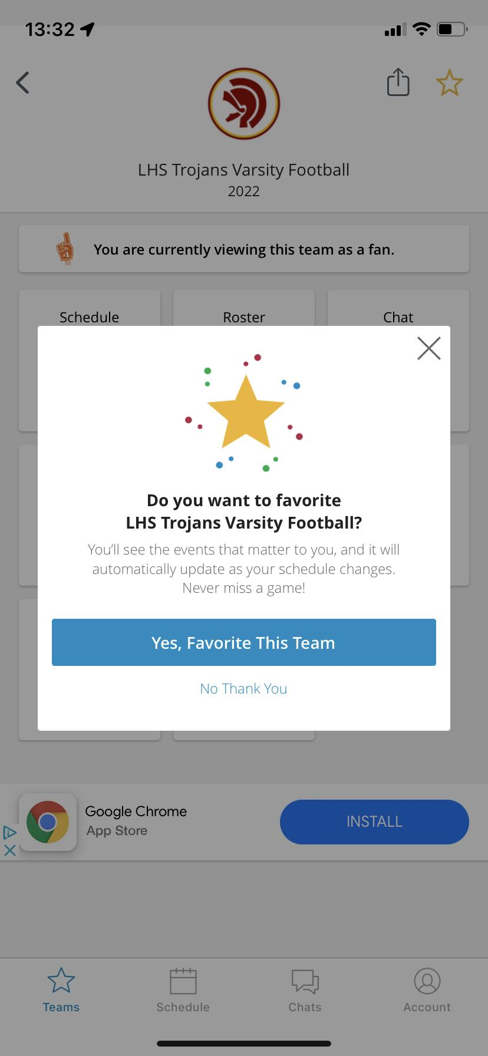

Communication
SportsEngine
LHStrojansfootball.com
Registration
Calendar
Schedule
Payments
Sign Ups
Downloads
Recruiting Info
DOWNLOAD
FOLLOW
FAVORITE
@FBLassiter
Lassiter Football
lassitertrojanfootball
LHSTrojansFootball@gmail.com

Slide 15
Sports Physical
Dr. Beirne THANK YOU!!
Dates – SAT April 19 & 26
WED April 23
PLEASE NOTE:
In order to participate in any school-sponsored athletic programs during the 2025-2026 school year, students must have a current sports physical on record. The physical must be completed on or after April 1st and before any athletic participation. Complete the information needed for the doctor (medical history, allergies, etc.) before the physical exam, print it out and bring form with you to the exam.
In the PARENT INFO section of our website
https://www.cobbk12.org/page/344/athletics

Slide 16

Contact Information
SEAN THOM
Lassiter High School Football
2601 Shallowford Road
Marietta, GA 30066
470-585-8470 (Cell)
Sean.thom@cobbk12.org
“KAIZEN”

Slide 17
LASSITER TOUCHDOWN CLUB

Slide 18
Overview & Purpose
LASSITER TOUCHDOWN CLUB, INC. IS A 501(C)3
The purpose of the Club is to support, encourage and advance the football program at Lassiter High School (“LHS”). The main objective of the Club is to raise the funds necessary to support the needs of the LHS football program and related student athlete programs that are not otherwise met by LHS and Cobb County. All fundraising activities of the Club will be conducted in accordance with Cobb County School District guidelines.

Slide 19
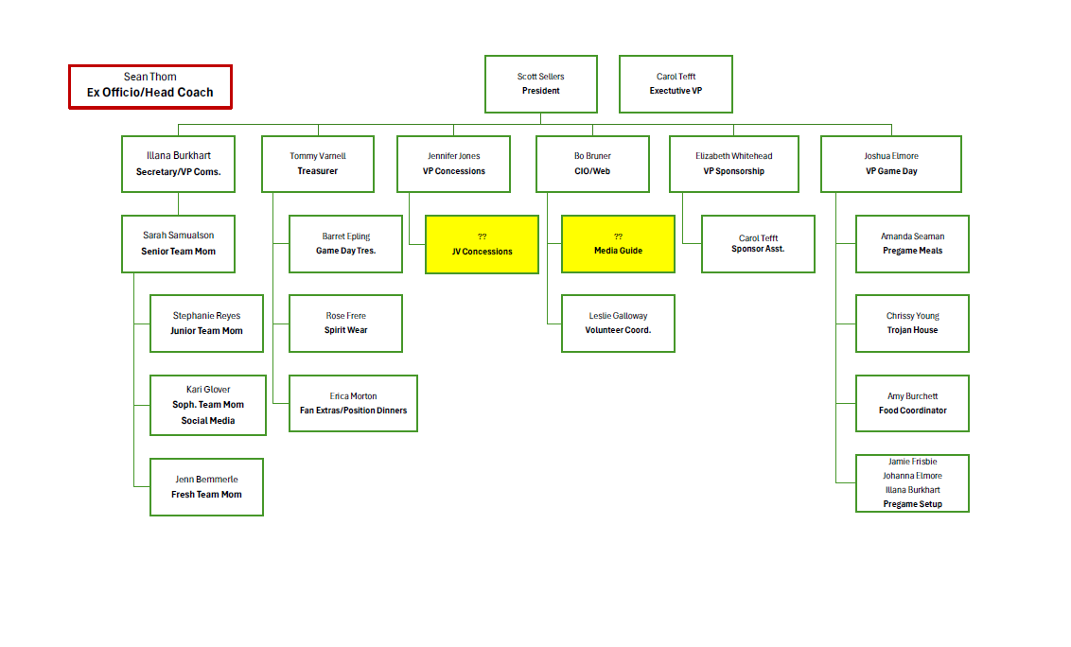
2025 LTDC Board of Directors

Slide 20
REGISTRATION

Slide 21
2025 Player Registration
Registration opens
April 1st!
$1300 - Includes Coupon Cards
Included Registration:
Equipment & Uniform Distribution
Operating Expenses & Transportation to games
Winter Strength & Conditioning
Spring & Summer Practice
Player Spirit Pack
Player Pregame Meals & Post-Workout Nutrition
Senior Week Activities
Early Bird to May 1
  Two reserved seats at two games of choice
Fundraising efforts will be separate from registration
Pay in full by Check or Zelle (no fee) or CC (fee).
Payment plan available online: 3 payments
  Credit card payments have a processing fee
$200 sibling discount

Slide 22
Refund Policy
Before Spring Practice Begins – The refund will be 95% of your registration fee less the cost
of the player pack, if they have already been ordered. Any volunteering opt out money will
be refunded at 100%.
After the First Day of Spring Practice (5/1) to July 28th – The refund will be 50% of your
registration fee less the cost of the player pack. Any volunteering or fundraising opt out
money will be reimbursed at 50%. Any additional items purchased will not be refunded.
There will be no refunds after July 28th.
No refunds will be given for injured players.
No refunds for a player dismissed from the team or school by the coaching staff or school administration.

Slide 23
FUNDRAISING

Slide 24
Fundraising
The money for our program comes from primarily three sources:
Registration Fees - $100 lower this year!
Sponsorship
Fundraising
  Lift-a-thon - June 7th
  Coupon Cards - July 7th
  Golf Tournament - Monday, October 13th (Digital learning day)
    Fairways of Canton

Slide 25
LIFT-A-THON
SATURDAY, June 7th @ Newly remodeled - Lassiter Weight Room, 8-11 am
Parent spectators welcome and encouraged
Grades 9th-12th
Pledges will be per pound. Players will max out their bench, squat, and power clean lifts for a total pound lifted.
We will be using an online platform to collect donations this year
The boys will have two weeks to collect their pledges
Prizes for top three money makers

Slide 26

Coupon Cards
Cost is included in registration this year
$400 for 20 cards
You keep all the money you make selling the cards
Boys may be asked to do a ‘Blitz’ to sell extra cards, if needed. These funds would go directly to the program

Slide 27
PARENT INVOLVEMENT

Slide 28

Be a Part of Trojan Nation
Volunteers are a Key to Program Success
Be involved
  Active part in raising funds, event coordination, program management
Bond with your player
Lower program costs
Build community interaction
Personal stake

Slide 29
Volunteer Expectations
All Parents are expected to work at least 2 volunteer shifts.
  These are shifts you select using the DIBs system.
  Pregame meals and special event help is considered community building, versus a ‘work’ shift.
We will collect a $200 deposit check at the equipment handout
  Plan ahead if you need to request a check from your bank
Free entrance to the game on the day of your shift
NEW: For each shift you work in the concession stand, you will receive one ticket for a Concession stand meal (hot item, side, drink)

Slide 30
Trojan Fan Extras (TFEs)
Applies to all varsity home games
Sports pass is good for ALL sports – it’s a steal!
Available at time of registration and can be part of a payment plan with your registration fee.
Reserved Seating - $50
Reserved Seating + All Sports Pass - $100
Reserved Seat + Sports Pass + Trojan House access - $200
Team Program - $25

Slide 31
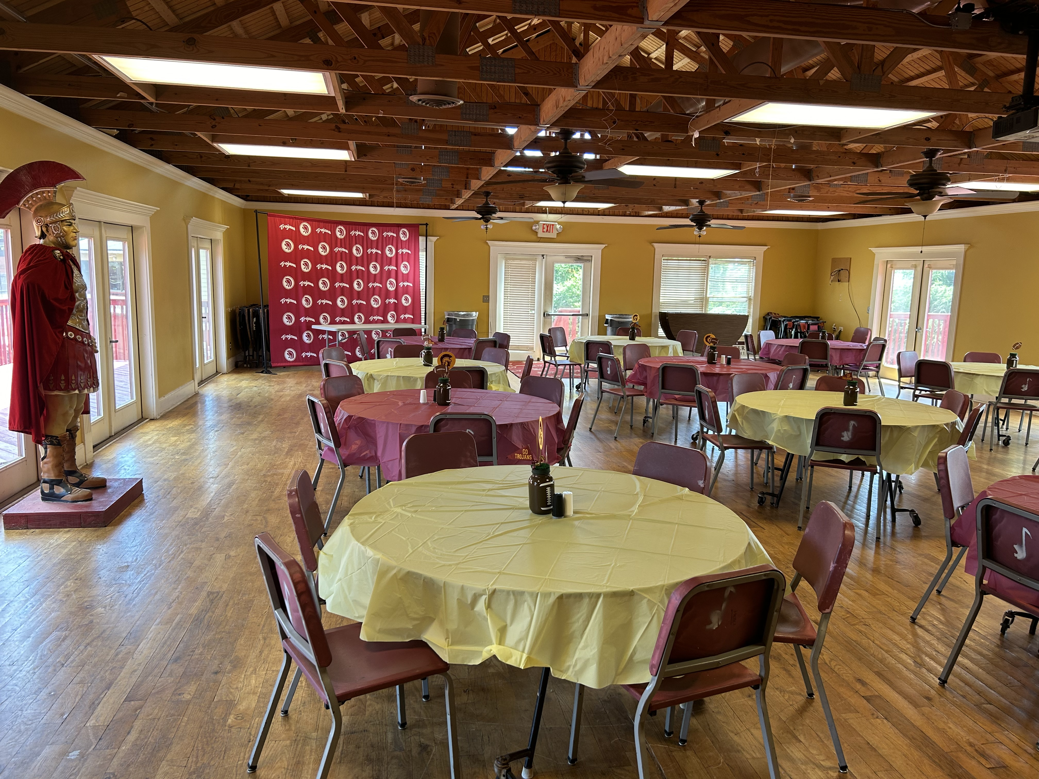
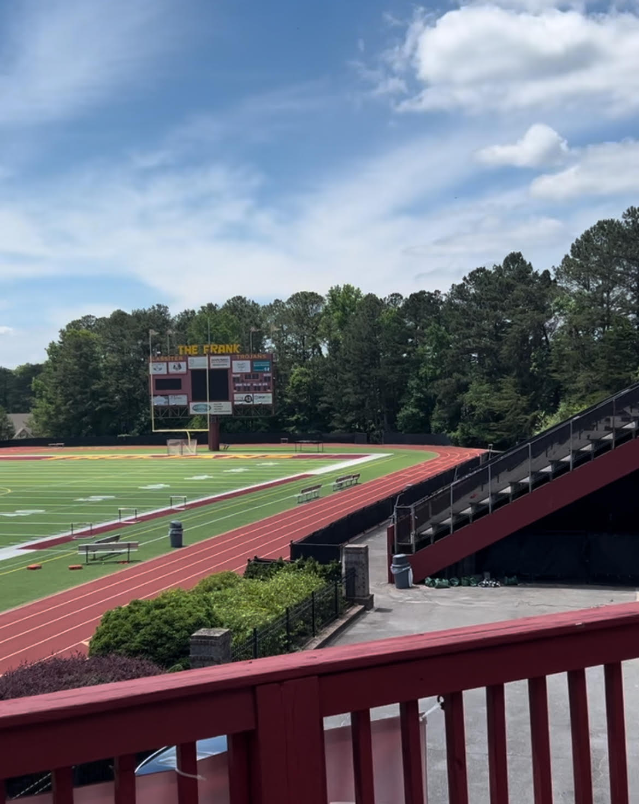
The Trojan House
The Trojan House (above the concession stand) is where the boys eat together. A group of parents give their time to set up and serve the team. The goal is to send these young men into battle with full bellies and hearts. We’d love to have your help as a member of our community in continuing this tradition. We feed all three levels of play, so many hands are needed!
Become a Trojan House membership and stick around to enjoy the home games! Membership includes a catered hot meal, access to private bathrooms, a view from the deck and most importantly COLD AC during varsity games.

Slide 32
Lassiter Trojans Football Mom’s Club
Main Goal – To create a positive and lively football culture by inspiring our boys, supporting our coaches, and increasing team spirit!
Why Join? – HAVE FUN, meet new people, work together to create a sense of unity throughout our entire football program! Unity = Strength!
PERKS included with membership – Mom’s Club Tshirt and Pom (of course to be worn during games), Social Events before, during, after and outside of football games ☺

Slide 33
Lassiter Trojans Football Mom’s Club
Details being considered –
  A reserved area for Mom’s Club members to sit together during Varsity games
  A ‘Halftime Social’
  A Mom’s Club lined player field entrance
  Sending notes/balloons to injured football players throughout the season
  ‘Mom’s Club Night at The Frank’ including a reduced entry fee for reserved seating and Trojan House (for non season pass holders)
  Post game goody bags/drinks to players and coaches

Slide 34
QUESTIONS?

