Slide 1

2025-2026 Hamilton Junior Chargers Girls Basketball Parent Meeting
August 13, 2025

Slide 2
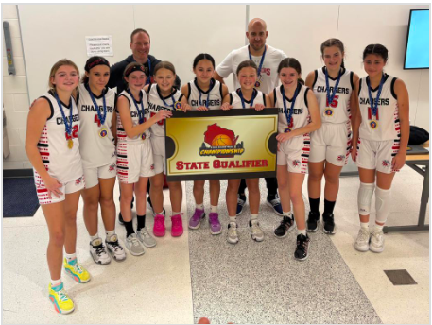
Tonight’s Agenda
Board of Directors & Club Committees
Club Purpose
Operational Approach
Player Development
Teams
Program Details
Practices
Leagues
Tournaments
Cost to play
Club Tryouts
Coaches
Expectations
Coach
Player
Parent
Uniform and Spirit Wear
Survey Feedback
Upcoming Key Dates
Website
2024-2025 Financials
Q&A

Slide 3
Board of Directors
President – Kevin Sandieson
Vice President – Josh King
Director of Player and Coach Development – Chris Mahal
Director of Basketball Operations – Mark Busalacchi
Treasurer – Maureen Schardt

Slide 4
Club Committee Chairpersons
Webmaster – Jiri Mikl**
Tournament Operations – Janice Rush** & Gina Martino
Tournament Concessions – Jamie Sershon, Ashley Mangold & Shelley Esson
Communications and Marketing – Erica Altuve
Uniforms, Spirit Wear and Pictures – Becky Buchholz
Fundraising – Julie Mrotek
** Looking for a volunteer for these positions in 2026

Slide 5

Club Purpose
Provide 3rd - 8th grade girls who are planning on attending Hamilton HS the opportunity to:
Work hard, develop their skills & develop a love for the game
Play competitive basketball
Be ready to play basketball at the high school levels
Youth League
(1st - 6th)
Hamilton High School Chargers
Templeton Bulldogs
(7th - 8th)
Junior Chargers
(3rd – 8th)

Slide 6
Club Purpose cont.
Have fun on and off the court
Teams expected to complete a volunteer/service activity during holidays
Team party at the end of the season
Marquette Girls Basketball events
Jr. Chargers Night at Varsity game
Not about making money
Money collected through registration, tournaments & fundraising used to pay for:
League and tournament fees
Equipment for club, schools and high school
Team parties, Marquette games & other events
Awards for completing challenges
Training sessions throughout the year
Website, Hired Coaches, Etc.

Slide 7
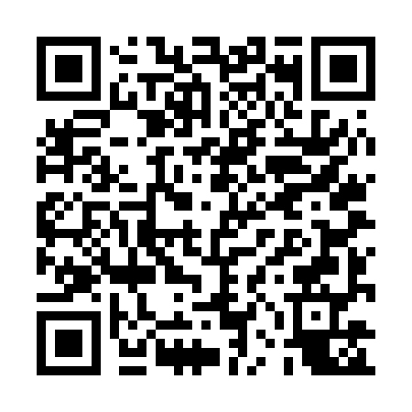
Club Purpose cont. – NON-PROFIT!!
Obtained non-profit status February 2025
Does your company offer:
Matching gifts
Volunteer grants
Charitable giving campaigns
www.hamiltonjrchargers.com/nonprofit
Improved Fundraising Opportunities
2025/2026 Fundraiser… details coming soon!
New This Year!

Slide 8
Operational Approach
Top-down / bottom-up approach from varsity level
Basketball strategy comes in collaboration with varsity staff
Strategy starts in 3rd grade to lay a foundation that is built upon year over year through 8th grade
Goal is that players leaving club in 8th grade are ready to compete at the high school levels
Director of Player and Coach Development
#1 goal is to develop shooters, decision makers and girls who can handle the ball
Work collectively to provide gym space and development opportunities throughout the year to help players achieve development goals

Slide 9
2024 – 2025 Season Player Development
12 winter skill sessions for 6th – 8th grade
10 spring series workouts for 3rd – 5th grade
5,000 Makes Challenge for 3rd – 5th grade
10,000 Makes Challenge for 6th – 8th grade
14 summer skills workouts for 5th – 8th grade
14 “movement” summer workouts for 7th & 8th grade
2 Coach Busalacchi summer skill camps

Slide 10
2025-2026 Player Development Plan
What we are keeping
Spring workout sessions for 3rd – 5th grade
As long as we have coaches to help coordinate and run
10,000 makes challenge
Summer morning workout sessions – both skill and movement
Coach Busalacchi summer skill camps
What we are re-evaluating
In season skill sessions
Would like to bring back, discussing how best to do it to avoid Friday nights
Summer workout schedule
How to best align with summer opportunities and available gym space
Shorten by 1-2 weeks
Winter basement ballhandling challenge
Looking into bringing this back for upcoming season – possible over holiday break

Slide 11
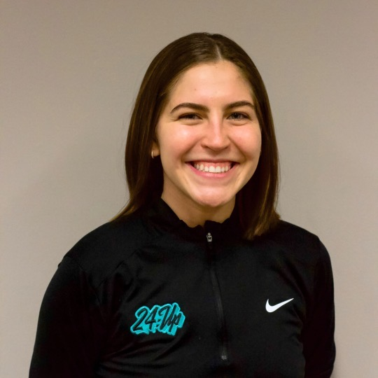

2025-2026 Planned Player Development Plan
Kara Shimko is planning to lead in season and summer training sessions
Kara currently is the High School director at 24up, coaches the U15 and U16 teams while helping to run and organize all 24UP training programs
Kara was a 4-year letter winner in HS while becoming her schools all time leading scorer. Kara also played 4 years of college basketball at Cardinal Stritch while leading her team to the NAIA Tournament twice.
Chris will work with Kara to build development plans for each training session to assure alignment with our club’s approach to player development
Keith Kahlenfeldt of the Pro Lane is planning to conduct summer movement workouts focusing on agility and ankle/knee/hip strength
We are also exploring ways to incorporate Keith during the season

Slide 12
Teams
Goal is to have up to 10 players per team, 2 teams per grade
Teams >10 or a 3rd team may be considered on a case-by-case basis
The goal is to not have to cut players, however, each situation will be reviewed on a case-by-case basis
Examples of why a player may be cut
More than 10 players on a team
Basketball / athletic skill is significantly below other team members
Playing time is not equal
Goal is to play every eligible player in every half of every game

Slide 13
Teams – 3rd & 4th Grades
Is my daughter ready for Jr Chargers?
Can she easily shoot a basketball on a 10-foot hoop?
Can she pass, catch and dribble adequately?
Does she enjoy competitive sports?
4th Grade will be divided into A and B level teams
3rd and 4th grade players may be combined on the same team
Ex: 4th grader may play on a team with all 3rd graders (vice versa)
Typically, 3rd Grade will be split into 2 even teams if we have enough players

Slide 14
Teams – 5th - 8th Grades
Grades 5 – 8 will be divided into A and B level teams
Multi-sport commitments may impact team placement

Slide 15
Program Details
Practices
Start in October
2 practices a week (most weeks)
Practices are typically M/W or T/Th between hours of 6pm-9pm
Some exceptions may occur such as M/Th or earlier start at TMS (5:30 pm)
Try to give early time slots to younger teams (3rd-5th); exceptions sometimes happen
Practices are typically 1.5 hours long
Practices are held at all district elementary schools, SSI and TMS

Slide 16
Program Details cont.
Leagues
Goal is for all teams to play in a league (approximately 16 games)
“A” League 5th – 6th play at Waukesha South
“A” League 7th – 8th play at Waukesha West
“B” League 5th – 8th play at Kettle Moraine
3rd and 4th play at Mukwonago in a combined league with 2 divisions (upper and lower)
League games on Saturdays or Sundays
Our teams playing in these leagues is dependent upon availability
If these leagues are not available, then an alternate league may be utilized and/or additional tournaments will be added

Slide 17
Program Details cont.
Tournaments
All 4th – 8th grade teams play in “up to” six (6) tournaments
Hamilton Tournament + up to five (5) of COACH’s CHOICE
3rd grade team will play in Hamilton tournament and one (1) additional tournament
Most teams end up playing 22 to 34 games between November and March

Slide 18
Program Details cont.
Hamilton Tournaments
Tournament dates are currently TBD:
Tentative Dates
Saturday & Sunday December 13th & 14th
Tournament dates TBD pending confirmation of scheduling with school district
Each players family will need to work approximately a 3–4 hour shift per player**
Failure to volunteer will result in a $200 fee
Note: daughter(s) will not play in games until fee is paid
We are all part of this club and this tournament, please volunteer
Expect an email from the club with a link to Sign-Up Genius

Slide 19
Program Details cont.
Cost to play:
4th – 8th grades = $475
3rd grade = $375
Note: if 4th grader is assigned to a 3rd grade team, then they will be refunded $100
$25 increase is first increase since 2022
Uniform costs are expected to be approximately $110
Required for new players; existing players can wear old uniforms if they fit
Basketball cost expected to be approximately $75-$80 (if buying new)
Note: If a family has a financial difficulty paying the registration/uniform costs, please reach out to the Board President to discuss payment plan options

Slide 20
Club Tryouts
Tuesday, August 26th and Thursday, August 28th
3rd, 4th & 5th grades check-in at 5:00 pm, tryouts from 5:30 pm - 7:00 pm
6th, 7th & 8th grades check-in at 6:30 pm, tryouts from 7:00 pm - 8:30 pm
High School Coach and Director of Player and Coach Development to facilitate tryouts
Each grade will be evaluated by 2-3 independent evaluators
Players are ranked by evaluators top to bottom
Teams formed based on evaluator feedback, spring and summer growth, prior year player evaluations and prior year coaches' feedback

Slide 21
Club Tryouts – cont.
Please note that it is expected that players attend both nights of tryouts
Attendance both nights is important in order to properly evaluate each player and ultimately make the best decisions possible when making team rosters
If a player is unable to attend try-outs, the club will do their best to make roster decisions based on evaluator feedback, spring and summer growth, prior year player evaluations and prior year coaches' feedback

Slide 22
Club Tryouts cont.
Notes:
Players to wear their Jr. Charger practice jersey’s if they are a returning player
New players will be provided a pinnie
Players to bring their own water bottle and basketball
No parents will be allowed in gym during tryouts
Unless you paid the registration fee online, please bring a check made payable to “Hamilton Girls Basketball Club”

Slide 23
Coaches
Final coaching assignments will be announced after tryouts and team rosters complete
Head Coaches are selected by the board of directors
Most coaches are parent volunteers
Paid, nonparent head coaches will be considered when available
Head Coaches can select their assistant from interested candidates approved by the board of directors (recommended 1 assistant)
All new coaches must complete a background screen (link will be sent upon being selected as a coach)
Existing coaches will need to pass a background screen every other year
If you are interested in coaching, contact Chris Mahal, Director of Player and Coach Development (chrismahal@gmail.com)
Thank you coaches for all the time, talent and dedication to the girls!

Slide 24
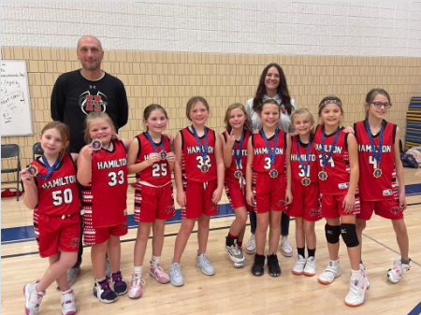
Coach Expectations
Attend mandatory Coaches Clinic (Date to be announced soon)
Understand and communicate the game of basketball
Be flexible and understanding of multi sport/activity players
Work with parents to accommodate scheduling conflicts
Use SportsEngine app to communicate all practices, games, and tournaments
Communicate with the parents
Register team for tournaments
Be a positive role model to the athletes

Slide 25
Coach Expectations cont.
Do not coach every game like it’s the National Championship
Connect with each player throughout the season so they continually improve and understand/embrace role on the team
Develop practice plan for every practice
Zero tolerance policy regarding legitimate and verified complaints from leagues or tournaments
Must complete player evaluations in the middle and end of season and provide to parents/players/club
Must practice through end of February (all teams)

Slide 26
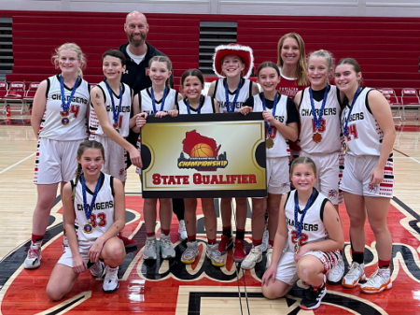
Player Expectations
Come ready to work hard with a great attitude
**Bring Ball to practice**
Listen to and learn from coaches
Work on their game outside of the gym
Be available and show up to practices and games on time
When there are conflicts with other sports, it is expected that basketball games and basketball tournaments take priority
Take chances and fail … especially in practice
Take care of your schoolwork
Make new friendships
No jewelry (earrings), fitbits, watches, etc. at practices or games

Slide 27
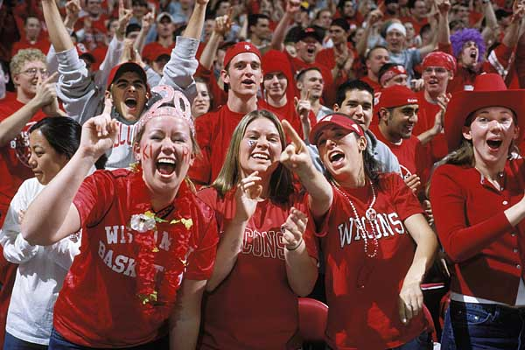
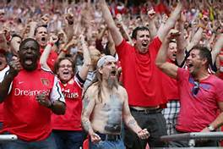
Parent Expectations
Parent Code of Conduct – Updated with registration process – PLEASE READ
Support your child; “I really loved watching you play today”
Be a fan, NOT a bleacher coach or a referee
24 hour rule: do not contact a coach about playing time or other concerns until 24 hours after a game has ended
Have child to practice and games on time
Use SportsEngine app to communicate all attendance in a timely manner (more than 24 hours in advance)
Please text/call coach if attendance is changing day of practice/game
Communicate early any multi sport/activity schedule conflicts
Work with coach to accommodate scheduling conflicts
It is expected that basketball games and basketball tournaments are priority

Slide 28
Parent Expectations
Pay player fees & uniform costs
Work roughly a 3-4 hour shift per player at one of the Hamilton Tournaments
Parents are expected to volunteer to work scorer’s table throughout the season at league games and tournaments (take turns)
Provide feedback to club as appropriate
Contact Coach first for game/player feedback (after 24 hours)
Contact the Board of Directors directly
Complete the end of year Parent Survey

Slide 29
Parent Expectations
New This Year!
Similar to other club sports in the area, we are looking for a parent to volunteer to be the Team Manager
Team Manager responsibilities to include:
Organizing team volunteer/service activity during holidays
Team party at the end of the season
Attendance at Jr. Chargers Night at Varsity game
If interested, reach out to your coach after teams have been posted

Slide 30
Uniforms & Spirit Wear
KM Sports will be utilized for uniform and Spirit Wear orders this year
More information to be provided in the coming weeks
Please be timely with your Uniform order
Uniforms will be available to try on before tryouts on both nights
FREE

Slide 31
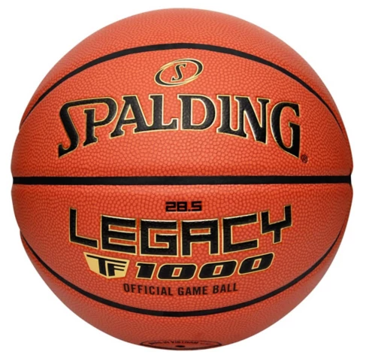
New This Year!
Uniforms & Spirit Wear – cont.
New Requirement for this season… Players are to bring their own ball to practice
Recommended ball is Spalding Legacy TF1000 (official basketball of WIAA)
Club will be selling our stock of basketballs on a first come first serve basis – details coming soon
FREE

Slide 32
2024 / 2025 Survey
Thanks to all who completed our 2024/2025 survey for last season
Response rate 46%
There were several changes implemented as a direct result of your feedback, including, but not limited to, the following:
Goal is to schedule summer trainings around Summer Opportunities and SAS
Coaching requirements for teams to practice through end of February
Multi-sport athlete conflicts to be reviewed and considered during team placement process

Slide 33
Upcoming Key Dates
Registration Deadline
Sunday, August 24th at 8 pm
Once registered, you should receive an email confirmation from SportsEngine
Club Tryouts @ Silver Spring Intermediate (SSI)
Tuesday, August 26th and Thursday, August 28th
3rd, 4th & 5th grades check in at 5:00pm, tryouts from 5:30pm - 7:00pm
6th, 7th & 8th grades check in at 6:30pm, tryouts from 7:00pm - 8:30pm
Team Assignments
Tuesday, September 2nd teams will be posted on club website
Uniform and Spirit Wear Order Deadline
TBD – expected to be beginning of September

Slide 34
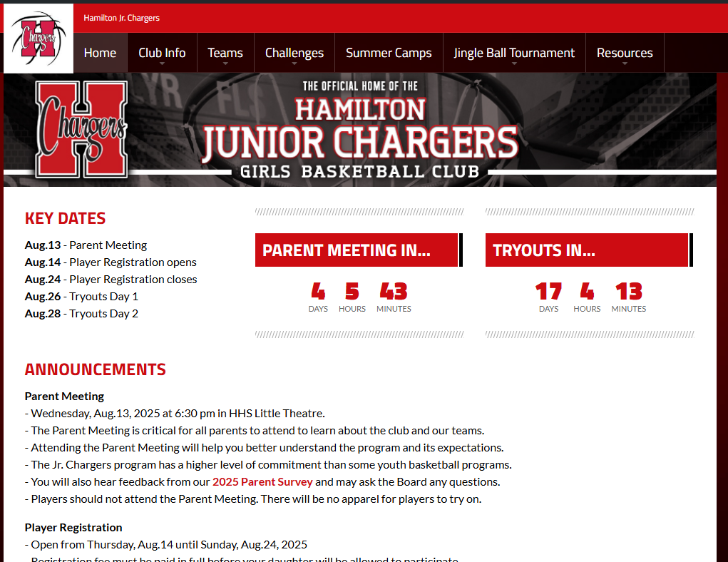
Where to find information … www.HamiltonJrChargers.com
Jr Charger League information
Challenges
Summer Leagues
Summer Camps
And much more!

Slide 35
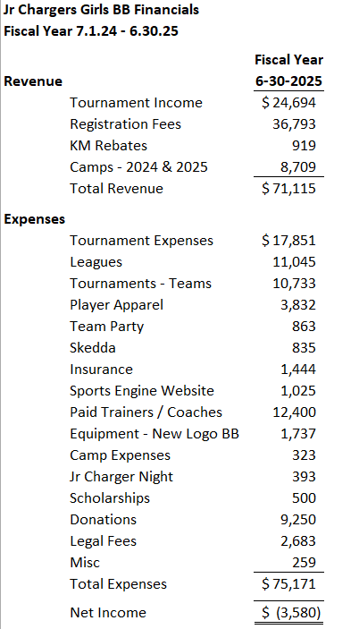
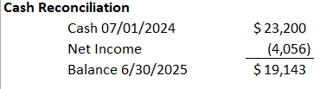
2025-2026 Financials

Slide 36
Thank you for your support of Hamilton Junior Chargers Girls Basketball Questions?

