Slide 1
Woodbury Area Hockey Club
MEMBER TOWN HALL
February 24, 2020

Slide 2
Agenda
Welcome & Introductions
State of the WAHC – WAHC By The Numbers
  Financial Summary
  Player Counts / Teams Counts / By High School Boundary
  Ice Hours
Topics / Initiatives In Focus
  Open Positions: Board Terms Expiring / Ice Director / Registrar / Goalie Equipment
  Intra-Association Realignment Pilot - 2020-21 Squirts
  Long Term Strategic Planning – Ice
Q & A
Closing Comments

Slide 3
2019-20 WAHC BOARD & LEADERSHIP
PRESIDENT-
Ryan Warner
Ice Scheduler-Aaron Etshokin
Secretary-Dan Weinmeyer
VP-Fundraiising
Brandy Kane
VP-Hosted Tournaments
Nick Nyhus
VP –Coaching Development
Tim O’Connor
VP-Hockey Development
Bill Kulesa
VP-Mites, MiniMites, Intro Matt Shillings
VP Administration-Ron Tarlton
VP-Girls Hockey
Scott Szybatka
VP-Hockey Operations
Dan Kraft
Administrator-Lonie Nelson
Co-Hockey Directors-Bolin / Vogelgesang
Level Director- Bantam
M. Tschida
Level Director- Peewee
B. Rogina
Level Director-Squirt
K. Zuber
Lawful Gambling-Amy Vasterling
Level Directors - Mite/MM-
Level Director-Girls8U/6U
Intro To Hockey Coordinator –
Paul Quinn
Goalie Development Director –
Reid Nelson
Goalie Equipment Coordinator – Brent Thompson
Webmaster-Troy Noll
Social Media Coordinator-Jen Sutch
Registrar – Michelle Chapman
Treasurer Tom Och

Slide 4
WAHC Board_By TERM
EXPIRING
President
Secretary
VP-Coaching
VP-Mites, Minis, Termites, Intro
VP-Fundraising
VP-Hockey Operations
Mid-Term
Treasurer
VP-Girls Hockey
VP-Hosted Tournaments
VP-Administrative Operations
VP-Hockey Development

Slide 5
WAHC Financial Snapshot
 | BUDGET | ACTUAL | ACTUAL | ACTUAL
 | 2019-20 | 2018-19 | 2017-18 | 2016-17
Revenue
Player Fee Revenue | 1,102,425 | 1,002,090 | 978,741 | 790,694
Hosted Tournaments - Net | 7,993 | 13,037 | 18,894 | 3,480
Fundraising - Net | 26,500 | 18,539 | 17,542 | 20,514
 | 1,136,918 | 1,033,666 | 1,015,176 | 814,688
Expenses | 1,135,748 | 955,955 | 1,009,172 | 829,737
Net Hockey Operations | 1,170 | 77,711 | 6,004 | (15,049)
Lawful Gambling
Lawful Gambling - Donations | 120,000 | 137,326 | 62,240 | 86,810
Projects/Programs Funded by Lawful Gambling -
Player Socks | (20,000) | (20,000) | (15,000) | (15,015)
Ice | (100,000) | (117,327) | (47,240) | (71,795)
Year End Cash & CDs Balance
General Operations |  | 509,053 | 413,912 | 389,825

Slide 6
WAHC Ice Purchase Summary
2013-14 thru 2018-19(actual) and 2019-20 Budget
 | 2013-14 | 2014-15 | 2015-16 | 2016-17 | 2017-18 | 2018-19 | 2019-20 BUDGET | Average ACTUALS
HealthEast Sports Center (Woodbury) | 1293 | 1296 | 1244 | 1316 | 1463 | 1440 | 1450 | 1342
Harding Arena (St. Paul) | 800 | 808 | 811 | 763 | 785 | 814 | 800 | 797
Doug Woog Arena (South St. Paul) | 449 | 361 | 323 | 383 | 482 | 390 | 400 | 398
Other Facilities | 19 | 57 | 23 | 29 | 14 | 24 | 200 | 28
TOTAL | 2561 | 2522 | 2401 | 2491 | 2744 | 2669 | 2,850 | 2565

Slide 7
WAHC YOUTH Player Counts – By Level of Play
2009-10 thru 2019-20
ALL PROGRAMS
LEVEL of PLAY | 2009-10 | 2010-11 | 2011-12 | 2012-13 | 2013-14 | 2014-15 | 2015-16 | 2016-17 | 2017-18 | 2018-19 | 2019-20
Jr Gold/16U | 35 | 36 | 45 | 36 | 35 | 34 | 20 | 0 | 37 | 32 | 38
Bantam | 117 | 111 | 104 | 101 | 86 | 93 | 104 | 100 | 95 | 92 | 104
Peewee | 131 | 119 | 106 | 115 | 128 | 118 | 96 | 105 | 128 | 119 | 115
Squirt | 108 | 132 | 141 | 128 | 110 | 102 | 113 | 110 | 110 | 116 | 122
15U (14Upre2016-17) | 17 | 20 | 22 | 24 | 17 | 0 | 0 | 0 | 15 | 17 | 18
12U | 41 | 42 | 38 | 45 | 41 | 25 | 31 | 38 | 48 | 41 | 49
10U | 41 | 45 | 46 | 29 | 30 | 41 | 45 | 35 | 47 | 51 | 60
8&Under | 249 | 250 | 241 | 261 | 258 | 256 | 252 | 266 | 308 | 311 | 320
Termites | 0 | 0 | 0 | 0 | 0 | 0 | 0 | 0 | 0 | 0 | 40
TOTAL | 739 | 755 | 743 | 739 | 705 | 669 | 661 | 654 | 788 | 779 | 866
Increase/(Decrease) |  | 16 | -12 | -4 | -34 | -36 | -8 | -7 | 134 | -9 | 87
% change |  | 2.2% | -1.6% | -0.5% | -4.6% | -5.1% | -1.2% | -1.1% | 20.5% | -1.1% | 11.2%

Slide 8
Player Count Comparative
City Population
(2018-19)
 | 2015-16 |  | 2018-19
Association | Population | Association Membership | Population (a) | Association Membership (b)
Osseo/Maple Grove | 65000 | 1099 | 73800 | 1155 | 1.6%
Woodbury | 68000 | 650 | 69800 | 778 | 1.1%
Eagan | 67000 | 515 | 66600 | 467 | 0.7%
Eden Prairie | 62000 | 526 | 64400 | 462 | 0.7%
Lakeville | 60000 | 818 | 63700 | 771 | 1.2%
Burnsville | 60000 | 336 | 61400 | 124 | 0.2%
Minnetonka | 51000 | 965 | 53100 | 1029 | 1.9%
Apple Valley | 50000 | 249 | 52400 | 301 | 0.6%
St. Louis Park | 45000 | 336 | 49000 | 380 | 0.8%
Stillwater | 20000 | 920 | 19400 | 868 | 4.5%
(a) source: '2017' population per |  | http://worldpopulationreview.com/us-cities
(b) source: Todd Elmer-USA Hockey MN District Registrar

Slide 9
WAHC Player Counts & Team Counts
YOUTH & GIRLS
2016-17 thru 2019-20
YOUTH & GIRLS PROGRAMS – PLAYER COUNTS
 | 2016-17 |  | 2017-18 |  | 2018-19 |  | 2019-20
LEVEL of PLAY | GIRLS | YOUTH | GIRLS | YOUTH | GIRLS | YOUTH | GIRLS | YOUTH
Jr Gold/16U |  | 0 |  | 37 |  | 32 |  | 38
Bantam |  | 100 |  | 95 |  | 92 |  | 104
Peewee |  | 105 |  | 128 |  | 119 |  | 115
Squirt |  | 110 |  | 110 |  | 116 |  | 122
15U |  |  | 15 |  | 17 |  | 18
12U | 38 |  | 48 |  | 41 |  | 49
10U | 35 |  | 47 |  | 51 |  | 60
8&Under | 48 | 218 | 74 | 234 | 78 | 233 | 65 | 295
TOTAL | 121 | 533 | 184 | 604 | 187 | 592 | 192 | 674
Total Registered Players |  | 654 |  | 788 |  | 779 |  | 866
YOUTH & GIRLS PROGRAMS - TEAM COUNT
 | 2016-17 |  | 2017-18 |  | 2018-19 |  | 2019-20
 | GIRLS | YOUTH | GIRLS | YOUTH | GIRLS | YOUTH | GIRLS | YOUTH
JRGOLD/16U |  | 1 |  | 2 |  | 2 |  | 2
BN |  | 6 |  | 6 |  | 6 |  | 7
PW |  | 7 |  | 8 |  | 8 |  | 8
SQ |  | 8 |  | 8 |  | 8 |  | 8
MITES |  | 9 |  | 9 |  | 9 |  | 9
MINIMITES |  | 9 |  | 9 |  | 8 |  | 9
15U |  |  | 1 |  | 1 |  | 1
12U | 3 |  | 3 |  | 3 |  | 4
10U | 3 |  | 4 |  | 4 |  | 5
8U | 2 |  | 4 |  | 4 |  | 3
6U | 3 |  | 2 |  | 2 |  | 2
TOTAL | 11 | 40 | 14 | 42 | 14 | 41 | 15 | 43
Total Rostered Teams |  | 51 |  | 56 |  | 55 |  | 58
YOUTH & GIRLS PROGRAMS
 | 2016-17 |  | 2017-18 |  | 2018-19 |  | 2019-20
LEVEL of PLAY | GIRLS | YOUTH | GIRLS | YOUTH | GIRLS | YOUTH | GIRLS | YOUTH
Jr Gold/16U |  | 0 |  | 37 |  | 32 |  | 38
Bantam |  | 100 |  | 95 |  | 92 |  | 104
Peewee |  | 105 |  | 128 |  | 119 |  | 115
Squirt |  | 110 |  | 110 |  | 116 |  | 122
15U |  |  | 15 |  | 17 |  | 18
12U | 38 |  | 48 |  | 41 |  | 49
10U | 35 |  | 47 |  | 51 |  | 60
8&Under | 48 | 218 | 74 | 234 | 78 | 233 | 65 | 295
TOTAL | 121 | 533 | 184 | 604 | 187 | 592 | 192 | 674
Total Registered Players |  | 654 |  | 788 |  | 779 |  | 866

Slide 10
WAHC By High School Boundary
2019-20 Players PROJECTED to 2020-21
(with 6/01 age range change)
 | East Ridge YOUTH | Woodbury YOUTH | Other YOUTH | TOTAL |  | East Ridge SKATER | Woodbury SKATER | Other SKATER |  | East Ridge GOALIE | Woodbury GOALIE | Other GOALIE
BANTAM | 59 | 53 | 3 | 115 |  | 53 | 52 | 2 |  | 6 | 1 | 1
 | 51% | 46% | 3% | 100% |  | 50% | 49% | 2% |  | 75% | 13% | 13%
PEEWEE | 63 | 45 | 9 | 117 |  | 56 | 40 | 8 |  | 7 | 5 | 1
 | 54% | 38% | 8% | 100% |  | 54% | 38% | 8% |  | 54% | 38% | 8%
SQUIRT | 77 | 52 | 3 | 132 |  | 75 | 46 | 3 |  | 2 | 6 | 0
 | 58% | 39% | 2% | 100% |  | 60% | 37% | 2% |  | 25% | 75% | 0%
MITE | 73 | 46 | 5 | 124 |  | 72 | 44 | 5 |  | 1 | 2 | 0
 | 59% | 37% | 4% | 100% |  | 60% | 36% | 4% |  | 33% | 67% | 0%
MINIMITE | 38 | 30 | 3 | 71 |  | 38 | 30 | 3 |  | 0 | 0 | 0
 | 54% | 42% | 4% | 100% |  | 54% | 42% | 4% |  | #DIV/0! | #DIV/0! | #DIV/0!
TOTAL | 310 | 226 | 23 | 559 |  | 294 | 212 | 21 |  | 16 | 14 | 2
 | 55% | 40% | 4% | 100% |  | 56% | 40% | 4% |  | 50% | 44% | 6%
Aged to H.S.&JR GOLD |  |  |  | 37 |  |  |  |  |  |  |  | 3
TOTAL 2019-20 Players |  |  |  | 596 |  |  |  |  |  |  |  | 35

Slide 11
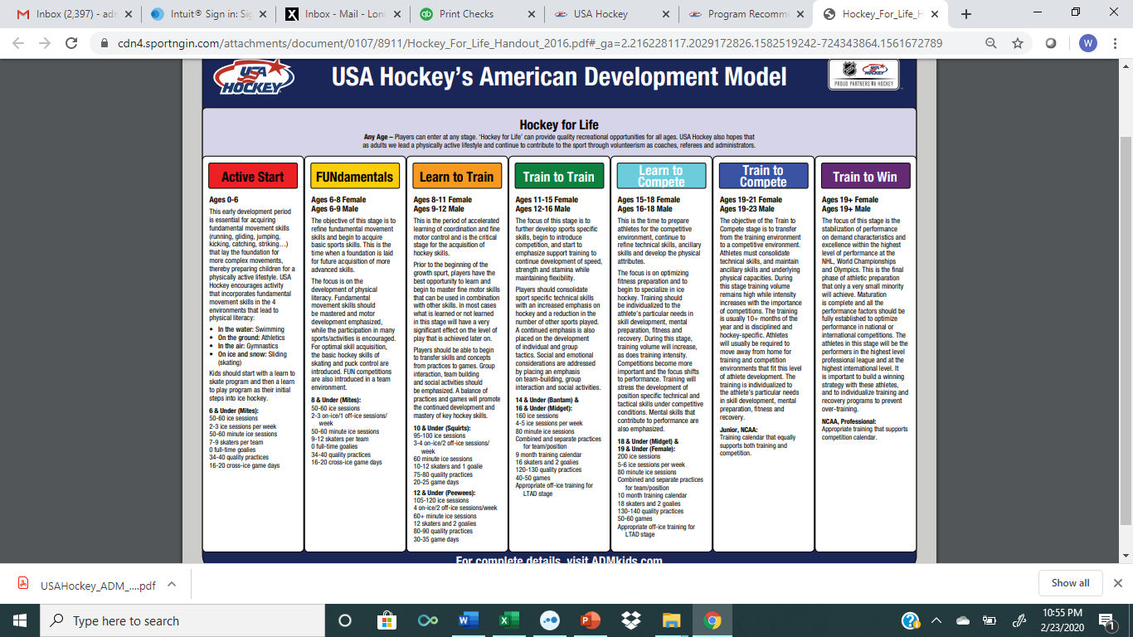

Slide 12
USA HOCKEY ADM_TEAM SIZES
LEVEL OF PLAY | # SKATERS | # GOALIES
6U | 7-9 | No full-time goalies
8U | 9-12 | No full-time goalies
SQUIRT/10U | 10-12 | 1
PEEWEE/12U | 12 | 2
BANTAM/15U | 16 | 2
JRGOLD | 18 | 2

Slide 13
Indoor Ice Benchmarking

