Slide 1

RISE ATL SPORTS
G.I.G. Initiative
Giving In Gwinnett Initiative!!
E: contactus@riseatlsports.com
P: 678-707-3968

Slide 2

Giving In Gwinnett?
What is Giving In Gwinnett (G.I.G.)?
It is our giving and donation program with local Gwinnett County schools and organizations.
We have given over $700 back to the schools and communities we serve and will continue to do so.

Slide 3
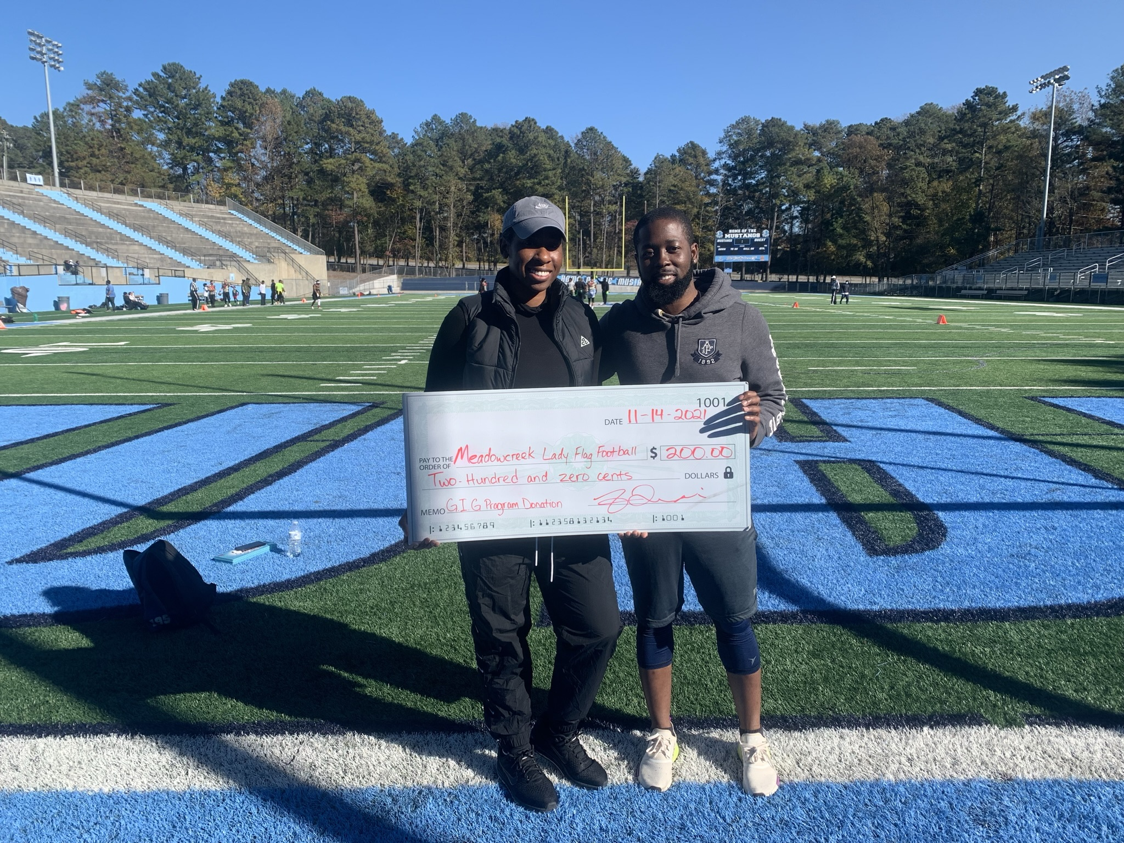
How Can I Help?
You can make a small donation on our giving form and we will add you to our wall of fame (Optional)
Donation of Items (Clothing,food,coupons,school supplies etc.)
An invoice will be created upon request for any items donated
Proceeds will be used for our back to school and holiday giving events as well as other charitable events.
https://www.riseatlsports.com/givingback
* If paying by debit/credit a small processing fee is charged by the card processor.

Slide 4

Upcoming Events/Promotions
Back To School Supplies Donation
Youth Sports Program(R.I.S.E. ATL Sports Youth)

Slide 5
Items Needed
Pencils
Pens
Eraser
Bookbags
Calculators
Notebooks/Notepads
Pen/Pencil Pouch
Kleenex
Bleach Wipes

