Slide 1
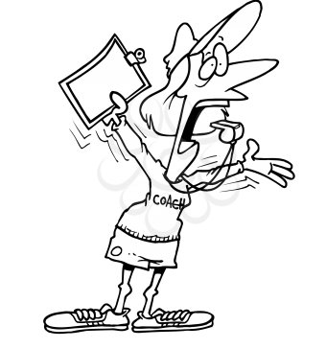

You want me to what?
If it's not fun I'm not doing it!

Slide 2
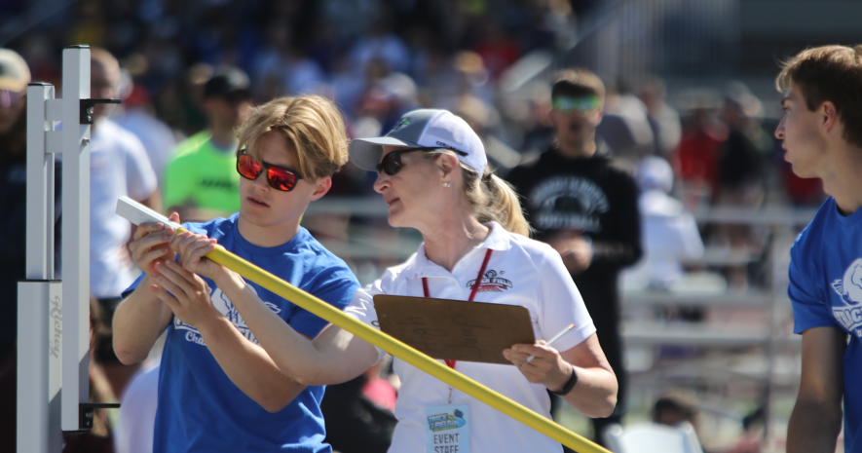
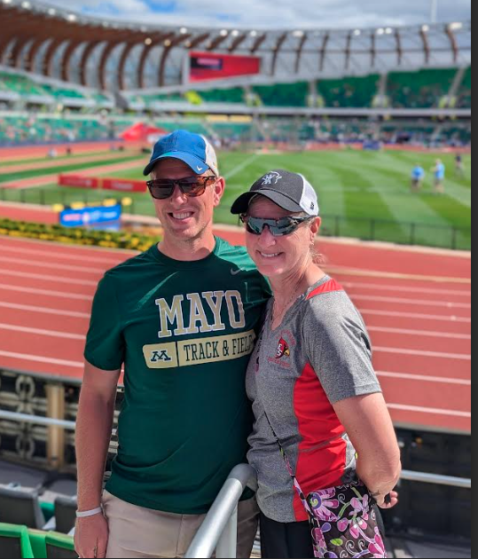
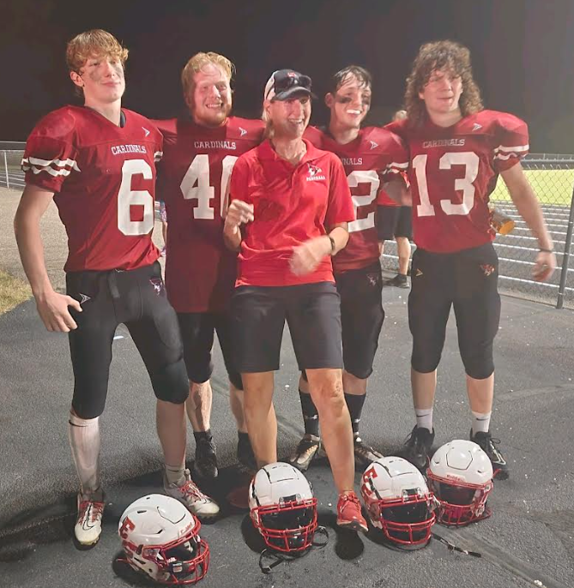

Who am I?
Head T&F coach Eleva-Strum
Assistant football coach ES
WIAA Head HJ official
WIAA team host, state boy's basketball
WIAA clerk, state cross country

Slide 3

I'm all about
TRACK & FIELD
1. Camaraderie, fun, party
2. Affirmation
3. Tidbits/Nuggets

Slide 4

RESPECT
A humorous view from a coaching perspective

Slide 5
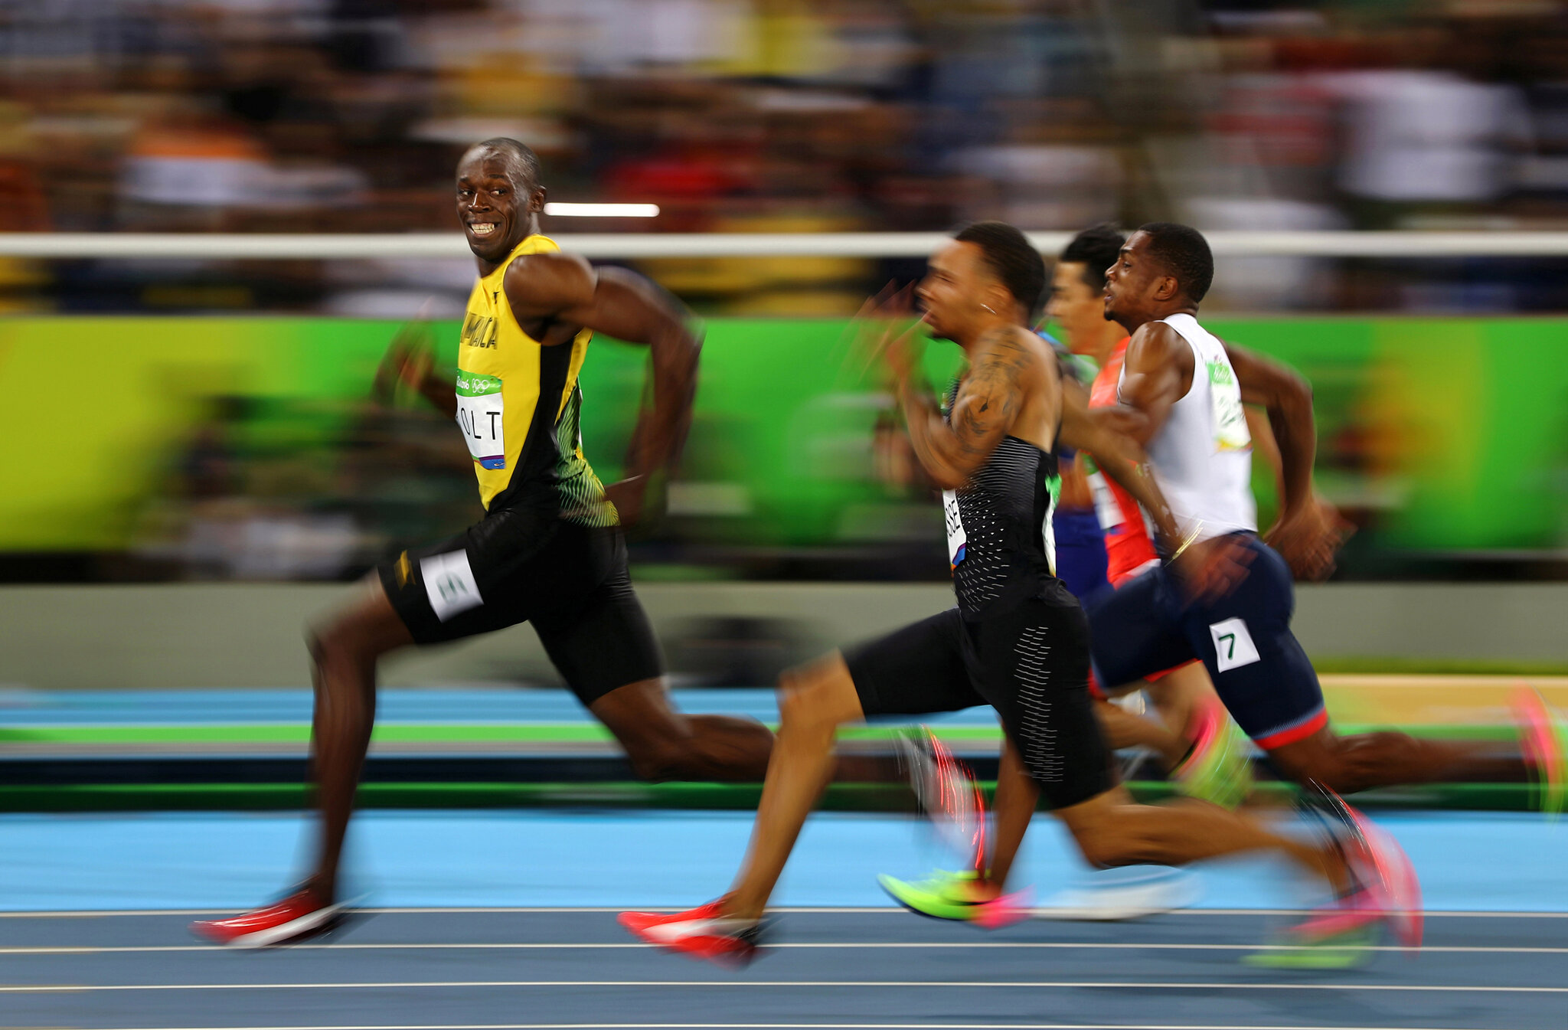
FEAR
"a feeling of profound respect"

Slide 6
You
Team
Staff/Administrators/Peers
Parents/Community

Slide 7



Slide 8
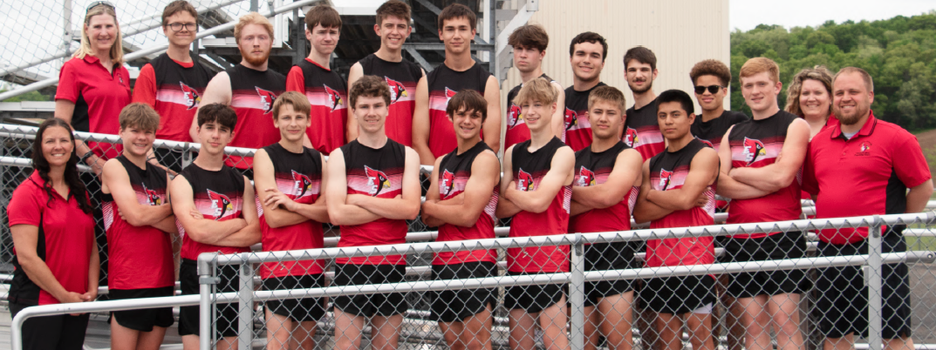
Describe...
Yourself
How do you think others see you as a coach
A coach you respect

Slide 9
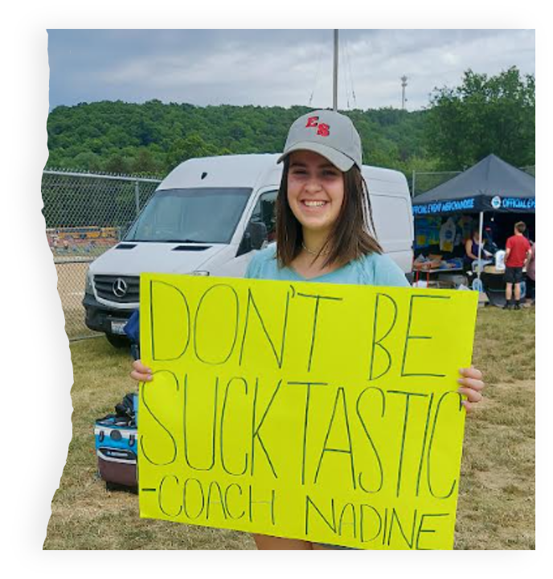
Truth

Slide 10
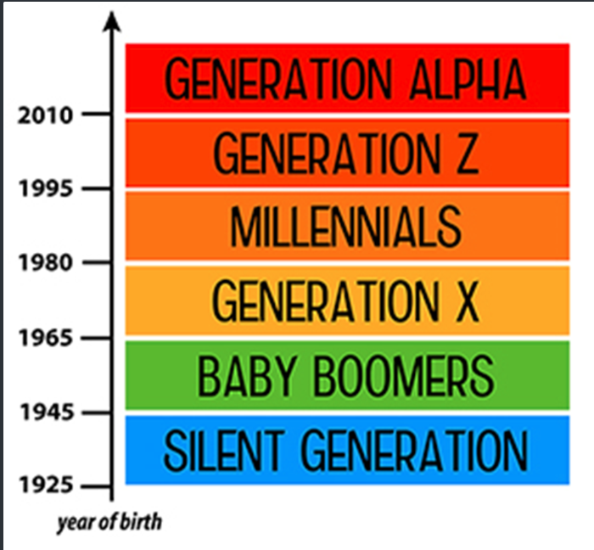
Generational Differences

Slide 11
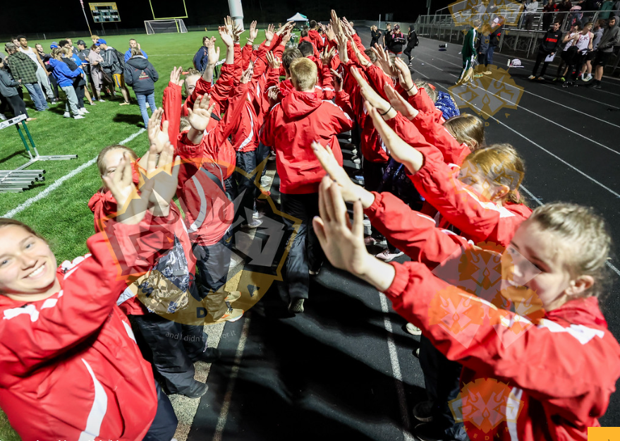
What doesn't change?
Athletes need structure and a sense of belonging.
Rules can be your friend.
Establish goals.
Recognition goes a long way.

Slide 12



